Slide 1
Merritt Burch
Lab Meeting
2019-07-10

Slide 2
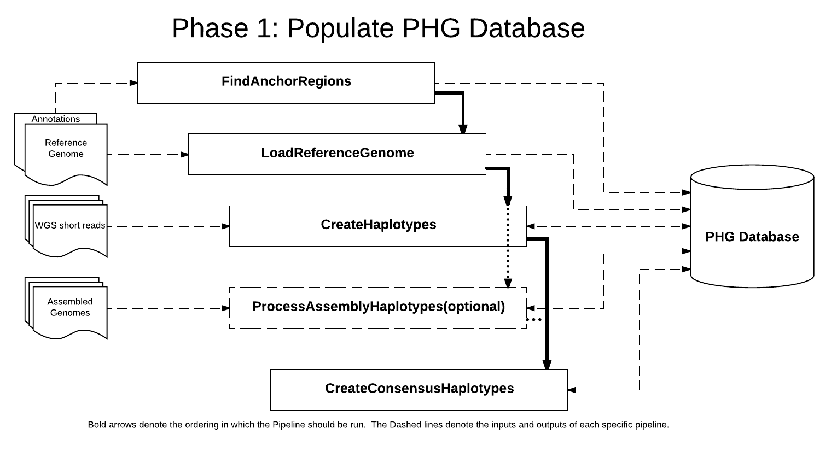
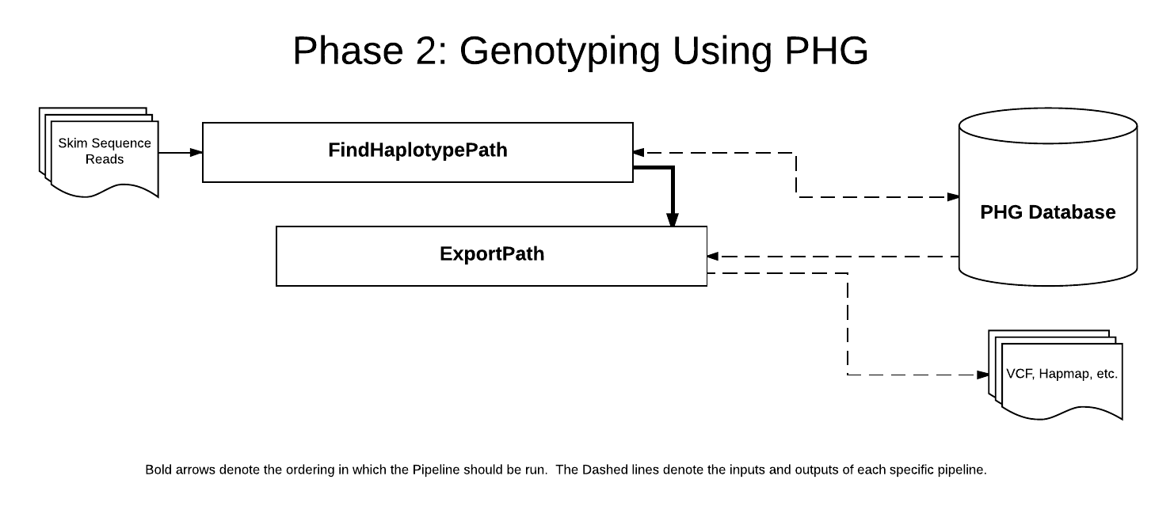
Ran PHG Pipeline
Populated database and genotyped test data

Slide 3
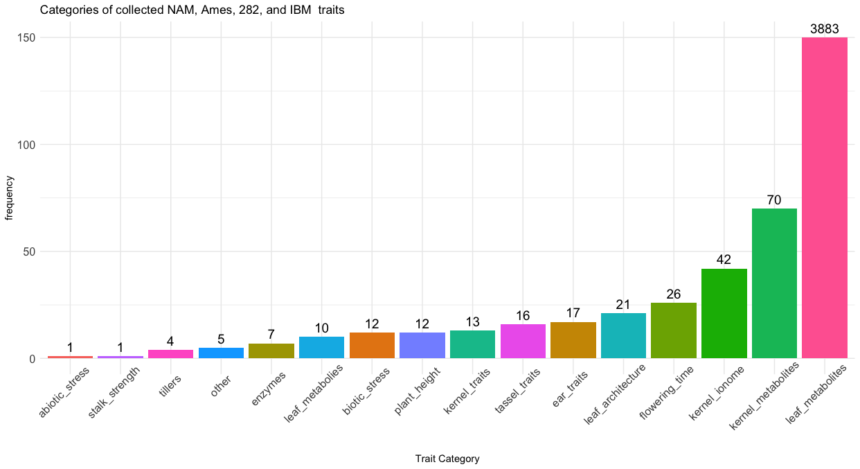
Phenotype collection
Not 10k metabolites, ~4k mass-features
Typo in Zhou abstract and methods

Slide 4
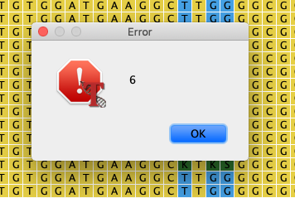
Next steps
Combining phenotypes (it’s messy)
  1 file per population + data type
Running tests in TASSEL with NAM+flowering time
  VNC to CBSU machines for TASSEL GUI
  Filtering by table sites is very important

