Slide 1
Lab Presentation
2019-03-21
Merritt Burch

Slide 2
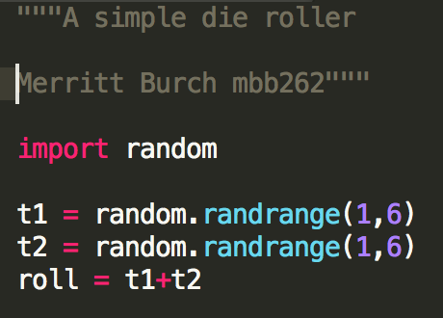
New Python words (to me)! → “Magic Numbers”
“Magic numbers”
Unique values with unexplained meaning
“Referred to as breaking one of the oldest rules of programming, dating back to the COBOL, FORTRAN and PL/1 manuals of the 1960s.”
}

Slide 3
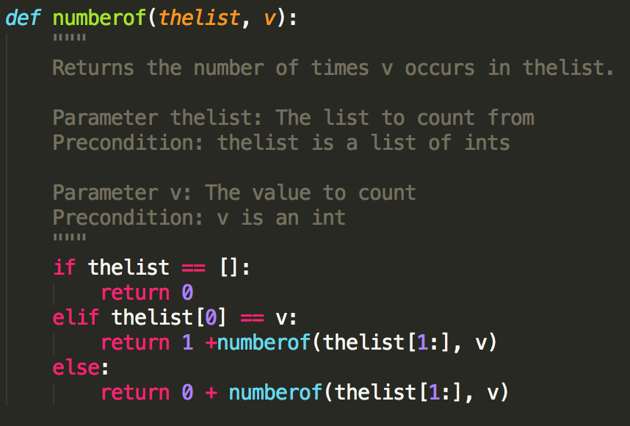
New Python words/ideas (to me)! → Recursion
}
Function definition
}
Docstring
Base-case → (if written well) saves computer from my wrath
}
Recursive case → count number of instances
Simple and complex case
“Divide and conquer”
Or list.count()

Slide 4
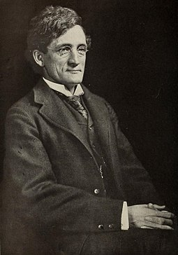
Liberty Hyde Bailey
https://en.wikipedia.org/wiki/Liberty_Hyde_Bailey
BS from Michigan State University
Developed and grew the field of horticulture and taxonomy; coined “cultivar”, “cultigen”, and “indigen”; rediscovered Mendel’s work in 1865 and 1869
Harvard, Founded Department of Horticulture and Landscape Gardening at MSU, Cornell University
1900 Member of AAAS, 1917 elected into National Academy of Sciences
Fun Fact: Published articles and book spanning over 81 years in all fields for almost every audience!

Slide 5
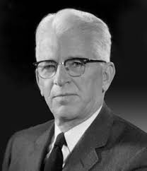
Paul C. Mangelsdorf
ScD from Harvard University (advisor Edward East)
With Reeves worked on the Tripartite Theory origin of maize, developed cytoplasmic male sterility and “restorer” genes for hybrid industry, characterization of yellow1 locus
Harvard University
1945 elected member of the National Academy of Sciences
“Applied” to Harvard by translating paragraph to/from French and German. East’s response; two foreign languages were hardly enough for a graduate student, as science was becoming quite international. Nevertheless, East allowed Mangelsdorf to enroll.
Notes:
NAS Sketch: http://www.nasonline.org/publications/biographical-memoirs/memoir-pdfs/mangelsdorf-paul.pdf

