Slide 1
Merritt Burch
Buckler Lab Presentation
2019-04-25

Slide 2
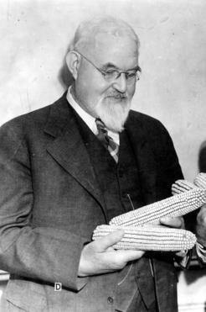
George Harrison Shull (1872-1954)
PhD from University of Chicago in 1904
Described heterosis and coined term in maize by crossing stable inbreds together to create vigorous hybrids (1908), estimated to have increased corn yields by 20% (+1.8 billion bushels = $2 billion dollars); founder of ‘Genetics’ journal, worked on many different crops (primrose, sunflower, tomato, poppy, tobacco, etc.)
Botanical expert to the Bureau of Plant Industry; Botanical investigator at Carnegie Institution at Cold Spring Harbor; Princeton University ( started in 1915)
1948 Public Welfare Medal from the National Academy of Sciences
Never completed a full-year of grade school. Went on to be a country school teacher in Ohio for 5 years, taught 7 grades/day, tried to become a principal in 1901

Slide 3
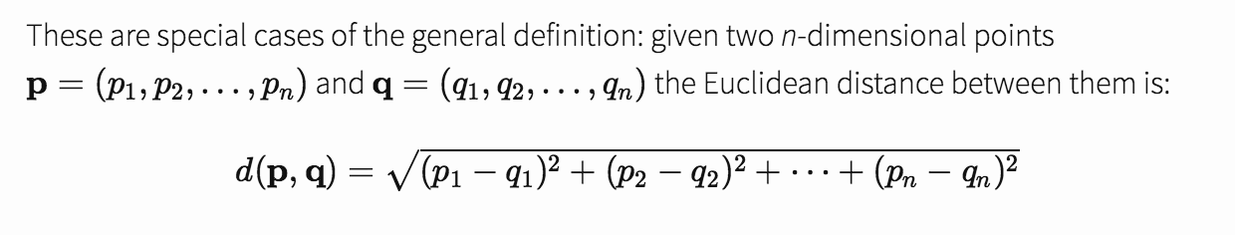
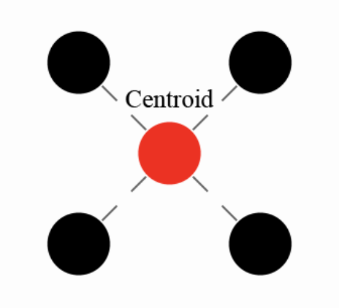
K-means clustering of multi-dimensional points
Centroids are the mean of cluster points
Points belong to cluster whose mean/centroid closest to
Steps to k-means clustering
Pick k centroids (randomly or through seeds)
Partition the data into centroids
Recompute centroid means with points
Repeat 2 and 3 until convergence (means stop changing)

Slide 4
Going to attempt to cast code/example to screen

