Slide 1


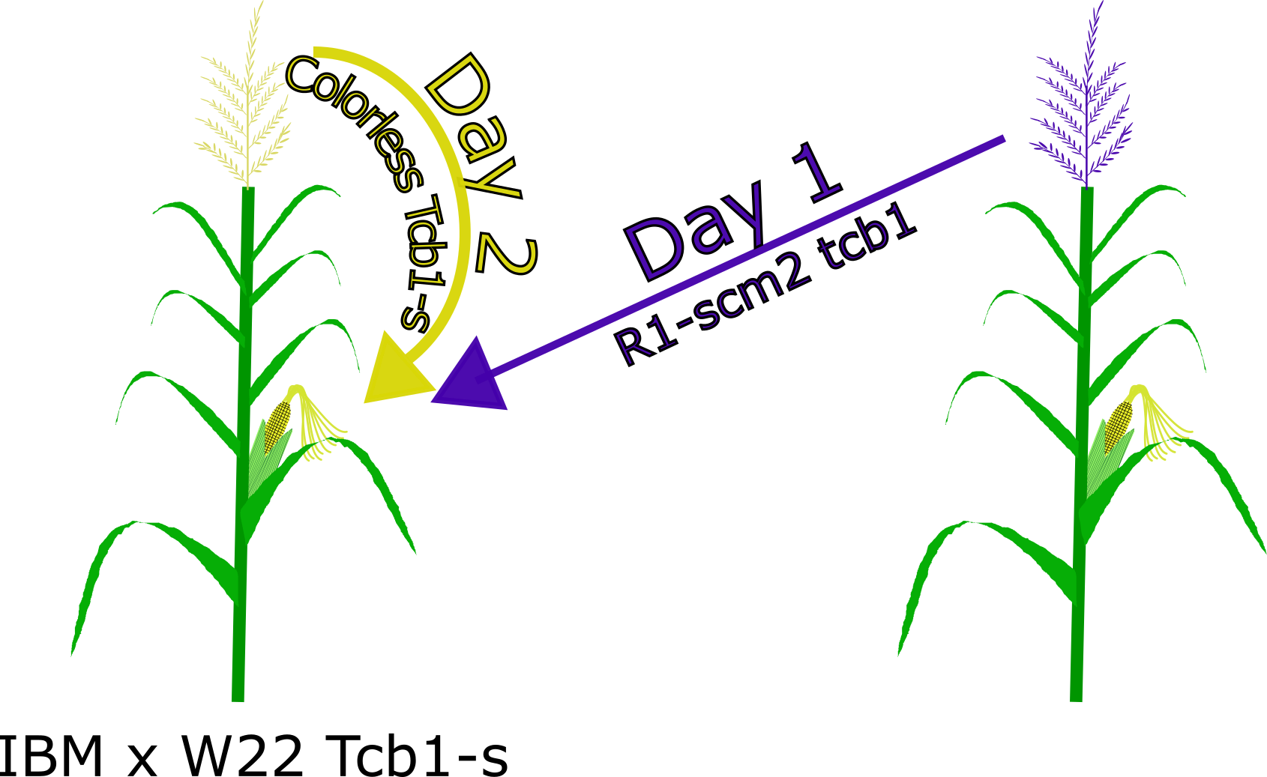
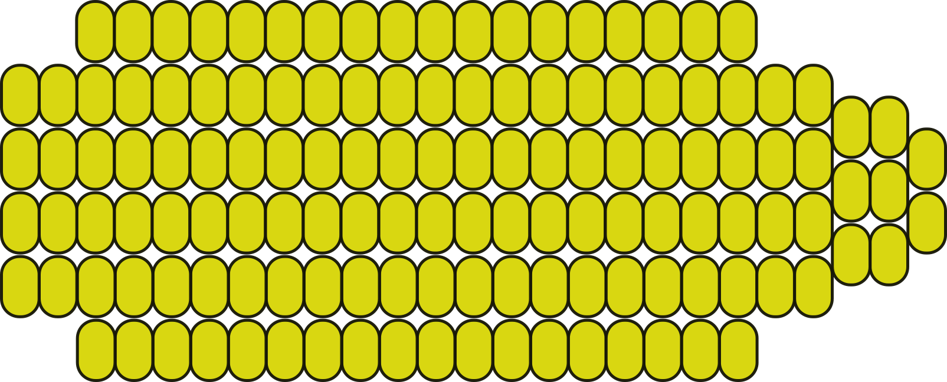
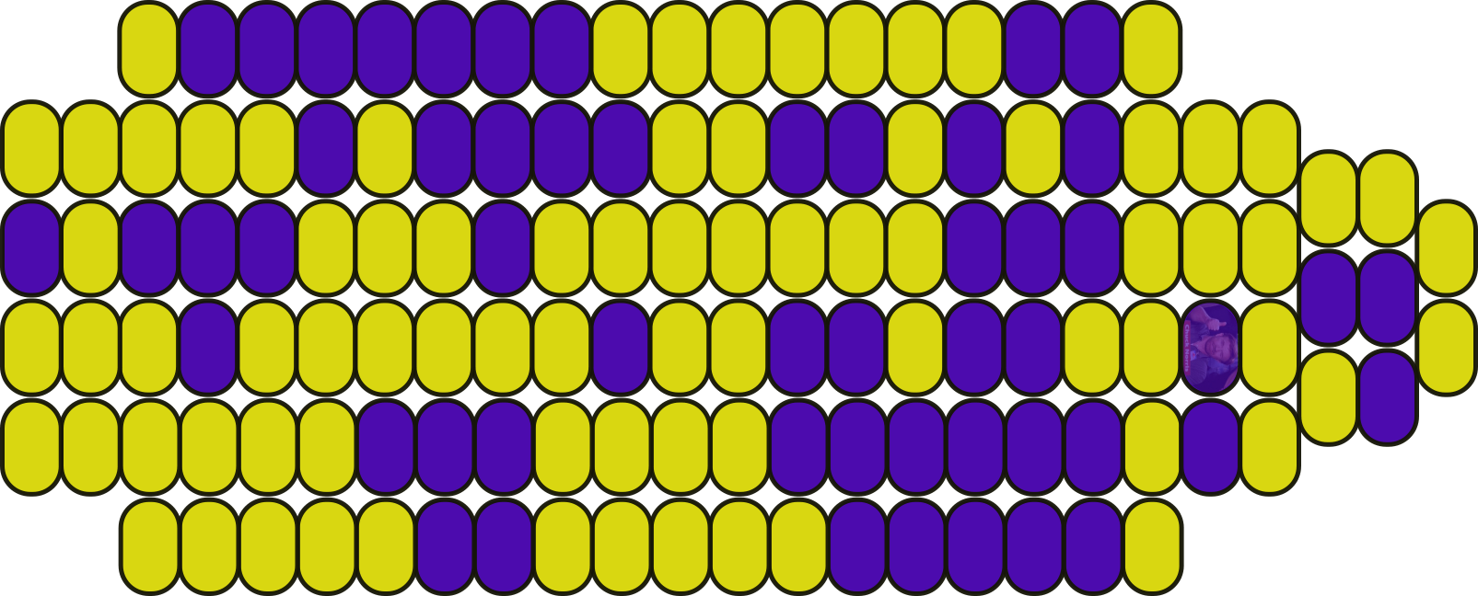
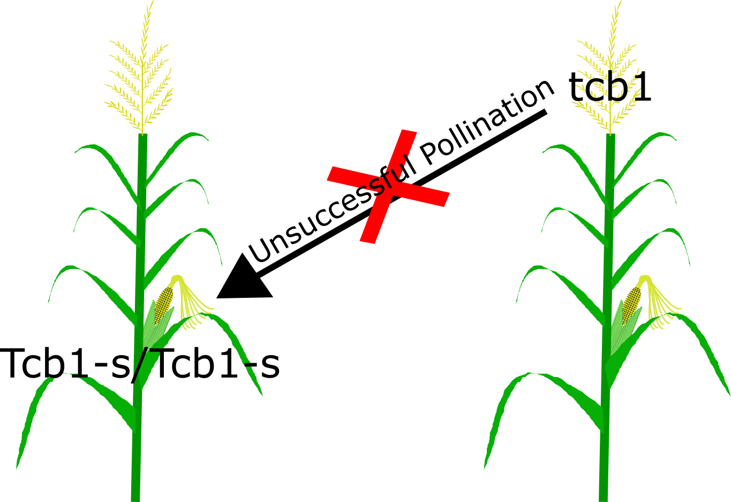
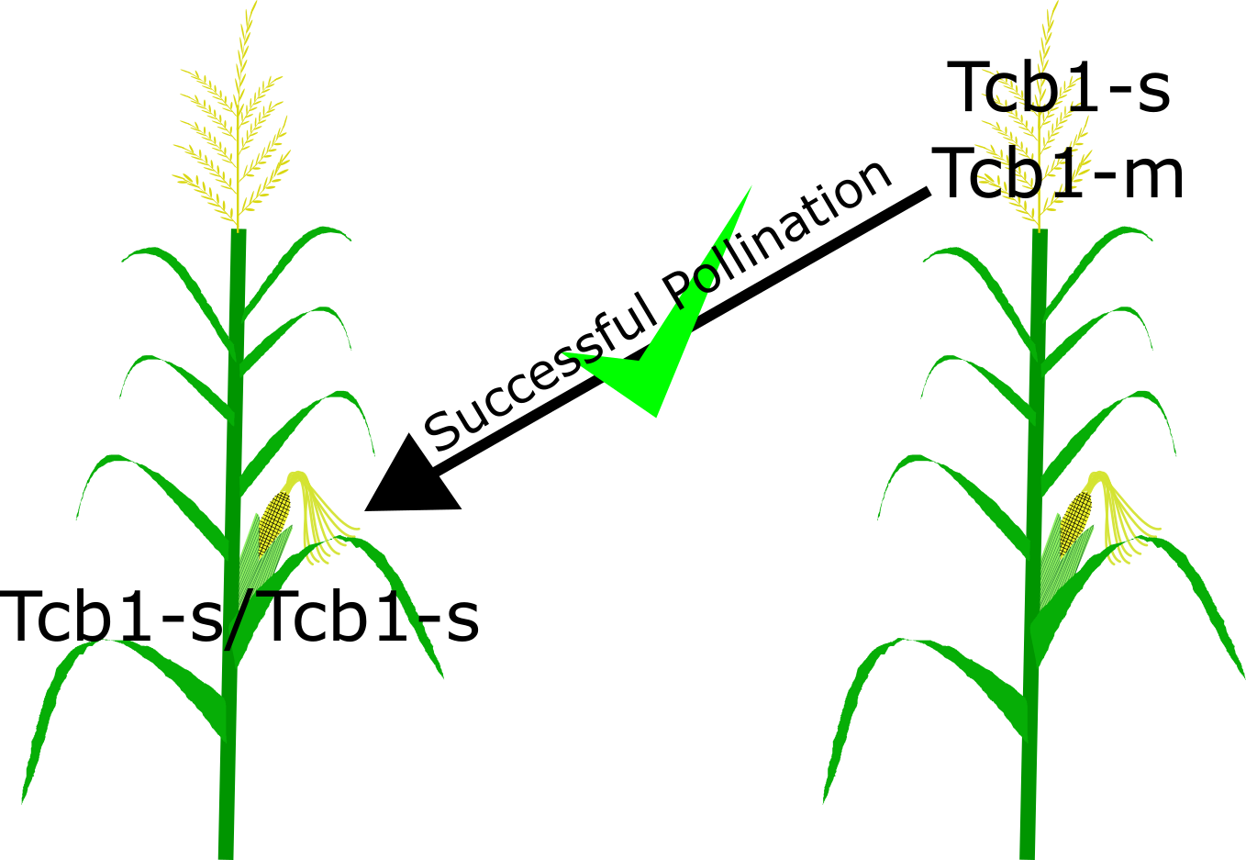
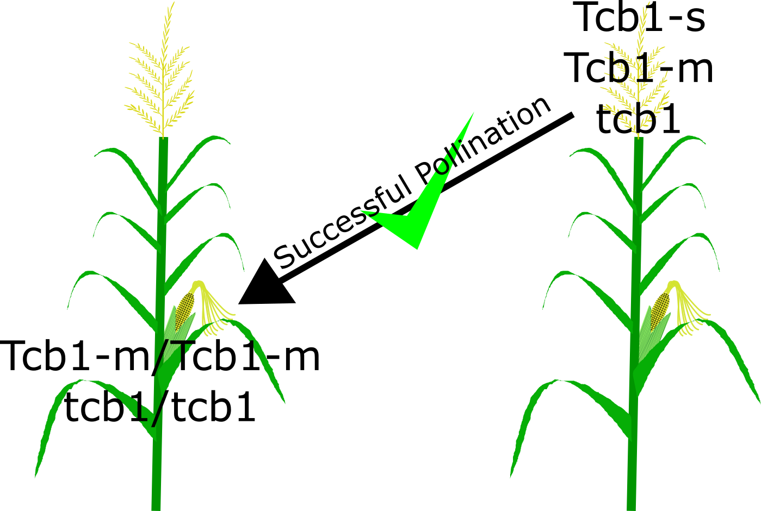

THE HUNT FOR MODIFIERS OF THE Tcb1 LOCUS
Merritt B. Burch and Donald Auger
Department of Biology and Microbiology, South Dakota State University, Brookings SD 57006, USA
Objectives
Materials and Methods
Find QTL from Tcb1 modifying loci or alternative alleles of the Tcb1 locus
From discovered QTL regions identify and isolate candidate genes
Determine the molecular mechanism is for Tcb1 cross incompatibility
Fig 2: Pollination of IBM Tcb1-s silks with colored R1-scm2 tcb1 pollen on day one (to test IBM x W22 Tcb1 efficiency) and self-pollination with colorless Tcb1-s on day two
Introduction & Background
Windborne contamination of organic maize varieties by genetically modified pollen can decrease profits
Currently, farmers place barrier crops, separate fields, or displace planting times to prevent cross contamination
An easier alternative would be to introgress one of three gametophyte cross incompatibility (CI) systems: Gametophyte factor 1 (Ga1), Gametophyte factor 2 (Ga2), or Teosinte crossing barrier 1 (Tcb1)
Three CI alleles are known: strong allele (-s), male allele (-m), and a null allele (Fig 1)
Traditionally found in teosintes (Zea mays spp. mexicana), Tcb1 is responsible for protecting silks from pollination by incompatible alleles (tcb1)
F1’s of many maize inbreds (e.g. B73) x W22 Tcb1-s show high incompatibility with tcb1, Mo17 x W22 Tcb1-s shows a weakened incompatibility
Fig 3: Predicted ear phenotypes of Fig 2 crosses. A: Strong effect of IBM x W22 Tcb1-s silks at rejecting colored tcb1 pollen. B: Weak effect of IBM x W22 Tcb1-s silks at rejecting colored tcb1 pollen
A
B
Preform experiment in summer 2017 in Brookings, South Dakota
Control crosses with R1-scm2 tcb1 pollen and colorless self Tcb1-s pollen
After harvest, shell and count kernels for the degree of tcb1 contamination
Gathered data with the extensively mapped IBM population will be used in a QTL analysis to determine if modifiers or alternative alleles of the Tcb1 locus are present
Conclusions
Future Work
We hope to find QTL that identify modifiers or alternative Tcb1 alleles
Results could shed light on the Tcb1 incompatibility system and give new meaning to the evolutionary speciation of maize from teosinte
Perform field experiment this summer
Identify regions of maize genome responsible for Tcb1 activity
Isolate and sequence candidate genes
Visualize pollen tube growth in compatible and incompatible silks, measure progress
A
B
Fig 1: Teosinte crossing barrier 1 (Tcb1) cross incompatibility system. A: Unsuccessful pollination between Tcb1-s silks and tcb1 pollen. B: Successful pollination between Tcb1-s silks and Tcb1-s OR Tcb1-m pollen. C: Successful pollination between Tcb1-m or tcb1 silks and Tcb1-s, Tcb1-m, OR tcb1 pollen
Acknowledgements & References
C
Evans, M. M. S., & Kermicle, J. L. (2001). Teosinte crossing barrier1 , a locus governing hybridization of teosinte with maize. Theoretical and Applied Genetics, 103(2-3), 259-265. doi:10.1007/s001220100549
Kermicle, J. L., & Allen, J. P. (1990). Cross-incompatibility between maize and teosinte. Maydica, 35(4), 399-408.
Kermicle, J. L., & Evans, M. M. S. (2005). Pollen–pistil barriers to crossing in maize and teosinte result from incongruity rather than active rejection. Sexual Plant Reproduction, 18(4), 187-194. doi:10.1007/s00497-005-0012-2
Lu, Y., Kermicle, J. L., & Evans, M. M. (2014). Genetic and cellular analysis of cross-incompatibility in Zea mays. Plant Reproduction, 27(1), 19-29. doi:10.1007/s00497-013-0236-5

