Slide 1
Automated methods enable direct computation on phenotypic descriptions for novel candidate gene prediction
Ian R. Braun, Carolyn J. Lawrence-Dill
bioRxiv 689976; doi: https://doi.org/10.1101/689976

Slide 3
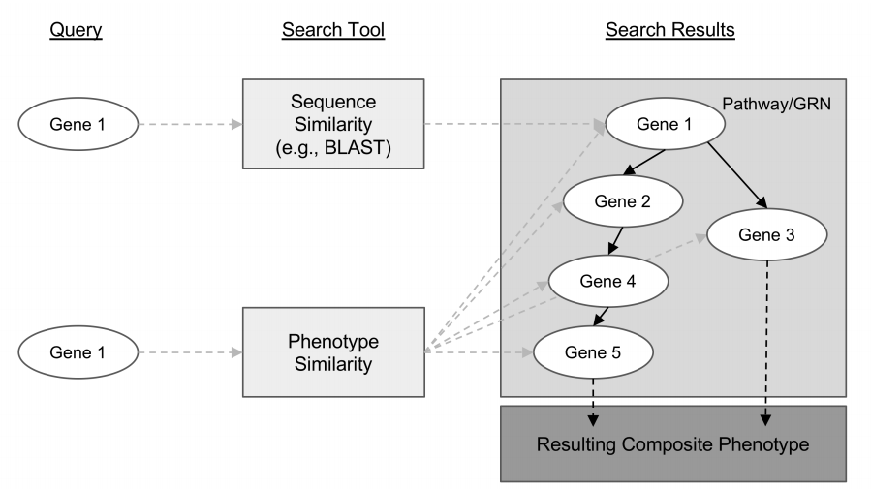

Slide 4


Slide 5
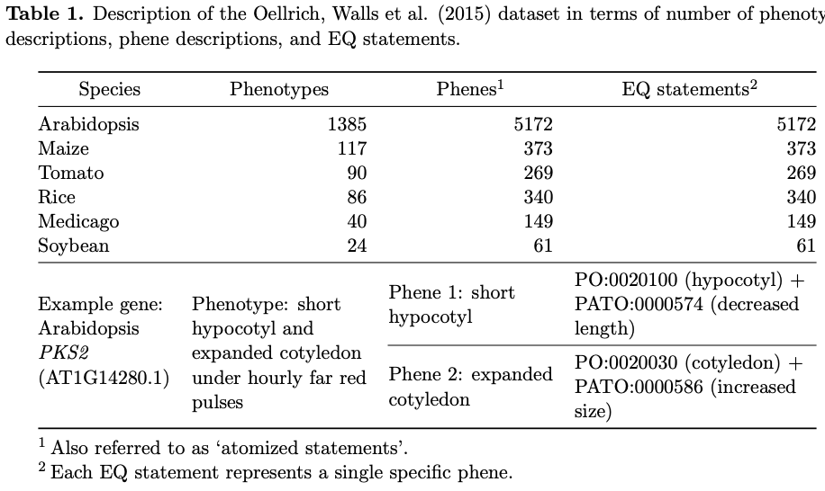

Slide 6
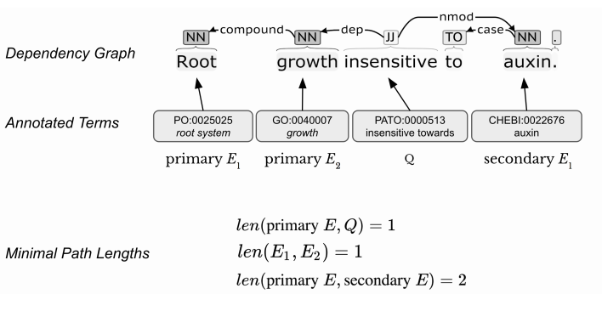

Slide 7
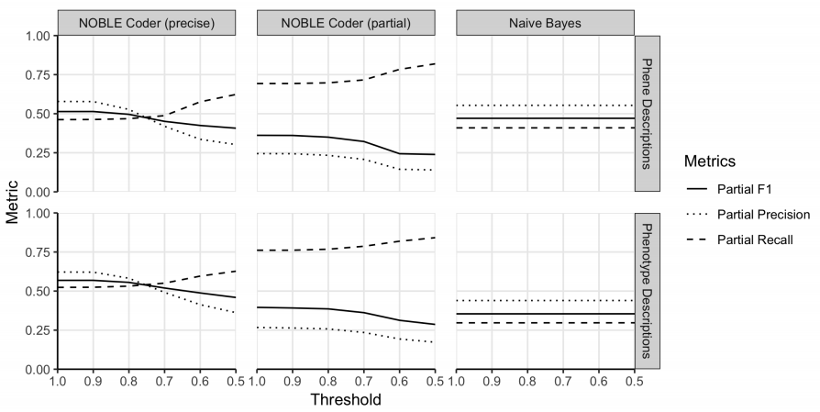

Slide 8


Slide 9
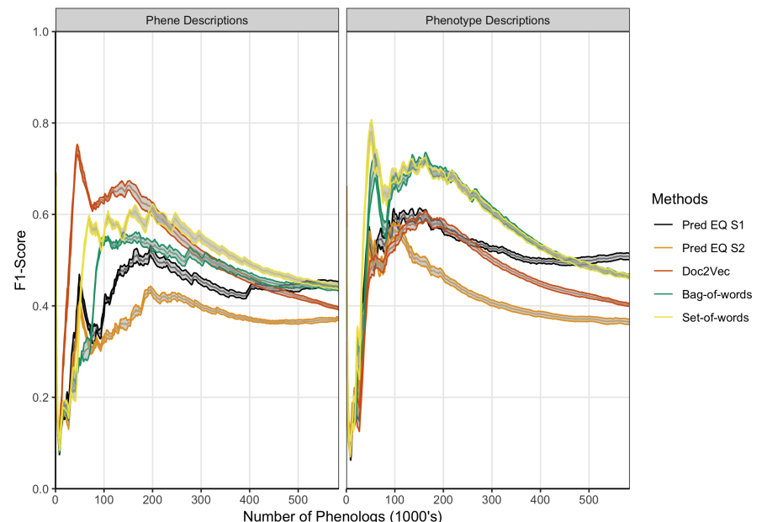

Slide 10
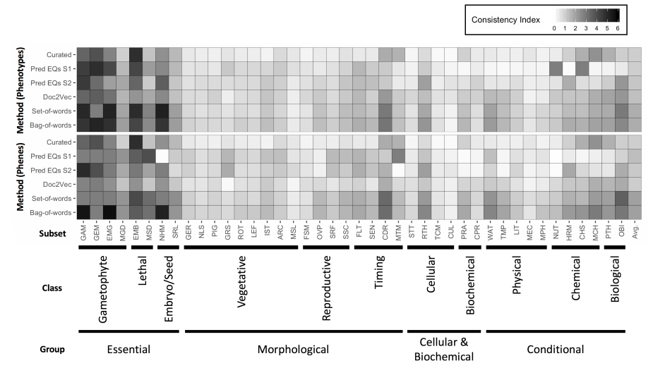

Slide 11


Slide 12
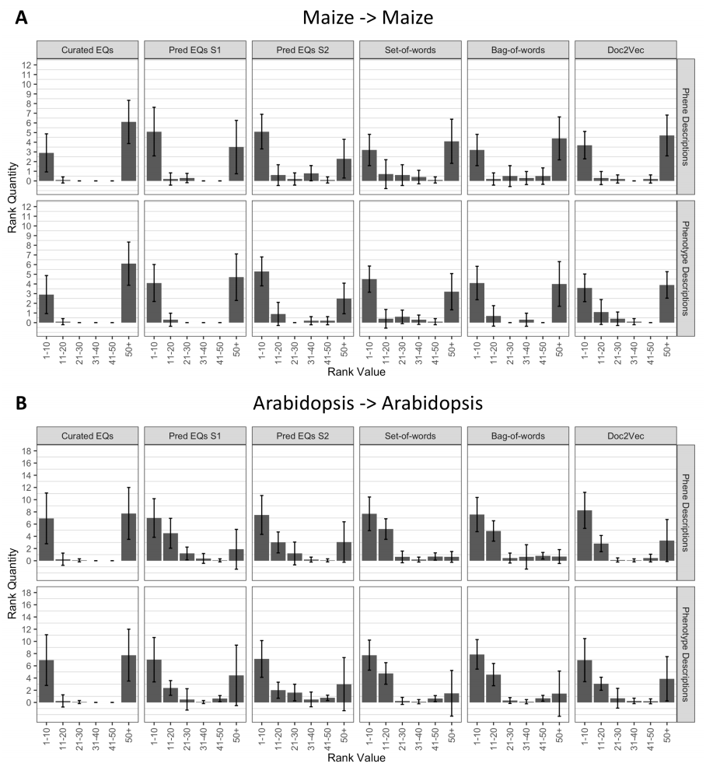

Slide 13
