Slide 1
Phylogenetic analysis of Two niphates Species
EEOB 563 Spring 2020– Final Project
Merritt C. Polomsky

Slide 2
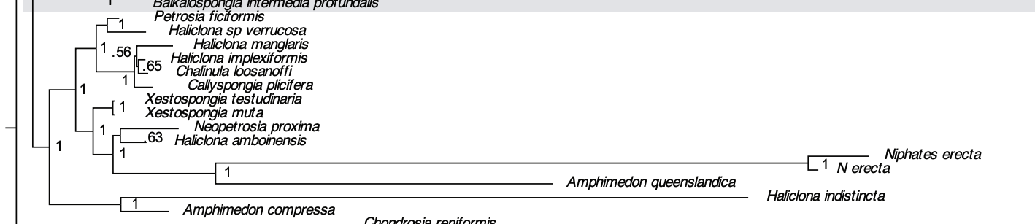
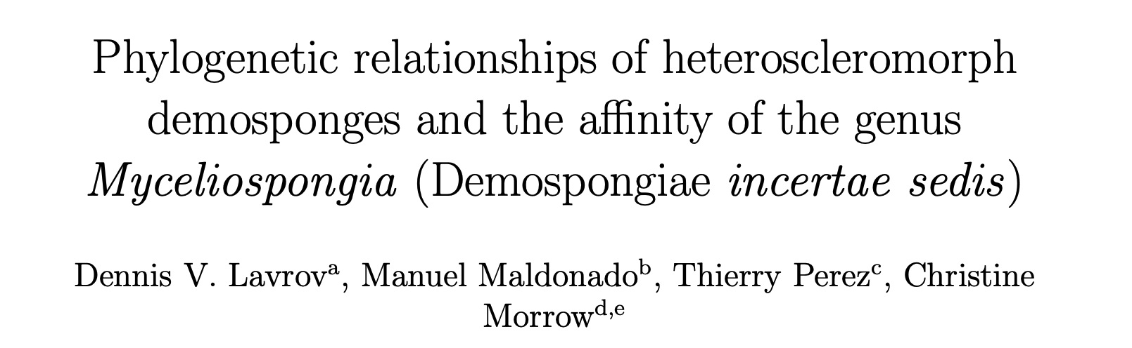
Niphates Erecta
Species of sponge that is a current focus of research in the Lavrov Lab
Previous research showed high rates of sequence evolution for Niphates erecta, but no analysis exists for Niphates digitalis

Slide 3
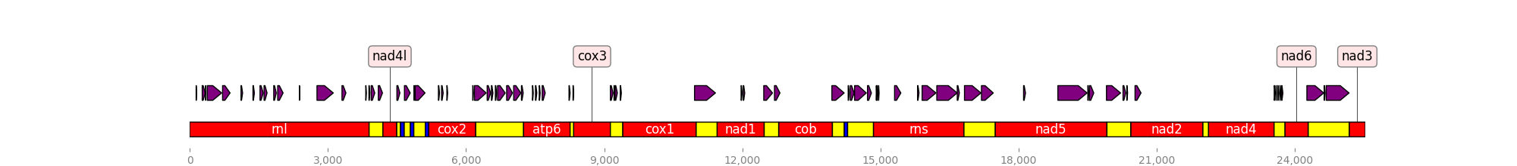
Niphates erecta
Extensive DNA insertions in N. erecta mitochondrial genome when compared to other species
Insertions appear in both coding and non-coding regions and in-frame and out-of-frame
Unknown if they are transcribed and translated, or cut out during mRNA editing

Slide 4
GOals
Validate the previously seen long branches and high rates of sequence evolution in N. erecta
See if N. digitalis follows the same phylogenetic patterns as seen in N. erecta
Evaluate the impact of insertions on tree building and phylogenetic analysis

Slide 5
Methods
1. Curate gene sequences from different species
2. Align by gene using MAFFT
3. Concatenate alignments by species; inspect for accuracy
4. Run alignment with gene partition through ModelTest-NG
5. Use RAxML-NG to generate maximum likelihood tree, bootstrap for verification
6. Repeat steps 2 through 5 without insertions
Final Model Selection for Partitions
P1 (rnl) – GTR+G4
P2 (rns) – GTR+G4
P3 (cob) – GTR+I+G4
P4 (cox1) - HKY+I+G4
P5 (cox2) – HKY+I
P6 (cox3) - HKY+G4

Slide 6
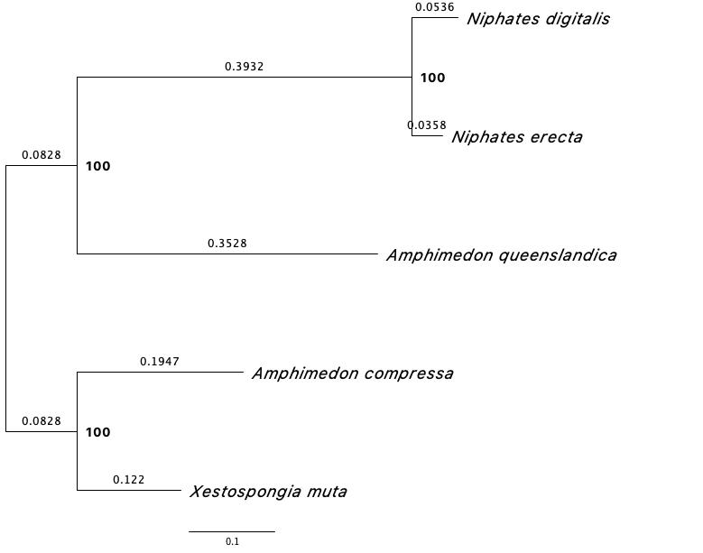
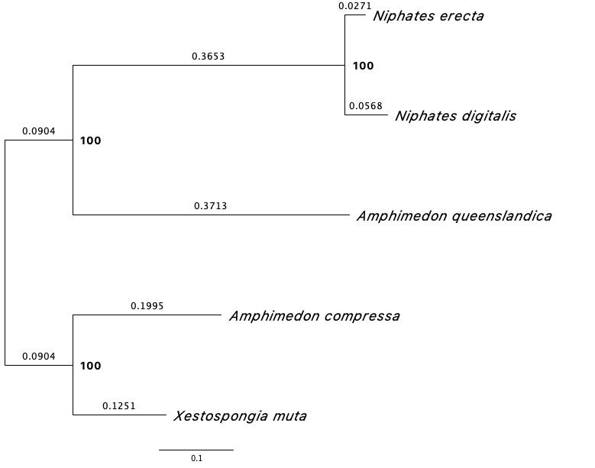
Results
Maximum Likelihood Tree – Insertions - Bootstraps
Maximum Likelihood Tree – No Insertions - Bootstraps
Final Likelihood: -35782.36
Final Likelihood: -32868.604
Trees viewed via FigTree v1.4.4

Slide 7
Conclusions
Insertions vs no insertions made no difference in model selection
Insertions vs no insertions made no difference in tree topology, and only minimum difference in branch length
Niphates digitalis – despite no insertions – showed greater branch length and rate of sequence evolution as compared to Niphates erecta
Close relationship of N. digitalis to N. erecta suggests insertions are either newly gained in N. erecta or newly lost in N. digitalis

Slide 8
Questions?

