Slide 1
A Visual Trace Map of
Edinburgh Place Names in Literature
Reframing literary place names as narrative structure, not geography
Merritt Wang
Supervisor: Uta Hinrichs
MSc Informatics, University of Edinburgh

Slide 2
The problem with geographic maps
Geographic maps assume a place name's meaning is fixed by its location.
In literature, meaning instead comes from narrative context: which chapter a place appears in, which other places surround it, and what that selection reveals about the author's imagination.
Core question: Can place names in literary text be visualised as an independent narrative structure, rather than simply a rendering of geographic information?
Data: LitLong Edinburgh database
548
2,135
48,056
345
literary works
(1687-2015)
distinct
place names
mention
records
authors

Slide 3
Two complementary research directions
Direction 1
Author spatial fingerprints
RQ: Does each author's distribution of place-name mentions form a visually distinctive spatial signature?
Stevenson clusters around the dark closes of the Old Town; Welsh clusters around Leith. Place choice is part of authorial style, just like vocabulary or syntax.
Builds on: Stange & Dörk's street-map fingerprint — pushed further by dropping geographic coordinates entirely.
Direction 2
Narrative topology networks
RQ: Does place co-occurrence reveal a narrative topology that diverges from geographic topology?
Two places far apart on the map may be narratively inseparable; two neighbours may never appear together. That divergence is the finding.
Builds on: The London Tube Map logic — replacing geography with functional, narrative connection.
Technical stack: Python (pandas, NetworkX) for processing | D3.js for interactive front-end

Slide 4
Progress so far
Complete
In progress
Ethics approval + data protection training
Sequence extraction method
Application 446635 (covering the planned user evaluation) was approved. Both required Learn Ultra modules — Data Protection Training and Data Protection for Research — completed.
Discovered that the start_word field is globally unique and strictly increasing within each document — meaning narrative order can be derived directly. Now validating this against real source-text excerpts found in a supervisor-provided CMS export, rather than only inferring it.
Data exploration
Mapped all four LitLong tables (documents, locations, mentions, location-by-document) and confirmed they support both planned analyses: per-author frequency distributions and place co-occurrence.
Visualisation sketches
Drafted six candidate directions (radar fingerprint, force-directed network, metro-map topology, reader-plot timeline, density heatmap, small multiples) to compare before committing to one approach.
Dissertation skeleton (Overleaf)
Set up the Informatics MSc template from a prior dissertation example, with title page, ethics declaration, and full chapter structure in place. Compiles cleanly.

Slide 5
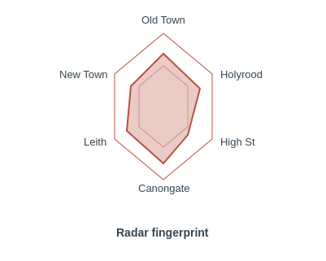
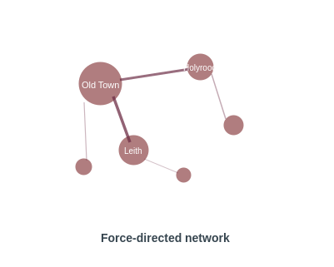
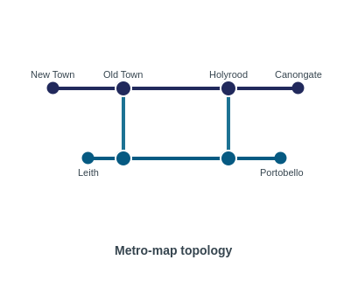
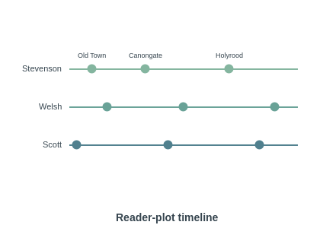
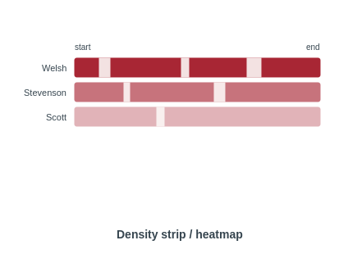
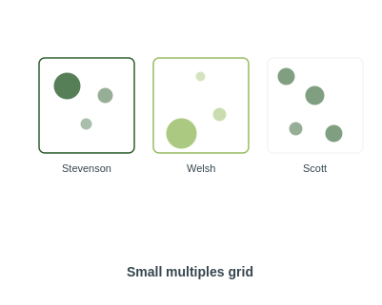
Six candidate sketch designs
Multiple directions drafted in parallel — final choice to be informed by user feedback

Slide 6
What's next
1
Design the user feedback study
Decide on participants (digital humanities students / general readers), in-person vs online format, and draft the task + interview questions
2
Validate sequence extraction
Cross-check start_word ordering against the source-text excerpts recovered this week, to confirm the method generalises across documents
3
Decide on database approach
Confirm with supervisor whether the CSV exports are sufficient, or whether direct PostgreSQL access is needed
4
Begin implementation
Start building the data processing pipeline for author fingerprints and the place co-occurrence network, based on the sketch chosen after feedback

Slide 7
Thank you

