Slide 1






Jujeop : Korean Puns for K-pop Stars on Social Media
Soyoung Oh
Jisu Kim
Seungpeel Lee
Eunil Park
Sungkyunkwan University
{sori424, rlawltn908, leepeel}@g.skku.edu, eunilpark@skku.edu
SocialNLP @ NAACL HLT ’21
Notes:
Hi, everyone from the world. Good to see you guys. I’m Soyoung Oh and I’m a Msc student at Sungkyunkwan University in South Korea.
Thanks all to be here and I’m really glad to present my work in SocialNLP. I’m gonna present our work Jujeop: Korean Puns for K-pop Stars on Social Media.
This work had be done by Soyoung Oh, Jisu Kim, Seungpeel Lee from Sungkyunkwan University, advised by Eunil Park.
1

Slide 2

What is Jujeop ?
Comment has a sense of humor by praising K-pop stars
with exaggerations and flashy modifiers.
You’re PAIN.
Luxury ChamPAIN that intoxicates me.
[Type 1] Fragmenting words to create a twist
[Type 2] Homophones and Homographs
[Type 3] Repetition
[Type 4] Nonsense
2
Notes:
The Korean word, Jujeop, originally, is used to describe someone that is acting pitiful and ridiculous.
But, well, in the K-pop world, Jujeop means to praise or express one’s love for K-pop stars in an exaggerated way.
These comments are seen very often on their favorite K-pop stars’ pics and videos, especially in Youtube. Here’s a example of the Jujeop comment:
You’re a PAIN. Luxury chamPAIN that intoxicate me.
And we found that pun like characteristics are shared between each Jujeop comment.
The puns exploit polysemy, homonymy, or phonological similarity to another word for an intended humorous or rhetorical effect. Based on this insight,
we classified Jujeop into four different types based on the semantic and syntactic distinctiveness as follow.
2

Slide 3


Type1. Fragmenting words to create a twist
Intentionally fragment a specific word and extract a single character from the word to disguise the word’s meaning
바다가 보이면 오션 뷰 언니가 보이면 언니 알러뷰
Ocean view, when I see the ocean, I love view, when I see you
왜 맨날 같은 티만 입어? 프리티!
Why are you always wearing a same Tee? Pretee!
3
Notes:
First, Fragmenting words to create a twist.
The comment in this type intentionally fragment a specific word and extract a single character from the word to disguise the word’s meaning.
By this word play, the meaning of the whole sentence is twisted. In this type, usually the meaning of the sentence has to be interpreted into two steps.
After the sentence with hidden or sarcastic meanings is first presented, the word with complimentary meaning is then provided.
For instance, “Why do you always wear the same Tee? preTee!” can be one of the example within this type.
The first sentence asks why she always wears the same t-shirt. And then segment the Tee in the first sentence to make twist.
Then, the following word changes the whole meaning of the sentence by using word [ti:] to make pre[ti:] which creates a humorous twist.
3

Slide 4
Type2. Homophones and homographs
Using specific lexical features of homophones and homographs
너 영어이름을 조지 부시로 해줘… 내 마음을 조지고 부시니까
Change your English name to George Bush… because you beat and break my heart
언니가 사는 곳은 여름이 없다면서요, 더 위*가 없으니까
There is no summer where you live in cause there’s no where to go higher
*더 위 means high temperature in Korean, which is pronounced same as go higher in Korean.
4
Notes:
Next, Jujeop comment that used homophones and homographs.
Users usually employ specific lexical features of homophones and homographs to make Jujeop comment.
For example, “Change your English name to Geroge Bush, because you beat and break my heart”.
Where Geroge Bush pronounced same as beat and break in Korean word, which are 조지다 and 부시다.
4

Slide 5
Type3. Repetition
Using repetition to emphasize the complimentary meanings
그만 보고 싶다. 그만 보고 싶다.
I want to stop seeing. I want to stop seeing.
그거 알아요? 멋진 사람을 보면 기억을 잃는대요. 그거 알아요? 멋진 사람을 보면 기억을 잃는대요. 그거 알아요? 멋진 사람을 보면 기억을 잃는대요.
Gosh, you know what? They say you lose your memory when you see a handsome person. Gosh, you know what? They say you lose your memory when you see a handsome person. Gosh, you know what? They say you lose your memory when you see a handsome person.
5
Notes:
Repetition.
This is a type of Jujeop employs repetition to emphasize the complimentary meanings on the K-pop stars.
For example, keep repeating the sentence like “Gosh, you know what?
They say you lose your memory when you see a handsome person.”
By repeating this kind of sentence, the comment can exaggerate the coolness of the stars with humor.
5

Slide 6
Type4. Nonesense
Using almost nonsensical,
over-the-top expressions
그녀가 예쁘다고 생각하는 사람 일어나! 라고 했더니 지구가 일어나서 태양계 순서가 바뀌었잖아!
Is anybody who thinks she’s pretty, get up! And then the whole Earth got up and the order of the solar system changed!
언니 사실 혼혈 이라 면서요, 천국과 한국
Sis, I heard you’re Mixture. Heaven and Korea.
6
Notes:
Finally, the type of Nonsense.
This type of comment supposed the fictional situation.
The majority of the comments were included in this type.
This type uses almost nonsensical, over-the-top expressions.
One of the representative example is as follow:
“I said, anybody who thinks she’s pretty, get up! And then the whole Earth got up and the order of the solar system changed.”
Where, the Earth can not get up like a human being, nor could the order of the solar system change due to a person’s prettiness.
6

Slide 7
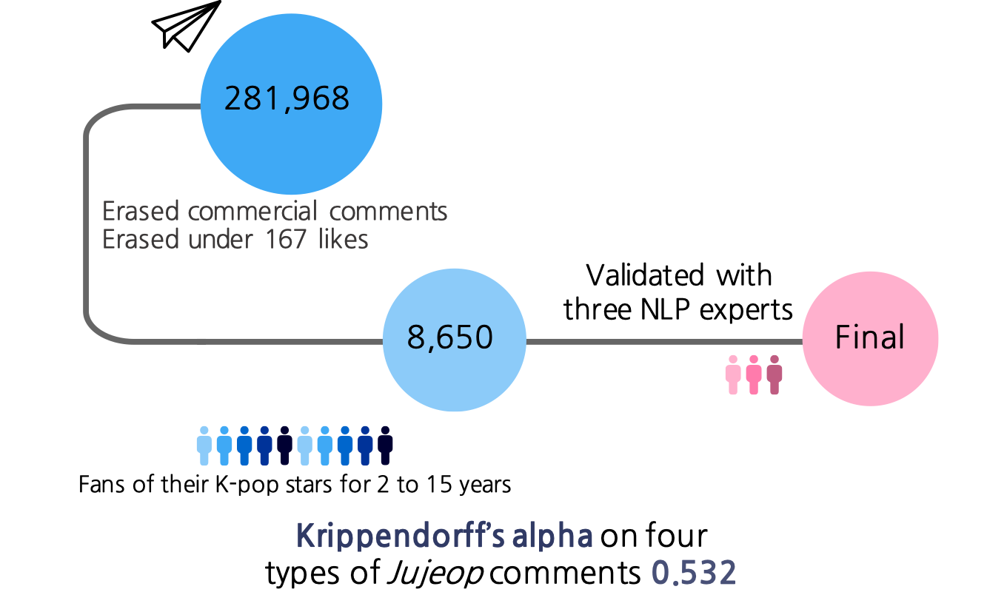
Annotation process
275 Channels (views : 5K to 38M)
7
Notes:
For the annotation process,
We collected Youtube comments from 275 channels with the number of views between 5K and 38 Million.
Then, we erased commercial comments which include urls, and advertisement words.
Also, we erased under 167 likes comments as Jujeop comments usually have high number of likes.
Based on the definition of the Jujeop, ten enthusiastic fans of their K-pop stars for at least 2 to 15 years
annotated the Jujeop comment and it’s types.
Then, three nlp researchers cross-validated the corpus.
A inter-rater reliability on four types of Jujeop annotations met moderate level.
7

Slide 8
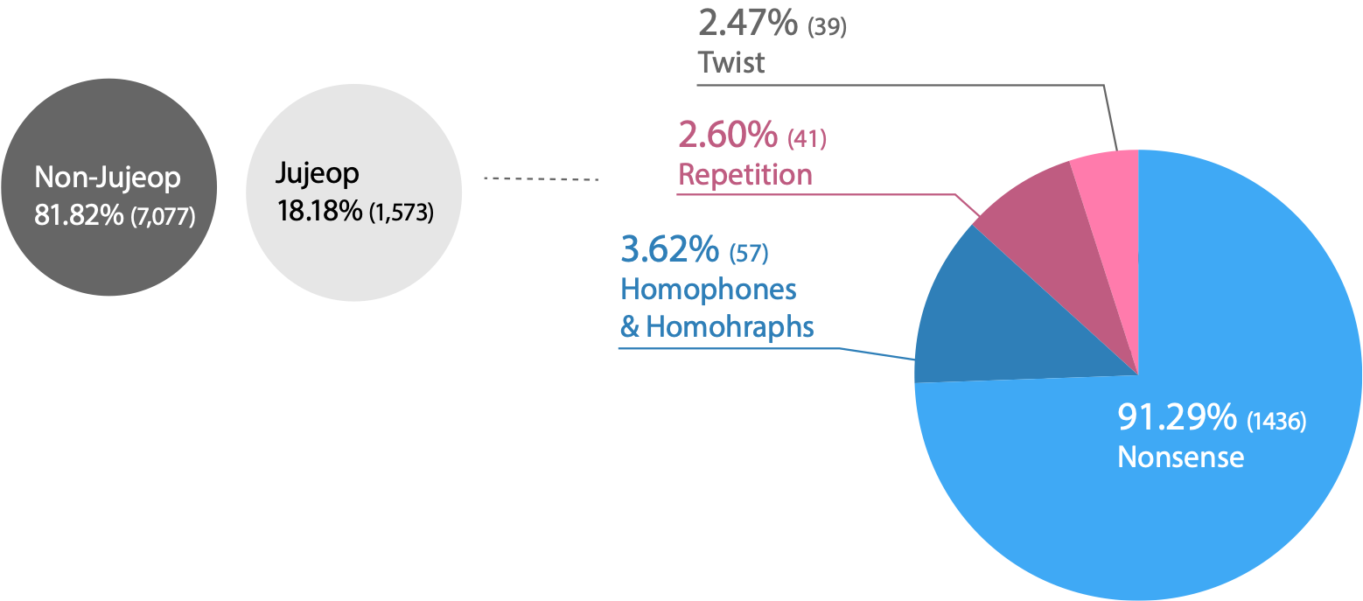
Corpus description
8
Notes:
Therefore, we collected 8,650 comments, where 1,573 were annotated as Jujeop comments.
And for each type of the Jujeop comment, described as in the screen, the Nonsense type consist the most number of corpus.
8

Slide 9
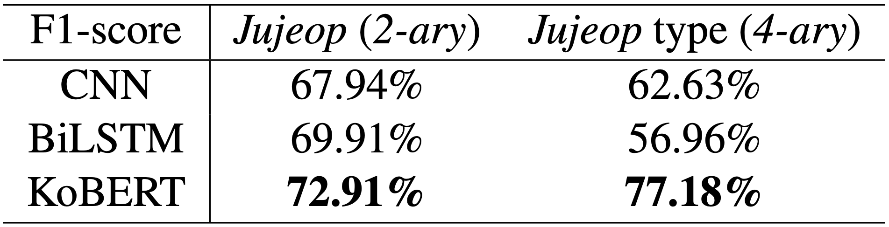
Experiments (1) Classification
Handle class imbalance
Non
Jujeop
(7,077)
Non
Jujeop
(1,573)
Jujeop
(1,573)
Binary Classification
Jujeop type classification
Binary and Multi-class classification for Jujeop types (marco f1-score)
9
Notes:
To validate quality of the corpus, we employed several nlp experiments.
At first, for the Jujeop classification, we applied three baseline classifiers, which are CNN, BiLSTM, and KoBERT.
KoBERT is BERT based model trained with Korean corpus.
We validated the difference between Jujeop and non-Jujeop comments by binary classification.
As more than 80% of the annotated comments in the dataset are non-Jujeop comments, so, we randomly selected the comments with same number of Jujeop comments.
The result shows that KoBERT with the highest macro f-1 score.
Also, we employed multi classification task to whether the model can learn the different features of each Jujeop type.
To handle the class imbalance problem with types, we employed class weights to handle it.
Same as the binary classification task, KoBERT shows the good performance.
9

Slide 10
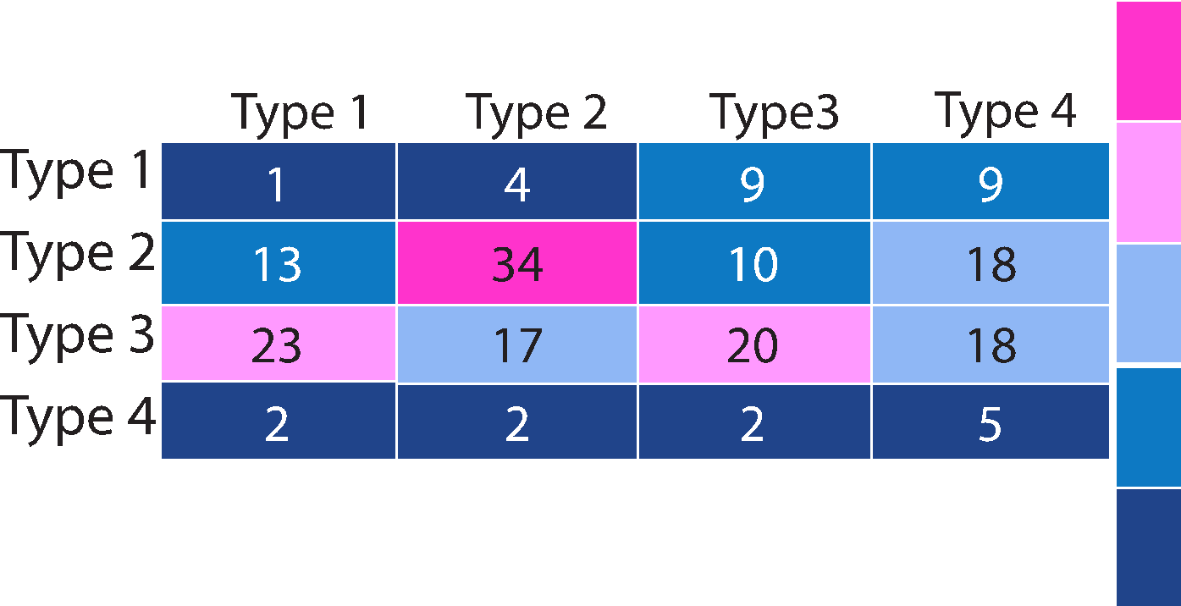
Experiments (2) Clustering
K-means clustering (k=4)
Total accuracy 32%
Used Part-Of-Speech tagged sentences as input
Type 1 : 2.56%
Type 2 : 59.65%
e.g., [언니/Noun, 다/Adverb, 좋은데/Adjective, 자꾸/Noun, 벽/Noun, 이/Josa, 느껴져요/Verb, 완벽/Noun]
Type 3 : 48.78%
Type 4 : 10%
T 1
(39)
Jujeop
(1,573)
T 2
(41)
T 3
(50)
T 4
(50)
10
Notes:
Pun usually relies on specific linguistic structure that can be classified based on the patterns of the syllable, word, or phrase similarity.
Since Jujeop comments share the characteristics of the pun, we assumed that Jujeop comments within the same type would share similar syntactic relations.
Based on the assumption, we employed pos tagging to analyze the distinctive linguistic structure of each Jujeop type.
Then, the tagged sentences with pos tags were used as the input for the k-means clustering, where we set the k as 4.
To balance the number of each type in Jujeop comments, we randomly selected 50 samples from nonsense type.
The total accuracy of the clustering was 32%, where the type of homophones and homographs with the most accuracy with about 59%.
10

Slide 11
Conclusion & Future Work
What we done is
First definition of the Jujeop with each type
Finding that Jujeop comments share semantic and syntactic characteristics
Publicly opened Jujeop corpus for further research
To make more balanced corpus
A crowd sourcing experiment
Text generation based on the given definition
11
Notes:
The current study first conceptualized the Jujeop where there’s lack of Korean pun study compared to English.
Jujeop comments have an important meaning in social nlp domain, as they act as one of the means of communication in our society.
Also, we found Jujeop comments share semantic and syntactic characteristics.
As mentioned earlier, we publicly opened our data so feel free to use them for further research.
However, it was hard to collect each type of Jujeop comment in the wild with a balanced number.
Therefore, we might use crowdsourcing experiment to collect more data.
Or, we could employ deep learning technologies for text generation to make novel Jujeop comment based on the definition we proposed.
11

Slide 12

Jujeop : Korean Puns for K-pop Stars on Social Media
Feel free to ping me at Gather.town!
paper9
Thank you ☺
Contact So-young
sori424@gmail.com
https://sori424.github.io/
Our data is publicly released!
SocialNLP @ NAACL HLT ’21
Notes:
Thank you for all you guys in the world attend to hear my presentation.
I hope to meet you at the Gather.town section paper9 to interact more with me.
Thanks!
12

