Slide 1
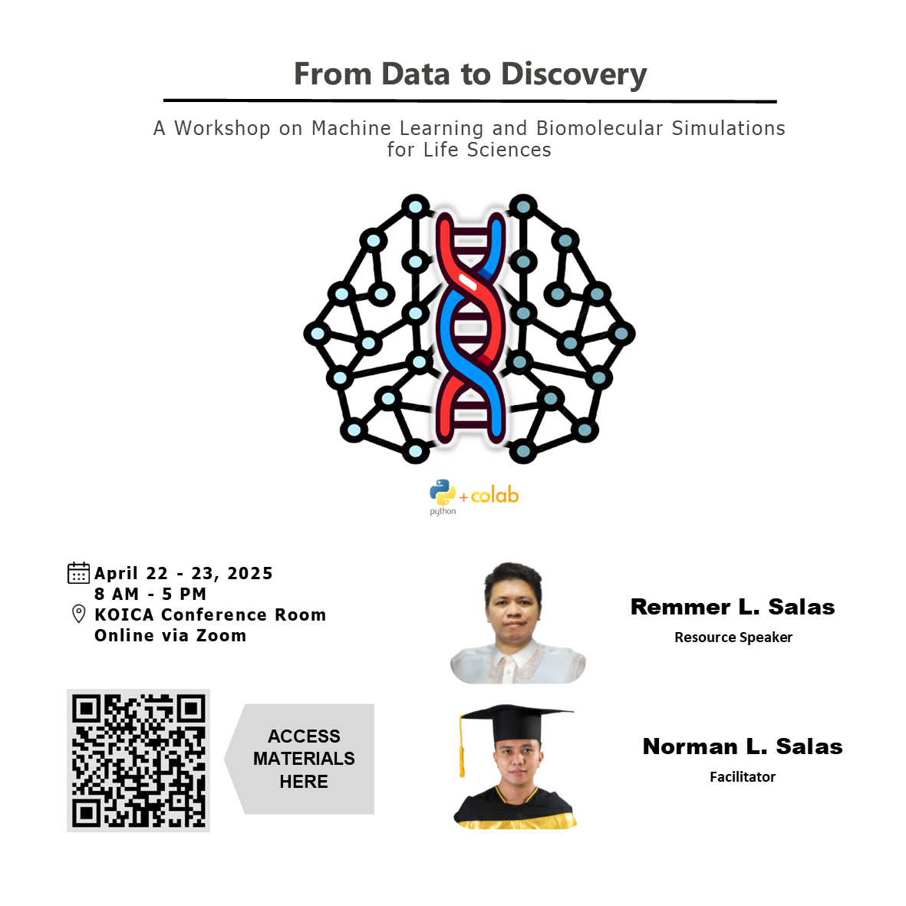

Slide 2
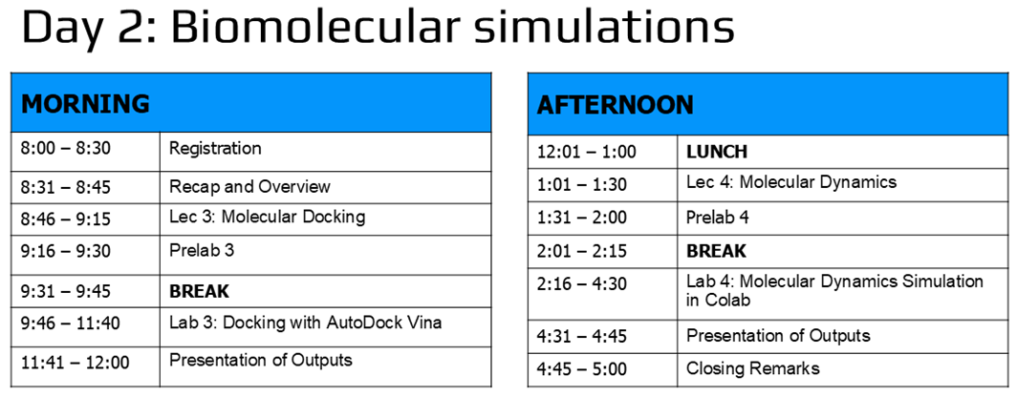

Slide 3
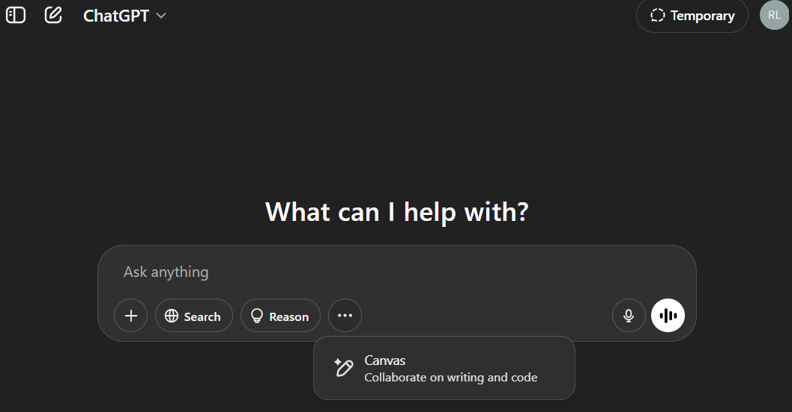
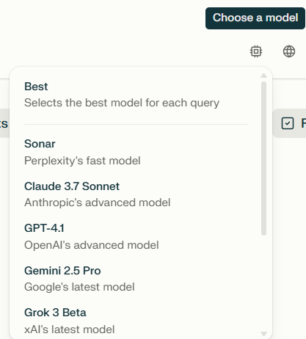
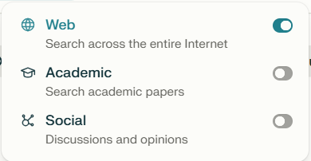
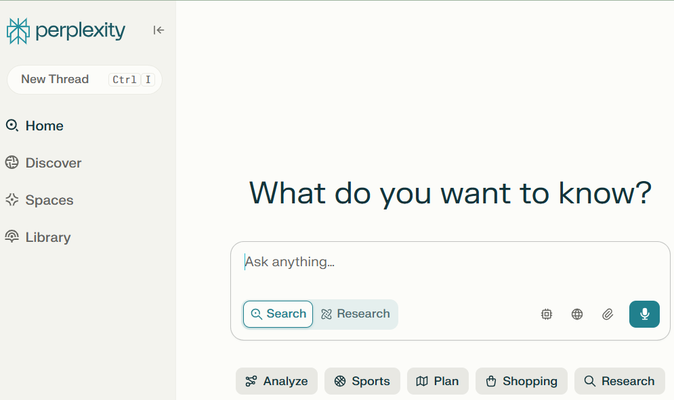
How to reduce hallucinations?*
Ans: It’s an inherent feature rather than a bug
* Ate Ferm’s question

Slide 4
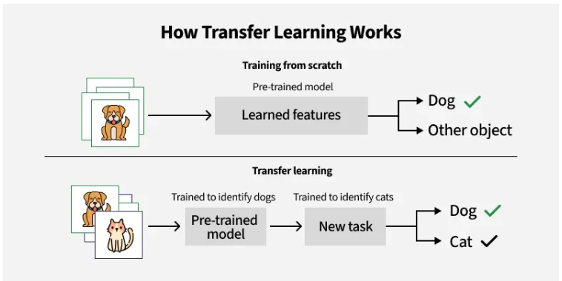
1000+ images
per class
50 images
per class
* Related to Jhon’s question, a BSAP student
https://www.geeksforgeeks.org/ml-introduction-to-transfer-learning/

Slide 5
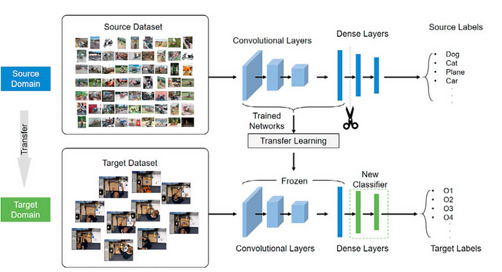
https://www.tredence.com/blog/transfer-learning-and-data-augmentation-in-deep-learning

Slide 6
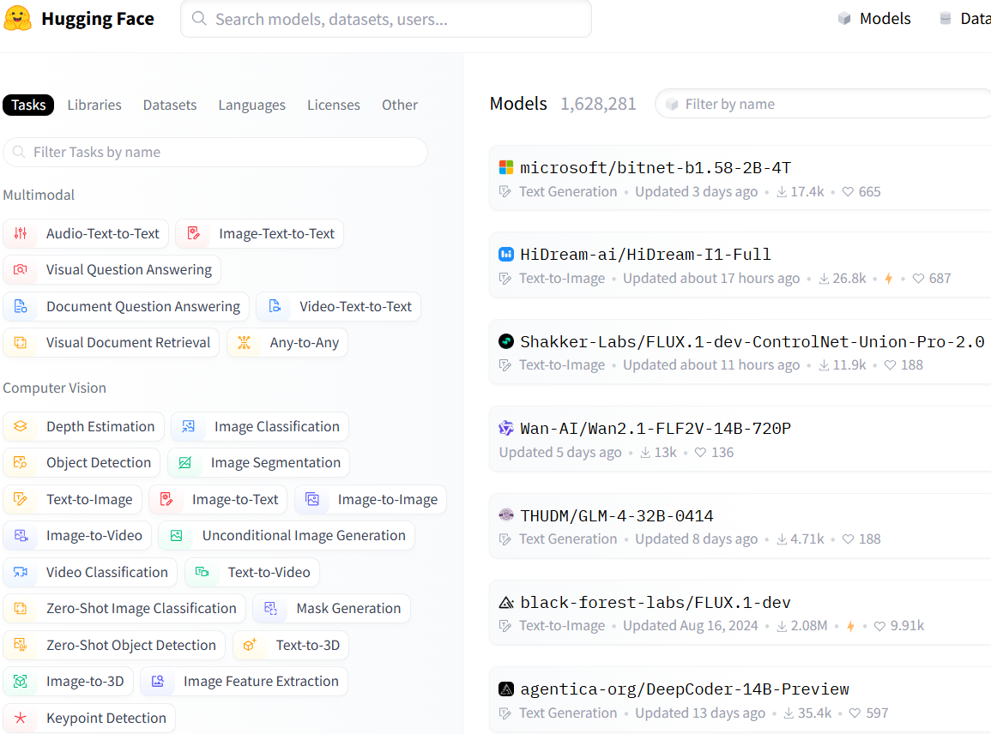

Slide 7
Molecular docking
LECTURE 3
Remmer L. Salas
Chemistry Instructor
Department of Natural Sciences and Mathematics
Visayas State University

Slide 8
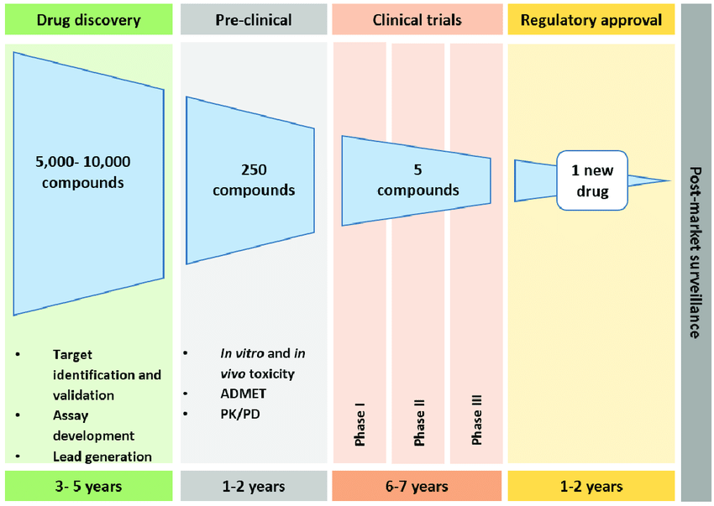
Drug development
Computational
drug design
Drug discovery & development timeline
https://www.researchgate.net/figure/Drug-discovery-and-development-timeline-The-current-drug-approval-pipeline-can-take-15_fig1_308045230

Slide 9
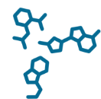
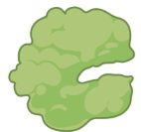
Computational Drug Design
Ligand-based drug design
Structure-based drug design
Quantitative structure-activity relationship (QSAR)
(e.g., 3D-QSAR.com,
ML-based)
Pharmacophore modeling
(e.g., PharmMapper)
Molecular docking
(e.g., AutoDock Vina)
Homology modeling
(e.g. Swiss-Model, I-Tasser)
Molecular dynamics simulation (e.g. AMBER, OpenMM)

Slide 10
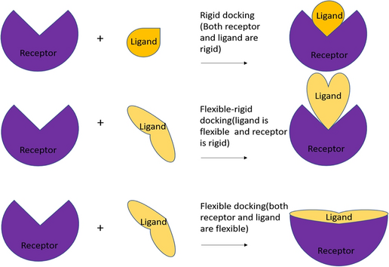
Molecular docking
A. Rigid docking (Lock-and-key)
rigid
rigid
B. Flexible-rigid docking
rigid
flexible
Simulate the molecular interaction between ligands & receptors
Predict binding mode & affinity
C. Flexible docking (Induced-fit)
flexible
flexible
https://doi.org/10.1007/s00706-023-03076-1

Slide 11
Types of docking
Based on availability of template
Template-based
Uses known structures (templates) as a scaffold
Template free
Do not need a template
Local
Binding site is known
Global
Binding site is unknown
Easy Difficulty level Hard
Known Interaction details Unknown
https://doi.org/10.1016/j.drudis.2018.05.006

Slide 12
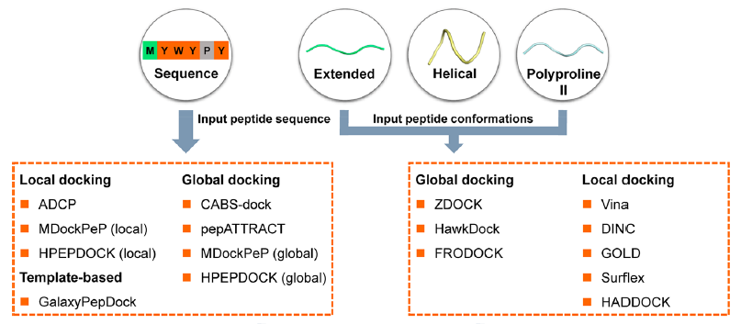
Some molecular docking software
https://doi.org/ 10.1021/acs.jctc.9b01208

Slide 13
Applications of docking software
Virtual screening – identify lead compounds
Reverse docking – identify novel targets
Design and optimize compounds
Identify key molecular interactions
Interpret biological data

Slide 14
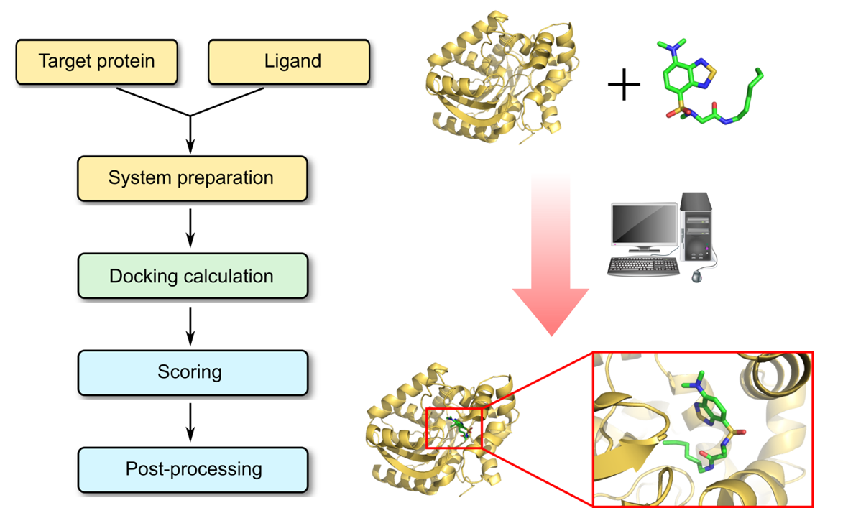
Target protein
select protein structure
remove water, cofactors
add missing atoms
add H
add charge
generate PDBQT
Define the
Pocket center
Pocket size
Scoring
+
Docking
Ligand
Extract from PDB
Add H
Optimize geometry
Generate PDBQT
Post-processing
Check interaction energies
Generate 2D & 3D interaction map
Identify molecular interactions
https://www.profacgen.com/protein-ligand-docking.htm

Slide 15
Limitations of molecular docking
Flexibility of receptor and ligand
Scoring functions that do not correlate well with experimental binding affinities

Slide 16
For more tutorials & workshops…
HADDOCK3 tutorials: https://www.bonvinlab.org/education/HADDOCK3
Rosetta virtual workshop 2020: https://meilerlab.org/rosetta-workshop-2020/
CompBio Asia workshop: https://compbioasia.net/
Cheminformatics-driven molecular docking: https://www.rcsb.org/news/feature/67d9853eaddf75595bd158f7

Slide 17
Molecular Docking
Prelab 3

