Slide 1
Elements of Game Design
Play and challenges
Conflicts and choices
Feedback loops
Goals and rewards
Imaginary world

Slide 2
Play and Challenges
Win the most points
Stay alive
Solve the riddle
Pattern recognition
First one out of cards
Be the fastest

Slide 3
Conflicts and Choices
Scarce resources
Competition
Decisions
Calculations
Planning
Adapting
Teamwork

Slide 4
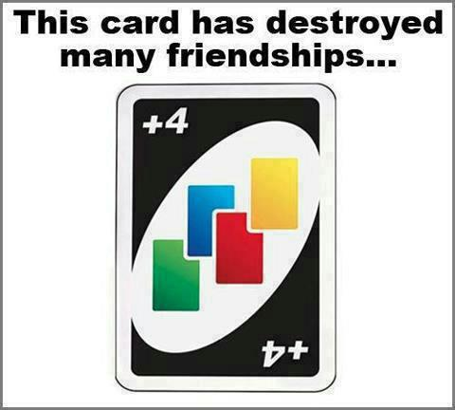

Slide 5
Feedback Loops
Lets the user know how they are doing
Awards players for doing things right
Penalizes players for doing things wrong

Slide 6
Goals and Rewards
Get to the next level
Earn points/badges
Gain status/rank

Slide 7
Motivators
Intrinsic motivators
Autonomy
Self-expression
Mastery
Extrinsic motivators
Money
Grades
Badges, points, leaderboard, status

