Slide 1
Feedback loops

Slide 2
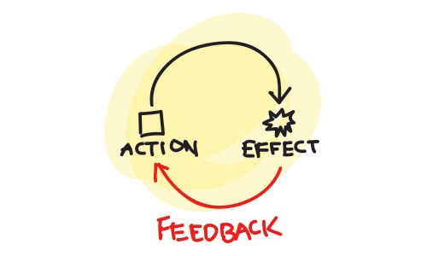
What is a feedback loop?
A person takes an action
The action has an effect
The person is presented with feedback and a choice
The user makes a decision and the process is repeated

Slide 3
Feedback loops
Where do we see feedback loops in websites?
Notes:
Form completion and thank you pages
“Likes” on a post
Statistics and metrics

Slide 4
Four stages
Evidence: a behavior is measured, captured, and stored
Relevance: The information must be related to the individual in a context that is meaningful
Consequence: The user must know what to do with this information
Action: The user associates the behavior with the consequence, makes a decision and acts

Slide 5
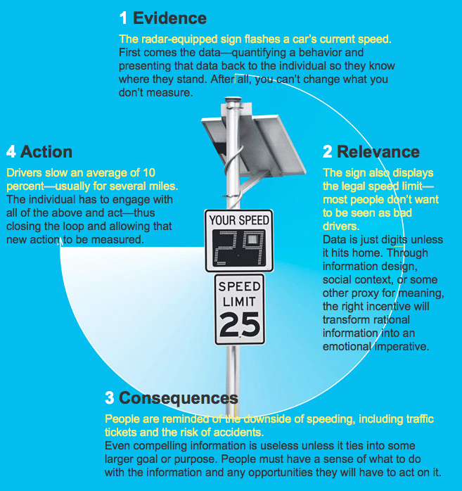

Slide 6
Feedback loop issues
Speed - The longer it takes for feedback to arrive, the less it will influence future decisions.
Measurability - Comparing vague, unquantifiable feedback to other factors in order to make an informed decision is too difficult.
Context - Feedback presented without the context of a larger goal isn’t as effective.
Motivation - Feedback that isn’t connected to the user’s true motivations doesn’t work sustainably.

Slide 7
Statistics and Metrics
“Attaching a measure to anything turns it into a game.”
What are some of the pros and cons of this?

Slide 8
Sources
http://uxdesign.smashingmagazine.com/2013/02/15/designing-great-feedback-loops/
http://www.wired.com/magazine/2011/06/ff_feedbackloop/

