Slide 1
DAY-BASED SALES FORECAST
CSE4062 – Group 4

Slide 2
Today’s Topics
Data Description
Data Visualization
K-Means
Clustering
Regression
Conclusion

Slide 3
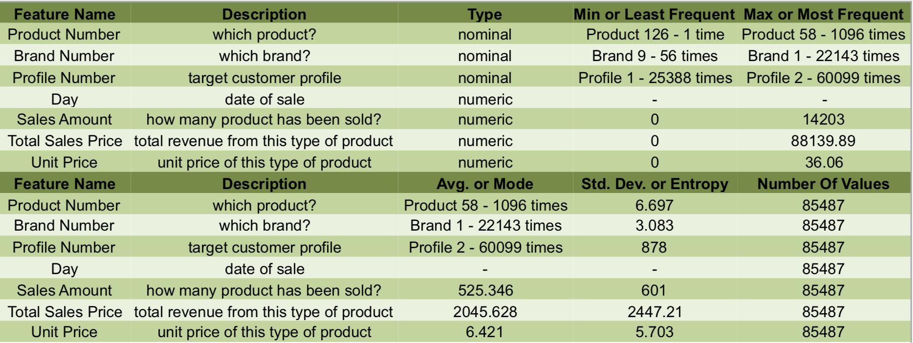
Data Description

Slide 4
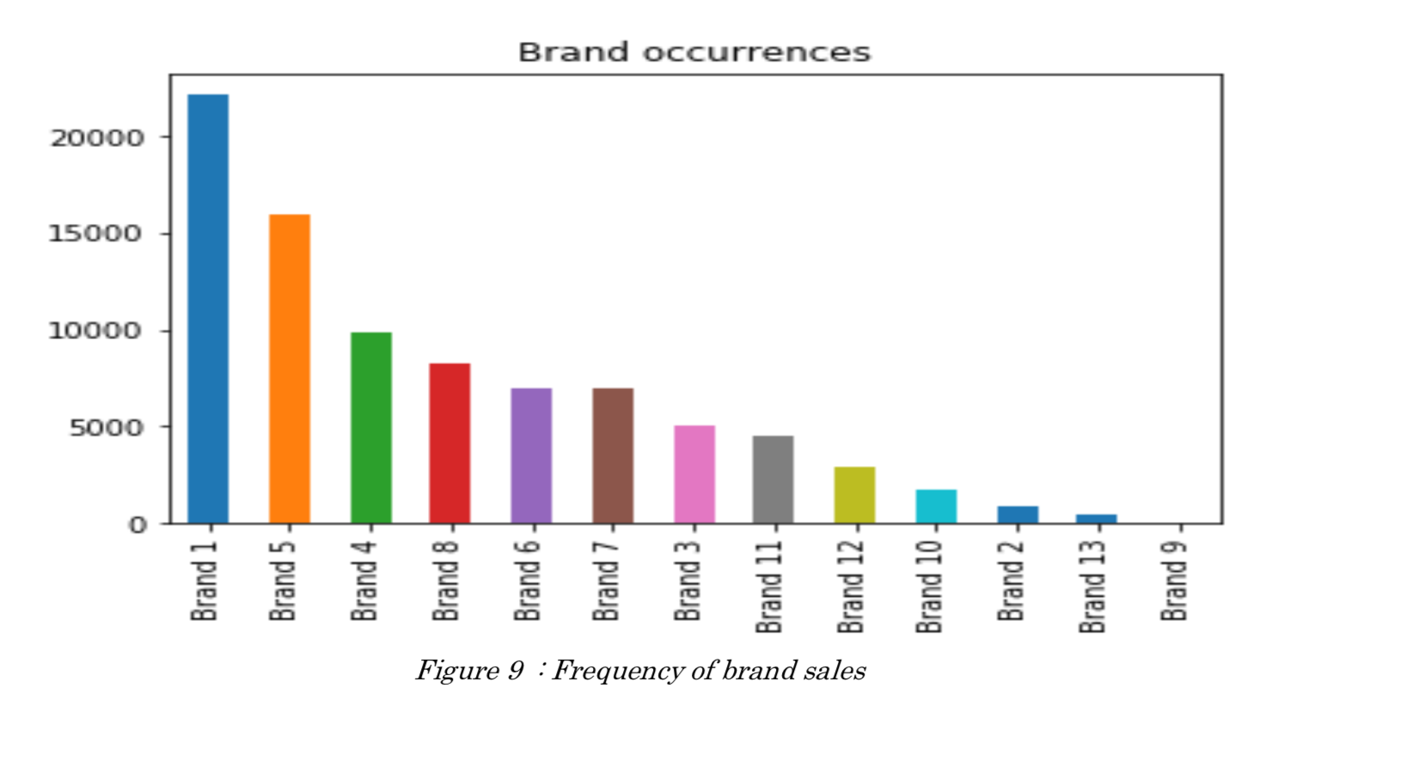
Data Visualization

Slide 5
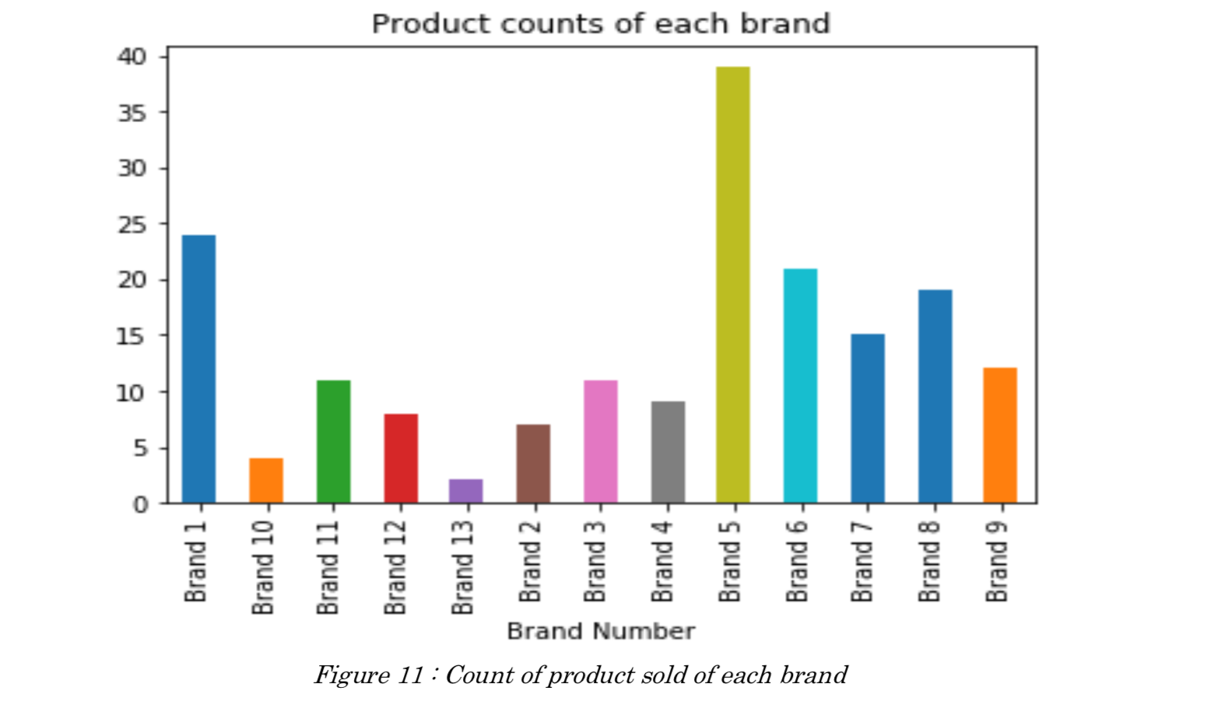
Data Visualization

Slide 6
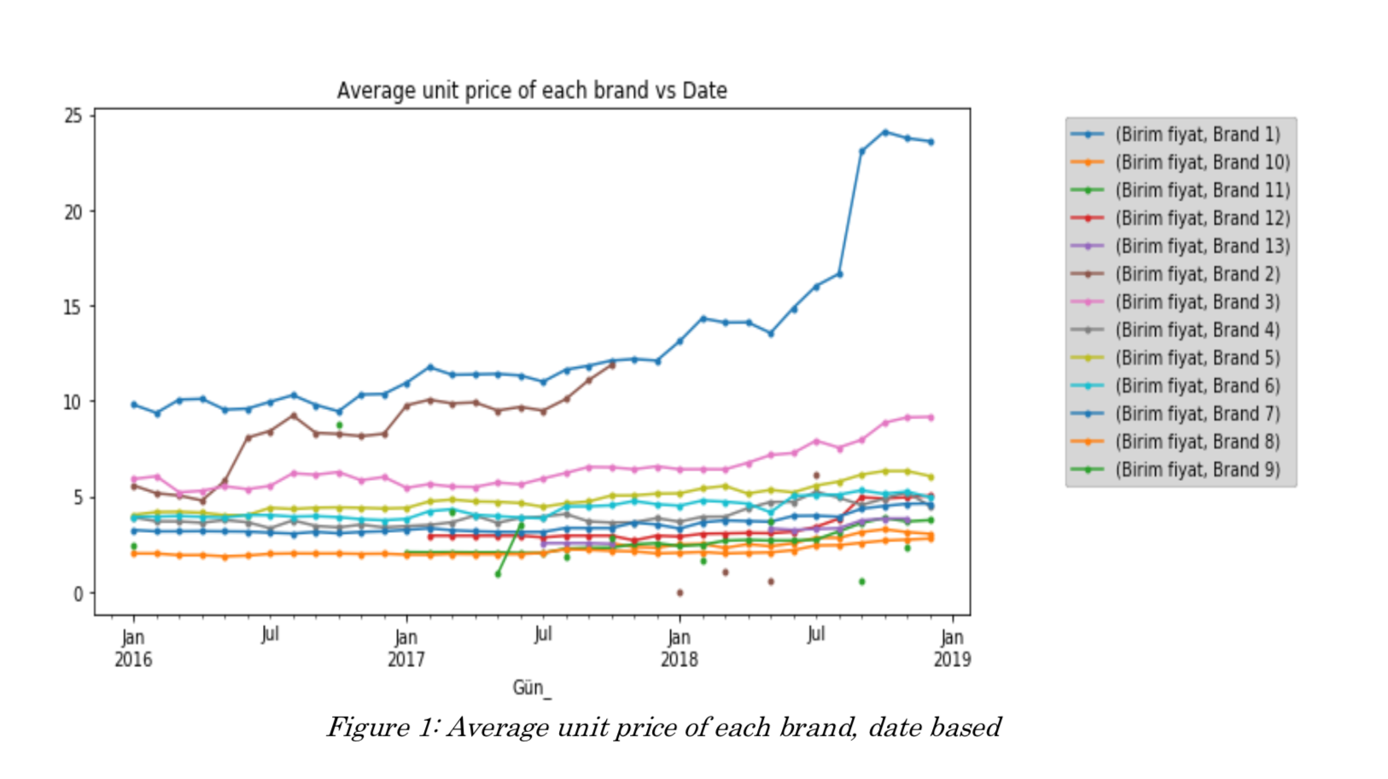
Data Visualization

Slide 7
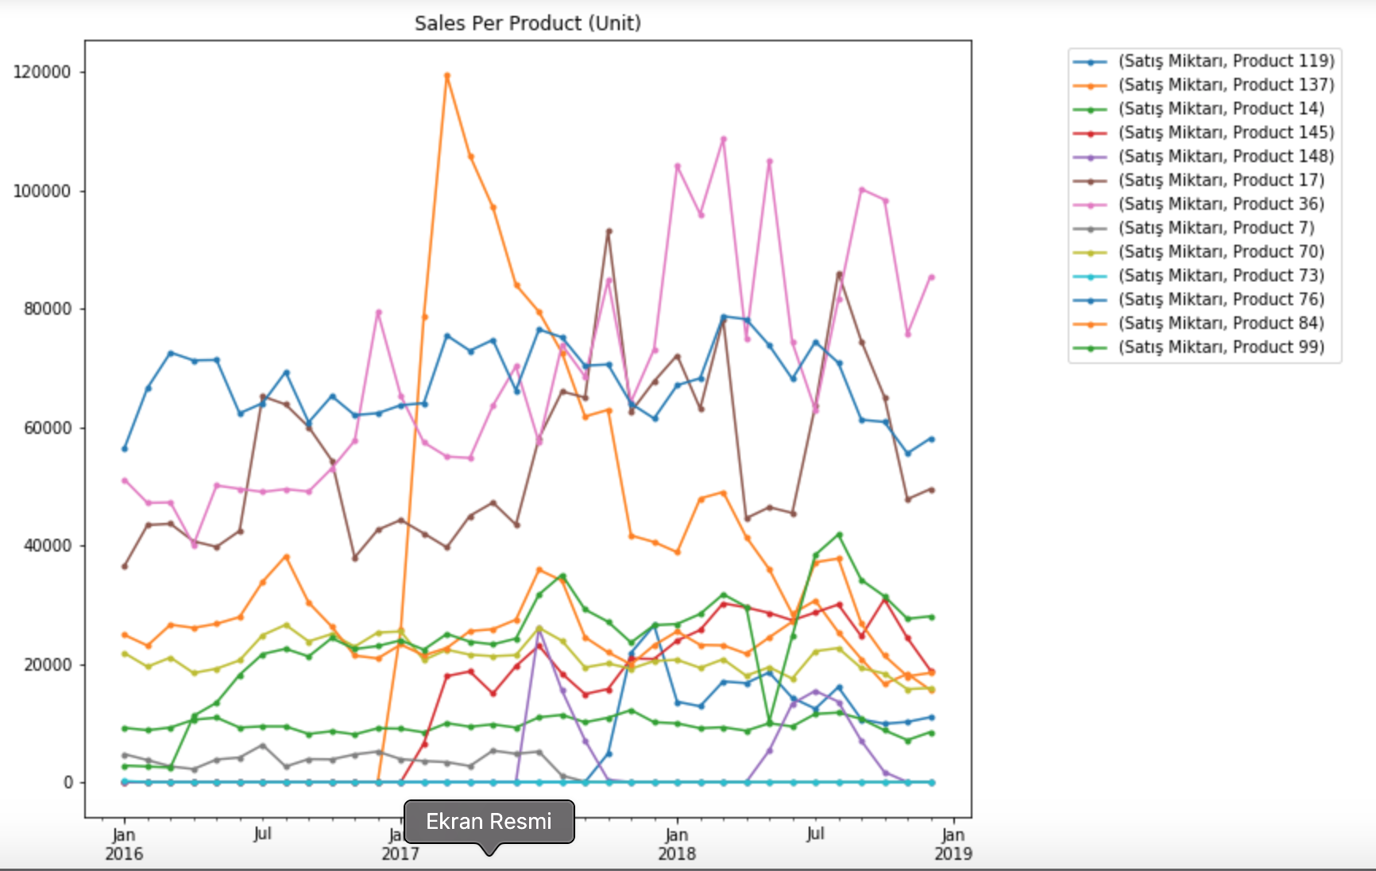
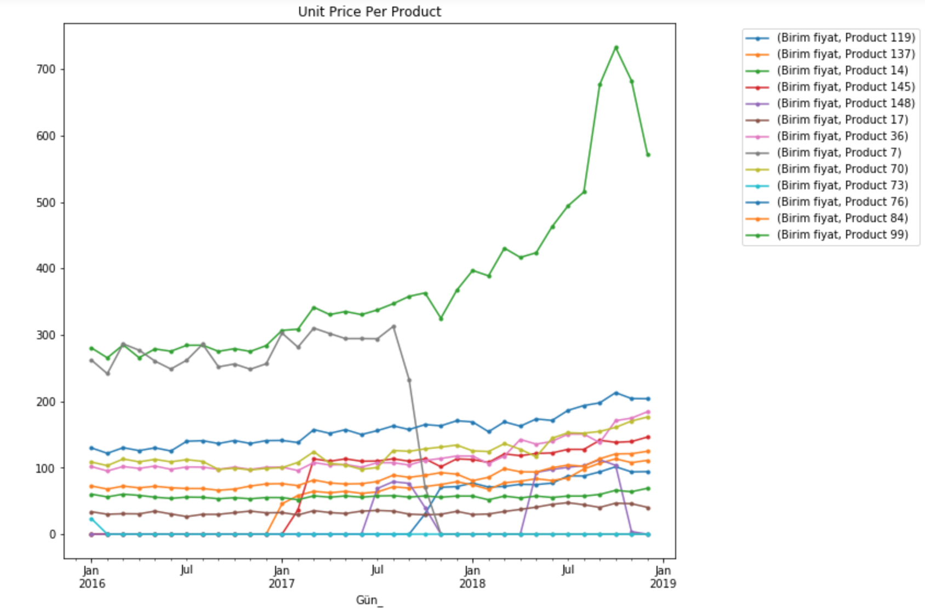
Data Visualization

Slide 8
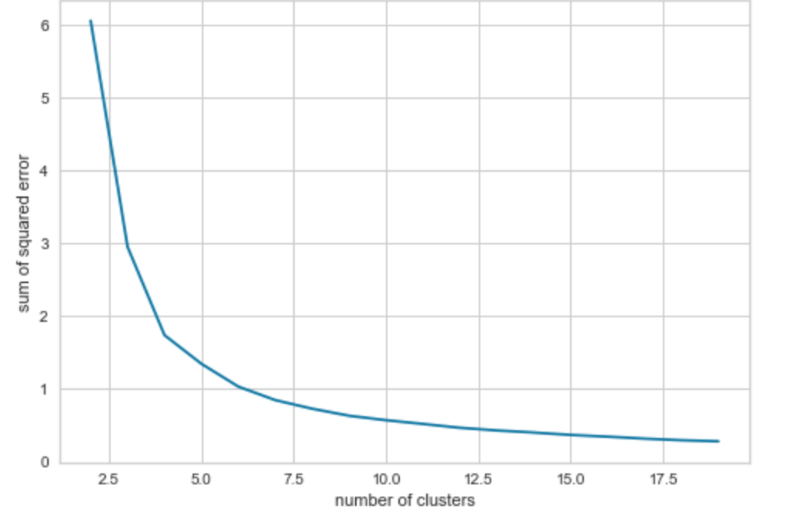
K-means Cluster Choosing k value by Sum of Squared Error

Slide 9
Cluster Centers with k = 6

Slide 10
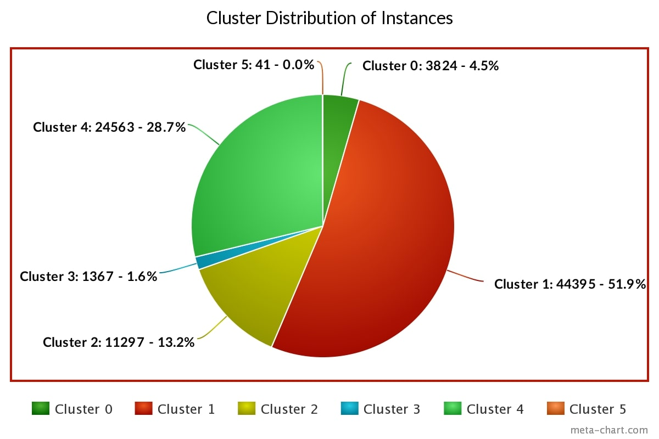

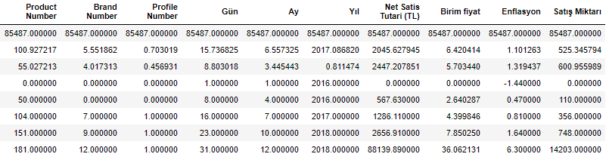

Slide 11
Regression
In this phase, we are required to predict total sales amount of a product on a given date with given inflation rate.

Slide 12
Steps of Regression
TRAIN
TEST
EVALUATE

Slide 13
Algorithms that We’ve Tested
Linear Regression
Polynomial Regression
Stochastic Gradient Descent Regressor
Linear SVR

Slide 14
Cross Validation
We used 2 techniques for cross validation:
Train-Test Split (changing parameter test_size)
K-Fold (changing parameter k)

Slide 15
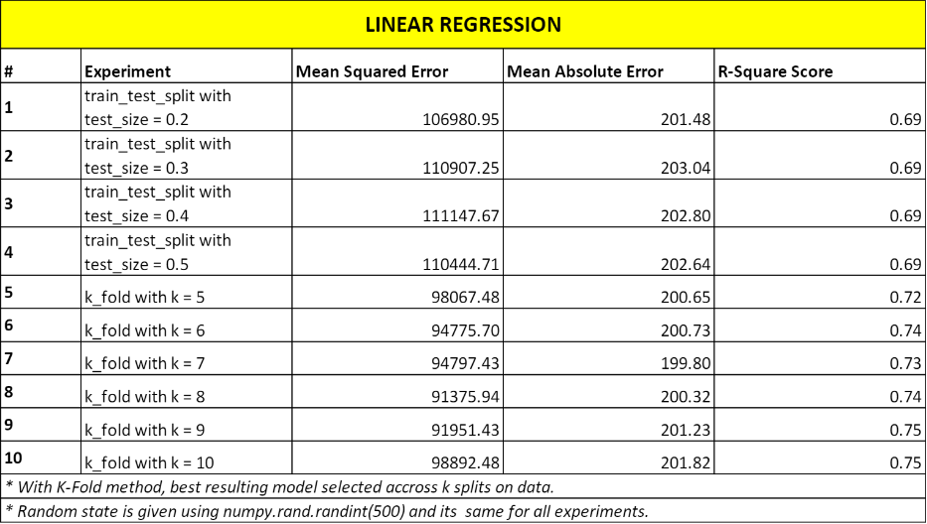
Results of Experiments

Slide 16
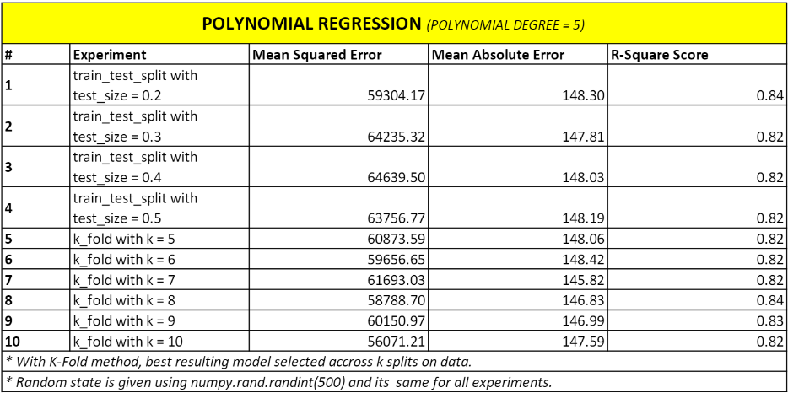
Results of Experiments

Slide 17
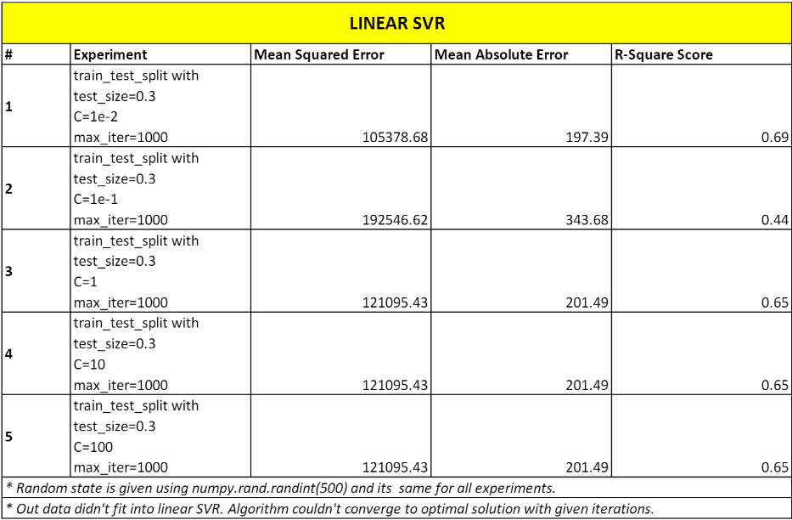
Results of Experiments

Slide 18
Evaluation Part
We calculated 3 metrics for all models that we tested:
Mean squared error – lower is better
Mean absolute error – lower is better
R square score – higher is better

Slide 19
Evaluation Part
We combined these 3 metrics like this:
Score = Normalize(mean squared error) + Normalize(mean absolute error) + (1 – R square score)
Our aim is to minimize this score. The model has the minimum score calculated above can be considered as the best model.

Slide 20
The Best Model
After experiments, best model is chosen, according to 3 metrics, as a polynomial regression model with polynomial degree of 5.
Polynomial features are unit price and inflation rate.

Slide 21
Prediction
Model expects inputs product number, brand number, profile number, day, month and year of sale, unit price, total sales revenue as ₺ and change in inflation rate for prediction.
It’s not so possible to give total sales revenue and unit price in order to predict a product’s sales amount in the future.

Slide 22
Prediction
Brand number and profile number can be obtained by product number directly.
Unit price and total sales revenue calculated as mean unit price/total sales revenue of given product on given month, day and years 2016, 2017 and 2018.

Slide 23
Prediction
By that way, product number, day, month and year of sale and estimated change in inflation rate is sufficient to make a prediction of sales amount of that product on given date.

Slide 24
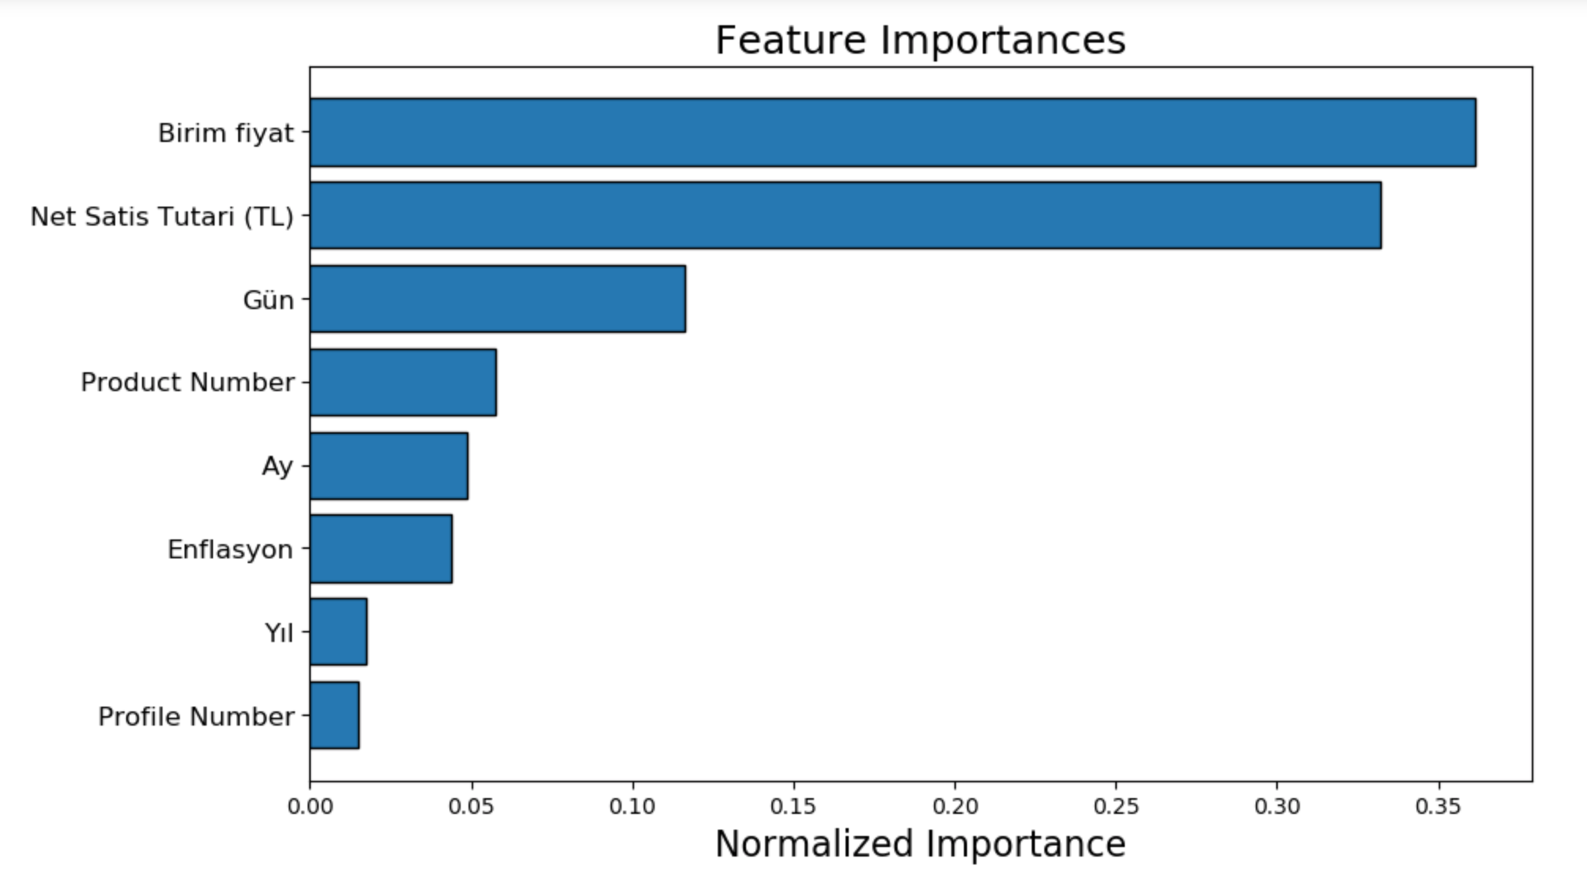
Feature Selection

Slide 25
Feature Importance
As we can see from previous figure, profile number and brand number has very low importance on a regression model.
‘Year’ has low importance too, but we cannot remove ‘Year’ feature.

Slide 26
Results after removing features that have low importance
According to these result, we removed feature ‘Profile Number’.

Slide 27
Example Predictions

Slide 28

THANKS!
Any questions?
Rümeysa ELİÖZ – 150114016
Mert KELKİT – 150115013
Taha Bilal ÖZBEY – 150114040
Nazım Berke DEMİR – 150314061
Merve DEREBOYLU - 150314009

