Slide 1
Startup and BRANDING IN SOFTWARE
PROCESSES IN SOFTWARE BRANDING

Slide 2

What ıs startup ?

Slide 3
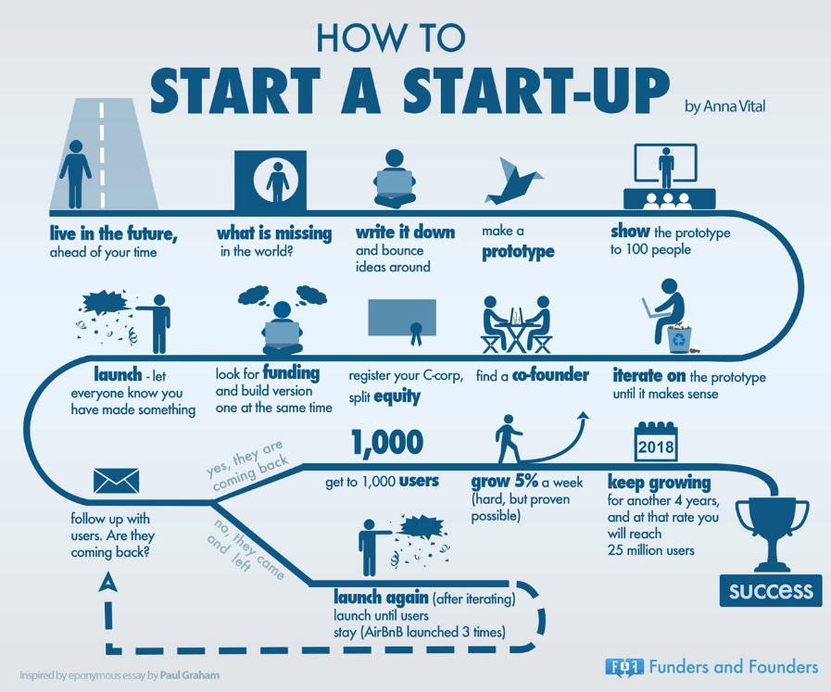

Slide 4
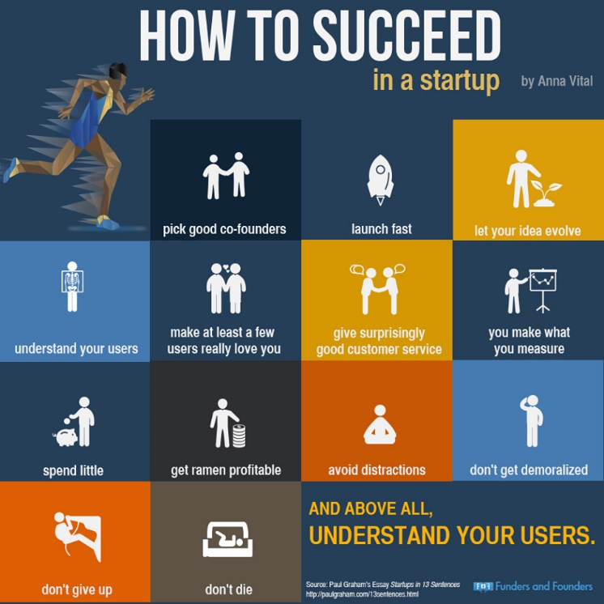
How to succed ın a startup

Slide 5
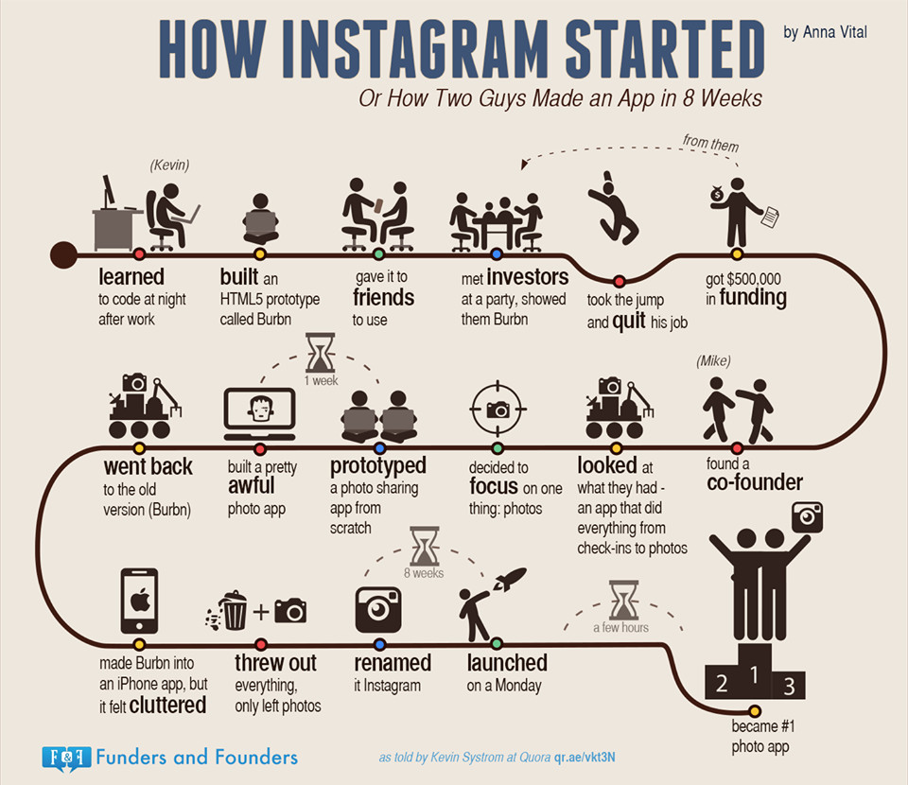

Slide 6
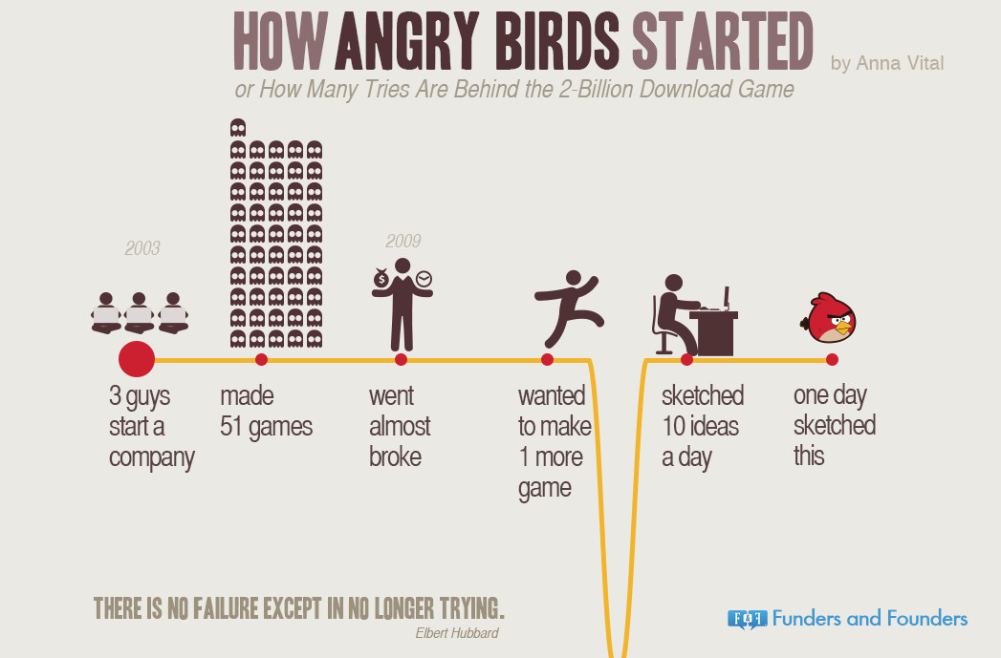

Slide 7
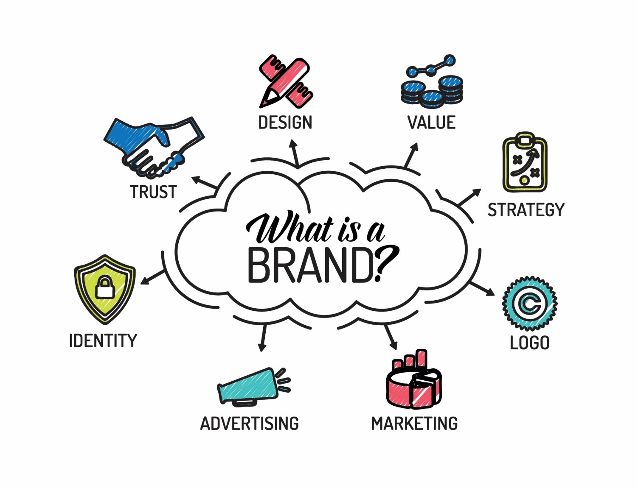
What is a Brand?
A brand is a product, service, or concept that is publicly distinguished from other products, services, or concepts so that it can be easily communicated and usually marketed.
A brand name is the name of the distinctive product, service, or concept. Branding is the process of creating and disseminating the brand name.
Branding can be applied to the entire corporate identity as well as to individual product and service names.

Slide 8

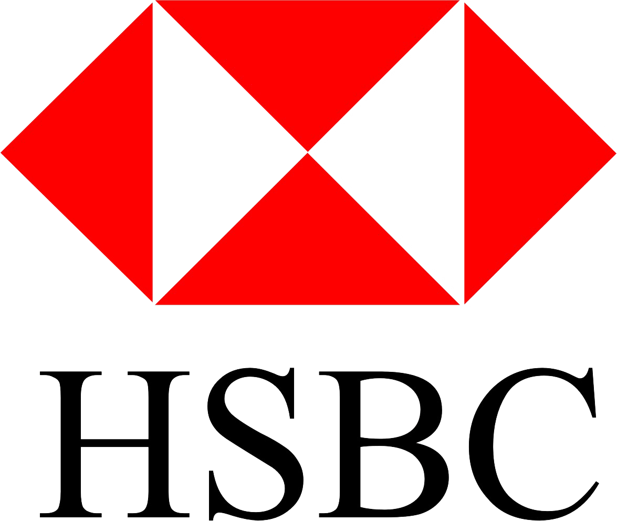
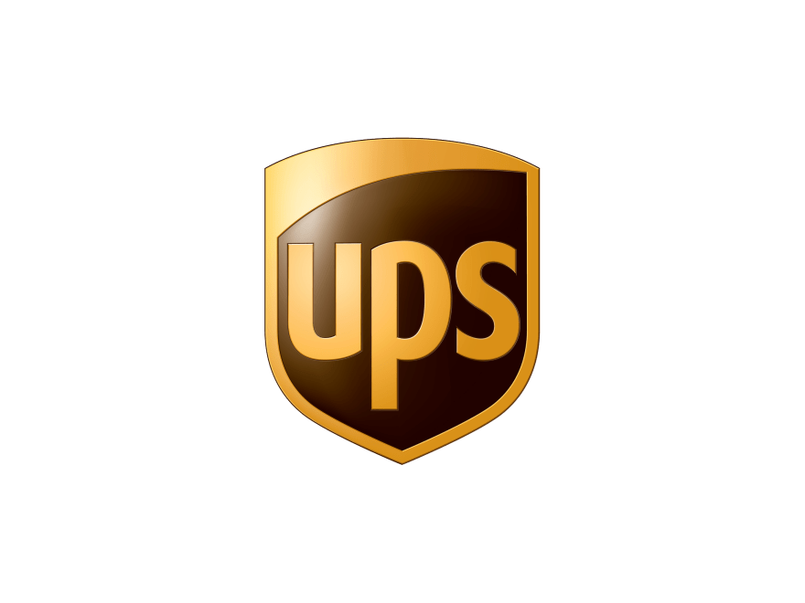
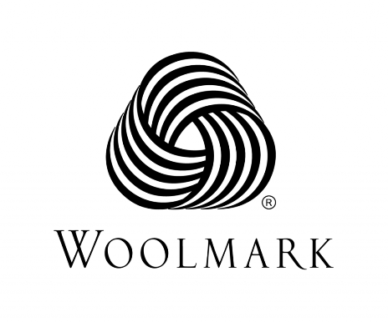


Types of brands in our country
Partner Brand (Co-Branding)
Warranty Brand
Service Brands
Trademark

Slide 9

HOW IS THE SOFTWARE PROTECTED?
Patents
How Patents Protect Software
How to Obtain a Patent
Copyrights
How Copyrights Protect Software
How to Obtain a Copyright
Trademarks
How Trademarks Protect Software
How to Obtain a Trademark

Slide 10
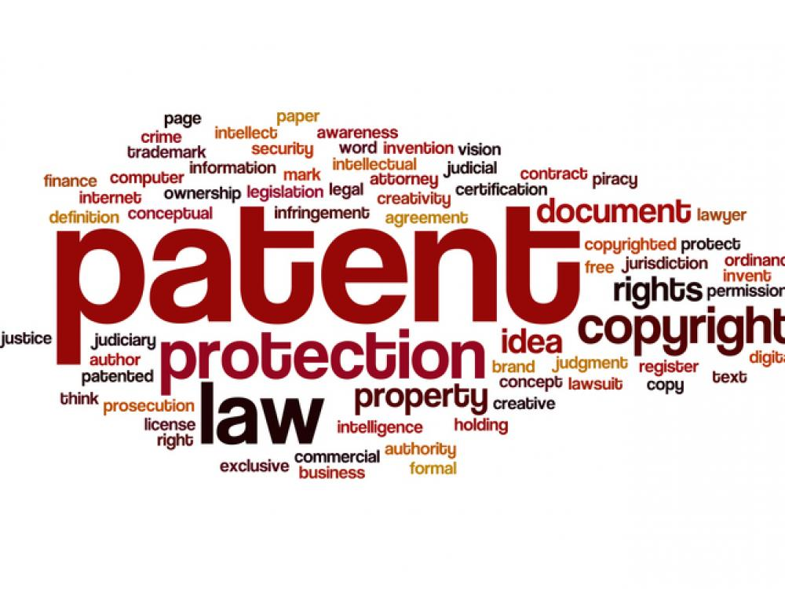
Patents
A patent grants an inventor the right to exclude others from making, using, importing or selling an invention in country.
Patents can prevent a competitor from making or selling software that utilizes technology covered by your patent. Software companies often use patents to block competitors or extract licensing or royalty fees.

Slide 11
Copyrights
A copyright grants the owner the exclusive right to reproduce the copyrighted work, prepare derivative works, distribute copies of the copyrighted work, and display the copyrighted work publicly.
Copyrights can prevent a competitor from replicating your software program, documentation and code. This includes the structure, sequence, organization and “look and feel” of a program. However, copyrights protect only the expression of an idea, not the idea itself. Copyrights do not protect program logic, algorithms, systems, methods, concepts, or output layouts.

Slide 12
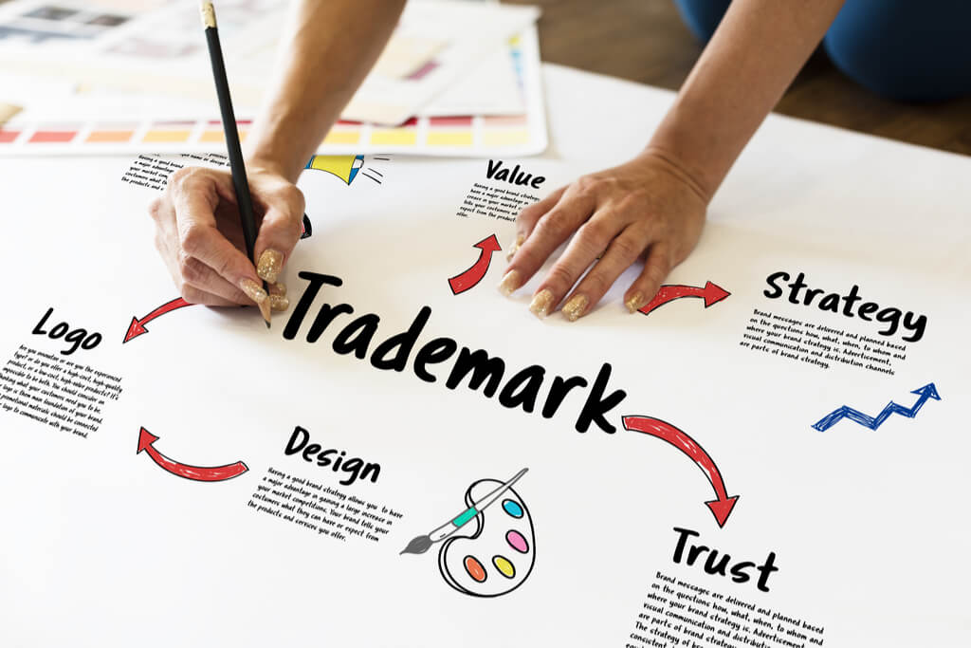
Trademarks
A trademark grants the owner the exclusive use of a word, name or symbol (mark) to describe a product and distinguish it from other products.

Slide 13
Trademarks
Trademarks can protect the name of a software company, its products and taglines, and prevent competitors from using similar names. Trademarks protect software brands, but not the software or code itself.
https://www.uspto.gov/trademark
http://online.turkpatent.gov.tr/trademark-search/pub/trademark_search?lang=tr

Slide 14
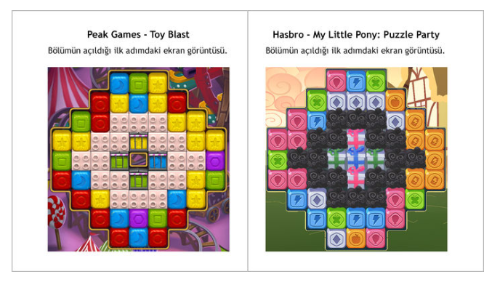
PEAK GAMES
In 2016, Peak Games came up with a lawsuit filed against Hasbro, one of the world's leading gaming and toy manufacturers.

Slide 15
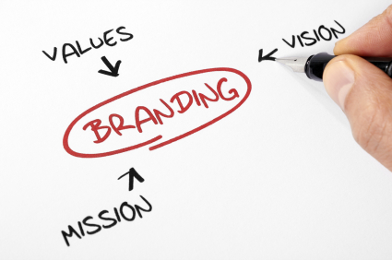
BRANDING PROCESS STRATEGIES
BRANDING CRITERIA
Senior management staff
Team spirit and effective communication
Quality product or service
Brand name
Sales and marketing
Research, Evaluation, Measurement
R & D
Brand image

Slide 16
BRANDING PROCESS STRATEGIES
Senior Management Staff
There should be a visionary senior management staff capable of producing products or services that are suitable for the target group.

Slide 17
BRANDING PROCESS STRATEGIES
Team Spirit and Effective Communication
However, well-motivated employees can create a brand. Career planning, performance evaluation, etc. The teams that meet the criteria must be successful.

Slide 18
BRANDING PROCESS STRATEGIES
Quality Product or Service
Producing the service adopted by the target audience is indispensable for branding.

Slide 19
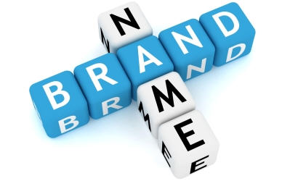
BRANDING PROCESS STRATEGIES
Brand Name
It is very important to create a brand name that is suitable to the target audience and has memorable characteristics.

Slide 20
BRANDING PROCESS STRATEGIES
Sales and Marketing
The quality of products and services, successful advertising and promotion work cannot be a success unless there is a good sales marketing management, strategy and team.

Slide 21
BRANDING PROCESS STRATEGIES
Research, Evaluation, Measurement
Always product, service, target audience, customer must be researched, measured and evaluated.

Slide 22
BRANDING PROCESS STRATEGIES
R & D
Research and development department should continuously produce innovative and quality products or services.

Slide 23
BRANDING PROCESS STRATEGIES
Brand Image
Brand image is the whole of the elements that add value and value to the brand. Consumers evaluate products, services and brands according to the image they create.

