Slide 1

COMP4107:Android Programming
Işık Car App

Slide 2

What is Işık Car?
A mobile app will connect drivers and passengers willing to travel together between campus and town for university students.

Slide 3
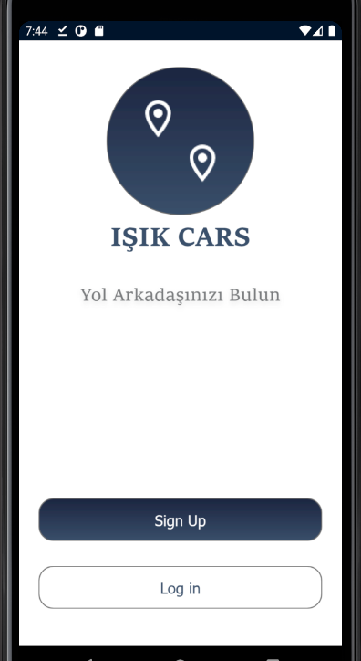
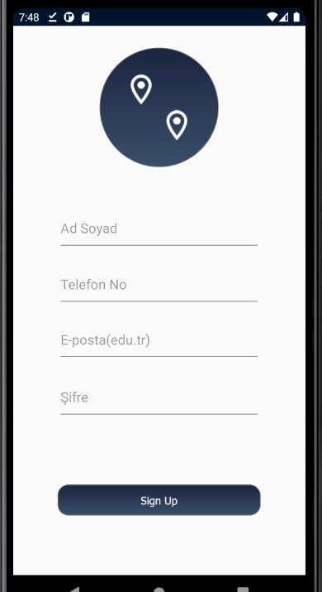
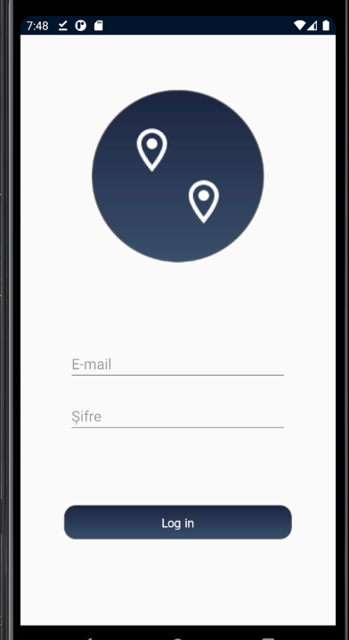
When users open the app, the welcome page greets the user.
Users can create new users with university e-mail or log in with existing user.

Slide 4
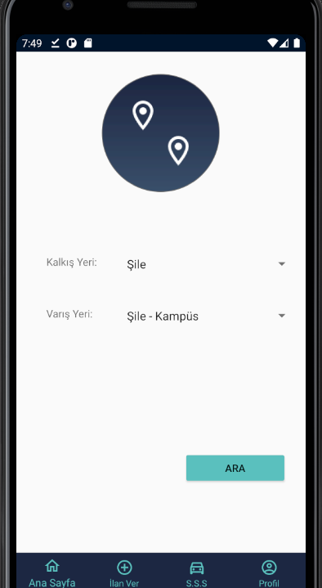
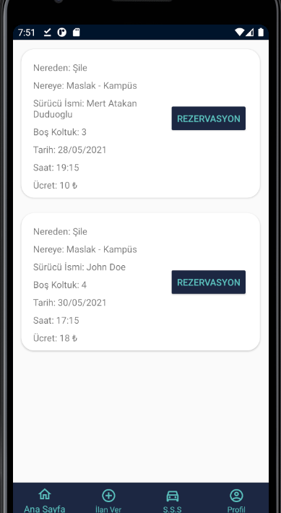
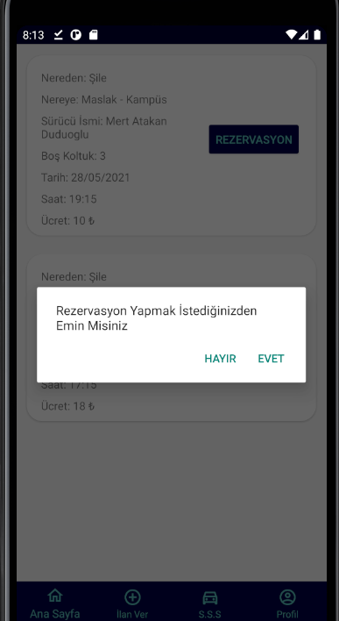
When users log in to the app, the home page greets the user. On the home page, user can search trip.
When the user searches, proper trips appear. When the user clicks on a reservation, an alert message appears.

Slide 5
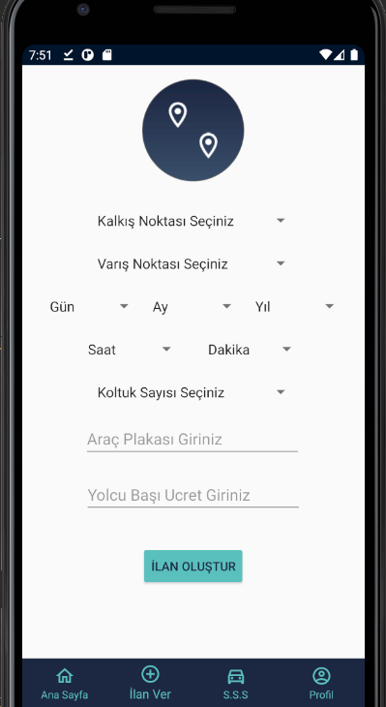
If the user has a car, he/she can publish a trip with the requested information.

Slide 6
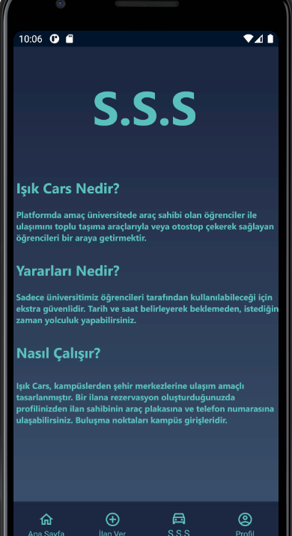
And there is also F.A.Q Page.

Slide 7
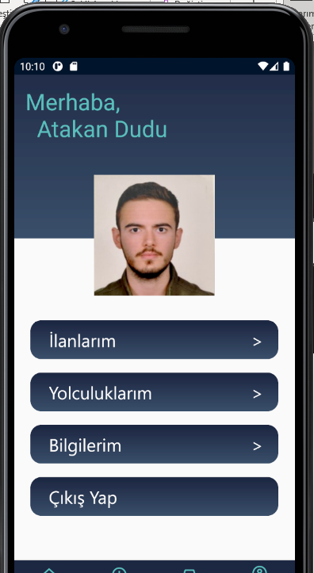
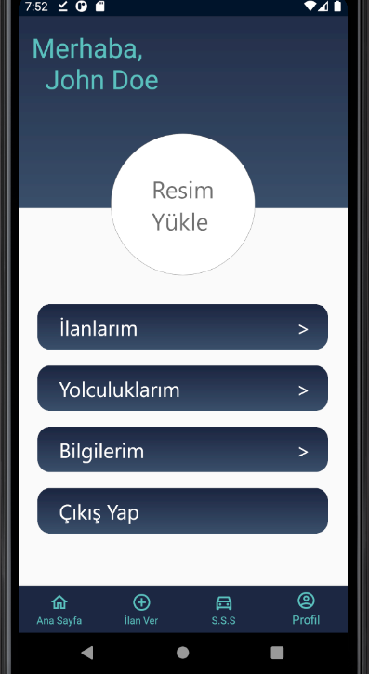
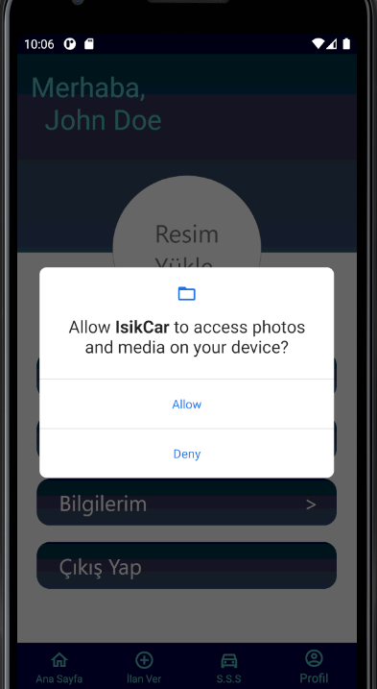
On the profile page, users can change profile photos – need access-, can see their published trips and their reservations.

Slide 8
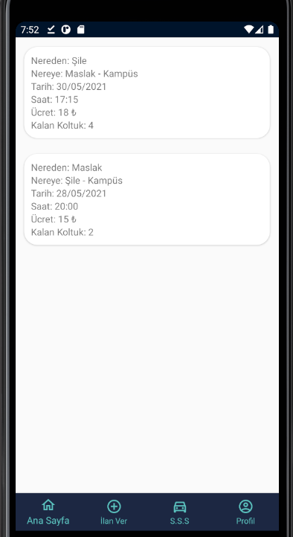
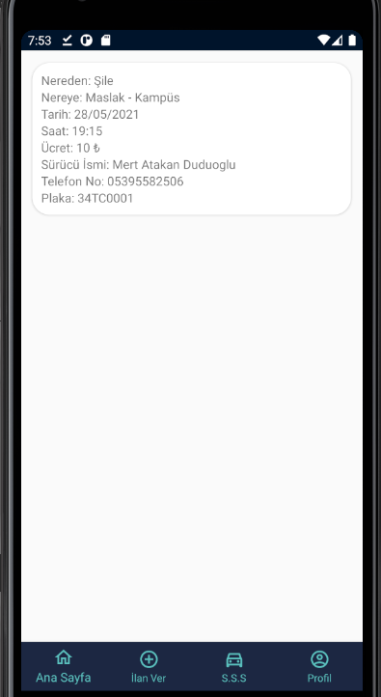
When user selects the published trips or reservations can see the details of them. When the user do reservations for the trip he/she can see the driver’s phone number.

