Slide 1
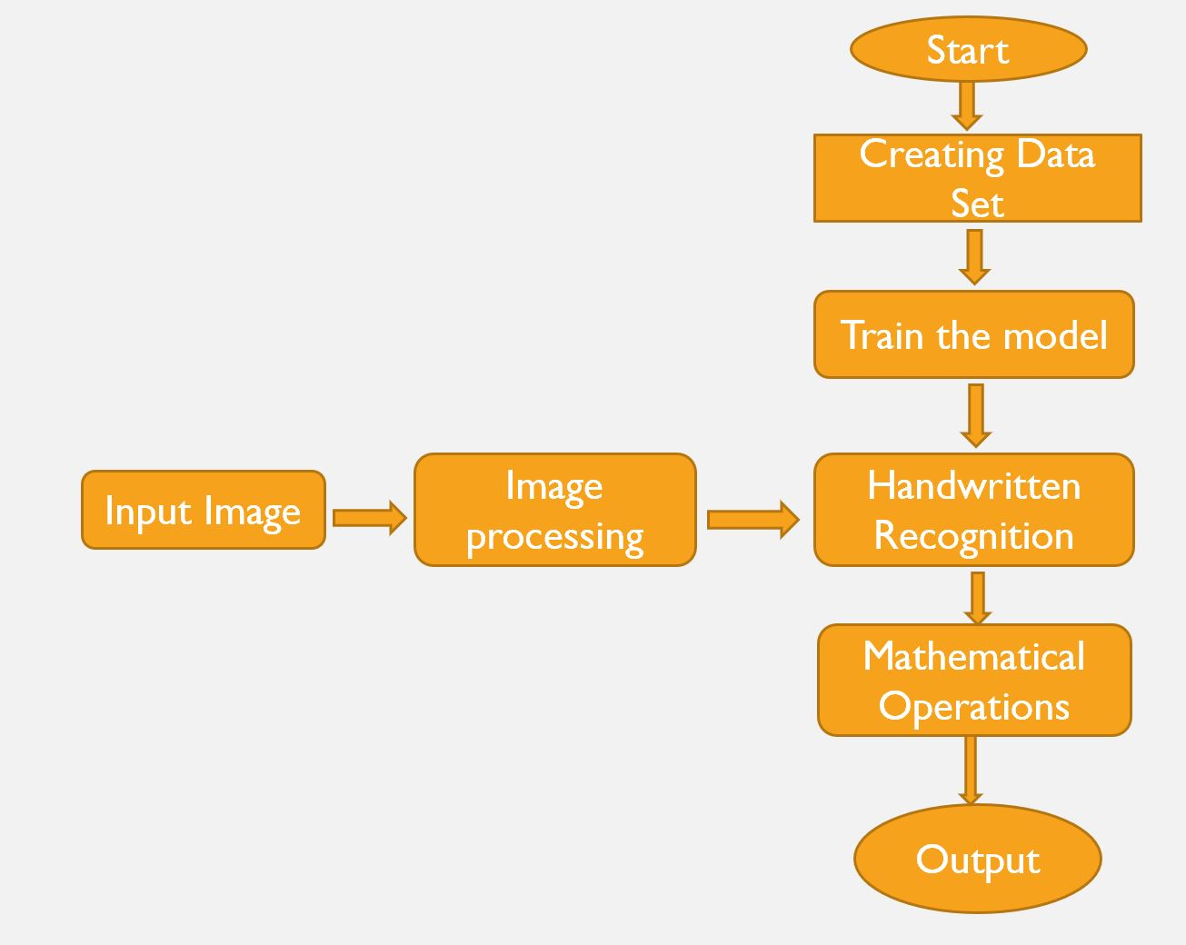
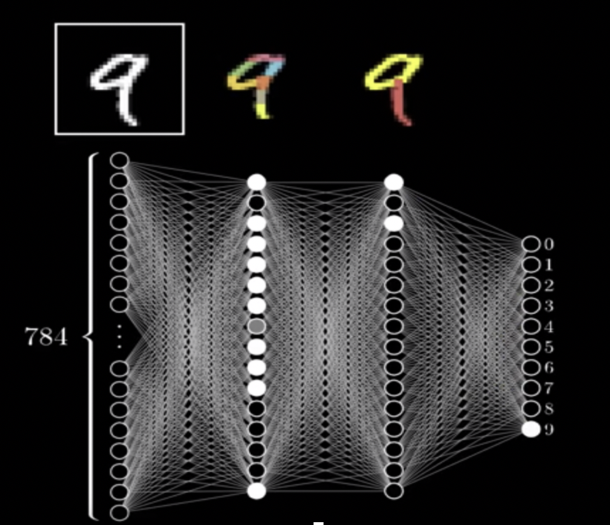
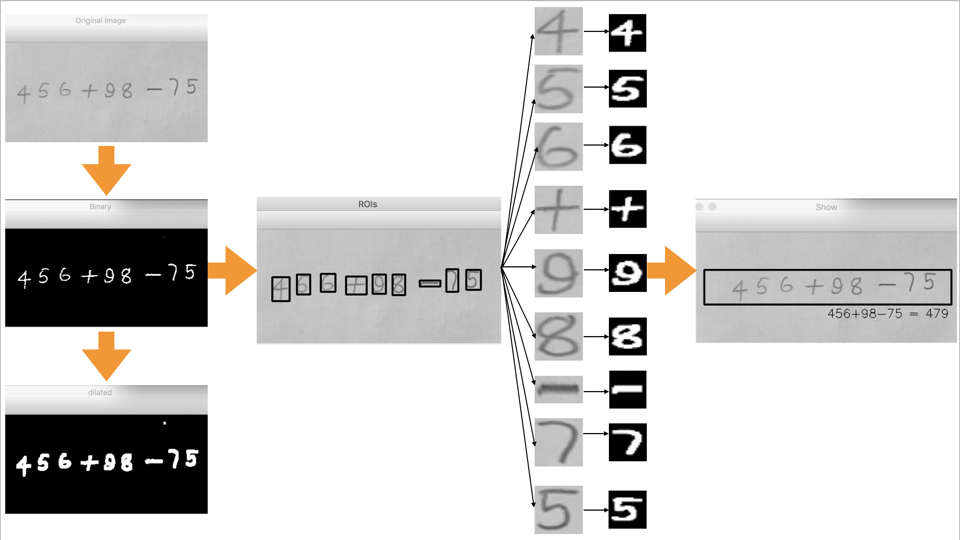
IMAGE CALCULATOR
Md Ashiqul Amin School of Informatics, Computing and Cyber Systems
Northern Arizona University
AZ, USA
ma3359@nau.edu
Mertay Dayanc School of Informatics, Computing and Cyber Systems Northern Arizona University AZ, USA
md2289@nau.edu
Abstract
Design & Methodology & Implementation
Design of Network
This paper represents a new technique to calculate the mathematical equations by analyzing the handwritten equations. Additionally, this image based technique recognizes the handwritten equations from the image and provides the solution of the equation as a result. Moreover, neural networks in tensor flow is used to classify the hand written digits and operators. A new data set is created and analyzed to recognize the hand written equations . To create a new data set, a newly created hand written mathematical operator data set was merged with the MNIST data set. The accuracy of the new data set is 99.7% where the accuracy of the MNIST data set is 98.3%. At the end, we introduced an algorithm to calculate the recognized equations.
In this project, neural network with two hidden layer is used for classifying the image. We built a data set that contains 70000 images of 28X28 pixels. So our input size is 784 and we have 12 outputs, including 10 digits and ‘+’ and ‘-’ signs. We trained the neural network with our own data set. In the input and hidden layer Relu activation function is used and in the output layer softmax function is used in the neural network. We used Tensorflow for the implementation of the network [4]. In Figure 2, digit 9 is input in the input layer of the neural network. Then it is processed in the hidden layers of the network. Finally, in the output layer it can recognize the digit 9. The hidden layers are trained in the training period. In our model , we input the Numpy array of the image instead of the raw image like Figure 2. Then this array values tried to match with the values of the nodes. If they matches the nodes are activated and pass the information into the next layer.
Introduction
To implement project , a new data set will be created. The new data set is the combination of MNIST Data set and our own data set. To create data set we collect images from different sources and then converted the image into 28x28 format. Then we created the 1D matrix of the pixels for the images and put them into a CSV file. After creating CSV file for every type of image, the csv files are merged to create a new and big dataset.
OpenCV is used to read the raw images of equation [1]. After reading the image , the images converted into the Numpy array. The input was converted to the Numpy array to fit the input data with the model. If the pixel values of the array matches with the values of node, the node will be activated and pass the information into the next layer. At the end of the network it represents the classification results.
In Figure 1, the algorithm of our proposed system is represented with a flow chart. At the end of classification steps , the system provided the recognized digits and operators. Then this recognized digits and operators used as a input of the calculation algorithm. After receiving the input the algorithm first try to recognize the equation pattern [2] . At the end , the algorithm provides the solution of the equation as a result.
Image Processing
In order to extract the digits and operators, four steps were applied to the raw image; removing channels from raw image, applying a threshold to catch the contrast dif- ference and binarize the image, applying dilation morphology to the binarized image with kerne value in order to enlarge the boundaries of the white foreground [5]. Binarized and dilated image was used to draw surrounding rectangles around them so that region of interests of each of them can be extracted separately, using the width, height and (x,y) coordinates of the rectangle. Later that , those region of interest(ROI) on the original image stored in an array. Then those extracted images sorted from left to right to create correct mathematical expression.
Figure 1. Methodology
Figure 2. Neural Network
Results
This model and with our data set, has test accuracy of 99.44%. However Image recognition techniques has to be implemented better. Even 1 pixel of change in the inout has a significant impact on the output. Current version of app extracts images well but Mathematical Dilation and applied kernel has to be investigated better and optimum values for dilation and kernel needs to be used for the future iterations.
Data Set
To recognize the hand written equations, we need a data set of hand written digits, alphabet letters and mathematical operation. However, there are lots of hand written digit and alphabet letter data set in the online repositories, we could not find a unique data set which has the hand written dig- its,alphabet letters and operator data sets. MNIST [3] , NIST are very popular data sets in hand written recognition process. NIST database has the hand written data of digits and alphabet letters and MNIST is the subset of NIST set. As a result , these conventional data sets can not meet our requirement.
Moreover, the .csv files were labeled and merged manually. Thus , the new data set was created to analyze which fulfilled all the requirements of the application. The data set was divided into two portion, i.e, test data set, training data set. The number of data that the test data set carries is about 70000 where the test data set carries 17000 data.
Conclusion
Image based calculator will provide a privilege to solve any kind of mathematical equation easily. This application bring a change in the field of modern day calculator. Moreover, it reduces the calculation time of equations and creates interest in students mind to mathematical equations. Beside, the accuracy of our new data set is very good. Our study also represents how a neural network works for the classifications. Overall , this study represents a novel technique to recognize the hand written equations and provides the result of the equation as a solution.
References:
[1] CVisionDemy. https://cvisiondemy.com/extract-roi-from-image-with- python-and-opencv/. December, 2018
[2] MateiO.,PopP.C.,Va ̆leanH.“ARobustApproachtoDigitRecognition in Noisy Environments.” In: Jiang H., Ding W., Ali M., Wu X. (eds) Advanced Research in Applied Artificial Intelligence. IEA/AIE 2012. Lecture Notes in Computer Science, vol 7345. Springer, Berlin, Heidelberg. [3] Yann LeCun, Corinna Cortes, Christopher J.C. Burges. “THE MNIST DATABASE of handwritten digits,” http://yann.lecun.com/exdb/mnist/ .
[4] TensorFlow.https : //www.tensorflow.org/tutorials/keras/basicclassification.
[5] Morphology. https://homepages.inf.ed.ac.uk/rbf/HIPR2/dilate.htm. De- cember,2018
Figure 3. Implementation

