Slide 1
CENG 396 Software EngIneerIng Project PresentatIon
Spring 2019 - 2020
Team S1G1
İrem ÖZTÜRK
Mert BAYRAMUSTA
Rana ÇAKMAK
Zeynep ÖZDOĞAN

Slide 2
Agenda
Project Management
Requirements
Design
Coding
Testing
Product Demo

Slide 3
Project Management

Slide 4
Project Management
Roles and Responsibilities
Communication Methods
Tools Used
Project Schedule
Quality Management
Configuration Management
Difficulties Encountered
Lessons Learned

Slide 5
Roles and Responsibilities
We shared responsibilities among each other for all parts of the Project.
We planned tasks; who will do what, when will we do it, does it depend on anything, etc.
We watched the progress together as well.
Whenever an issue occurred, we discussed how to solve it together.

Slide 6
Communication Methods
We met at the weekends almost every week when all group members have free time.

Slide 7
Tools Used
We used electronic communication for meetings such as Zoom and messaged via Whatsapp.

Slide 8
Project Schedule
For Requirements part, it was given three weeks but we had to finish it in one-two days because of other responsibilities we had.
For Design Part, it was given two weeks, but again we had to finish writing SDD in three-four days.
For Coding part, it was given two weeks and we finished almost in two weeks.
For Testing, it was given one week, we finished it in two days.

Slide 9
Quality Management
After each step, we double-checked the outputs we produced, to see whether they were satisfying enough.

Slide 10
Configuration Management
Whenever a change has to be made, we determined its priority.
If the priority was high, we made necessary changes on the documents and code files.

Slide 11
Difficulties Encountered
Because of the limited time, we only had one week for the most part of the project.

Slide 12
Lessons Learned
We learned that using MS Project it is much easier to plan the schedule for the project.

Slide 13
RequIrements

Slide 14
Requirements
Method Followed
Tools Used
Quality Management
Configuration Management
Difficulties Encountered
Lessons Learned

Slide 15
Method Followed
FAST (Facilitated Application Specification Technique)
We met on Zoom.
We exchanged ideas and agreed on requirements and priorities.
We avoided design decisions.
We sat down for 4-5 hours until SRS is finished.

Slide 16
Tools Used
We used MS Word to write the SRS document.

Slide 17
Quality Management
We checked whether the requirements we wrote down were,
Feasibily possible
Consistent
Valid
Complete

Slide 18
Configuration Management
We collected the necessary changes with higher priority.
«Functional Requirements» is added to the SRS document.
We numbered the requirements for traceability.
We wrote a «Change History» section for SRS.

Slide 19
Difficulties Encountered
We had to write the SRS in one-two days because of limited time.

Slide 20
Lessons Learned
We learned that we had to double, even triple check for every output we had produced.

Slide 21
DesIgn

Slide 22
Design
Method Followed
Tools Used
Quality Management
Configuration Management
Difficulties Encountered
Lessons Learned

Slide 23
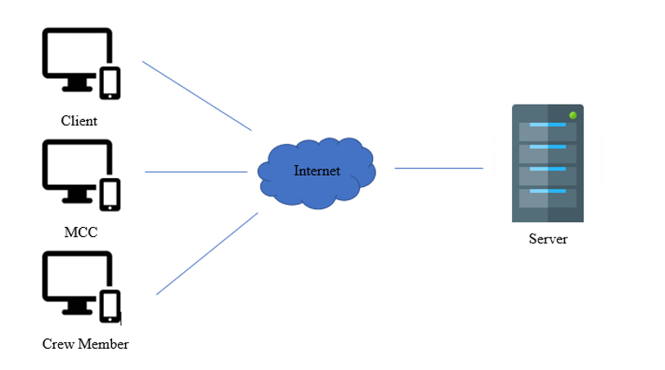
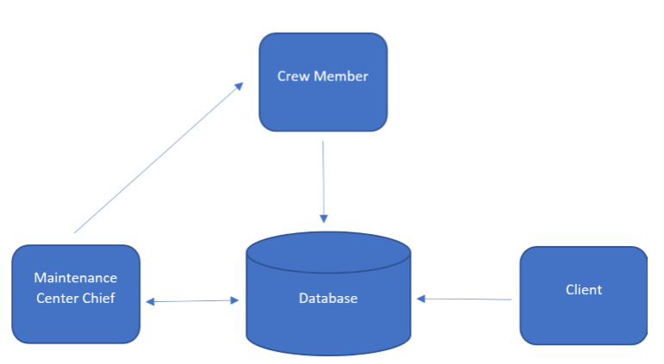
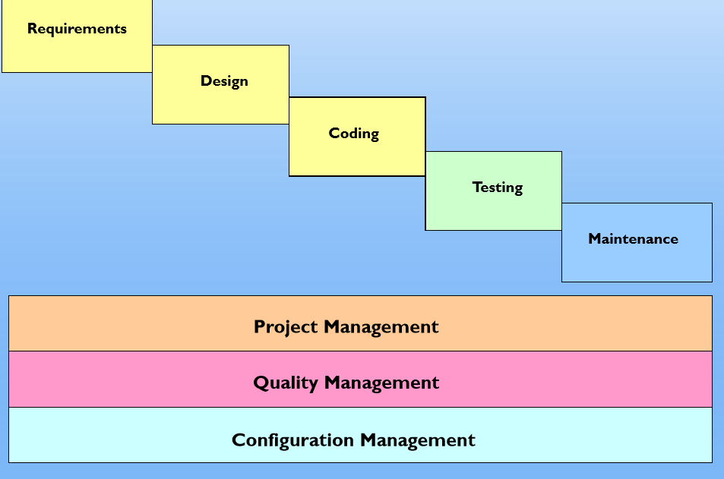
Method Followed
Waterfall Model
Data-Centric
Client-Server
Notes:
We have decided to use Waterfall Model Development Model for our project, because of this we all focused on each software process more carefully.
As for software architecture part we have decided it was best to model our project from a Data-Centric method. Data(which was the trouble in our project) was the most important part of our project, so positioning the database in the middle worked for our favor.
And last, because there were no such application between Client, MCC, and Crew Members screens and a server, we have decided that using Client-Server method as for hardware architecture would also work in our favor.

Slide 24
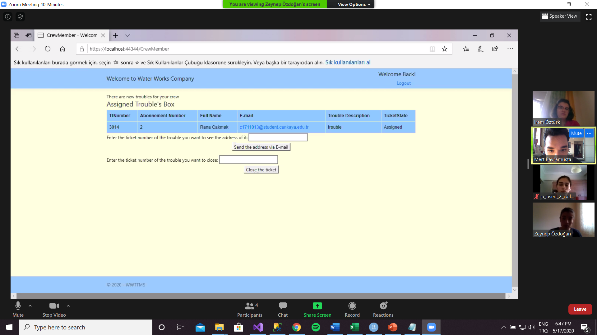
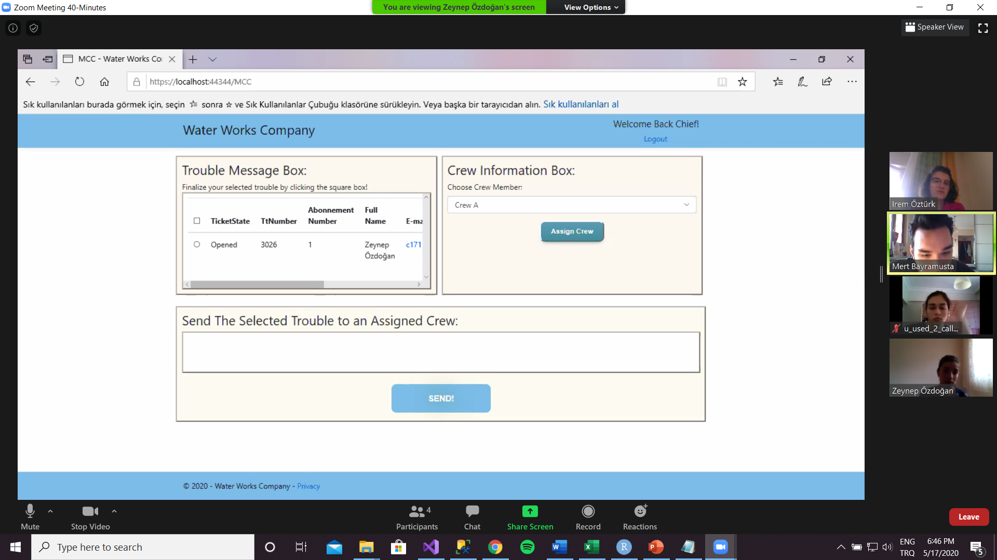
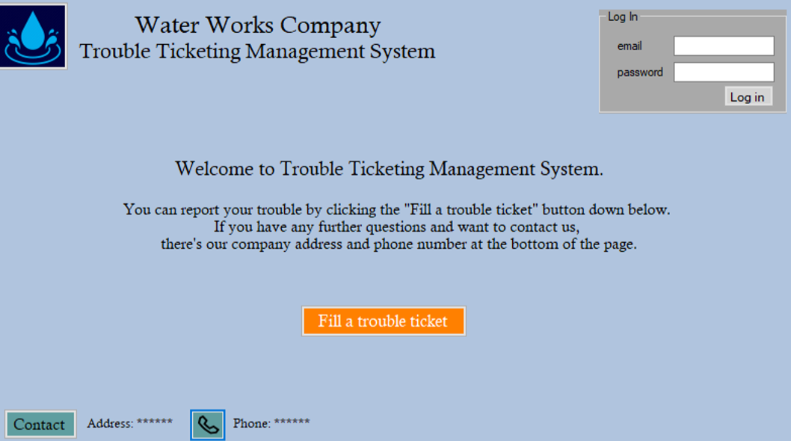
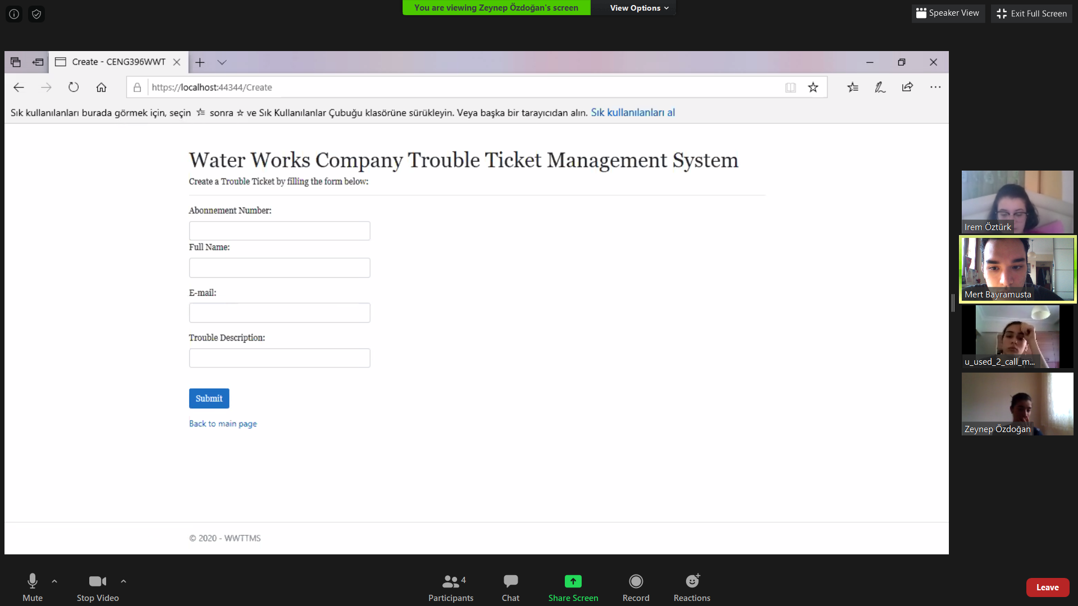
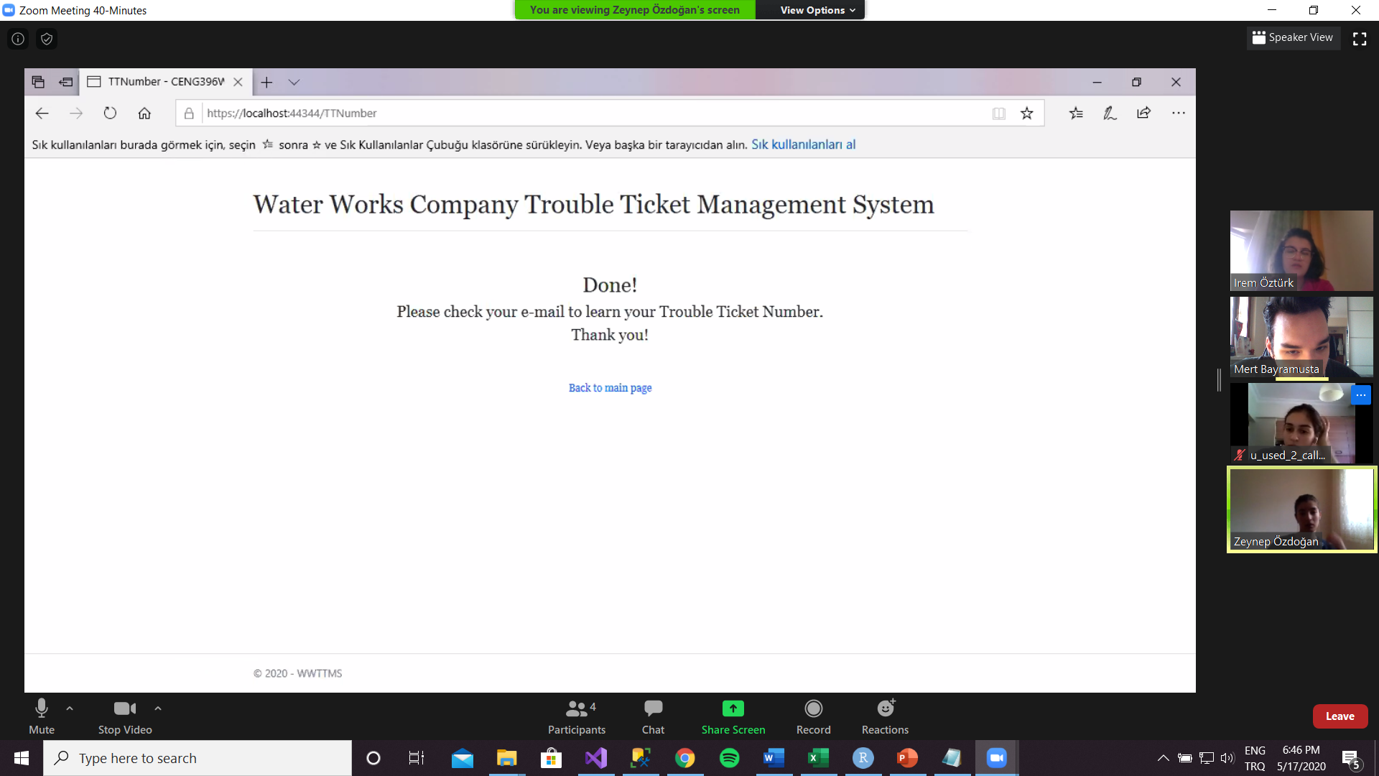
Tools Used
Notes:
We used Visual Studio 2019 IDE for Client’s, MCC’s, Crew Member’s and finally filling the Trouble Ticket Form’s screens, MS Paint for UML – Use Cases, Dia 0.97.2 for E-R Diagram, and MS Word 360 for drawing software and hardware architecture, respectively.

Slide 25
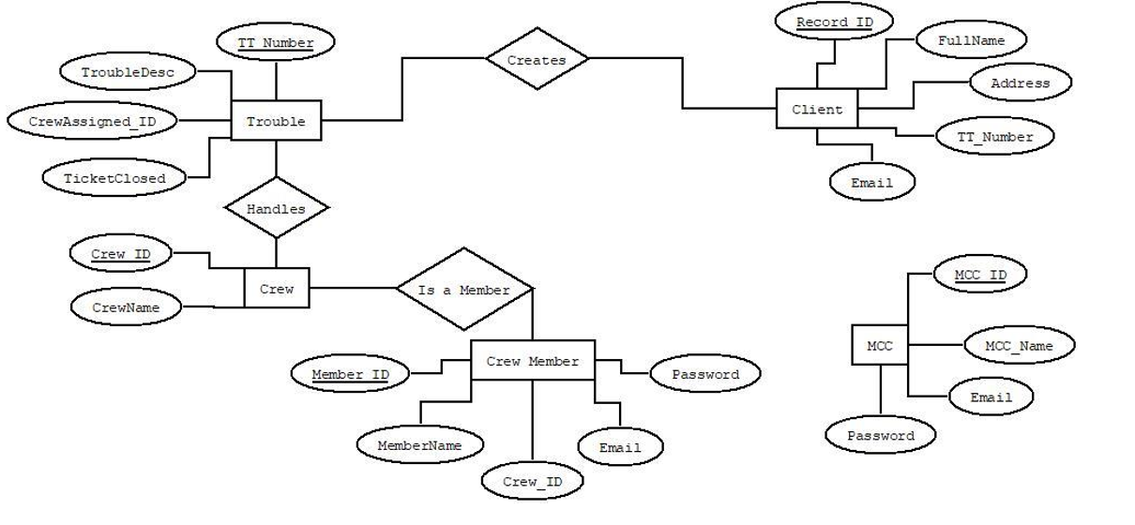
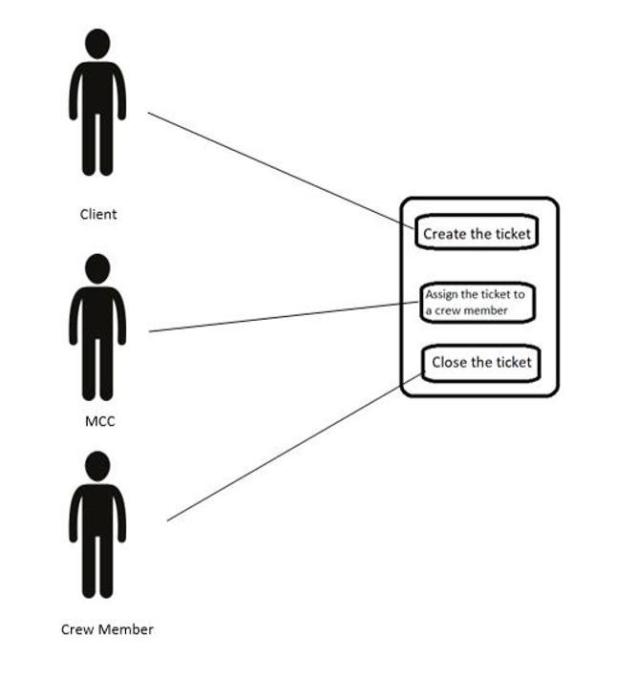
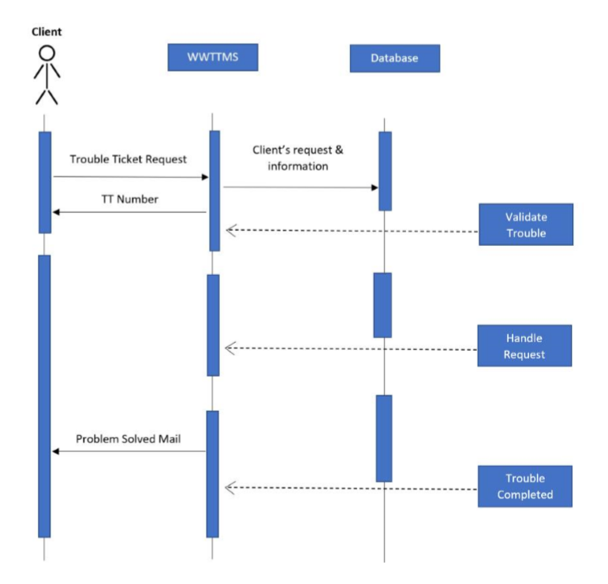
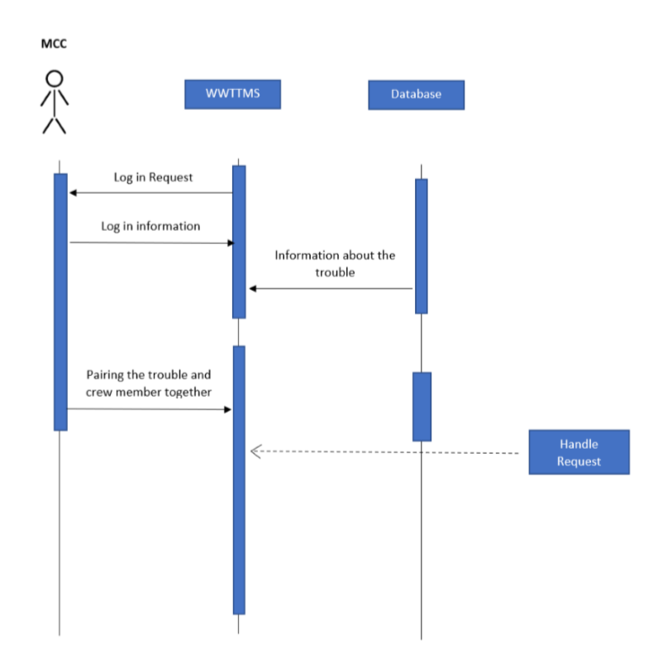
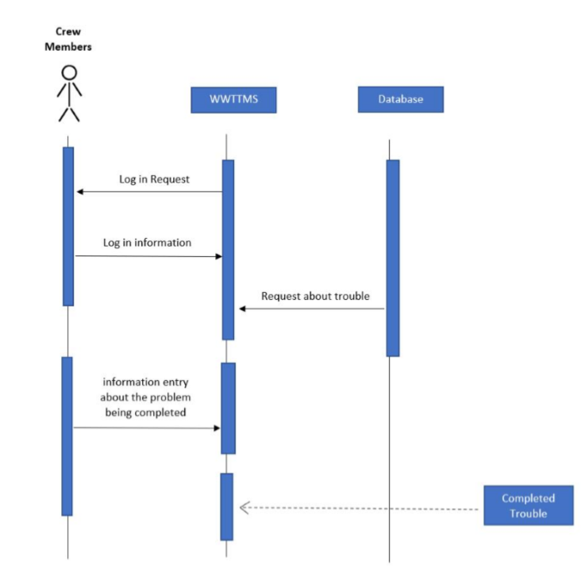
Tools Used
Notes:
We used Visual Studio 2019 for Client’s, MCC’s, Crew Member’s and finally filling the Trouble Ticket Form’s screens, MS Paint for UML – Use Cases, Dia 0.97.2 for E-R Diagram, and MS Word 360 for drawing software and hardware architecture, respectively.

Slide 26
Quality Management
When we finished the design, there were times where we left out some steps to re-think in another time, and some changes about the interface of the system along the way. So, we reviewed our designs and documents once again together to check everything until we were satisfied with the results.

Slide 27
Configuration Management
After checking and controlling all our steps and correcting the places where we missed or left out for another time to re-think, we agreed to finalize our SDD and submitted for grading.

Slide 28
Difficulties Encountered
Because of the Covid-19 and the quarantine it was though to communicate and produce satisfying concepts.

Slide 29
Lessons Learned
While preparing our SDD and creating our design concepts for our project, we have learned how challenging it could get while creating and designing a project because of due to the steps that we need to pay attention to, but at the end, we learned the concepts of a design process and how they are implemented in a project.
Also, we have learned that even in the quarantine times the world doesn’t stop and you must produce and deliver a Project (even if your time is limited).

Slide 30
CodIng

Slide 31
Coding
Method Followed
Tools Used
Quality Management
Configuration Management
Difficulties Encountered
Lessons Learned

Slide 32
Method Followed
Since we have four pages in WWTTMS and our group has four members, we shared these pages as follows:
Rana coded the Main Page,
Zeynep coded the Trouble Ticket Form Page,
Mert coded the MCC Control Page,
İrem coded the Crew Member Control Page.

Slide 33
Tools Used
We coded our program with C# language using in Visual Studio 2019 IDE.
We kept client’s, crew members’, and MCC’s information in Microsoft SQL Server.

Slide 34
Quality Management
Every member coded their own pages but when we encounter a problem in our codes and could not fix it, we tried to correct it together.
After we coded each page, we connected these pages and executed the program.

Slide 35
Configuration Management
Whilst coding our pages we tried to:
Assign meaningful names to our variables and functions according to what they perform.
Keep the body of the functions short to make our code easily understandable.
After we finished coding part we submitted our code.

Slide 36
Difficulties Encountered
We could not keep 5000 client’s information and 10000 trouble ticket information in our database because of hardware issues.
Trying to connect our pages was a bit difficult because even if we try to use the same attributes or variables in our databases and our codes, there were times that we encounter errors.

Slide 37
Lessons Learned
We learned how important it is to keep each other informed when we change something in our codes.

Slide 38
TestIng

Slide 39
Testing
Method Followed
Tools Used
Quality Management
Configuration Management
Difficulties Encountered
Lessons Learned

Slide 40
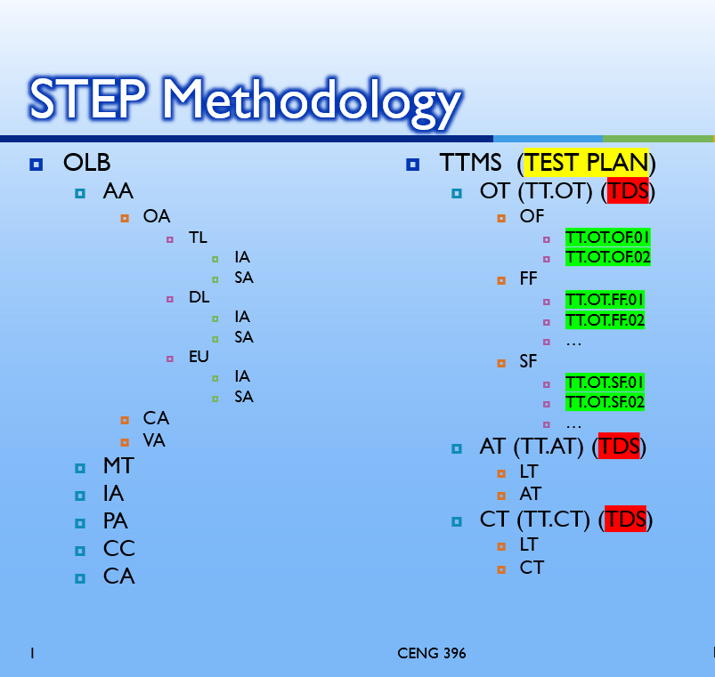
Method Followed
We used White Box Approach for testing because we know the design and coding part that’s why we choose the code base approach.

Slide 41
Tools Used
We used Visual Studio 2019 IDE for coding, we will also use it for testing.
We exploit the IIS Express which is the default web server for web application projects in Visual Studio.
The reason to use IIS Express is, it does not require an admin account to debug/run applications using the development IDE.

Slide 42
Quality Management
We tested only the requirements with higher priority because of the time limit we had.
The tests were suspended because of we met with hardware failure and limited time that we had to complete the test part.

Slide 43
Configuration Management
We tested the failures that have high priority. After the testing, we finalized the testing part of our project.

Slide 44
Difficulties Encountered
We tested only the requirements with higher priority because of the time limit we had.
For testing, we tried to use a randomized data query to see if we can create 5000 client information and 10000 trouble ticket information, but we could not because of the hardware problem we had.

Slide 45
Lessons Learned
We learned how important to detect defects while working on the project.
We had limited time and insufficient hardware system. Despite this, we handled these and learned how to manage time and find different alternatives.

