Slide 1
Detect obstacles in roads from accelerometer data
Mertcan Coskun

Slide 2
Introduction
The task is to detect obstacles on the roads utilizing data from the accelerometer of the units installed in the moving vehicles.
The goal is to provide data solutions in road authorities and municipalities where they can prioritize the fixing of obstacles.
We will reach the goal by detecting potholes and speed bumps on the road.
The data provided represents a single vehicles journey.

Slide 3
Approach
1. First step is to load, clean and to sort data for further analysis.
2. The data will be resampled into 1 second intervals as the granularity provided is too detailed.
3. Generation of features is necessary. Instead of only using absolute values of acceleration, speed and heading angle, we will focus on the percent change of these factors.
4. A clustering model will be built to understand the behaviour of the vehicle and to predict the road condition.
5. After the model is built, each cluster will be analyzed and will be assigned to a condition: Normal, Pothole or Speed Bump.

Slide 4
Main Logic
Before we go into the programming, we must understand what happens to a vehicle in these 3 to-be-predicted clusters.
1. Normal course: The driver will continue his journey in normal conditions where no change in speed and heading should simultaneously occur.
2. Speed bump: A steady change in speed and acceleration is expected when a driver faces a speed bumpy. No sudden change in heading should occur.
3. Pothole: Potholes are unexpected and hard to avoid, therefore a change in, most importantly, the heading angle is expected. A sudden change in speed can also be the case.

Slide 5
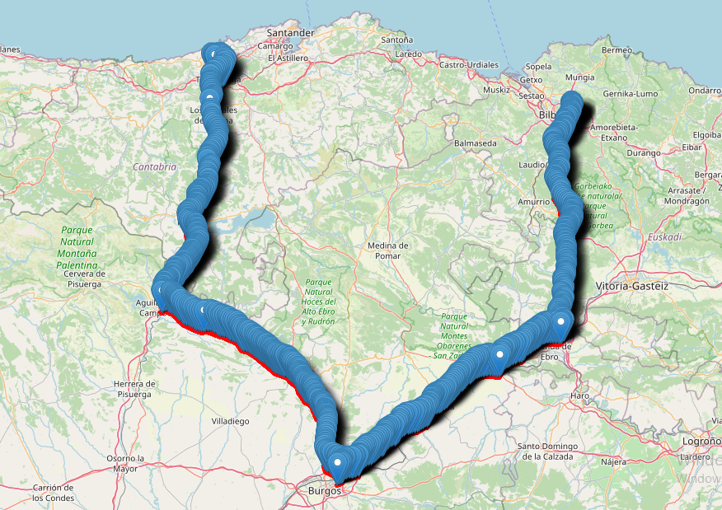
Map

Slide 6
Indicators: Speed Bumps
Majorly important roads tend to have more speed bumps, but not motorways.
Little change in the heading angle and speed decrease indicates a chance of a speed bump, regardless of time.
Indicators: Potholes
Less important roads like secondary roads will have more potholes.
Sudden change in the heading angle and speed indicates a chance of pothole, especially at night.

Slide 7
Clustering
A K-means clustering algorithm will be used to predict the road condition.
There are three scenarios in the case study, therefore the number of clusters is 3.
The data will be scaled before it is processed by the clustering algorithm to reduce the errors caused by the different value ranges of columns.
The results will go through a logic check to see the clusters meet the expectations.

Slide 8
Cluster Results
Cluster 0
Sample size: 22.6K
Speed: 86 km/h
Change in heading: 8
Change in acceleration: 0.32
Common road types: Motorway, Major roads.
Cluster 1
Sample size: 580
Speed: 64 km/h
Change in heading: 370
Change in acceleration: 1.04
Common road types: Motorway, Secondary Road
Cluster 2
Sample size: 2.9K
Speed: 37 km/h
Change in heading: 16
Change in acceleration: 2.5
Common road types: Secondary Road, Major Road, Motorway

Slide 9
Conclusion
From the results, it is clear that:
Cluster 0 is when vehicle is traveling at high speed without much change in acceleration and heading. Common roads are important roads and motorways.
Cluster 1 is when a vehicle is traveling at relatively high speed with a change in heading and moderate change in acceleration. Most common road types are secondary and motorway.
Cluster 2 is when a vehicle is traveling through mostly secondary roads and there is a sudden change in speed but not a big change in heading.
Cluster 0 is standard roads, Cluster 1 is potholes, Cluster 2 is speed bump.
From the analysis, the required output of informing road authorities where they can prioritize the fixing of obstacles that are causing dangerous events in the roads can be achieved.

