Slide 1
Cyclistic Google Capstone Project
Mert Can Cankaya

Slide 2
Business Question:
How do annual members and casual riders use Cyclistic bikes differently?
Business Task:
Use the data to explore and gain insights to assist the team to implement marketing strategies aimed at converting casual riders into annual members.

Slide 3
What tool I used?
I used R Studio to clean, analyze and visualize the data.

Slide 4
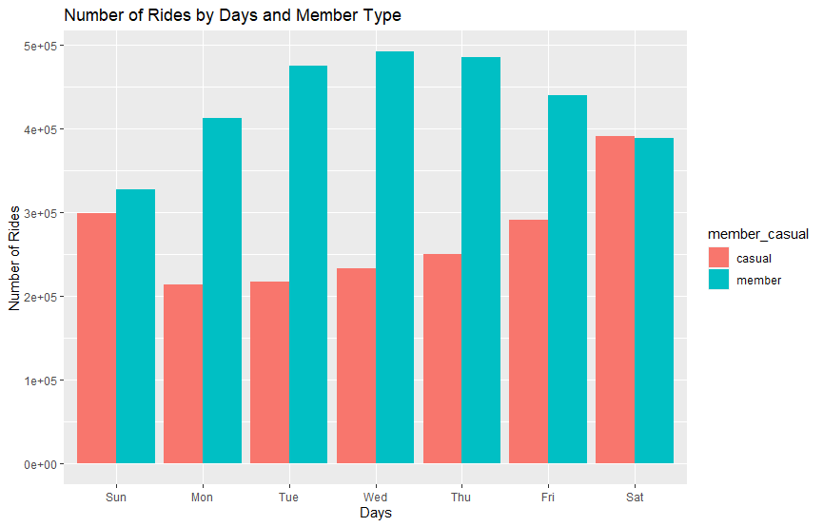

Slide 5
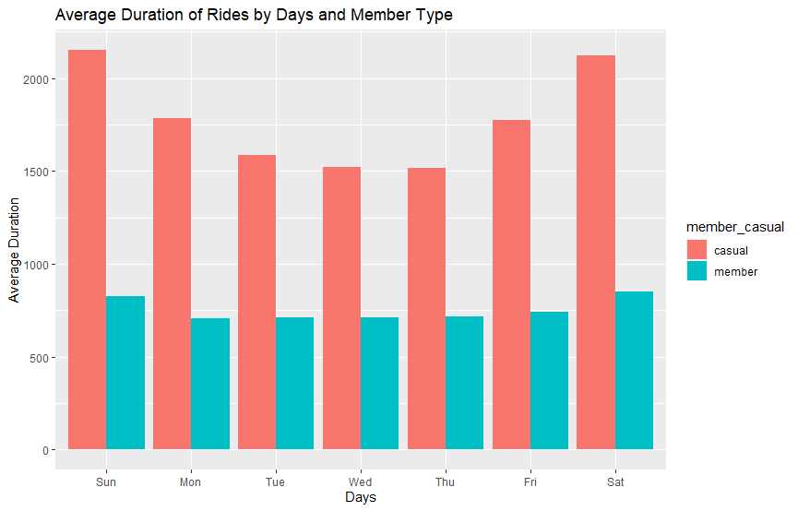

Slide 6
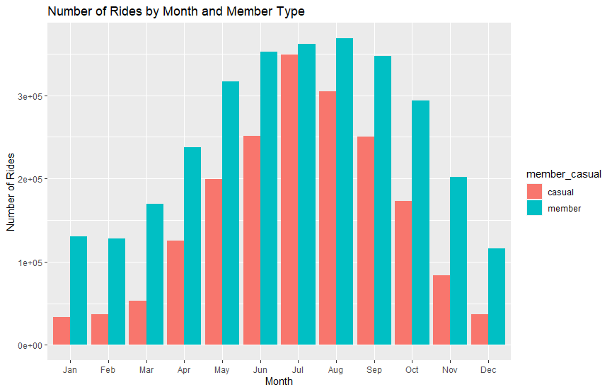

Slide 7
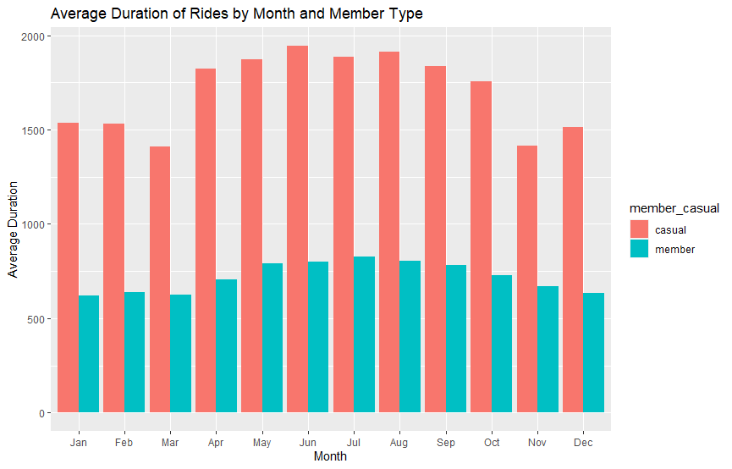

Slide 8
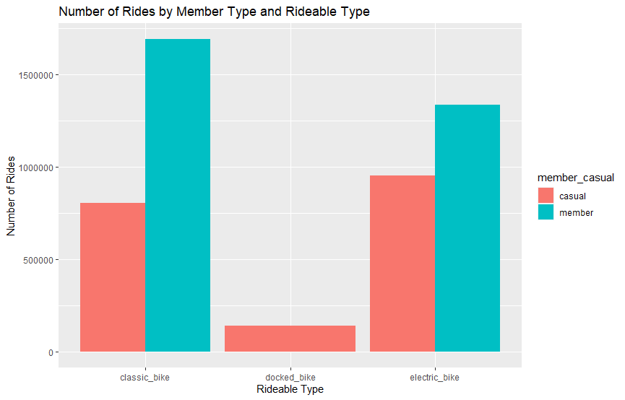

Slide 9
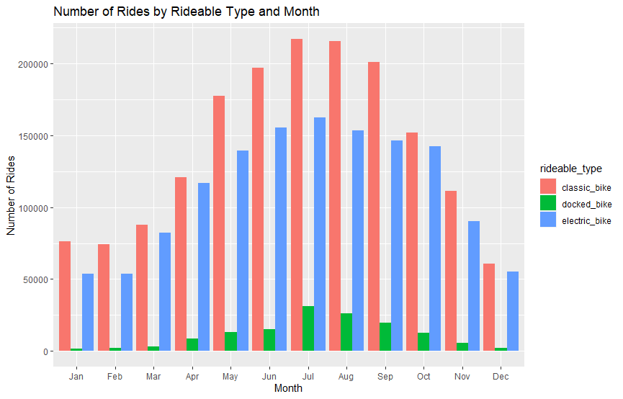

Slide 10
Comparison of Casual Riders and Members
Casual riders use bikes for leisure, while members use them for daily commuting.
Average ride length varies, shorter and consistent for members, longer and more exploratory for casual riders.
Peak months align with the weather for both groups, but peak days differ - weekdays for members and weekends for casual riders.

Slide 11
Conclusion
The analysis of the information provided reveals members primarily use bicycles for daily commuting, with shorter and consistent ride lengths, while casual riders prefer them for leisure, leading to longer and exploratory rides during weekends in warmer months. Understanding these distinctions can aid in promoting and taking better business decisions in the future.

Slide 12
Recommendations
Due to the high popularity of bike usage throughout the summer and early fall, it would be a good idea to launch an incentive campaign to maintain or increase bike usage
Casual riders spend more time riding bikes, therefore providing some kind of discounts or promotions for the electric bike would help them save some time
Launch a marketing campaign that targets the benefits of converting into annual membership for casual riders through advertisements, emails, and brochures

Slide 13
Recommendations
Summer Membership: Offer a seasonal membership for summer (May to August) tailored for casual riders, emphasizing bikes near popular attractions and entertainment spots.
The company should not invest more in docked bikes because its least used by both members and causals by a large margin. Also, the company might think of completely removing docked bikes and changing them with more used classic or electric bikes.

Slide 14
Thanks!
Do you have any questions?
mert@learndata.net
https://www.learndata.net/
Mert Can Cankaya

