Slide 1

EGE UNIVERSITY · FUNDAMENTALS OF SOFTWARE ENGINEERING · SPRING 2026
Voltline
Smart EV Charging Network
Mert Akyıldız
Hedera Yağmur Aşkar
Zeynep Nur Alanat
GROUP 28
FSE Spring 2026 · Prototype Presentation

Slide 2
OVERVIEW
Presentation Overview
01
Architecture
Hybrid pattern · 8 components · subsystem traceability · request flow · implementation mapping
02
UI Design
7 design criteria · role-based views · Help Guides · UC screenshots
03
Testing
Domain unit tests · API workflow tests · 29 tests passing · RBAC · audit integrity · requirements traceability

Slide 3
01
PART 1
Architecture
Patterns · Components · Subsystems · Request Flow · Implementation

Slide 4
PART 1 · ARCHITECTURE
Hybrid Architecture Overview
The prototype is a web-based information system — a practical hybrid of established course patterns, not an experimental design.
01
02
03
04
Multi-tier
Client–Server
Layered
Architecture
Repository /
Data-Centered
MVC-Inspired
Separation
React browser client ↔ Express API server ↔ Prisma/SQLite data tier. No UI code runs on the server; no DB access from the browser.
UI layer → API/routing layer → application/domain service layer → repository/data access layer. One responsibility per layer.
All persistent state stored in central SQLite through Prisma. No scattered queries. One access point for all subsystems.
React components = View/interaction. Express routes = Controllers. Prisma/domain models = Model.

Slide 5
PART 1 · ARCHITECTURE
System Block Diagram
Driver
Operator
Admin
FRONTEND — React + Vite + TypeScript
UI Pages · Components · API Client (axios) · State & Routing
EXTERNAL
Google Maps / Geolocation
REST/ JSON API
API LAYER — Node.js + Express
Routes · Middleware ( RBAC / Validation / Error Handling) · REST/JSON
DOMAIN / APPLICATION SERVICES
EXTERNAL
Reservation
Session
Wallet
Audit
Notification
Reports / Auth
Payment Gateway (stub)
REPOSITORY — Prisma ORM
Queries · Migrations · Transactions
SQLite DB
file-based

Slide 6
PART 1 · ARCHITECTURE
Main Components & Responsibilities
Component | Responsibility | Implementation
Browser UI layer | Presents workflows and handles user interaction | src/components/common.tsx
Map / UI integration | Stations, map markers, route visualization, fallback map support | src/MapView.tsx · src/features/reservation/ReserveStep.tsx
API / routing layer | REST endpoints grouped by subsystem | server/app.ts · server/routes/*
Application services | RBAC, audit, notifications, reports, reservation/session logic | server/services/*
Domain rules | Validation, money conversion, reservation rules, cost calc | server/domain.ts · src/shared/*
Repository / data | Persistent storage and entity relationships | prisma/schema.prisma · server/db.ts
Seed / demo data | Demo users, stations, chargers, wallet, audit baseline | server/seedData.ts
Automated testing | Development and release confidence for main workflows | tests/api.test.ts · tests/domain.test.ts

Slide 7
PART 1 · ARCHITECTURE
Subsystem Mapping
Subsystem | UI Module | API Route | Service / Domain | DB Models | Req.
Vehicle Registration | VehicleStep.tsx | routes/vehicles.ts | domain vehicle validation | User, Vehicle | EDR-01,02 SDR-01
Map & Reservation | ReserveStep.tsx MapView.tsx | routes/system.ts routes/reservations.ts | station + reservation services reservation rules | ChargingStation, Charger, Reservation, Wallet | EDR-03–08 EDR-15 MNS-01–07
Charging Session | ChargeStep.tsx | routes/sessions.ts | sessions svc cost calculation | ChargingSession, Reservation, Transaction | EDR-09,17,18 PWS-02,08
Wallet & Receipts | WalletStep.tsx | routes/wallet.ts | money conversion receipt generation | Wallet, Transaction | PWS-01–07 GRR-01–04
Operator Maintenance | OpsStep.tsx | routes/operator.ts routes/issues.ts | notifications refund/release | Charger, ChargingStation, IssueReport, Notification | SOR-01–06 EDR-12
Admin Reporting | OpsStep.tsx (admin view) | routes/admin.ts routes/reports.ts | reports service | User, Reservation, ChargingSession, IssueReport, Transaction | ADR-01–08
Security & Audit | EvidenceStep.tsx | routes/security.ts routes/audit.ts | auth/audit services | AuditLog, FailedLoginAttempt, User | SDR-01–05 ADR-06,07

Slide 8
PART 1 · ARCHITECTURE
How Components Are Interconnected
COMMUNICATION FLOW — UC-2 RESERVATION EXAMPLE
General Principles
1
ReserveStep displays station markers and available slots
JSON over REST
2
UI sends REST/JSON reservation request with demo RBAC headers
All payloads are JSON; demo role/user passed as headers.
3
routes/reservations.ts validates request data and user scope
Routes → Services → Domain → Prisma
server/domain.ts; compatibility, hours, 2h, 24h, double-booking, wallet
Routes validate, call services, services call domain rules, then Prisma writes.
4
5
Reservation service persists reservation, wallet hold, and transaction through Prisma
Cross-cutting centralized
After data changes, services create notifications and audit records automatically.
6
Notification and audit services record the event (cross-cutting)
Bootstrap refresh
7
Frontend refreshes bootstrap data and shows confirmation
After mutations the UI re-fetches the bootstrap endpoint to stay in sync.

Slide 9
PART 1 · ARCHITECTURE
Reservation Request Flow — UC-2
1
2
3
4
5
6
7
Select station
+ time slot
POST
/api/reservations
Zod schema
validation
domain.ts
business rules
Prisma
transaction
Audit +
Notification
201 JSON
→ UI refresh
ReserveStep.tsx
Axios client
Zod request validation
Reservation constraints enforced
+ Wallet hold
Cross-cutting
Confirmation
Domain Rules
· Connector compatibility
· ≤ 2h duration
· ≤ 24h advance window
· No double-booking
· Wallet balance
· Operating hours

Slide 10
PART 1 · ARCHITECTURE
Design-to-Implementation Traceability
ARCHITECTURAL PRINCIPLE
CODEBASE REALITY
UI components never access Prisma directly, they call REST endpoints only
Layered architecture
src/features/* → fetch → server/routes/*
src/features/* runs in browser; server/routes/* runs in Node/Express
Client-server architecture
Frontend and backend separated by REST API boundary
All persistent state centralised in Prisma/SQLite, not duplicated per subsystem
Repository pattern
prisma/schema.prisma · server/db.ts
Cost calculation, reservation rules and validation in server/domain.ts, not UI
Domain separation
server/domain.ts · src/shared/* (Zod shared both sides)
RBAC, audit hash-chain, notifications and reporting centralised in services
Cross-cutting concerns
server/services/* (auth, audit, reports, stations, sessions)

Slide 11
02
PART 2
UI Design
Criteria · Role-Based Views · Screens · Help Guides

Slide 12
PART 2 · UI DESIGN
UI Design Criteria
The UI is built as an operational dashboard; fast repeated actions, readable status, clear feedback.
01
02
03
04
Consistent Navigation
Role-Based User Diversity
Readable Information
Appropriate Interaction Styles
Sidebar groups driver, operator and system workflows. Same layout logic across all screens.
Role/account switch in UI. Protected APIs still enforce RBAC regardless of UI context.
Cards, metric tiles, tables, dark mode and status pills show balance, station status, reports and audit records.
Selects for role/status/charger, buttons for commands, sliders for SoC, numeric inputs, checkbox toggles for simulations.
05
06
07
Same-Page Validation
Map-Oriented Discovery
Financial Transparency
UI disables invalid reservation actions. API errors appear in the notice panel on the same page.
MapView.tsx uses Google Maps when a key is configured. Falls back to a compatible text/list map automatically.
Wallet, transaction history, receipt numbers, refund results and charging history visible in wallet screen.

Slide 13
PART 2 · UI DESIGN
UI Principles Applied in Voltline
The UI design follows the UI principles that interfaces should match users' skills, expectations and working environment.
01
User Familiarity
02
Consistency
03
Minimal Surprise
EV charging terms users already know: vehicle, charger, reservation, wallet, receipt. Technical database/API concepts hidden from end users.
Driver, Operator and Admin screens share the same sidebar logic, card structure, button language, status pills and form patterns.
Similar commands behave the same way: Save Vehicle, Reserve Slot, Start Charging, Complete Session, Top up, Update Status.
04
Recoverability
05
User Guidance
06
User Diversity
Cancellation/refund, sync recovery, safe interruption, out-of-service cascade and explicit confirmations support recovery from errors.
Each role has its own built-in Help Guide and FAQ: Driver Guide, Operator Guide and Admin Guide / Reference.
Interface separated by role: EV Driver (casual), Station Operator (operational), Administrator (technical/system).

Slide 14
PART 2 · UI DESIGN
Interaction Styles & Information Presentation
Voltline uses interaction styles appropriate for a web-based operational system: form fill-in, menu selection, limited direct manipulation, and an in-app natural-language assistant.
INTERACTION STYLES USED
INFORMATION PRESENTATION
Course Concept | Voltline | Example
Form fill-in | Yes | Vehicle registration, wallet top-up, station configuration
Menu selection | Yes | Role switch, connector selector, charger selector, status dropdowns
Direct manipulation | Partly | Map marker / station card selection, SoC sliders
Command language | No | Not suitable for casual EV drivers and operational staff
Natural language | Partly | Rule-based in-app assistant parses free-text and routes the user to the relevant page
Static information
Dynamic information
Station name, charger type, connector type, receipt numbers
Availability status, live charging cost, wallet balance, notifications
Digital presentation
Analogue / at-a-glance
Precise values such as 45 kWh, 180 TL, 99.5% availability
SoC sliders, status pills, color-coded station availability
Most web-based systems use form-based interfaces; Voltline follows this with forms, menus, sliders and buttons.

Slide 15
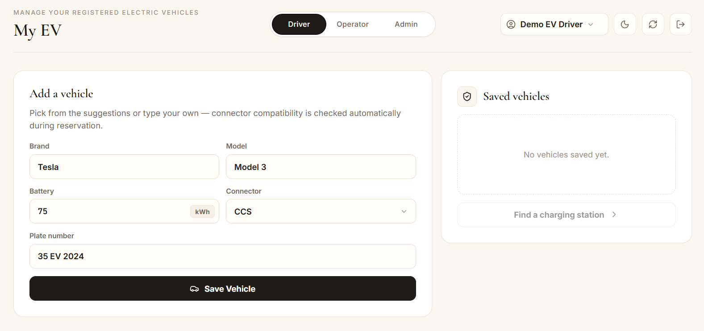
PART 2 · UI DESIGN
Vehicle Registration Screen — UC-1
Multi-vehicle support
EDR-01
One account, multiple registered vehicles
Connector enum enforced
EDR-02
Type 2 / CCS / CHAdeMO only
Battery capacity validation
UIR-03
Boundary check on save
Same-page inline errors
UIR-02
API errors surface without page reload
Audit log on save
SDR-03
Vehicle registration action recorded
Form: fill-in + menu selection

Slide 16
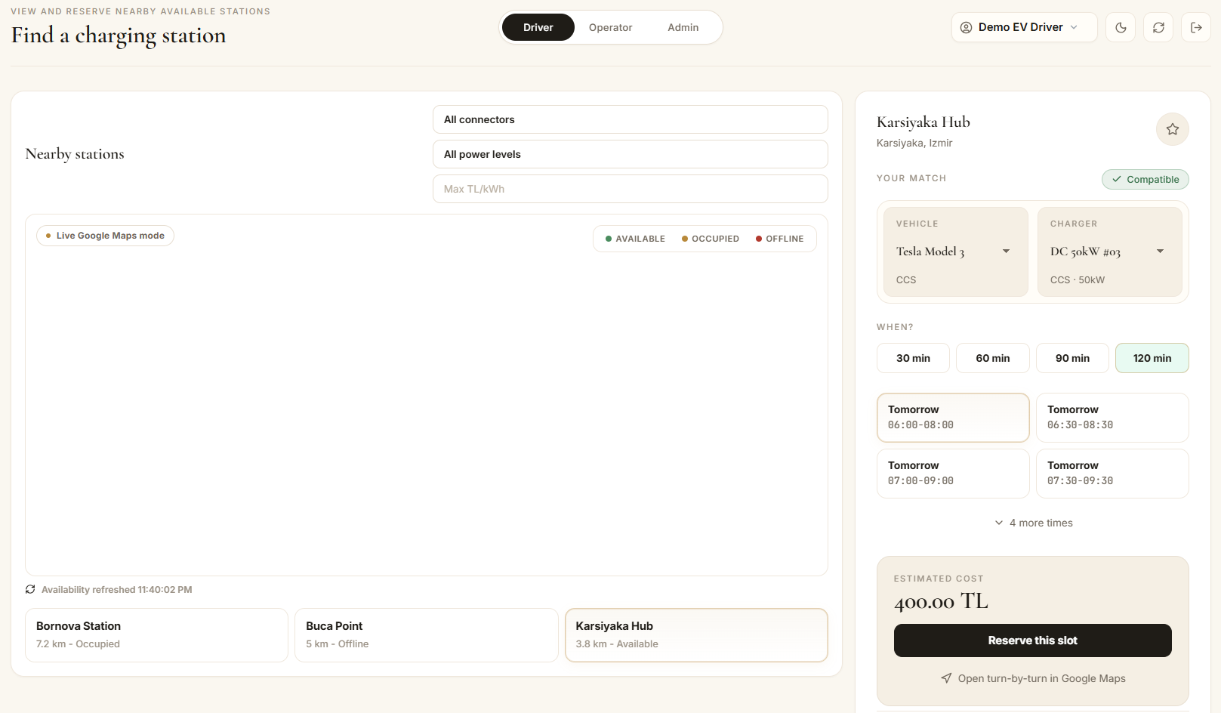
PART 2 · UI DESIGN
Find Charger & Reservation — UC-2
→ Color-coded markers (green/amber/red)
→ Distance from current location
MNS-03
MNS-04
Direct manipulation + colour display + information presentation
→ Connector compatibility badge before slot selection
→ Estimated cost + wallet check before confirm
EDR-07
EDR-15, PWS-07

Slide 17
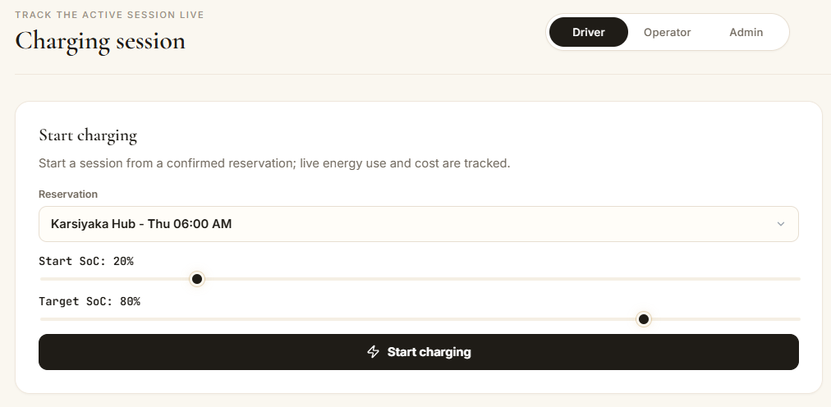
PART 2 · UI DESIGN
Charging Session Screen — UC-3
Start SoC + Target SoC sliders
EDR-17
Continuous range — slider is the right control
Live energy/cost estimate
EDR-09
kWh and running cost during session
Dynamic information + analogue/digital presentation

Slide 18
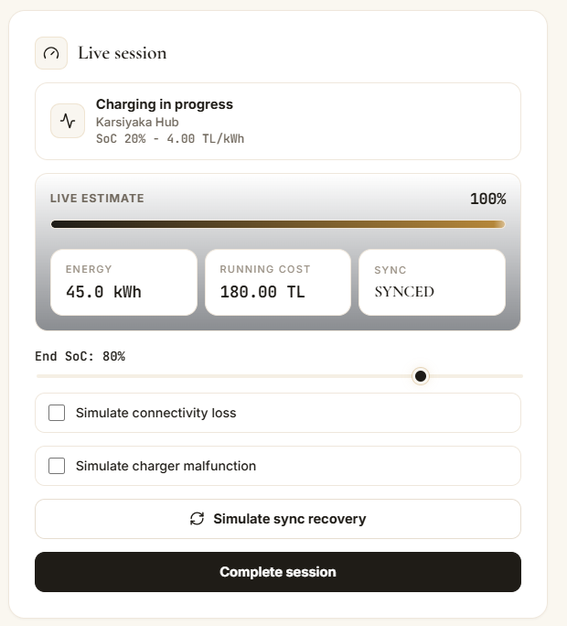
PART 2 · UI DESIGN
Charging Session Screen — UC-3
Auto-stop at target SoC
EDR-17
Session completes without manual action
Connectivity recovery simulation
EDR-18
Session state synchronized after reconnect
Wallet depletion interruption
PWS-08
Session interrupted + notification + partial receipt

Slide 19
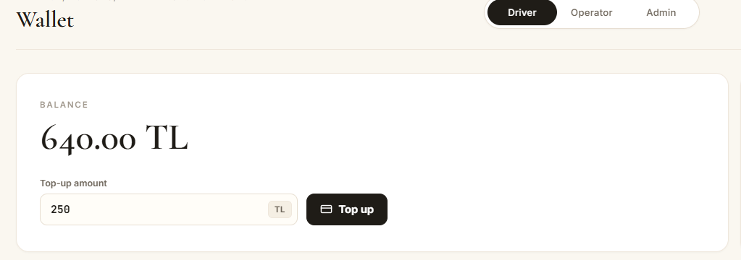
PART 2 · UI DESIGN
Wallet & Financial Transparency
Balance + top-up on one screen
PWS-06
No separate page for payment actions
Digital information presentation

Slide 20
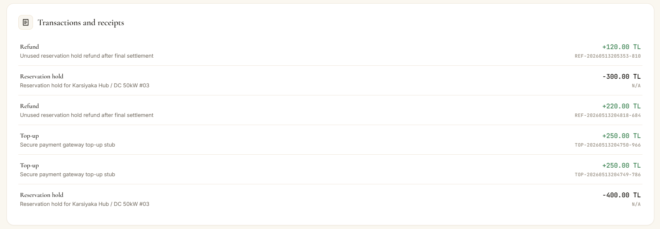
PART 2 · UI DESIGN
Wallet & Financial Transparency
Transaction history
GRR-04
Top-ups, charges, refunds with receipt numbers
Digital receipt after every transaction
GRR-01
CHG / REF receipt generated automatically
Refund results visible inline
PWS-04
Cancelled reservation → refund shown immediately

Slide 21
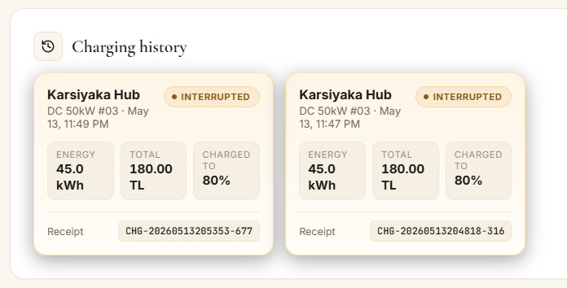
PART 2 · UI DESIGN
Wallet & Financial Transparency
Charging history with energy + cost
EDR-10
Complete session record for all sessions

Slide 22
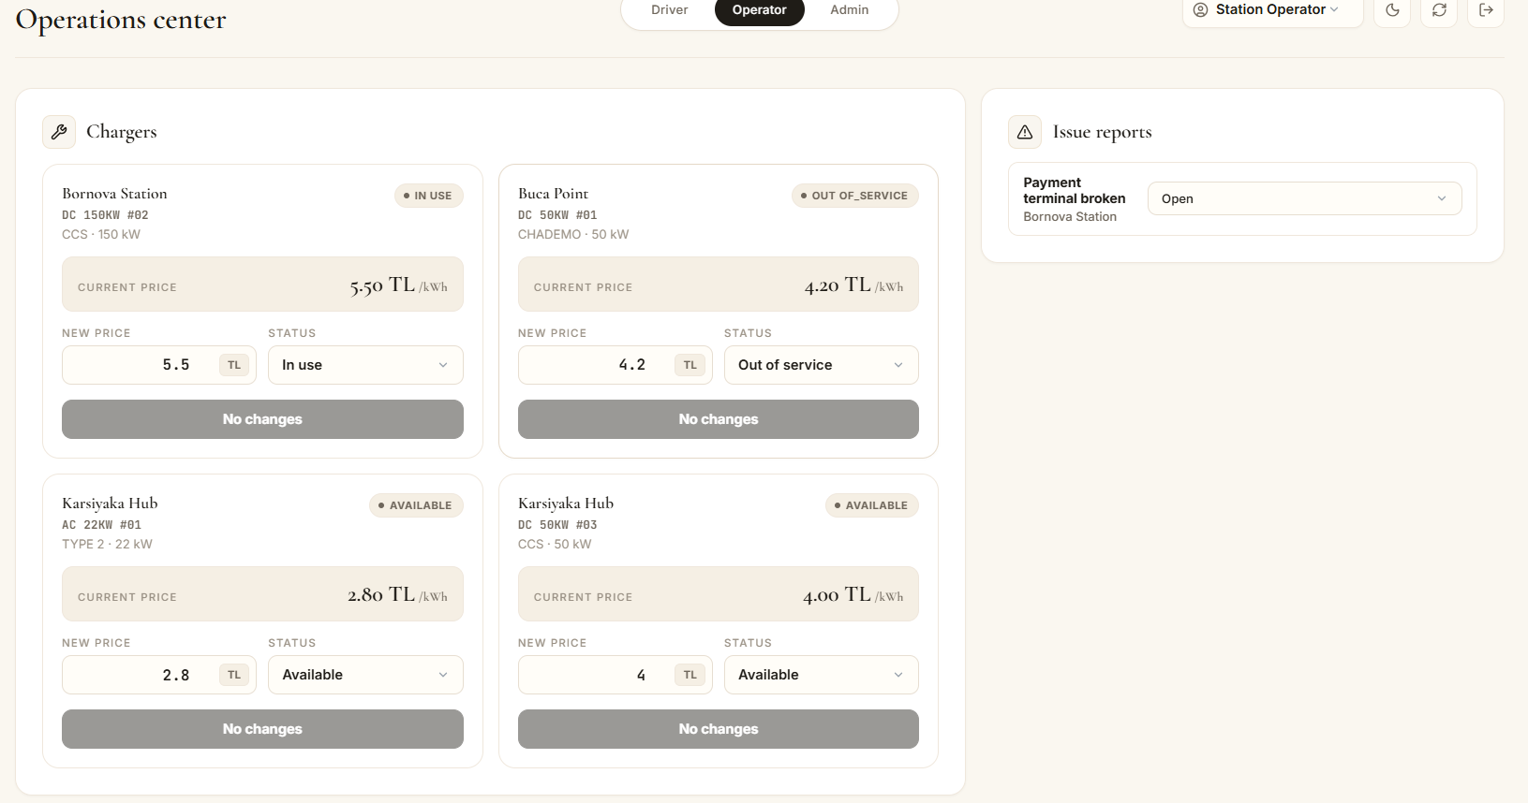
PART 2 · UI DESIGN
Operations Center & Activity System

Slide 23
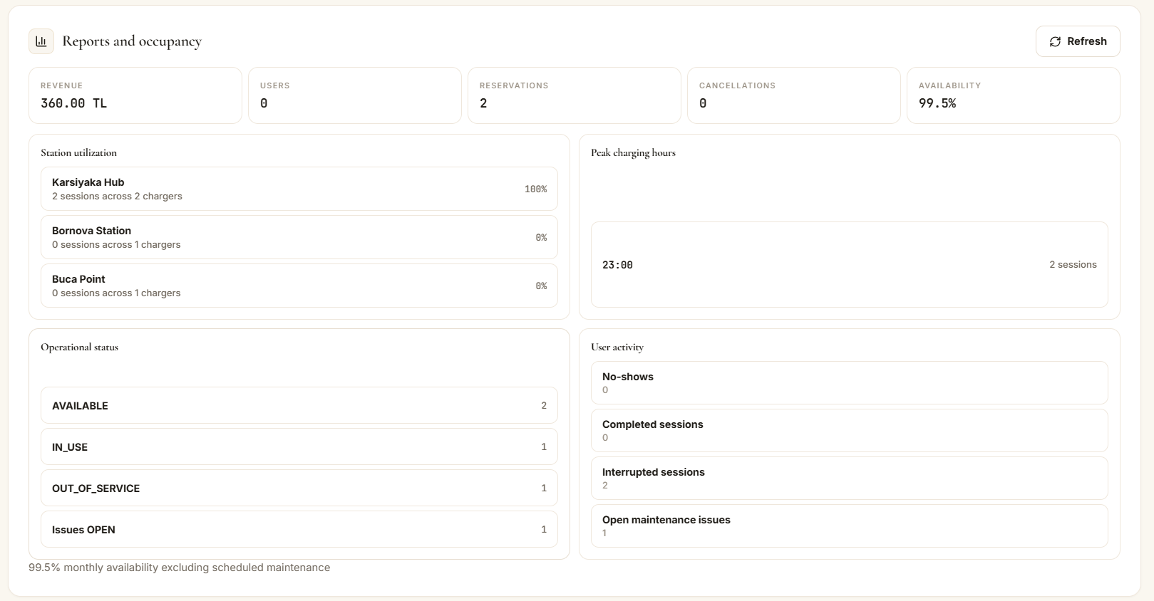
PART 2 · UI DESIGN
Operations Center & Activity System

Slide 24
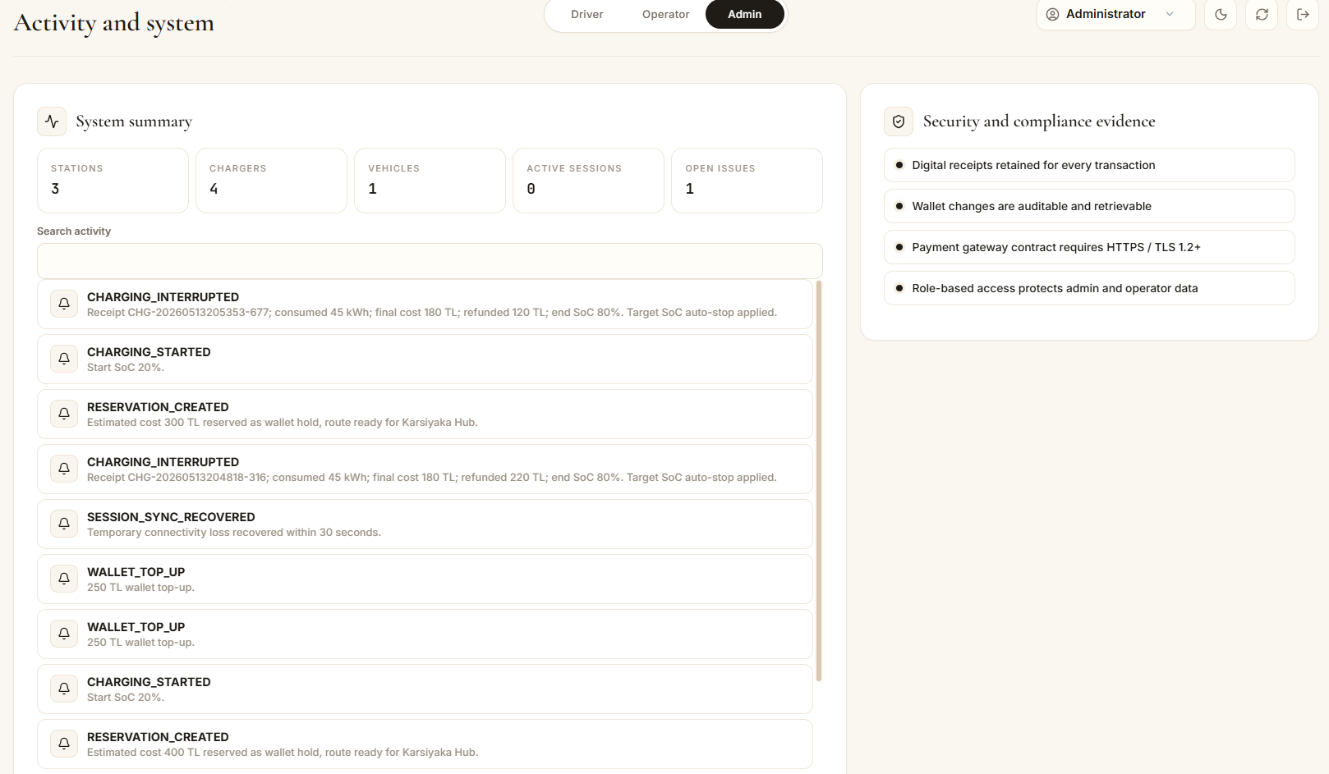
PART 2 · UI DESIGN
Operations Center & Activity System

Slide 25
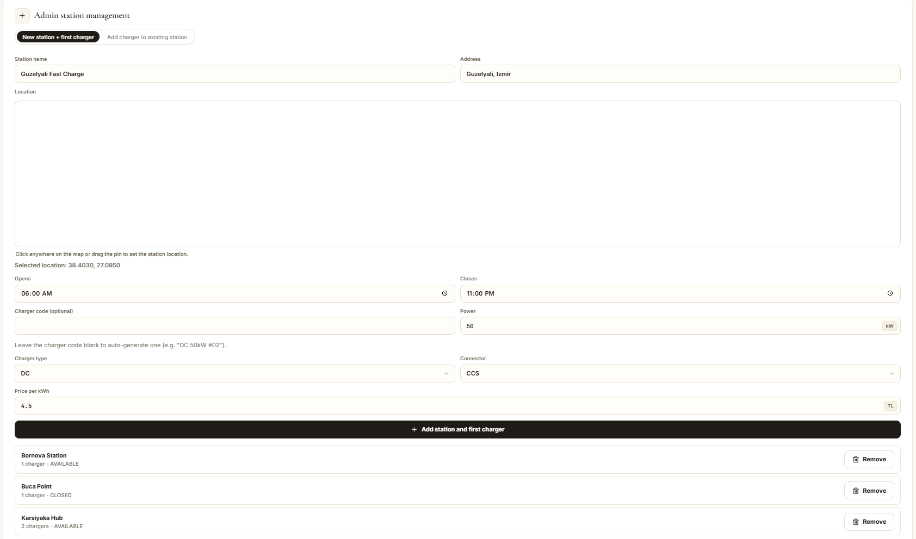
PART 2 · UI DESIGN
Operations Center & Activity System

Slide 26
PART 2 · UI DESIGN
Help Guide & Role-Based Assistance
Built-in onboarding and guidance system, each role has its own dedicated Help Guide page.
Driver Guide
Operator Guide
Admin Guide / Reference
Onboarding walkthrough
Station and charger management
User and operator account management
How to register a vehicle
How to update charger status/pricing
Station add/remove workflow
How to find and reserve a charger
Viewing reservations and occupancy
Reports and analytics reference
Understanding cost and wallet
Handling issue reports
Security alert configuration
Charging session explained
Out-of-service workflow
Audit log interpretation
FAQs for common driver questions
Operational playbooks
Technical/reference documentation
FAQ accordion system · role-specific guidance · operational playbooks · in-app assistant · improves onboarding and aligns with UI design criteria.
Design principles: User guidance + user documentation

Slide 27
PART 2 · UI DESIGN
In-App Assistant — Conversational Navigator
Free-text input
UI
Floating chat panel accepts free-form queries from any role
Rule-based intent match
NLP
Regex keyword table maps phrases to target views (no LLM)
Role-aware suggestions
Role
Quick chips and intents adapt to the active role
Direct page navigation
Nav
Reply includes a CTA that opens the matched page in one tap
Fallback guidance
Help
Unmatched queries show example prompts to steer the next try
Natural language + form fill-in + menu selection

Slide 28
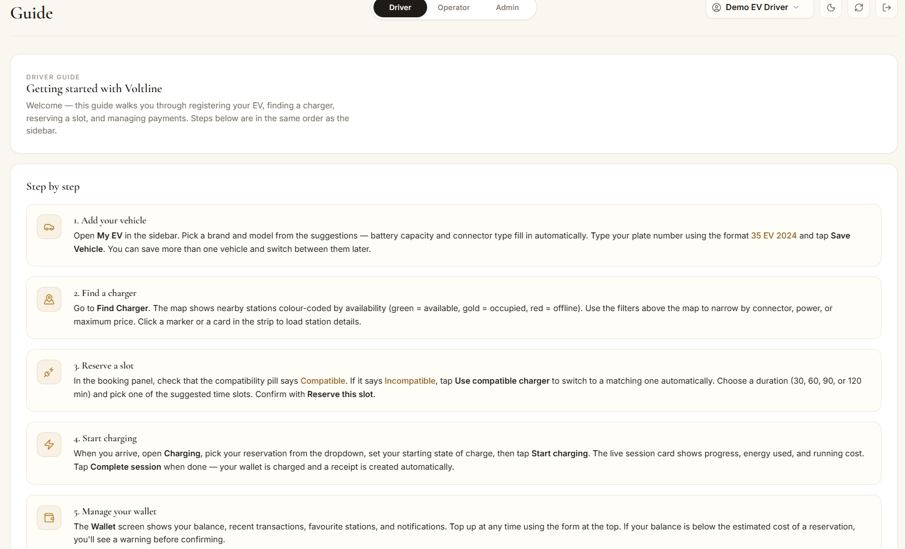
PART 2 · UI DESIGN
Help Guide & Role-Based Assistance

Slide 29
03
PART 3
Testing
Strategy · Domain Tests · API Tests · RBAC · Audit · Traceability

Slide 30
PART 3 · TESTING
Testing Strategy — Requirements to Verified Workflows
Tests are derived from: assignment use cases, project topic, requirements report, architecture report, implemented workflows.
Layer 1 — Domain Rule Tests
Layer 2 — API Workflow Tests
tests/domain.test.ts
tests/api.test.ts
Pure function tests · no server · no database
HTTP tests via Supertest · validates routes, Prisma, RBAC, DB
Vehicle validation, connector compatibility
POST /api/vehicles, POST /api/reservations
Reservation duration, 24h limit, operating hours
Session start/complete, operator status
Double-booking detection, cost calculation
Admin reports, audit integrity
Cents conversion, Haversine distance
RBAC enforcement per endpoint
Reserved slot logic, boundary checks
DB reset + seed before tests
development testing = unit/domain tests + component/API tests + system/use-case workflow tests.

Slide 31
PART 3 · TESTING
Testing Concepts Applied in Voltline
Course Concept | Voltline Implementation
Validation testing | UC-1 vehicle registration, UC-2 reservation happy path, UC-3 charging session happy path confirm expected requirements.
Defect testing | Invalid connector, duplicate plate, insufficient wallet, out-of-service charger and RBAC 403 cases expose unsafe behaviour.
Development testing | Domain and API tests written by the development team during implementation not after release.
Unit testing | tests/domain.test.ts verifies isolated business rules such as cost calculation, reservation constraints and validation.
Component / interface testing | tests/api.test.ts uses Supertest to verify route inputs/outputs, Zod validation, RBAC headers and persistence.
System / use-case testing | UC-1, UC-2 and UC-3 exercise several components together through full workflows.

Slide 32
PART 3 · TESTING
Test Case Selection: Partitions, Boundaries & Error Conditions
01
Equivalence Partitions
02
Boundary Values
03
Error-Message Forcing
· valid connector vs invalid connector
· sufficient wallet vs insufficient wallet
· available charger vs out-of-service charger.
· Battery capacity range (1–200 kWh)
· 2-hour reservation limit
· 24-hour booking window
· target SoC limits.
· duplicate plate
· missing required field
· connector mismatch
· insufficient balance
each triggers a controlled validation/error response.
04
Interface Testing
05
Regression Testing
· API payload validation with Zod
· demo RBAC headers
· route → service → Prisma data transfer verified end-to-end.
Automated Vitest suite reruns after each change; currently 29 tests across 2 suites pass successfully.

Slide 33
PART 3 · TESTING
Test Environment & Tools
npm test
prisma generate
database init
vitest run
domain.test.ts
api.test.ts
29 tests passed
2 suites passed
entry point
ORM client
SQLite reset
runner
29 tests
+ DB side effects
✓
Vitest
Supertest
Prisma
Fast unit/integration test runner, ESM-compatible
HTTP integration testing through Express app
ORM for SQLite — test DB initialised fresh per run
SQLite
Zod
Seed DB
Lightweight embedded DB reset before each suite
Request body validation in routes — first gate
Deterministic demo data loaded before assertions
Automated testing: Vitest reruns the suite without manual intervention, supporting regression testing after changes.

Slide 34
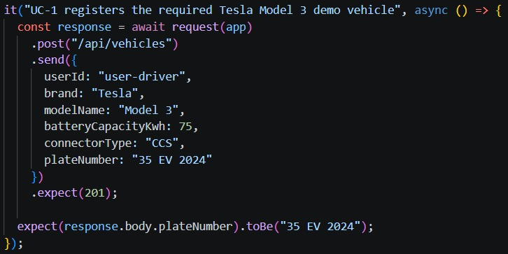
PART 3 · TESTING
UC-1 · Vehicle Registration Tests
Scenario | Input | Expected Result | Why It Matters
Happy path | Tesla Model 3 · 75 kWh · CCS · 35 EV 2024 | 201 Created | Assignment example — baseline verification
Duplicate plate | Existing 35 EV 2024 | 400 rejected | Prevents invalid duplicate records
Invalid battery | 0 kWh or outside 1–200 range | 400 validation error | Boundary check for domain rule
Unsupported connector | connector: NACS or unlisted enum | 400 validation error | Protects downstream compatibility
Missing required field | model field omitted | 400 rejected | Required form validation
Cross-user protection | Driver 2 accesses Driver 1 vehicle | 403 Forbidden | Account scope / RBAC security
Partition testing + boundary testing + abnormal input tests
All 6 scenarios pass · Zod validation runs before any Prisma write

Slide 35
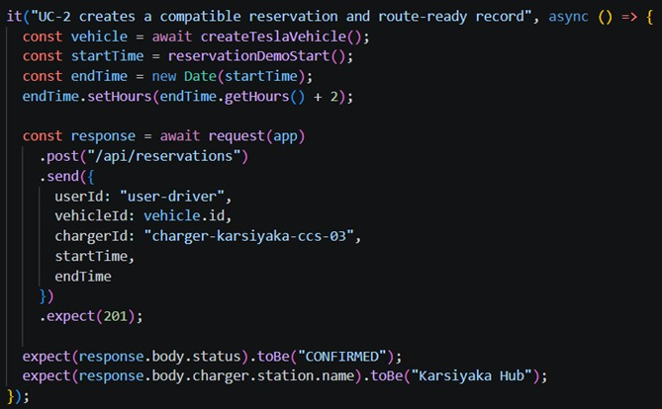
PART 3 · TESTING
UC-2 · Reservation Happy Path
INPUT
· Registered: Tesla Model 3 · CCS
· Station: Karsiyaka Hub · DC 50kW #03
· Valid time slot within operating hours
· Wallet balance ≥ estimated cost
EXPECTED OUTPUT
· 201 CONFIRMED — reservation created
· Linked to correct charger and station
· Route-ready station data returned
· UI bootstrap refresh triggered
· Confirmation notification created
validation testing: expected use case confirms the system meets requirements.
RESERVATION FLOW
Load vehicle
Select station/charger
POST /api/reservations
Validate + apply rules
Persist in Prisma
Return CONFIRMED

Slide 36
PART 3 · TESTING
UC-2 · Reservation Exception Tests
Rule Tested | Input Example | Expected Output | Requirement
Connector compatibility | CHAdeMO vehicle → CCS charger | Rejected — connector mismatch | EDR-07
Max 2h duration | endTime − startTime > 120 min | Rejected — max duration | EDR-08
24h advance window | startTime = now + 48h | Rejected — booking window | EDR-08
Operating hours | Outside station open/close times | Rejected — outside hours | EDR-08
Double-booking | Overlapping slot, same charger | 409 Conflict — slot taken | EDR-08
Wallet sufficiency | Estimated cost > wallet balance | 402 — balance insufficient | PWS-07
Out-of-service charger | charger status = OUT_OF_SERVICE | Rejected — unavailable | SOR-01/05
Privacy — reserved windows | Exposed without PII/plate number | No data leakage | SDR-05
defect testing: abnormal inputs expose incorrect or unsafe behaviour.
expect(r.body.error).toMatch(/connector/i);
6
});

Slide 37
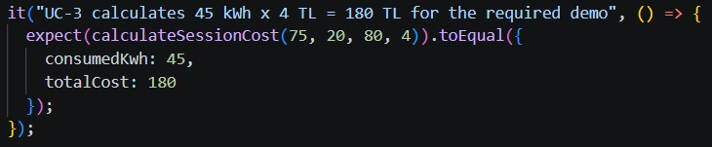
PART 3 · TESTING
UC-3 · Charging Session & Cost Calculation
Battery capacity
75 kWh
Expected Outputs
· energyKwh = 45, totalCost = 180
Start SoC
20 %
· Digital receipt generated (CHG type)
Target SoC
80 %
· Wallet deducted by 180 TL
· Charging history updated
Δ SoC
60 %
· Charger status released → AVAILABLE
Energy delivered
45 kWh
Price per kWh
4.00 TL
45 kWh × 4 TL/kWh = 180 TL
boundary values + timing/interface behaviour

Slide 38



PART 3 · TESTING
UC-3 · Edge Cases: Safe Stop, Sync Recovery, Fault Handling
Scenario | Trigger | Expected Output | Requirement
Target SoC auto-stop | Target 60%, end requested at 80% | Session stops at target | EDR-17
Connectivity recovery | Simulate sync loss + restore | Status: SYNCED, data reconciled | EDR-18
Wallet depletion mid-session | Balance depleted during charge | INTERRUPTED · wallet 0 · LOW_BALANCE notification | PWS-08
Two-hour limit reached | Session exceeds 2h | Auto-stop with limit notification | EDR-08/09
Charger fault / malfunction | Malfunction trigger during session | Charge delivered energy only · notification · audit trace | UC-3 exceptions
All edge cases verified in tests/domain.test.ts and tests/api.test.ts

Slide 39
PART 3 · TESTING
Wallet, Refund, No-Show & Financial Integrity Tests
Charging payment
Wallet access protection
Cents-based money storage
Wallet deducted correctly, CHG receipt generated
Driver 2 cannot access or top up Driver 1's wallet — 403 returned
All amounts stored as integers (cents) to prevent floating-point money errors
PWS-02, GRR-01
SDR-05
PWS-02
No-show detection
Reservation cancellation
Insufficient balance guard
Reservation marked NO_SHOW after 15 min, slot released
CANCELLED status, refund returned, REF receipt, REFUND transaction created
Reservation rejected when estimated cost > wallet balance
EDR-16
PWS-04, EDR-14
PWS-07
Wallet access cross-checks prevent financial data leakage between driver accounts.

Slide 40
PART 3 · TESTING
Operator Workflow Tests
OUT-OF-SERVICE CASCADE
Operator Tests Verified
1
Operator marks charger
OUT_OF_SERVICE
Station info update (name, address, hours)
System queries all
CONFIRMED reservations
Charger pricing update
2
Charger status update (Available/OOS)
3
Each reservation
→ CANCELLED
Issue report creation and status update
OOS cascade: reservations cancelled
4
Refund transaction
created
OOS cascade: affected users notified
OOS cascade: affectedReservations count returned
5
RESERVATION_CANCELLED
notification sent
Operator permissions (403 for admin-only endpoints)
6
Map marker updates
→ RED / unavailable
system testing: multiple components interact through one operational scenario.

Slide 41
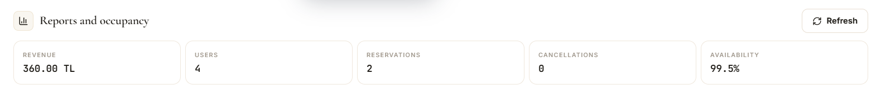
PART 3 · TESTING
Admin, Reports, Security Alert & RBAC Tests
RBAC ENDPOINT MATRIX
Admin Tests Verified
Endpoint | EV Driver | Operator | Admin
GET /api/audit | ✗ 403 | ✗ 403 | ✓ 200
GET /api/admin/reports | ✗ 403 | ✗ 403 | ✓ 200
PATCH /api/operator/chargers/:id/status | ✗ 403 | ✓ 200 | ✓ 200
POST /api/admin/stations | ✗ 403 | ✗ 403 | ✓ 201
PATCH /api/admin/users/:id | ✗ 403 | ✗ 403 | ✓ 200
POST /api/reservations | ✓ 201 | ✗ 403 | ✓ 201
· Reports: revenue, utilization, peak hours, user activity
· 99.5% availability target returned in reports
· Admin can add station with default charger
· Admin can remove station
· Admin can deactivate / reactivate operator
· Deactivated operator blocked from API
· Failed-login simulation → SECURITY_ALERT notification
interface testing + access-control defect testing.
Failed login → admin SECURITY_ALERT · Deactivated operator blocked · All admin endpoints role-guarded

Slide 42
PART 3 · TESTING
Audit Integrity — Tamper-Evident Logging
AUDIT HASH CHAIN
Entry 1
Entry 2
Entry 3
SEED_READY
hash: a1b2c3...
STATION_ADDED
prev: a1b2c3 + payload → e4f5g6
RESERVATION
prev: e4f5g6 + payload → h7i8j9
What is verified
Why It Matters
· GET /api/audit as admin → 200, chainValid = true
· Detects audit-log tampering through hash-chain validation
· Each audit row includes prevHash + entryHash
· Provides accountability for critical system actions
· Chain validation checks entries sequentially
· Supports admin-side traceability and debugging
· Non-admin GET /api/audit → 403 Forbidden
· RBAC protects audit evidence from non-admin access
static + dynamic V&V boundary — audit logic inspected in code, verified through API behaviour.

Slide 43
PART 3 · TESTING
Requirements Traceability Through Testing
Area | Requirements | Test Evidence
Vehicle Registration | EDR-01, EDR-02, SDR-01 | Creation, validation, cross-user protection
Map & Reservation | EDR-03–08, EDR-15, MNS-06, PWS-07 | Compatible reservation, slot rules, wallet sufficiency
Charging Session | EDR-09, EDR-17, EDR-18, PWS-02, PWS-08 | Cost calc, target stop, sync recovery, wallet depletion
Wallet & Receipts | PWS-01–07, GRR-01–04 | Deduction, refunds, receipts, cents storage
Operator Maintenance | SOR-01–06 | Charger status, pricing, OOS cascade
Admin & Reports | ADR-01–08 | Station CRUD, user management, reports, 99.5% target
Security & Audit | SDR-01–05, ADR-06, ADR-07 | RBAC, audit chain, failed-login alerts, hash integrity
63 requirements traced across 7 test areas · all main use cases covered end-to-end

Slide 44
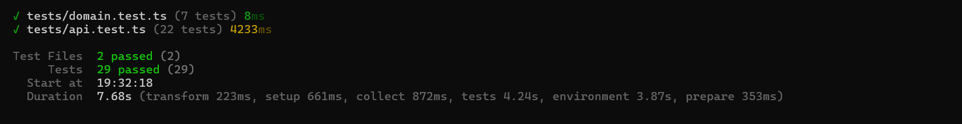
PART 3 · TESTING
Test Coverage Summary
29
63
3
100%
Tests passed
Req. mappings
Core use cases
RBAC enforced
2 suites
8 areas
end-to-end
all endpoints
Use Cases
Business Rules
Security
UC-1, UC-2, UC-3 tested end-to-end
All 6+ domain reservation rules validated
RBAC per endpoint, failed-login alert, cross-user guard
Reliability
Financial
Audit Integrity
Connectivity sync, wallet depletion, fault handling
Cost calc, deduction, refund, receipts, cents storage
Hash chain validation, tamper-evident log

Slide 45
PART 3 · TESTING
Verification Notes & Prototype Boundaries
✓ Verified
⚠ Prototype Boundaries
· TypeScript check: npx tsc --noEmit → passed
Payment gateway stub
Not a real bank/payment provider integration
· Vitest run: npx vitest run → 29 tests passed
Demo authentication
Simulated through headers — not production auth
· Vite build: npx vite build → passed
Google Maps optional
App runs with key or compatible fallback map
· All 3 main use cases tested end-to-end
Charging simulated
Projected from SoC/battery — not real charger telemetry
· RBAC enforcement verified per endpoint
TLS is deployment-level
Local dev runs HTTP; TLS 1.2+ is a compliance control
· Audit hash-chain integrity confirmed
99.5% availability = target KPI
Not measured from production monitoring data
Note: top-level npm test/build previously hit Windows Prisma DLL lock before app logic; direct npx commands confirm pass.
Testing can reveal the presence of defects, not prove their absence; therefore we state prototype boundaries explicitly.

Slide 46
EV CHARGING NETWORK · GROUP 28 · FSE SPRING 2026
Voltline is not just a prototype.
It is a validated working system.
Implemented
Validated
Future Work
Full EV charging workflows (UC-1, UC-2, UC-3)
29 tests passing across 2 suites
Real payment gateway integration
Hybrid architecture — 8 components, 7 subsystems
Domain unit + API integration layers
WebSocket live session updates
Role-based UI — Driver / Operator / Admin
RBAC enforced on all protected endpoints
PostgreSQL migration for production
Help Guide pages for all three roles
Operator cascade and wallet integrity
Mobile PWA + push notifications
Tamper-evident audit chain
Audit hash-chain integrity confirmed
Multilingual support (TR / EN)
99.5% availability SLA tracking
63 requirements traced through tests
Automated deployment pipeline

