Slide 1
VET PROJECT
REST API
MERT DUMANLI
mertdumanli.cse@gmail.com
https://www.linkedin.com/in/mertdumanli
https://github.com/mertdumanlicse

Slide 2

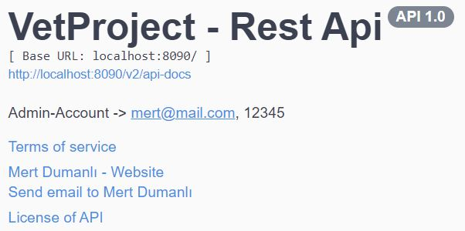

SWAGGER
LOGIN

Slide 3
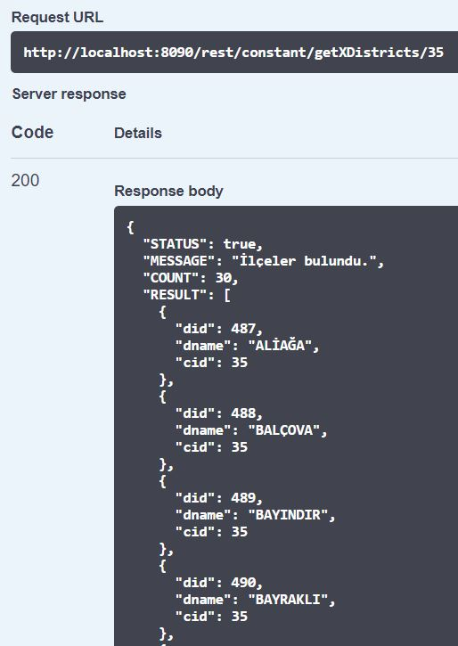
REDIS successful
EXAMPLE

Slide 4
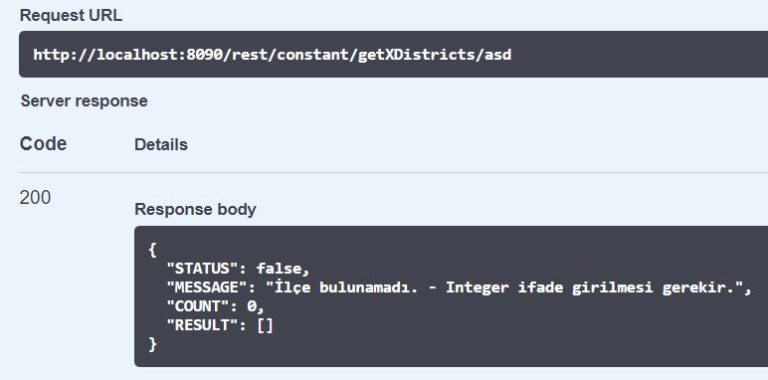
REDIS unsuccessful
EXAMPLE

Slide 5
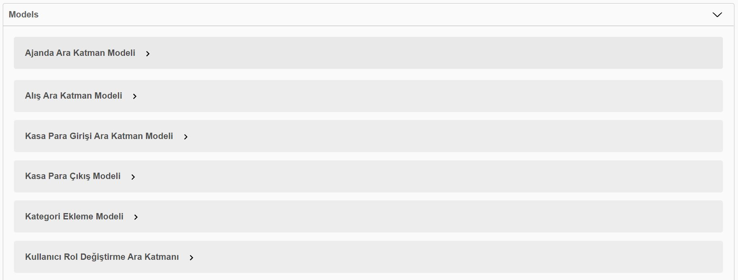
MODELS

Slide 6
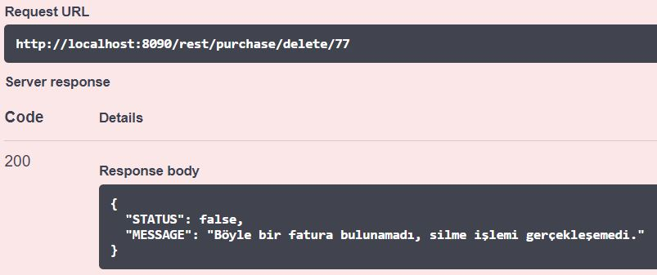
PURCHASE successful
EXAMPLE

Slide 7
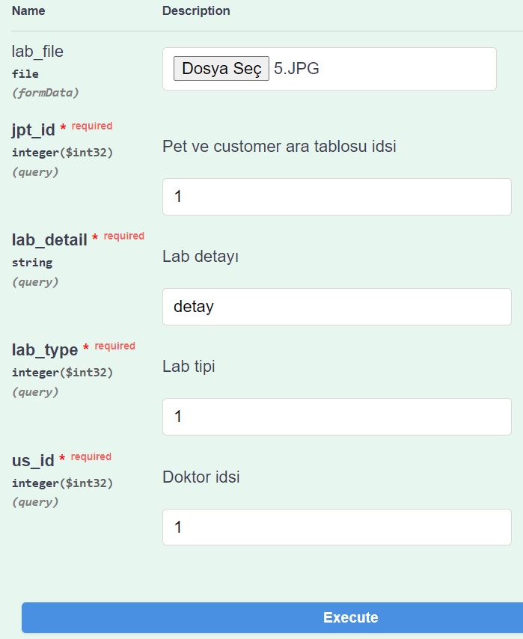
LAB
EXAMPLE

Slide 8
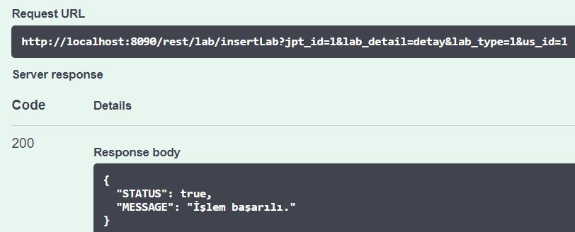
LAB successful INSERT
EXAMPLE

Slide 9
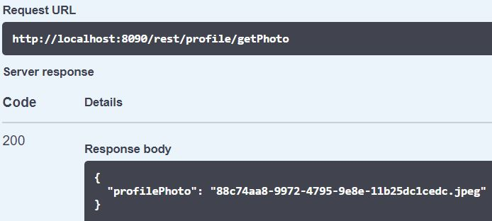
PROFILE successful
EXAMPLE

