Slide 1

Ordinary World:
Katniss lives in District 12, where hunger and survival dominate everyday life. She hunts illegally to provide for her family, showing she’s already brave and used to taking risks. Her bond with Prim is strong—this emotional connection becomes her motivation throughout the journey.

Slide 2
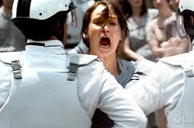
Call to Adventure:
When Prim’s name is drawn at the Reaping, Katniss volunteers to take her place. This moment shows Katniss’s instinct to protect others, even if it means sacrificing herself.

Slide 3

Refusal of The Call:
Katniss doesn’t say no with words, but she’s full of fear and doubt. She questions her ability to survive and whether she can play the Capitol’s deadly game. Her silence and body language show this refusal.

Slide 4
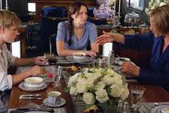
Meeting the Mentor:
Haymitch becomes Katniss’s mentor, but it’s not easy at first. He’s drunk. Over time she learns from him. Not just how to survive, but how to perform for the audience which shows Katniss starting to understand the game is psychological.

Slide 5
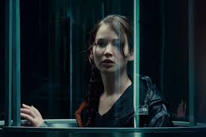
Crossing the Threshold:
Katniss enters the arena. This is her “new world”. It’s not just about survival now; It’s about playing the Capitol’s twisted game. She has officially left behind the world she knew.

Slide 6

Tests, Allies and Enemies:
Katniss faces obstacles: surviving fireballs, finding water, avoiding Careers. Rue becomes her ally, showing her that kindness and teamwork can exist even here. Katniss is tested not only physically, but morally.

Slide 7
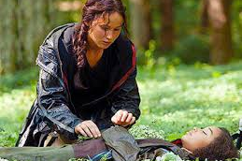
The Approach:
After Rue’s death, Katniss becomes emotionally dull. She sings to Rue and buries her with flowers, an act of rebellion. This shows that even in the Capitol’s game, she refuses to lose her humanity.

Slide 8
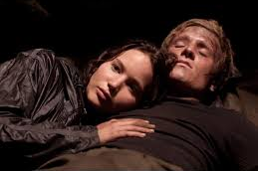
The Ordeal:
The rule change allows two tributes from the same district to win. Katniss finds Peeta and nurses him back to health. She must decide: is her kindness real, or a strategy? This is her inner conflict.
Image: Katniss feeding Peeta or in the cave scene.

Slide 9
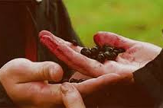
Seizing the Sword:
Katniss and Peeta win, but it’s not over. When the Capitol tries to change the rules again, Katniss pulls out the berries. She chooses death over being played with by the Capitol. This moment gives her real power.

Slide 10
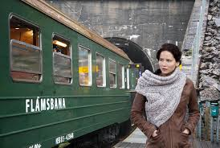
The Road Back:
Katniss returns home, but she’s changed. She’s no longer just a girl from District 12. She’s a symbol of resistance. Her “road back” is full of danger as the Capitol is watching her.

Slide 11
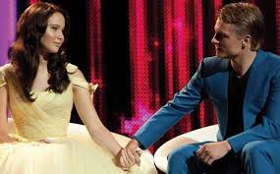
The Resurrection:
Katniss learns that every action has consequences. She survived, but now she must keep pretending with Peeta. Her identity is split between girl on fire and regular Katniss.

Slide 12

Return with the Elixir:
Katniss brings back something more valuable than victory; hope. She didn’t just survive; she showed the Capitol can be challenged. That’s the real “elixir” she brings to her people.

