Slide 1

QUANTITATIVE
ANALYSIS OF
GRAPPLING &
STRIKING METRICS
DSA210 Spring 2026
Mert Erpolat | Student ID: 32236
Sabanci University
UFC FIGHT HISTORICAL DATA • 6,012 BOUTS • 1993–2021

Slide 2
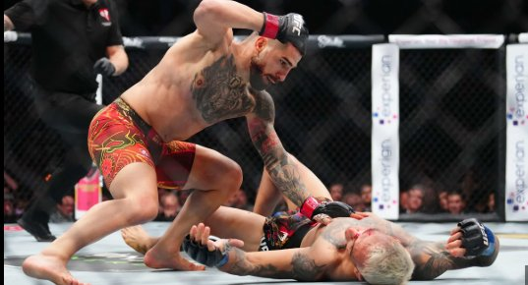
RESEARCH MOTIVATION
1 / 19
ARE GRAPPLERS
TRULY MORE
DOMINANT?
The Question
I have been following the UFC closely for almost three years. One debate keeps coming up everywhere — from analysts to casual fans: are grapplers truly more dominant than strikers? Almost everyone seems to believe wrestlers and submission artists hold a structural advantage. Rather than accepting that as fact, I decided to put it to a real data-driven test.
The Approach
Using 6,012 UFC bouts from 1993 to 2021, I applied statistical hypothesis testing and machine learning to find out whether the grappling advantage is real — and, crucially, under what conditions it actually shows up.
Two Core Questions
Short-term: Does takedown accuracy predict who wins an individual fight? (t-test)
Long-term: Do grappling metrics predict which fighters build lasting UFC careers? (ML)
Source: essentiallysports.com

Slide 3
DATASET OVERVIEW
2 / 19
6,012
3,596
144
15.3%
BOUTS ANALYZED
UNIQUE FIGHTERS
VARIABLES
VETERAN RATE
1993 – 2021
UFC athletes
strikes · grappling · physical
>10 career fights
About the Dataset
The dataset was sourced from Kaggle (UFC Fight Historical Data), originally scraped from the official UFC statistics database. It consists of two CSV files: data.csv — containing fight-by-fight metrics for all 6,012 bouts — and raw_fighter_details.csv — containing physical and biographical data for 3,596 unique fighters.
The 144 variables include per-fighter averages for strikes landed and absorbed, takedown attempts and completions, submission attempts, control time, and physical attributes such as height, weight, reach, and stance.
Data Enrichment
A new feature — Experience_Level — was derived by counting each fighter's total UFC appearances. Fighters with more than 10 career bouts were labelled Veteran (327 fighters, 15.3%); all others were labelled Prospect (1,812 fighters, 84.7%). This single enrichment step transforms fight-level records into a career-level success label that drives the entire machine learning phase.

Slide 4
DATA CLEANING & FEATURE ENGINEERING
3 / 19
Data Cleaning
Engineered Features
Percentage strings
Grappling_Score
Columns like Str_Acc, TD_Acc, Str_Def, and TD_Def were stored as strings (e.g. '57%'). These were converted to float values by stripping the % sign and dividing by 100.
TD_Avg + TD_Acc + Sub_Avg
Combines takedown volume, precision, and submission threat into a single offensive grappling value. Captures how actively and effectively a fighter takes the fight to the ground.
Physical measurements
Striking_Score
Height, weight and reach were stored as mixed strings ('5\'11"', '185 lbs.'). Each was parsed and converted to metric units (centimetres and kilograms).
SLpM + Str_Acc
Blends output rate (strikes landed per minute) with precision. Measures not just how much a fighter throws, but how many of those strikes actually land.
Missing values
Grappling_Striking_Ratio
Numeric missing values were imputed using column means — the standard approach for continuous sports statistics. 1,912 fighters had missing Reach values.
Grappling_Score / Striking_Score
A single number capturing a fighter's stylistic bias — above 1 means grappling-dominant, below 1 means striking-dominant. Used as a feature for style segmentation.
Categorical encoding
Experience_Level
Stance (nominal) was encoded with One-Hot Encoding. Experience_Level (ordinal) was encoded with Label Encoding: Prospect = 0, Veteran = 1.
fights > 10 → Veteran
The ML target variable. Transforms fight-level records into a career-level binary label. Statistically validated: Veterans and Prospects differ significantly in both grappling (p=0.0001) and striking metrics (p<0.0001).

Slide 5
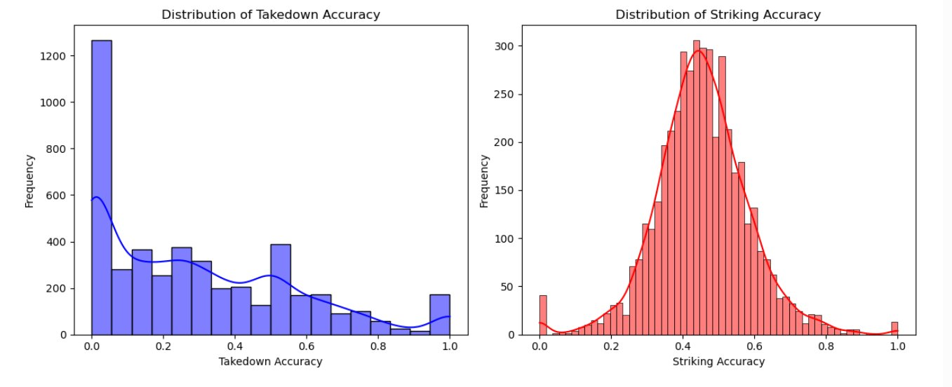
EDA — DISTRIBUTION PLOTS
4 / 19
Takedown Accuracy
Heavily right-skewed with a large spike at zero. Many fighters attempt very few or no takedowns at all — the median sits around 0.25. This skewness rules out any normal-distribution assumption and directly motivated using the median as the threshold in the hypothesis test.
Striking Accuracy
Unlike takedown accuracy, striking follows a clean bell-shaped distribution centred around 40–45%. Most fighters, regardless of style or era, operate within a predictable striking efficiency range.
Figure 1: Distribution of Takedown Accuracy (left) and Striking Accuracy (right)
These two distributions are shaped completely differently — one is skewed with a zero-spike, the other is symmetric and bell-shaped. That contrast is not just visual: it means grappling and striking metrics capture fundamentally different dimensions of fighter performance. Analysing them with the same statistical assumptions would produce misleading results. This is why the project treats them separately in hypothesis testing and why two separate composite scores were engineered rather than combining everything into one feature.
Key Implication

Slide 6
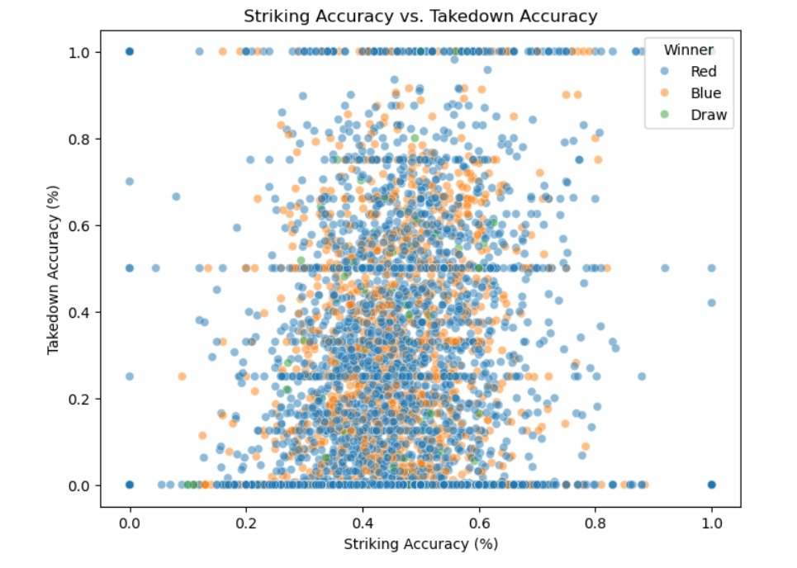
EDA — SCATTER PLOT: STRIKING vs. TAKEDOWN ACCURACY
5 / 19
What This Plot Shows
Each dot represents a fighter in a single bout. The x-axis is striking accuracy, the y-axis is takedown accuracy. Dots are coloured by which corner won — Red, Blue, or Draw.
The Key Observation
The three colour groups overlap almost entirely across the full range of the plot. There is no region that belongs exclusively to one type of winner. You cannot draw a line — or any boundary — that cleanly separates Red wins from Blue wins.
What This Means
A simple accuracy threshold — grappling or striking — cannot predict fight outcomes. This visual evidence directly motivates the full machine learning approach: a multi-feature model is required to extract meaningful signal.
Figure 2: Striking Accuracy vs. Takedown Accuracy colored by Winner (Red / Blue / Draw)

Slide 7
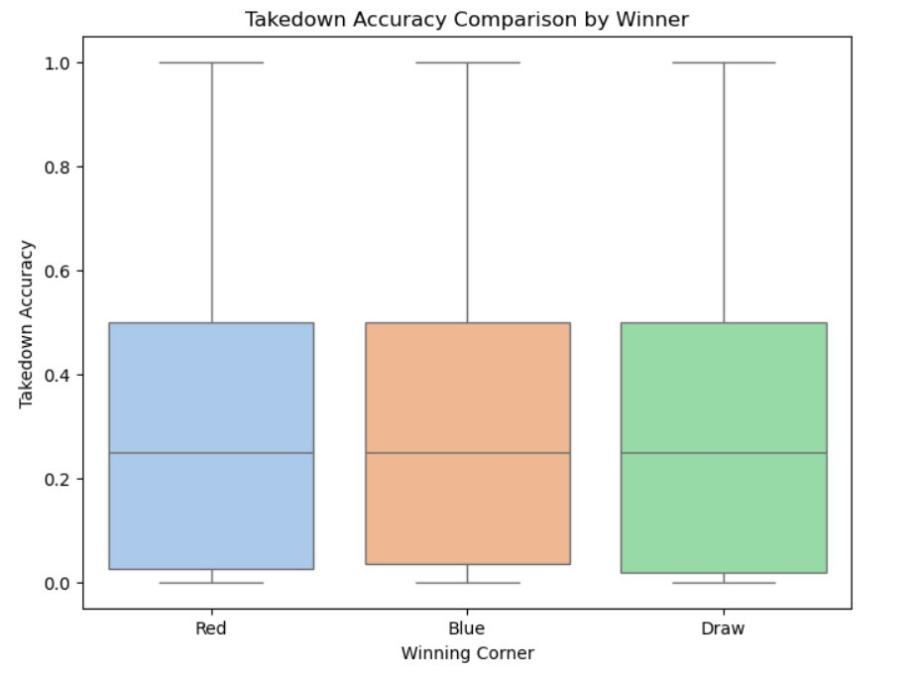
EDA — BOX PLOT: TAKEDOWN ACCURACY BY WINNER
6 / 19
What This Plot Shows
Three side-by-side box plots comparing the distribution of takedown accuracy for each winning outcome: Red corner wins, Blue corner wins, and Draws.
The Key Observation
All three groups share nearly identical medians — approximately 0.25 — and almost fully overlapping interquartile ranges. The whiskers extend to similar ranges as well. There is no meaningful statistical separation between the three groups.
Why It Matters
This box plot is the visual pre-confirmation of the hypothesis test result. Before running any statistics, the data is already telling us: takedown accuracy alone does not differentiate winners from losers at the individual fight level. The formal t-test on the next slides will confirm this with numbers.
Figure 4: Takedown Accuracy Comparison by Winning Corner (Red / Blue / Draw)

Slide 8
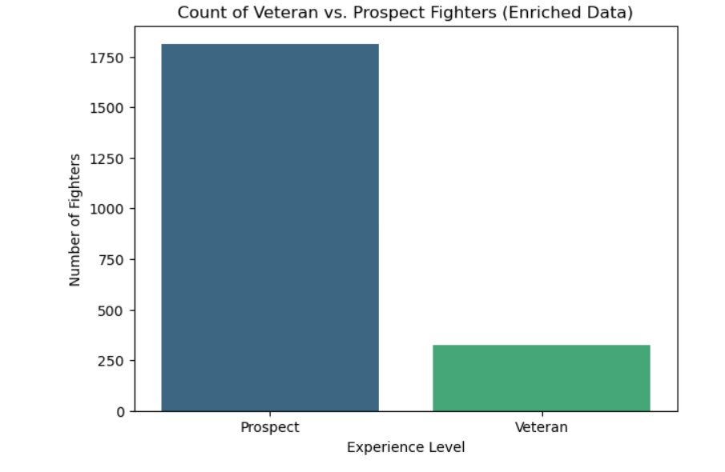
UFC CAREER FUNNEL — CLASS IMBALANCE
7 / 19
The 85/15 Split (nearly)
The bar chart confirms a severe class imbalance in the enriched dataset: 1,812 Prospects (84.7%) vs. 327 Veterans (15.3%). This lopsided distribution is not a data quality issue — it reflects the real-world structure of a UFC career. Most fighters compete for only a few bouts before leaving the promotion. Breaking through and staying active for more than 10 fights is genuinely rare.
Why This Matters for Modelling
A naive classifier trained on this data would achieve 84.7% accuracy simply by predicting every fighter as Prospect — without learning anything meaningful. To prevent this, class_weight='balanced' was applied to both ML classifiers. This forces the models to pay equal attention to both classes during training, ensuring Veterans are not ignored.
Figure 3: Count of Veteran vs. Prospect Fighters (Enriched Data)
Veterans: 327 • Prospects: 1,812 • Total analysed: 2,139 fighters

Slide 9
HYPOTHESIS TEST — SETUP
8 / 19
The Research Question
Formal Setup
At the individual fight level, do fighters with above-median takedown accuracy win significantly more often than those with below-median takedown accuracy?
This is the short-term dimension of the research question. The hypothesis test isolates grappling accuracy as a single variable to see whether it carries independent predictive power in any given fight.
H₀ (Null Hypothesis)
No significant difference in win rate between fighters with above- and below-median takedown accuracy.
H₁ (Alt. Hypothesis)
Fighters with above-median takedown accuracy have a significantly higher win rate.
Significance Level (α)
Why the Median as the Threshold?
0.05 — the standard threshold for statistical significance.
The distribution analysis in Slide 5 showed that takedown accuracy is heavily right-skewed. Using the mean as a threshold would be misleading — it would be pulled upward by a small number of elite grapplers. The median (0.25) is a more robust and fair dividing line that splits the fighter population into genuinely comparable halves.
Test Method
Independent samples t-test using scipy.stats.ttest_ind. The two groups are treated as independent populations.
Split Threshold
Median takedown accuracy = 0.25. Fighters at or above this value form the 'high TD' group; all others form the 'low TD' group.

Slide 10
HYPOTHESIS TEST — RESULTS
9 / 19
What This Result Means
p = 0.6289
With a p-value of 0.6289 — far above the 0.05 threshold — we fail to reject the null hypothesis. At the individual fight level, having above-median takedown accuracy does NOT translate into a statistically significant higher win rate.
This was one of the most surprising findings of the project. It directly challenges the widespread belief that grappling skill is a decisive edge in any given fight.
The t-statistic of -0.4832 is essentially zero — there is barely any difference in win rates between the two groups at all. The result is not close to significance; it is not even in the right direction.
T-STATISTIC: −0.4832
FAIL TO REJECT H₀
Why This Makes the ML Phase Essential
If grappling accuracy alone cannot predict fight outcomes, where does the grappling advantage actually live? The answer lies in career-level patterns. The machine learning phase shifts the question from 'who wins this fight?' to 'which fighters sustain long careers?' — and that is where the grappling signal emerges clearly.

Slide 11
MACHINE LEARNING PHASE — OVERVIEW
10 / 19
From Fight-Level to Career-Level
The hypothesis test answered a short-term question and came up empty. The ML phase asks a longer-term question: can a fighter's combat metrics — their grappling scores, striking numbers, defensive stats, and physical attributes — predict whether they will become a UFC Veteran? The target variable is Experience_Level (Veteran / Prospect), which serves as a validated proxy for career success.
Logistic Regression
Random Forest
K-Means Clustering
Chosen as the primary interpretable model. Its coefficients directly answer which metrics push a fighter toward Veteran status — giving us a clear, ranked answer to the research question.
Implemented to capture non-linear relationships. Tuned via 5-fold CV over max_depth ∈ {3,5,10,15} and n_estimators ∈ {50,100,200}. Best config: depth=10, n=200. Feature importances give the most direct quantitative answer.
Applied unsupervised to segment fighters by combat style — no labels, no bias. Independently validates the grappling-vs-striking story by comparing Veteran rates across naturally emerging style clusters.
Statistical validation: Veterans and Prospects differ significantly in both grappling (p = 0.0001) and striking metrics (p < 0.0001), confirming Experience_Level is a meaningful and learnable target.

Slide 12
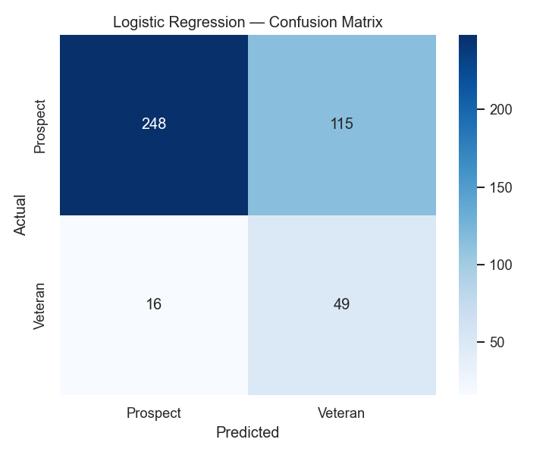
LOGISTIC REGRESSION — CONFUSION MATRIX
11 / 19
0.694
0.770
0.756±0.029
TEST ACCURACY
AUC SCORE
5-FOLD CV AUC
Reading the Confusion Matrix
The matrix shows predicted labels on the x-axis and true labels on the y-axis. The top-left cell (248) represents Prospects correctly predicted as Prospects. The bottom-right cell (49) represents Veterans correctly predicted as Veterans — this is what the model is really being optimised for.
With class_weight='balanced' applied to correct for the 85/15 split, the model correctly identifies 49 out of 65 Veterans in the test set — a recall of 75%. Without balancing, the model would have labelled almost every fighter as Prospect by default, achieving high accuracy while learning nothing meaningful.
The 115 false positives (Prospects predicted as Veterans) are the cost of the recall improvement. This trade-off is intentional and appropriate given the severe class imbalance.
Figure 5: Logistic Regression — Confusion Matrix

Slide 13
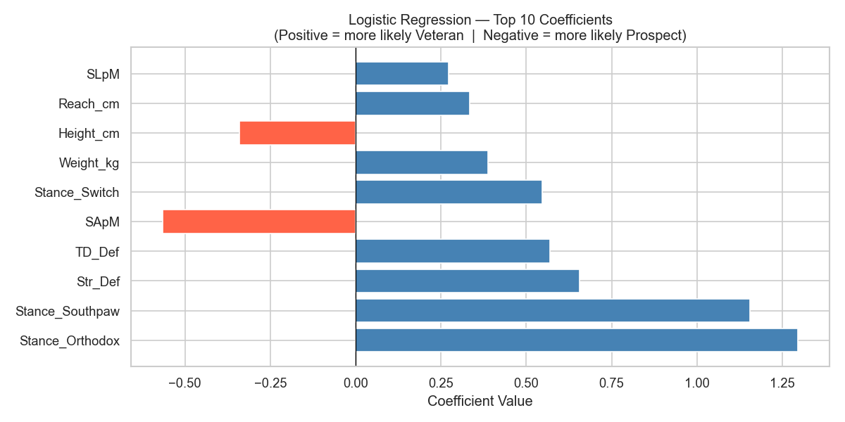
LOGISTIC REGRESSION — TOP 10 COEFFICIENTS
12 / 19
How to Read This
Positive coefficients (blue) push the model toward predicting Veteran. Negative coefficients (red) push toward Prospect. The longer the bar, the stronger the influence.
Key Findings
Stance_Orthodox and Stance_Southpaw carry the highest absolute coefficients — suggesting fighter identity and adaptability are strong signals. Str_Def and TD_Def also rank high, confirming that defensive competence matters more than offensive output for career durability. SApM (strikes absorbed per minute) carries a strong negative coefficient — the more punishment you absorb, the shorter your career.
Figure 6: Top 10 Logistic Regression Coefficients (Blue = toward Veteran, Red = toward Prospect)
Defensive skills (Str_Def, TD_Def) outrank offensive metrics in predicting career longevity.
Stance features dominate — adaptability and fighter identity are the strongest career signals in this model.
Takeaway
Career longevity is shaped by how well you protect yourself, not just how hard you attack.

Slide 14
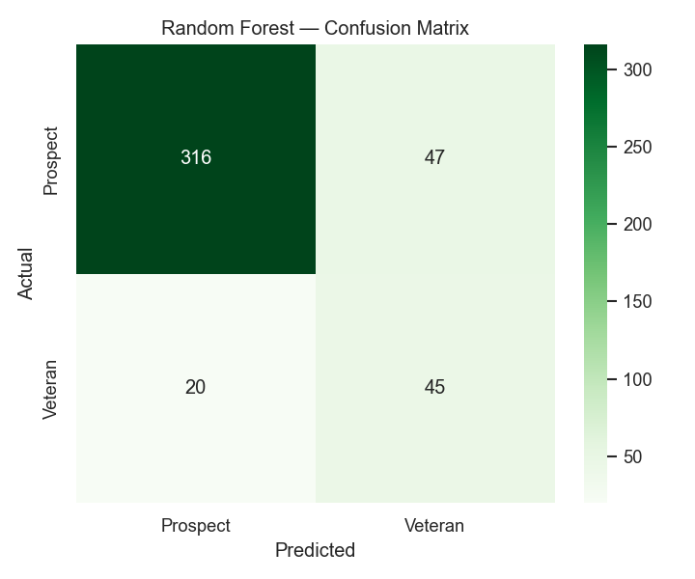
RANDOM FOREST — CONFUSION MATRIX
13 / 19
0.844
0.879
0.872±0.029
depth=10, n=200
TEST ACCURACY
AUC SCORE
5-FOLD CV AUC
BEST PARAMS
Improvement Over Logistic Regression
The Random Forest confusion matrix shows a clear step up from Logistic Regression. 45 out of 65 Veterans are correctly identified (69% recall) — slightly lower than LR's 75%, but with substantially higher precision at 49% vs. 30%. This means far fewer false alarms: fighters being labelled Veteran when they are actually Prospects dropped from 115 to 47.
The model was tuned via 5-fold cross-validation over a grid of max_depth values (3, 5, 10, 15) and n_estimators values (50, 100, 200). The optimal configuration — max_depth=10 with 200 trees — balances complexity and generalisation. Deeper trees captured non-linear interactions; more trees reduced variance.
The AUC improvement from 0.77 to 0.88 is the most meaningful metric — it reflects the model's overall ability to rank Veterans above Prospects across all thresholds.
Figure 7: Random Forest — Confusion Matrix

Slide 15
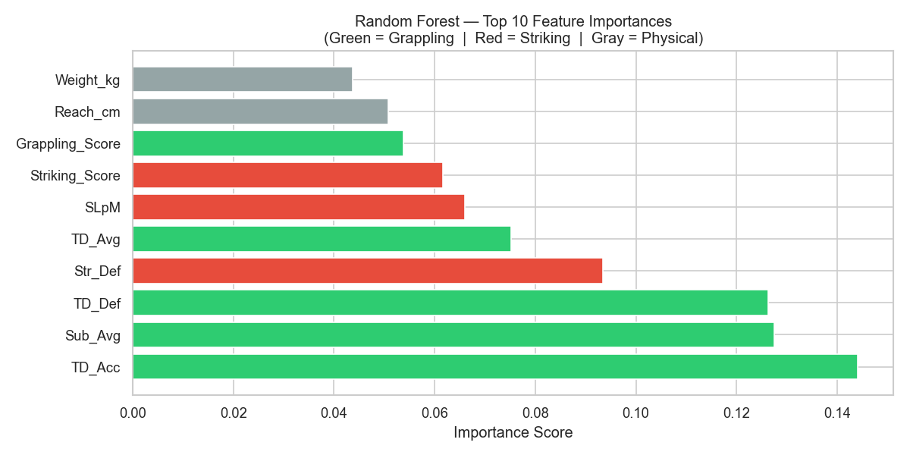
RANDOM FOREST — FEATURE IMPORTANCE
14 / 19
The Direct Answer
This chart is the most direct quantitative answer this project gives to its own research question. Grappling metrics collectively account for 56.2% of the model's total predictive power.
Top Features
TD_Acc (~14.5%) — The single most important feature. Sub_Avg and TD_Def follow closely. All three are grappling metrics. Str_Def ranks 4th — the only striking metric in the top four, and it is a defensive one. SLpM and Striking_Score appear in the bottom half of the top 10.
Figure 8: Top 10 Feature Importances (Green = Grappling, Red = Striking, Gray = Physical)
The Takeaway
Grappling: 56.2%
Striking: 30.2%
Physical: 13.6%
Grappling dominates career prediction. Striking matters — but plays a supporting role.

Slide 16
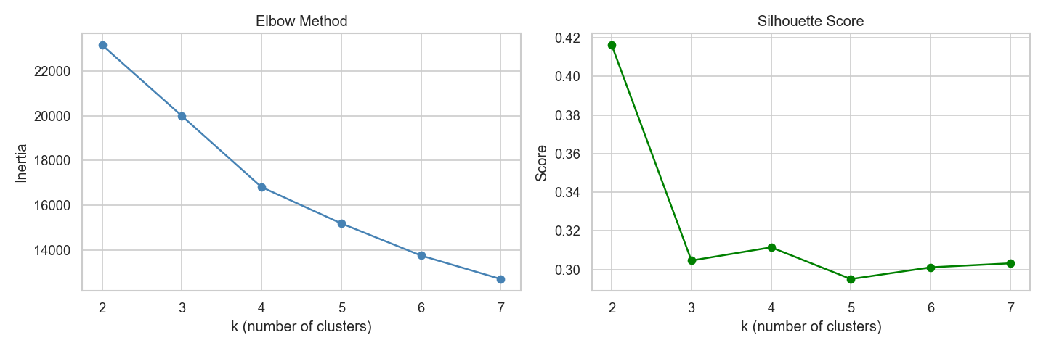
K-MEANS CLUSTERING — FINDING OPTIMAL k
15 / 19
k = 3
OPTIMAL CLUSTERS
Elbow + Silhouette agree
Figure 9: Elbow Method (left) and Silhouette Score (right) — Both confirm k=3
How the Optimal k Was Selected
Two independent methods were used to choose k, and both pointed to the same answer:
Elbow Method: The within-cluster inertia drops steeply from k=2 to k=3, then the curve flattens out. The 'elbow' — the point of diminishing returns — is clearly at k=3.
Silhouette Score: This metric measures how well each data point fits its own cluster compared to neighbouring clusters. It peaks at k=2 (0.42) and then at k=3 (0.30), with a clear drop at k=4 and beyond. k=3 is the highest meaningful structure.
When two independent methods agree on the same number of clusters, it provides strong confidence that the structure in the data is real — not an artefact of the algorithm.

Slide 17
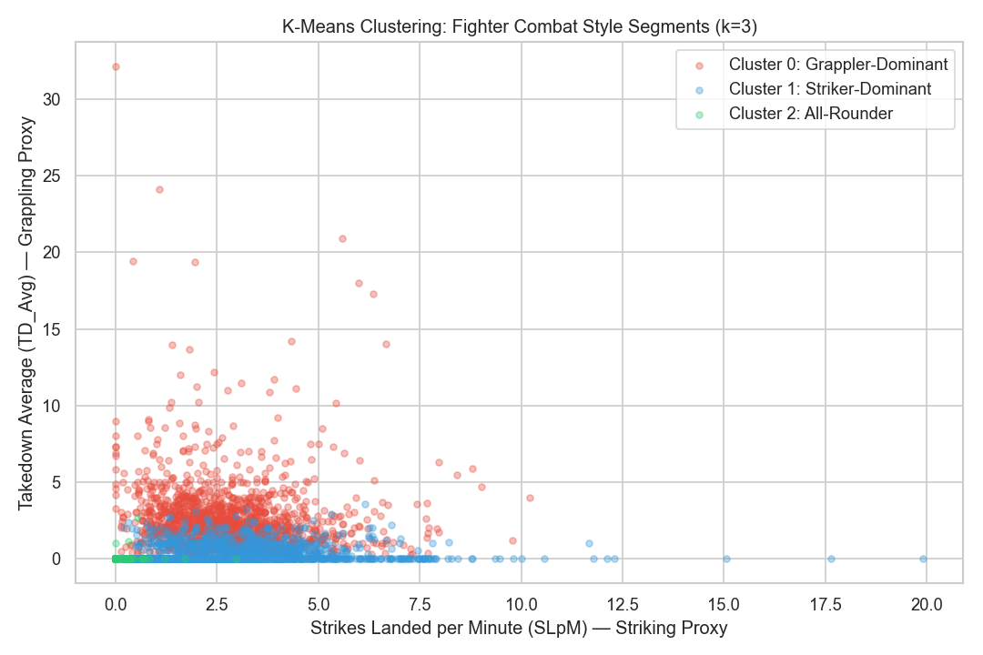
K-MEANS CLUSTERING — COMBAT STYLE SEGMENTS
16 / 19
Grappler-Dominant
22.6%
High TD_Avg, Low SLpM
Fighters who take the fight to the ground. They do not necessarily throw a lot of strikes, but they are consistently active with takedowns and submission attempts. More than 1 in 5 become Veterans.
Veteran Rate
~1,198 fighters
Striker-Dominant
8.9%
High SLpM, Low TD_Avg
Fighters who prefer to keep the fight standing. High strike output, minimal grappling activity. Less than 1 in 11 reach Veteran status — 2.5x lower than the grappler group.
Veteran Rate
~1,199 fighters
All-Rounder
0.6%
Moderate in both
Perhaps the most surprising finding: fighters who try to be balanced across both dimensions have by far the lowest Veteran rate. Specialisation — not versatility — is the key to career longevity.
Veteran Rate
~1,199 fighters
Figure 10: K-Means Clusters — Fighter Combat Style Segments (k=3)
Grapplers are 2.5× more likely to reach Veteran status than pure strikers (22.6% vs. 8.9%)

Slide 18
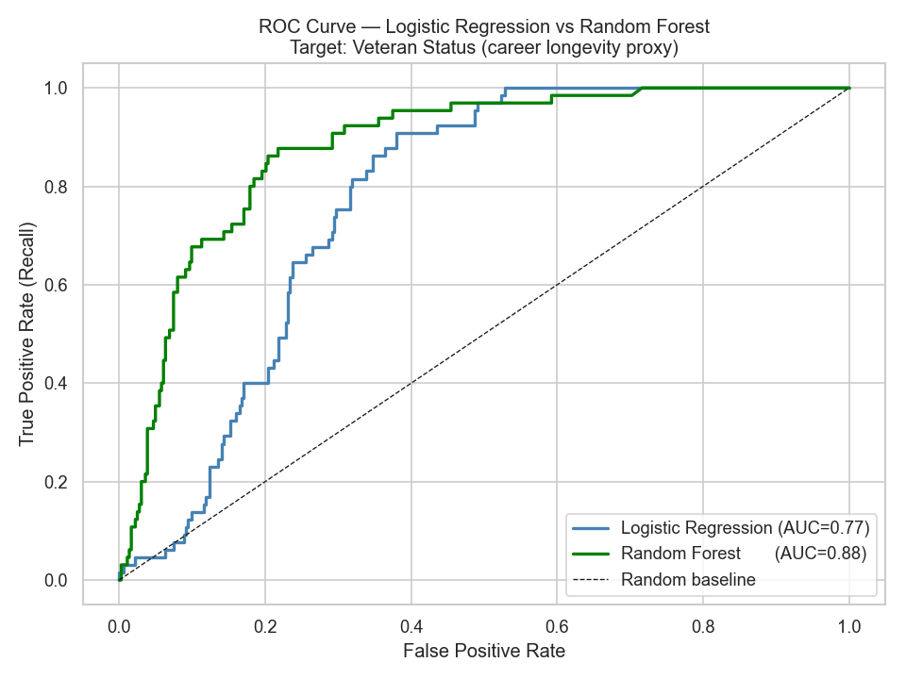
MODEL COMPARISON — ROC CURVES
17 / 19
How to Read the ROC Curve
The ROC curve plots True Positive Rate (Veterans correctly caught) vs. False Positive Rate (Prospects mislabelled as Veterans) across all classification thresholds. A perfect model hugs the top-left corner. A random guess follows the diagonal dashed line (AUC = 0.50). The further a curve sits above the diagonal, the better the model.
Random Forest's green curve sits clearly above Logistic Regression's blue curve across the entire range — confirming it as the stronger model at every threshold.
PERFORMANCE SUMMARY
METRIC
LOG. REG.
RANDOM FOREST
Test Accuracy
0.694
0.844
AUC Score
0.770
0.879
5-Fold CV AUC
0.756 ±0.029
0.872 ±0.029
Figure 11: ROC Curve — Random Forest (AUC=0.88) vs. Logistic Regression (AUC=0.77)
Veteran Recall
75%
69%
Precision
30%
49%

Slide 19
KEY FINDINGS & CONCLUSION
18 / 19
#01
Short-term: Grappling ≠ decisive
#04
Defence is the real differentiator
The t-test returned p=0.6289 — far above α=0.05. At the individual fight level, above-median takedown accuracy does NOT produce a significantly higher win rate. H₀ cannot be rejected.
TD_Def and Str_Def rank among the top predictors across all models. The ability to absorb and neutralise attacks matters more than offensive output for career sustainability.
#02
Long-term: Grappling dominates
#05
Model stability confirmed
Grappling metrics account for 56.2% of total feature importance in the Random Forest. TD_Acc alone (~14.5%) is the single most powerful predictor of career longevity.
CV standard deviations of ±0.029 for both models confirm the results are stable, generalisable, and not artefacts of any particular train/test split.
#03
Grapplers outlast strikers 2.5×
Grappler-Dominant fighters reach Veteran status at 22.6% vs. 8.9% for Striker-Dominant. Independently confirmed by K-Means clustering without any supervision.
The Nuanced Reality: Grappling may not win you every single fight — but it keeps you in the sport. Success is a marathon, not a sprint.

Slide 20

THANK YOU FOR LISTENING
LISTEN THE MAKACHEV:
(watch the video !!)
Mert Erpolat | Student ID: 32236
DSA210 Spring 2026 — Sabanci University

