Slide 1



FlatFlash: Exploiting the Byte-Accessibility of SSDs within A Unified Memory-Storage Hierarchy
Ahmed Abulila, Vikram Sharma Mailthody, Zaid Qureshi,
Jian Huang, Nam Sung Kim, Jinjun Xiong, Wen-mei Hwu
Notes:
Hello everyone, thanks for attending our talk about FlatFlash, an optimized unified memory storage hierarchy to efficiently use byte addressable ssds.
I am Ahmed Abulila, and this work has been done in collaboration with Vikram Sharma Mailthody, Zaid Qureshi, Jian Huang, Nam Sung Kim, Jinjun shiong from IBM, and Wen-mei Hwu

Slide 2



Flash is a Revolutionary Technology
Increased Performance
Increased Parallelism
Became Commodity
10x lower latency & higher throughput
Dozens of
parallel chips
Less than $0.2/GB
Significant improvements on Flash
Notes:
Flash is revolutionary technology. Compared to flash produced 10 years ago, todays flash has significantly improved. For example, latency and throughput has improved 10 times and we have dozens of parallel chips in a single SSD to provide high bandwidth to satisfy the applications requirement. Also, Flash is very cheap. It only costs $0.20/GB which is an order of magnitude cheaper than DRAM.
Because of these significant improvement, Flash is becoming popular and widely used.

Slide 3



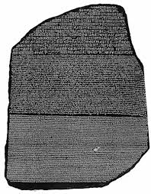

Using Flash as Non-Volatile Memory
Application
Virtual Memory
File System
SSD
mmap()
munmap()
msync()
File
More
Memory
Minimal Code Modifications
Data Durability
Notes:
A typical way to use Flash is to use it as memory. The way to use Flash as memory, is to leverage the memory map interface which is available in today's operating systems.
We can map a file into virtual memory system so the applications can directly access the data with the virtual address. If data needs to be made durable, one can flush the data using msync()
With the memory map interface, we can transparently extend the memory capacity with minimum code modification and also provide data durability.
Even though we can use flash as memory the system was designed under the assumption that the SSDs just provide block interface.

Slide 4
Limitations of Block I/O Interface
Application
OS
Stalls the process
Virtual Memory
High I/O traffic
File System
DRAM thrashing/pollution
Paging
Mechanism
Byte Accessibility
Block
Interface
Page-level persistency
SSD
Notes:
We still have to rely on the paging mechanism to access data on the SSD. The paging mechanism has lot of issues.
First, it stalls the process
Second, it increases the IO traffic because, even though we access a byte from a page, we have to move the entire page.
Also, the applications can suffer from DRAM thrashing/pollution. This is especially critical for workloads with low data locality.
Also, it can only guarantee page level persistency.
So what if the SSDs have byte accessible interface?

Slide 5
FlatFlash: Exploiting the Byte-Accessibility of SSDs
Avoid paging
Reduces I/O traffic
Reduces DRAM thrashing/pollution
Fine-grained data persistency
Notes:
With this interface,
We can avoid paging mechanism, we can reduce IO traffic and we can reduce DRAM thrashing/pollution and we can even provide fine-grain data persistency
So, how do we enable such an interface in modern SSDs.

Slide 6
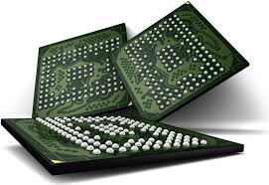


Enabling the Byte-Accessibility of SSDs
DRAM in SSD
PCIe MMIO
Cacheable Accesses
Byte addressable interface is feasible with modern SSDs
Notes:
In todays' SSDs, we already have DRAM as buffer. We can leverage the DRAM with the PCIe Memory map interface to provide byte accessibility. Because PCIe MMIO does not support cacheable access, we leverage OpenCAPI to achieve cacheable access. So, it is feasible today to provide byte accessible interface on modern SSDs.

Slide 7
Unifying the Memory and Storage
Process A
PGD
PUD
PMD
PTE
Offset
DRAM
Complex interface to manage
Unified Memory Interface*
Page Table Walk
…
Byte
page fault
update PTE
Shared Leaf-level Page Table Pages
Byte
Block
Unified
Memory
Interface
Mapped File
Flash
*FlashMap, ISCA’ 15
Notes:
In today's memory and storage hierarchy, we have byte addressable DRAM, and we also have SSD that provide both block and the byte interface.
This will increases the complexity of managing the memory and storage.
To address this problem, we leverage our previous work FlashMap, unified memory interface to simply the management.
In this case, the programmer has a unified interface and can access both DRAM and SSD with the virtual address. And the users don’t need to worry about which interface they have to use - byte or block.
For those who may not know the FlashMap, let me briefly introduce how FlashMap works.
FlashMap combines the virtual memory system, file system and FTL layers into a single address translation layer. This can reduce the translation overhead. Now, let me go through an example on how FlashMap works.
For example, a process has a virtual address and going to access the data.
We first do the page walk. If the page is in the SSD, a page fault occurs and then it is going to load the page to the DRAM and update the PTE and TLB entries.
Now, we have a unified memory interface and this can simply the management of byte addressable SSD but we still have some other issues.

Slide 8
Enabling Off Critical-Path Page Promotion
4.8 µsec
Promotion
Promote in the Background
12.1 µsec
Notes:
Even though the CPU can access the SSD in byte granularity, it is still quiet slow. It will take 5us which is much slower than accessing the DRAM.
To leverage the high performance DRAM, we propose page promotion.
But page promotion is also costly operation - about 12us.
We propose off-critical path page promotion.
But handling page promotion in the background is not easy. We have to ensure data consistency when we promote the pages.

Slide 9
Ensuring Consistency while Promoting
SSD Cache
Host DRAM
Promotion Lookaside Buffer
PLB has 64 entries &
28 bytes per entry (8 bytes per tag)
Set an entry in the PLB
Mark a page as hot
Mark CL as copied
In-flight promotion
Detect & drop stale CL
CPU cache writeback
Notes:
FlatFlash promotes in page granularity but each page is promoted in cache line granularity.
To ensure the consistency, we add to the Host bridge, a promotion look-aside buffer.
And this is how the table looks like.
Each entry has a valid bit, SSD tag to point to the SSD address and a memory tag to point to the DRAM address and we have bit map to indicate if the cacheline is in the DRAM or in the SSD.
As each entry is small and it only takes 28B per entry and we have only 64 entries, the PLB hardware overhead is small and takes 2KB for the PLB.
Let me give you an example how the page promotion works.

Slide 10
Enabling Byte-Granular Data Persistence
verify addr &
disable promotion
❷
❶
flush cache lines:
clflush/clwb
❸
write-verify read
SSD-Cache
CPU
Cache
Host Bridge
PCIe
SSD
create_pmem_region (void* vaddr, size_t size)
FlatFlash disables page promotion for persistent memory regions
Notes:
At this point, we have enables unified memory interface and off-critical path page promotion for higher performance.
Another advantage of FlatFlash is it enables byte-granular data persistency.
To ensure data persistency, we have to go through 3 steps.
First, we have to perform clflush/clwb to flush the cachelines from the volatile CPU cache.
Then we have to disable the promotion to ensure the flushed cacheline goes to the SSD.
We use a write-verify-read as a persistency fence.
With this three steps we ensure the cacheline is persistent in the SSD.
We provide a simple API, create_pmem region, to allow FlatFlash to disable promotion for the persistent memory region.

Slide 11
System Implications of FlatFlash
Rethink the Systems Software Design
Application
TX_{B}
TX_{A}
TX_{C}
TX_{A}
TX_{B}
TX_{C}
root
OS
Virtual Memory
packed in blocks
Lock
Contention
pointer block
metadata structure
Centralized Log Buffer
pointer block
File System
Log
Log
Log
inodes
SSD
SSD
Byte Accessibility
Byte Accessibility
Block
Interface
data block
(a) Logging with block I/O
(b) Logging with FlatFlash
Metadata Durability in File Systems
SSD
Scalable Logging for Database
Notes:
As we discussed the system software was designed based on the assumption that the SSD only provides a block interface. But today, the SSDs have byte interface. This is going to fundamentally change the way in which we build systems software. Let me give you two examples.
In file system ensuring metadata consistency is very critical.
When we update the file, we also need to make sure the inode is persisted in the storage.
In the traditional case , since the the SSD accessed in the block interface, multiple inodes are packed into blocks.
Even though we update only one inode , we have to persist entire block.
With byte accessibility of SSD, we can just flush the one inode.
Another example is the database.
For database, we have centralized log that group log entries to sequentially write them to the block interface of the SSD. But with the byte interface, we can decentralize this log, and enable per transaction logging. Which enhances the scalability of database

Slide 12
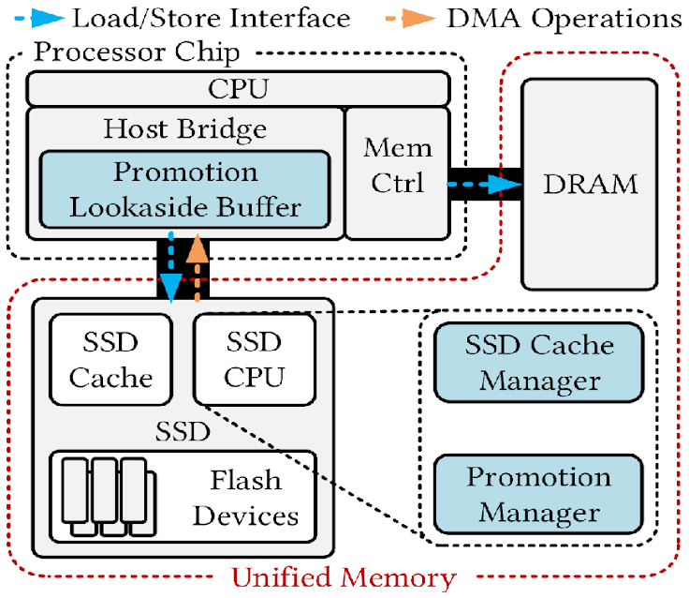
FlatFlash Implementation
Byte-accessibility with
PCIe MMIO + OpenCAPI
Unified Memory Space
Off Critical Path Page Promotion
Byte-Granular Data Persistency
Notes:
Here, we show the overview of our FlatFlash design. It has promotion look aside buffer in the host bridge, it has SSD Cache manager and also has a promotion manager to have a simple algorithm to identify the page that can be promoted. With the FlatFlash, we provide byte addressibility with PCIe interface and cacheable access using OpenCAPI. We manage the byte-accessible SSD with a unified memory interface while supporting adaptive page promotion and enable data persistence.

Slide 13
Comparison
MMap (mmap + paging mechanism)
FlashMap (mmap + unified address translation + paging mechanism)
Experimental Setup
Workloads
Memory-intensive
GraphChi + PageRank
Latency-Critical
Redis + YCSB
Data-Durability
ShoreMT + TPCC
File Systems (EXT4, XFS, BtrFS)
Notes:
We compare FlatFlash with traditional memory mapped interface. We use EXT4 filesystem with the traditional paging mechanism.
We also compare FlatFlash with the FlashMap which provides a unified address translation layer to reduce translational overhead but still relies on paging mechanism.
To evaluate FlatFlash, we run three types of workloads:
1. Memory intensive - graph computation workload - with page rank and other algos.
2. For latency critical application - we use key-value store with Yahoo Cloud Service Benchmark.
3. We also evaluate on the database and filesystems for determine persistency benefit.
////////////////////////////////////////////////////////////////////////
We compare flatflash against 2 systems:
1- Mmap that it uses the EXT4 file system and memory mapped interface to maps the application data to its VM.
2- FlashMap which unifies Mmap’s three layers of indirection (VM,FS, FTL) into a single translation layer and still uses the paging mechanism to access the SSD
We have chosen a wide range of real world workloads to highlight different benefits of FlatFlash.
First we have GraphChi, an enterprise graph analytics application to demonstrate that FlatFlash can benefit memory-intensive applications that preserve certain levels of data locality
Second we have Redis , a latency critical Key-value store application, with the YCSB workloads. that represent the typical cloud services.
To show the data durability benefits, we used two systems software (a transactional database, and filesystem)

Slide 14
Performance Benefit of FlatFlash (PageRank+Twitter)
Speedup over
MMap
FlashMap
Page Movements
MMap
FlashMap
FlatFlash
FlatFlash performs 1.6x better than FlashMap by reducing the paging overhead.
Notes:
Let's take a look at the FlatFlash's performance benefit.
Here, we run the graph computation with the pagerank algorithm on the Twitter dataset.
To show that FLatFlash can scale with the SSD size, we varied the ratio of the SSD size to the DRAM size and as you can see when the SSD size is much larger than the available host DRAM size, the benefit of FlatFlash is increased. Compared with Mmap, we improve the performance by 3.3x. And compared to FlashMap, we improved the performance by 1.6x.
WE PROFILEd THE PAGE MOVEMENT. And as you can see Flatflash has significantly reduced the page movement. The reduced io traffic is why flatflash gets its benefit
//////////////////
We first show the performance of FlatFlash when running PageRank, with the graphchi framework, on the Twitter dataset
Here we plot the effect of varying the DRAM size (with respect to the SSD size) on the performance improvement of FlatFlash in this workload.
FlatFlash outperforms MMap by up 3.3x and FlashMap by up to 1.6x.
This is because FlatFlash can directly issue memory requests to the SSD which:
1) avoids page movement between the SSD and DRAM and 2) reduces the thrashing of the limited DRAM

Slide 15
Tail Latency Benefit of FlatFlash (Redis + YCSB)
Speedup over
MMap
FlashMap
Page Movements
MMap
FlashMap
FlatFlash
FlatFlash reduces tail latency by up to 2.8x by alleviating
cache pollution.
Notes:
FlatFlash also brings the tail latency benefit for latency critical application for example key-value store. To evaluate this, we use the Redis key value store with Yahoo cloud serving benchmark. the tail latency is reduced by upto 2.8X when compared to flashMap
As you can see, this mainly due to the fact that FlatFlash significantly reduces the page movements which reduces the cache pollution, this avoids possible performance interference. This helps to reduce tail latency.

Slide 16
Persistency Benefit for Databases (ShoreMT + TPCC)
MMap
FlashMap
Mmap+Scalable Logging
FlashMap+Scalable Logging
FlatFlash
FlatFlash scales the throughput of transaction operations by up to 3x because of the per-transaction logging.
Notes:
Now, we discuss the persistent benefit of FlatFlash for databases. We evaluate the ShoreMT database with TPCC benchmark. Here, we want to see how flatflash scales the performance of database. So we increase the number of clients from 4 to 16 and as we see MMAP and FlashMap can’t scale very well.
Even though we apply the per transaction logging their performance doesn’t improve. THat is because of the limitation of the block interface. Now here is flatflash performance, as you can see as we increase the number of threads flatflash scales very well. This mainly due to applying the per transaction logging for FLatflash.

Slide 17
Persistency Benefit for File Systems
Create File
Rename File
Create Directory
VarMail
WebServer
FlatFlash reduces the metadata persistency overhead of file systems by up to 18.9x
Notes:
Lastly, we also show the benefit of FlatFlash for meta consistency in the file system. We collect the traces from different filesystems such as EXT4, XFS and BtrFS.
We use file benchmark such as createDir, CreateFile and also use real workload such as VarMail and webserver from FIlebench. As we can see, FlatFlash significantly reduces meta data persistency overhead due to byte-granular persistency.

Slide 18
FlatFlash
Summary
Unified
Memory
Interface
Notes:
To conclude, we discussed flatflash in which we enabled a unified memory interface to easily manage the byte-accessible interface with the off-critical path page promotion to enhance performance and enabled byte-granular data persistence that is expected to change the way we build systems software.

Slide 19


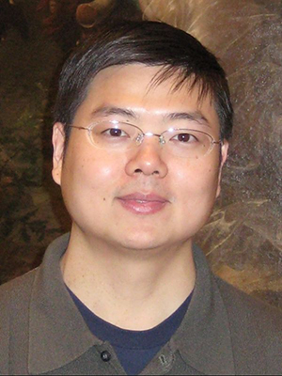




Thank you
Notes:
Thank you and I am happy to take questions

Slide 20
Backup
Notes:
Thank you and I am happy to take questions

Slide 21
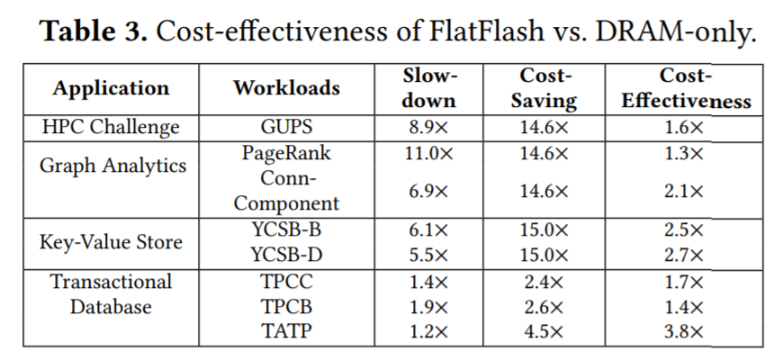

Slide 23
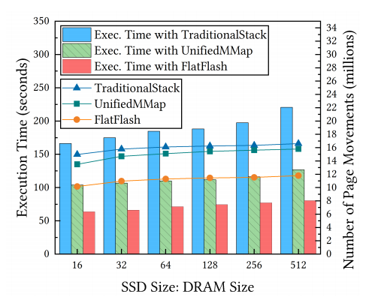
HPCC-GUPS
Notes:
Need to redraw this. No origin pro data with me.

Slide 25
Single translation layer
Modified version of mmap and munmap
Host DRAM
Memory Manager
(Kernel module)
Host DRAM
read protection bit
Real SSD using mprotect
Notes:
We implement a helper kernel module that manages all the mapped data using single translation layer similar to FlashMap, with a modified version of mmap and munmap. it fulfills the PLB functions and the page promotion algorithm.
The regular main memory is modeled using a region of the host DRAM
The SSD Cache is also modeled using the host DRAM but with enabling the read protection bit, to be able to intercept accesses to that region and introduce the PCIe MMIO latency
The Flash device is modeled using real SSD with the help of mprotect, so when accessed an exception will be raised and FlatFlash will bring the page to the SSD Cache.
/////
The SSD emulation has been implemented as part of the memory manager which keeps track of the pages cached in the SSD-Cache and the pages promoted to host DRAM, and fulfills the PLB functions and the page promotion algorithm.
Mprotect bit to raise exception when an SSD page is accessed
Read protection bit to intercept the SSD cache accesses

