Slide 1
THE EFFECT OF COVID-19 ON UNEMPLOYMENT RATES IN TURKEY

Slide 2

Unemployment figures have increased considerably with Covid-19 in our country, as in the whole world. With the measures taken by the states, unemployment was closed with short-time working allowance.

Slide 3
At the time when the case numbers were announced at the peak, unemployment rate increased. However, the sudden increase in the number of cases does not seem to be reflected in the unemployment figures at the same rate. The reason for this is the prohibition of dismissal and unpaid leave.

Slide 4
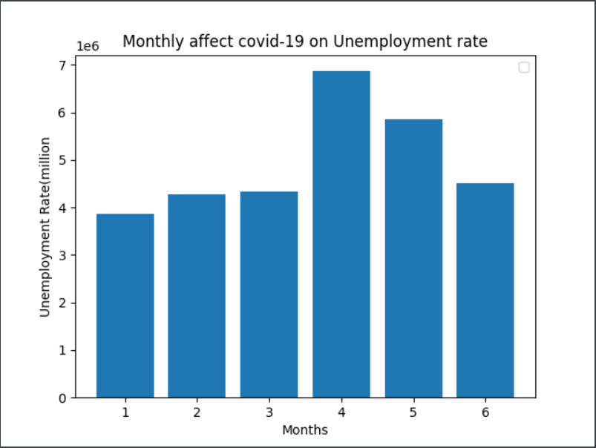

Slide 5
With the acceleration of the pandemic, it was decided to close in May. It was the holiday regions that were most affected by this closure period. The intense unemployment experienced in the holiday regions was reflected in the figures directly

Slide 6
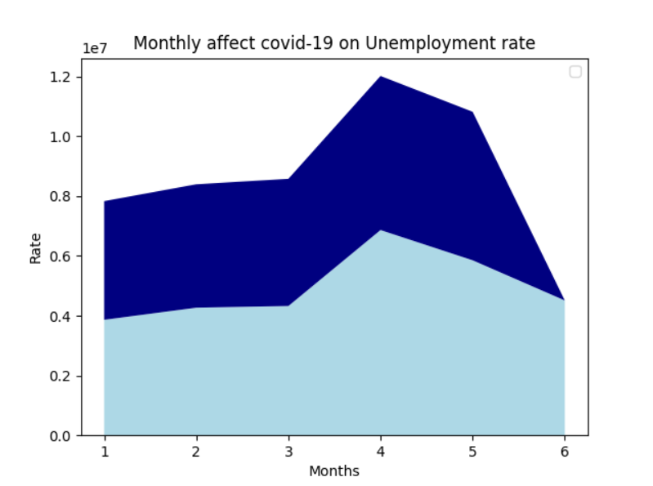

Slide 7
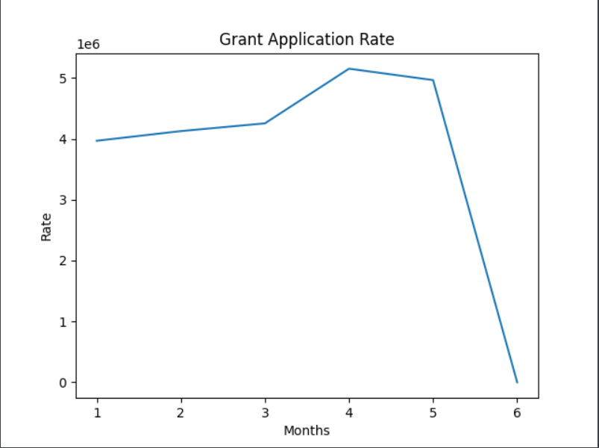

Slide 8
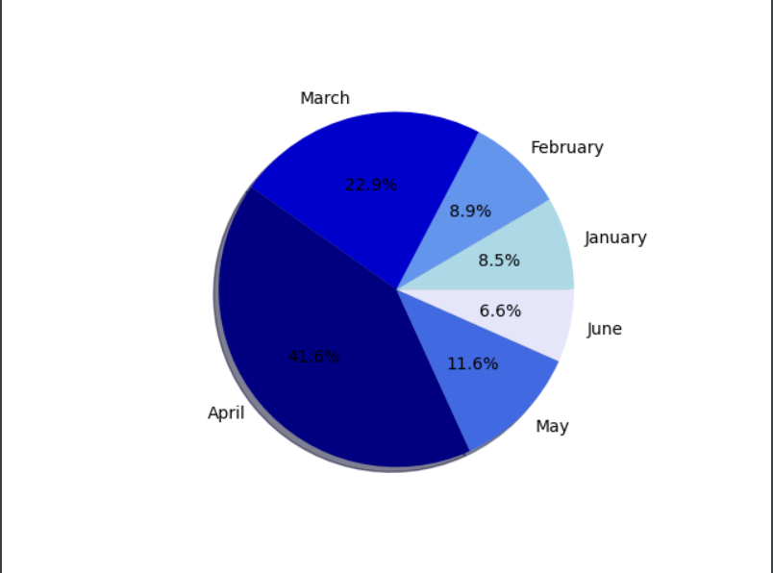

Slide 9
COVID-19 does physically affect older people at a higher rate, but younger age groups feel the financial effects. The service sector has had to lay off a lot of people due to many businesses being considered non-essential, such as salons and clothing stores. Economists say the unemployment rate could rise another 10% by the end of the year. Since we do not know when the epidemic will end, we cannot determine the estimated damage that may occur. Hoping to recover as soon as possible. Thank you for listening

