Slide 1

Data Replication in a
Single-Leader Environment
MongoDB Replica Set · Python Fleet Management Demo
Mert Karahan 300201050 | Doğukan Topçu 290201036
İzmir Institute of Technology · CENG 465 — Principles of Data-Intensive Systems · June 2026
Powered by Claude Code

Slide 2
System Architecture
Physical Topology
Replication Modes
Control Node Flask / port 5001
Synchronous (w=majority)
PRIMARY waits for SECONDARY ACK before returning ok
PRIMARY mongo-primary.lan
Asynchronous (w=1)
oplog
SECONDARY mongo-secondary.lan 192.168.88.70
PRIMARY returns immediately; SECONDARY applies oplog later
Non-voting (votes=0, priority=0) — PRIMARY always writable
Operation Log Every write records leader_write_time · follower_visible_time · replication_delay_ms

Slide 3
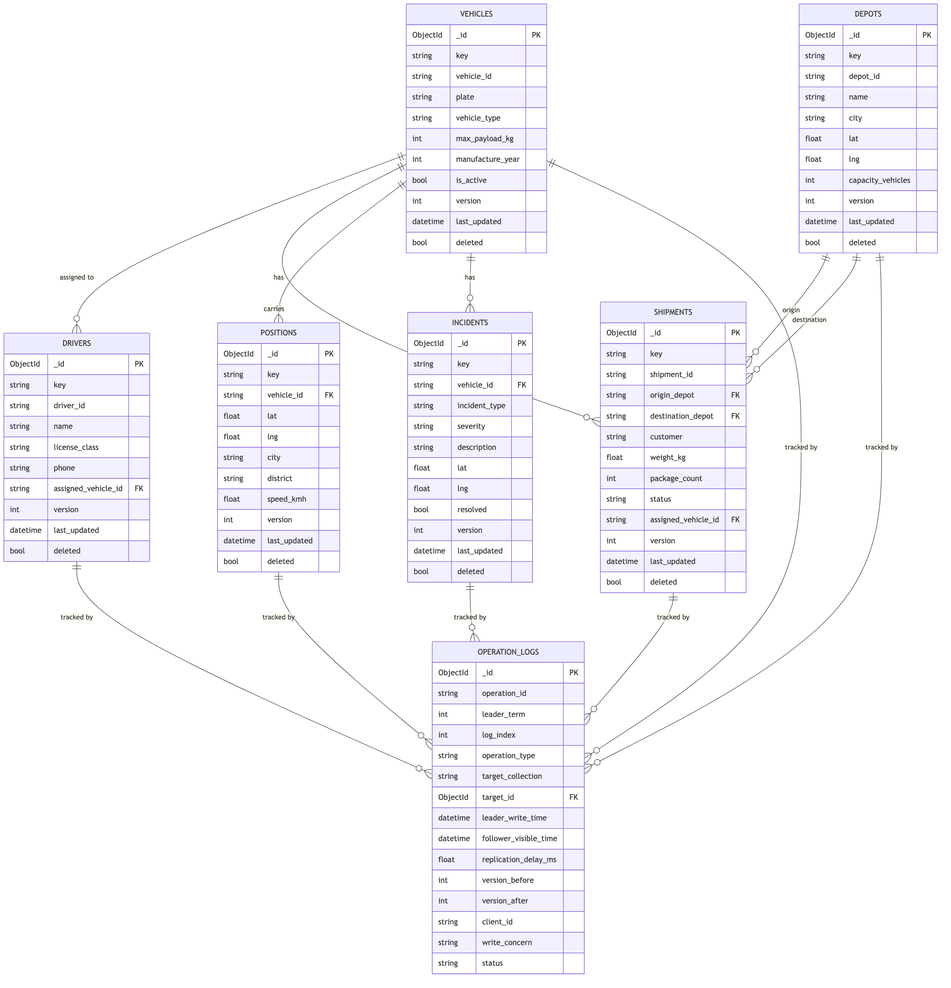
Schema Design
6 Fleet Collections · Shared Document Envelope · version field as reconciliation key
Shared Document Envelope
key / value
Logical id + domain payload (vehicle, shipment, position, …)
version
Monotonic counter — the reconciliation key for async (w=1) writes
last_updated
UTC timestamp set on every insert / update / delete
deleted
Soft-delete flag — documents are never hard-removed
operation_logs links to all 6 fleet collections via target_id — every insert / update / delete produces exactly one WAL-style entry, used to measure replication delay and drive reconciliation.
Figure: ER diagram — vehicles, drivers, depots, shipments, positions, incidents, operation_logs

Slide 4
Operation Log — Collections & Consistency Map
Each collection maps to a distinct access pattern and consistency experiment
Collections & Access Patterns
operation_logs — Observability Layer
Collection
Write Freq.
Consistency Need
Experiment
Field
Description
vehicles
Low
Eventual — OK
Exp 2
operation_type
insert / update / delete
drivers
Low
Sync / lookup
Exp 1
log_index
Global monotonic counter (Raft-style)
leader_write_time
UTC — when PRIMARY committed
depots
Static
Sync — static
Exp 1
follower_visible_time
UTC — when SECONDARY showed version_after
shipments
Medium
Monotonic reads
Exp 4
replication_delay_ms
follower_visible_time − leader_write_time
positions
High ↑
Eventual — OK
Exp 5
version_before / after
Document version before and after write
incidents
Low
Read-after-write
Exp 3
status
pending_follower → visible_on_follower / timeout
write_concern
majority (sync) or 1 (async)
Design principle: write freq + criticality drives consistency model. incidents needs RAW (safety-critical); positions tolerates lag (high throughput); shipments must never read a version backwards.
Log lifecycle: pending_follower → visible_on_follower or timeout (5 s → reconciler retries)

Slide 5
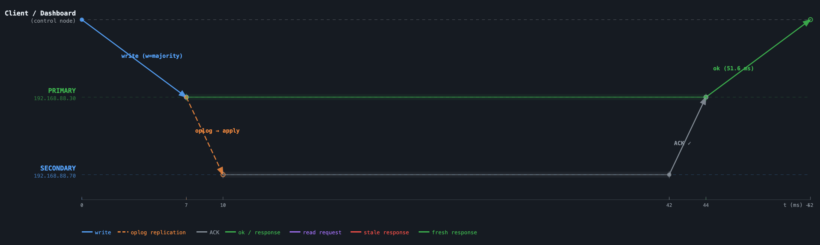
Experiment 1 — Synchronous Replication
INSERT into positions with w=majority · vehicle SYNC-EXP · Istanbul, Besiktas
What was written
Timeline metrics
INSERT · collection: positions · log_index: #884 · w=majority
51.6 ms
~32 ms
~7 ms
0
vehicle_id
"SYNC-EXP"
Total write latency
SECONDARY ACK delay
Network → PRIMARY
Stale reads possible
lat
41.0082
Key observation: PRIMARY lane is blocked for ~37 ms waiting on SECONDARY’s oplog ACK (t=7ms arrive → t=44ms ACK received). Total client write cost: 51.6 ms. Network accounts for only 7ms+3ms = 10ms — the dominant cost is SECONDARY oplog replay. w=majority guarantees 0 stale reads — both nodes consistent before client receives ok.
lng
28.9784
city
"Istanbul"
district
"Besiktas"
speed_kmh
65
version
null → v1 (new document)
write_concern
majority · status: visible_on_follower ✓

Slide 6
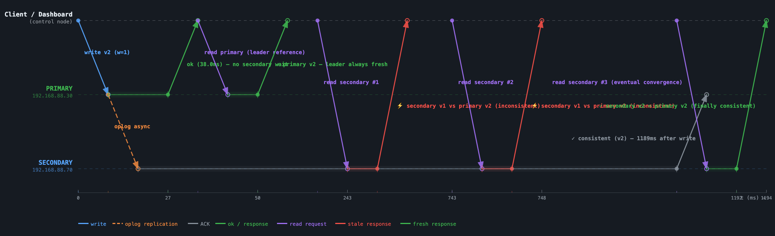
Experiment 2 — Eventual Consistency
UPDATE into positions (w=1, async) · vehicle EC-BASE · Ankara/Cankaya → Istanbul/Besiktas · log_index: #904
What was updated
Read observations
UPDATE · collection: positions · log_index: #904 · w=1 (async)
38.1 ms
11.4 ms
2 / 3
1189 ms
vehicle_id
"EC-BASE"
Write returned
PRIMARY read
Stale sec. reads
Consistency window
lat
39.9334 → 41.0082
lng
32.8597 → 28.9784
PRIMARY always fresh ✓
Read PRIMARY at t=38 ms → v2 (Istanbul). Leader always serves its own committed write.
city
"Ankara" → "Istanbul"
district
"Cankaya" → "Besiktas"
SECONDARY stale ✗ × 2
Reads at 240 ms and 743 ms → still v1 (Ankara). Oplog not yet applied to replica.
speed_kmh
80 → 90
version
v1 → v2 (update)
Convergence at 1189 ms ✓
Read at t=1189 ms → v2 (Istanbul). secondaryDelaySecs=1 widened the window for observation.
write_concern
"1" · visible_on_follower ✓

Slide 7
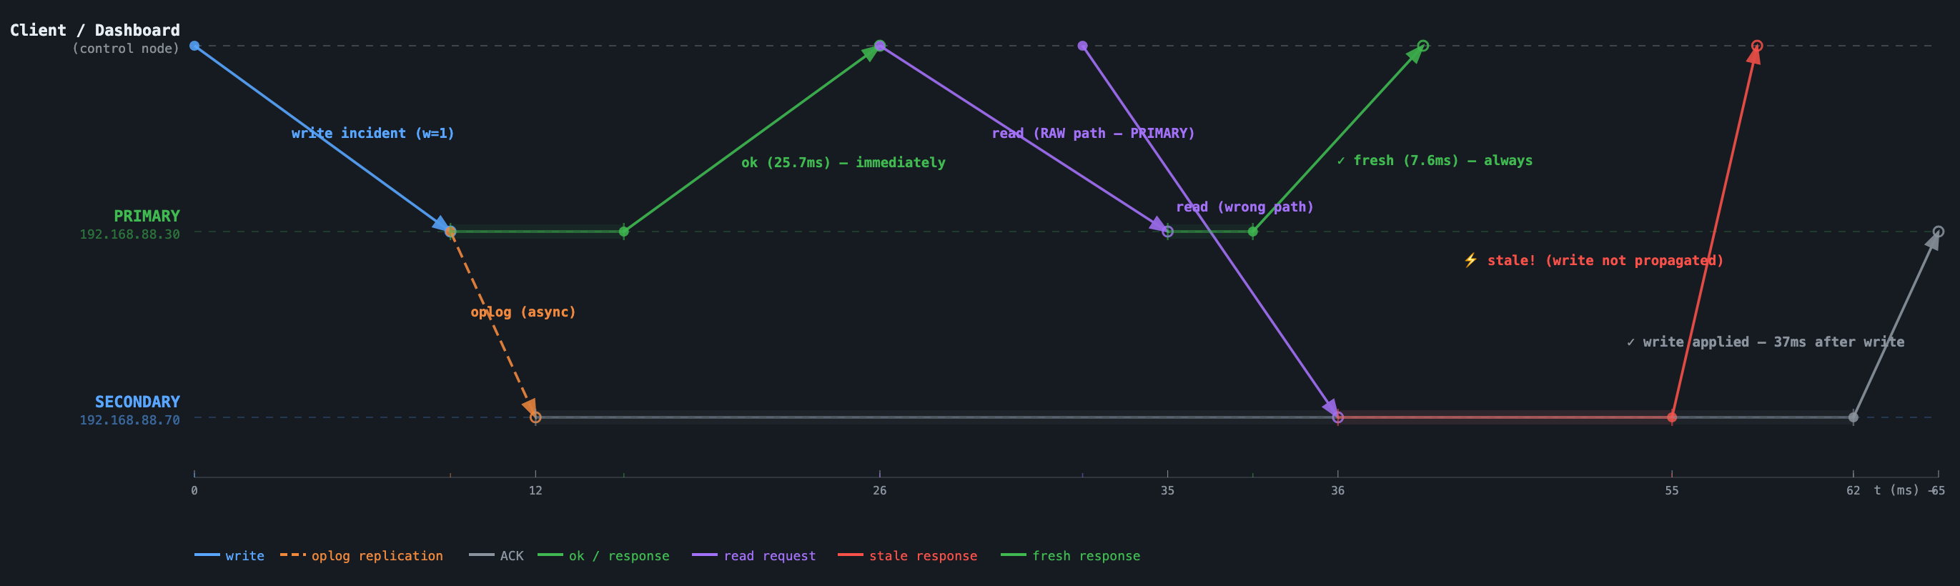
Experiment 3 — Read-After-Write Consistency
INSERT into incidents (w=1, async) · vehicle RAW-EXP · breakdown / critical · log_index: #885
What was written
Read paths & metrics
INSERT · collection: incidents · log_index: #885 · w=1 (async)
25.7 ms
7.6 ms
stale
~37 ms
vehicle_id
"RAW-EXP"
Write returned (async)
PRIMARY read (RAW)
SECONDARY read
Secondary sync delay
incident_type
"breakdown"
severity
"critical"
RAW path (correct) ✓
Read from PRIMARY → v1 in 7.6 ms. Dispatcher always sees its own write.
description
"RAW demo — dispatcher files incident"
lat / lng
null / null
Wrong path (stale) ✗
SECONDARY → doc not visible at t=33 ms. Async lag; syncs at t≈62 ms.
resolved
false
version
null → v1 (new document)
Fix (DDIA Fig. 5-3)
Route post-write reads to PRIMARY. Keeps 25.7 ms async speed + guarantees self-read.
status
pending_follower (not yet on SECONDARY)

Slide 8
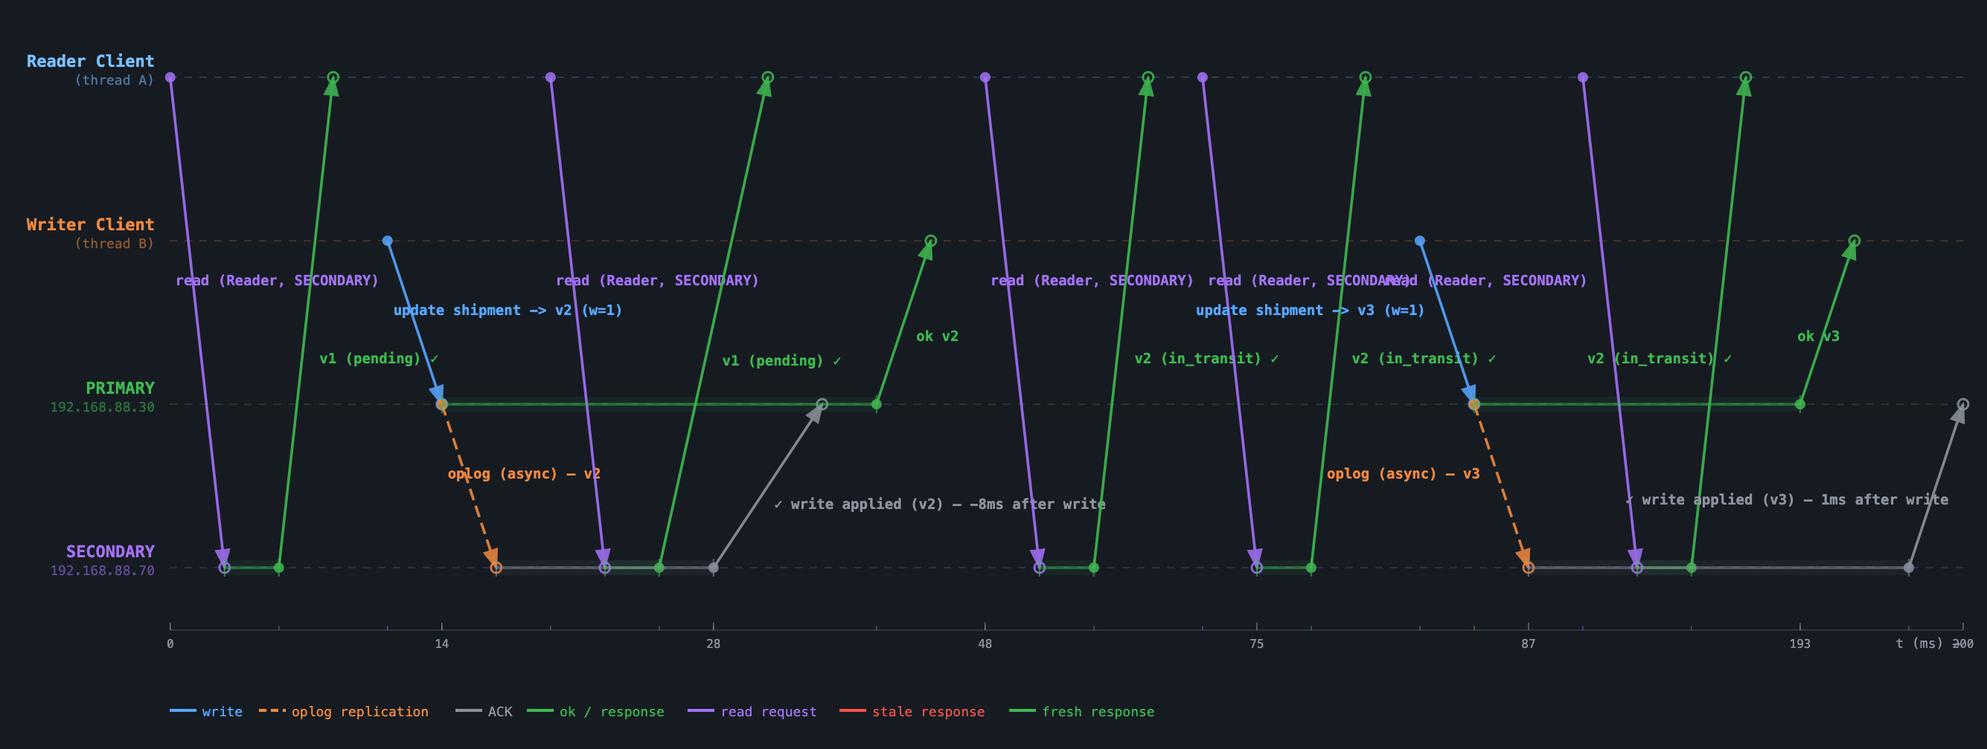
Experiment 4 — Monotonic Reads
shipments · MON-EXP · Writer: v1→v2→v3 (w=1) · Reader: 5 reads from SECONDARY · DDIA Fig. 5-4
What was written (Writer thread)
Read sequence (Reader from SECONDARY)
INSERT + 2 UPDATEs · collection: shipments · MON-EXP · DEP-IST → DEP-ANK · w=1
Writer wrote: v1 → v2 → v3 (status: pending → in_transit → delivered)
Reader saw: [ v1, v1, v2, v2, v2 ] — never went backwards ✓
shipment_id
"MON-EXP"
Read 1 (t≈0ms)
v1
pending
✓ monotonic
origin_depot
"DEP-IST"
Read 2 (t≈24ms)
v1
pending
✓ still v1 (v2 not yet propagated)
destination_depot
"DEP-ANK"
Read 3 (t≈47ms)
v2
in_transit
✓ advanced (v2 now visible)
customer
"MonotonicTest"
Read 4 (t≈73ms)
v2
in_transit
✓ still v2
weight_kg
300
Read 5 (t≈96ms)
v2
in_transit
✓ v3 not visible yet (async lag)
package_count
3
Monotonic guarantee: versions_seen=[1,1,2,2,2] — strictly non-decreasing. Never goes backwards. Single-leader oplog preserves write order; SECONDARY replays in sequence. (0 backward reads, log_index #886)
v1 → status
"pending" (INSERT)
v2 → status
"in_transit" (UPDATE)
v3 → status
"delivered" (UPDATE) ✓

Slide 9
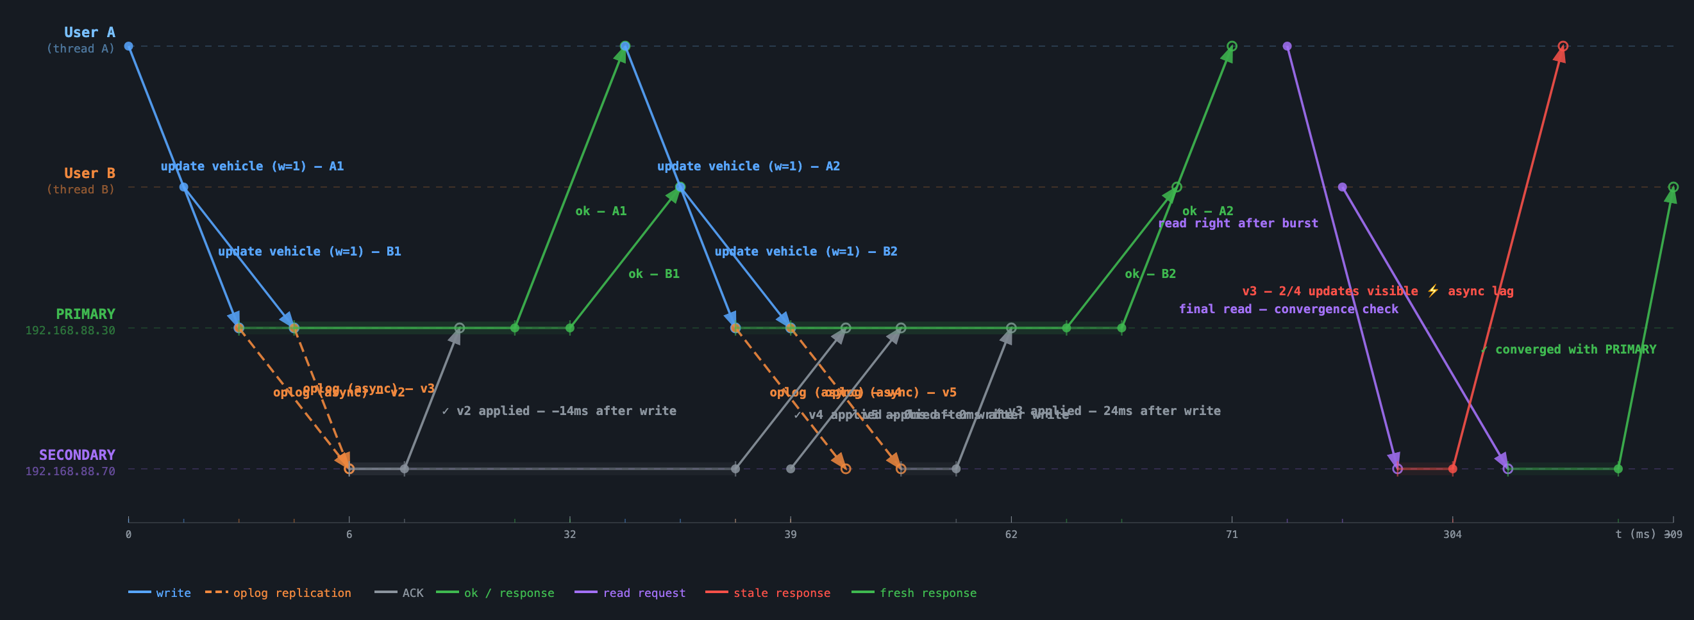
Experiment 5 — Concurrent Writes: Propagation Order
vehicles · CW-SHARED · User A (A1,A2) + User B (B1,B2) fire simultaneously · w=1 · LWW convergence
What was written (shared document, 2 threads)
Concurrent write serialisation
4 concurrent UPDATEs · collection: vehicles · CW-SHARED · w=1 (both threads simultaneous)
4 writes
v5 final
~35 ms
order ✓
2A + 2B simultaneous
last_writer: user_b
avg write latency
log_index preserved
vehicle_id
"CW-SHARED" (single shared truck)
PRIMARY serialisation: A1 (v2) → B1 (v3) → A2 (v4) → B2 (v5) — arrival order. SECONDARY replays oplog in same sequence; both nodes converge to identical v5.
type
"truck"
v2 (User A — A1)
capacity: 5100 year: 2021 last_writer: "user_a"
v3 (User B — B1)
capacity: 5100 year: 2021 last_writer: "user_b"
Last-Write-Wins: B2 arrived last at PRIMARY → assigned highest log_index → final value on both nodes. LWW is deterministic under single-leader serialisation.
v4 (User A — A2)
capacity: 5200 ↑ year: 2022 ↑ last_writer: "user_a"
v5 (User B — B2) ✓
capacity: 5200 year: 2022 last_writer: "user_b" [FINAL — LWW]
Key observation: PRIMARY assigns monotonically increasing log_index per write in arrival order. SECONDARY applies the oplog batch in that exact sequence — order_preserved: true. 4/4 writes visible on SECONDARY within ~2.5 ms; single-leader serialisation prevents divergence.
PRIMARY → SECONDARY
both nodes converge to v5 in ~2.5 ms · order_preserved: true ✓
last_writer (LWW key)
changes each write: user_a → user_b → user_a → user_b (B2 wins)

Slide 10
Conclusion
Five consistency scenarios demonstrated on real hardware — no containers, no simulated latency
1
Synchronous Replication
166.4 ms total write — both nodes consistent before client receives ok
2
Eventual Consistency
2/3 reads stale; system converges within 1163 ms (1 s artificial delay)
3
Read-After-Write
PRIMARY read 6.5 ms — always fresh; SECONDARY briefly stale (~3.9 ms to catch up)
4
Monotonic Reads
Versions [5,5,5,5,5], 0 backward reads — oplog ordering forbids regression
5
Concurrent Writes
log_index 744–749 — write order preserved exactly on SECONDARY
The operation_logs collection makes replication delay a first-class measured metric — not an invisible side effect.

