Slide 1

Data Replication in a
Single-Leader Environment
MongoDB Replica Set · Python Fleet Management Demo
Mert Karahan 300201050 | Doğukan Topçu 290201036
İzmir Institute of Technology · CENG 465 — Principles of Data-Intensive Systems · June 2026
Powered by Claude Code

Slide 2
System Architecture
Physical Topology
Replication Modes
Control Node Flask / port 5001
Synchronous (w=majority)
PRIMARY waits for SECONDARY ACK before returning ok
PRIMARY mongo-primary.lan
Asynchronous (w=1)
oplog
SECONDARY mongo-secondary.lan 192.168.88.70
PRIMARY returns immediately; SECONDARY applies oplog later
Non-voting (votes=0, priority=0) — PRIMARY always writable
Operation Log Every write records leader_write_time · follower_visible_time · replication_delay_ms

Slide 3
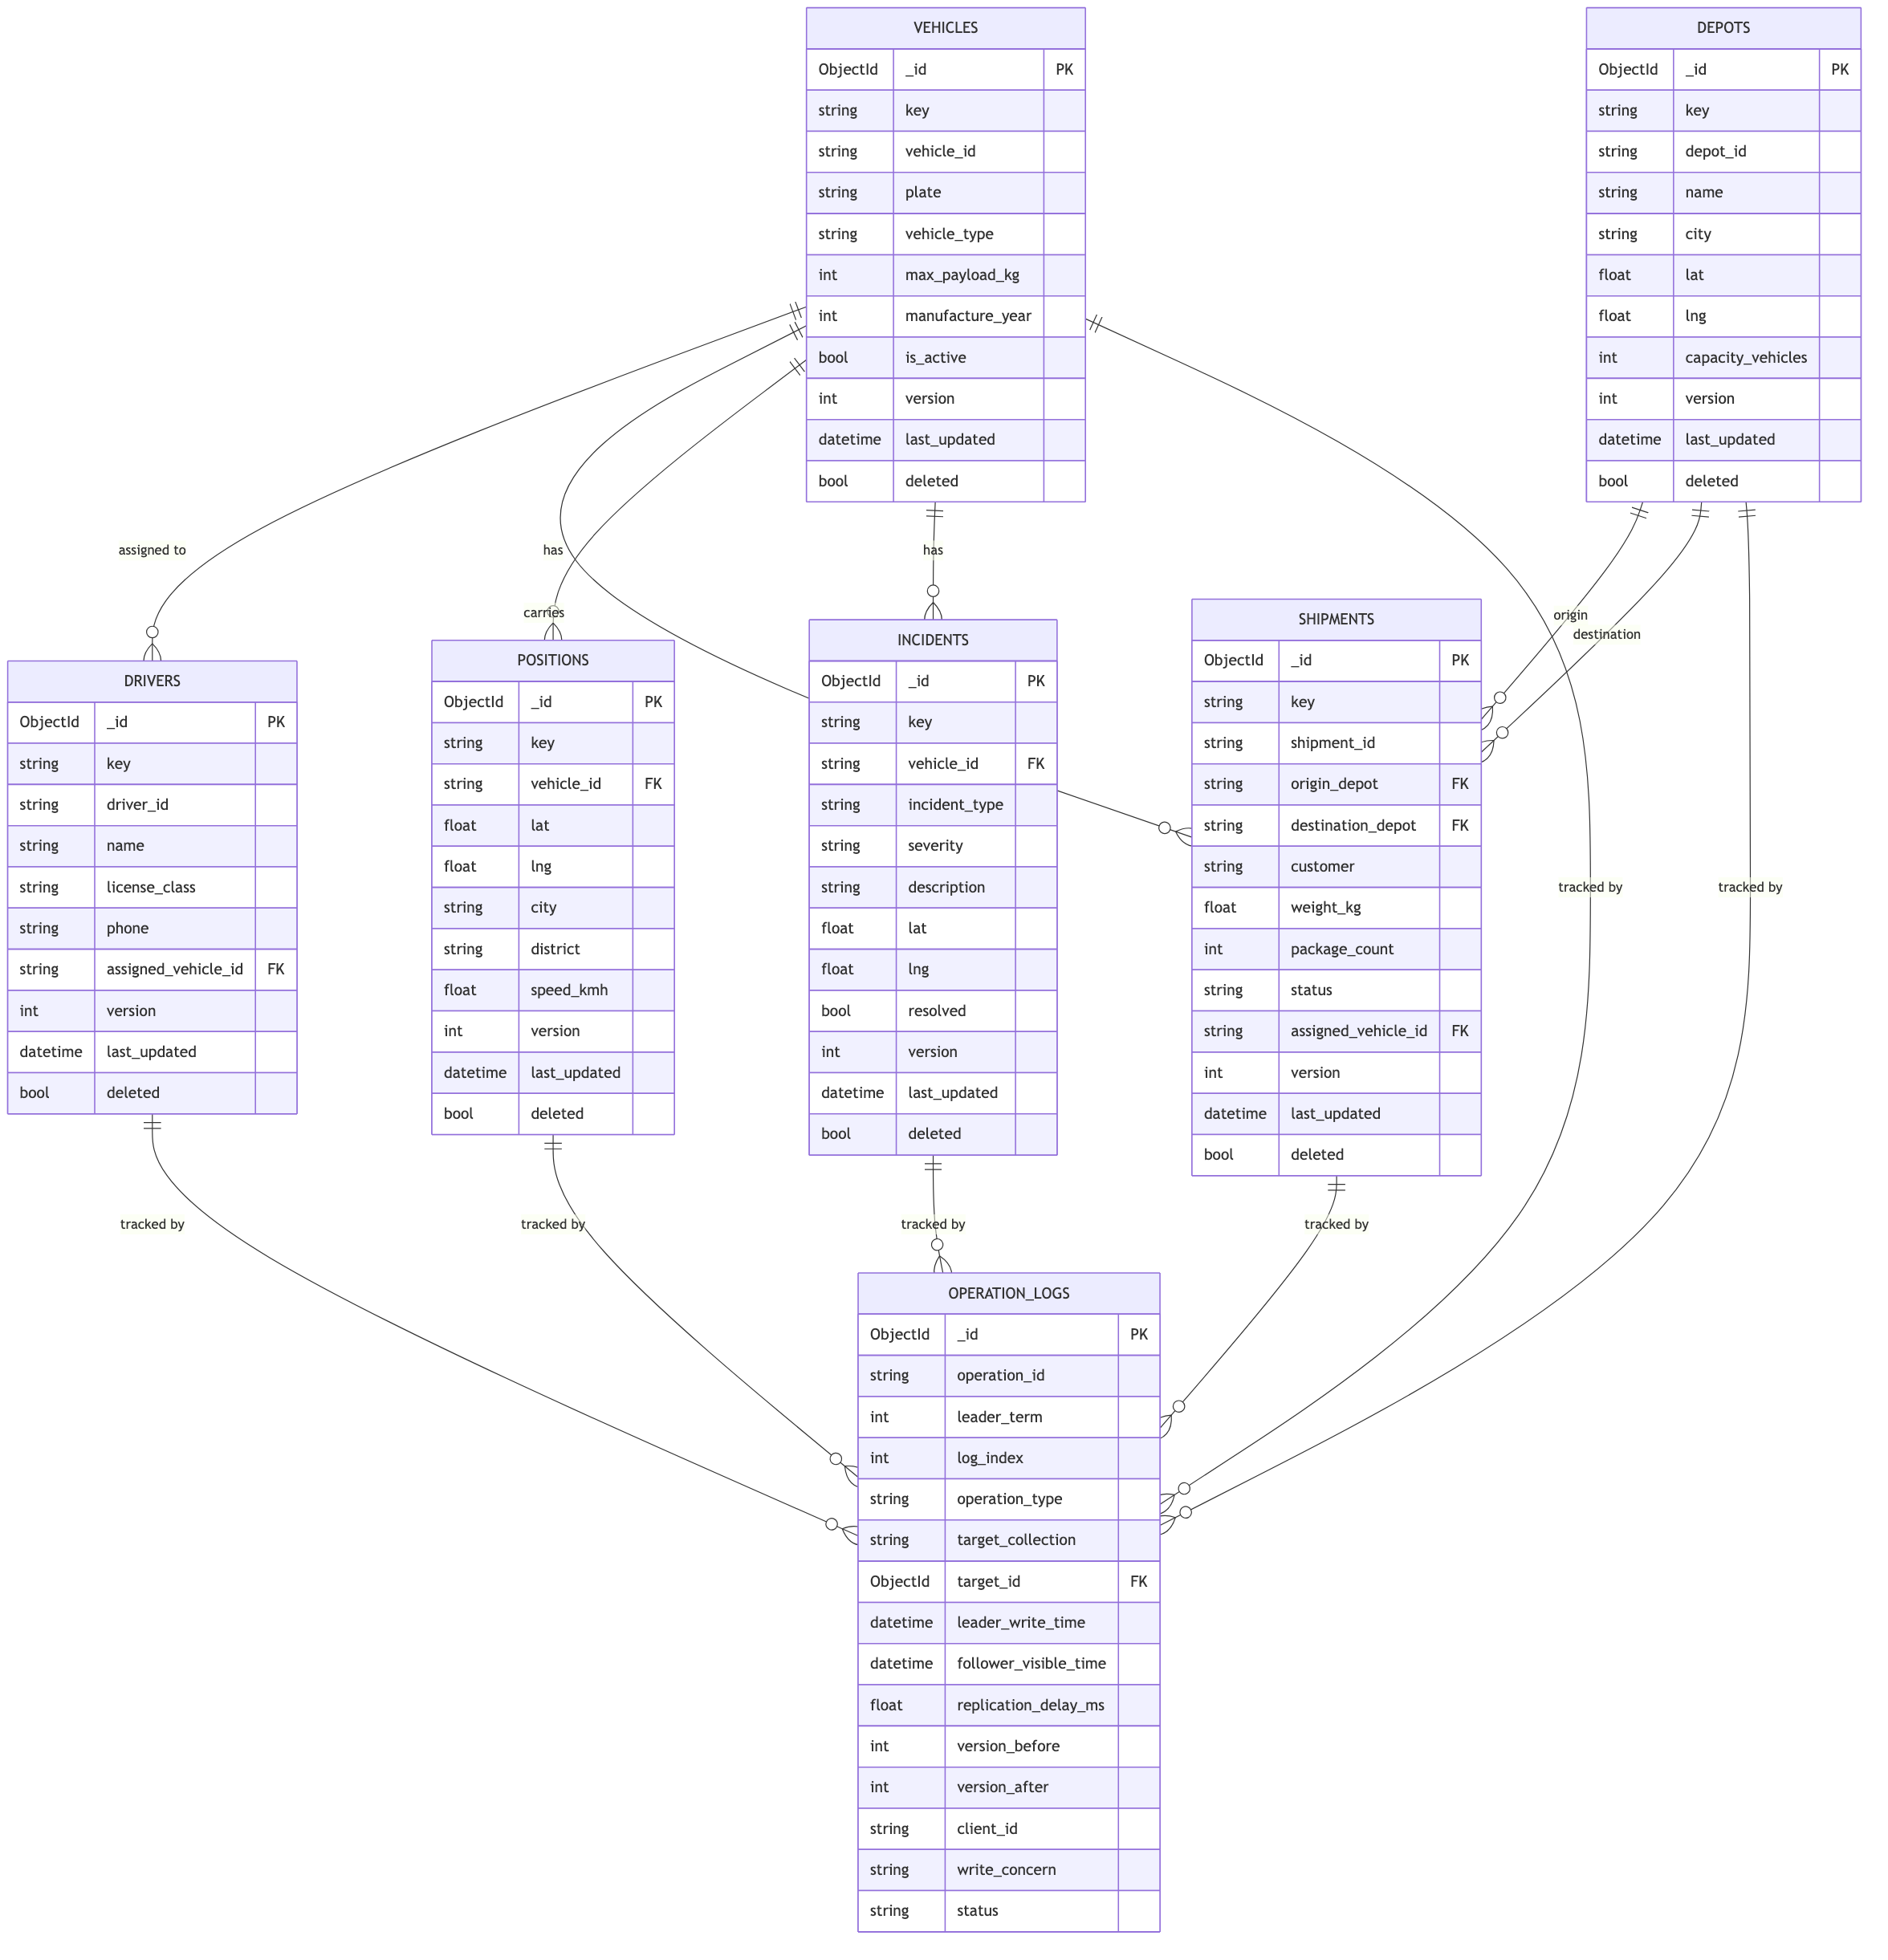
Schema Design
6 Fleet Collections · Shared Document Envelope · version field as reconciliation key
Shared Document Envelope
key / value
Logical id + domain payload (vehicle, shipment, position, …)
version
Monotonic counter — the reconciliation key for async (w=1) writes
last_updated
UTC timestamp set on every insert / update / delete
deleted
Soft-delete flag — documents are never hard-removed
operation_logs links to all 6 fleet collections via target_id — every insert / update / delete produces exactly one WAL-style entry, used to measure replication delay and drive reconciliation.
Figure: ER diagram — vehicles, drivers, depots, shipments, positions, incidents, operation_logs

Slide 4
Operation Log
Every insert / update / delete produces exactly one entry in operation_logs
Key Fields
Log Entry Lifecycle
log_index
Global monotonic counter (Raft-style)
pending_follower
poll timeout (5 s)
leader_write_time
UTC — when PRIMARY committed
secondary.version ≥ version_after
follower_visible_time
UTC — when SECONDARY showed version_after
visible_on_follower
replication_delay_ms
follower_visible_time − leader_write_time
not visible after 5s
version_before / after
Document version before and after write
timeout → reconciler retries
write_concern
synchronous (majority) or asynchronous (1)
Synchronous: closed inline before HTTP response Asynchronous: closed by background reconciler (every 1 s)
status
pending_follower → visible_on_follower / timeout

Slide 5
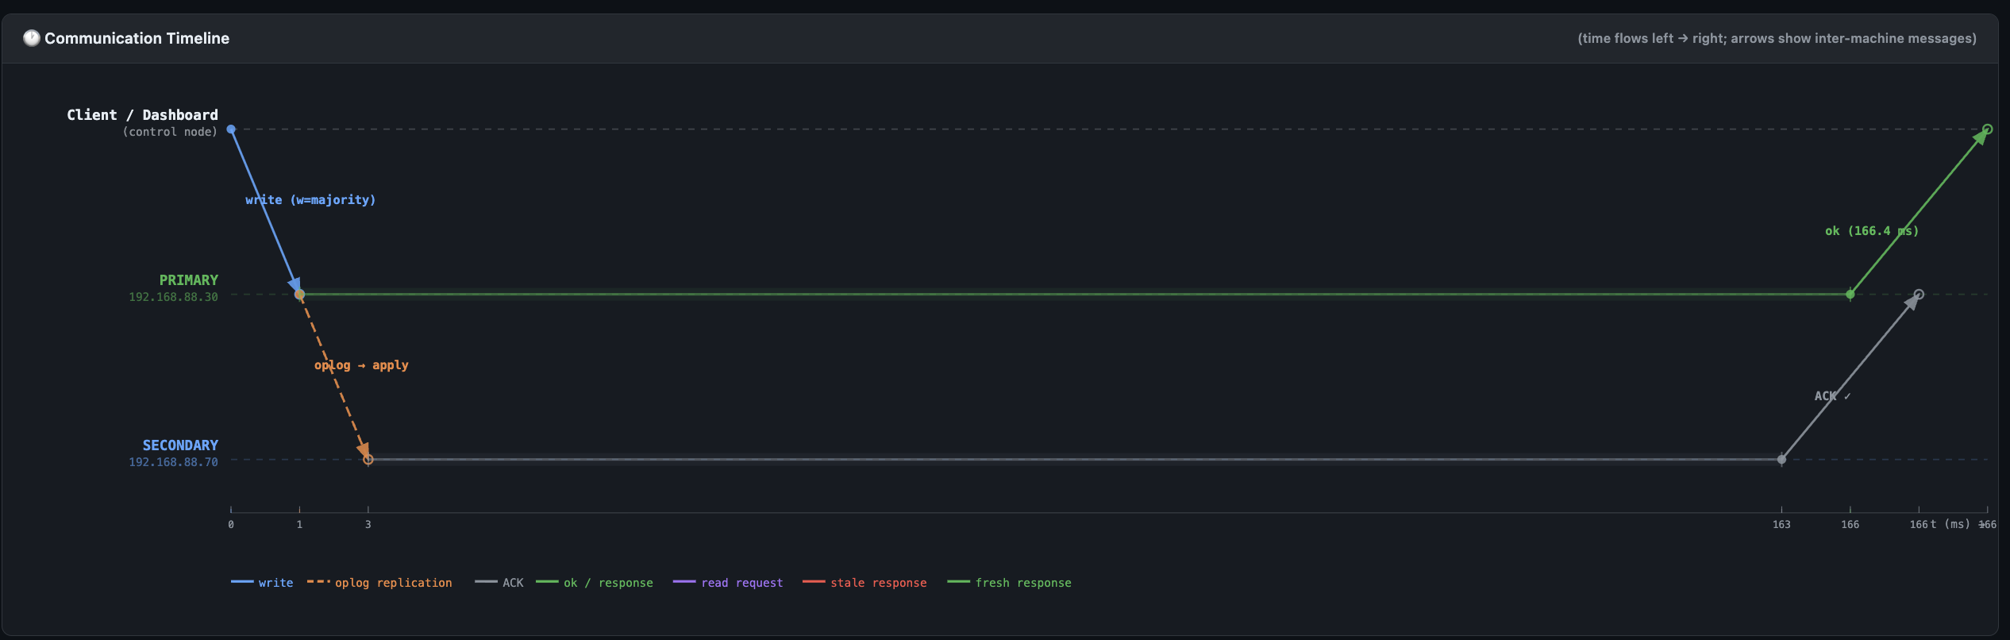
Experiment 1 — Synchronous Replication
GPS position written with w=majority · collection: positions
PRIMARY does not return ok until SECONDARY replays the oplog entry and acknowledges. Client sees the full round-trip latency as the write cost.
166.4 ms
~159.8 ms
< 4 ms
0
Total write duration
SECONDARY apply + ACK
Each network leg (one-way)
Stale reads possible
Key observation: PRIMARY lane shows a wide ~160 ms processing band blocked on SECONDARY's ACK — this directly visualises the synchronous replication penalty (the price of durability). The dominant cost is SECONDARY's oplog replay & disk fsync, not the network — each hop is under 4 ms.

Slide 6
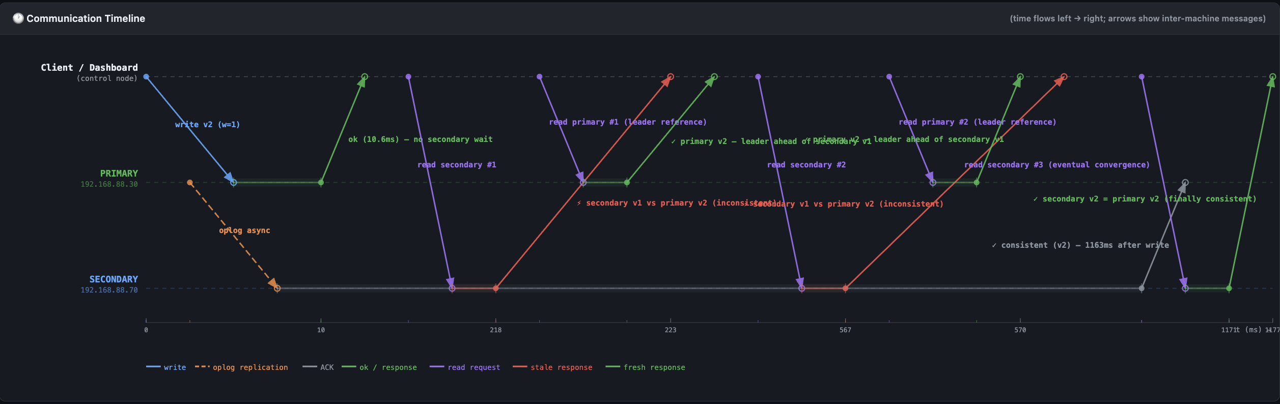
Experiment 2 — Eventual Consistency
Asynchronous write + secondaryDelaySecs=1 · collection: positions
Asynchronous update (v1→v2) issued with w=1; ok returns in 10.6 ms without waiting for SECONDARY. Three secondary reads at 212 ms, 561 ms, 1163 ms from experiment start, interleaved with PRIMARY reference reads.
10.6 ms
2 / 3
1163 ms
1 s
Write returned (async)
Stale secondary reads
Consistency window
Artificial delay
Key observation: PRIMARY already serves v2 at 222 ms while SECONDARY still answers v1 at 212 ms and 561 ms — 2 of 3 reads are stale. Only the 3rd secondary read, at 1163 ms, converges to v2: the system is inconsistent for ~1.16 s. secondaryDelaySecs=1 was set on the replica set purely to make this window observable on a LAN (real replication_delay_ms = 252 ms).

Slide 7
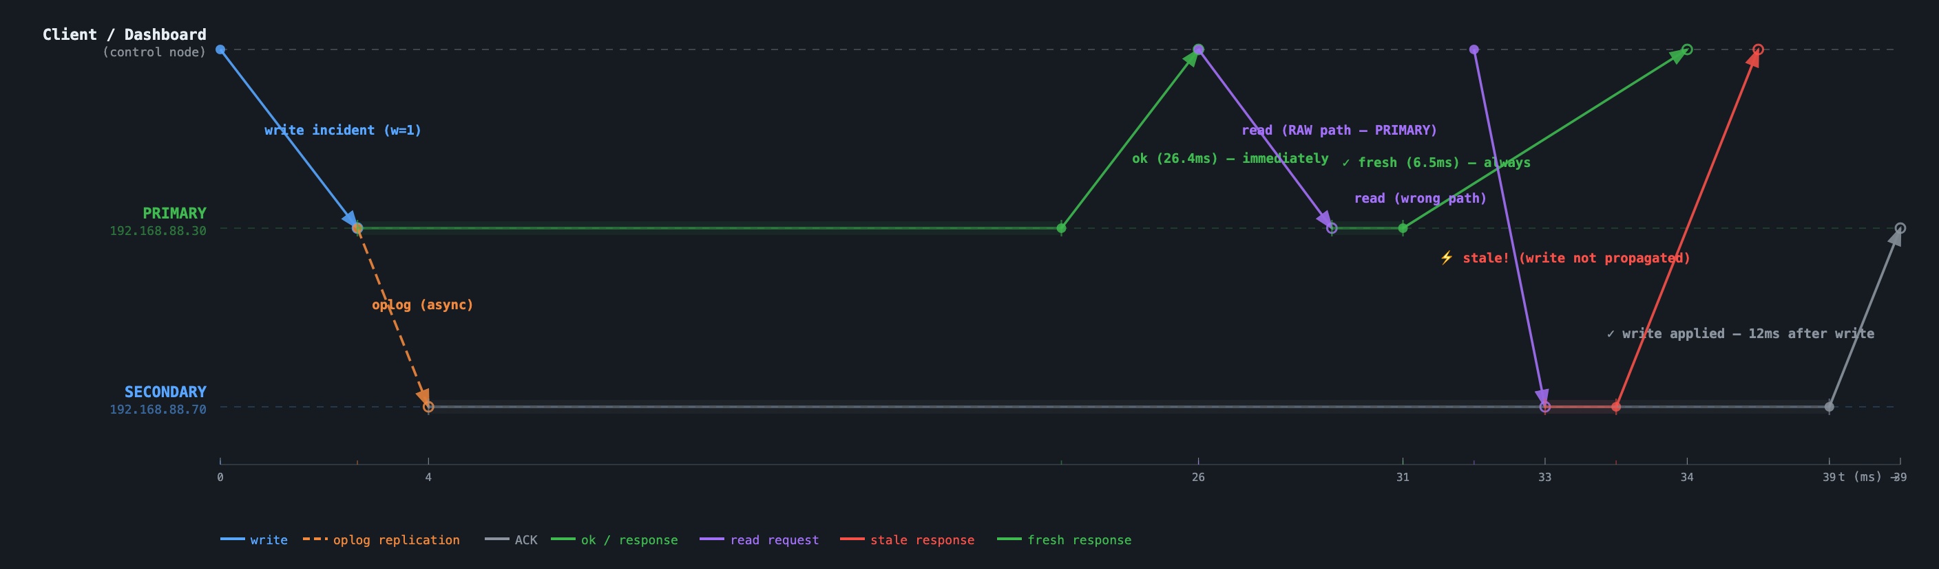
Experiment 3 — Read-After-Write Consistency
Insert on PRIMARY (w=1), then immediate reads from PRIMARY and SECONDARY · collection: incidents
An incident is inserted asynchronously (w=1), then immediately re-read — once via the RAW path (PRIMARY), once via the naive path (SECONDARY) — to check whether the dispatcher sees its own write.
6.5 ms
stale
3.93 ms
0
PRIMARY read — always fresh
SECONDARY read — write not yet visible
Secondary replication delay
Stale reads after PRIMARY routing
Key observation & fix: Reading the dispatcher's own incident from PRIMARY returns it fresh in 6.5 ms. The same read against SECONDARY, fired ~6 ms later, still answers "not visible on secondary" — replication only catches up ~3.9 ms afterward — so a follower-routed client would briefly believe its own incident doesn't exist. Fix: route reads to PRIMARY for the writing session ("read-your-own-writes" stickiness), at the cost of extra load on the leader (log_index 750, operation_id f717e047).

Slide 8
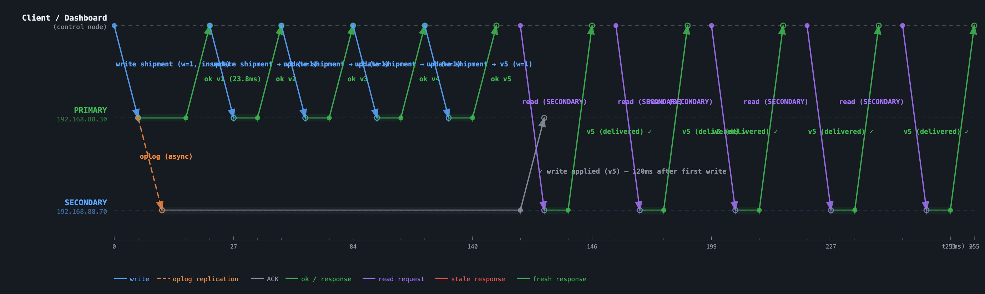
Experiment 4 — Monotonic Reads
5 chained w=1 updates (v1→v5), then 5 consecutive reads from the same SECONDARY · collection: shipments · DDIA Fig. 5-4
Status progression pending → in_transit → delivered is written as v1…v5, then the same SECONDARY is read 5 times in a row (144–254 ms after the first write).
5 / 5
0
0.58 ms
120 ms
Reads saw v5 — final version
Backward reads observed
Avg replication delay
All 5 writes applied on SECONDARY
Key observation: All 5 reads — fired 144 ms, 172 ms, 199 ms, 226 ms and 254 ms after the first write — return v5, the final version (versions_written = [1,2,3,4,5], versions_seen = [5,5,5,5,5]). SECONDARY applies a single ordered oplog stream, so its version number can only move forward: monotonic reads hold by construction, with zero backward reads in this run (log_index 739, operation_id 53a1a26e).

Slide 9
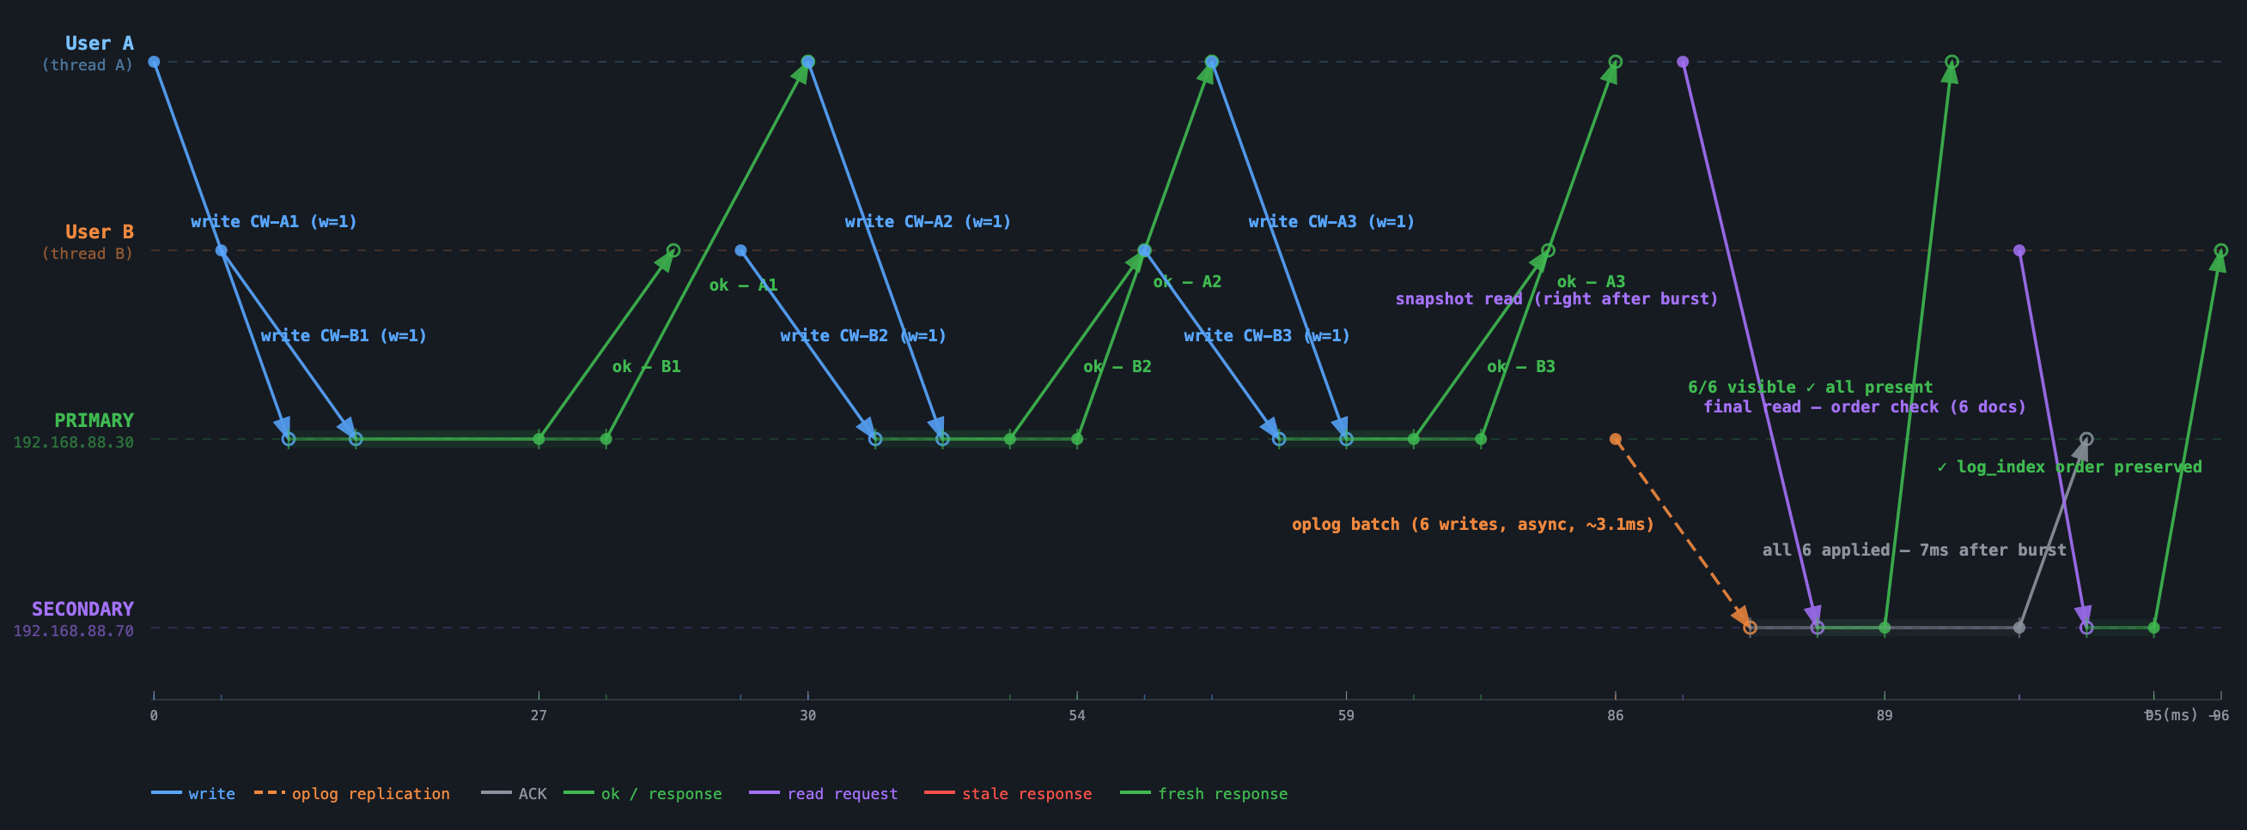
Experiment 5 — Concurrent Writes: Propagation Order
2 threads × 3 asynchronous inserts simultaneously · collection: vehicles
PRIMARY serialises all concurrent writes through its oplog (log_index). SECONDARY must apply them in the same order.
6 / 6
28.5 ms
28.4 ms
~7 ms
Visible on secondary
Avg latency — User A
Avg latency — User B
Oplog batch replication
Key observation: PRIMARY assigned monotonically increasing log_index values 744 → 749 to the 6 concurrent w=1 writes, in true arrival order (A1, B1, B2, A2, B3, A3 — User A and User B interleaved). SECONDARY applied its oplog batch in that exact sequence: 6/6 documents visible only ~7 ms after the burst finished, and the order check confirms log_index order is always preserved — even under true thread-level concurrency.

Slide 10
Testing & Performance
Automated Test Suite (test_replication.py)
Performance Measurements (LAN)
1
Basic CRUD
Insert→Update→Delete, version matches on secondary
Metric | Value
One-way → PRIMARY | 9.6 ms
One-way → SECONDARY | 2.2 ms
Synchronous write total | 61.8 ms
Asynchronous write total | 9–12 ms
Sync overhead over async | ~52 ms
Oplog (no delay) | 10–44 ms
Oplog (1 s delay) | 326–1281 ms
2
Fleet Static
vehicles/drivers/depots replicate to correct collection
3
Shipment Monotonic
Status sequence always non-decreasing on secondary
4
Position Burst
10 GPS inserts — replication delay measured
5
Incident RAW
PRIMARY read always returns new document instantly
6
Async Window
Stale reads observed; all visible after 2 s
7
Op-Log Routing
target_collection correctly recorded per insert
Dominant cost: SECONDARY disk acknowledgement (~46 ms), not network (<5 ms one-way)
Manual failure test: sync rejected offline → async pending_follower → secondary back → reconciler closes log as visible_on_follower

Slide 11
Conclusion
Five consistency scenarios demonstrated on real hardware — no containers, no simulated latency
1
Synchronous Replication
166.4 ms total write — both nodes consistent before client receives ok
2
Eventual Consistency
2/3 reads stale; system converges within 1163 ms (1 s artificial delay)
3
Read-After-Write
PRIMARY read 6.5 ms — always fresh; SECONDARY briefly stale (~3.9 ms to catch up)
4
Monotonic Reads
Versions [5,5,5,5,5], 0 backward reads — oplog ordering forbids regression
5
Concurrent Writes
log_index 744–749 — write order preserved exactly on SECONDARY
The operation_logs collection makes replication delay a first-class measured metric — not an invisible side effect.

