Slide 1

ARTIFICIAL INTELLIGENCE PROJECT
Brain Tumor Classificaiton
Mert Metin ERDEMLİ - Musa ALAGÖZ

Slide 2
CONTENTS
Introduction
Objective of the Project
Problem Definition
Motivation and Significance
Dataset Information
Dataset Arrangement & Optimization
Training Model
Model Features & Advantages
Network Architecture
Performance Metrics
Evaluation Methods
Feature Importance
True vs Predicted
Experiments and Analysis
Model Performance Evaluation
Model Weight Distribution
Results
Training & Validation Results
Model Performance Evaluation
Discussion and Future Work
Limitations
Suggestions for Future Improvements
Conclusion

Slide 3
1. Introduction
1. Introduction
1.1 Objective of the Project
The primary goal of this project was to develop a deep learning-based model using Convolutional Neural Networks (CNN) to classify brain tumors from MRI images. The model classifies tumors into four categories: glioma, meningioma, pituitary tumor, and no tumor. This classification system can assist healthcare professionals by providing quick and reliable tumor diagnosis.
1.2 Problem Definition
Brain tumor classification using MRI images aims to automate the detection process to reduce human error and speed up diagnosis. By leveraging CNN, this project focuses on building a model that can accurately identify various brain tumor types.
1.3 Motivation and Significance
Accurate brain tumor detection significantly impacts the early treatment of patients. This project helps enhance diagnostic accuracy and assists medical professionals in making more informed decisions.

Slide 4
2. Dataset Information
Dataset Overview:
The dataset used in this project was sourced from Kaggle's MRI Brain Tumor dataset, which includes 3000+ images divided into four categories. The dataset was preprocessed for optimal use in CNN models, ensuring effective feature extraction and accurate predictions.
Key Features:
Grayscale MRI images
Class labels: Glioma, Meningioma, Pituitary, No Tumor
Dataset Arrangement & Optimization:
Data cleaning, resizing, and normalization
Data augmentation to prevent overfitting (e.g., rotations, zoom, and shifts)
Data split into training, validation, and test sets.

Slide 5
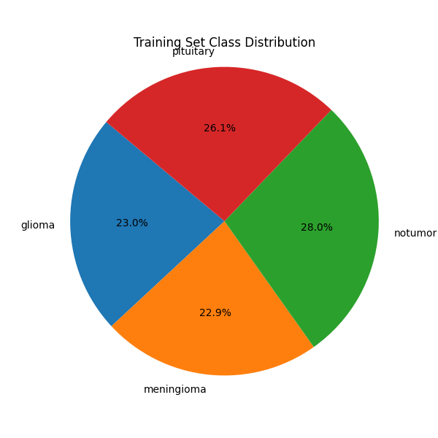
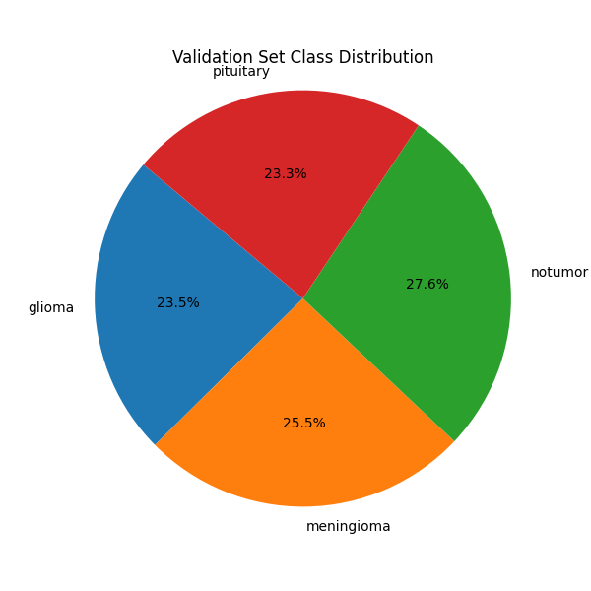

Slide 6
3. Training Model
Training Model Overview:
Convolutional Layers: Detect various features like edges and textures.
Pooling Layers: Reduce dimensionality and computational cost.
Fully Connected Layers: Make final predictions based on the features learned.
Key Model Features:
Optimizer: Adam (for faster convergence)
Loss Function: Categorical Cross-Entropy
Activation Functions: ReLU for hidden layers, Softmax for output

Slide 7
4. Performance Metrics
4.1 Model Performance Evaluation
The model's performance was evaluated using the following metrics:
Accuracy
Precision
Recall
F1 Score
Visualizations:
Confusion Matrix
Normalized Confusion Matrix
Per-Class Accuracy
Precision and Recall per Class
ROC Curve

Slide 8
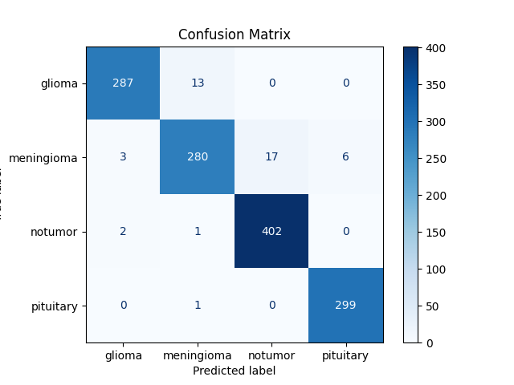
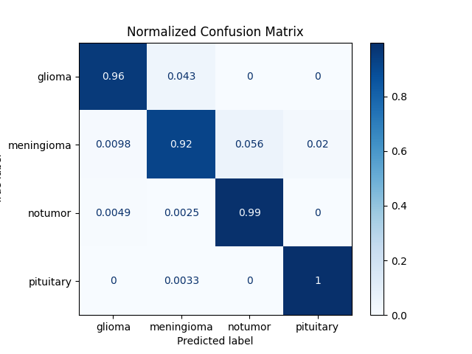
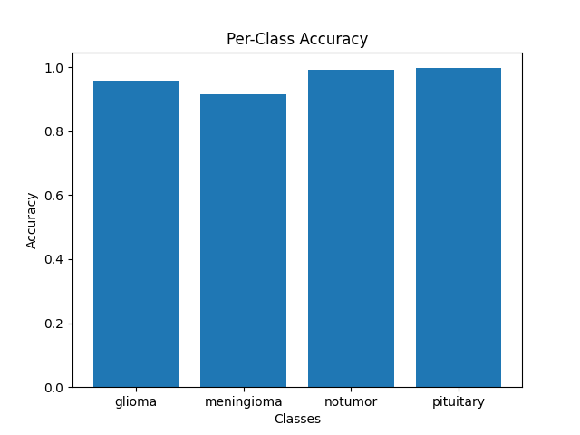
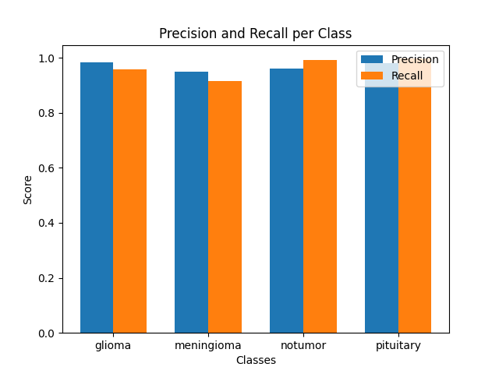
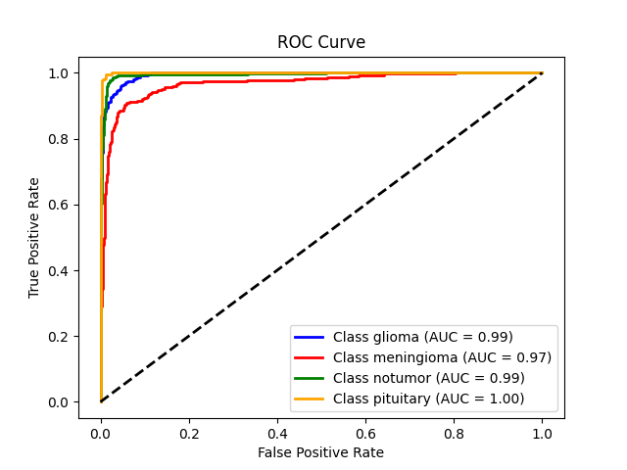

Slide 9
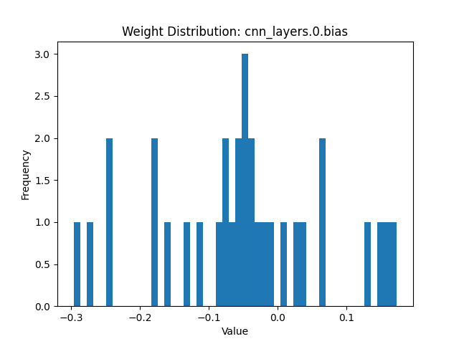
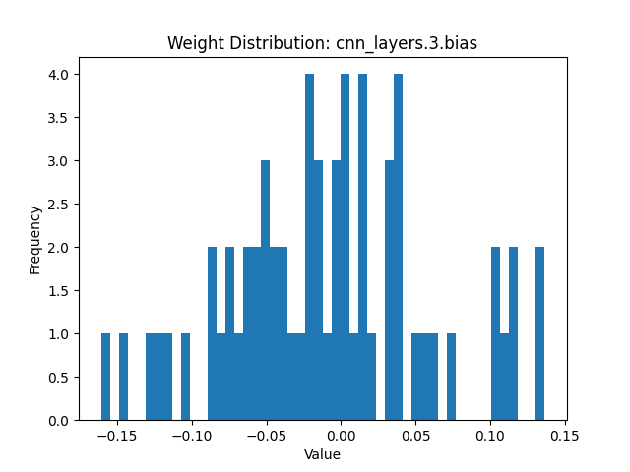
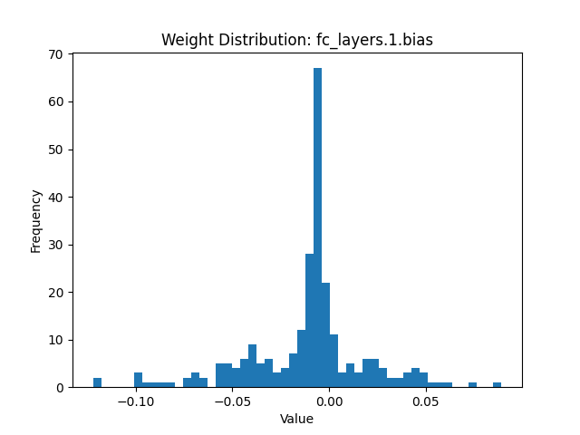
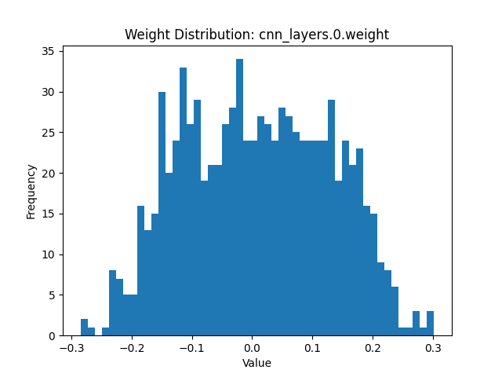
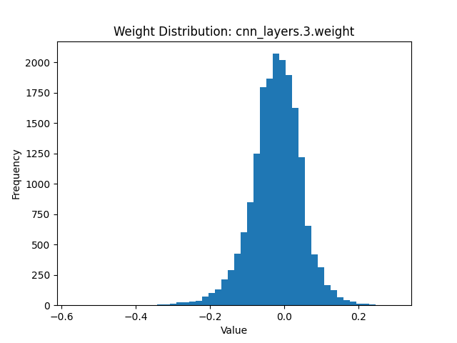
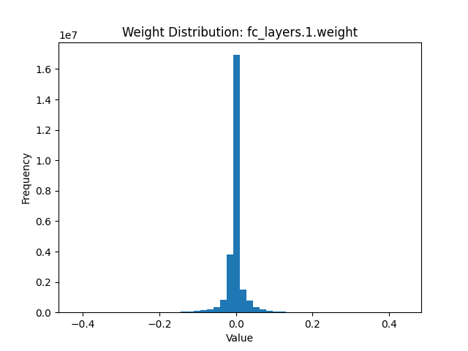
4.2 Model Weight Distribution
The weight distribution of various layers helps assess how the model learns and which layers are influential. The CNN's deeper layers handle complex features, while the initial layers detect basic patterns.
Visualizations:

Slide 10
5. Results
5.1 Training and Validation Results
The training process showed that the loss decreased and accuracy improved over epochs, reaching over 95% accuracy on the validation set.
Training vs Validation Loss:
The model showed steady learning with no signs of overfitting.
Training Set Class Distribution:
The training set showed a well-distributed class structure.
Validation Set Class Distribution:
The model's performance on the validation set confirmed its ability to generalize.

Slide 11
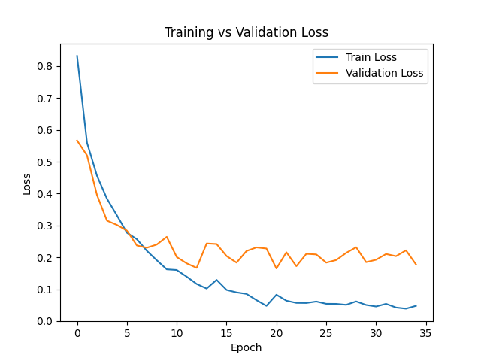

Slide 12
5.2 Model Performance Evaluation
The model's correct and incorrect predictions were visualized to understand where it succeeded and where improvements are needed.
Visualizations:
Correct Predictions
Incorrect Predictions

Slide 13
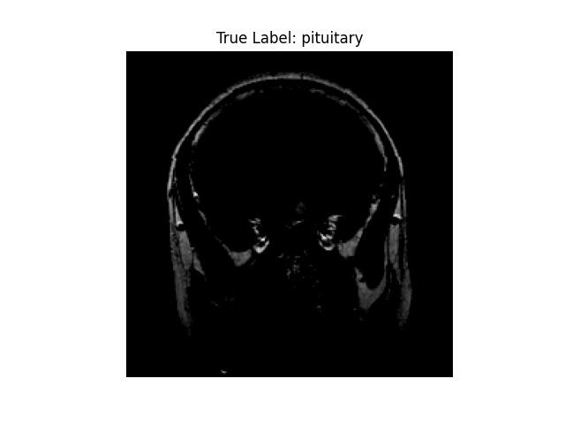
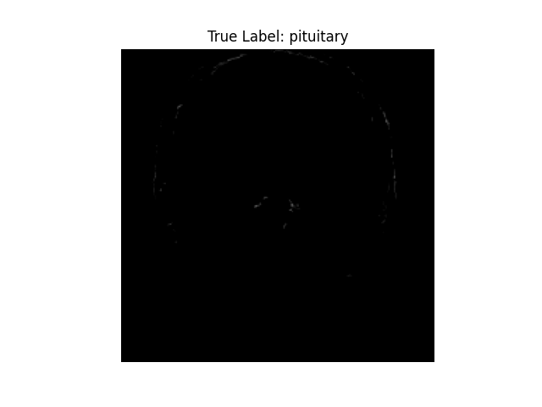
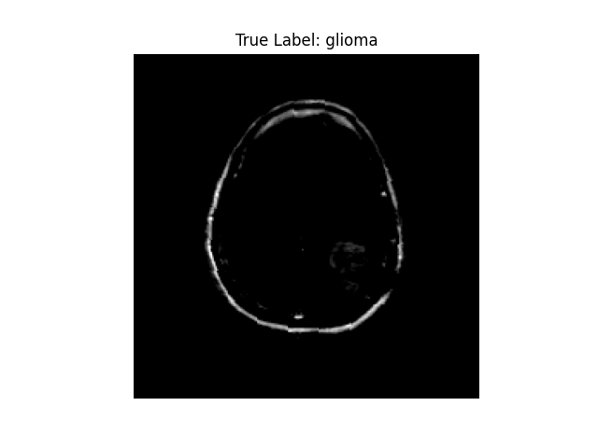
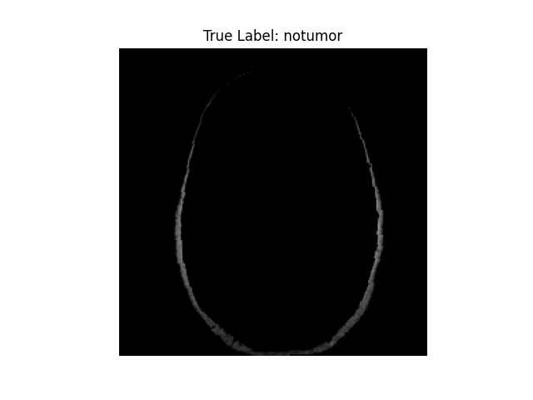
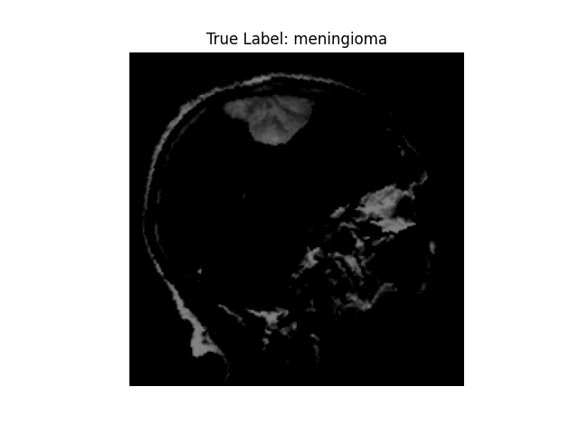
Correct Predictions

Slide 14
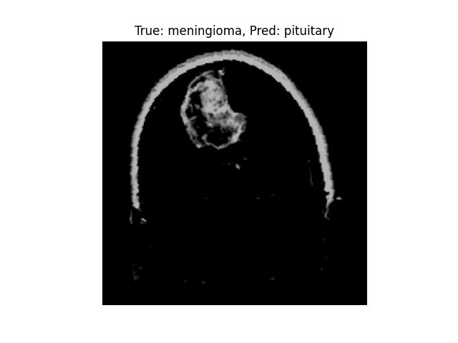
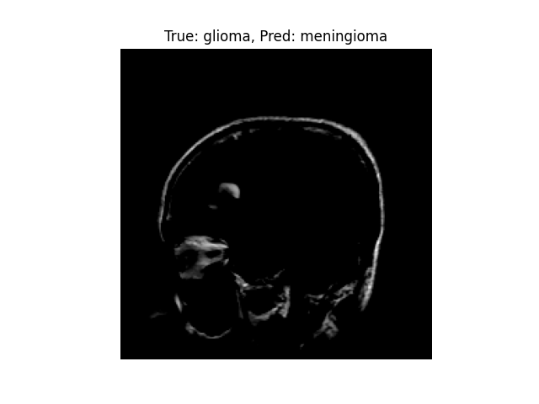
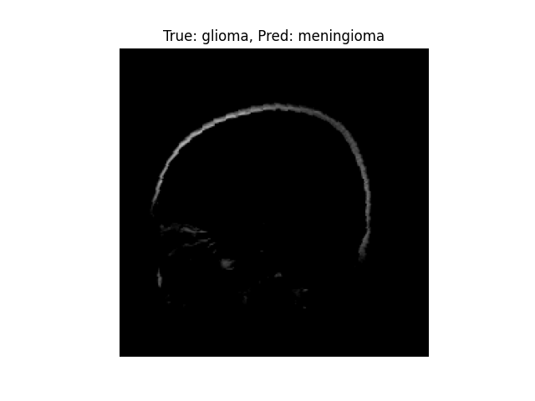
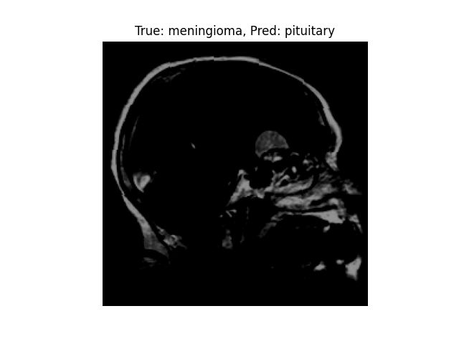
Incorrect Predictions

Slide 15
6. Discussion and Future Work
6.1 Limitations of the Work:
Limited Dataset: The dataset's size was small, and increasing the dataset could help improve generalization.
Misclassifications: Some images were misclassified, indicating room for model improvement.
6.2 Suggestions for Future Improvements:
Larger Dataset: Adding more MRI images and more tumor types can improve accuracy.
Network Architecture: Using deeper CNN models or applying Transfer Learning could enhance performance.
Evaluation on Real-World Data: Testing on real-world data would ensure better generalization.
Incorporation of Other Modalities: Using different MRI modalities could improve classification accuracy.

Slide 16
7. Conclusion
This project demonstrated the potential of CNNs in classifying brain tumors from MRI images. The model achieved high accuracy (>95%) and showed transparency through Grad-CAM visualizations, which highlighted key regions the model focused on during prediction.
Key Findings:
High accuracy and generalization on unseen data.
Effective Grad-CAM visualizations provided transparency in the decision-making process.
The model’s performance can be further improved by increasing the dataset and refining the model architecture.
Future Work:
A larger and more diverse dataset can improve the model's accuracy.
Exploring deeper models and real-world MRI scans will enhance the model's real-world application.

Slide 17


