Slide 1
vmap
Group 3-C
Yağız Gani
Kanan Asadov
Ömer Faruk Karakaya
Mert Osman Dönmezyürek

Slide 2
Completion
Functionality of filters,
Style and Theme for UI,
Log-in, sign-in manage users are not completely done yet.

Slide 3
Problems & Changes
DatabaseManager
getAnnouncementsConcise() was replaced with getAnnouncements() since there was no difference in amount of data downloaded
SessionManager
The timer function for signup case is cancelled. We planned to deal with the timer, in view subsystem.

Slide 4
Teamwork
Working on the same problem using Git.
Time & task management has thaught us a lot.
Communication skills of each team member increased.
Brainstorming as a team.

Slide 5
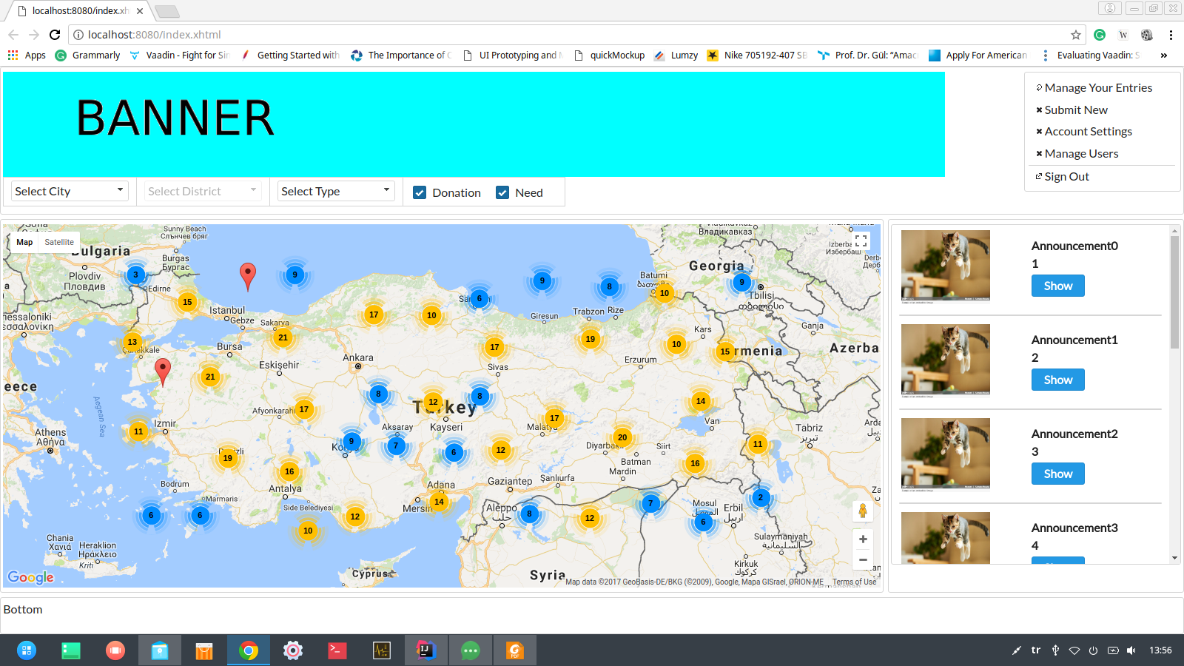
Screenshots

Slide 6
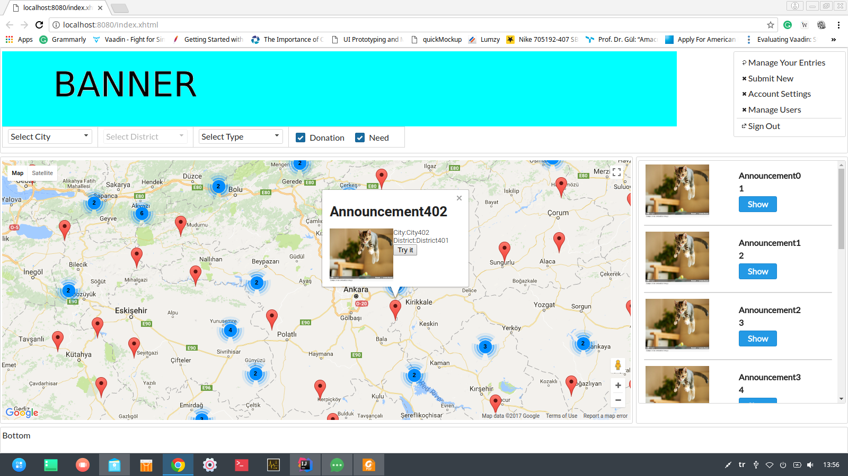

Slide 7
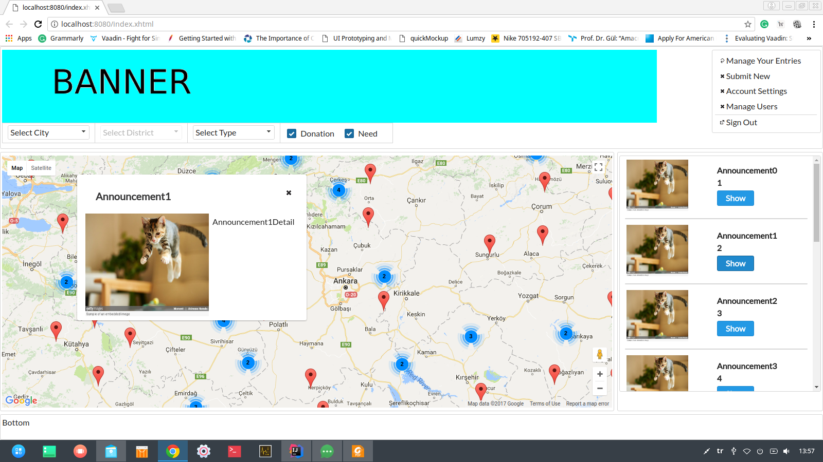

Slide 8
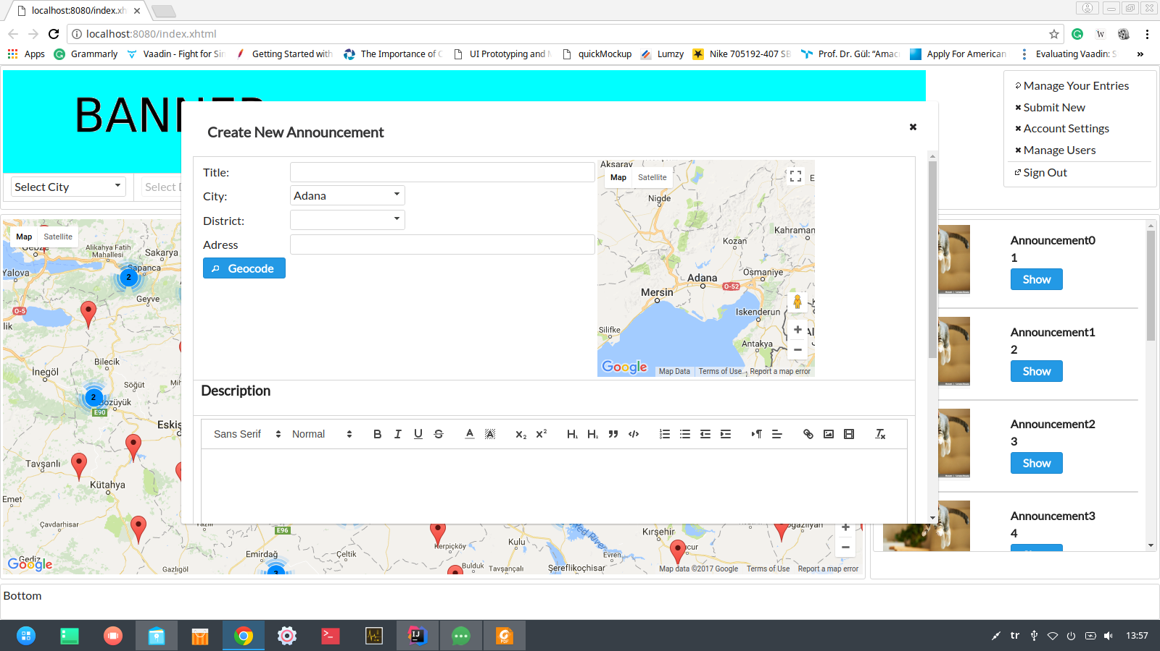

Slide 9
