Slide 1



Negative Link Prediction and Its Applications in Online Political Networks
Mehmet Yigit Yildirim
Mert Ozer
Hasan Davulcu

Slide 2

Politics & Social Media

Slide 3

Politics & Social Media

Slide 4
Politics & Social Media

Slide 5
Politics & Social Media

Slide 6


Politics & Social Media

Slide 7
Politics & Social Media

Slide 8
Politics & Social Media

Slide 9
Politics & Social Media

Slide 10

Politics & Social Media

Slide 11
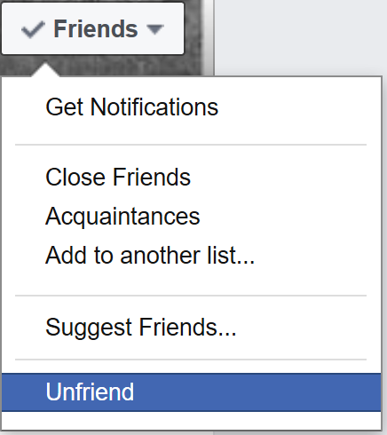
Politics & Social Media

Slide 12


Politics & Social Media
From Social Media Perspective:
From Online Political Network Perspective:
(-)

Slide 13
Politics & Social Media
Major social media platforms are not “tailored” to be online political networks.

Slide 14
Politics & Social Media
Major social media platforms are not “tailored” to be online political networks.
Negative Link: Any form of overall political disagreement, enmity, or antagonism between two interacting users.

Slide 15
Politics & Social Media
Major social media platforms are not “tailored” to be online political networks.
Negative Link: Any form of overall political disagreement, enmity, or antagonism between two interacting users.
Positive Link: Any form of overall political agreement, alignment, or comradeship between two interacting users.

Slide 16

Politics & Social Media
Major social media platforms are not tailored to be online political networks.
Negative Link: Any form of overall political disagreement, enmity, or antagonism between two interacting users.
Positive Link: Any form of overall political agreement, alignment, or comradeship between two interacting users.
Inherent, yet implicit

Slide 17
Motivation
Going beyond simple friendship/followership networks
More complete picture of online political landscape.
Detecting rivalries, antagonisms, enmities, or disagreements in other words negative links.

Slide 18

Why do we need a new model?
Train with previously available links, predict future ones.
(+)
(+)
(-)
(-)
(-)
(+)
(+)

Slide 19
Why do we need a new model?
Train with previously available links, predict future ones.
(+)
(+)
(+)
(-)
(+)
(-)
PREDICT
(-)
(-)
(-)
(+)
(-)
(+)
(-)
(+)
(+)
(+)
Jure Leskovec, Daniel Huttenlocher, and Jon Kleinberg. 2010. Predicting positive and negative links in online social networks. In Proceedings of the 19th international conference on World wide web. ACM, 641–650.
Jure Leskovec, Daniel Huttenlocher, and Jon Kleinberg. 2010. Signed networks in social media. In Proceedings of the SIGCHI Conference on Human Factors in Computing Systems. ACM, 1361–1370.

Slide 20



Why do we need a new model?
Infer the signs of unsigned links based on attitudes towards items.
(-)
(-)
(-)
(+)
(+)
(+)
(+)

Slide 21
Why do we need a new model?
Infer the signs of unsigned links based on attitudes towards items.
(-)
(-)
(-)
(+)
(+)
(-)
(-)
(+)
PREDICT
(+)
(+)
(+)
(-)
(+)
(+)
Shuang-Hong Yang, Alexander J Smola, Bo Long, Hongyuan Zha, and Yi Chang. Friend or Frenemy?: predicting signed ties in social networks. In SIGIR,2012.

Slide 22
Why do we need a new model?
Previous works experimented with Slashdot, Epinions and Wikipedia adminship datasets.
Explicit signs of links available.
Not hotspots where users express their political views.

Slide 23




What is novel about our work?
(+)
(+)
(-)
PREDICT
(-)
(-)
(+)
(+)
Unsupervised - applicable to platforms in which no explicit signed link is available
First analysis of negative link prediction for Twitter data.

Slide 24
Model
Pieces of information available
Sentiment words in interactions
Explicit positive platform-specific interactions (likes, retweets)
Social psychology theories;
Social balance theory

Slide 25
Model – Sentiment Words
Textual interactions with negative sentiments may imply negative link between two users.

Slide 26
Model – Sentiment Words
Textual interactions with negative sentiments may imply negative link between two users.

Slide 27
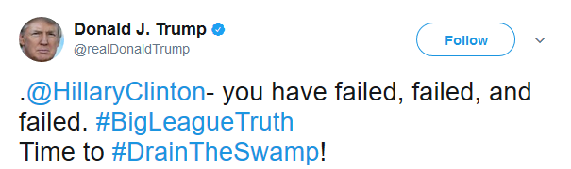
Model – Sentiment Words
Textual interactions with negative sentiments may imply negative link between two users.
failed, failed, failed

Slide 28
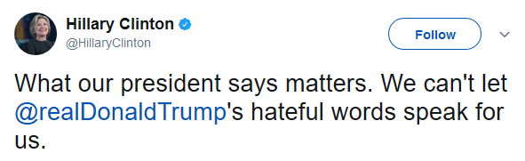
Model – Sentiment Words
Textual interactions with negative sentiments may imply negative link between two users.
failed, failed, failed
hateful,

Slide 29
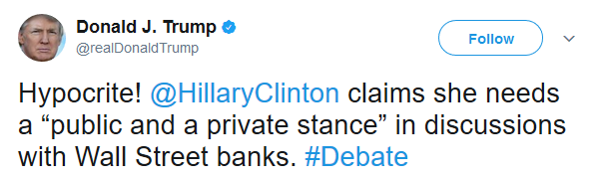
Model – Sentiment Words
Textual interactions with negative sentiments may imply negative link between two users.
failed, failed, failed
hateful, hypocrite,

Slide 30
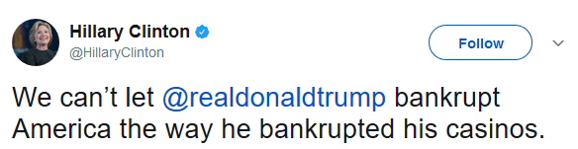
Model – Sentiment Words
Textual interactions with negative sentiments may imply negative link between two users.
failed, failed, failed
hateful, hypocrite,
bankrupt

Slide 31
Model – Sentiment Words
Textual interactions with negative sentiments may imply negative link between two users.
failed, failed, failed
hateful, hypocrite,
bankrupt
Negative Link?

Slide 32
Model – Platform-specific Interactions
Major online social network platforms encourage their users to “like” each other.

Slide 33
Model – Platform-specific Interactions
Major online social network platforms encourage their users to “like” each other.

Slide 34


Model – Platform-specific Interactions
Major online social network platforms encourage their users to “like” each other.

Slide 35
Model – Platform-specific Interactions
Major online social network platforms encourage their users to “like” each other.
Positive Link?

Slide 36
Model – Social Balance Theory
Dates back to Heider’s structural balance theory (1958).

Slide 37
Model – Social Balance Theory
Dates back to Heider’s structural balance theory (1958).
(+)
(+)
(-)
(-)
(-)
(+)
(-)
(-)
(+)
(+)
(+)
(-)

Slide 38
Model – Social Balance Theory
Dates back to Heider’s structural balance theory (1958).
(+)
(+)
(-)
(-)
(-)
(+)
(-)
(-)
(+)
(+)
(+)
(-)
friend of my friend is my friend
enemy of my enemy is my friend

Slide 39
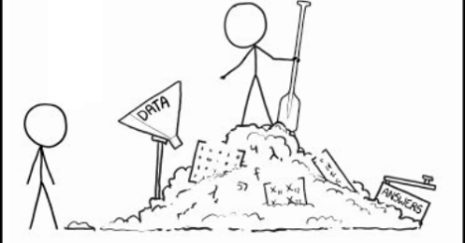

SocLS-Fact Formulation

Slide 40






SocLS-Fact Formulation
support
bankrupt
hypocrite
hypocrite
failed
support
bankrupt
(-)
(+)
failed
$$=\left[\begin{matrix} & & & & & \\ & & & & & \\ ⋯ & 0 & 3 & 1 & ⋯ & 1 \\ & & & & & \\ & & & & & \\ & & & & & \\ & & & & & \\ & & & & & \end{matrix}\right]$$
X
$$H$$
X
(-)
(+)
$$X$$
$$≈$$
$$S_{w}^{T}$$
User Pair x Sentiment Words
$$S_{u}$$

Slide 41
SocLS-Fact Formulation
support
bankrupt
hypocrite
hypocrite
failed
support
bankrupt
(-)
(+)
failed
$$=\left[\begin{matrix} & & & & & \\ & & & & & \\ ⋯ & 0 & 3 & 1 & ⋯ & 1 \\ & & & & & \\ & & & & & \\ & & & & & \\ & & & & & \\ & & & & & \end{matrix}\right]$$
1 | 0
X
$$H$$
X
(-)
 | 0 | 1 | 1 |  | 1
 | 1 | 0 | 0 |  | 0
(+)
$$X$$
$$≈$$
$$S_{w}^{T}$$
User Pair x Sentiment Words
$$S_{u}$$

Slide 42




SocLS-Fact Formulation
hypocrite
bankrupt
hypocrite
bankrupt
support
support
failed
failed
(-)
 | 0 | 1 | 1 |  | 1
 | 1 | 0 | 0 |  | 0
(-)
$$≈$$
(+)
(+)
$$S_{w}^{T}$$
$$S_{w0}^{T}$$

Slide 43

SocLS-Fact Formulation
hypocrite
bankrupt
hypocrite
bankrupt
support
support
failed
failed
(-)
 | 0 | 1 | 1 |  | 1
 | 1 | 0 | 0 |  | 0
(-)
$$≈$$
(+)
(+)
$$S_{w}^{T}$$
$$S_{w0}^{T}$$
Initial Dictionary
Opinion Lexicon
2007 positive
4784 negative

Slide 44







SocLS-Fact Formulation
(-)
(+)
(-)
(+)
$$≈$$
$$S_{u}$$
$$S_{u0}$$

Slide 45
SocLS-Fact Formulation
(-)
(+)
(-)
(+)
0 | 1
$$≈$$
$$S_{u}$$
$$S_{u0}$$

Slide 46



SocLS-Fact Formulation

Slide 47
SocLS-Fact Formulation

Slide 48
SocLS-Fact Formulation

Slide 49

SocLS-Fact Formulation
(-)
(+)
X
(-)
(+)
$$≈$$

Slide 50
SocLS-Fact Formulation
(-)
(+)
X
(-)
 |  |  |  | 1
(+)
$$≈$$

Slide 51

SocLS-Fact Formulation

Slide 52
SocLS-Fact Formulation

Slide 53
DATA DESCRIPTION & EXPERIMENTS

Slide 54





Dataset
United Kingdom | Canada | United States
421 parliament members’ Twitter account | 192 parliament members’ Twitter account | 603 senate or congress members’ Twitter account
3,367 interacting pairs of users | 1,291 interacting pairs of users | 6,114 interacting pairs of users
5 political parties | 5 political parties | 2 political parties

Slide 55
Dataset – Labelling Links
United Kingdom | Canada | United States
421 parliament members’ Twitter account | 192 parliament members’ Twitter account | 603 senate or congress members’ Twitter account
3,367 interacting pairs of users | 1,291 interacting pairs of users | 6,114 interacting pairs of users
5 political parties | 5 political parties | 2 political parties
User pairs interacted with each other more than 3 times.

Slide 56
Dataset – Labelling Links
United Kingdom | Canada | United States
421 parliament members’ Twitter account | 192 parliament members’ Twitter account | 603 senate or congress members’ Twitter account
3,367 interacting pairs of users | 1,291 interacting pairs of users | 6,114 interacting pairs of users
5 political parties | 5 political parties | 2 political parties
1,074 interacting pairs of users labelled | N/A | N/A
User pairs interacted with each other more than 3 times.

Slide 57
Dataset – Labelling Links
Asked 3 Mechanical Turk Masters to rate the polarity of link between two users as [-4,+4].

Slide 58
Dataset – Labelling Links
Asked 3 Mechanical Turk Masters to rate the polarity of link between two users as [-4,+4].
All textual interactions between two users;
Textual interactions that have only one user mentioned are kept.
Political party affiliations of two users.
Total retweet count between two users.

Slide 59
Dataset – Labelling Links
Asked 3 Mechanical Turk Masters to rate the polarity of link between two users as [-4,+4].
All textual interactions between two users;
Textual interactions that have only one user mentioned are kept.
Political party affiliations of two users.
Total retweet count between two users.
Inter-rater agreement:
Cohen’s Kappa Scores 0.810, 0.898, 0.911
Fleiss’ Kappa Score 0.731

Slide 60

Dataset – Labelling Links
Asked 3 Mechanical Turk Masters to rate the polarity of link between two users as [-4,+4].
All textual interactions between two users;
Textual interactions that have only one user mentioned are kept.
Political party affiliations of two users.
Total retweet count between two users.
Inter-rater agreement:
Cohen’s Kappa Scores 0.810, 0.898, 0.911
Fleiss’ Kappa Score 0.731
948 positive links
126 negative links

Slide 61
EXPERIMENTS

Slide 62
Experimental Questions
How effective is our model at predicting negative links accurately?
Do predicted negative links contribute to community detection performance?
What is the added value of predicted negative links at revealing polarization patterns among political party members on social media?

Slide 63
Experimental Questions
How effective is our model at predicting negative links accurately?
Do predicted negative links contribute to community detection performance?
What is the added value of predicted negative links at revealing polarization patterns among political party members on social media?

Slide 64
Negative Link Prediction Performance
Imbalanced dataset;
High accuracy scores may be misleading,
F-measure and Precision are more informative.
Compared methods:
Random
Only Sentiment
Only Link
NMTF
SSMFLK
Link + Sentiment

Slide 65
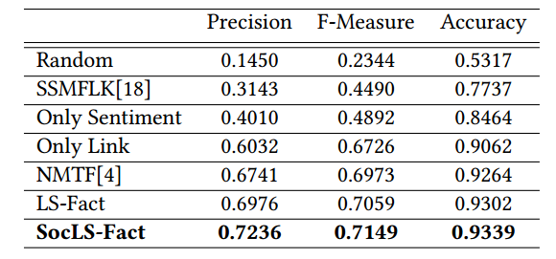
Negative Link Prediction Performance
Negative Sentiment is not the strongest predictor.

Slide 66
Negative Link Prediction Performance
Negative Sentiment is not the strongest predictor.
Positive interactions are informative.

Slide 67
Negative Link Prediction Performance
Negative Sentiment is not the strongest predictor.
Positive interactions are informative.
Social Balance Theory helps to predict negative links more precisely and accurately.

Slide 68
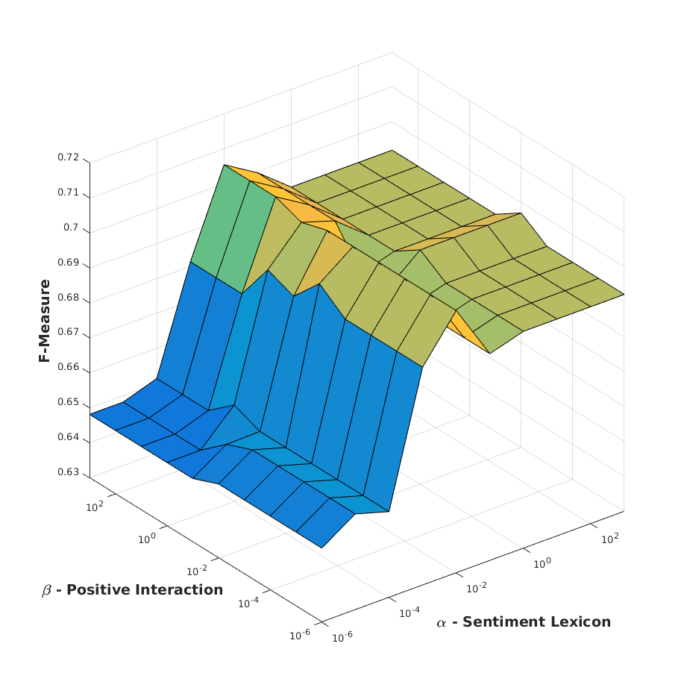
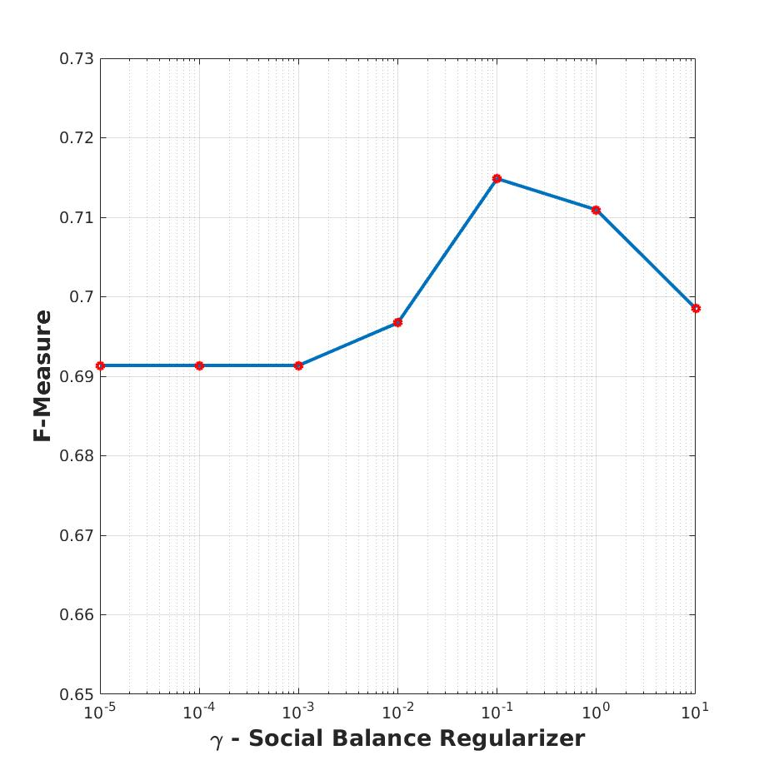
Negative Link Prediction Performance – Parameter Analysis
All regularizers contribute to the performance of prediction.
Robust model to changes of parameters. [0.65,0.71]

Slide 69
Experimental Questions
How effective is our model at predicting negative links accurately?
Do predicted negative links contribute to community detection performance?
What is the added value of predicted negative links at revealing polarization patterns among political party members on social media?

Slide 70
Community Detection Results
Spectral Clustering on unsigned and signed networks;
Signed network is derived by the output of our model.

Slide 71
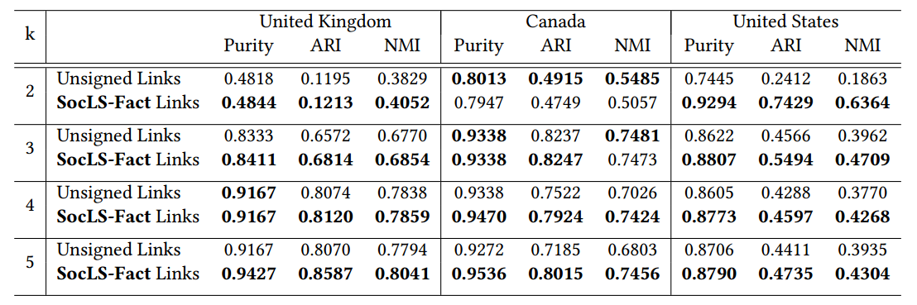
Community Detection Results
Spectral Clustering on unsigned and signed networks;
Signed network is derived by the output of our model - fixed parameters α, β, γ as 1.
.

Slide 72
Community Detection Results
Spectral Clustering on unsigned and signed networks;
Signed network is derived by the output of our model - fixed parameters α, β, γ as 1.
Predicted negative links contribute to better identifying underlying ground-truth communities.

Slide 73
Community Detection Results
Spectral Clustering on unsigned and signed networks;
Signed network is derived by the output of our model - fixed parameters α, β, γ as 1.
Contribution of signed links is at its highest for k’s equal to number of ground-truth communities.

Slide 74
Experimental Questions
How effective is our model at predicting negative links accurately?
Do predicted negative links contribute to community detection performance?
What is the added value of predicted negative links at revealing polarization patterns among political party members on social media?

Slide 75





Polarization Patterns among Political Parties
Fixed parameters α, β, γ as 1.

Slide 76
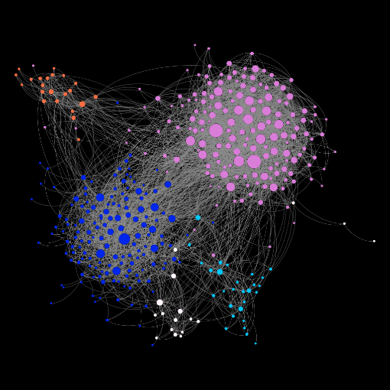
Polarization Patterns among Political Parties
Fixed parameters α, β, γ as 1.
Unsigned Links

Slide 77
Polarization Patterns among Political Parties
Fixed parameters α, β, γ as 1.
SocLS-Fact
Unsigned Links

Slide 78
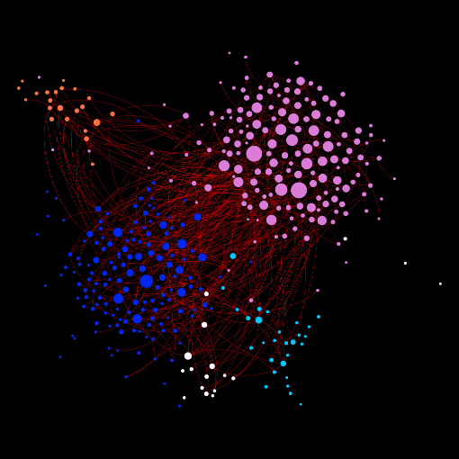
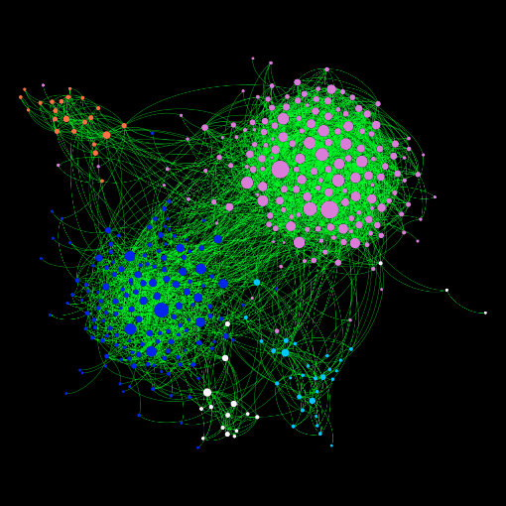
Polarization Patterns among Political Parties
Fixed parameters α, β, γ as 1.
SocLS-Fact
Unsigned Links
Negative Links
Positive Links

Slide 79


Polarization Patterns among Political Parties
Fixed parameters α, β, γ as 1.
Aggregate
Negative Links
Positive Links

Slide 80
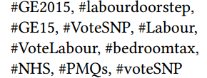
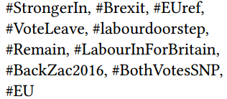
Polarization Patterns among Political Parties
Interactions from 2015
United Kingdom
421 parliament members’ Twitter account
3,367 interacting pairs of users
5 political parties
Interactions from
first 6 months of 2016

Slide 81
Polarization Patterns among Political Parties
General Election
Interactions from 2015
United Kingdom
421 parliament members’ Twitter account
3,367 interacting pairs of users
5 political parties
Brexit
Interactions from
first 6 months of 2016
Overall Climate

Slide 82




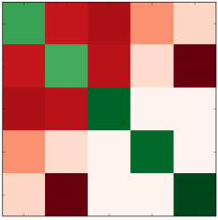
Polarization Patterns among Political Parties
(+)
(-)
Overall Political Climate

Slide 83
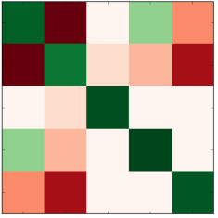
Polarization Patterns among Political Parties
(+)
(-)
General Election 2015

Slide 84
Polarization Patterns among Political Parties
(+)
(-)
Overall Political Climate
General Election 2015

Slide 85
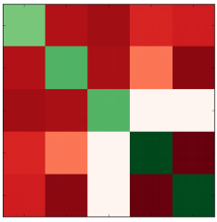
Polarization Patterns among Political Parties
(+)
(-)
Brexit

Slide 86
Polarization Patterns among Political Parties
(+)
(-)
Overall Political Climate
Brexit

Slide 87
Polarization Patterns among Political Parties
(+)
(-)
General Election 2015
Brexit

Slide 88
Polarization Patterns among Political Parties
(+)
(-)
Overall Political Climate
General Election 2015
Brexit

Slide 89
Conclusion
Proposed an unsupervised framework to predict negative links.
First work exploring negative links in social media platforms which have no explicit negative interaction.
Two use cases;
better community detection,
polarization patterns among political groups.

Slide 90
Drawbacks & Future Directions
Evaluated on small dataset;
Lack of ground-truth & budget constraints,
Could not provide generalizable parameter guidance.

Slide 91
Drawbacks & Future Directions
Evaluated on small dataset.
Lack of ground-truth & budget constraints.
Could not provide generalizable parameter guidance.
Modeling dynamic networks.
Modeling issue-based link prediction.

Slide 92
Any Questions?

