Slide 1
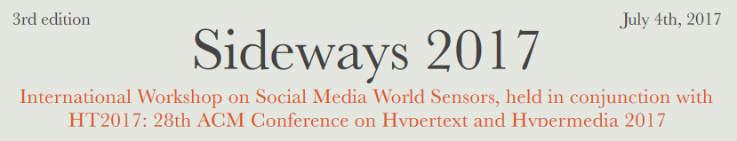
Three Facets of Online Political Networks: Communities, Antagonisms, and Controversial Issues
presented by Mert Ozer

Slide 2

Politics & Social Media

Slide 3
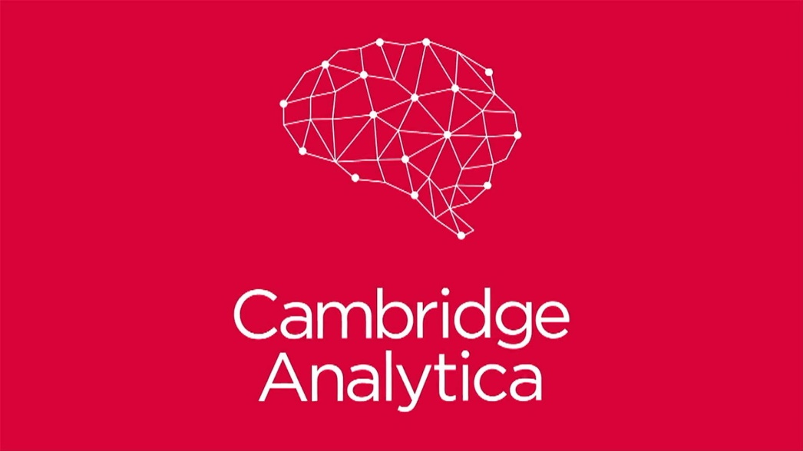
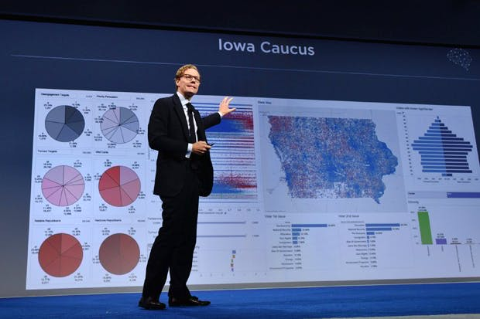
Politics & Social Media

Slide 4
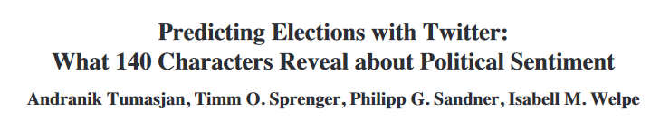
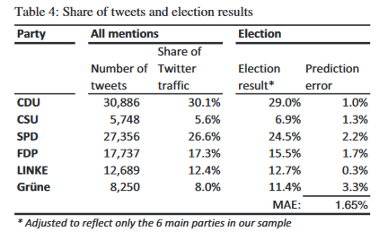
Politics & Social Media

Slide 5
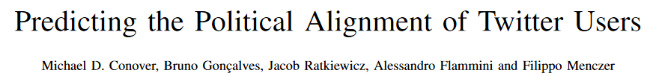
Politics & Social Media

Slide 6
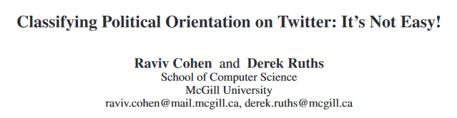
Politics & Social Media

Slide 7
Challenges
Availability of ground-truth for supervised models.
Dynamic nature of social media;
Learning from past may not apply to future.

Slide 8
Solutions
Detect underlying communities,
Detect antagonisms, rivalries, enmities among communities,
Detect controversial issues among communities and positions that each community takes towards those issues.

Slide 9
Solutions
Detect underlying communities,
Detect antagonisms, rivalries, enmities among communities,
Detect controversial issues among communities and positions that each community takes towards those issues.

Slide 10
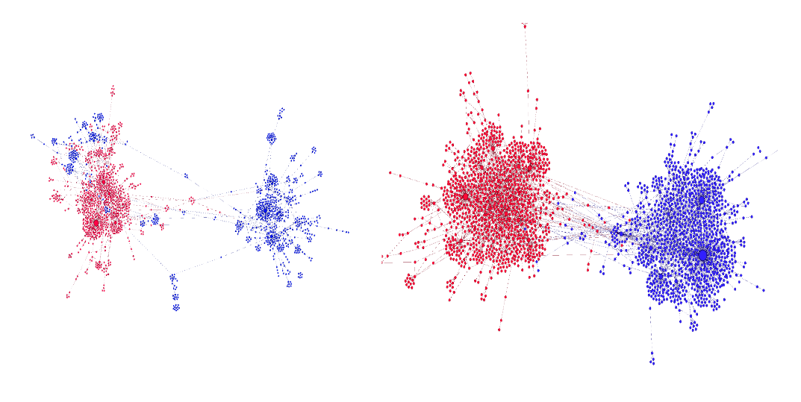
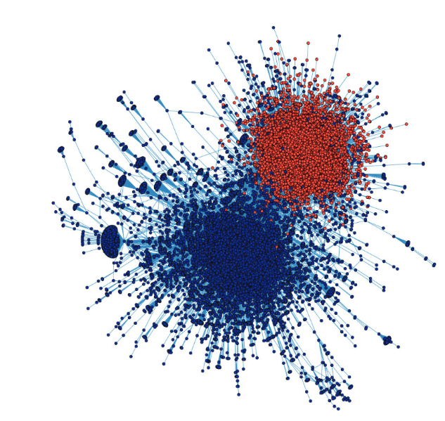
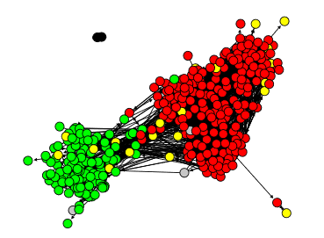
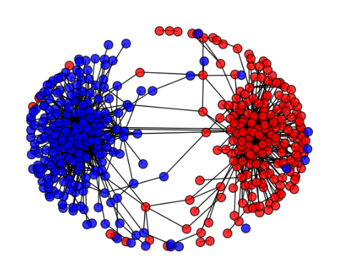
Retweet Network Polarization in Literature
Garimella et. al [2017]
Conover et. al [2011]
#beefban
#russiamarch
#p2, #tcot
#globalwarming
#healthcare
Williams et al. [2015]

Slide 11
Community Detection
User network is known to be sparse in social media.

Slide 12
Community Detection
User network is known to be sparse in social media.
disconnected components lead to artificially large number of communities.

Slide 13
Community Detection
User network is known to be sparse in social media.
disconnected components lead to artificially large number of communities.
4
5
3
2
6
1

Slide 14
Community Detection
User network is known to be sparse in social media.
disconnected components lead to artificially large number of communities.
1
2
2
How to elaborate user network to bridge the gaps?
2
1
1

Slide 15
Community Detection – How to elaborate user network?
Pick the brain of structuralist social scientists of early 20th century.

Slide 16
Community Detection – How to elaborate user network?
Pick the brain of structuralist social scientists of early 20th century.
Social Balance Theory

Slide 17

Community Detection – How to elaborate user network?
Pick the brain of structuralist social scientists of early 20th century.
Social Balance Theory
(+)
(+)
(-)
(-)
(-)
(+)
(-)
(-)
(+)
(+)
(+)
(-)

Slide 18
Community Detection – How to elaborate user network?
Pick the brain of structuralist social scientists of early 20th century.
Social Balance Theory
(+)
(+)
(-)
(-)
(-)
(+)
(-)
(-)
(+)
(+)
(+)
(-)
friend of my friend is my friend
enemy of my enemy is my friend

Slide 19





Utilizing Social Balance Theory for Twitter
Retweet without edit
Mention
Positive Mention
Retweet with edit
(+)
(+)
(+)
(+)
or
?
(+)

Slide 20
Community Detection
What else is there to bridge the disconnected groups?
4
5
3
2
6
1

Slide 21
Community Detection
What else is there to bridge the disconnected groups?
Content!
4
5
3
2
6
1

Slide 22
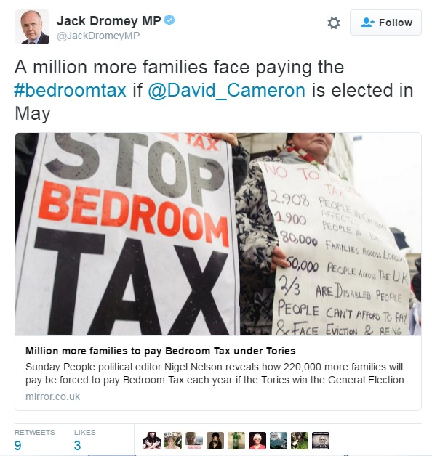
Community Detection
What else is there to bridge the disconnected groups?
Content!

Slide 23
Community Detection
What else is there to bridge the disconnected groups?
Content! Words, hashtags, URLs.
1
.
.
1
.
.
1
.
1
.
1
1
.
.
1
.
million
.
.
more
.
.
families
.
face
.
paying
elected
.
.
may
.
partisan hashtag about Welfare Reform Act 2012
mirror.co.uk
Link to newspaper
Daily Mirror
domain aligned with
Labour Party

Slide 24
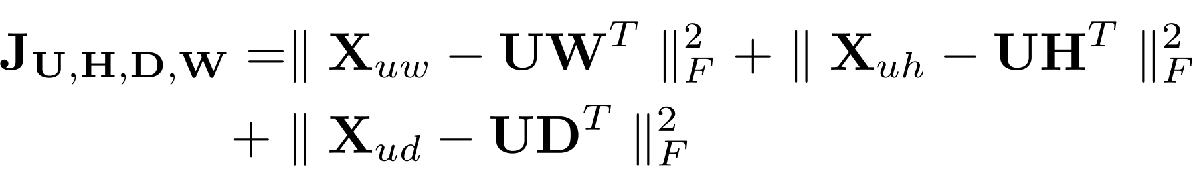
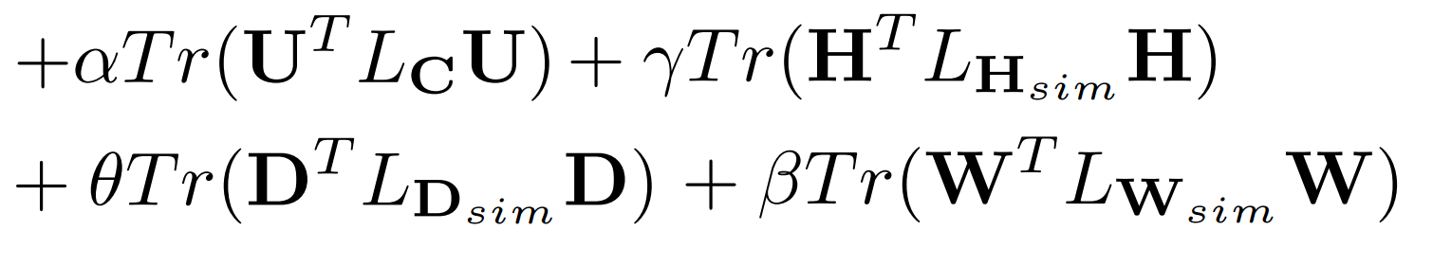
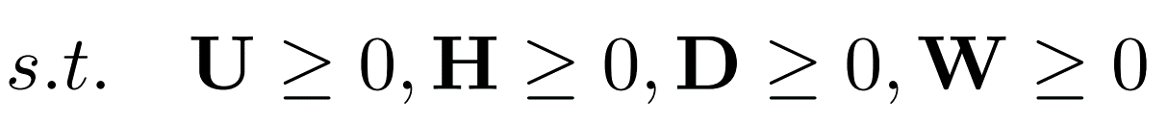
Community Detection
M. Ozer, N. Kim, and H. Davulcu. 2016. Community Detection in Political Twitter
Networks using Nonnegative Matrix Factorization methods. In 2016 IEEE/ACM International Conference on Advances in Social Networks Analysis and Mining (ASONAM). 81–88. hps://doi.org/10.1109/ASONAM.2016.7752217

Slide 25
Community Detection – Experiments
Experimented with
419 members of parliament from 5 political parties from United Kingdom.
349 members of parliament from 5 political parties from Ireland.

Slide 26
Community Detection – Experiments
Experimented with
419 members of parliament from 5 political parties from United Kingdom.
349 members of parliament from 5 political parties from Ireland.
 | United Kingdom |  |  | Ireland
 | k | Purity | NMI | k | Purity | NMI
User Network + Social Balance | 42 | .9613 | .5916 | 31 | .9186 | .7393
User Network + Words | 5 | .8326 | .5146 | 5 | .7364 | .5397
User Network + Social Balance + Words | 5 | .8970 | .6380 | 5 | .8721 | .7096
User Network + Words + Hashtags + URL Domains | 5 | .7554 | .3343 | 5 | .7481 | .4938
User Network + Social Balance + Words + Hashtags + URL Domains | 5 | .8112 | .4978 | 5 | .8178 | .6411

Slide 27
Community Detection – Experiments
Experimented with
419 members of parliament from 5 political parties from United Kingdom.
349 members of parliament from 5 political parties from Ireland.
 | United Kingdom |  |  | Ireland
 | k | Purity | NMI | k | Purity | NMI
User Network + Social Balance | 42 | .9613 | .5916 | 31 | .9186 | .7393
User Network + Words | 5 | .8326 | .5146 | 5 | .7364 | .5397
User Network + Social Balance + Words | 5 | .8970 | .6380 | 5 | .8721 | .7096
User Network + Words + Hashtags + URL Domains | 5 | .7554 | .3343 | 5 | .7481 | .4938
User Network + Social Balance + Words + Hashtags + URL Domains | 5 | .8112 | .4978 | 5 | .8178 | .6411

Slide 28
Community Detection – Experiments
Experimented with
419 members of parliament from 5 political parties from United Kingdom.
349 members of parliament from 5 political parties from Ireland.
 | United Kingdom |  |  | Ireland
 | k | Purity | NMI | k | Purity | NMI
User Network + Social Balance | 42 | .9613 | .5916 | 31 | .9186 | .7393
User Network + Words | 5 | .8326 | .5146 | 5 | .7364 | .5397
User Network + Social Balance + Words | 5 | .8970 | .6380 | 5 | .8721 | .7096
User Network + Words + Hashtags + URL Domains | 5 | .7554 | .3343 | 5 | .7481 | .4938
User Network + Social Balance + Words + Hashtags + URL Domains | 5 | .8112 | .4978 | 5 | .8178 | .6411

Slide 29
Community Detection – Experiments
Experimented with
419 members of parliament from 5 political parties from United Kingdom.
349 members of parliament from 5 political parties from Ireland.
 | United Kingdom |  |  | Ireland
 | k | Purity | NMI | k | Purity | NMI
User Network + Social Balance | 42 | .9613 | .5916 | 31 | .9186 | .7393
User Network + Words | 5 | .8326 | .5146 | 5 | .7364 | .5397
User Network + Social Balance + Words | 5 | .8970 | .6380 | 5 | .8721 | .7096
User Network + Words + Hashtags + URL Domains | 5 | .7554 | .3343 | 5 | .7481 | .4938
User Network + Social Balance + Words + Hashtags + URL Domains | 5 | .8112 | .4978 | 5 | .8178 | .6411

Slide 30
Community Detection – Experiments
Experimented with
419 members of parliament from 5 political parties from United Kingdom.
349 members of parliament from 5 political parties from Ireland.
 | United Kingdom |  |  | Ireland
 | k | Purity | NMI | k | Purity | NMI
User Network + Social Balance | 42 | .9613 | .5916 | 31 | .9186 | .7393
User Network + Words | 5 | .8326 | .5146 | 5 | .7364 | .5397
User Network + Social Balance + Words | 5 | .8970 | .6380 | 5 | .8721 | .7096
User Network + Words + Hashtags + URL Domains | 5 | .7554 | .3343 | 5 | .7481 | .4938
User Network + Social Balance + Words + Hashtags + URL Domains | 5 | .8112 | .4978 | 5 | .8178 | .6411

Slide 31
Community Detection – Experiments
Experimented with
419 members of parliament from 5 political parties from United Kingdom.
349 members of parliament from 5 political parties from Ireland.
 | United Kingdom |  |  | Ireland
 | k | Purity | NMI | k | Purity | NMI
User Network + Social Balance | 42 | .9613 | .5916 | 31 | .9186 | .7393
User Network + Words | 5 | .8326 | .5146 | 5 | .7364 | .5397
User Network + Social Balance + Words | 5 | .8970 | .6380 | 5 | .8721 | .7096
User Network + Words + Hashtags + URL Domains | 5 | .7554 | .3343 | 5 | .7481 | .4938
User Network + Social Balance + Words + Hashtags + URL Domains | 5 | .8112 | .4978 | 5 | .8178 | .6411

Slide 32
Community Detection – Insights and Future Directions
Retweet network is sparse, but most informative.
User network elaboration with social balance theory helps to identify communities more accurately.
Common word usage helps us to bridge politically aligned but socially disconnected groups.

Slide 33
Community Detection – Insights and Future Directions
Future Directions

Slide 34
Solutions
Detect underlying communities,
Detect antagonisms, rivalries, enmities among communities,
Detect controversial issues among communities and positions that each community takes towards those issues.

Slide 35
Negative Link Prediction

Slide 36

Negative Link Prediction
(-)
(+)
(-)
(-)
(+)

Slide 37
Negative Link Prediction
Major online social network platforms do not provide its users ability to form negative links
Negative links are implicit, yet evident in online political networks
Can give insight about community formation motivations
Common enemy

Slide 38
Why do we need new models?
Train with previously available links, predict future ones.
(+)
(+)
(-)
(-)
(-)
(+)
(+)

Slide 39
Why do we need new models?
Train with previously available links, predict future ones.
(+)
(+)
(+)
(-)
(+)
(-)
PREDICT
(-)
(-)
(-)
(+)
(-)
(+)
(-)
(+)
(+)
(+)
Jure Leskovec, Daniel Huttenlocher, and Jon Kleinberg. 2010. Predicting positive and negative links in online social networks. In Proceedings of the 19th international conference on World wide web. ACM, 641–650.
Jure Leskovec, Daniel Huttenlocher, and Jon Kleinberg. 2010. Signed networks in social media. In Proceedings of the SIGCHI Conference on Human Factors in Computing Systems. ACM, 1361–1370.

Slide 40



Why do we need new models?
Infer the signs of unsigned links based on attitudes towards items.
(-)
(-)
(-)
(+)
(+)
(+)
(+)

Slide 41
Why do we need new models?
Infer the signs of unsigned links based on attitudes towards items.
(-)
(-)
(-)
(+)
(+)
(+)
(+)
(-)
PREDICT
(-)
(+)
(+)
(-)
(+)
(+)
Shuang-Hong Yang, Alexander J Smola, Bo Long, Hongyuan Zha, and Yi Chang. Friend or Frenemy?: predicting signed ties in social networks. In SIGIR,2012.

Slide 42
Negative Link Prediction – Model
Lack of labelled ground-truth in Twitter/Facebook data
Need for an unsupervised, generalizable model
Pieces of information available
Sentiment Words in users’ interactions with each other
Explicit positive platform-specific interactions (likes, retweets)
Social balance theory

Slide 43
Model – Sentiment Words
Textual interactions with negative sentiments may imply negative link between two users.

Slide 44
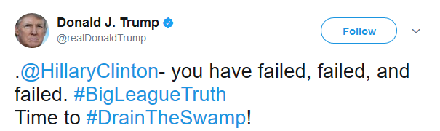
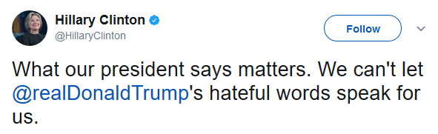
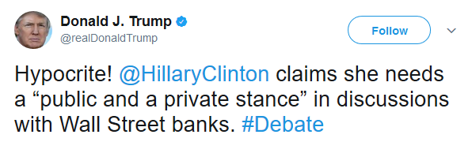
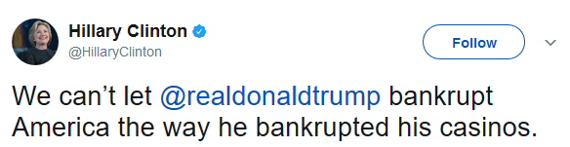
Model – Sentiment Words
Textual interactions with negative sentiments may imply negative link between two users.
failed, failed, failed
hateful, hypocrite,
bankrupt
Negative Link?

Slide 45




Model – Platform-specific Interactions
Major online social network platforms encourage their users to “like” each other.
Positive Link?

Slide 46

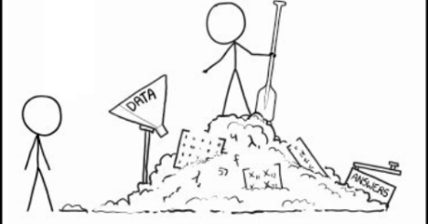
Negative Link Prediction – Model

Slide 47
Contribution of Negative Links in Community Detection Task
Spectral Clustering on unsigned and signed networks
Signed network is derived by the output of our model - fixed parameters α, β, γ as 1.

Slide 48
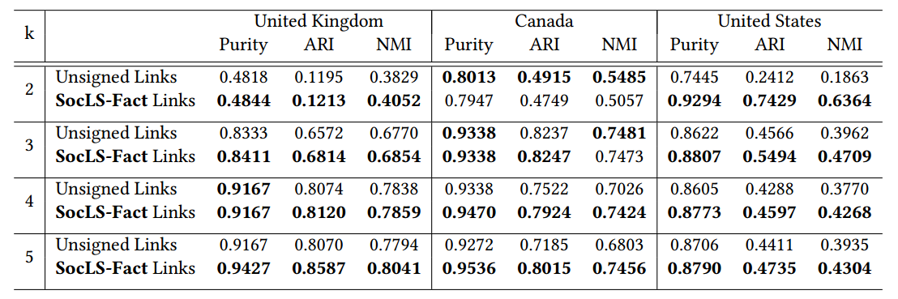
Contribution of Negative Links in Community Detection Task
Spectral Clustering on unsigned and signed networks
Signed network is derived by the output of our model - fixed parameters α, β, γ as 1.

Slide 49
Contribution of Negative Links in Community Detection Task
Spectral Clustering on unsigned and signed networks
Signed network is derived by the output of our model - fixed parameters α, β, γ as 1.
Predicted negative links contribute to better identifying underlying ground-truth communities.

Slide 50
Contribution of Negative Links in Community Detection Task
Spectral Clustering on unsigned and signed networks
Signed network is derived by the output of our model - fixed parameters α, β, γ as 1.
Predicted negative links contribute to better identifying underlying ground-truth communities.
Come to
Social Media Session
at 4:00 pm tomorrow
for further details!

Slide 51
Solutions
Detect underlying communities,
Detect antagonisms, rivalries, enmities among communities,
Detect controversial issues among communities and positions that each community takes towards those issues.

Slide 52
Detecting Controversial Issues and Positions

Slide 53
Detecting Controversial Issues and Positions
Detect underlying communities,
1
2

Slide 54

Detecting Controversial Issues and Positions
Detect negative links,
(-)
1
2
(+)
(-)

Slide 55
Detecting Controversial Issues and Positions
Detect negative links,
(-)
1
2
(+)
(-)

Slide 56
Detecting Controversial Issues and Positions
Lessons from Political Communication Theory;
Topic/Issue Ownership
Framing

Slide 57
Detecting Controversial Issues and Positions
Lessons from Political Communication Theory;
Topic/Issue Ownership
Framing
climate change

Slide 58
Detecting Controversial Issues and Positions
Lessons from Political Communication Theory;
Topic/Issue Ownership
Framing
government spending
climate change

Slide 59
Detecting Controversial Issues and Positions
Lessons from Political Communication Theory;
Topic/Issue Ownership
Framing
health care

Slide 60
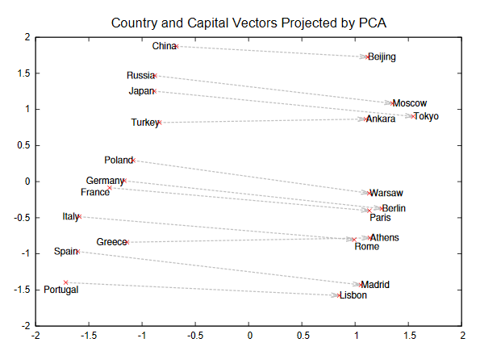
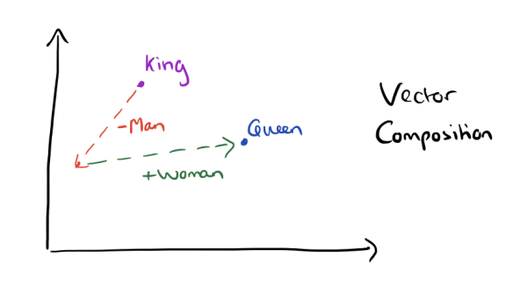
Detecting Controversial Issues and Positions
Recent developments in distributed vector representations of words
You shall know a word by the company it keeps
T. Mikolov, I. Sutskever, K. Chen, G. Corrado, and J. Dean. Distributed Representations of Words and Phrases and their Compositionality. NIPS 2013

Slide 61
Detecting Controversial Issues and Positions
Intuition: Compare word vector representations of issues among communities.

Slide 62
Detecting Controversial Issues and Positions
Intuition: Compare word vector representations of issues among communities.

Slide 63


Detecting Controversial Issues and Positions
Intuition: Compare word vector representations of issues among communities.
Corpus-1
Corpus-2

Slide 64
Detecting Controversial Issues and Positions
Intuition: Compare word vector representations of issues among communities.
Corpus-1
Corpus-2
Compute Word Vectors

Slide 65
Detecting Controversial Issues and Positions
Intuition: Compare word vector representations of issues among communities.
health care
#bipartisan
#bipartisan
health care
0
Corpus-1
Corpus-2
Compute Word Vectors

Slide 66
Detecting Controversial Issues and Positions
Intuition: Compare word vector representations of issues among communities.
health care
#bipartisan
#bipartisan
<------Controversial ------>
health care
0
Corpus-1
Corpus-2

Slide 67
Detecting Controversial Issues and Positions
Intuition: Compare word vector representations of issues among communities.
Not controversial!
health care
#bipartisan
#bipartisan
health care
0
Corpus-1
Corpus-2

Slide 68
Detecting Controversial Issues and Positions
Intuition: Compare word vector representations of issues among communities.
Issue appeared in Corpus-1
climate change
Issue not appeared in Corpus-2
climate change
0
Corpus-1
Corpus-2

Slide 69
Detecting Controversial Issues and Positions
Intuition: Compare word vector representations of issues among communities.
{broken system, repeal, website}
health care
health care
0
{middle class, hardworking, deserve}
Corpus-1
Corpus-2

Slide 70
DEMO ~1.5 million tweets from 603 congress and senate members of United States

