Slide 1


Mega.com
Mert Özsaydı 150110225
Efe Mert Yılmaz 150110231
Gülce Başar 150120201
Alper Özaydın 150110239

Slide 2
Objective
In 21th century the role of the cell phones can not be underestimated. We saw an opportunity to sell cell phone product in a growing market. That’s why we created Mega.com.
We designed a website for selling all the things about the phone such as batteries, phone covers, charging and connection cables, headphones, car accessories, screen protectors, phone stands, portable speakers, armbands etc.

Slide 3
Deliverables
An e-shopping website that sells all the thinks about a phone.
Users can see the products without login and if they want to buy something from Mega.com they need to login to our website.

Slide 4
Milestones
Project requirements planning
Planning and creating tables for database
Designing and coding website
Database and website connected
Test case
Bug fix

Slide 5
Normalization
Normalization is the process of efficiently organizing data in a database. The purpose of normalization is to reduce data storage and to reduce data redundancy by making sure any given piece of data is stored only once.
Normalization aims to reduce data repetition and easy operations for insert, delete, update.
The important point is that all forms of normalization assume you have met all prior forms.

Slide 6
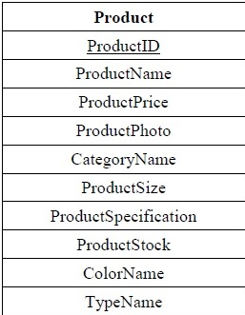
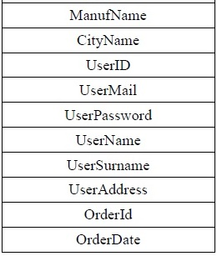
1NF

Slide 7
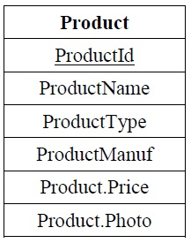
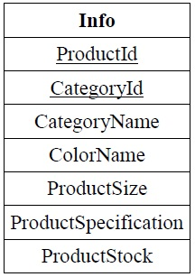
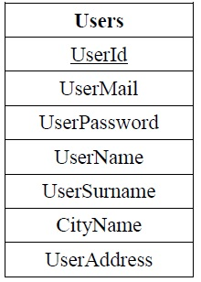
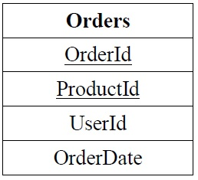
2NF

Slide 8
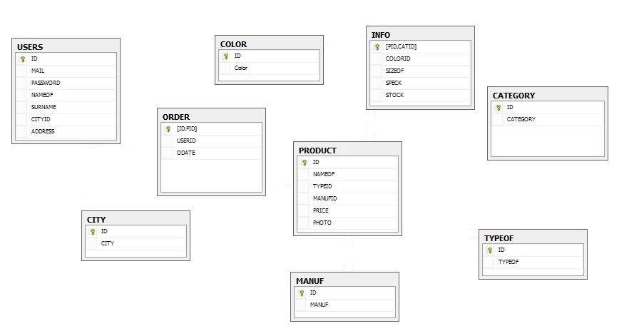
3NF

Slide 9
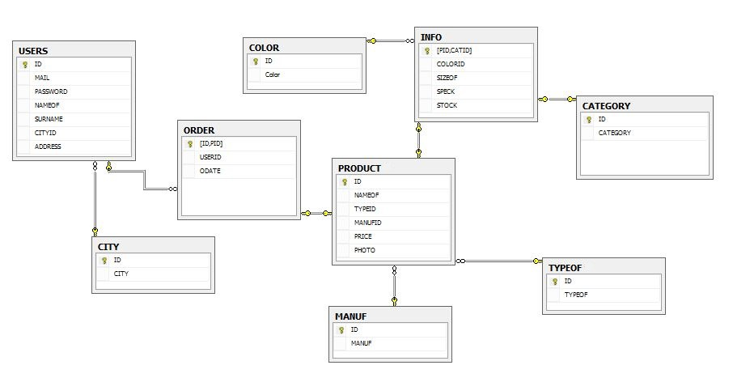
ER Diagram

Slide 10
Application Information Platforms
Java
GlassFish : Open-source application server
Html: HyperText Markup Language
Css : Cascading Style Sheet
JDBC : Java database connectivity technology
Derby : Open source database
Netbeans IDE : Software development platform

