Slide 1
EYAP SALES PROJECT
GROUP 5
DİCLE DOĞAN, YILMAZ MERT AKIN, GÖZDE GÖZÜTOK, ERDİ KÖSE,İLHAMİ BERKER GÜRÇAY
MENTORS: MEHMET HALİLOĞLU
MERVE SARI

Slide 2
Abstract
Aim to explain, analyze data, extract new insights and develop a predictive model for the sales data of the 3 largest authorized dealers of Eczacıbaşı Building Products.
Data was provided and anonymized by Eczacıbaşı Group, contains 30449 rows and 10 columns
Data covers a 35-month period (from January 2018 to the end of November 2020)
2 numeric columns: Quantity sold and total price. Negative values in these columns represent returns.
Different regression models and Facebook’s Prophet(Time Series Model) were used for the project.

Slide 3
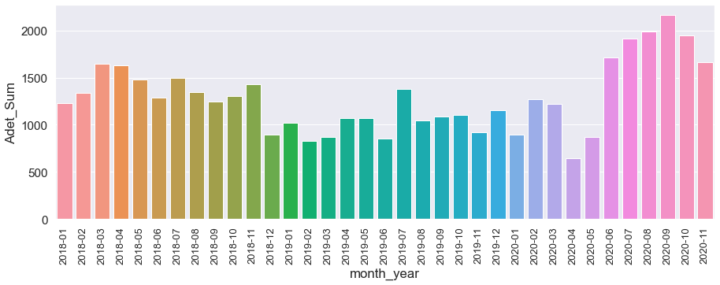
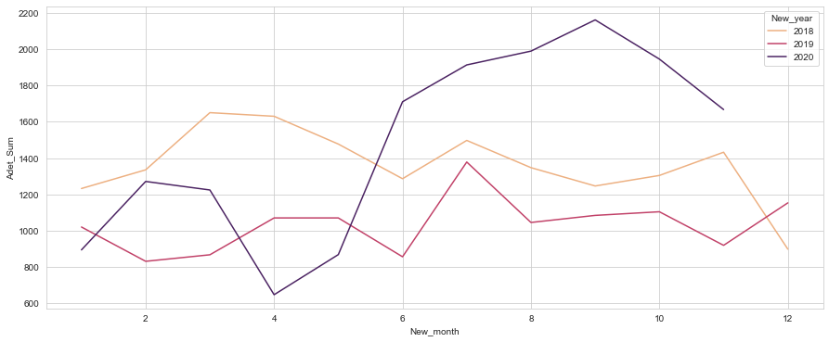
Aylara ve Yıllara Göre Satış
Sales are low from the end of 2018 to June of 2020.
After this, there is a very high increase:
Due to staying home during Covid, people wanted to renovate their homes,
this caused sales to increase since interest rates were low as well

Slide 4
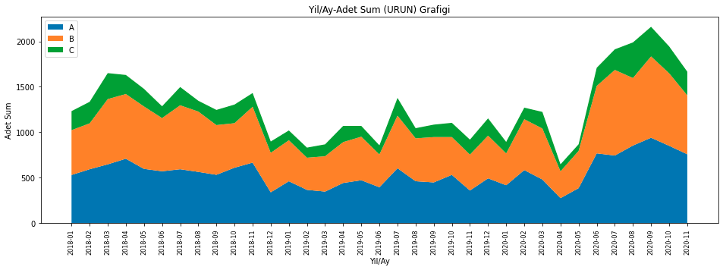
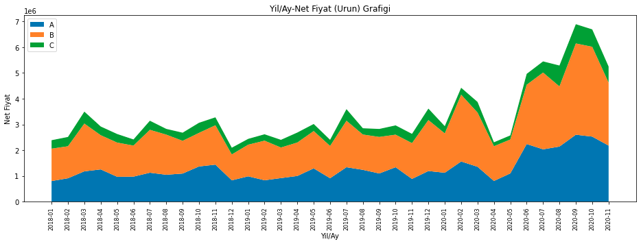
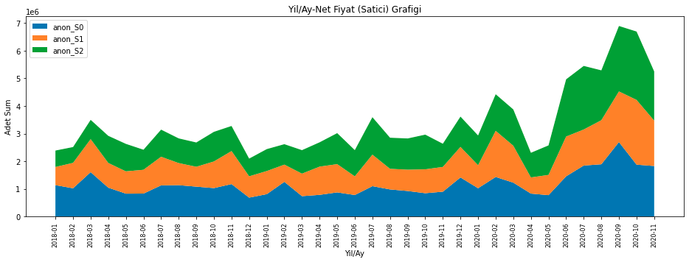
C products are the cheapest one, A slightly more expensive and B product is the most expensive product.
Product A and B were sold approximately 3.3 times more than product C
Dealer S2 has sold more but S0 has earned slightly more than S2.
After normalization started in June 2020, Dealer S2’s sales were increased.

Slide 5
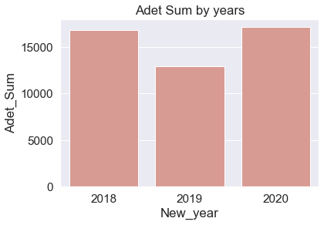
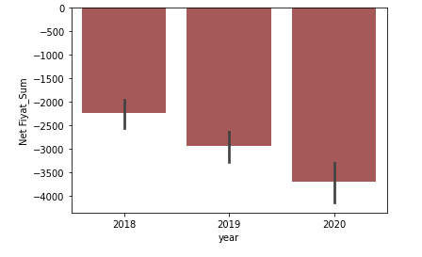
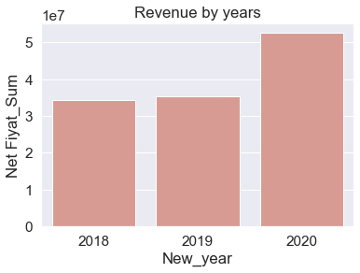
Distribution of prices by year
Net price total increased from 2018 to 2020.
However in 2019 sale amount significantly decreased.
Reasons: price raise or more expensive products were sold.
Returns have increased yearly base

Slide 6
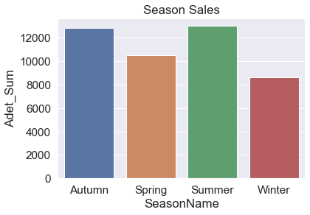
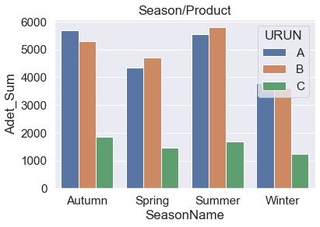
Distribution of prices by seasons
Although we did not find any obvious differences here, the sales of product B in the Winter sales are higher than in other seasons.
This graph shows us that winter has lower sale numbers.

Slide 7
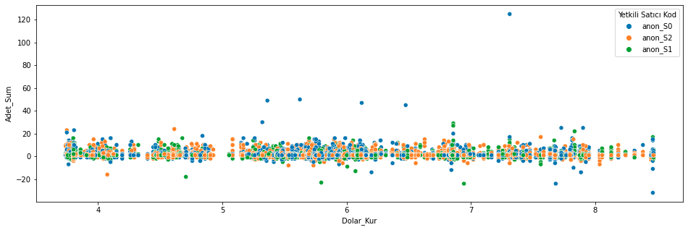
Feature Engineering
Features that added: special days(holidays), value of the dollar, UFE, TUFE, sale index and date related features such as day of the week, Quarter end and start, month, year, end of month and start of month to see if they make any difference.
Dollar’s value doesn’t show a high effect on the sales.

Slide 8
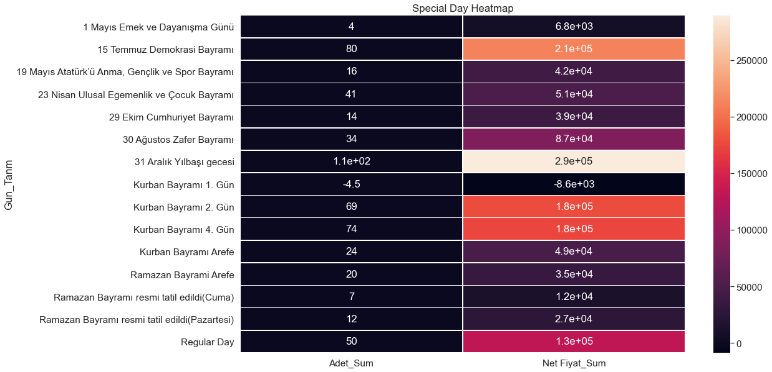
Special Days Analyze
“First day of Eid al-Adha” which is the most interesting one because it shows us that return numbers are
higher than the sales.
While there were no sales on January 1th, it is observed that sales on May 1st, sales are lower than the average.

Slide 9
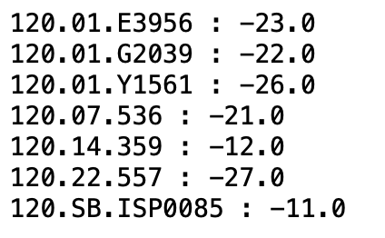
Rule Based Fraud Detection
Since the average sales are negative on “First day of Eid al-Adha “, we found a customer who has returned more than she/he has purchased that day and we looked for such customers.
In order to rule based fraud detect, we listed number of those customers who have returned more than they have purchased and listed their information
7 of those customers purchase-return difference is more than 10

Slide 10
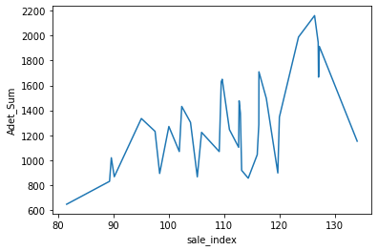
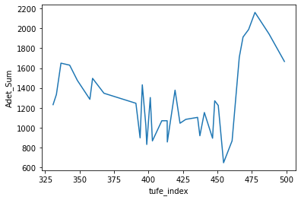
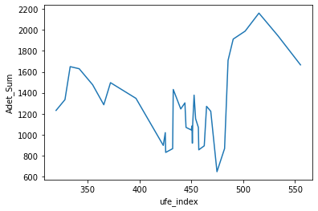
Sale Index, TUFE and UFE Features
Sale Index
TUFE Index
UFE Index
Sale index shows positive correlation, however ufe and tufe indexes doesn’t give clear result for us.
The reason why we needed and graphed those indexes was that our sales distribution does not show trend, seasonality or any pattern according to months.

Slide 11
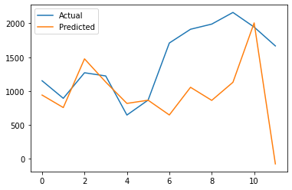
Prophet was used for time series analysis
The model was designed for forecasting
Provides tools to automatically evaluate models and plot results.
Last 10 months were used for testing
The model doesn’t work well due to huge sale increase in the middle of 2020.

Slide 12
Missing Values & Outliers
There was no missing value in the original data. Very few ones in the features we added, we filled those with medians of those variables.
For outliers, we used IQR and just “shrunk” our data between low and up values that we calculated.
We kept time related variables and our target variable out of our outlier functions.
We didn’t include categorical cardinal variables such as “MatbuNo”, “FaturaTarihi” and “MüşteriNo”, since we got all the required information from them by our the features we added.

Slide 13
REGRESSION THE PREDICTION OF THE AMOUNT THAT WILL BE PURCHASED
BASE MODEL
including return of sales
excluding return of sales
NEW FEATURES ADDED MODEL
including return of sales
excluding return of sales

Slide 14
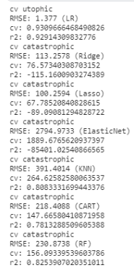
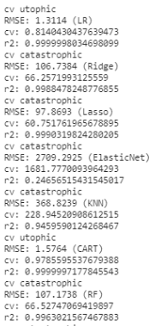
BASE MODEL
First, we’ve tried many models with train set to be able to choose the best ones and use them for prediction with test set
This is the model that is done without any new features.We want to see how effective our variables to predict “Adet_Sum” in the first place
Including return of sales
Excluding return of sales

Slide 15
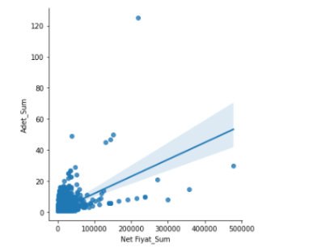
From cv (coefficient of variance), RMSE and R2 results we can conclude that Multiple Linear regression is the best option to continue with
But we have to make sure and only way to do that is the graph that will show us the relation between target variable and “Net Fiyat_ Sum”, since it is the only numeric variable we have at this point.
Multiple linear regression
excluding returns test r2 0.465
rmse 1.354
cv 0.84
There is a slight change in RMSE, cv and R2 comparing train values we’ve seen before

Slide 16
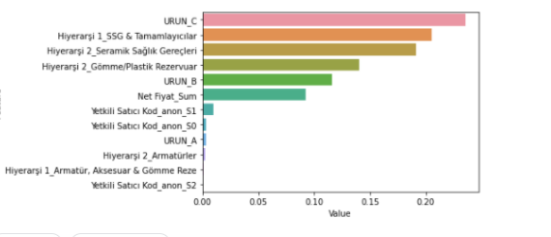
The most successful features for our prediction
To be able to see which features are the most important to use, we have to use something else than linear models so we used Xgboost model.
For that end, there is a required additional step of feature importance after hyperparameter optimization,
Using these with tuned model, we get 0.5175 for R2 but more importantly, we can see that the product types of “Hiyerarşi 2” and “URUN” are relatively more important than the others to use in our model.

Slide 17
FEATURES ADDED MODEL
At this point, we have 26 variables in total with the new features added.
We used the same logic as in our base model and doubled our trials for both “including returns” and “excluding returns”.
This time, “including returns” got us slightly better results so we pursued that version of our model.

Slide 18
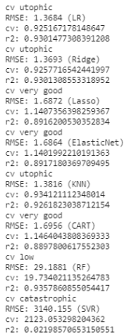
Like our base model, Linear Regression models end up having higher R2 and lower RMSE results in general.
There is also XGBM and Catboost results relatively higher, for the efficiency reasons, we carried on with XGBoost
First, we need to make sure our newly added numeric features have also a linear relation with “Adet_Sum”

Slide 19
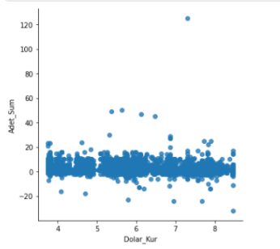
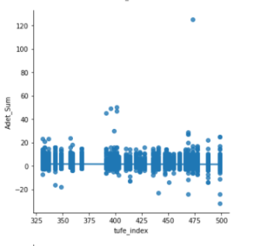
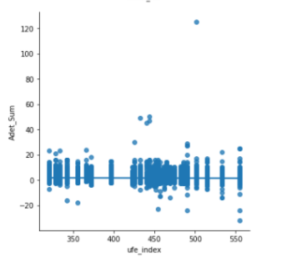
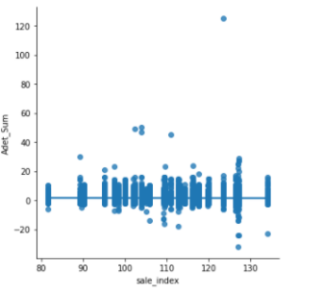

Slide 20
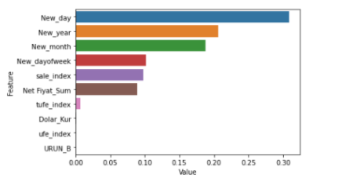
 | LR Train | LR Test | Ridge Train | Ridge Test | XGBM before optimization | XGBM after optimization
RMSE | 1.37 | 1.45 | 1.37 | 1.45 | 1.30 | 1.28
R2 | 0.93 | 0.46 | 0.93 | 0.46 | 0.47 | 0.49
CV | 0.92 | 0.98 | 0.93 | - | 0.97 | 0.87
Even though we have a linear model, we can see that Xgboost gave a better result with rmse value of 1.28
We can clearly see that our new features especially the ones that derived from our time variable “Fatura_Tarihi” are more effective and they are followed by sale_index, UFE and TUFE

Slide 21
CONCLUSION
We managed to reach around 0.5 for R2 with our linear models. Considering 0.4-0.7 is optimum, we might say our model is working out well but still needs to improve.
Our RMSE values is relatively high, considering out target variable mean is 1 , the error we get is higher than that which implies we need more data.
Some results of analysis:
Due to lower sales on public holidays, cost analysis can be done to compare if sales match expenses
Ruled Based Fraud Detection can be done
Unexpected increase in the demand during lockdown caused us some trouble
We need more data for better insight and analysis.

