Slide 1
Routing in Generalized Geometric Random Graphs
Antonio Fernández Anta
Joint work with Andrés Sevilla

Slide 2
Geometric Graphs
Consider a network in which each node has asigned a position in a metric space (geometric graph)
Each node may be connected to the neighbors in the space
Objectives:
Add (long distance) links in order to obtain a small-world network (each pair on nodes very small shortest distance)
Devise an efficient routing algorithm in the resulting network

Slide 3
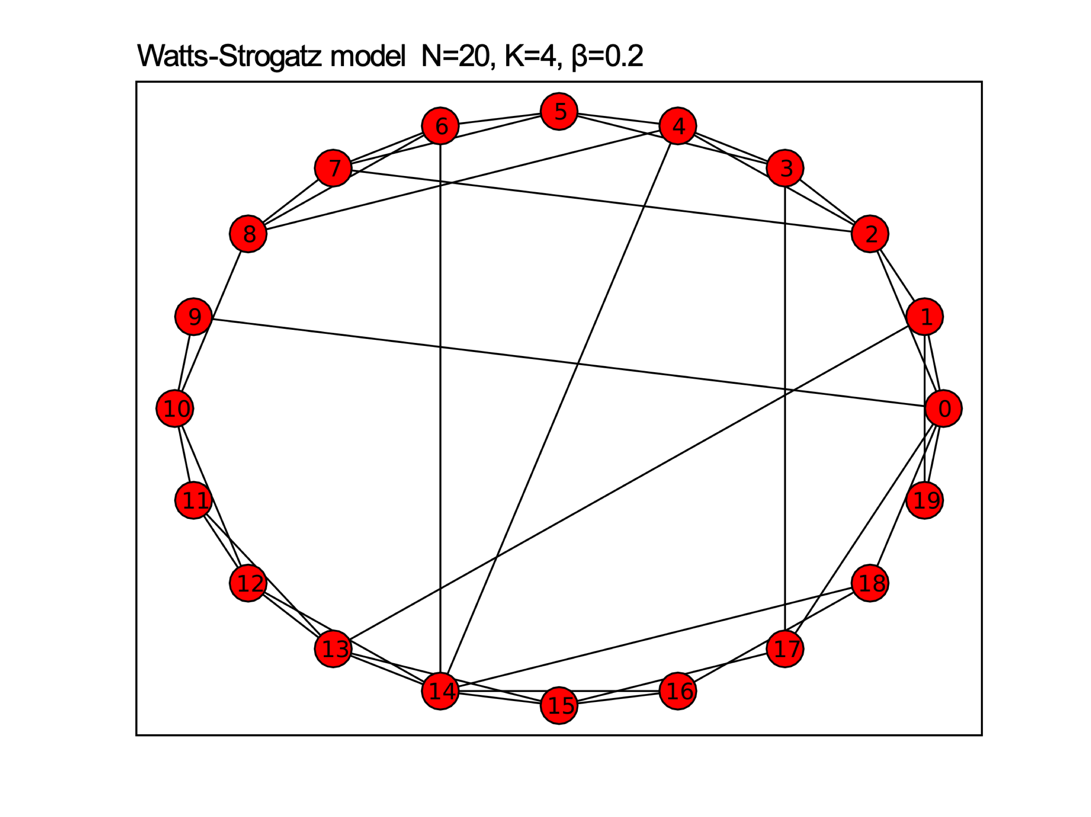
Geometric Graphs
Watts and Strogatz [WS 1998]
Kleinberg [K 2000]
Geographich greedy routing
Rejilla completa
Arpad Horvath

Slide 4
Geometric Graphs
Hyperbolic geometric graphs
Nodes embedded in a hyperbolic space
Nodes are randomly linked with probabilities that depends on the hyperbolic distance
Construction [Krioukov et al. 2010]
Internet embedding [Boguñá et al. 2010].
P2P overlays [Cassagnes et al. 2011]
Routing for ad-hoc wireless networks [Kleinberg 2007]

Slide 5
Geometric Inhomogeneous Random Graphs
Geometric Inhomogeneous Random Graphs (GIRG) [Bringmann et al. 2019]
Generalizes and simplifies hyperbolic graphs
Avoids the using of hyperbolic cosines
Mixes Kleinberg [Kleinberg 2000] & Chung-Lu [Chung et al. 2002] constructions
Each node has uniform random position x in a δ-dimensional geometric space (e.g., torus)

Slide 6
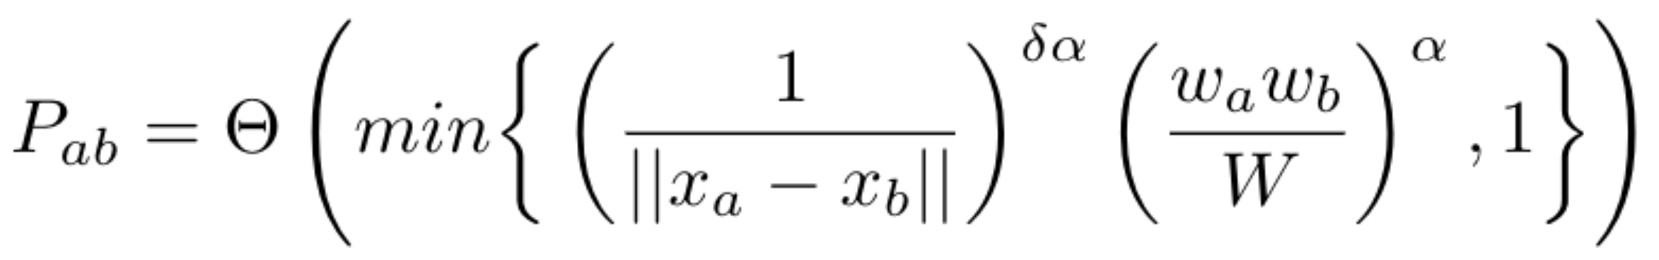
Geometric Inhomogeneous Random Graphs
Construction:
Each node has a weight drawn from a power-law distribution
The nodes are linked with a probability that:
increases with the node weight (power-law factor)
decreases with the distance between nodes

Slide 7
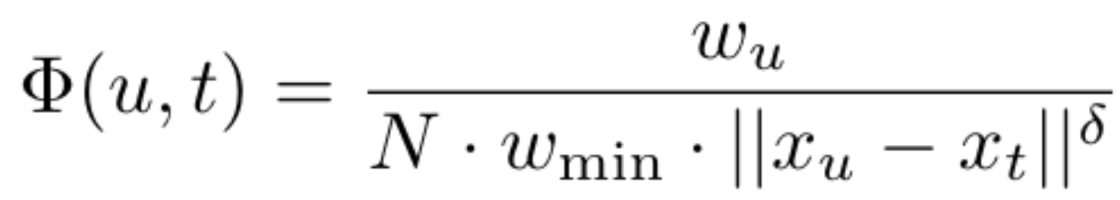
Geometric Inhomogeneous Random Graphs
Routing in GIRG: [Bringmann et al. 2017]
Greedy routing GIRG-Φ
An objective function Φ is used to choose the next hop to the destination (larger value)
The algorithm fails when the objective function does not increase its value

Slide 8
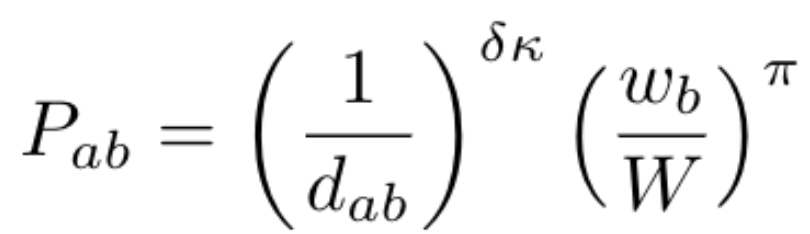
Contributions: The (κ,π)-KG model
Based on the GIRG model
Construction:
A complete 2-D torus as base graph
Each node has a weight drawn from a power-law distribution with 2 < β < 3
All nodes have four local neighbors and one long range neighbor
The node a chooses b as long range neighbor with probability proportional to

Slide 9
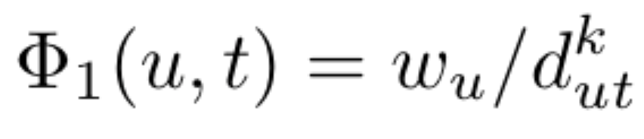
Contributions: The (κ,π)-KG model
Greedy routing algorithm:
A new objective function Φ₁
with k = τ ln(w_{max}/w_{min})
It makes sure a message reaches the destination when the distance is ≤τ:
Lemma. Let u,t ∈ V be nodes such that d_{ut}≤τ, then for any v ∈ V such that d_{vt}< d_{ut} it holds that
Φ₁(v,t)>Φ₁(u,t)

Slide 10
Contributions: The (κ,π)-KG model
Greedy routing algorithm:
Two version of the routing:
τ-Det (deterministic): Use Φ₁ as long as posible. If it fails, geographic greedy routing can be used
τ-RW (probabilistic): Follows a random walk with Φ₁ as weights for the next hop. It guarantees success.
The objective is to minimize the (average) number of hops from source to target

Slide 11
Simulation Evaluation
Construction and routing methods are evaluated by simulation
Torus size 101x101, β = 2.1, 50,000 messages routed
Deterministic algorithms: GIRG-Φ, τ-Det , geographic
Probabilistic algorithms: GIRG-Φ, τ-RW, geographic random walk

Slide 12
(κ,π)-KG Construction
Degree distribution follows a power law

Slide 13
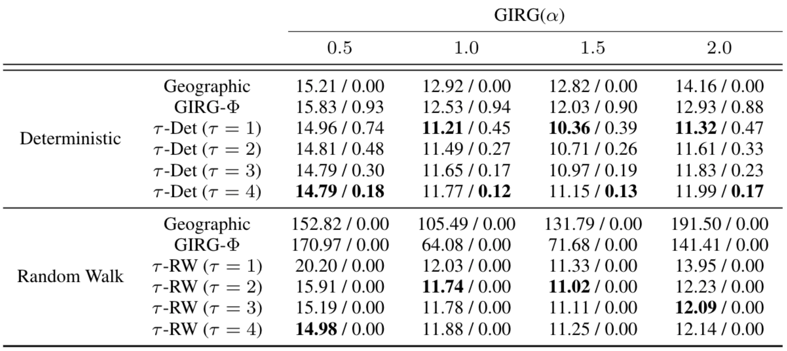
Simulation Evaluation of GIRG
Avg length
Fail ratio

Slide 14
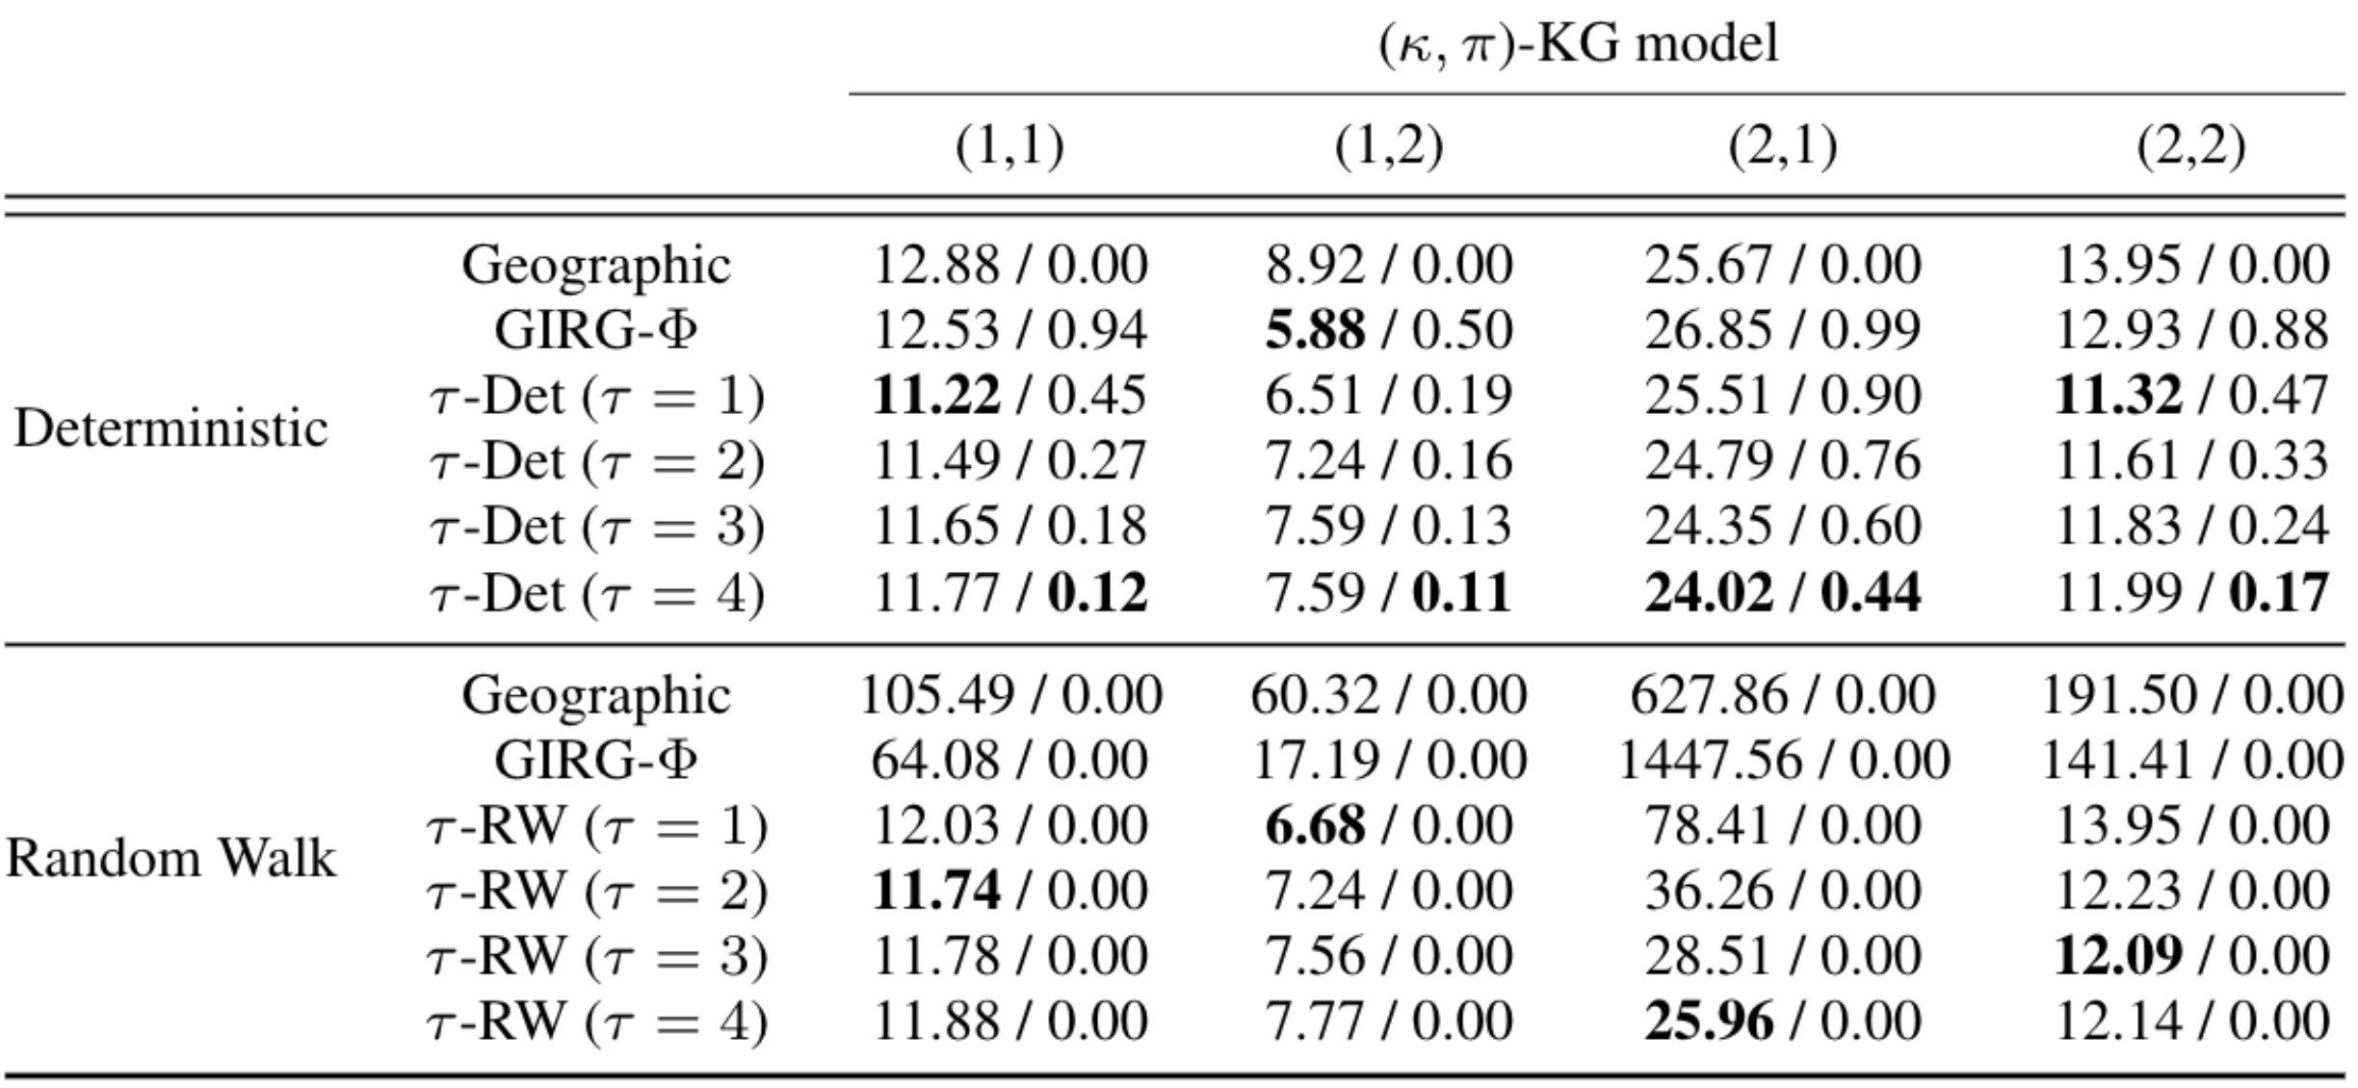
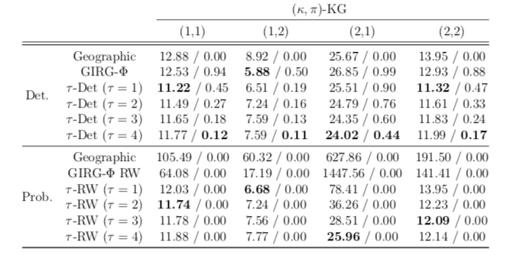
Simulation Evaluation of (κ,π)-KG
Long. caminos
Avg length
Fail ratio

Slide 15
Comparison of Construction and Routing

Slide 16
Conclusions
(κ, π)-KG graphs are an alternative to GIRG and hyperbolic geometric graphs
By simulation they present better performance than GIRG, both in hops and fail ratio
Deterministic routing algorithms have the best performance in hops but they have a positive fail ratio
τ-Det outperforms other deterministic algorithms. Increasing the τ parameter, the fail ratio drops with a small overhead in the hops.
τ-RW show almost identical results (in hops) to the deterministic version for (κ, π)-KG graphs

Slide 17
Future Work
More simulations are been done with other torus sizes and measuring other parameters, like congestion
Analytical results are pending:
Shortest paths distribution in (κ,π)-KG
Stretch with τ-Det and τ-RW
Anyone interested?

Slide 18
Thank you! Questions?
antonio.fernandez@imdea.org
Andrés Sevilla, Antonio Fernández Anta: Routing in Generalized Geometric Inhomogeneous Random Graphs - (Extended Abstract). NETYS 2020: 368-373

