Slide 1
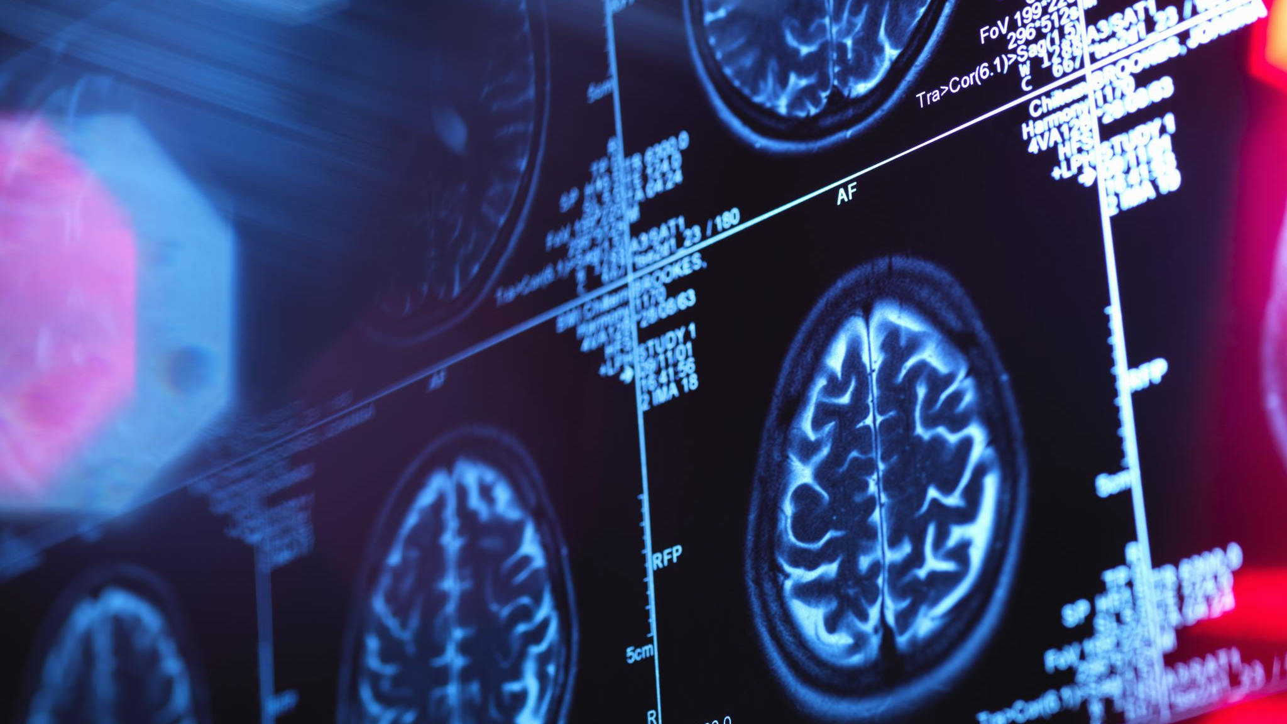
Brain Tumor Segmentation
Patrick Ries
Merve Taskaya
Tomasz Wlodarski

Slide 2
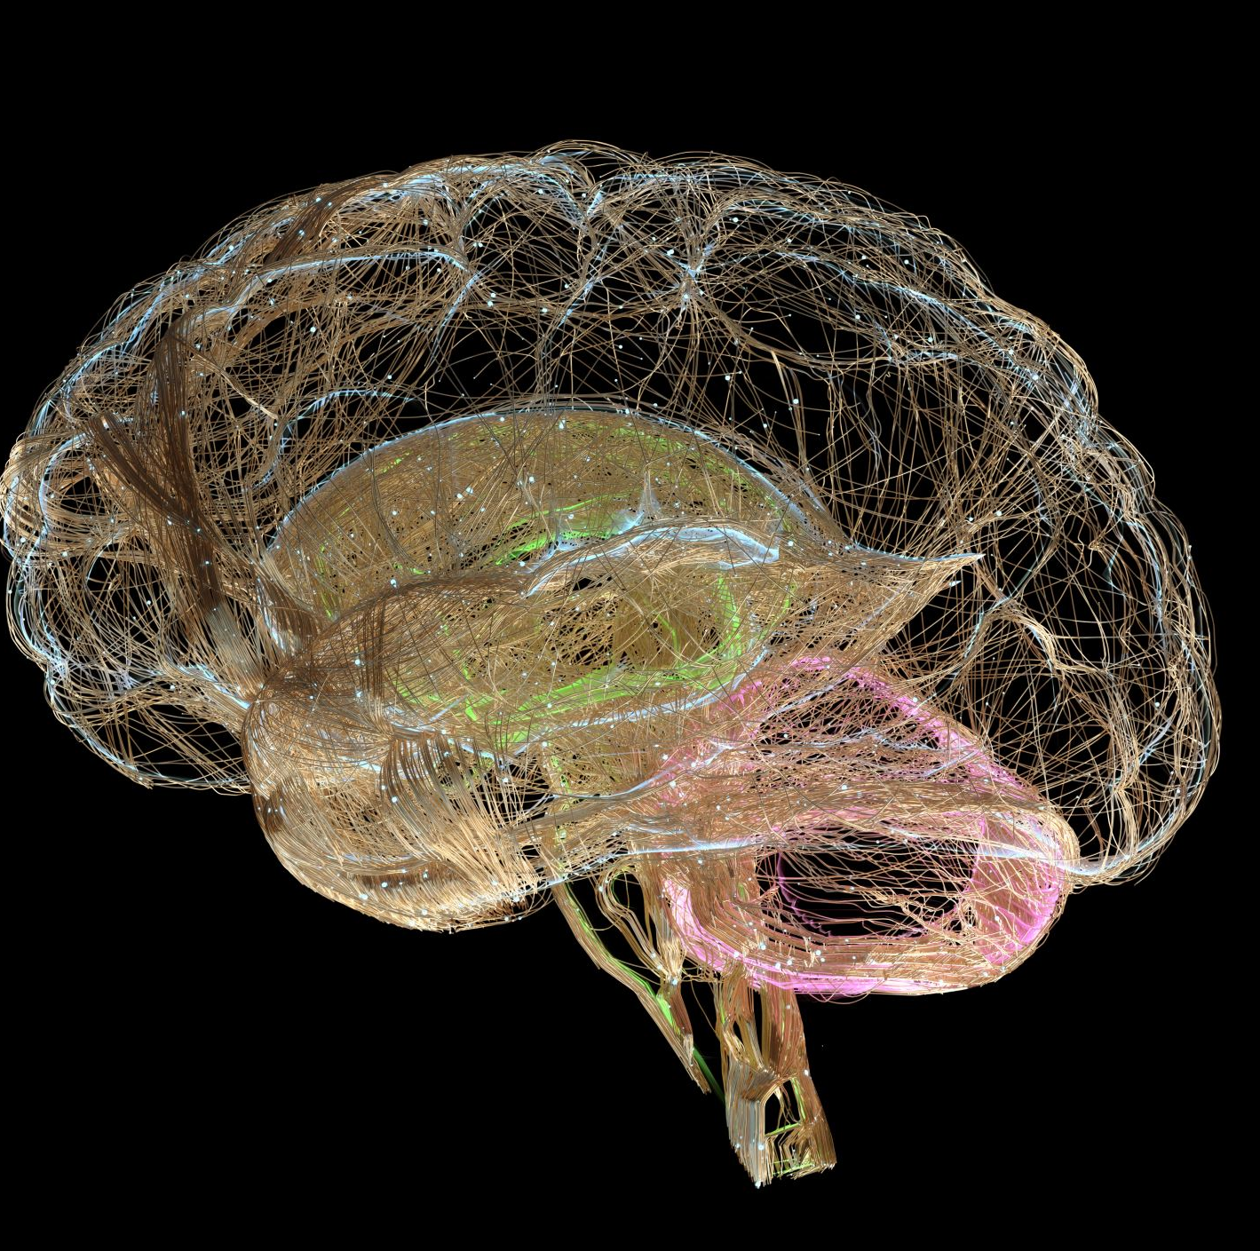
Research Question
"How effective is the nnU-Net framework in segmenting brain tumors from MRI dataset from The Cancer Imaging Archive?"

Slide 3

Data Overview
Data Source: The Cancer Imaging Archive (TCIA)
Description: MRI scan data of 114 patients with pre-segmented brain tumors.
Usage: Training and validating machine learning models for tumor segmentation.

Slide 4

Overview of methods
EDA
Primary Method: nnU-Net
Alternative Method: Convolutional Neural Network (CNN) or a variant like U-Net or V-Net for comparison → for benchmarking to evaluate nnU-Net's performance

Slide 5

Metrics for evaluation of results
Dice Coefficient: Overlap between the predicted segmentation and the ground truth
Sensitivity and Specificity: Evaluation of the true positive rate and the true negative rate
Notes:
Haustoff Distanz (?)
sensitivity and specifity weglassen
Tumorvolumen vergleichen

Slide 6

Overview of results
Clearer Segmentation Outcomes: Show how nnU-Net improves accuracy of tumor segmentation in MRI scans compared to previous papers/methods
Handling Diverse Tumor Characteristics: Evaluate the nnU-Net's effectiveness in segmenting tumors with different sizes, shapes, and locations
Model Efficiency: Discussion of the time and the computational resources required for nnU-Net to process MRI scans
(Benchmarking Performance: Performance of nnU-Net in comperison to other methods on the same data set)

