Slide 1
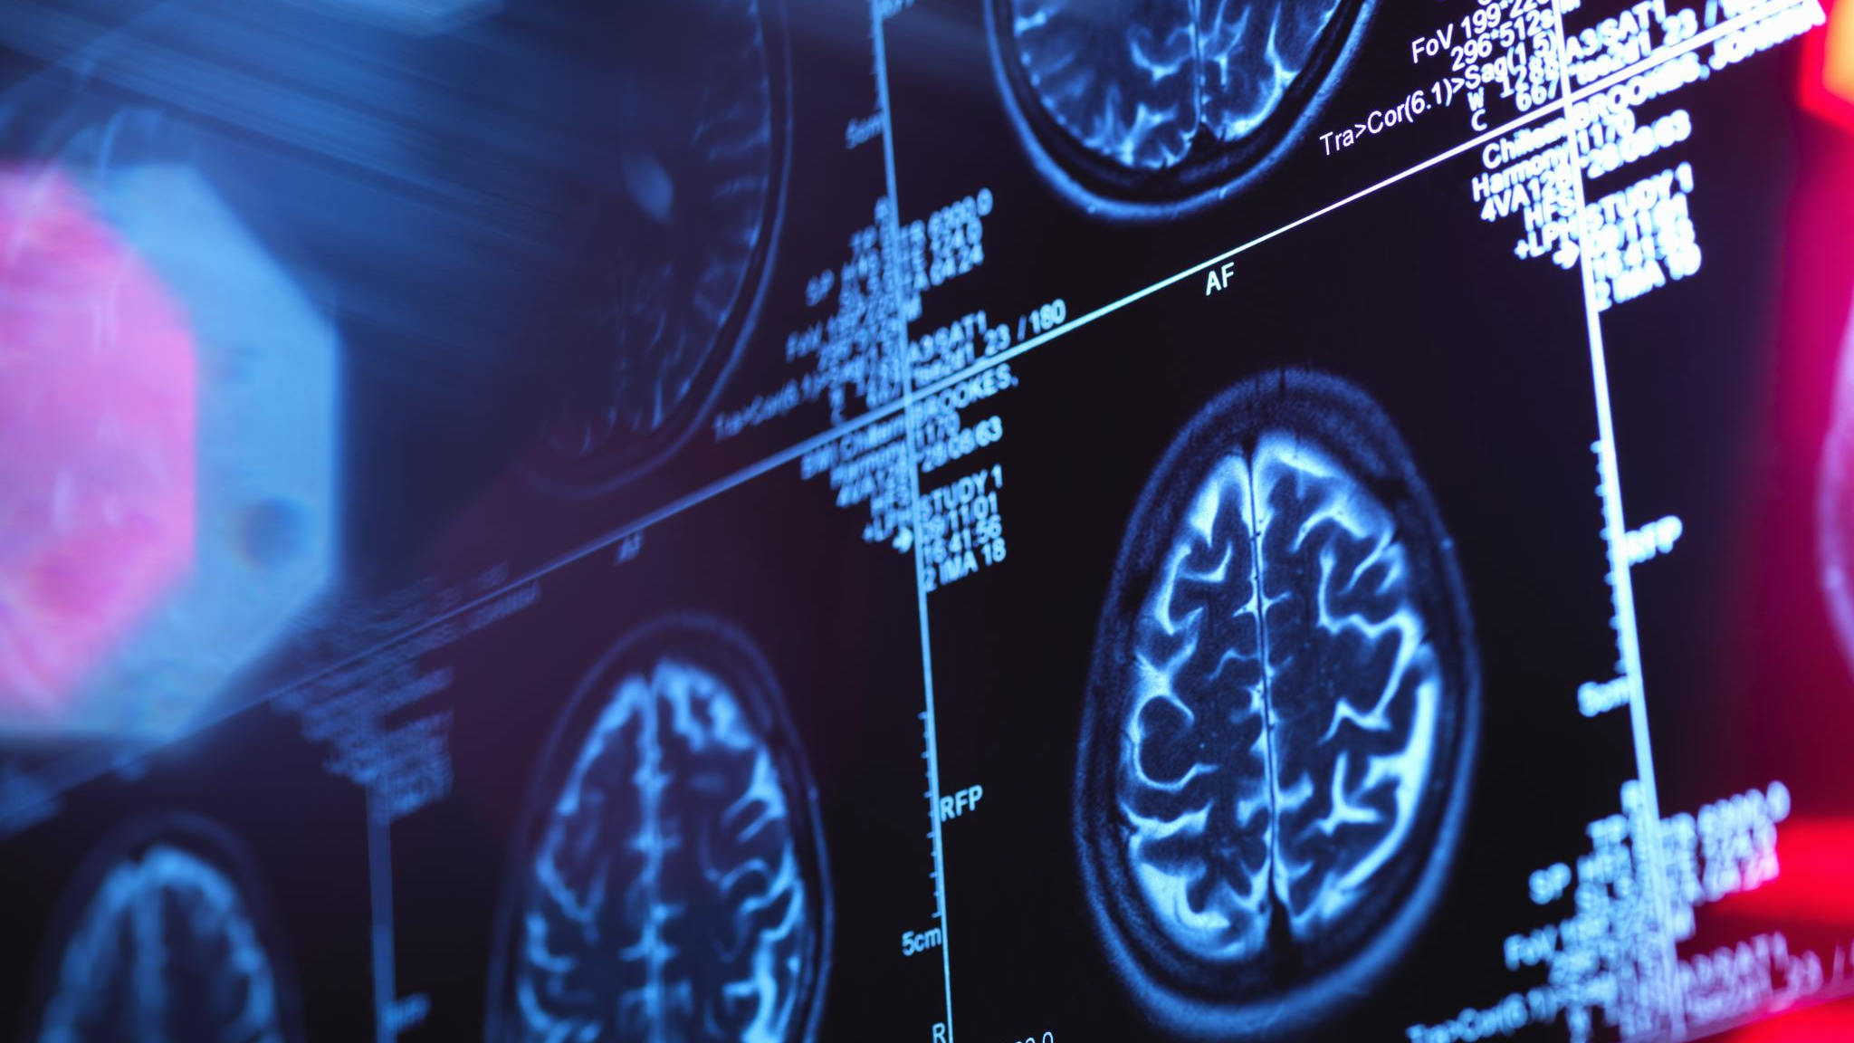
Brain Tumor Segmentation
Patrick Ries
Merve Taskaya
Tomasz Wlodarski

Slide 2
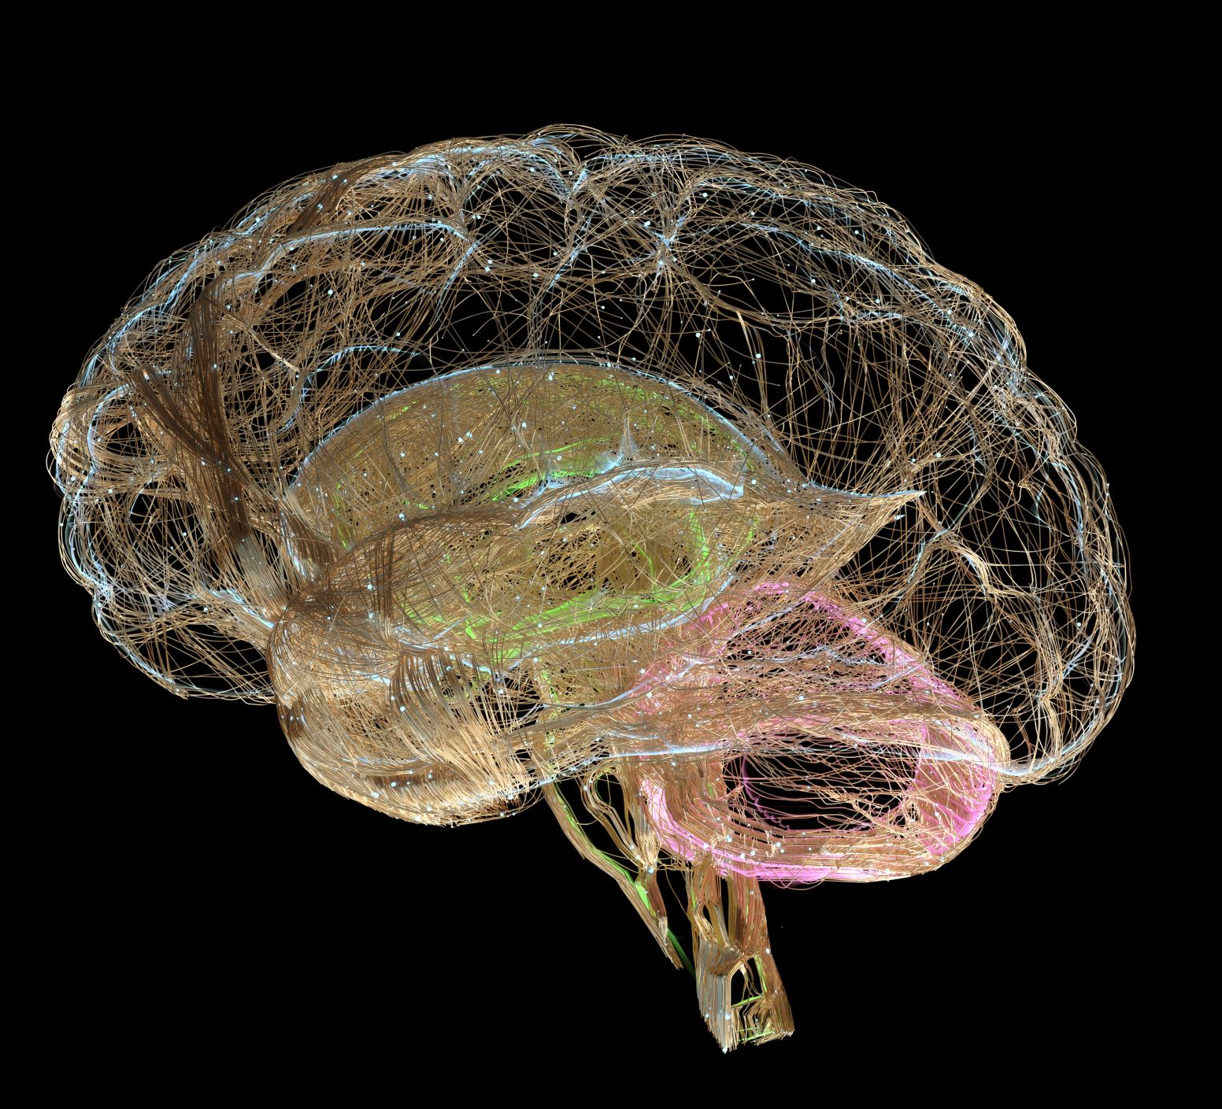
Research Question
"How effective is the nnU-Net framework in segmenting brain tumors from ReMIND dataset?“

Slide 3

Data
Data Source: The Cancer Imaging Archive (TCIA)
ReMIND Database
MRI scan data of 114 patients with pre-segmented brain tumors.
Available Files:
Clinical data (information about the patients)
Metadata (information about the file structures)
different MRI files (T1, T2, Flair)
Different segementations (tumor, cerebrum, …)

Slide 4
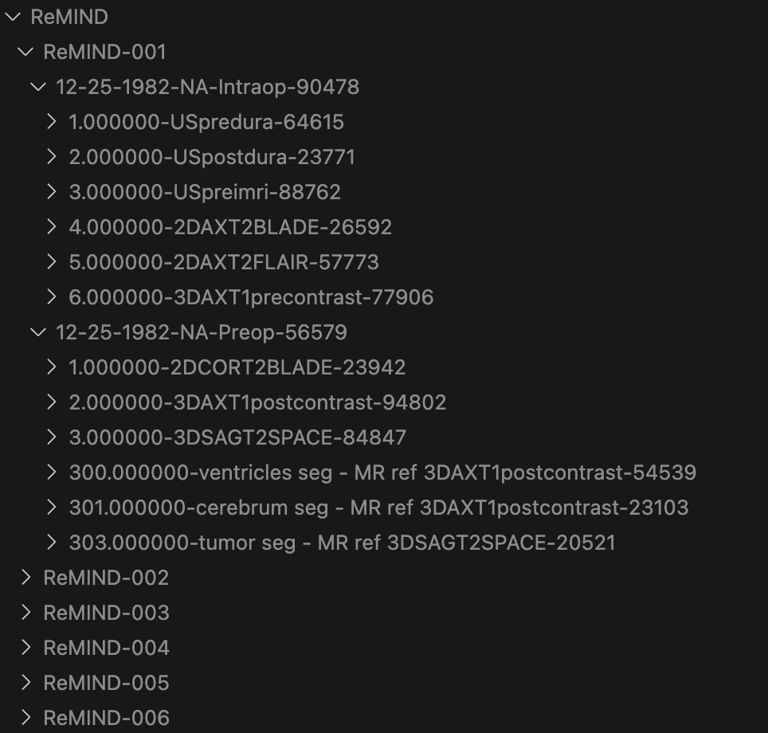
Data Structure
Preop and Inraop Data available
Different 2D, 3D files available
T1 and T2 files available
! For every patient file availability is different example:
ReMIND-001 = Patient No. 1: 2D COR T2, 3D AX T1 and 3D SAG T2 available
ReMIND-002 = Patient No. 2: 2D AX T2 , 3D AX T1

Slide 5
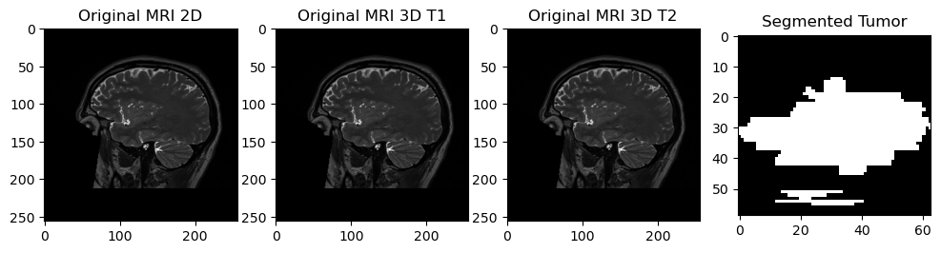
Data
Image Shapes of one Slice for patient 1 (ReMIND-001)
MRI image shape 2D: (256, 256)
MRI image shape 3D T1: (256, 256)
MRI image shape 3D T2: (256, 256)
Segmentation image shape: (59, 63, 61)

Slide 6
Data Preprocessing
Manual preoperative whole tumor segmentations are provided for 113 cases.
Dicom2Nifti conversion
Resampling of tumor segmentation.
Remapping of Labels

Slide 7
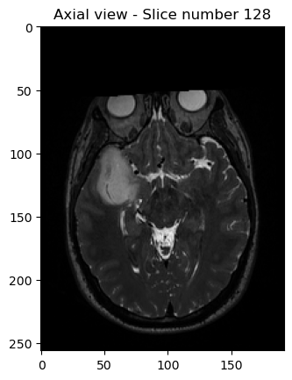
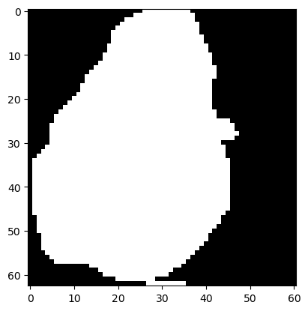
Data Preprocessing
Resampling of tumor segmentation:
Finding the correct view – axial better than sagital to see the tumor

Slide 8
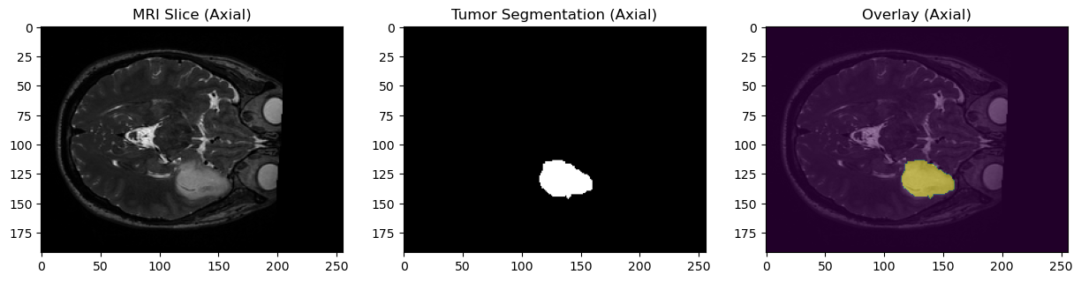
Data Preprocessing
Resampling of tumor segmentation

Slide 9
Challanges in Preprocessing
nnUNet needs all images in the same shape.
If a detail modality want to be provided, the files should be available for all patients.
Therefore: Only the tumor segmentation file and the referenced MR img was kept. As all other files were removed because the shapes of each files (T1, T2, ..) are not fitting. The different modalities was not used as only one image per patient was available.

Slide 10

Model Training
Model: nnUNet (nnUNetv2)
Default setting in nnUNet: model training runs for 1000 epochs (with 5 cross-validation)
Changed setting to 100 epochs per fold with 5 cross-validation
3d full resolution, and FOLD will be 0–4

Slide 11
Model Training
Training/Validation Split:
for each training fold, randomly choosen by nnUNet 80% for training and 20% for validation
Training set = 90
Validation set = 23

Slide 12
Model Training
Benchmarking done for 5 epochs for
2D model
3D model
Results: has to be added

Slide 13
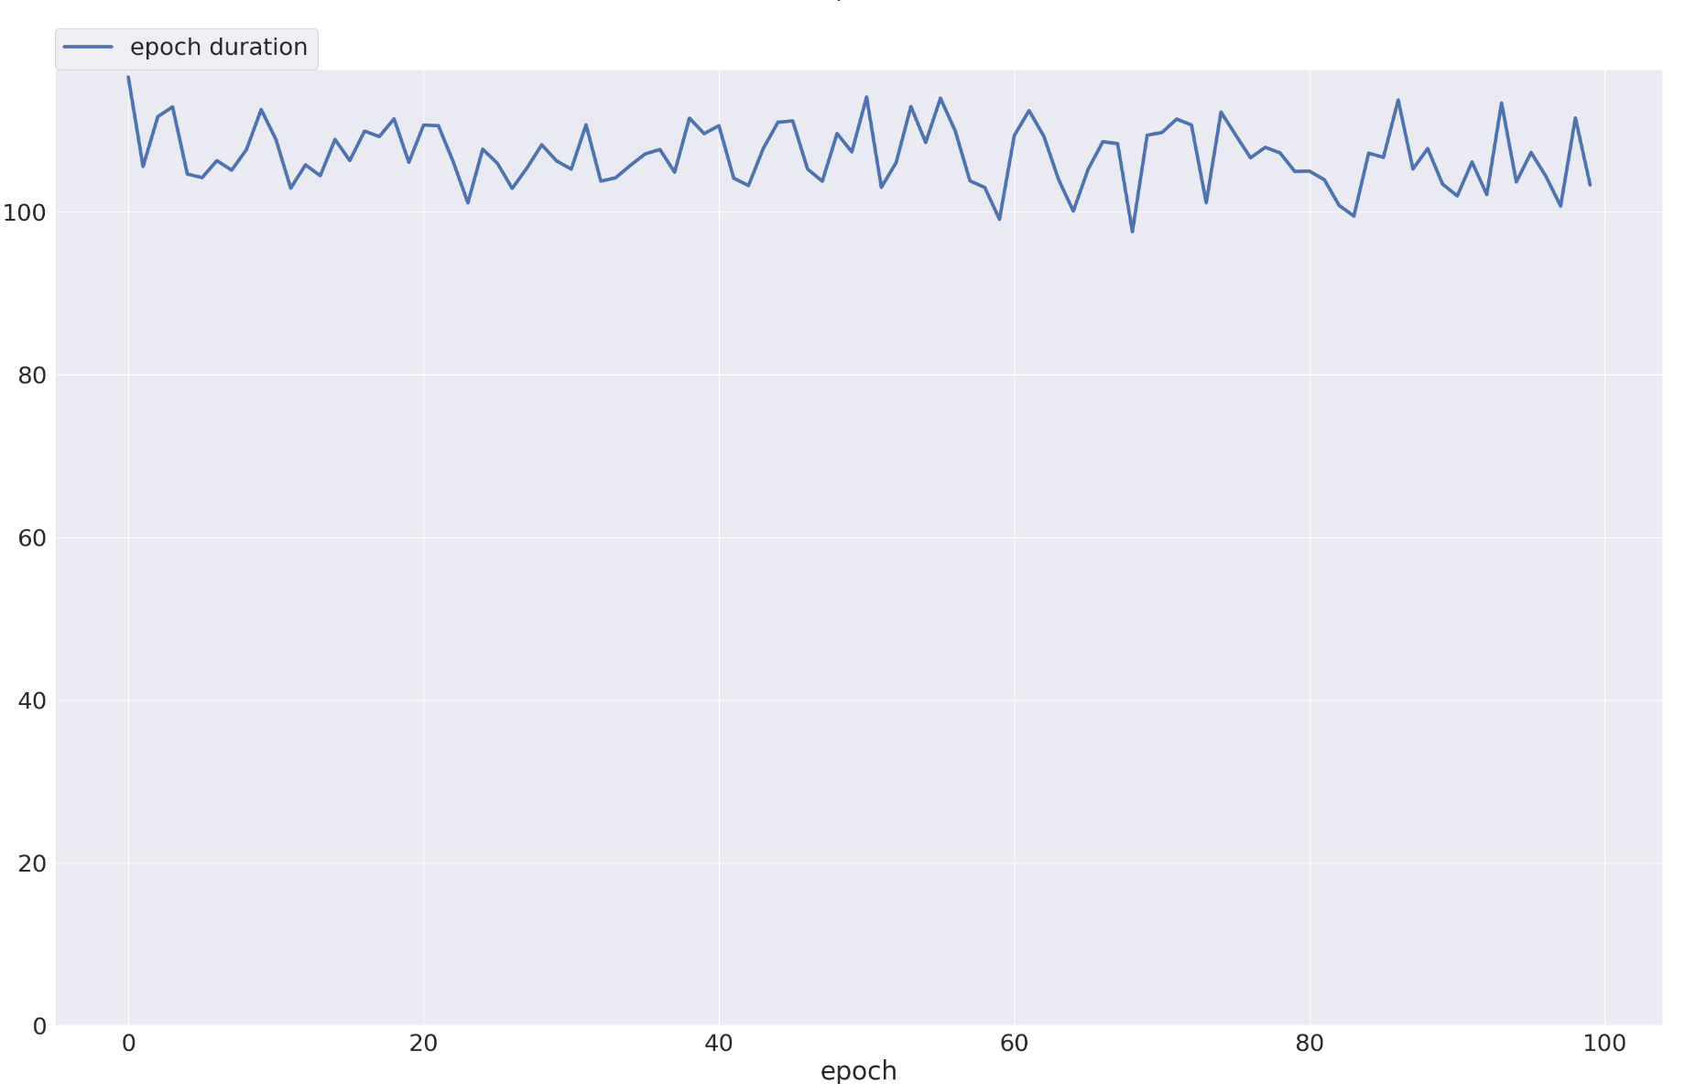
Model Training
Training Time: 2-3 min per epoch ~ 5 hours training time
Training of the 4 fold Model →

Slide 14

Results
Best Model:
Model with Fold number: 4
Best pseudo dice score: 0.6434
Mean dice score: 0.5671184980502029
Notes:
Haustoff Distanz (?)
sensitivity and specifity weglassen
Tumorvolumen vergleichen

Slide 15
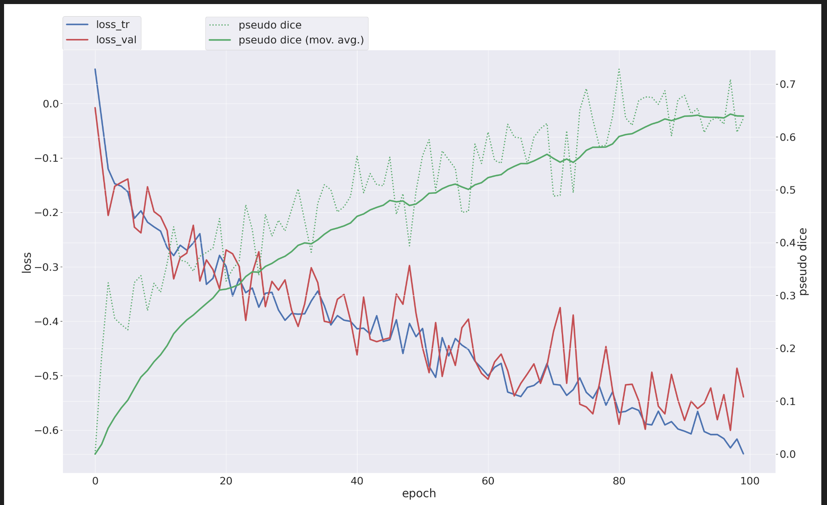
Results
With train and validation loss, can check of Overfitting/underfitting

Slide 16
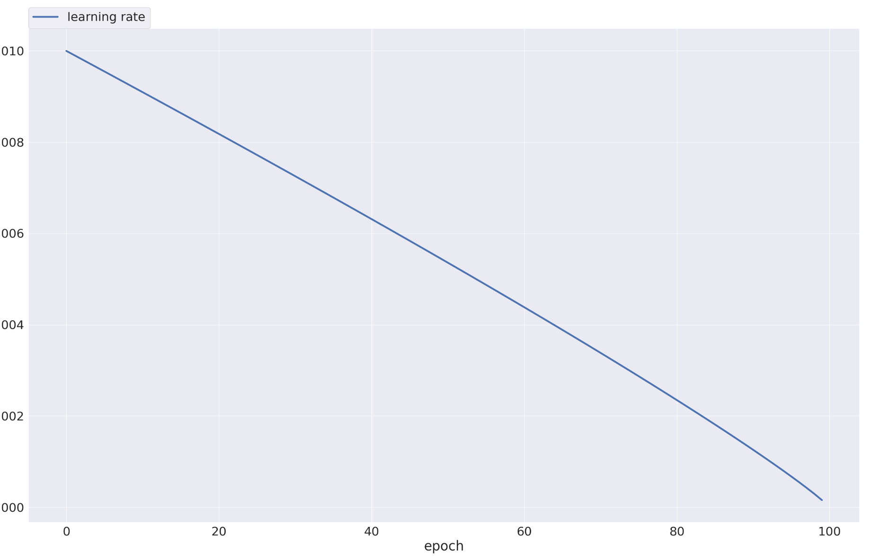
Results
nnUnet dynamically decreases the learning rate every epoch

Slide 17
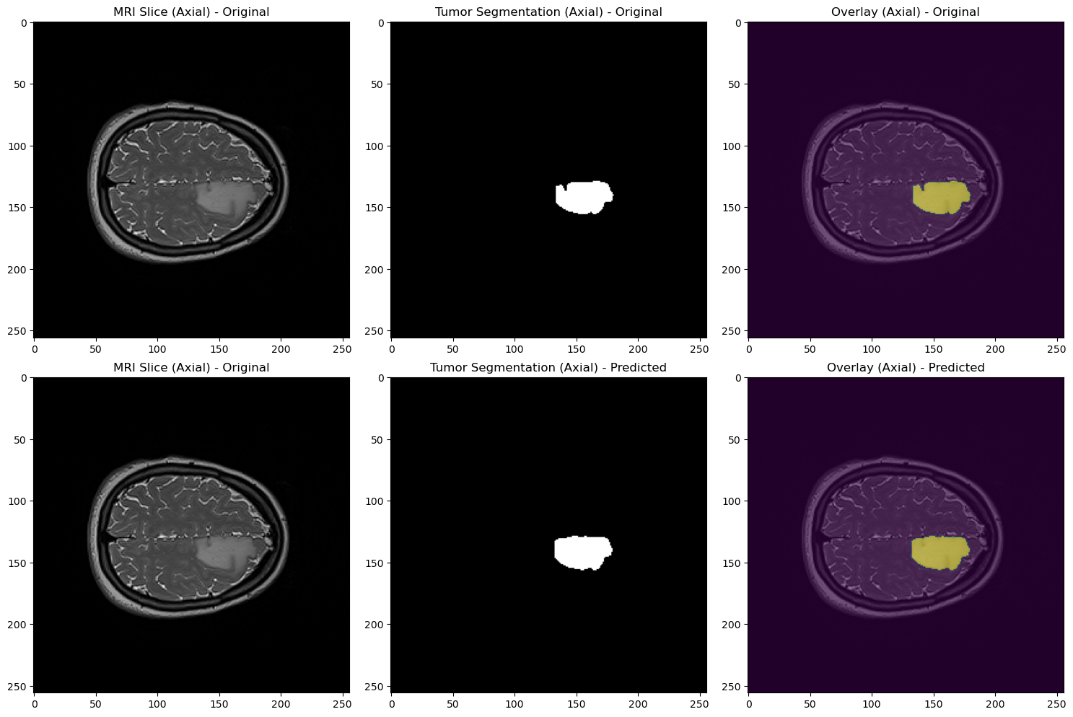
Results
Validation of 5-fold model: Dice Score: 0.926538 (ReMIND-002)

Slide 18
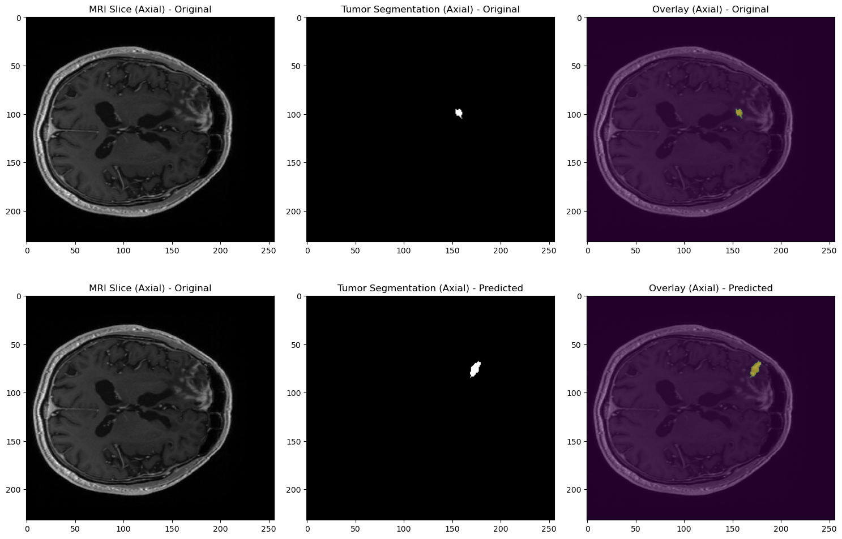
Results
Validation of 5-fold model: Dice Score: 0 (ReMIND-075)

Slide 19
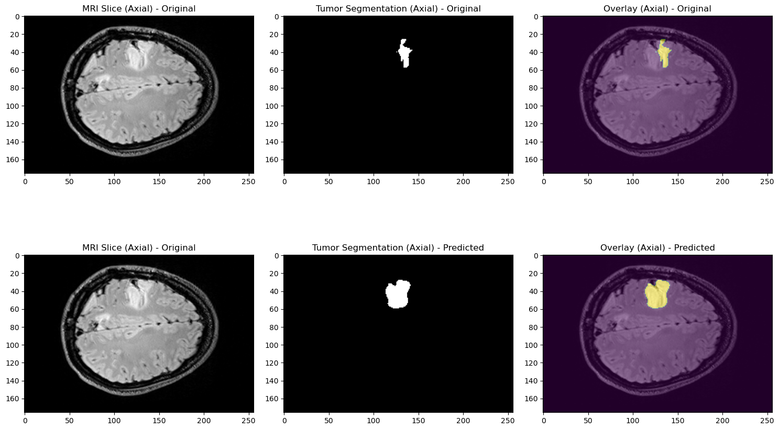
Results
Additional predicition is done.

Slide 20
Conclusion
The model effectively identifies clear tumors but struggles with less distinct ones.
Limited epochs (limited from 1000 to 100) due to training time and resource constraints may affect performance.
Optimizing training could improve detection in challenging cases.

