Slide 1

Spin Photo Detector: A Breakthrough in AI Data Transmission
Presented by Merve gök

Slide 2
Abstract
Spintronics is one of the rising technologies with massive growth potential and has the capability to develop in the coming years, especially in the industrial market for AI applications. In spintronics or spin electronics, data are accumulated by using the spin property of electrons. Due to this property of electrons, there is a huge shift in device functionality. A lot of research work has been done and is still ongoing to enhance this property. Here, we use spin property, which solves the biggest issue which the world is facing today, that is, power consumption. With this new technology, there are many advantages like high speed, compact devices, less power consumption, reduced heat dissipation, and nonvolatility. In this chapter, we discuss the technology of spintronics. The applications of the different types of spintronic-based devices are quantum computer, data storage, industrial motors, MRAM, current sensor, magnetic sensor, and many more. This chapter covers the basic idea of spintronics, the working principle of spintronics, the different types or material used for the fabrication of devices, and the challenges which the researcher is facing. The different types of power-reducing techniques and devices are discussed along with the phenomena of spintronics like GMR, TMR, spin transfer torque, spin hall effect, etc. The main purpose of writing this chapter is to understand the basics of spintronic and spintronic devices, with their applications in AI.

Slide 3
Contents
1. What is Spintronics?
2. TDK Corporation’s Spin Photo Detector
3. Key Features
4. Where Can It Be Used?
5.The Potential of Spintronic Technology in AI Applications
6. What’s Next?
7. Why It Matters

Slide 4
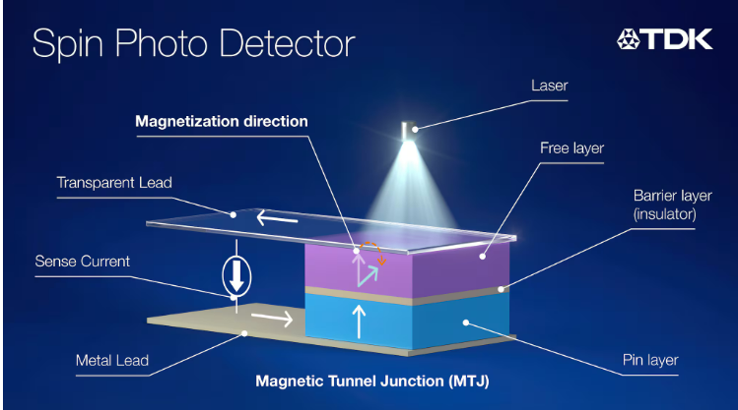
What is Spintronics?
- Uses charge and spin of electrons
- Enables faster and energy-efficient processing
- Used in next-gen memory and sensors

Slide 5
The Potential of Spintronic Technology in AI Applications
Spintronics and AI Integration
Spintronic technology enables integration with rapidly advancing AI infrastructures.
This study examines the role of spintronic devices in AI applications and how they can be integrated into industrial production processes.
High Speed and Low Power Consumption
Spintronic devices have the capacity to process data at high speeds with low energy consumption.
Given that AI algorithms require intensive computations on large amounts of data, spintronic technology becomes crucial for improving energy efficiency.
Compact Devices and Heat Management
Spintronic devices are more compact and generate less heat compared to traditional electronics.
This feature enables AI hardware to be smaller and more efficient, improving device interactions and overall performance.
Non-volatility
Spintronic devices feature non-volatile memory, reducing the risk of data loss and enabling faster data access in AI applications.
Other Potential Applications
Spintronic technology has potential in data storage, quantum computing, and MRAM.
This study will explore how spintronics can revolutionize these fields and the challenges that need to be addressed.

Slide 6
TDK’s Spin Photo Detector
- World's first spin photo detector
- Converts light into spin current
- 20 picosecond response time
- 10x faster than traditional devices

Slide 7
Key Features
- 800 nm wavelength
- Uses Magnetic Tunnel Junction (MTJ) tech
- Optical + Electronic + Magnetic integration
- Compact and energy-saving

Slide 8
Where Can It Be Used?
- AI data transfer
- AR/VR smart glasses
- High-speed cameras
- Space and satellite systems

Slide 9
What’s Next?
- Sample production by 2026
- Mass production in 5 years
- May revolutionize AI hardware

Slide 10
Why It Matters
- Solves AI data bottlenecks
- Enables faster, smarter tech
- Spintronics = Future-ready tech

Slide 11
Thank you ☺

Slide 12
Kaynakça:
TDK Corporation. (2025, April 23). TDK Develops World's First Spin Photo Detector Using MTJ Technology. Retrieved from https://www.global.tdk.com/news_center/press/202504231200.htmlSharma, P., Gill, S. S., & Raj, B. (2023). Spintronic technology applications for artificial intelligence. In S. S. Gill & B. Raj (Eds.), AI for big data-based engineering applications from security perspectives (ss. 47–68). CRC Press. https://doi.org/10.1201/9781003230113-3​

