Slide 1

How Can We Identify Unsatisfied Customers in an Early Stage?

Slide 2
Data Description
Target Variable
Binary – 0 (Satisfied) vs 1 (Unsatisfied)
Observations
76,020 in training set / 75,818 in test set

Slide 3
Exploring The Data & Cleaning Process
Understanding the Structure of Variables
- Data types, categories and classes
Cleaning the Data
- Removed 29 Constant Variables
- Removed 34 Identical Variables
- Removed ID Variable (Uninformative)
Looking for Missing Value
- Not found
Challenges in Interpreting the Variables
- No straightforward descriptions on variables - Variables in Spanish & over 370 Variables - Need of understanding of different culture & regulations

Slide 4


3 Choices Of Models
Classification Tree (Rpart)
Random Forest (Ranger)
Extreme Gradient Boosting (XGB)
Since our target data is binary data,
we explored different alternatives for the Classification Algorithms

Slide 5
Main Approach
Split the
Train Data Set into
Train & Validation
Manage
Unbalanced Data
Build Models with
Train Data Set
Run the Models with Validation Set
Measure the Accuracy of the Model
Examine the Test Data
Notes:
https://www.svds.com/learning-imbalanced-classes/

Slide 6
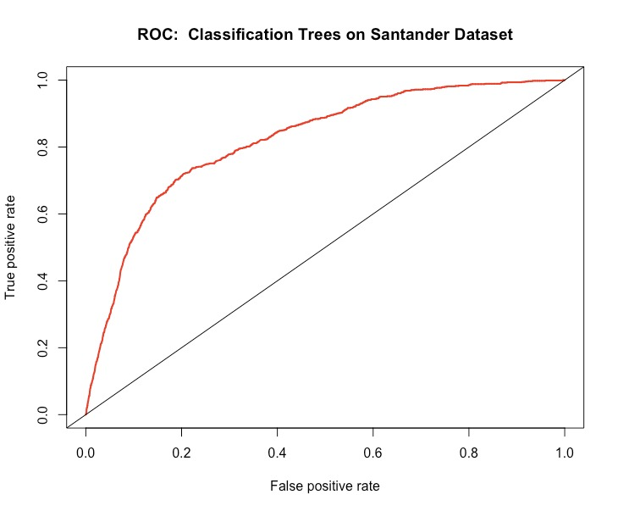
Random Forest with Ranger
ROC Curve
Balancing the data with SMOTE algorithm
Can be Improved with CV and Parameter Tuning
n=22806 | Predicted Satisfied (0) | Predicted Unsatisfied (1)
Actually Satisfied | 17801 | 4103
Actually Unsatisfied | 293 | 609

Slide 7
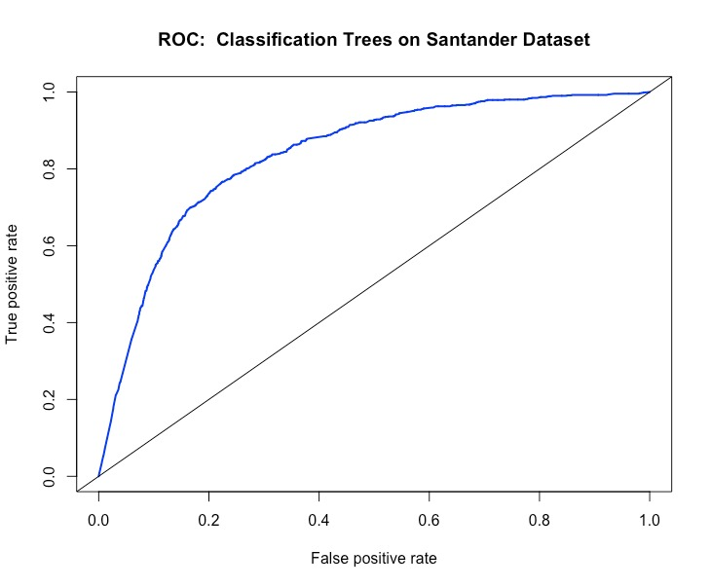
Extreme Gradient Boosting
ROC Curve
Cross Validation for Boosting Rounds (Nrounds)
Control for Imbalanced Groups
Receiver Operator Characteristic (ROC)
n=22806 | Predicted Satisfied (0) | Predicted Unsatisfied (1)
Actually Satisfied | 17847 | 4007
Actually Unsatisfied | 217 | 735

Slide 8
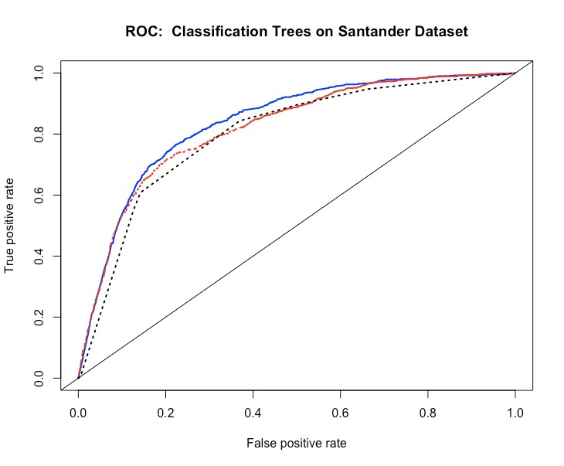
Comparison 1: Performances
ROC Curve
Model | AUC (Evaluation)
Classification Tree | 0.7998
Random Forest | 0.8197
XGB | 0.8373
Extreme Gradient Boosting
Random Forest
Classification Tree
Notes:
We want the curves to increase steeper, so that true positive and false positive ratio is better thus our model is better. We can see all of the models perform similarly. At this point we can look at the area under the curve to compare the models. Highest value is 83% and it means 83% of the area, can be explained with XGB model. So we classify 83% of the true positives correctly.
It is equal to the probability that a random positive example will be ranked above a random negative example.

Slide 9
Comparison 2: False Negative Rates
Confusion Matrix of XGB
n=22806 | Predicted Satisfied (0) | Predicted Unsatisfied (1)
Actually Satisfied (0) | TN | FP
Actually Unsatisfied(1) | FN | TP
False Negative: Customers who are predicted incorrectly as satisfied but actually unsatisfied
We see that XGB does better job in prediction and missed less unsatisfied customers.
Notes:
It is better to flag some of the customers, who are False Positives, as possible unsatisfied than missing actually unsatisfied customers. Alternatively we can also have a look at the false negative rates, which in this case number of actually unsatisfied people that we misclassified. These are the customers at bank would not like to loose, and predict unsatisfied customers in the best way. So the model that reduces the number of false negatives would be in favor.

Slide 10
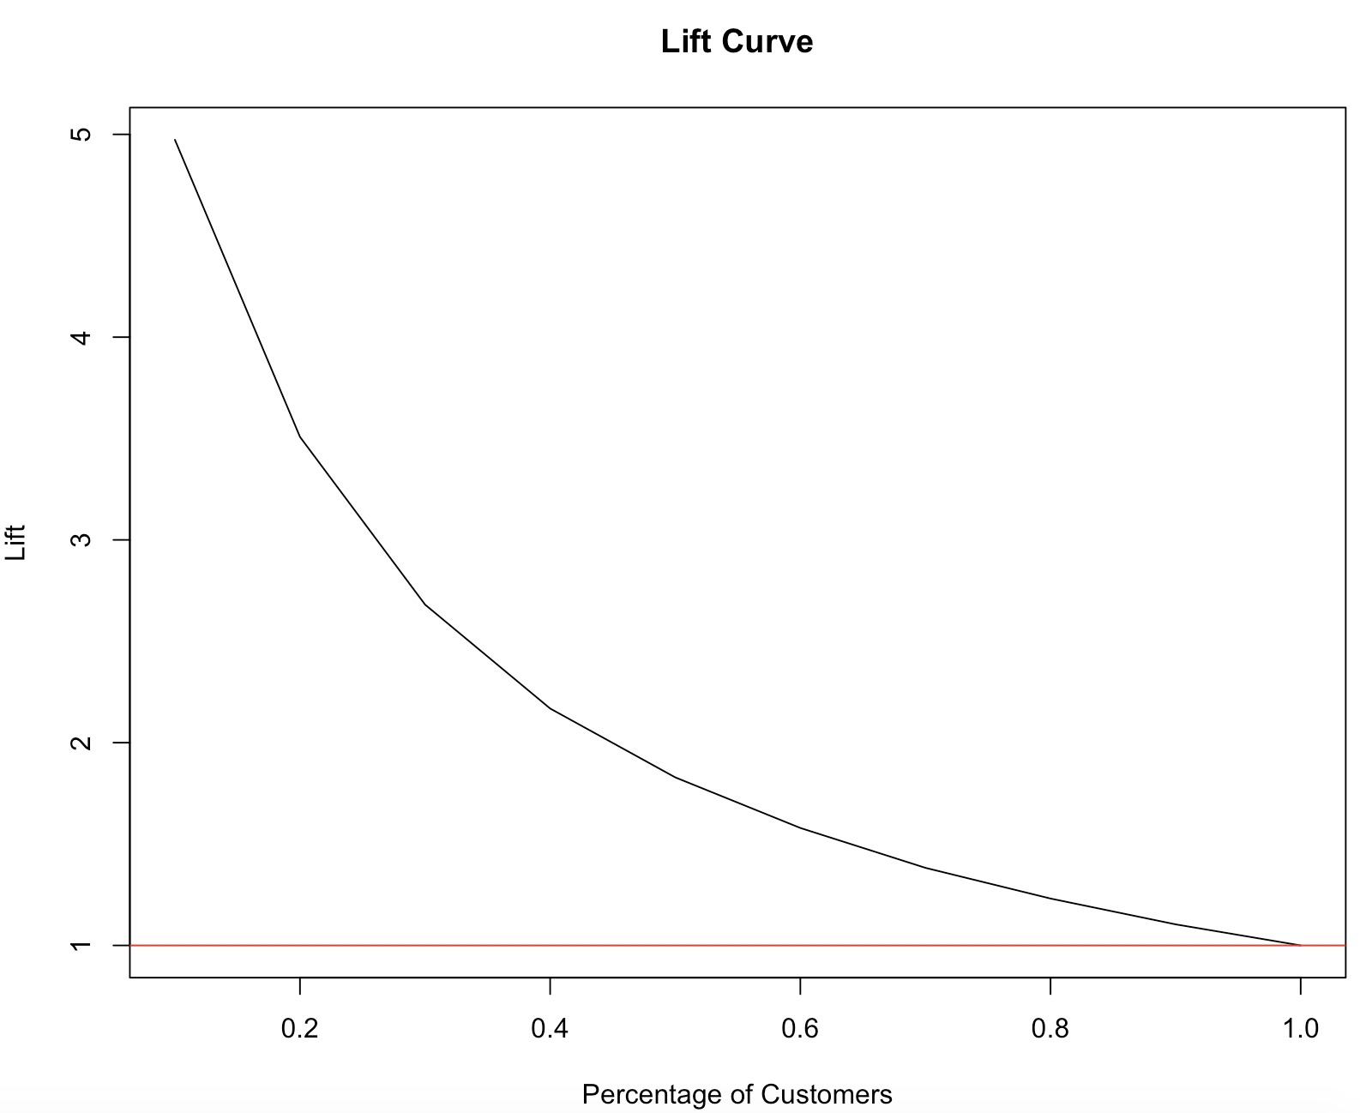
Effectiveness of XGB
Ratio between the results obtained with and without the predictive model
Finding unsatisfied customers with a minimum effort
By targeting 20% of the customers, 70% unsatisfied customers will be in the group
Notes:
https://www.ibm.com/support/knowledgecenter/en/SSLVMB_23.0.0/spss/tutorials/mlp_bankloan_outputtype_02.html

Slide 11
Most Important Variables for Satisfaction (XGB)
Age
Account Balance
Customer Lifetime Value

Slide 12
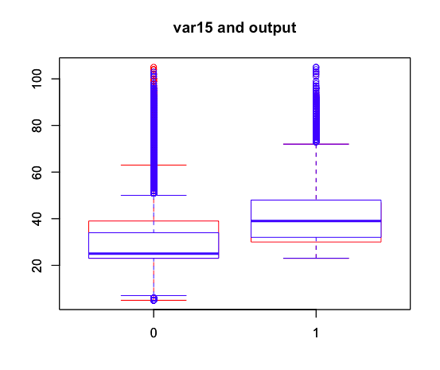
Variable 1 (Age): Customers Older than 65
Older Customers are Less Satisfied
Make Channels 65+ friendly
Website, Apps, other approaches
More Personalized Customer Service
Knowledgeable and Friendly Employees
Enhance Pensions Schemes
2
Blue : Predictive
Red: Actual
0: Satisfied
1: Unsatisfied
1
3

Slide 13
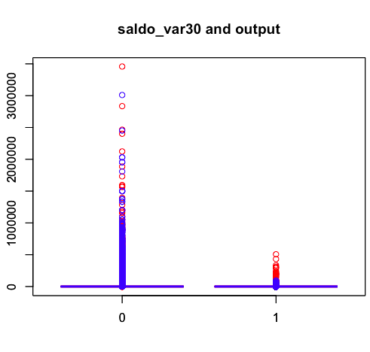
Variable 2 (Account Balance): Customers with Lower Balance
Customers with Lower Balance are less Satisfied
Change Interests on Services
Loans, mortgage, savings, debts
More Personalized Customer Service
Knowledgeable and friendly employees
2
Blue : Predictive
Red: Actual
0: Satisfied
1: Unsatisfied
1
3

Slide 14
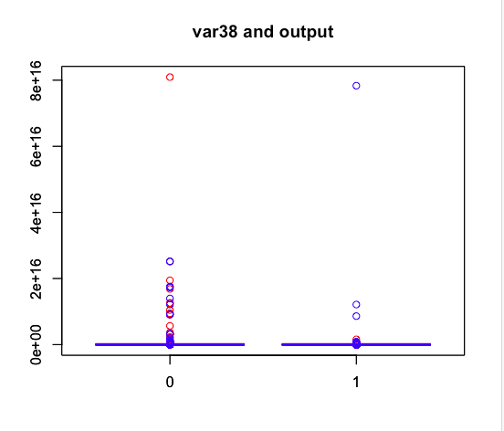
Variable 3 (CLV): Customers with Lower Lifetime Value
Customers with Lower Lifetime Value are Less Satisfied
Casual Understanding on CLV
Collect detailed data to understand the casual relationship between CLV and service
More Personalized Customer Service
Knowledgeable and friendly employees
2
1
3
Blue : Predictive
Red: Actual
0: Satisfied
1: Unsatisfied

Slide 15
Factors For Better Decision Making
Business Context
2
Quality Data
1
- Clear goal
- Alignment
- Compatibility
- Reliability
.
Decision
Making
Model Fit
3
4
Optimizing
- Suitability
- Data & Model
- Analysis Process
- Business Strategy
Notes:
Now I would like to summarize what we have learned through this project. We have been learning Data Analysis to make better decision in business. To perform a data analysis that would fulfill its original purpose, we would have to consider four important factors. First, we need to understand the business context, meaning that we have to have a clear goal why we need to perform a certain data analysis. Secondly, we need quality data, which is appropriate to achieve the goal, from a reliable source. Thirdly, model that suits the type of the data or the questions is really important. Finally, by optimizing the data, model, or the whole analyzing process would make the quality of the whole analysis better. Of course, the final decision in business strategy derived from the analysis would have to be aligned with other business strategies in an organization.

Slide 16
Data Analysis Suggestions for Banks
CRM Optimization
Profitability
Improvement
Economic Prediction
Risk Management
Targeting and segmentation
Product Development
Inflation
Credit risk
Service improvement
Price (Interest) Determination
Interest rate
Leverage level
Personalization
Profitability Analysis
Economic cycle
Cashflow
Notes:
Finally, here I have picked some further suggestions for Santander, or any other banks. I believe that they would be able to gain competitive advantages through these types of data analysis. Here, CRM Optimization and Profitability Improvement would be pretty much similar to all other industries. However, economic predictions and risk management would be much more important for companies in finance industry compared to the others, not only for the profit wise, but for the prolonged sustainability of the business.

Slide 17

Appendices

Slide 18
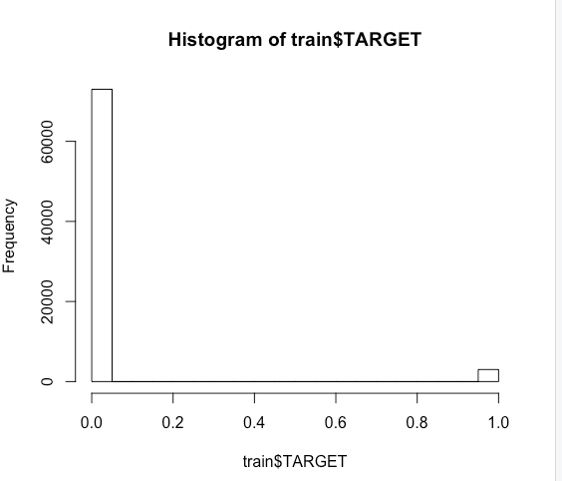
Appendix 1 – Imbalanced Data Handling
Undersampling : reducing satisfied
Oversampling: duplicating unsatisfied
Hybrid method with package “Smote”
Control for imbalanced groups with scale_pos_weight as a parameter in xgb
Training Dataset
0=Satisfied | 1=Unsatisfied
73012 | 3008

Slide 19
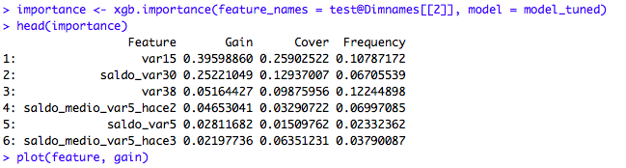
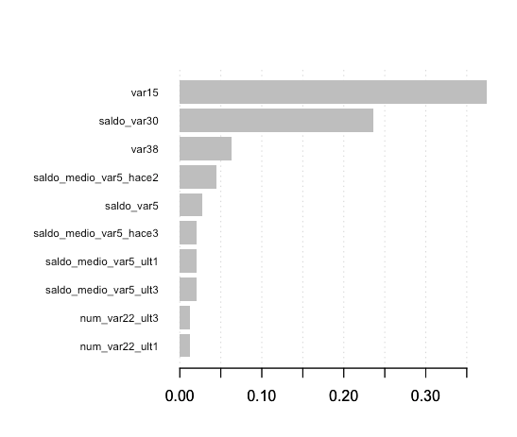
Appendix 2 – Most Important Features
G
Contribution of a feature to the model
C
Number of observations related to a feature
Feature Importance Alternative Graph
Number of observations related to a feature
Number of observations related to a feature
F
Percentage of number of times a particular feature occurs in the model

Slide 20
Appendix 4 – Classification Tree Confusion Matrix
True Positives: we correctly predicted that 555 customers are unsatisfied
True Negatives: We correctly predicted that customers are satisfied, 18776
False Positives: We incorrectly predicted 3118 customers as unsatisfied
False Negatives: We incorrectly predicted 357 customers as satisfied who are actually unsatisfied
n=22806 | Predicted Satisfied (0) | Predicted Unsatisfied (1)
Actually Satisfied(0) | 18776 | 3118
Actually Unsatisfied(1) | 357 | 555

Slide 21
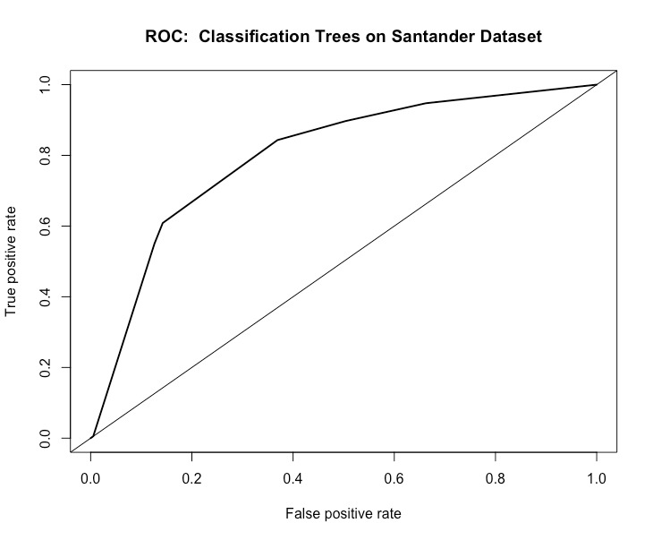
Appendix 3 - Classification Tree with rpart!
Balancing the data with SMOTE algorithm
If we don’t control for the imbalance, model predicts
100% of the customers as satisfied which is wrong
n=22806 | Predicted Satisfied (0) | Predicted Unsatisfied (1)
Actually Satisfied | 18776 | 3118
Actually Unsatisfied | 357 | 555

Slide 22
Appendix 5 – Random Forest Confusion Matrix
True Positives: we correctly predicted that customers are unsatisfied, 619
True Negatives: We correctly predicted that customers are satisfied, 17801
False Positives: We incorrectly predicted 4093 customers as unsatisfied
False Negatives: We incorrectly predicted 293 customers as satisfied who are actually unsatisfied
n=22806 | Predicted Satisfied (0) | Predicted Unsatisfied (1)
Actually Satisfied (0) | 17801 | 4093
Actually Unsatisfied(1) | 293 | 619

Slide 23
Appendix 6 – XGB Confusion Matrix
True Positives: we correctly predicted that customers are 695 unsatisfied
True Negatives: We correctly predicted that customers are satisfied, 17047
False Positives: We incorrectly predicted 4847 customers as unsatisfied, who are actually satisfied
False Negatives: We incorrectly predicted 217 customers as satisfied who are actually unsatisfied
n=22806 | Predicted Satisfied (0) | Predicted Unsatisfied (1)
Actually Satisfied (0) | 17047 | 4847
Actually Unsatisfied(1) | 217 | 695
22806/76020 is 0.3. So this is the test data set that was split from the original training set.
Notes:
https://www.ritchieng.com/machine-learning-evaluate-classification-model/

Slide 24
Appendix 7 – Finding The Unsatisfied Customers
Targeting the unsatisfied customers is cheap, xgb is the best model
Although the best model still makes mistakes, it performs better in predicting unsatisfied customers correctly

Slide 25
Appendix 8 – Comparison Confusion Matrix
Its important for us to reduce the number of customers in the False Negatives, as they are incorrectly classified as satisfied customers
Since those customers are classified incorrectly and they are unsatisfied, bank will face with a risk of loosing of those customers
False Positives are more acceptable than False Negatives in this case
It is better to flag some of the customers as possible unsatisfied than missing actually unsatisfied customers

Slide 26
Appendix 9: Effectiveness of XGB
Finding unsatisfied customers with a minimum effort
Lift at 20% is 3.5 (70% of the unsatisfied customers)

Slide 27
References
http://thestatsgeek.com/2014/05/05/area-under-the-roc-curve-assessing-discrimination-in-logistic-regression/
https://www.getfeedback.com/blog/40-stats-churn-customer-satisfaction/
https://advanceddataanalytics.net/2015/08/27/if-you-did-not-already-know-lift-chart/
http://www2.cs.uregina.ca/~dbd/cs831/notes/lift_chart/lift_chart.html
https://www.ritchieng.com/machine-learning-evaluate-classification-model/
https://www.kaggle.com/c/santander-customer-satisfaction
https://www.youtube.com/watch?v=1dYOcDaDJLY
Data Science for Business: What You Need to Know about Data Mining and Data-Analytic Thinking, 1st edition, by Foster Provost and Tom Fawcett

