Slide 1
AN ANALYSIS OF U.S. MORTGAGE APPROVAL
Mervin McDougall

Slide 2
CONTENTS
Introduction
Analysis Process
Findings
Remediation
Summary

Slide 3
INTRODUCTION
According to Freddie Mac, the mortgage financier, the week ending Dec 5, 2024, saw mortgage rates decrease to their lowest levels in over a month, and as a result purchase demand has improved.
But is access to mortgages equitable?
Notes:
Freddie Mac - https://www.freddiemac.com/pmms

Slide 4
ANALYSIS PROCESS
An Analysis was performed on the 2023-2024 Home Mortgage Disclosure Act Data from Rocket Mortgage with some focus on gender equity.
Evaluations were performed for Dataset imbalances, Highest predictors of approval, Fairness Analysis, and Data Drift (whether changes in new data affected the quality of the output of a predictive model)
US Mortgage Approval - https://respai.s3.us-east-2.amazonaws.com/rocket+mortgage_pr.csv
Notes:
Rocket Mortgage: https://respai.s3.us-east-2.amazonaws.com/rocket+mortgage_pr.csv

Slide 5
CURRENT APPROVAL RATINGS
107,962 applications
Notes:
Dataset: https://www.google.com/url?q=https%3A%2F%2Fffiec.cfpb.gov%2Fdocumentation%2Fpublications%2Fmodified-lar%2Fmodified-lar-schema
Males: 63 % - 68,414
Females: 37 % - 39,504
Non-binary: immeasurable - 44
Total 107,962

Slide 6
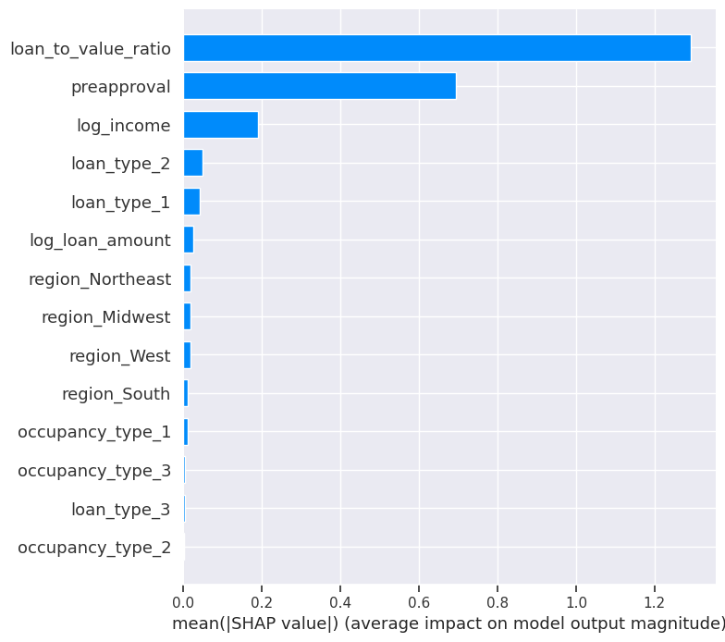
LOAN APPROVAL PREDICTORS: LIME AND SHAP ANALYSIS
Over Entire Dataset (SHAP)
Individual Observations (LIME)
Loan to Value Ratio
Preapproval
Income
Occupancy Type
Region
Loan Type
Top 3 SHAP features most influential on applicant approval

Slide 7
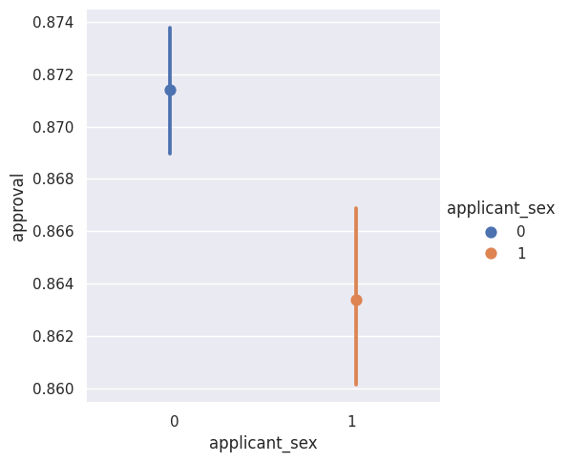
FAIRNESS CHECKS ON GENDER: FAIRLEARN METRICS
Gender
False Negative Rate
Selection Rate
Balanced Accuracy
Male
Female
43 %
51 %
53 %
45 %
64 %
65 %
A high false negative rate and low selection rate for females suggest a bias
toward Males.
Notes:
Balanced accuracy was found to be about the same between males and females. However, the higher false-negative rate among females and higher selection rate among males as opposed to females suggest a bias toward male applicants.

Slide 8
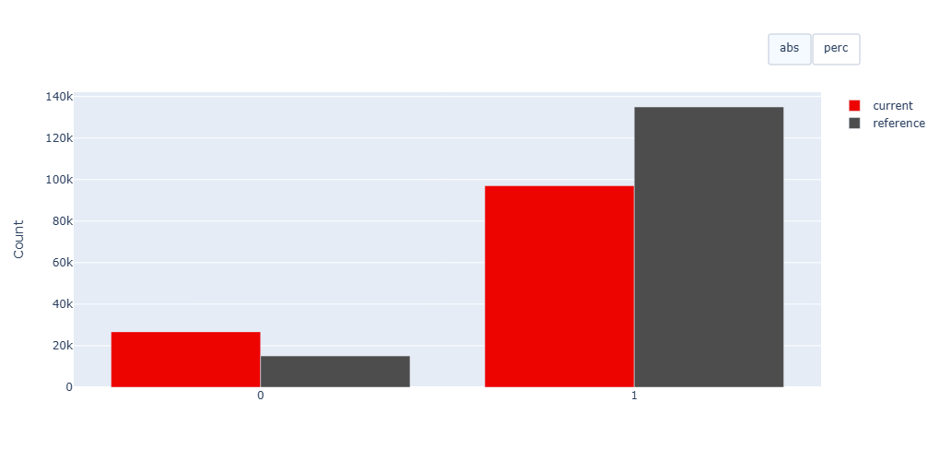
PREDICTIVE QUALITY ANALYSIS ON NEW DATA: DATASET DRIFT
Having compared the 2023 data with the current 2024 data, a small drift was discovered in the Preapproval feature and accounted for 6.67% of all features. It was not enough to affect the predictive output quality of the model for the year 2024.

Slide 9
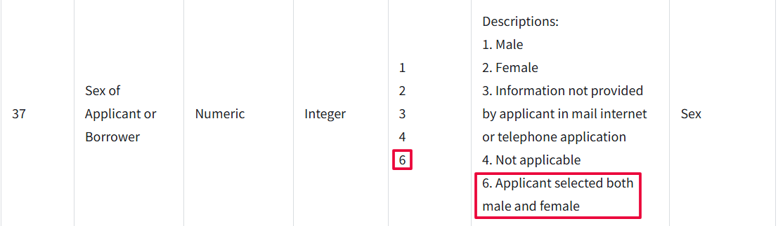
REMEDIATION
More data on Female and Non-binary applicants need to be collected. The imbalance in gender attributed to gender bias in the model
Further, paying closer attention to those who identify as Non-binary will need to be reviewed for a better assessment of their challenges.
Increasing the preapproval rate among Females and Non-binary groups is key to improving equitable access to mortgage loans.

Slide 10
SUMMARY
The recent decline in mortgage rates was accompanied by a corresponding rise in the number of people applying for mortgages.
Loan to Value Ratio, Preapproval, and Income were found to be the highest predictors of approval.
However, the applicants are overwhelmingly Males with Females and Non-binary being in the minority leading to biases in models.
Access to more quality data on Females and Non-binary applicants will help create a less biased model and better predictions.

Slide 11
THANK YOU
Mervin McDougall
msmcdouga@syr.edu
Google Colab: https://colab.research.google.com/drive/11Y8LS_0_r90zXWgwwh7sBD2apUNQXDv-?usp=sharing

