Slide 1
ADS Portfolio Reflection by Mervin McDougall

Slide 2
Agenda
Introduction
Project Reviews
Learning Goals
Next steps & takeaways

Slide 3
Introduction
Who am I?
Purpose of portfolio
Delivery approach
Notes:
The report reflects on whether I have met the learning goals of the MS Applied Data Science program and demonstrated competency in applying these goals throughout my academic career at Syracuse University
My approach will be to explain these through the paradigm of the main learning goals of the program, which include

Slide 4
Project Reviews
IST692 – Mortgage Approval and Gender Bias Analysis
IST707 – NBA Match Outcome Predictor
Build a neural network model to predict NBA match winners and point spread (the difference in the score)
IST718 – Toxic Comment Discovery
Develop a dataset to train models for detecting toxic comments in social media discussions.
Develop a predictive model for mortgage approval while investigating gender disparities in the approval process

Slide 5
Learning Goals
Collect, store, and access data by identifying and leveraging applicable technologies.
Create actionable insight across a range of contexts (e.g., societal, business, political), using data and the full data science life cycle.
Apply visualization and predictive models to help generate actionable insight.
Communicate insights gained via visualization and analytics to a broad range of audiences (including project sponsors and technical team leads).
Apply ethics in the development, use, and evaluation of data and predictive models (e.g., fairness, bias, transparency, privacy)
Use programming languages such as R and Python to support the generation of actionable insights

Slide 6
Collect, store, and access data by identifying and leveraging applicable technologies.
IST718 – Toxic Comment Discovery
PySpark
Google Colab
ToxicBert
LDA (Latent Dirichlet Allocation)
Parquet files used as intermediate transformation states
IST707 – NBA Match Outcome Predictor
Google Colab
Tensorflow and Keras
Scikit-Learn
Sourced and compiled from multiple sources.
Parquet used to distribute data among group members
Notes:
IST718
Large size of reddit posts lead to PySpark
Google Colab chosen because cloud service freed resources
Google Colab allowed for up to 12 hours of running time on one session.
IST 707
Google Colab chosen for long running hours
Google Colab allowed for collaborative work on the same notebook

Slide 7
Create actionable insight across a range of contexts (e.g., societal, business, political), using data and the full data science life cycle.
IST692 - Mortgage Approval and Gender Bias Analysis
Discovered gender categories included male, female, and non-binary applicants
Males had the largest number of applications, resulting in a skewed dataset, and ultimately a biased model.
Loan preapproval, loan-to-value ratio, and income are significant predictors of who is approved for mortgage loans
Even after removing protected characteristics from the dataset and adjusting for imbalances in the ratio of approvals to denials, no significant data drift was detected in the model performance.
Notes:
Various analysis were performed for imbalance, SHAP and LIME feature analysis, Data Drift, Fairlearn metrics.

Slide 8
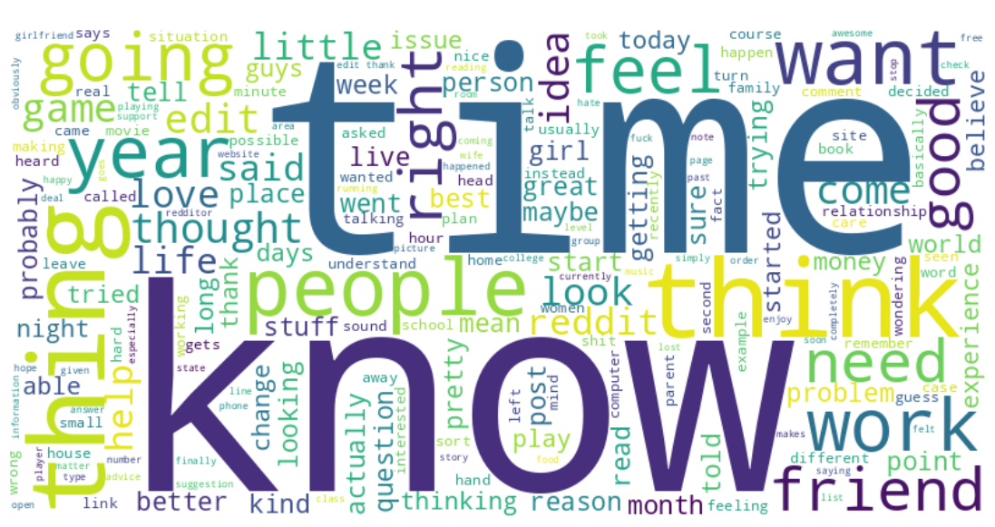
Apply visualization and predictive models to help generate actionable insight.
IST718 – Toxic Comment Discovery
Figure 1 illustrates a word cloud of the most common words found in the corpus.
Figure: 1

Slide 9
Apply visualization and predictive models to help generate actionable insight. Cont’d
IST692 – Mortgage Approval and Gender Bias Analysis
Figure 2 illustrates imbalance between mortgage approvals and denials
Figure: 2

Slide 10
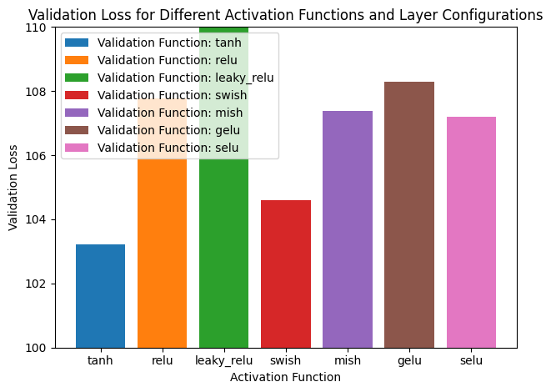
Apply visualization and predictive models to help generate actionable insight. Cont’d
IST707- NBA Match Outcome Predictor
Figure 3 illustrates the validation loss after applying different activation functions.
Figure: 3

Slide 11
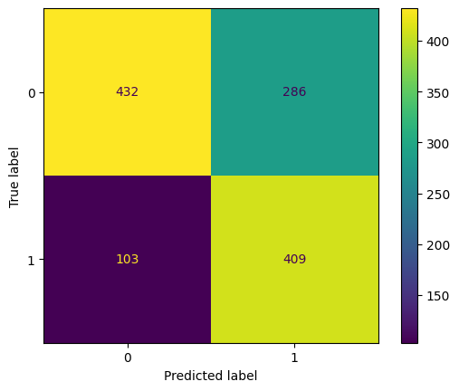
Use programming languages such as R and Python to support the generation of actionable insights
IST707 – NBA Match Outcome Predictor
Used bar charts and line charts to visualize performance metrics to fine-tune the model
Used confusion matrix to help determine how accurately the model was able to predict the outcomes of matches and spread
Used PCA analysis and correlations to determine what features should be included in the training dataset
Figure: 4

Slide 12
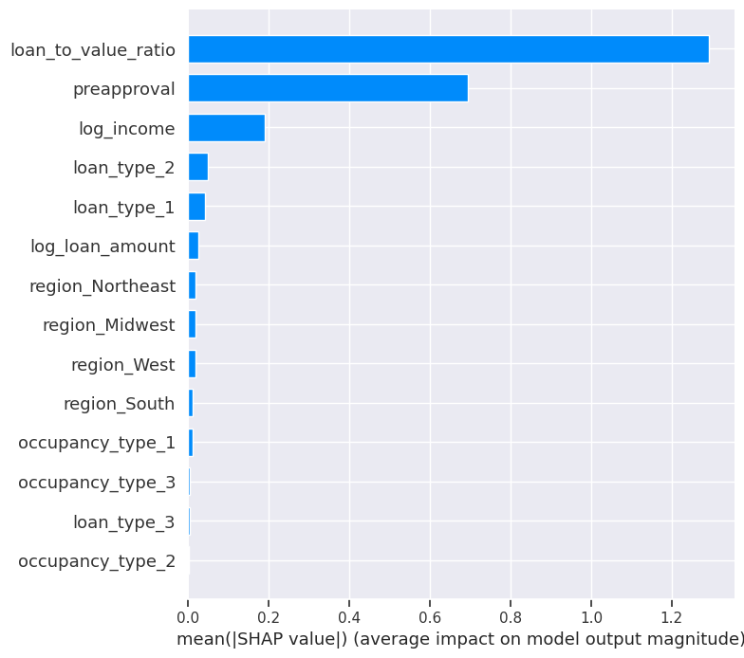
Communicate insights gained via visualization and analytics to a broad range of audiences (including project sponsors and technical team leads).
IST692 – Mortgage Approval and Gender Bias Analysis
Figure 5 illustrates a SHAP analysis on the features that most influence loan approval.
Figure: 5

Slide 13
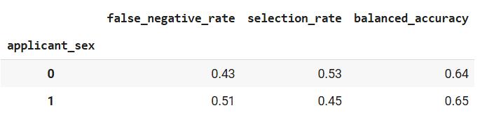
Apply ethics in the development, use, and evaluation of data and predictive models (e.g., fairness, bias, transparency, privacy)
IST692 – Mortgage Approval and Gender Bias Analysis
Figure 6 illustrates fairness metrics between males (0) and female(1) mortgage applicants.
Figure: 6

Slide 14
Next steps
Looking ahead, I am eager to apply these skills in professional settings, whether in research, industry, or data-driven decision-making roles. The knowledge and experience gained from this program have significantly shaped my approach to problem-solving, analysis, and communication.
Goals:
Become active in a data science community
Continued research into best practices and techniques in data science
Learn contemporary ways to integrate fairness and ethics into workflow
Continue to challenge myself with new projects

Slide 15
Thank you!
Mervin McDougall
msmcdoug@syr.edu

