Slide 1
WEB MVC Framework - EA final project
Student: Mingwei He
Professor: Rujuan(Tina) Xing

Slide 2
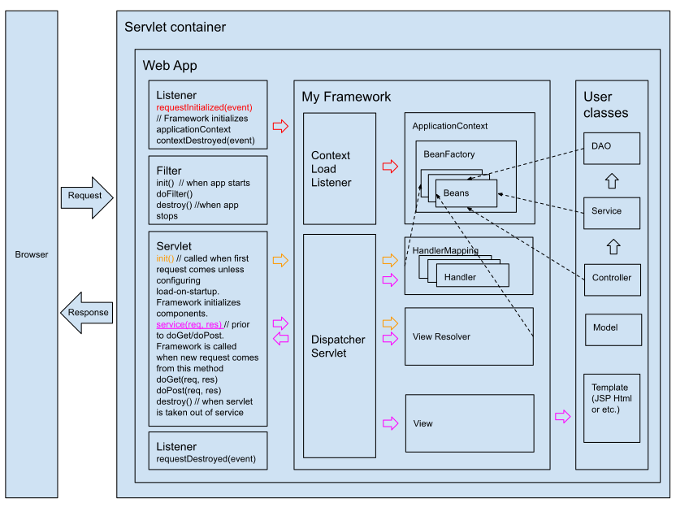
Architecture

Slide 3
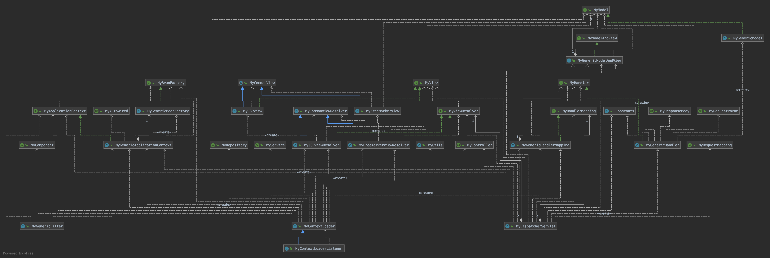
Class Diagram

Slide 4


Statistic
For whole project | count | lines
java | 47 | 1146
ftl | 1 | 42
jsp | 1 | 51
properties | 1 | 8
xml | 1 | 118
total | 51 | 1365
For framework | count
interfaces | 8
plain classes | 20
abstract classes | 2
annotations | 9
properties | 1
total | 40

Slide 5

Implemented Functions
IOC container ( classes creation by matching annotations - @MyComponent @MyController @MyRepository @MyService)
Dependencies auto injection (@MyAutowired)
URL routing (@MyController @MyRequestMapping)
View resolver – FreeMarker, JSP
Auto-binding parameters by matching names
Customized request parameter key (@MyRequestParam)

Slide 6
Implemented Functions (cont.)
Model parameters - add attributes to model instead of using HttpServletRequest
RESTFUL interaction – JSON data return (@MyResponseBody)
Exception capture – redirect to 403, 404, 500 pages
Blacklist – block specific IP addresses
Transaction Management (@MyTransactional)

Slide 7
Design patterns and principles used
MVC
Front Controller
Bean Factory
Proxy
Template
Singleton
SOLID
P2I (program to interface)

Slide 8
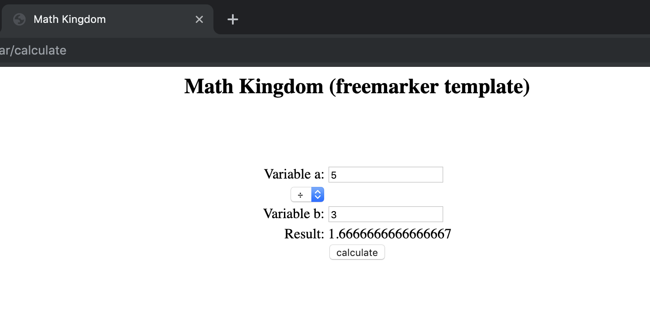
Sample page using framework

Slide 9
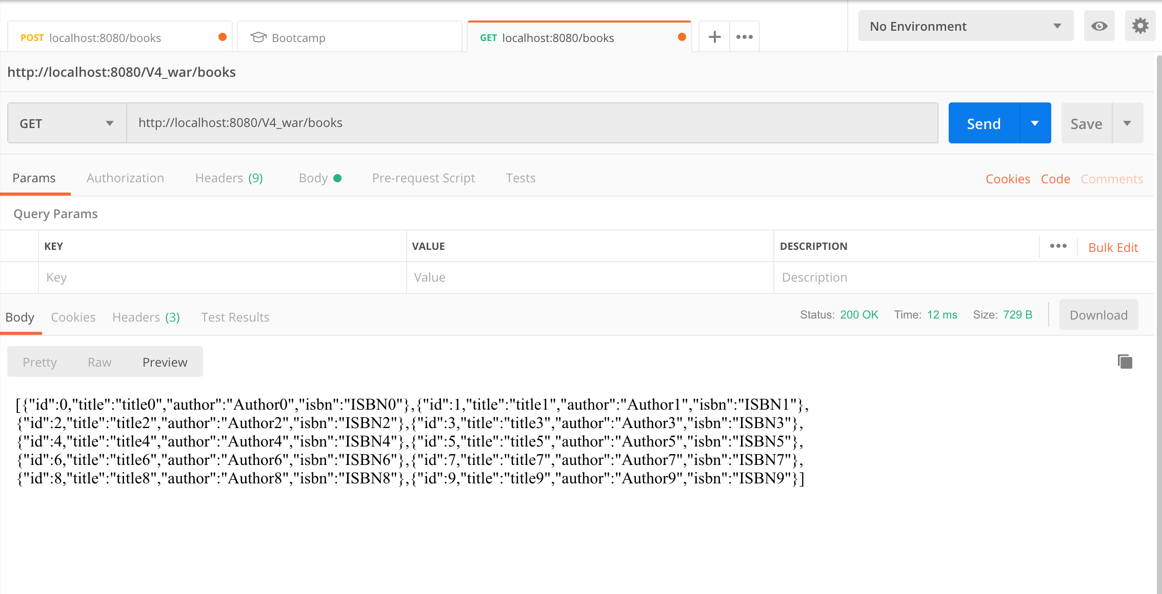
Restful interaction

Slide 10
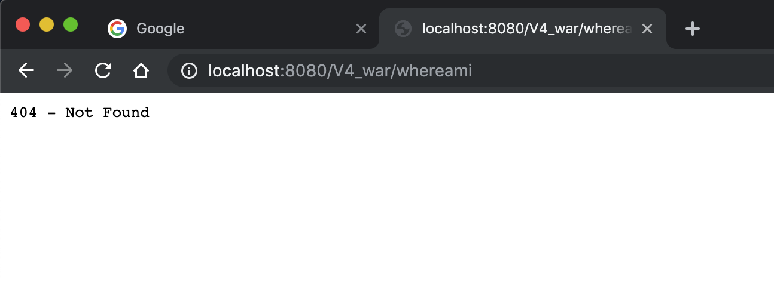
404 - Page Not Found

Slide 11
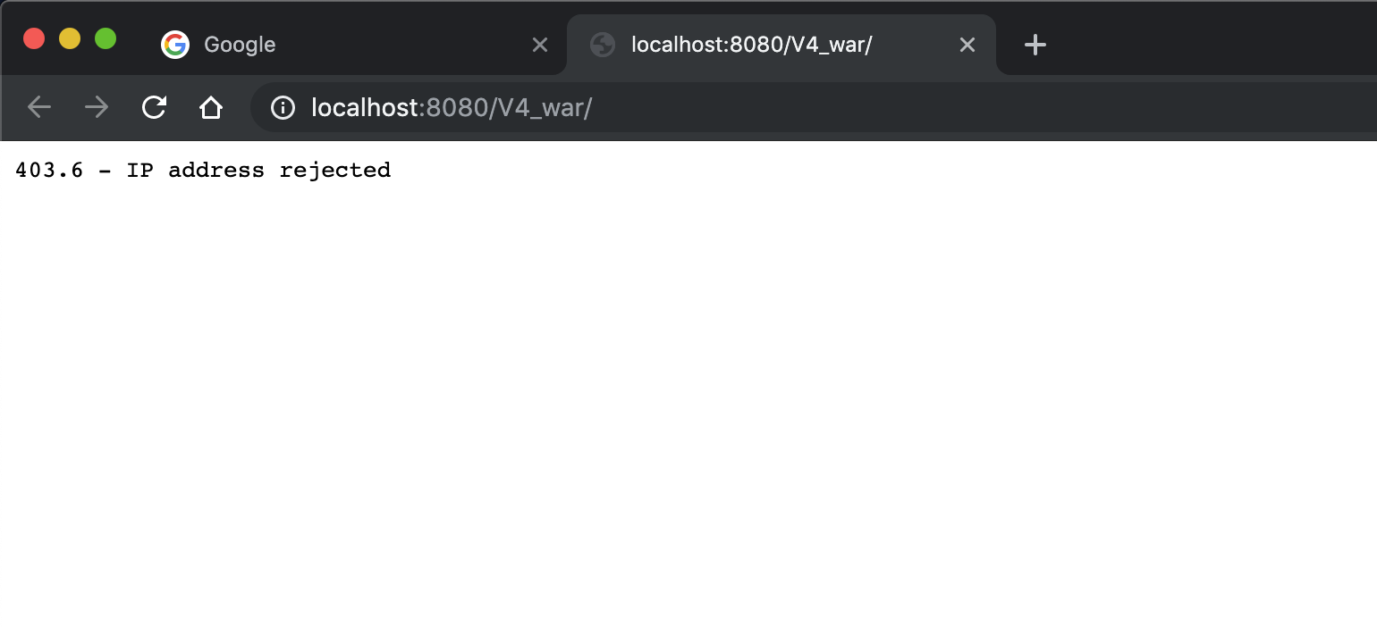
403 - IP address rejected

Slide 12
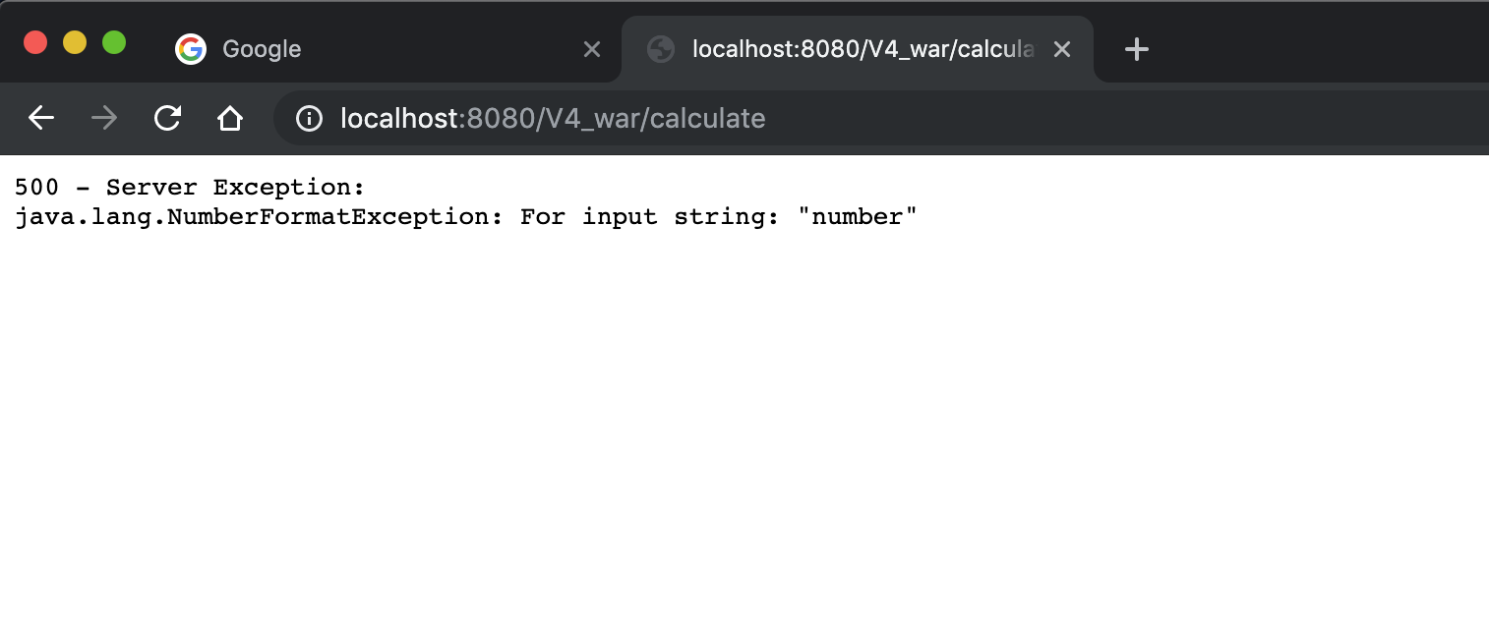
500 - server exception

Slide 13
Functions demonstration

Slide 14
Thanks for your attention
Jai Gurudev

