Slide 1









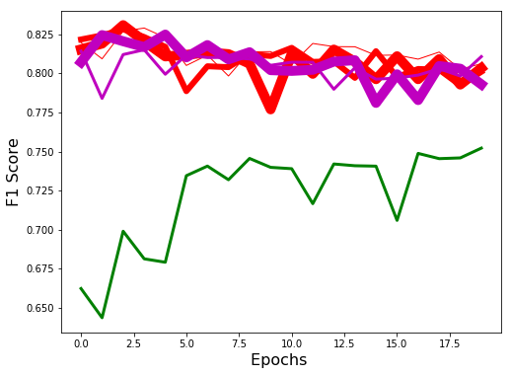
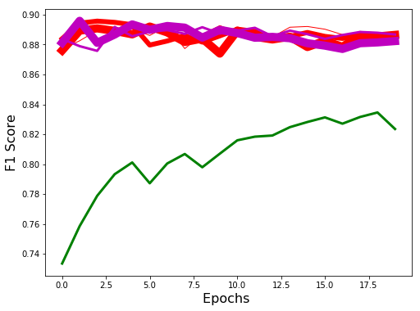
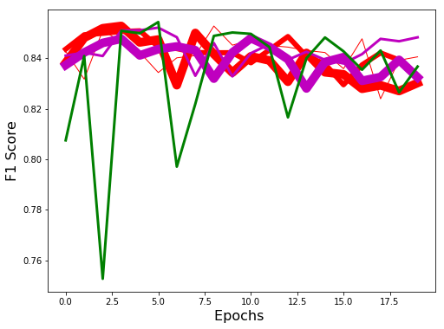
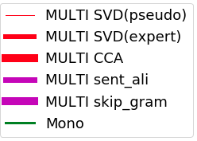
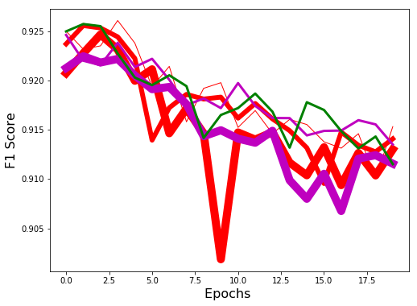
Multilingual Embeddings: A Systematic Evaluation on Downstream Semantic Tasks
Meryem M’hamdi
Dr. Claudiu Musat, Data Analytics & AI Laboratory , Swisscom
Prof. Robert West, Data Science Laboratory, EPFL
Word Embeddings
Multilingual Embeddings
Main Contributions
Keys characteristics of word embeddings:
Low-dimensional compared to vocabulary size
Capture semantic and syntactic similarities between words
Word Analogies are mathematical equations
Extension of word embeddings to cross-lingual space has the following advantages:
Overcome the overhead of training from scratch language-specific models
Semantic transfer of annotation from low to high resourced languages
Provide unique customer experience across the globe and detect anomalies in their behavior
Existing benchmarks [1] focus mainly on the comparison between the different multilingual embeddings methodologies on simpler models, our contributions consists of:
An end-to-end library for the multi-dimensional performance evaluation of different multilingual and monolingual embeddings across different architectures.
Explore new tasks namely cross lingual churn detection and event detection
Investigate the correlation between intrinsic and extrinsic evaluations
I. Introduction
man
king
woman
queen
king – man + woman = queen
Cross-lingual Text Classification
Multi-tasking embeddings with task:
General Pipeline for benchmarking multilingual training for text classifi-cation (document classification and churn detection) where multilingual embeddings are obtained independently from the task
Alternate Training
of Losses
Loss 2: Classification Loss
Loss 1: Similarity Loss
Softmax
Classifier
Test Classifier
on L1
Euclidean Distance
Sentence Level Bi-GRU + Attention
Preprocessing
Dense +
Softmax
Shared Training
Weights
Word Level Bi-GRU + Attention
Word Level Bi-GRU + Attention
Tokenization& stop word removal
Text in language L1
Conversion
to ids
Feature Extractors: CNN, GRU
or both
Test Classifier
on L2
Word Embeddings Layer
II. Methodology
Europarl Sentences
Cross-lingual Documents
Text in L1 + L2
Padding with 0s
Embedding Layer
Text in language L2
Event Detection
1. Training on ALL languages
2. Testing on ANY language
Bursty Trigger
Extraction^{[3]}
Architecture of Cascaded CNN with bidirectional GRU with attention for text classification^{[2]}
Preprocessing
GRU
h₀
A
t
t
e
n
t
I
on
S
o
f
t
ma
x
Tokenization
Jarvis Patrick
Algorithm
Dr
opou
t
Kernel
size k
GRU
h₁
POS Tagging& Lemmatization
Embedding
Matrix
…
Convolution
filters
n-k+1
Filter outputs
matrix
GRU
h₂
Tweets
Tweet
Frequency
Probability
User
Frequency
Word Embeddings
m features
f filters
f feature vectors
…
h_{n}
Sliding Time Windows Split
m embeddings features
GRU
Gaussian Distribution
Document Classification
Churn Detection
Event Detection
Dataset
CNN with bi-GRU Attention Results
Dataset:
 | Monolingual | Multilingual (EN+DE) | Gain
EN_{t} | 84.23 ± 3.14 | 85.88 ± 2.36 | +1.65
DE_{t} | 66.69 ± 3.30 | 78.09 ± 2.43 | +11.4
MLP Results
Social Media Data^{[2]}
Tweets Statistics (In Millions)
III. Evaluation & Results
Average per language gain of 6.52%
Qualitative Results:
Correlation with Ground
Truth (goals, yellow/red cards)
Lang | #Clusters | Avg Trig | # Tweets
AR | 2 | 11.58 | 805
DE | 2.25 | 14.58 | 1,824
EN | 5.91 | 15.85 | 22,176
ES | 6.26 | 20.15 | 17,217
FA | 0.33 | 7 | 134
FR | 2.58 | 13.74 | 1,330
IT | 2 | 12.66 | 1,160
KO | 0.5 | 6 | 20
PL | 0.67 | 9.67 | 344
PT | 3.14 | 14.15 | 6,324
RU | 0.5 | 7 | 72
multi | 12.8 | 19.92 | 32,620
Lang | F1 | P | R
AR | 43.31 | 81.82 | 29.45
DE | 16.28 | 50.0 | 9.72
EN | 47.7 | 70.07 | 36.16
ES | 54.03 | 75.36 | 42.11
FA | 16.66 | 33.33 | 11.11
FR | 37.99 | 54.1 | 29.27
IT | 16.28 | 50.0 | 9.72
KO | 0 | 0 | 0
PL | 21.7 | 66.67 | 12.96
PT | 43.75 | 85.71 | 29.37
RU | 9.78 | 50.0 | 5.42
multi | 56.68 | 77.45 | 44.69
Italian
French
 | Monolingual | Multilingual (EN+DE) | Gain
EN_{c} | 82.10 | 84.43 | +2.33
DE_{c} | 74.25 | 73.58 | -0.67
Chatbot Dataset ^{[2]}
German
English
Average per language gain of 0.83%
Resourced = Gain
Average Multilingual Gain over monolingual: 4.47% for MLP vs 2.52% for Multi-Filter CNN complex = Gain
For more information, check [1] Abbet C. etd al.(2018). “Churn Intent Detection in Multilingual Chatbot Conversations and Social Media” CONLL [2] Upadhyay S. etd al. (2016). “A Survey of Cross-Lingual Word Embeddings Models”. ACL. [3] Li C. etd al.(2012). “Twevent: Segment-based Event Detection from Tweets”

