Slide 1
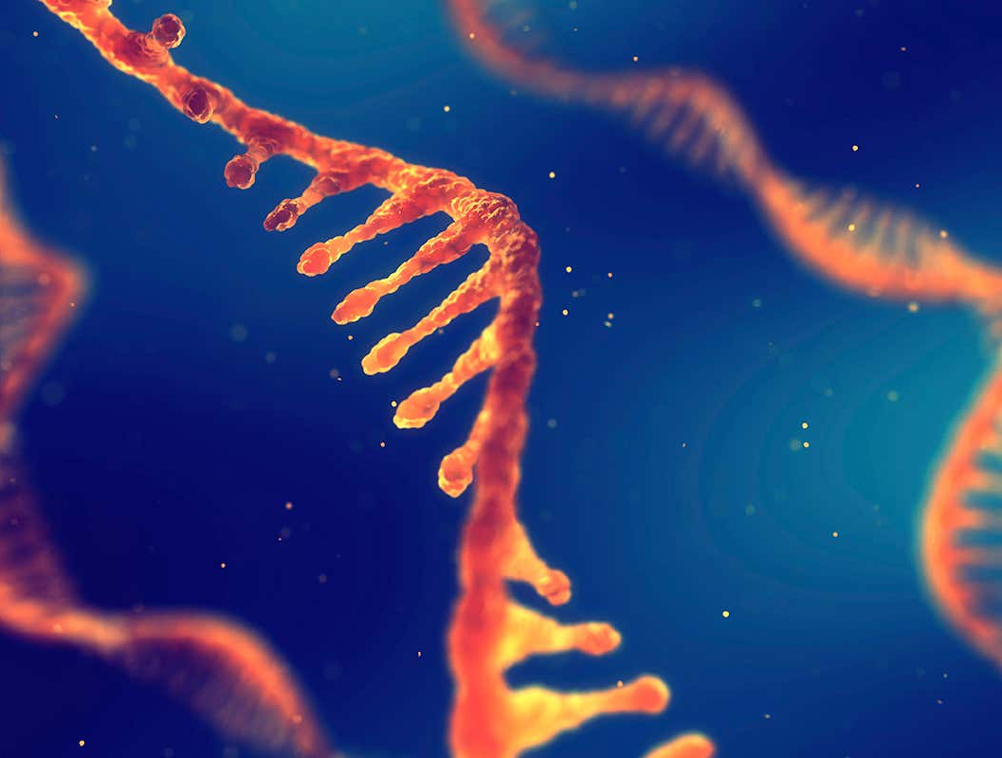
Day 4: RNAseq

Slide 2
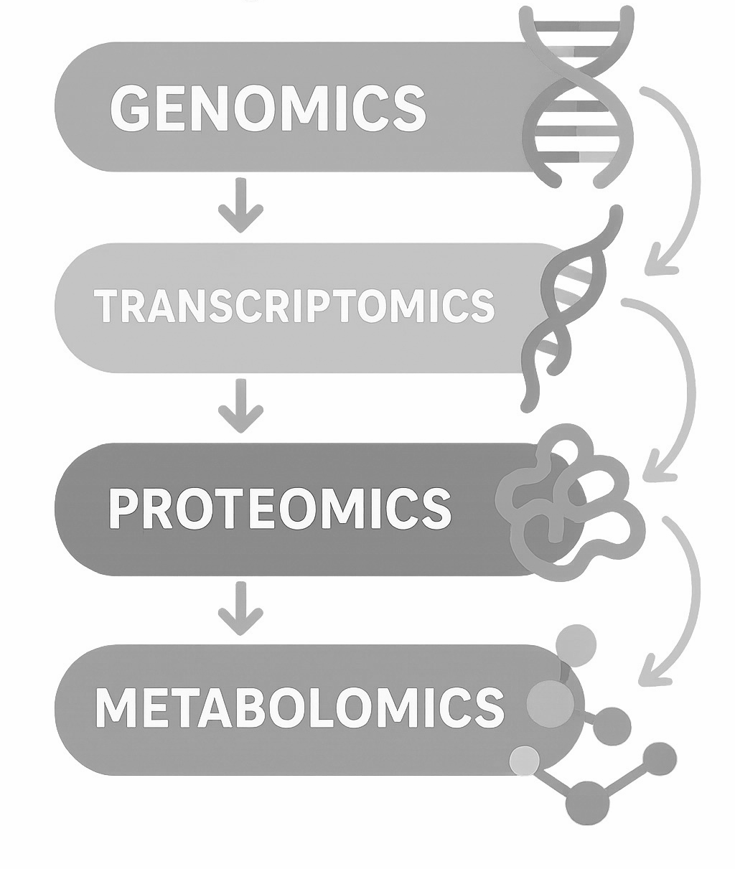

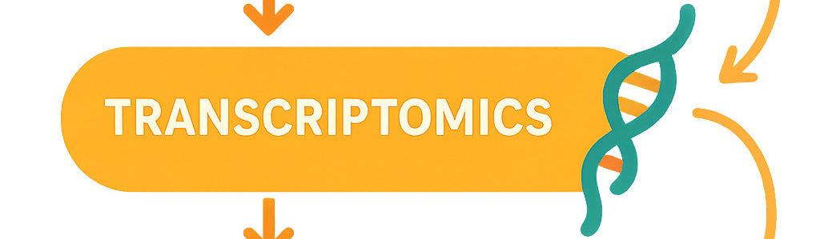
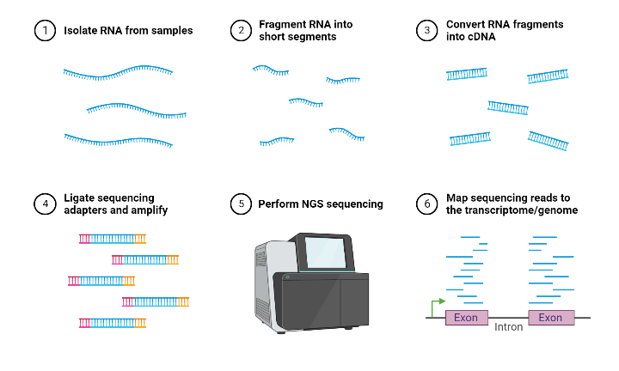
RNA-seq as the dominant method in transcriptomics
RNA sequencing (RNA-Seq) is a high-throughput, next-generation sequencing (NGS) technology used to analyze the entire transcriptome—all RNA molecules—in a cell or group of cells at a specific time. It works by isolating RNA, converting it to cDNA, and sequencing it to identify, quantify, and analyze gene expression.

Slide 3
Questions for bulk* RNA-seq
How many/which genes are differentially expressed? (Up/down regulated between conditions)
What are absolute expression levels? (Which genes are "on" vs "off")
What biological pathways are affected? (Functional interpretation)
How do samples compare? (Disease vs healthy, treated vs control, etc.)
Can we predict outcomes from expression? (Biomarkers, classification)

Slide 4
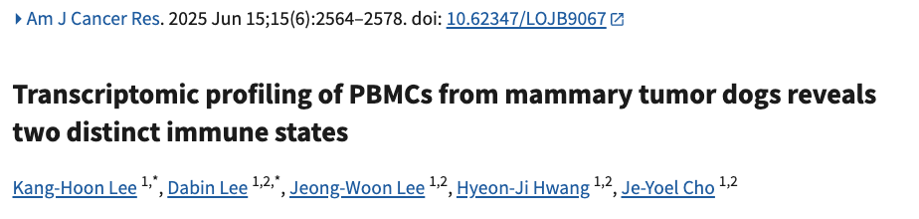
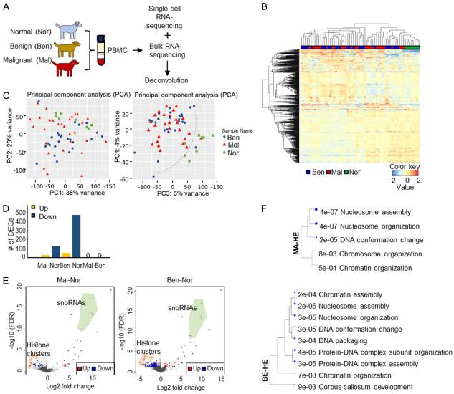

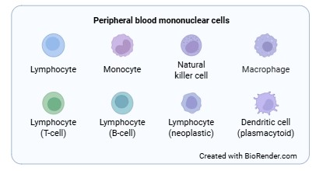
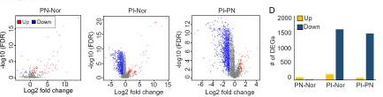
RNA-seq
normal, benign, and malignant
Normal vs. tumor expression is different
Gene expression in PBMCells of dogs with different mammary tumor types?
Cells impaired by tumors (PI) have a large number of downregulated genes compared to normal and normal like (PN)
Notes:
https://pmc.ncbi.nlm.nih.gov/articles/PMC12256404/

Slide 5

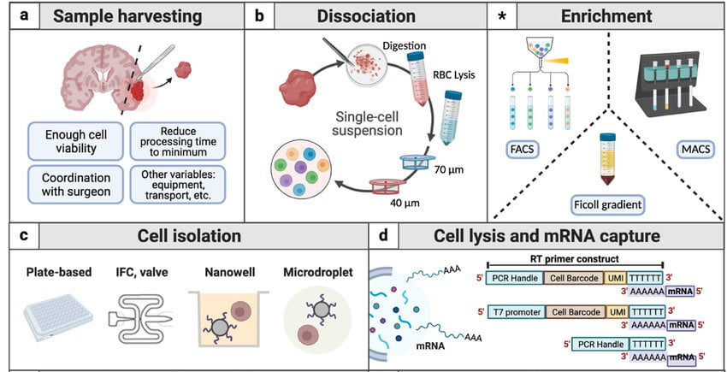
Single cell (sc) vs bulk RNA-seq
A high-resolution technology that measures gene expression in individual cells rather than averaging them across a bulk sample. By isolating cells and sequencing their unique mRNA, researchers can identify distinct cell types, reveal cellular heterogeneity, and track disease progression or development.
scRNA-seq
Notes:
Bulk rnaseq: A tumor sample, for instance, contains cancer cells, immune cells, stromal cells, and endothelial cells all mixed together.

Slide 6
Questions for scRNA-seq
What cell types are present? (Cell identity & clustering)
What's the developmental trajectory? (Cell state transitions, pseudotime)
Which genes distinguish cell types? (Marker genes per cluster)
What's the cell-cell interaction network? (Ligand-receptor pairs)
How heterogeneous is expression? (Cell-to-cell variability)
Are there rare cell populations? (Minor cell types missed in bulk)

Slide 7
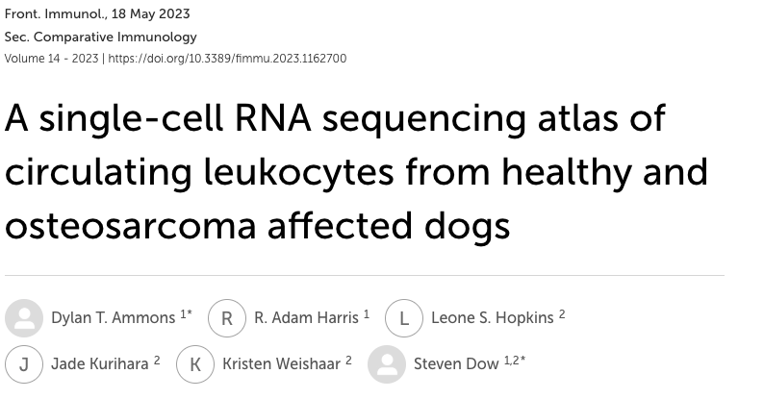
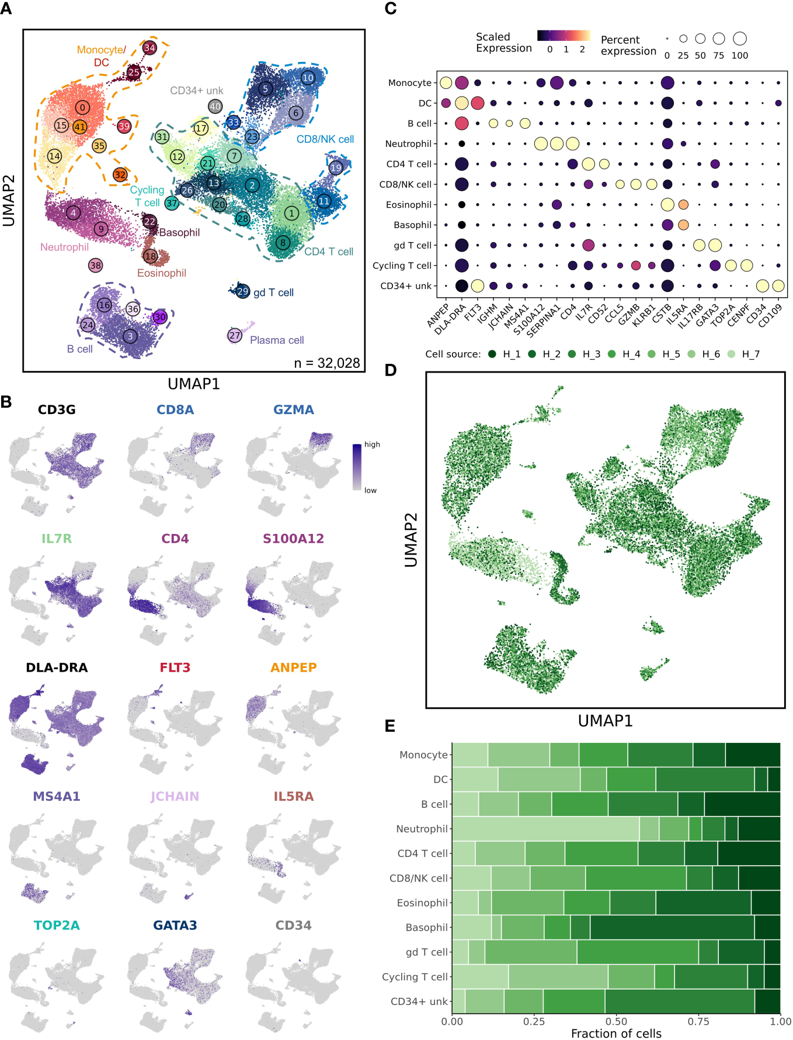
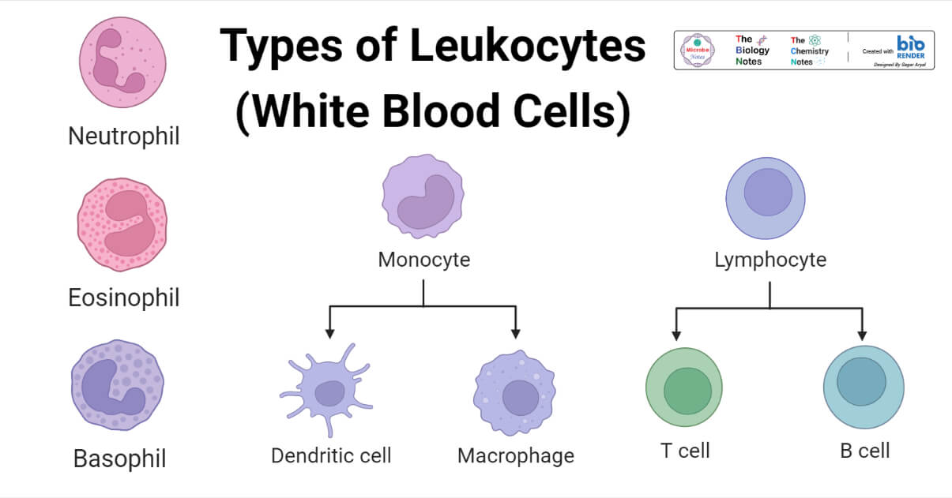
Single cell (sc) vs bulk RNA-seq
healthy vs osteosarcoma
characterize the heterogeneity of circulating leukocytes
scRNA-seq
Unsupervised clustering reveals 42 unique cell populations in healthy dog leukocytes.
Notes:
https://www.frontiersin.org/journals/immunology/articles/10.3389/fimmu.2023.1162700/full
Unsupervised clustering reveals 42 unique cell populations in healthy dog leukocytes. (A) UMAP representation depicting the unsupervised clustering results of 32,028 leukocytes from 7 healthy dogs. Major immune cell populations are labeled on the plot (CD34+ unk = CD34+ unclassified; gd = γδ) and each number corresponds to a unique cluster, with numbers increasing as cluster size becomes smaller. (B) Feature plots depicting expression of stereotypic genes used to define cell populations.

Slide 8
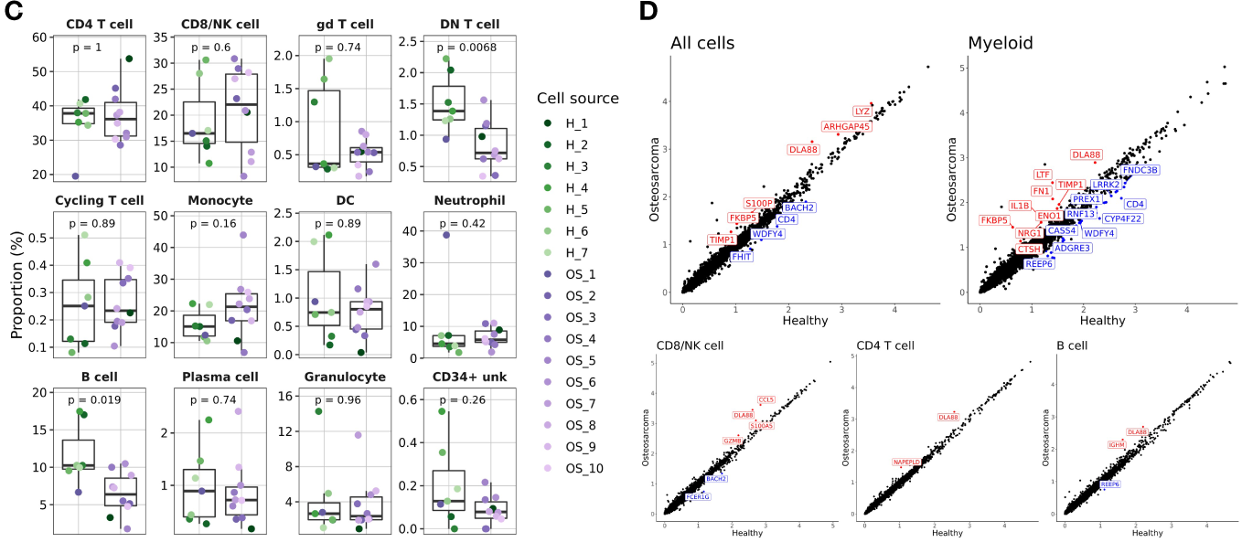
Single cell (sc) vs bulk RNA-seq
myeloid cells contribute to most transcriptomic aberrations
healthy vs osteosarcoma
characterize the heterogeneity of circulating leukocytes
scRNA-seq
Notes:
https://www.frontiersin.org/journals/immunology/articles/10.3389/fimmu.2023.1162700/full
(C) Box plots quantifying changes in cell abundances between healthy and cancer dogs (Granulocyte = Eosinophil and Basophil clusters; DN T cell = Cluster 26 of CD8/NK T cell group). P values were obtained using a two-sided Wilcoxon Rank Sum test. (D) Scatter plots comparing average feature expression in osteosarcoma (y-axis) verses healthy cells (x-axis) with all (74,067) cells and 4 of the major immune cell populations, with labeled features significantly altered, as determined using a Wilcoxon Rank Sum test.

Slide 9
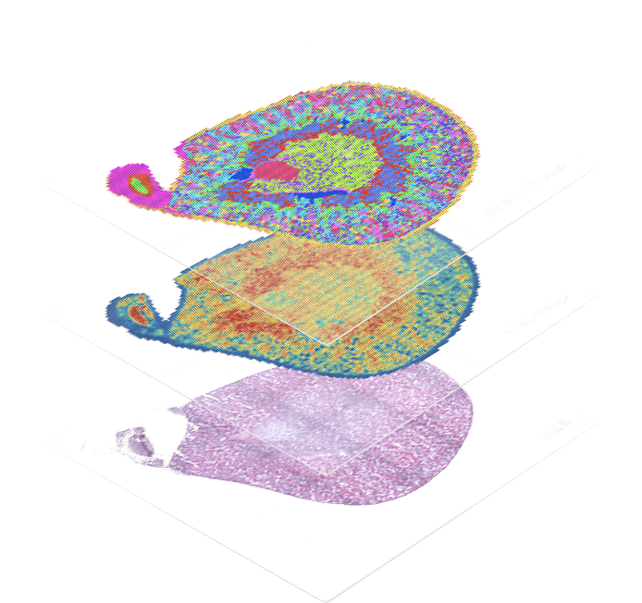
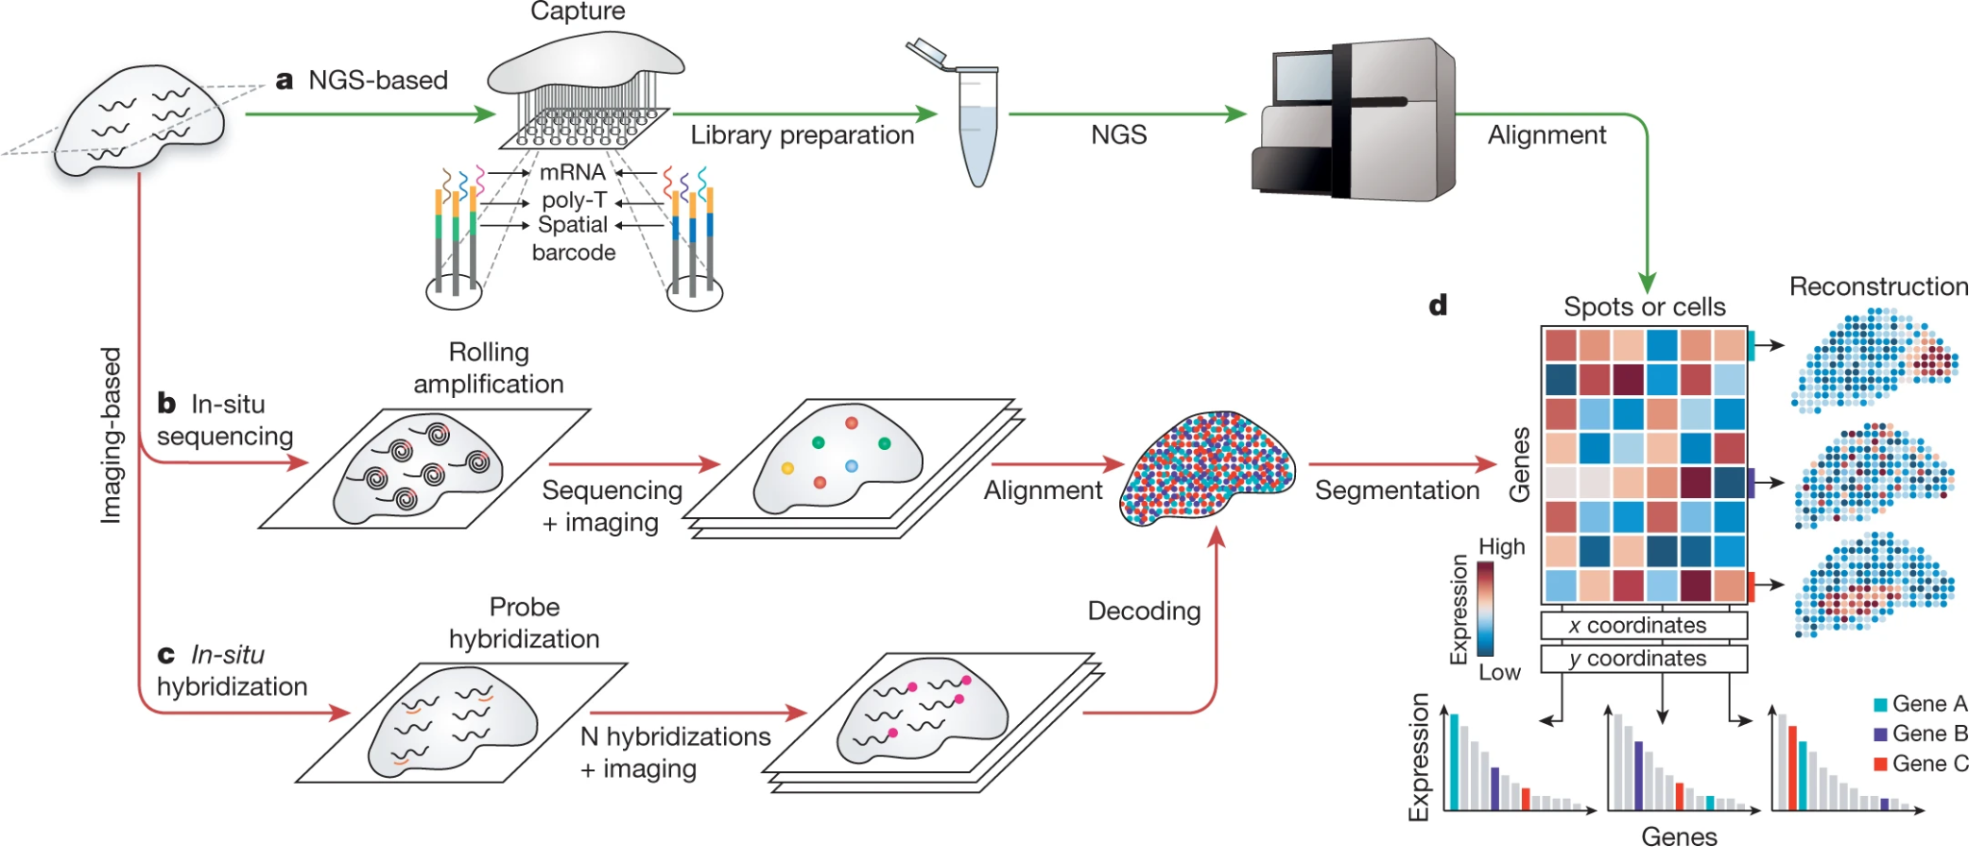
Spatial transcriptomics
A molecular profiling method that maps gene expression (mRNA) directly within intact tissue samples, preserving the spatial location of cells. By combining imaging with next-generation sequencing, it reveals which genes are active and where they are located, providing crucial context on cellular interactions and tumor microenvironments.
Rao et al. 2021. Nature
Notes:
https://www.nature.com/articles/s41586-021-03634-9

Slide 10
Questions for spatial transcriptomics
Where are genes expressed in tissue? (2D/3D spatial localization)
What's the spatial organization of cell types? (Tissue architecture)
How do neighboring cells interact? (Proximity-based cell-cell communication)
What are disease-associated spatial patterns? (Lesions, infiltration, zonation)
How does expression vary by tissue region? (Microdomain biology)
What's the tissue structure/layer composition? (Histological context with transcriptomics)

Slide 11
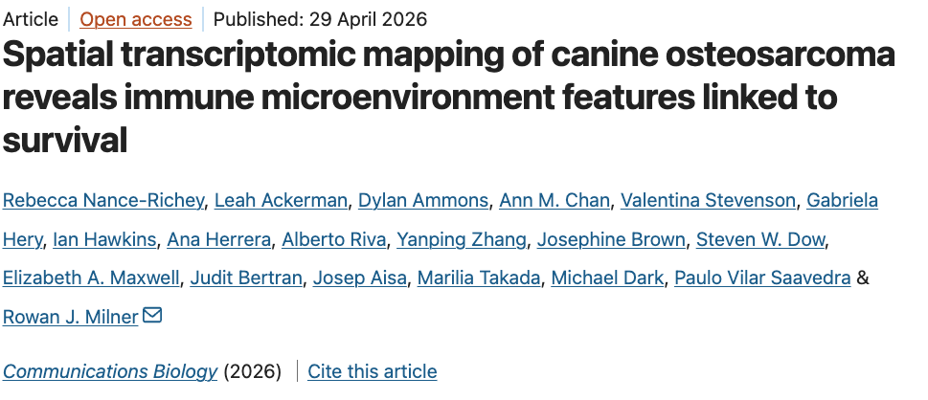
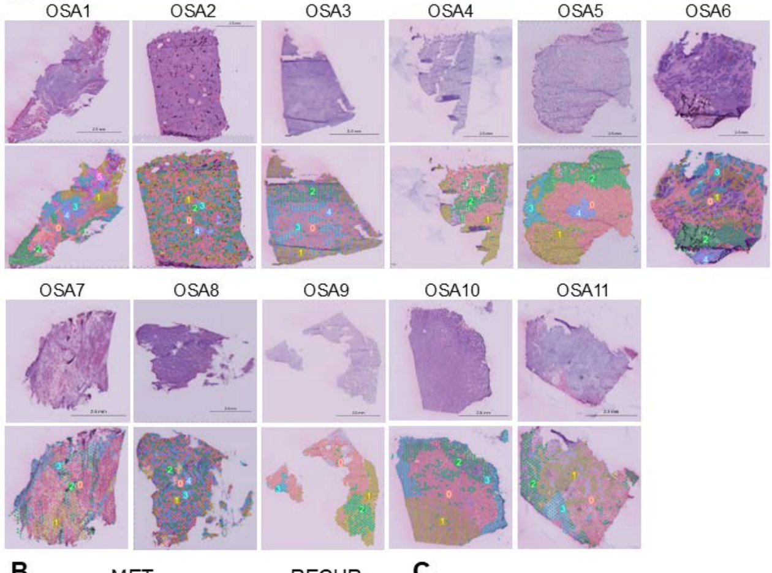

Spatial transcriptomics
Primary, metastatic, recurrent
Intratumoral subpopulations and spatial clustering patterns based on gene expression
Investigate intratumoral complexity and the tumor environment
Notes:
https://www.nature.com/articles/s42003-026-10152-9

Slide 12
Aspect | Bulk RNA Sequencing | scRNA-seq | Spatial Transcriptomics
Definition | Analysis of gene expression in tissues and cell populations. | Sequencing of single cells to obtain information about their transcriptome. | Simultaneously examine the gene expression and spatial location of cells.
Sample Processing | Direct RNA extraction and amplification of tissues and cell populations. | Isolation, lysis, and amplification of individual cells. | Sections or fixation according to sample needs.
Experimental Costs | Relatively low | Higher | Higher
Data Quality | Affected by factors such as RNA extraction and amplification, there is a certain batch effect. | Difficult to obtain high-quality data due to various factors such as fluorescent labeling of individual cells and RNA library preparation. | Relatively difficult, but can provide high-precision spatial information.
Data Analysis | Relatively simple, commonly used differential expression analysis method for analysis. | Complex to process and requires analysis of individual cell characteristics. | Need to combine with molecular biology, imaging, and other fields for comprehensive analysis.
Application Scenarios | Analyze the overall gene expression of tissues and cell populations to study gene function and physiological mechanisms. | Analyze individual cell phenotypes, cell developmental trajectories, etc. | Analyze the spatial structure of different cell types in tissues, cellular interactions, etc.
Notes:
https://www.nature.com/articles/s41586-021-03634-9

Slide 13
Spatial Transcriptomics
Bulk RNA-seq
scRNA-seq
Definition
Definition
Definition
Gene expression in tissues & cell populations
Transcriptome of individual single cells
Gene expression + spatial location of cells
Cost
Cost
Cost
Low
Higher
Higher
Data Complexity
Data Complexity
Data Complexity
Simple
Complex
Multi-field
Best For
Best For
Best For
Overall gene expression & gene function
Cell phenotypes & developmental trajectories
Spatial structure & cellular interactions in tissue
What genes are expressed
Which cell types express them
Where in the tissue they're expressed
Notes:
https://www.nature.com/articles/s41586-021-03634-9

Slide 14

RNA-seq approaches
You are studying a feline mammary tumor and want to understand why some cells resist chemotherapy while others don't. You suspect different tumor cell subpopulations behave differently.
Bulk RNA-seq
Single-cell RNA-seq
Spatial transcriptomics
Why: Bulk RNA-seq would average signals across all cells, masking the resistant subpopulation. scRNA-seq lets you identify distinct cell clusters within the tumor and pinpoint which cells are driving resistance — essential for targeted therapy.

Slide 15
RNA-seq approaches
You are studying how the liver responds to canine distemper virus across a cohort of 30 dogs. You want to identify differentially expressed genes between infected and healthy animals.
Bulk RNA-seq
Single-cell RNA-seq
Spatial transcriptomics
Why: This is a classic bulk RNA-seq use case. You're comparing overall gene expression across groups at scale — bulk is cost-effective, statistically powerful for differential expression, and single-cell resolution isn't needed to answer this question.

Slide 16
RNA-seq approaches
You are studying equine neuroaxonal dystrophy and want to know which brain regions show abnormal gene expression, and whether there is a spatial gradient of neuroinflammation from lesion core to periphery. Which approach would you choose?
Bulk RNA-seq
Single-cell RNA-seq
Spatial transcriptomics
Why: Spatial transcriptomics maps gene expression directly within tissue sections while preserving anatomical context. You can visualize the inflammation gradient and understand how the lesion microenvironment is organized — information that bulk or scRNA-seq would lose entirely.

Slide 17
RNA-seq approaches
A dog has a poorly healing wound. You biopsy the tissue and want to understand where fibroblasts are being activated, how the wound margin differs from the center, and which signaling pathways are spatially coordinated. What do you choose?
Bulk RNA-seq
Single-cell RNA-seq
Spatial transcriptomics
Why: Spatial transcriptomics preserves tissue architecture — it shows you gene expression in situ, revealing activation gradients and cell-cell communication zones. Neither bulk nor scRNA-seq can tell you where in the tissue these events are happening.

Slide 18
RNA-seq approaches
You are investigating immune tolerance in bovine intestinal mucosa and want to understand how different immune cell populations (T cells, macrophages, dendritic cells) coordinate their responses to commensal bacteria. Which method is best?
Bulk RNA-seq
Single-cell RNA-seq
Spatial transcriptomics
Why: scRNA-seq lets you dissect the immune landscape at high resolution, identify rare cell populations, and determine how each cell type individually responds. Bulk RNA-seq would mix all signals together, masking the differences between populations.

Slide 19
RNA-seq approaches
You are evaluating a new avian influenza vaccine. You need to compare whole-blood transcriptomes of vaccinated vs. unvaccinated chickens at 3, 7, and 14 days post-vaccination across 50 birds. What is the most practical and statistically appropriate approach?
Bulk RNA-seq
Single-cell RNA-seq
Spatial transcriptomics
Why: Large cohort, multiple time points, group-level comparison — this is exactly what bulk RNA-seq is designed for. It's cost-effective at scale and gives you the statistical power needed to draw conclusions across 50 animals. Single-cell would be prohibitively expensive and unnecessary here.

Slide 20


Slide 21
Bioinformatics in bulk RNA-seq

Slide 22
Questions for bulk* RNA-seq
How many/which genes are differentially expressed? (Up/down regulated between conditions)
What are absolute expression levels? (Which genes are "on" vs "off")
What biological pathways are affected? (Functional interpretation)
How do samples compare? (Disease vs healthy, treated vs control, etc.)
Can we predict outcomes from expression? (Biomarkers, classification)

Slide 23
The bulk* RNA-seq workflow
Quality trim and filter
(TrimGalore)
Align to genome
(STAR)
Count reads
(featureCounts)
Short
reads
Count
matrix
Get rid of bad quality stuff
Figure out what genes the reads belong to
Count how many copies of each gene there were
Read: a unit of sequencing. A sequence fragment that has been sequenced
Depth/coverage: the average number of reads that map to a given region of the genome (or transcriptome). Higher depth means greater sensitivity for detecting lowly expressed genes.
Counts matrix: genes as rows, samples as columns, numbers = how many reads mapped to each gene in each sample.
“Raw counts” are not directly comparable between samples → normalization
A bad design can't be fixed computationally, replication, randomization, and controlling for batch effects must happen before sequencing.

Slide 24
STAR alignment: Splicing-aware transcriptome mapping
Quality trim and filter
(TrimGalore)
Align to genome
(STAR)
Count reads
(featureCounts)
Short
reads
Count
matrix
Get rid of bad quality stuff
Figure out what genes the reads belong to
Count how many copies of each gene there were
GenA
GenB
Genome
Handles spliced reads (exon-exon junctions)
Fast and accurate compared to unspliced aligners
Why DNA aligners fail on RNA: reads span introns and need splice-junction detection
 | Raw counts
GeneA | 6
GeneB | 12

Slide 25
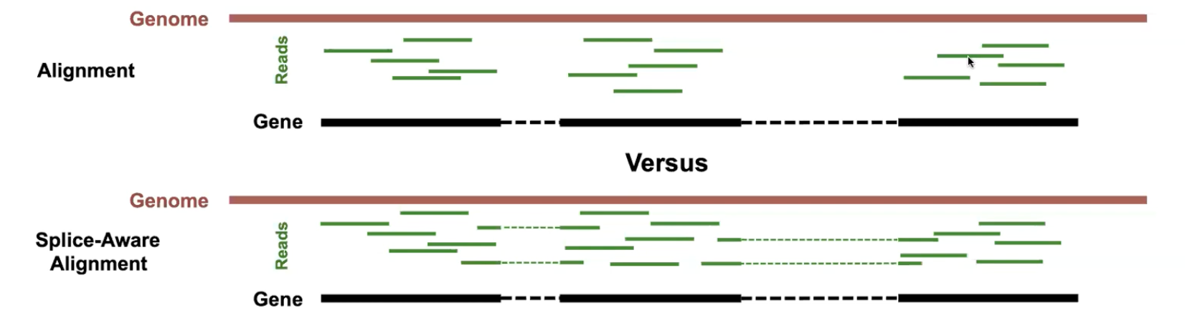
STAR alignment: Splicing-aware transcriptome mapping
Handles spliced reads (exon-exon junctions)
Fast and accurate compared to unspliced aligners
Why DNA aligners fail on RNA: reads span introns and need splice-junction detection

Slide 26
STAR alignment: Splicing-aware transcriptome mapping
STAR
Genome indexing
Seed searching
Clustering
Junction detection
Creates a searchable data structure
Genome index scans for short k-mers
Group seeds by position in genome
Distinguishes real junctions from sequencing artifacts
Notes:
https://hbctraining.github.io/Intro-to-rnaseq-hpc-O2/lessons/03_alignment.html

Slide 27
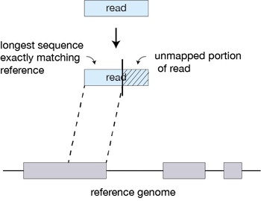
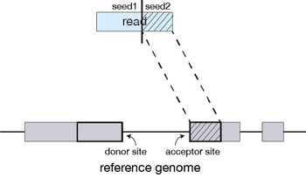
STAR alignment: Splicing-aware transcriptome mapping
STAR
Genome indexing
Seed searching
Clustering
Junction detection
Creates a searchable data structure
Genome index scans for short k-mers
Group seeds by position in genome
Distinguishes real junctions from sequencing artifacts
Notes:
Seed searching
For every read that STAR aligns, STAR will search for the longest sequence that exactly matches one or more locations on the reference genome. These longest matching sequences are called the Maximal Mappable Prefixes (MMPs):
The different parts of the read that are mapped separately are called ‘seeds’. So the first MMP that is mapped to the genome is called seed1.
STAR will then search again for only the unmapped portion of the read to find the next longest sequence that exactly matches the reference genome, or the next MMP, which will be seed2.
This sequential searching of only the unmapped portions of reads underlies the efficiency of the STAR algorithm. STAR uses an uncompressed suffix array (SA) to efficiently search for the MMPs, this allows for quick searching against even the largest reference genomes. Other slower aligners use algorithms that often search for the entire read sequence before splitting reads and performing iterative rounds of mapping.
https://hbctraining.github.io/Intro-to-rnaseq-hpc-O2/lessons/03_alignment.html

Slide 28
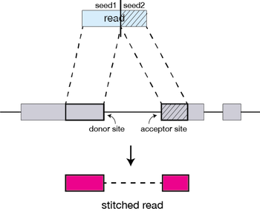
STAR alignment: Splicing-aware transcriptome mapping
STAR
Genome indexing
Seed searching
Clustering
Junction detection
Creates a searchable data structure
Genome index scans for short k-mers
Group seeds by position in genome
Distinguishes real junctions from sequencing artifacts
Notes:
The separate seeds are stitched together to create a complete read by first clustering the seeds together based on proximity to a set of ‘anchor’ seeds, or seeds that are not multi-mapping.
Then the seeds are stitched together based on the best alignment for the read (scoring based on mismatches, indels, gaps, etc.).

Slide 29
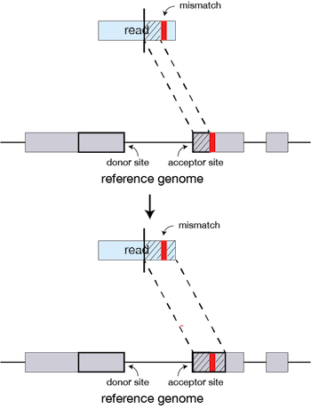
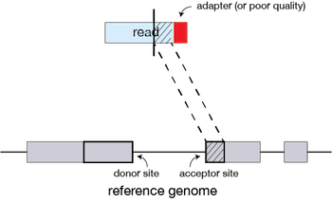
STAR alignment: Splicing-aware transcriptome mapping
STAR
Genome indexing
Seed searching
Clustering
Junction detection
Creates a searchable data structure
Genome index scans for short k-mers
Group seeds by position in genome
Distinguishes real junctions from sequencing artifacts

Slide 30
The bulk* RNA-seq workflow
Quality trim and filter
(TrimGalore)
Align to genome
(STAR)
Count reads
(featureCounts)
Short
reads
Count
matrix
Get rid of bad quality stuff
Figure out what genes the reads belong to
Count how many copies of each gene there were

Slide 31
Quality checks!!
Quality trim and filter
(TrimGalore)
Align to genome
(STAR)
Count reads
(featureCounts)
Short
reads
Count
matrix
Get rid of bad quality stuff
Figure out what genes the reads belong to
Count how many copies of each gene there were
Library prep quality check
Alignment quality check
Check the content of:
Ribosomal RNA
Duplication
Seq depth
Check:
Alignment quality
Most of reads are mapping to genome uniquely

Slide 32
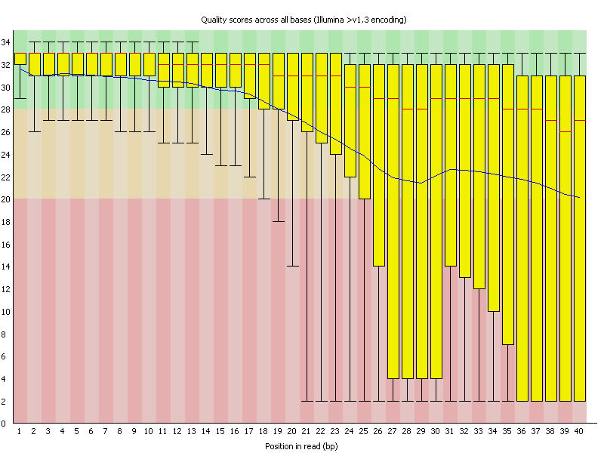
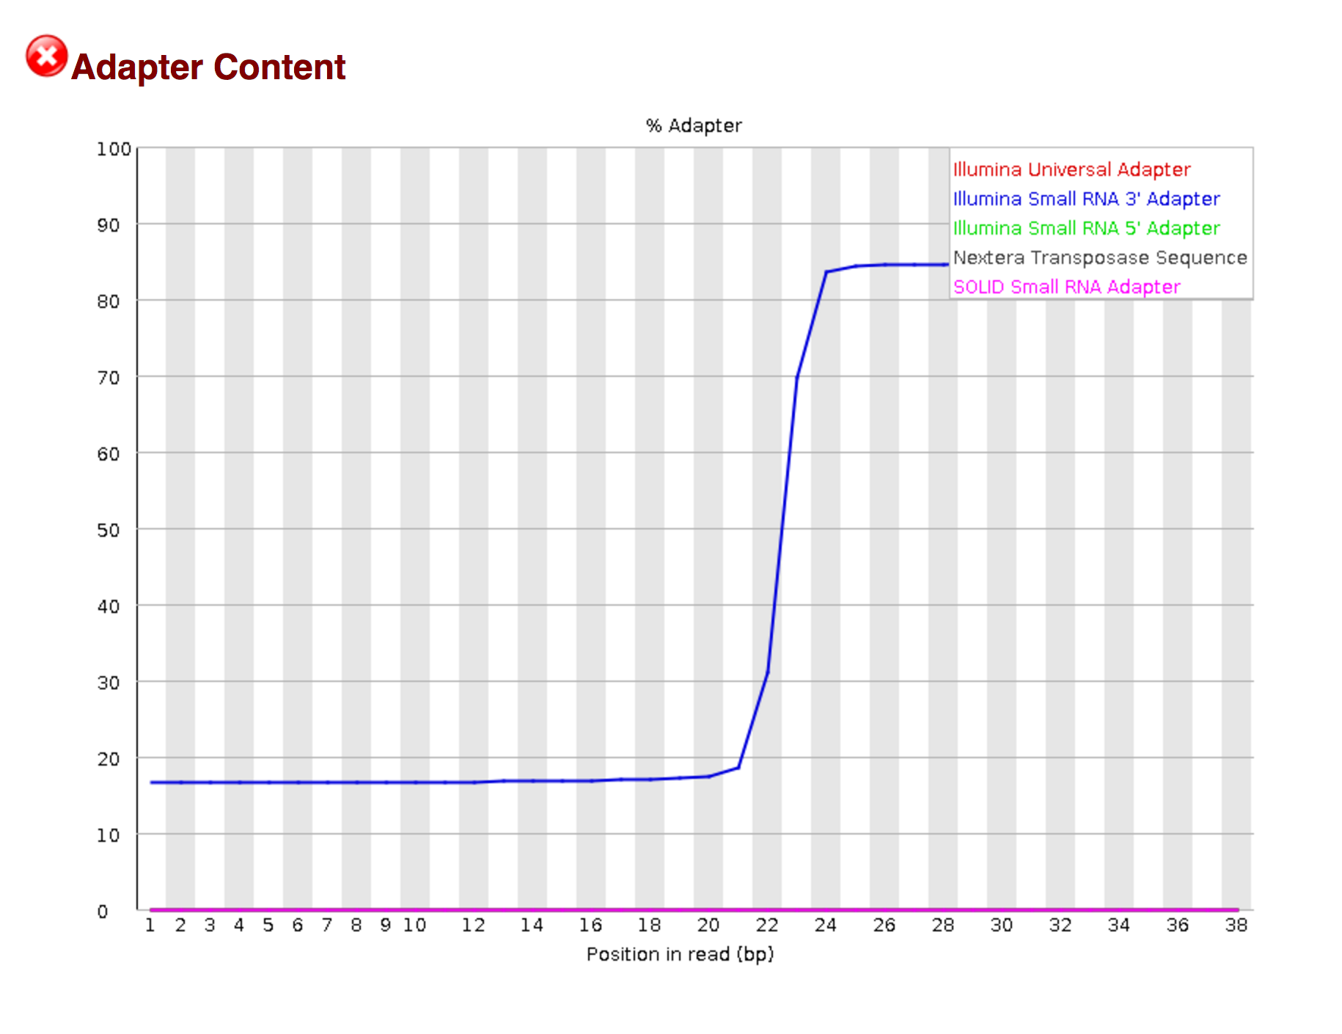
Output of quality trim and red flags
Not all reads coming off the sequencer are trustworthy
Low-quality bases
at the ends of reads (the machine gets tired)
Adapter sequences
synthetic sequences added during library prep that are not biological signal
Very short reads
that remain after trimming and are uninformative
Keeping low-quality reads introduces errors downstream. A misread base can cause a read to map to the wrong gene, or not map at all, corrupting your count matrix.

Slide 33

Output of quality trim and red flags
High adapter content (>10–15% of reads) Suggests library prep issues or very short insert sizes. A little adapter is normal; a lot means something went wrong during library construction.
Very high duplication rates (>50–60%) Reads are identical copies of the same original molecule, usually from over-amplification during PCR. In extreme cases it means you sequenced the same few molecules over and over and have little real coverage.
Poor per-base sequence quality at read ends Expected and fixable by trimming — but if quality drops early (first 20–30 bases) rather than just at the tail, it may indicate a sequencing run problem.
Overrepresented sequences that are not adapters Could be rRNA contamination (very common if mRNA enrichment failed), primers, or other contaminants. rRNA reads are uninformative and inflate your total read count without adding gene-level data.
Reads getting trimmed to very short lengths (<20–25 bp) If most reads are being cut down to almost nothing, the original insert was tiny — a library prep problem that trimming cannot recover.
Low % reads surviving trimming (<70–75%) Means a large fraction of your data was unusable before you even started.

Slide 34
Alignment check and red flags
D0_R1 | 84.65%
D0_R2 | 86.06%
D0_R3 | 84.39%
D7_R1 | 85.29%
D7_R2 | 85.59%
D7_R3 | 81.25%
D14_R1 | 84.81%
D14_R2 | 84.21%
D14_R3 | 84.65%
Low overall mapping rate (<70–75%) The most important metric. Reads that don't map are invisible to all downstream analysis. Common causes:
Wrong reference genome or annotation
Heavy rRNA or adapter contamination
RNA degradation
Sequencing of a divergent strain with significant genomic differences from the reference
Very high multimapping rate Reads mapping to many genomic locations equally well (repetitive elements or paralogous gene families)
Uneven coverage across gene bodies - some genes are being undercounted
3’ bias = RNA degradation (RNA degrades from the 5' end first).
5' bias = problems library prep chemistry. Either pattern means
(look at genes individually in IGV)
Strand-specificity mismatch If the alignment parameters don't match how the library was actually prepared (stranded vs. unstranded), reads get assigned to the wrong gene or discarded. Ask your sequencers!, pick the STAR out for your sequencing parameters
Inconsistent mapping rates across samples If one sample maps at 90% and another at 40%, they are not comparable. The low-quality sample may need to be excluded, which affects your statistical power and experimental design. (analysis)

Slide 35
Alignment check and red flags
D0_R1 | 84.65%
D0_R2 | 86.06%
D0_R3 | 84.39%
D7_R1 | 85.29%
D7_R2 | 85.59%
D7_R3 | 81.25%
D14_R1 | 84.81%
D14_R2 | 84.21%
D14_R3 | 84.65%
Low overall mapping rate (<70–75%) The most important metric. Reads that don't map are invisible to all downstream analysis. Common causes:
Wrong reference genome or annotation
Heavy rRNA or adapter contamination
RNA degradation
Sequencing of a divergent strain with significant genomic differences from the reference
Very high multimapping rate Reads mapping to many genomic locations equally well (repetitive elements or paralogous gene families)
Uneven coverage across gene bodies - some genes are being undercounted
3’ bias = RNA degradation (RNA degrades from the 5' end first).
5' bias = problems library prep chemistry. Either pattern means
(look at genes individually in IGV)
Strand-specificity mismatch If the alignment parameters don't match how the library was actually prepared (stranded vs. unstranded), reads get assigned to the wrong gene or discarded. Ask your sequencers!, pick the STAR out for your sequencing parameters
Inconsistent mapping rates across samples If one sample maps at 90% and another at 40%, they are not comparable. The low-quality sample may need to be excluded, which affects your statistical power and experimental design. (analysis)

Slide 36
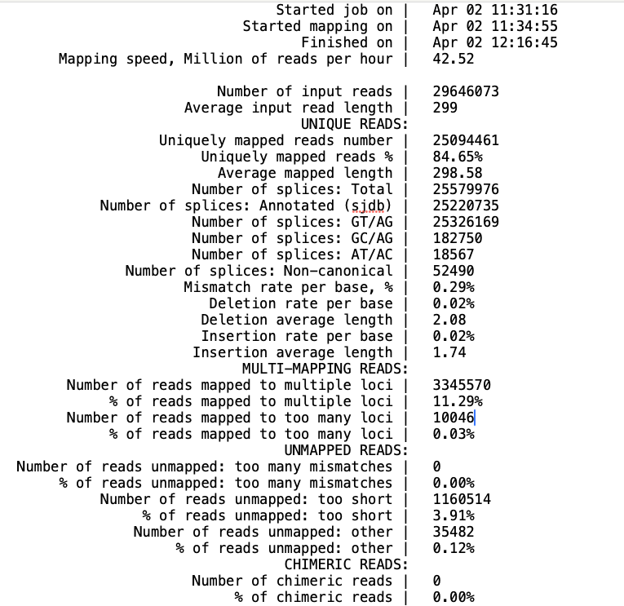
Alignment check and red flags
D0_R1 | 84.65%
D0_R2 | 86.06%
D0_R3 | 84.39%
D7_R1 | 85.29%
D7_R2 | 85.59%
D7_R3 | 81.25%
D14_R1 | 84.81%
D14_R2 | 84.21%
D14_R3 | 84.65%
Number of reads mapped to 1<10 loci
10 or more loci that the
Partially mapped

Slide 37
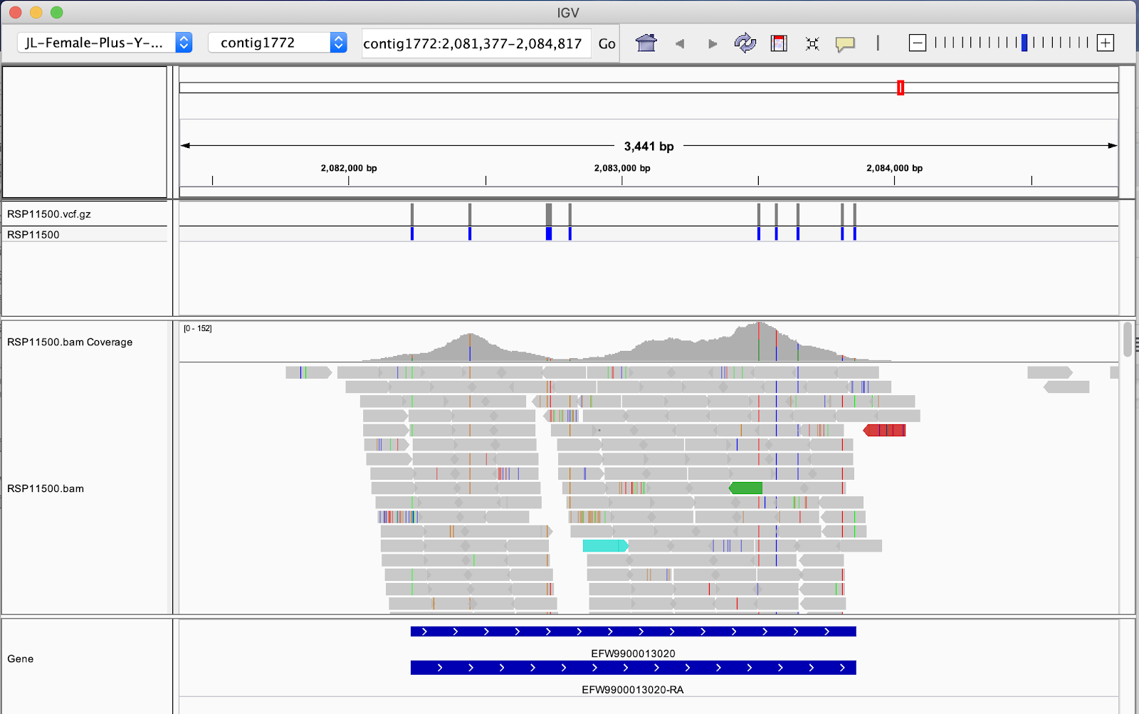
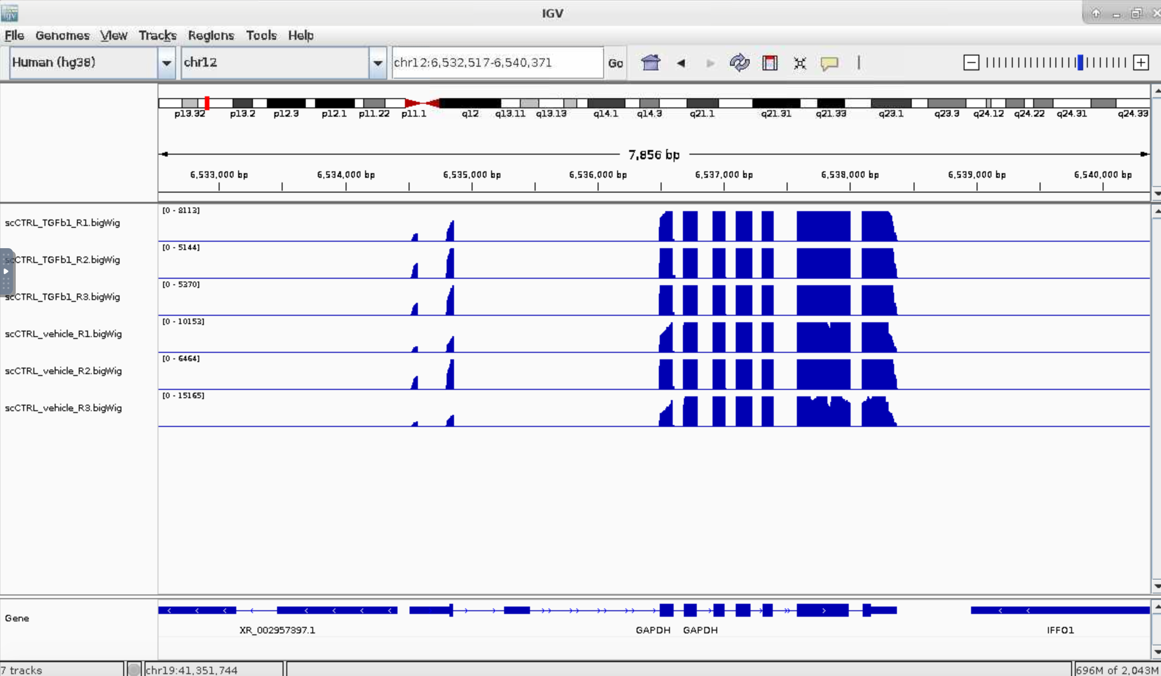
Alignment check and red flags

Slide 38
Alignment check and red flags
D0_R1 | 84.65%
D0_R2 | 86.06%
D0_R3 | 84.39%
D7_R1 | 85.29%
D7_R2 | 85.59%
D7_R3 | 81.25%
D14_R1 | 84.81%
D14_R2 | 84.21%
D14_R3 | 84.65%
Low overall mapping rate (<70–75%) The most important metric. Reads that don't map are invisible to all downstream analysis. Common causes:
Wrong reference genome or annotation
Heavy rRNA or adapter contamination
RNA degradation
Sequencing of a divergent strain with significant genomic differences from the reference
Very high multimapping rate Reads mapping to many genomic locations equally well (repetitive elements or paralogous gene families)
Uneven coverage across gene bodies - some genes are being undercounted
3’ bias = RNA degradation (RNA degrades from the 5' end first).
5' bias = problems library prep chemistry. Either pattern means
(look at genes individually in IGV)
Strand-specificity mismatch If the alignment parameters don't match how the library was actually prepared (stranded vs. unstranded), reads get assigned to the wrong gene or discarded. Ask your sequencers!, pick the STAR out for your sequencing parameters
Inconsistent mapping rates across samples If one sample maps at 90% and another at 40%, they are not comparable. The low-quality sample may need to be excluded, which affects your statistical power and experimental design. (analysis)

Slide 39
The bulk* RNA-seq workflow
Quality trim and filter
(TrimGalore)
Align to genome
(STAR)
Count reads
(featureCounts)
Short
reads
Count
matrix
Get rid of bad quality stuff
Figure out what genes the reads belong to
Count how many copies of each gene there were

Slide 40
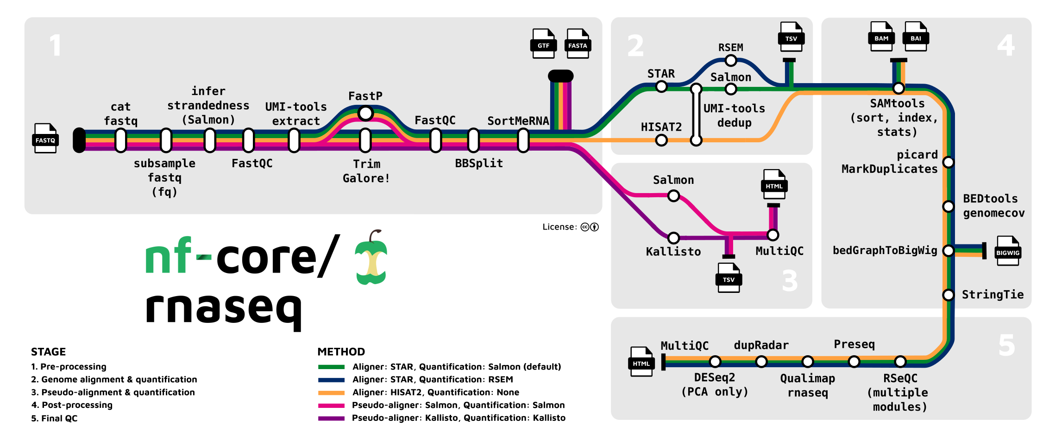
The RNA-seq Workflow

Slide 41

The bulk* RNA-seq workflow
Quality trim and filter
(TrimGalore)
Align to genome
(STAR)
Count reads
(featureCounts)
Short
reads
Count
matrix
Get rid of bad quality stuff
Figure out what genes the reads belong to
Count how many copies of each gene there were
Raw RNA counts table
 | Sample1 | Sample2 | Sample3 | …
GeneA | 6 | 2 | 500 | …
GeneB | 12 | 20 | 65 | …
GeneC | 32 | 1000 | 2 | …
… | … | … | … | …

Slide 42
Differential expression

Slide 43
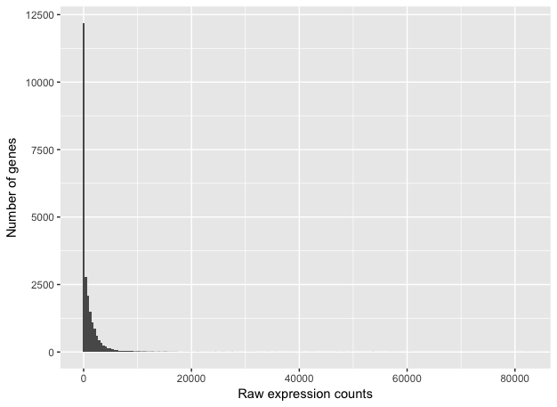
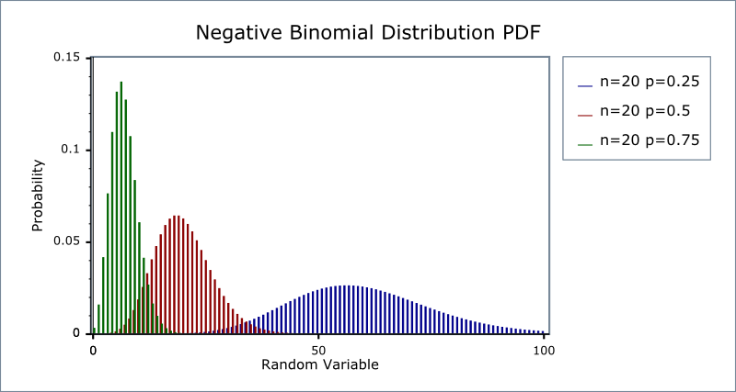
The Statistics of Differential Expression
Differential expression: A gene expressed higher in condition A vs B, consistently across replicates
Count distribution:
Not normal; Counts are over-dispersed: var > mean
Most genes: low counts
Few genes: very high counts (housekeeping genes, ribosomal genes)
Bounded at zero (you can't have negative counts), which forces any spread to go rightward
Negative binomial: a discrete distribution bounded at zero with a long right tail and a dispersion parameter (α)
Multiple testing problem — you're testing 20,000 genes at once. p < 0.05 means 1,000 false positives by chance → FDR and adjusted p-value
Log2 fold change: what it means, why log2 (doubling = +1, halving = -1 — clean)
Notes:
Why not Poisson? Poisson has only one parameter (λ), which forces variance = mean. But as we just discussed, RNA-seq counts are overdispersed — variance > mean. Poisson systematically underestimates the spread, which makes your test statistics look more significant than they really are, inflating false positives.
Why not a normal/Gaussian? Counts are discrete, bounded at zero, and right-skewed — especially at low expression levels. The normal distribution is continuous and symmetric, so it's a poor fit, particularly for lowly expressed genes.
Why Negative Binomial:
Mathematically: it adds a second parameter (the dispersion, α) that lets variance grow faster than the mean — specifically σ² = μ + αμ². When α → 0, it collapses back to Poisson. So Poisson is just a special case. Biologically: you can think of NB as a Poisson where the rate λ itself varies across cells/samples according to a Gamma distribution. This Gamma noise captures biological variability between samples (e.g. cell-to-cell or sample-to-sample stochasticity in transcription), while the Poisson layer captures the technical counting noise from sequencing.

Slide 44
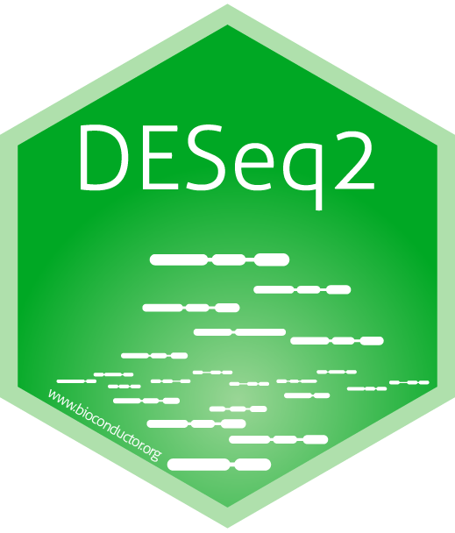
DESeq2
Estimates variance across genes, shrinks noisy estimates, tests each gene
Raw count matrix
The model is based on your design
# One condition, two groups (e.g. treated vs untreated)
dds <- DESeqDataSetFromMatrix(countData = counts,
colData = metadata,
design = ~ condition)
# Then specify the contrast you want explicitly results(dds, contrast = c("condition", "day7", "day0"))
Step 1: Size factor estimation
Normalize for sequencing depth
Step 2: Dispersion estimation
Shrunk towards fitted trend
# You have a batch effect you want to account for
# batch is controlled for, condition is tested
dds <- DESeqDataSetFromMatrix(countData = counts,
colData = metadata, design = ~ batch + condition)
Step 3: GLM fitting and Wald test
NB GLM per gene, test log, fold change
# Tests whether treatment effect depends on genotype
dds <- DESeqDataSetFromMatrix(countData = counts,
colData = metadata,
design = ~ genotype * treatment)
Results table
Log2 FC
Effect size
p-value
Wald test stat
padj
BH correction
baseMean
average expression

Slide 45


Slide 46
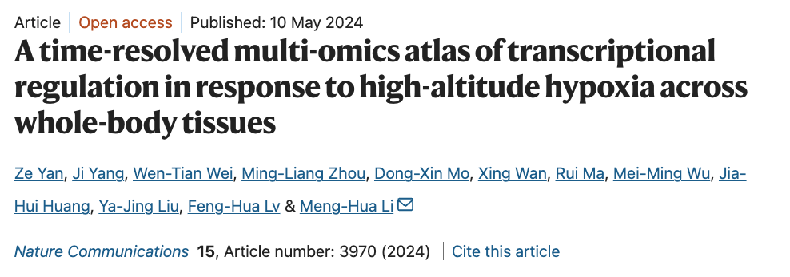
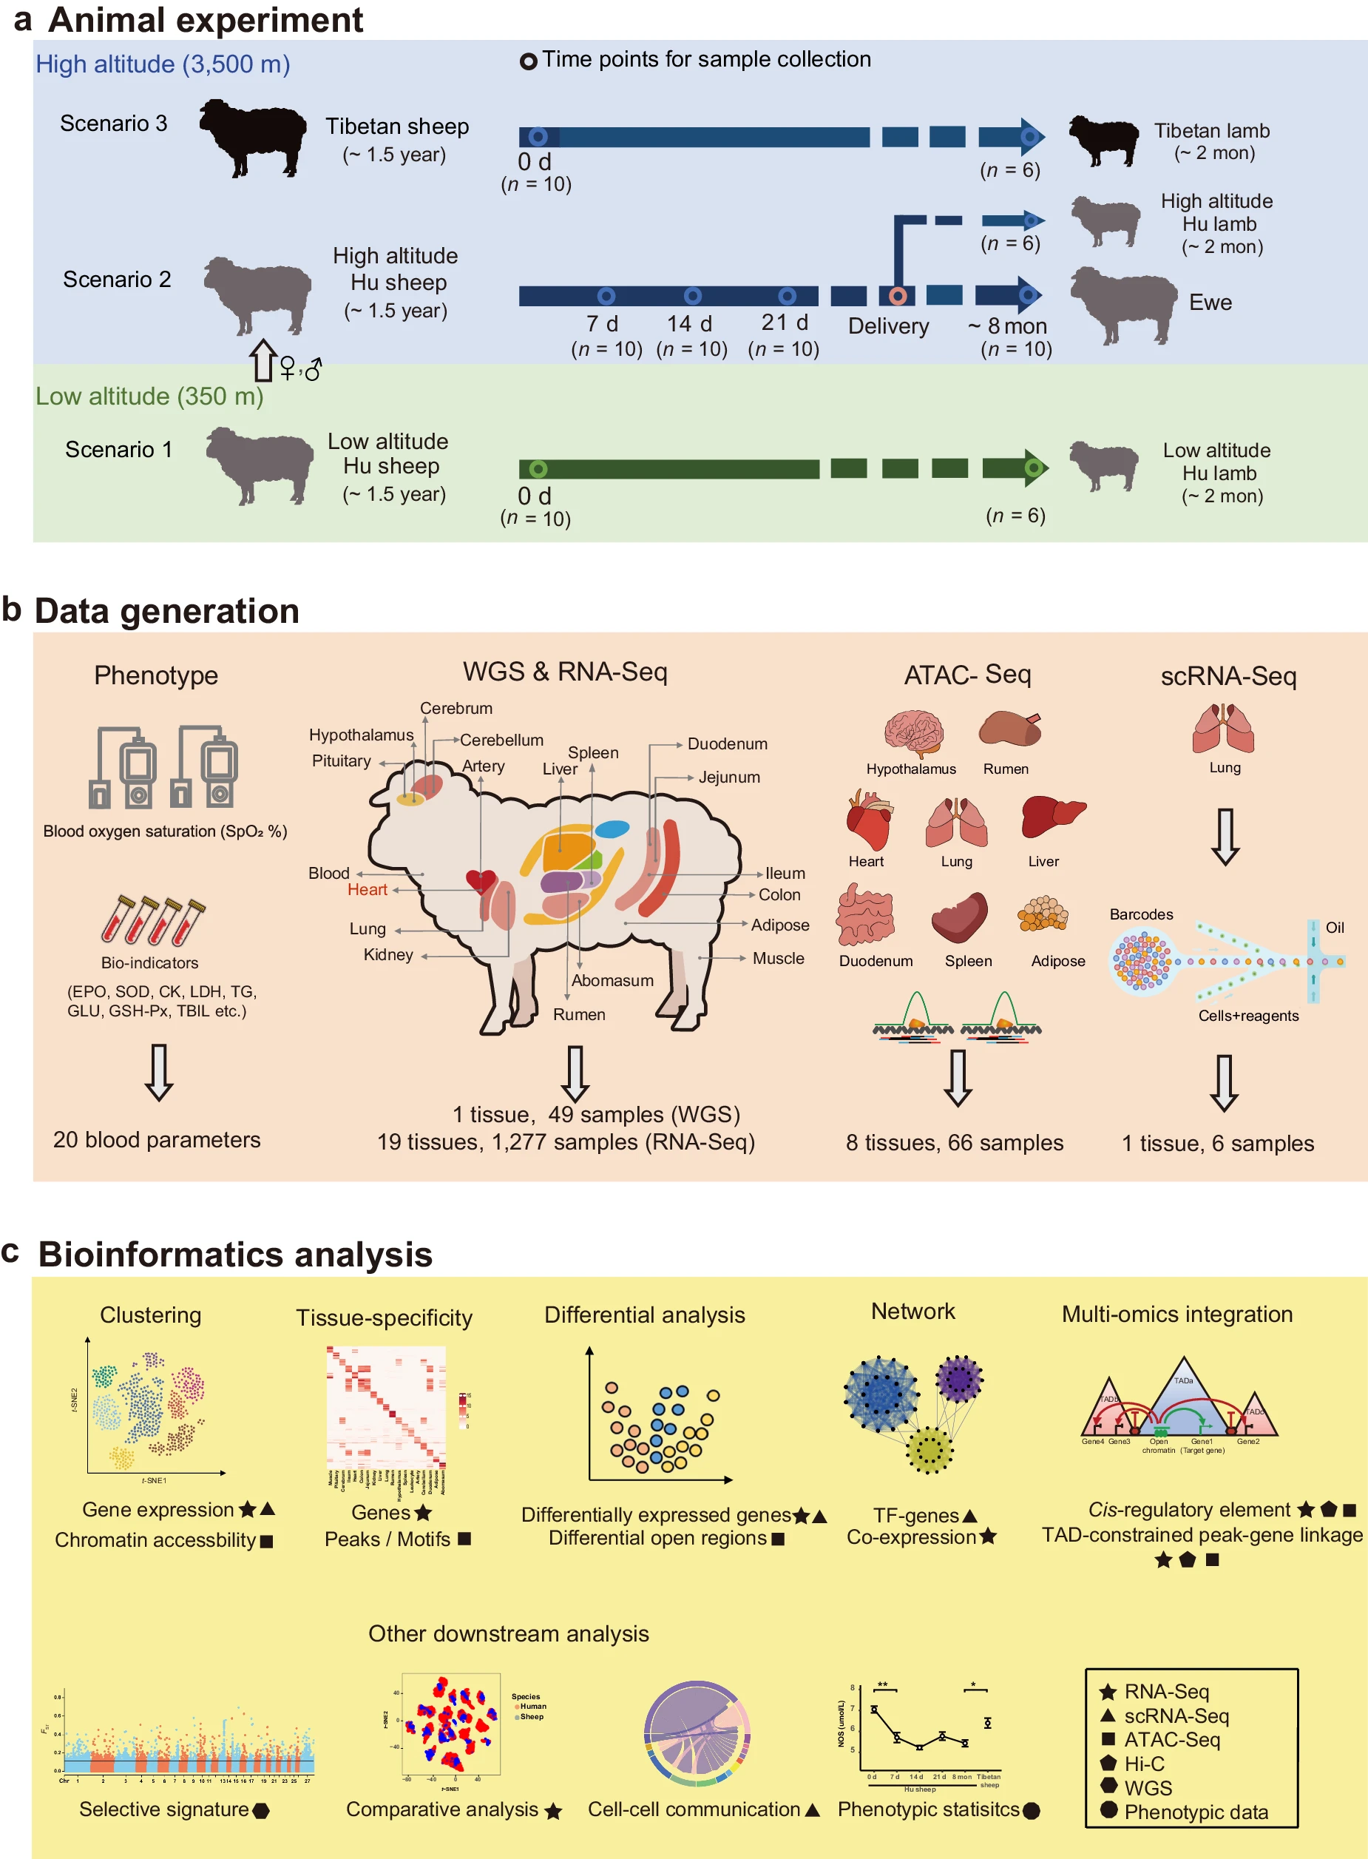
Example dataset
Notes:
https://www.nature.com/articles/s41467-024-48261-w

Slide 47
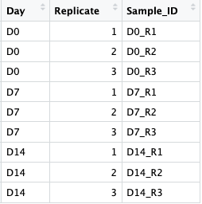
Analysis explanation
1. Load data, setup and clean
9 samples
3 days
3 replicates/day
2. Run DESeq2 to find DEGs
3. Visualize
Data prep
PCA
General patterns
Questions for this dataset:
Do we see differences in the expression of genes with time? Are those time trends consistent across animals?
How many genes are expressed differently?
What genes are expressed differently?
Data prep
MA plots
Data prep
Volcano
DEGs
Data prep
Heatmap

Slide 48


Slide 49
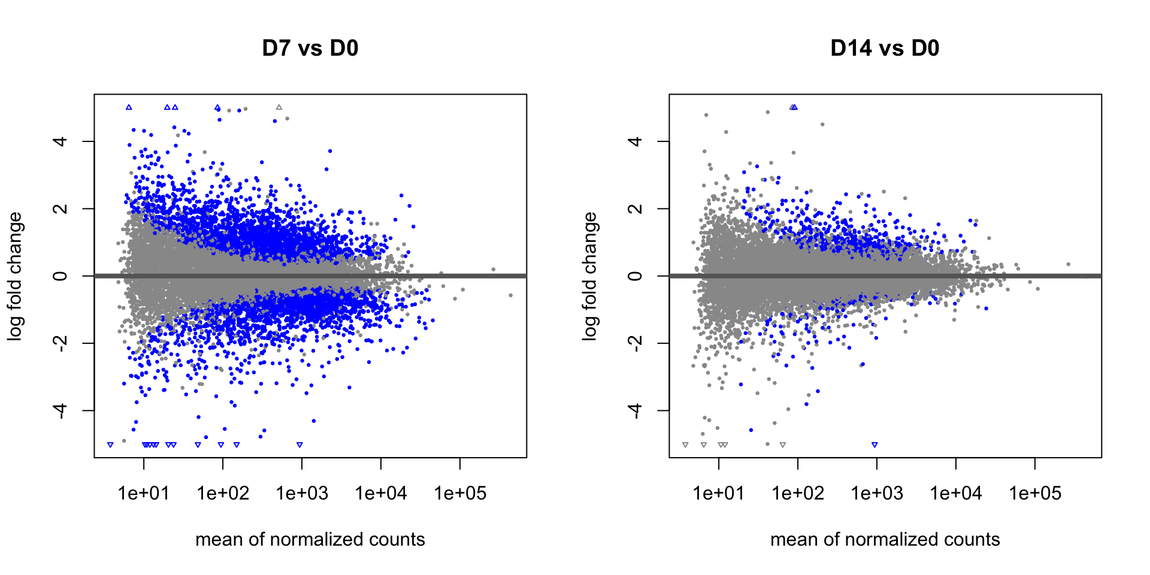
Interpreting Results: MA plots
What you're looking at:
X-axis (A): Mean expression level — genes on the right are more highly expressed.
Y-axis (M): log₂ fold change — above 0 means upregulated, below 0 means downregulated.
Each dot = one gene
How to interpret
Blue points: Statistically significant DEGs (padj < 0.1 by default).
What to look for:
The cloud of grey points should be centered around M = 0 (most genes don’t change).
If the whole cloud is shifted up or down, there may be a normalisation issue.
low-expression genes (left side) have more scatter — this is expected, since estimates are noisier with fewer counts.
They show the relationship between expression level and fold change for all genes simultaneously.

Slide 50
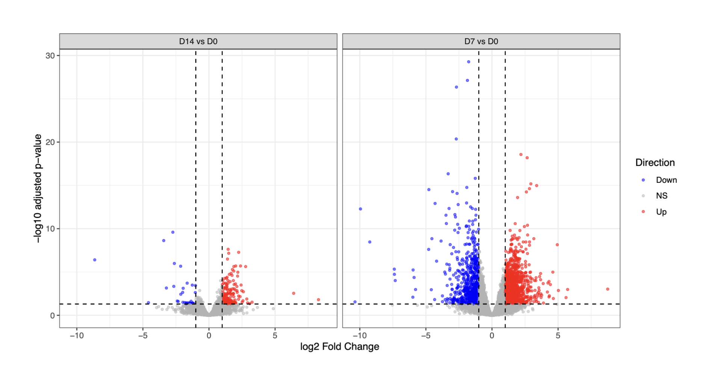
Interpreting Results: Volcano Plots
What you're looking at:
X-axis = log₂ fold change (magnitude of change between conditions)
Y-axis = −log₁₀ adjusted p-value (statistical confidence)
Each dot = one gene
How to interpret:
Upper right = significantly upregulated genes
Upper left = significantly downregulated genes
Bottom/center = not significant or small effect size
The further from center + higher up → the more biologically and statistically meaningful
Thresholds typically used:
|log₂FC| > 1 (at least 2-fold change)
Adjusted p-value < 0.05 (FDR-corrected)
They show: which individual genes changed most significantly between two conditions

Slide 51
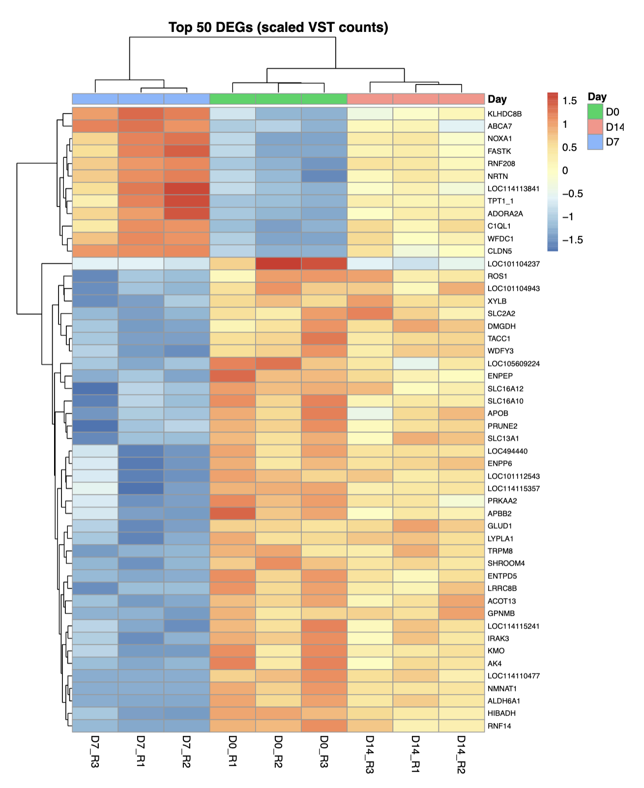
Interpreting Results: Heatmaps
What you're looking at:
Rows = individual genes (here, the top 50 differentially expressed genes)
Columns = individual samples, grouped by timepoint (D0, D7, D14)
Color = scaled expression level (VST-normalized counts)
Red → high expression
Blue → low expression
Yellow/white → near-average expression
The dendrogram (tree structure):
Samples and genes are clustered by similarity in expression patterns
Branches that join early (lower) = more similar to each other
Reveals groups of genes that behave the same way across conditions
They show: expression patterns across many genes and samples at once — good for identifying clusters of co-regulated genes
*DEG = differentially expressed gene
Notes:
How to read the pattern in this heatmap:
The D0 samples (green bar) cluster together and show a distinct expression profile from D7 and D14
A large block of genes is highly expressed at D0 and downregulated by D7/D14 (top cluster, red → blue left to right)
A second block shows the opposite pattern — low at D0, higher at D7/D14 (middle cluster, blue → orange)
This suggests a coordinated transcriptional shift occurring between Day 0 and Day 7
Key genes to highlight (from this heatmap):
Strongly upregulated at D0: KLHDC8B, ABCA7, NOXA1, FASTK
Strongly upregulated at D7/D14: SLC2A2, TACC1, APOB, SLC16A10

Slide 52

Extra activities
Easy — change a parameter and see what happens
Change the fold-change threshold in the volcano plot from 1 to 0.5 or 2 and describe how the number of DEGs changes
Change n = 50 in the heatmap to 25 or 100 — does the biological story change?
Change padj < 0.05 to padj < 0.01 — how many genes do you lose?
Add labels for the top 10 most significant genes on the volcano plot using ggrepel
Medium — extract and explore the results
Write code to count exactly how many genes are Up, Down, and NS in each contrast — present it as a table
Filter the results to only significant DEGs (padj < 0.05, |log2FC| > 1) and save them to a CSV file
Add a third contrast: D14 vs D7 — what genes are still changing between those two time points?
Colour the PCA plot by a different variable (e.g., replicate number) to check for batch effects
Hard — extend the analysis
Look up what the top 10 DEGs actually are — do they make biological sense for a time-course experiment?
Instead of pooling both contrasts for the heatmap, make separate heatmaps for D7-specific and D14-specific DEGs and compare the patterns
Apply lfcShrink() to the results and compare the MA plot before and after — why does shrinkage matter?
or… go back to day 2 and try to run DESeq2 on the microbiome data!
Notes:
How to read the pattern in this heatmap:
The D0 samples (green bar) cluster together and show a distinct expression profile from D7 and D14
A large block of genes is highly expressed at D0 and downregulated by D7/D14 (top cluster, red → blue left to right)
A second block shows the opposite pattern — low at D0, higher at D7/D14 (middle cluster, blue → orange)
This suggests a coordinated transcriptional shift occurring between Day 0 and Day 7
Key genes to highlight (from this heatmap):
Strongly upregulated at D0: KLHDC8B, ABCA7, NOXA1, FASTK
Strongly upregulated at D7/D14: SLC2A2, TACC1, APOB, SLC16A10

Slide 54
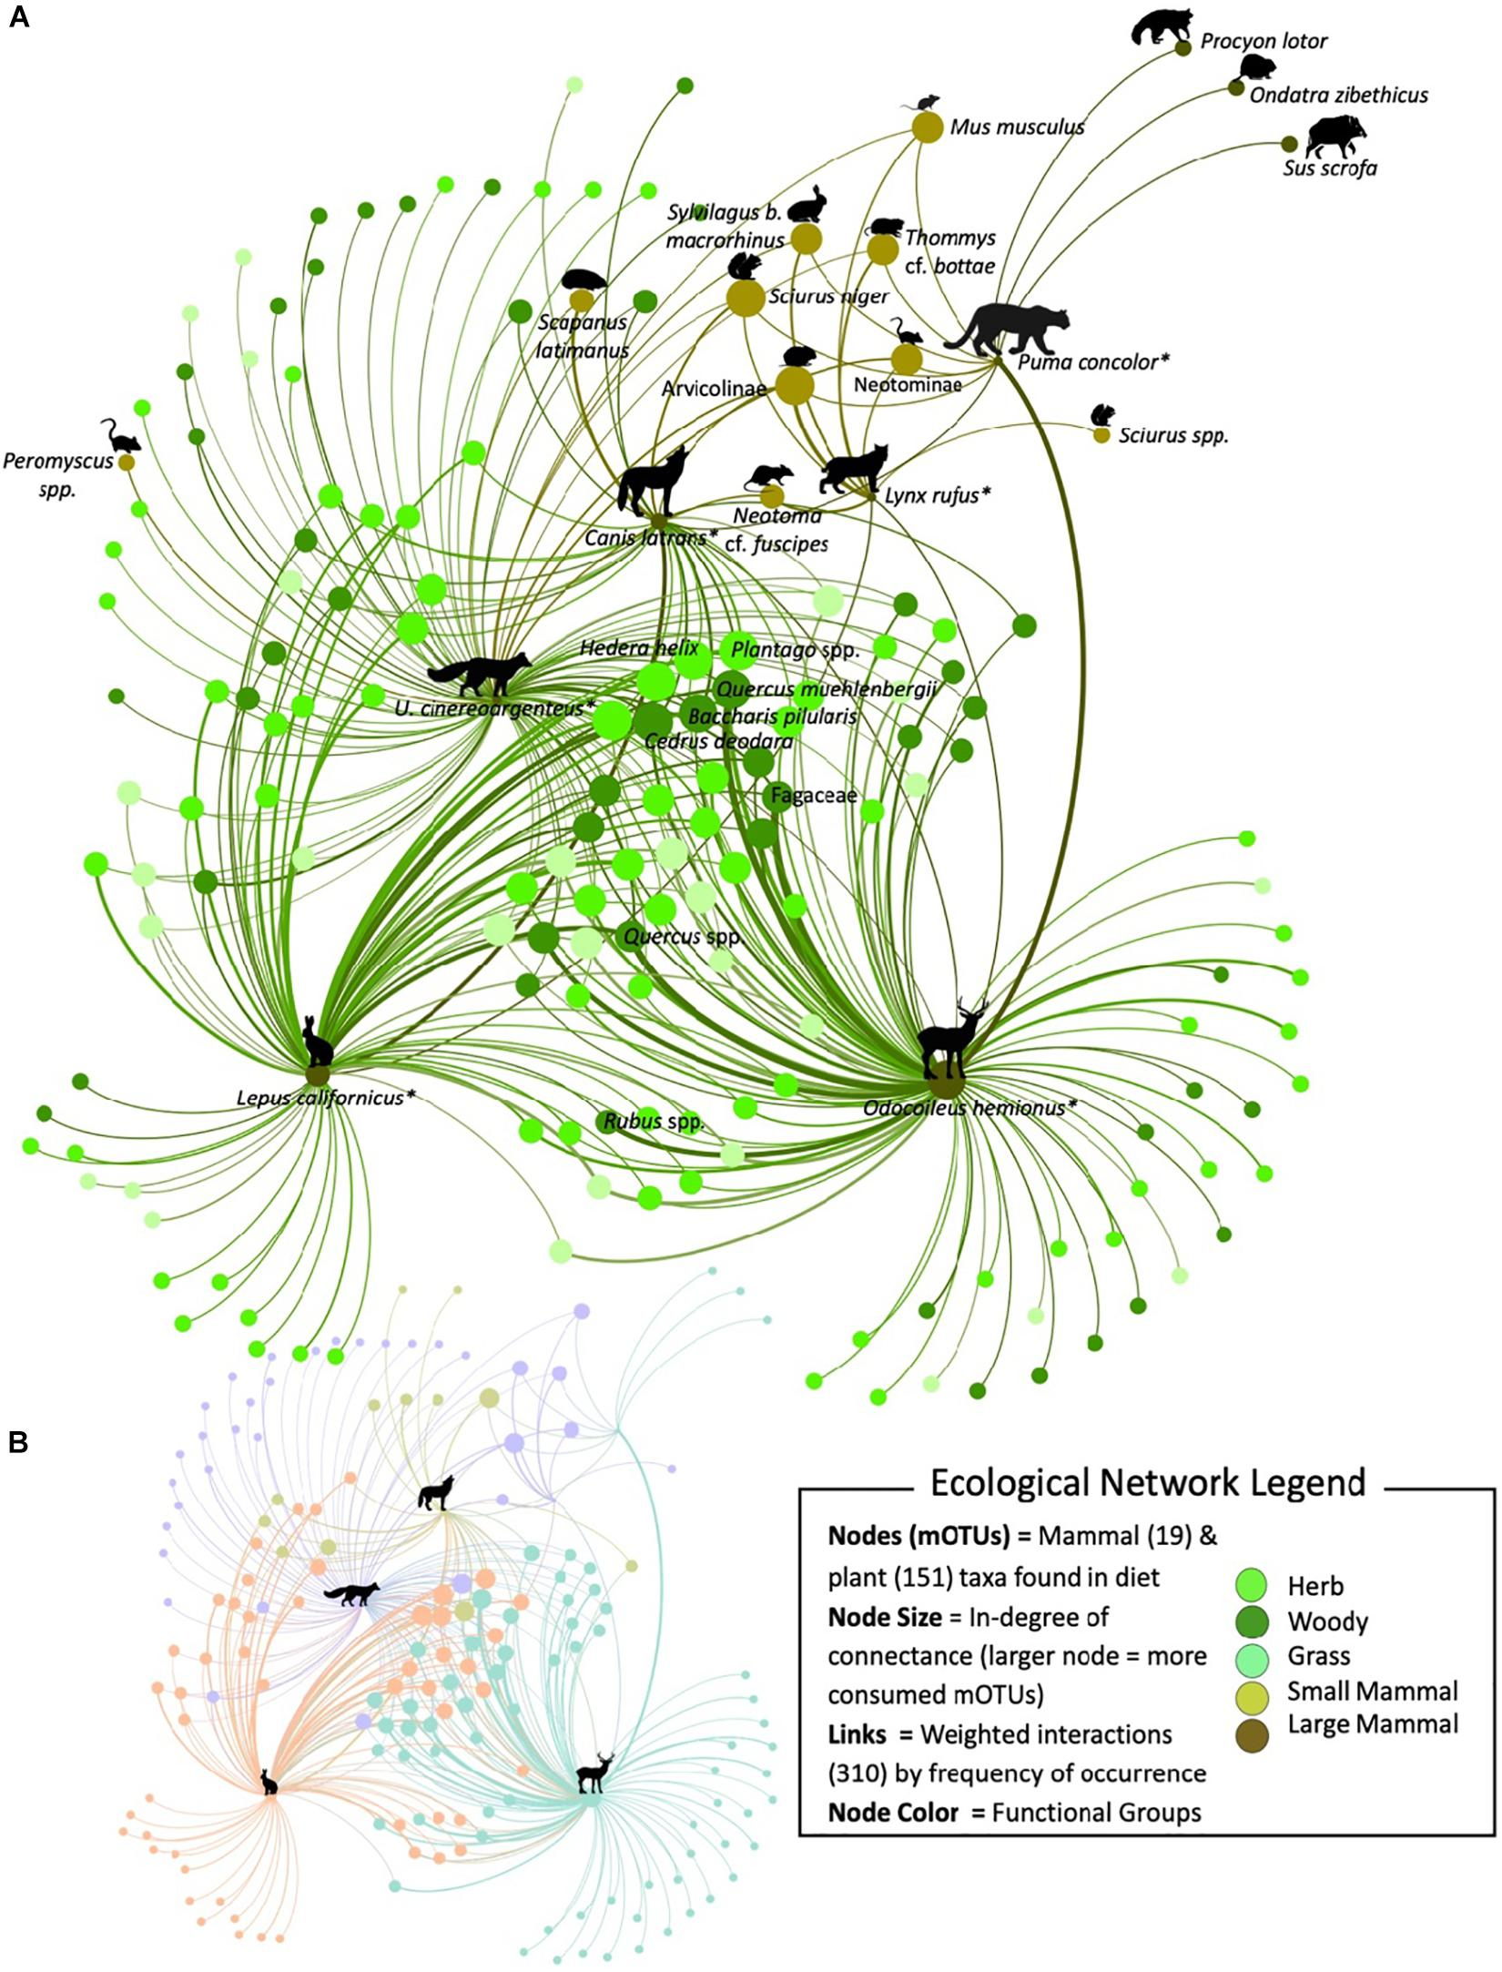
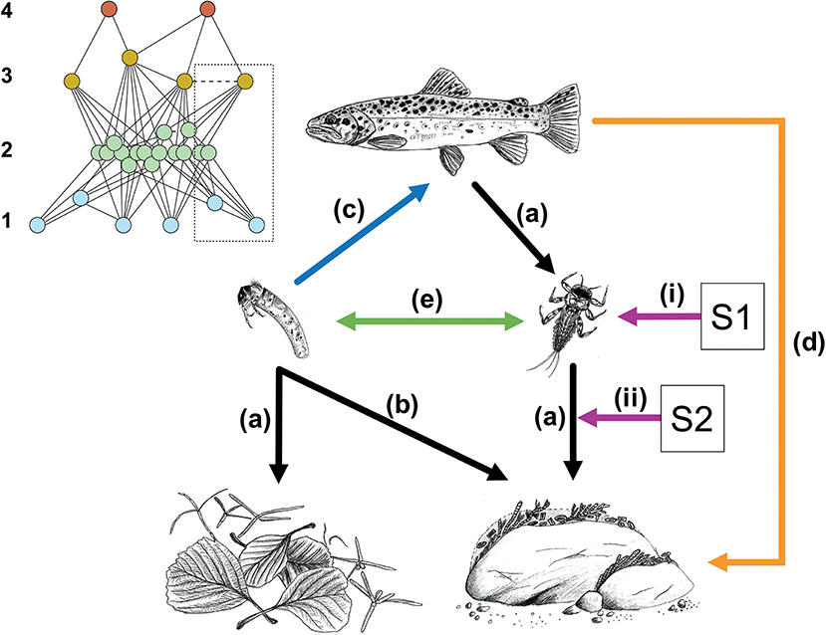
Networks
Networks encode the interactions between the components in complex systems
Bruder et.al. 2019
Meyer et.al. 2020
Notes:
Review networks in microbial ecology: https://journals.asm.org/doi/full/10.1128/mSystems.00124-19
Newman: https://drive.google.com/file/d/1vuwIeIfuOCN-xcKxeBnubP0Bg9GQG95z/view?ts=63b49e85
FIGURE BRUDER:
A simplified representation of biotic interactions in a stream food web based on leaf litter (left-hand pathway) and periphyton (right-hand pathway), and affected by multiple stressors (represented by stressors S1 and S2). Black arrows (A,B) represent trophic interactions with top-down effects on resources, with (B) showing the use of a secondary resource by a consumer with a certain degree of omnivory. The blue arrow (C) represents a trophic interaction with bottom-up effects on the consumer. The orange arrow (D) represents an indirect consequence of trophic interactions, e.g., cascading effects or trait-mediated effects, whereas the green arrow (E) represents non-trophic interactions, e.g., competition/facilitation among species in the same trophic level. Purple arrows represent multiple stressors (S1 and S2) with effects on organism groups (i) and on interactions (ii), e.g., due to changes in foraging activity. The inset shows the complete network of species at the site of which the large scheme is an extract or simplification as shown by the dotted box. Blue nodes (trophic level 1) in the inset represent basal resources including autotroph and heterotroph microorganisms (e.g., fungi), green nodes (trophic level 2) represent invertebrates, and orange (trophic level 3), and red nodes (trophic level 4) represent fish. Trophic interactions in the network are exemplified by continuous lines and non-trophic interactions by the dashed lines.
NATURE ECOLOGICAL NETWORKS: https://www.nature.com/subjects/ecological-networks#:~:text=Definition,interest%20include%20stability%20and%20structure.
(To see the importance and advances that networks contribute with in ecology)

Slide 55
Network components
node
edge

Slide 56
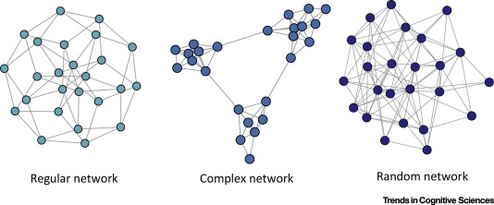
Types of networks
Random
Each node same # of connections but random
Low distance
Low clustering
Scale free
Medium-low distance
Higher clustering
= “Small-world”

Slide 57
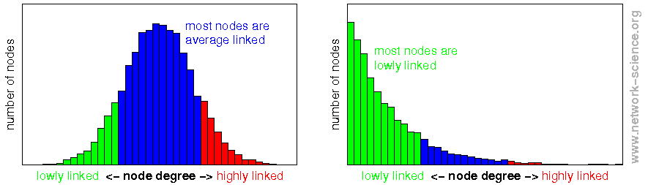
Degree distribution
Random networks
Scale free networks
Notes:
https://www.youtube.com/watch?v=pYMsI-8GsxI
http://social-dynamics.org/scale-free-network/
photo reference: http://www.network-science.org/powerlaw_scalefree_node_degree_distribution.html

Slide 58
https://link.springer.com/article/10.1007/s00265-025-03641-0

Slide 59
Co-expression Networks: The Concept
Co-expression Network: nodes = genes, edges = correlation of counts from RNA-seq
Pitfalls:
Loss of Information from "Hard Thresholding”
- Arbitrary thresholds: strict correlation cutoff (e.g., \(r > 0.8\)).
- Data exclusion: a correlation of 0.79 is discarded, while 0.81 is kept
Failure to reflect scale-free topology
Vulnerability to Background Noise and False Positives
Genes that are consistently co-expressed are likely regulated by the same transcription factors, involved in the same pathways, or functionally related. By grouping them into modules, we can summarise thousands of genes into a handful of patterns and ask which patterns associate with our experimental conditions
Notes:
https://bigomics.ch/blog/introduction-to-wgcna-and-its-applications-in-gene-correlation-network-analysis/

Slide 60
Weighted Gene Coexpression Network Analysis (WGCNA)
Identify clusters of genes (called modules) that share correlated expression patterns and explore how these clusters relate to one another.
The core idea of WGCNA: genes with correlated expression across samples are likely co-regulated or functionally related
WGNCA = Weihghted gene coexpression network analysis
Modules = clusters of co-expressed genes, each gets a color name (MEblue, MEturquoise, etc.)
Hub genes: the most connected gene in a module — often biologically meaningful
How a network is visualized: nodes = genes, edges = correlation strength
One real example: a module enriched in immune genes that correlates with disease severity
Explicitly set expectations: "This afternoon you'll run a simplified version — the concept is the same, the parameters are pre-set so you can focus on interpretation"
Notes:
https://bigomics.ch/blog/introduction-to-wgcna-and-its-applications-in-gene-correlation-network-analysis/

Slide 61
Weighted Gene Coexpression Network Analysis (WGCNA)
Step 0.5: VST normalization
We are interested in how much expression changes, not the absolute number
Step 1: Create a gene co-expression network
Step 2: Identify modules
Notes:
https://bigomics.ch/blog/introduction-to-wgcna-and-its-applications-in-gene-correlation-network-analysis/
Why VST: Heteroscedasticity — in RNA-seq, highly expressed genes naturally show much larger absolute count differences between samples than lowly expressed genes, even if their relative variation is the same. Pearson correlation is distorted by this.
Skewed distributions — raw counts are right-skewed integers; correlation assumes approximately continuous, roughly symmetric data.

Slide 62
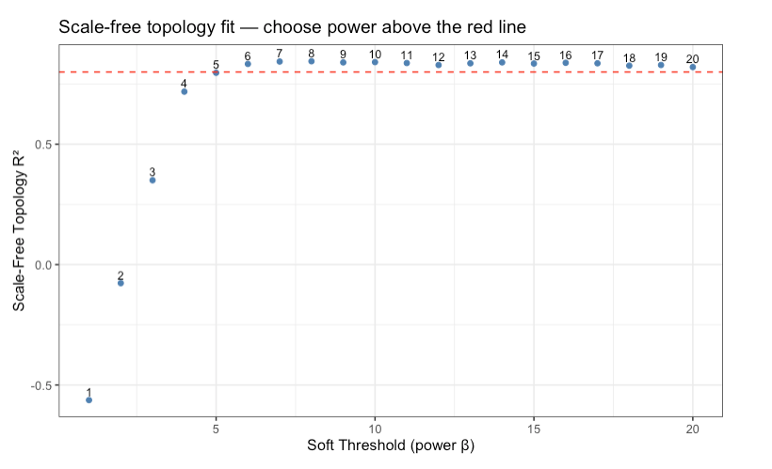
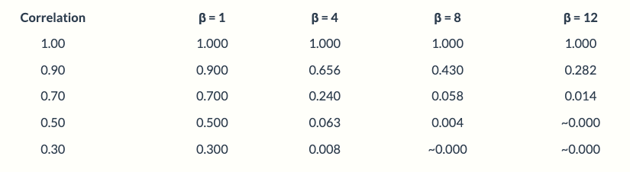
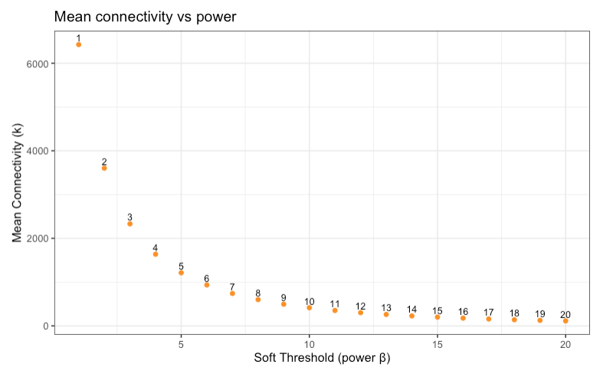
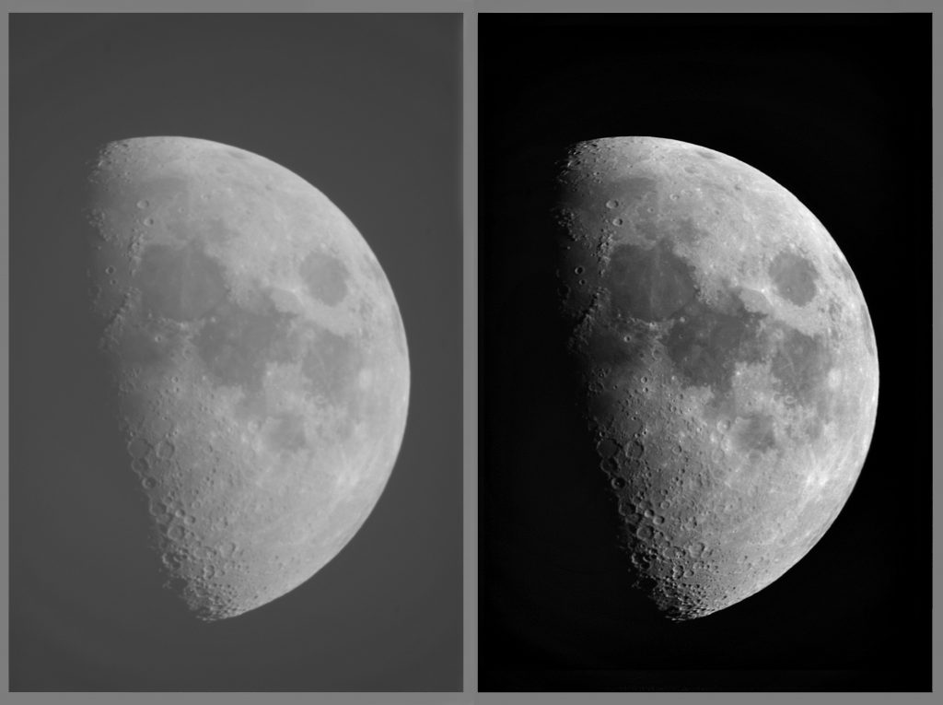
Weighted Gene Coexpression Network Analysis (WGCNA)
Step 2: Identify modules
At β = 1 you are using raw correlations — everything stays connected and the network has no structure.
At β = 12 only very strongly correlated genes retain meaningful connection weights — the network becomes sparse and biologically interpretable.
Notes:
https://bigomics.ch/blog/introduction-to-wgcna-and-its-applications-in-gene-correlation-network-analysis/
Why VST: Heteroscedasticity — in RNA-seq, highly expressed genes naturally show much larger absolute count differences between samples than lowly expressed genes, even if their relative variation is the same. Pearson correlation is distorted by this.
Skewed distributions — raw counts are right-skewed integers; correlation assumes approximately continuous, roughly symmetric data.

Slide 63
Weighted Gene Coexpression Network Analysis (WGCNA)
Step 2: Identify modules
Notes:
https://bigomics.ch/blog/introduction-to-wgcna-and-its-applications-in-gene-correlation-network-analysis/
Why VST: Heteroscedasticity — in RNA-seq, highly expressed genes naturally show much larger absolute count differences between samples than lowly expressed genes, even if their relative variation is the same. Pearson correlation is distorted by this.
Skewed distributions — raw counts are right-skewed integers; correlation assumes approximately continuous, roughly symmetric data.

Slide 64
Weighted Gene Coexpression Network Analysis (WGCNA)
Step 0.5: VST normalization
We are interested in how much expression changes, not the absolute number
Step 1: Create a gene co-expression network
Step 2: Identify modules
Step 3: Relate modules to external information
Notes:
https://bigomics.ch/blog/introduction-to-wgcna-and-its-applications-in-gene-correlation-network-analysis/
Why VST: Heteroscedasticity — in RNA-seq, highly expressed genes naturally show much larger absolute count differences between samples than lowly expressed genes, even if their relative variation is the same. Pearson correlation is distorted by this.
Skewed distributions — raw counts are right-skewed integers; correlation assumes approximately continuous, roughly symmetric data.

Slide 65
Weighted Gene Coexpression Network Analysis (WGCNA)
Step 3: Relate modules to external information
Notes:
https://bigomics.ch/blog/introduction-to-wgcna-and-its-applications-in-gene-correlation-network-analysis/
Why VST: Heteroscedasticity — in RNA-seq, highly expressed genes naturally show much larger absolute count differences between samples than lowly expressed genes, even if their relative variation is the same. Pearson correlation is distorted by this.
Skewed distributions — raw counts are right-skewed integers; correlation assumes approximately continuous, roughly symmetric data.

Slide 66
Weighted Gene Coexpression Network Analysis (WGCNA)
Step 0.5: VST normalization
We are interested in how much expression changes, not the absolute number
Step 1: Create a gene co-expression network
Step 2: Identify modules
Step 3: Relate modules to external information
Step 4: Study module relationships
Step 5: Find the key drivers in modules of interest
Notes:
https://bigomics.ch/blog/introduction-to-wgcna-and-its-applications-in-gene-correlation-network-analysis/
Why VST: Heteroscedasticity — in RNA-seq, highly expressed genes naturally show much larger absolute count differences between samples than lowly expressed genes, even if their relative variation is the same. Pearson correlation is distorted by this.
Skewed distributions — raw counts are right-skewed integers; correlation assumes approximately continuous, roughly symmetric data.

Slide 68

End of day 2 lecture

Slide 69
Resources
Bulk RNA-seq: https://academic.oup.com/bib/article/22/6/bbab259/6330938
Differential expression and RNA-seq data analysis: https://hbctraining.github.io/Training-modules/planning_successful_rnaseq/lessons/count_modeling.html
WGCNA Network analysis: https://bigomics.ch/blog/introduction-to-wgcna-and-its-applications-in-gene-correlation-network-analysis/
Video: https://www.youtube.com/watch?v=q9a2RvqYZzQ
Examples in literature: https://www.mdpi.com/2076-2615/14/10/1470

Slide 70
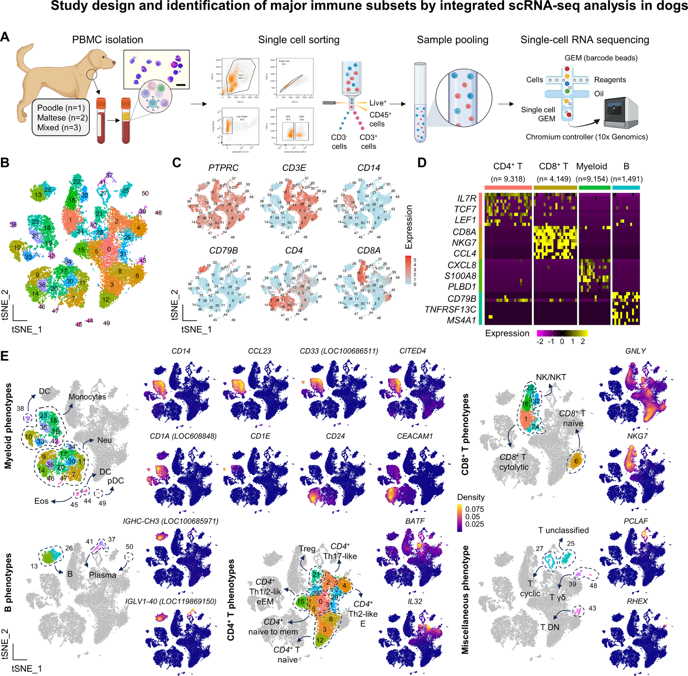
Single cell (sc)RNA-seq*

