Slide 1
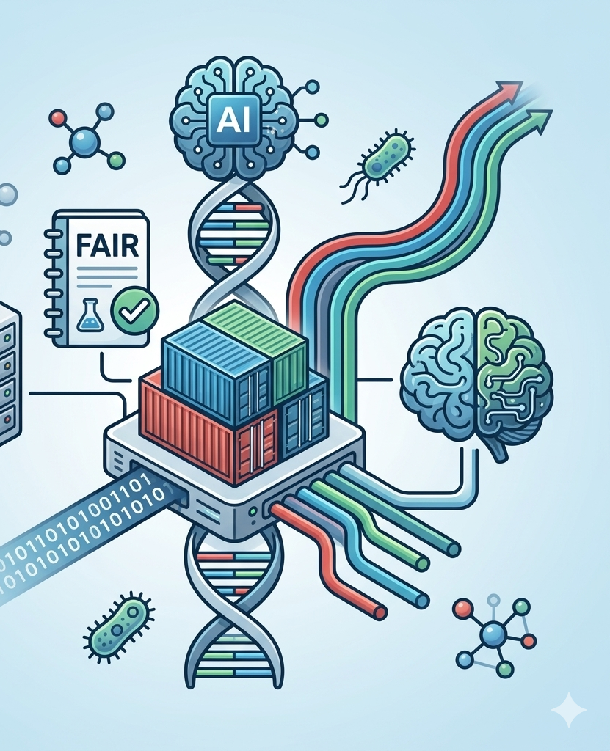

Bonus: in bioinformatics

Slide 2
Today
Long-Read Sequencing and Its Impact on Microbial Genomics
Pipeline managers (Nextflow)
Software managers (Containers)
Reproducibility and FAIR data principles
AI in bioinformatics

Slide 3
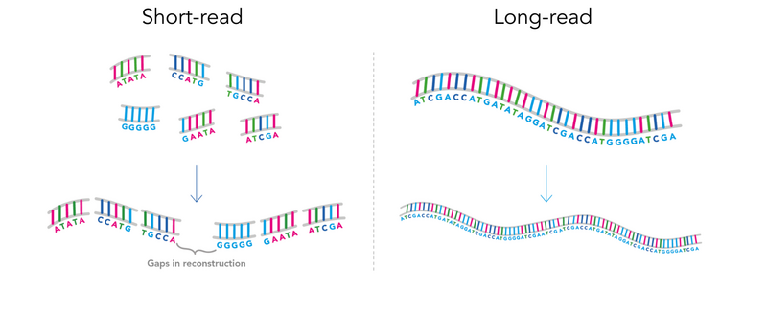
Long-read sequencing

Slide 4


Long-Read Sequencing and Its Impact on Microbial Genomics
Short-read sequencing = 150 to 300 base pairs.
Long-read = x 1k – 100k basepairs
Assembling complete microbial genomes
Phasing structural variants
Resolving repetitive regions
Characterizing mobile genetic elements
Reconstructing near-complete MAGs
Tracking transmission of antimicrobial resistance genes on plasmids
Characterizing outbreak strains with high resolution
Reference-quality assembly of novel pathogens
Worse at finding non-dominant genomes
Require different assembly algorithms
Different quality control approaches
Different error models.
Hybrid assembly strategies = long = short read
Understanding the characteristics and limitations of the data you are working with is as important as understanding the tools.

Slide 5

Nextflow

Slide 6

Nextflow
Bioinformatics workflow manager and language
The problem: You have ten samples, a shell script that works for sample one, and then something breaks on sample seven. You are not sure which step failed, you have log files scattered across three directories, and reproducing the results six months later when a reviewer asks feels like archaeology. Workflow managers exist to solve this class of problem.
The building blocks:
Processes
Channels
Workflows
Atomic computational tasks. Each runs in its own directory with defined inputs & outputs.
Asynchronous queues that connect processes. Data flows through channels between tasks.
Orchestration layer that wires processes together and defines the execution topology.

Slide 7
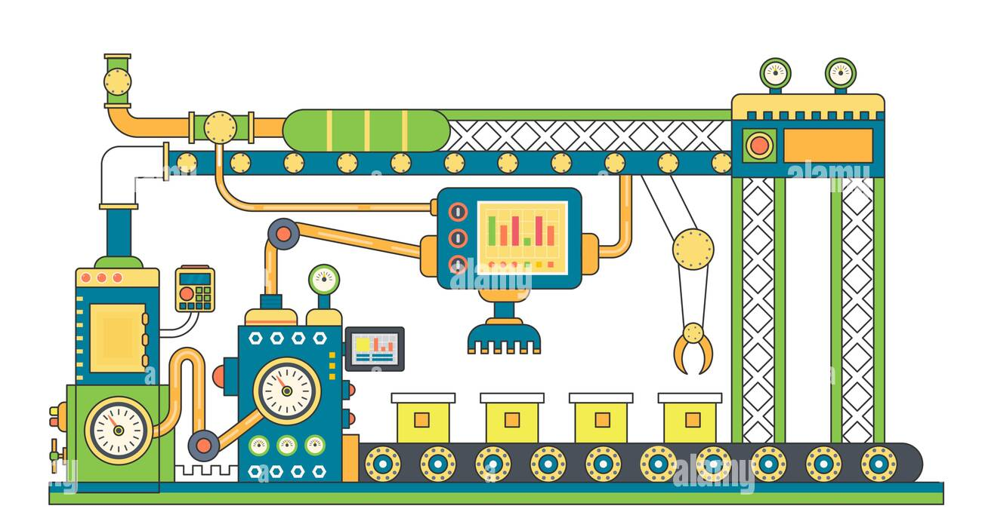
Workflow (logic, factory plan)
Processes (tools, factory stations)
Channels (conveyor belts)

Slide 8


Nextflow components: config files
Configuration files (nextflow.config) separate execution settings from pipeline logic:
Executor settings: Where to run (local, HPC, cloud)
Resource allocation: Default CPU, memory per process
Container settings: Docker/Singularity configuration
Profiles: Different configurations for different environments (laptop vs cluster)
This separation allows the same pipeline to run across different infrastructure without code changes.

Slide 9

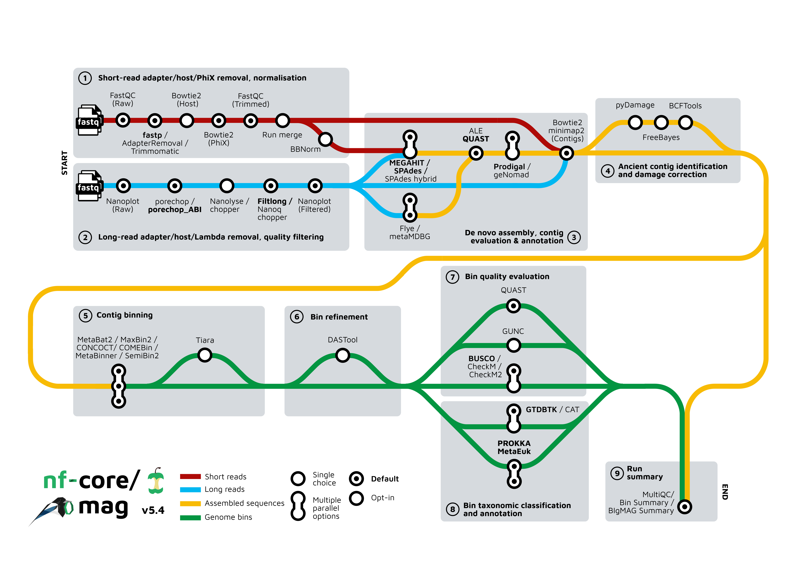
Nf-core
This is a community-maintained collection of curated, peer-reviewed Nextflow pipelines:
production-grade
extensively tested
standardised structure.
Great for using their pipelines
Also borrowing modules and other chunks of code

Slide 10
When use nextflow
What Nextflow Is Not
Nextflow is not a magic solution to poorly designed analyses
It does not help you choose the right tool for your data or interpret your results.
It is also a genuine investment to learn: the Groovy-based DSL2 syntax has its own logic and takes time to become comfortable with.
When to use nextflow
Running analyses at scale and/or multiple times
Sharing pipelines with collaborators
Deploying same pipeline in multiple systems
Trying to ensure that your methods are truly reproducible

Slide 11

Containers

Slide 12
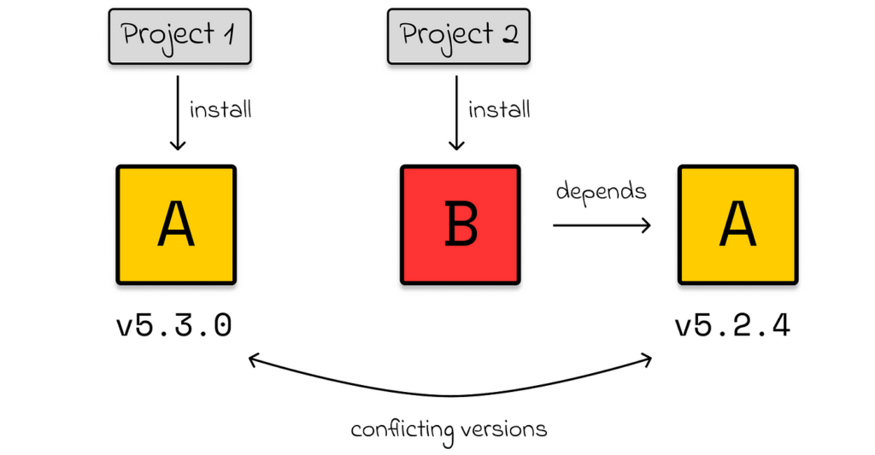
The dependency problem

Slide 13
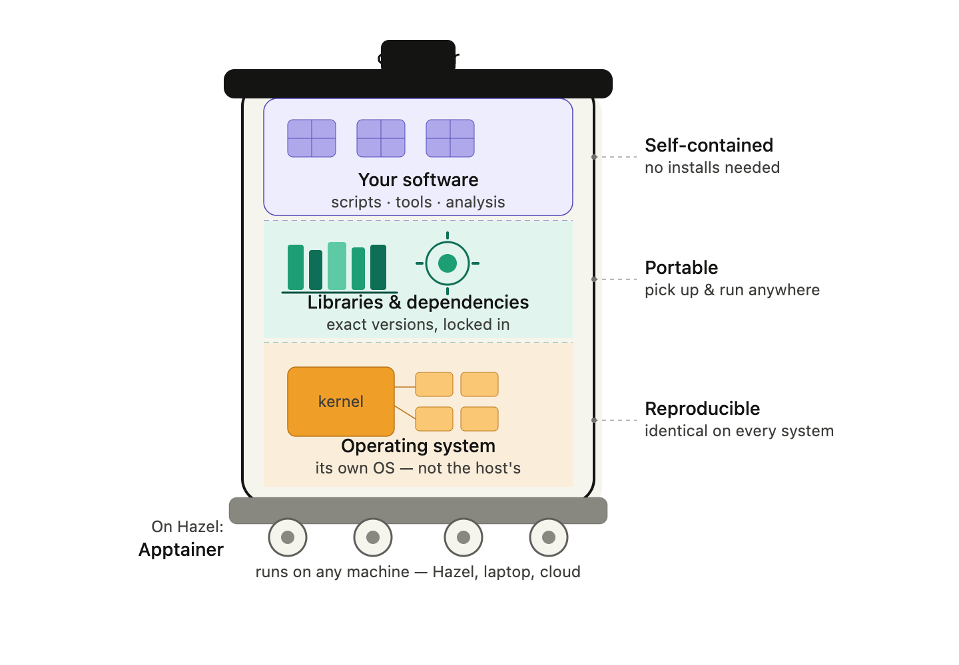
Introduction to containers
We have to use containers when:
extremely complex dependencies
require a specific operating system configuration
need to guarantee that analysis will run identically on any system — not just Hazel
We should generally use containers
A container is like a complete mini-computer:
Operating system
Libraries
Software
You don't install the software — you just run the container.
portable, versioned, immutable environments
An analysis is not just a script — it is a script plus the exact environment in which it run

Slide 14
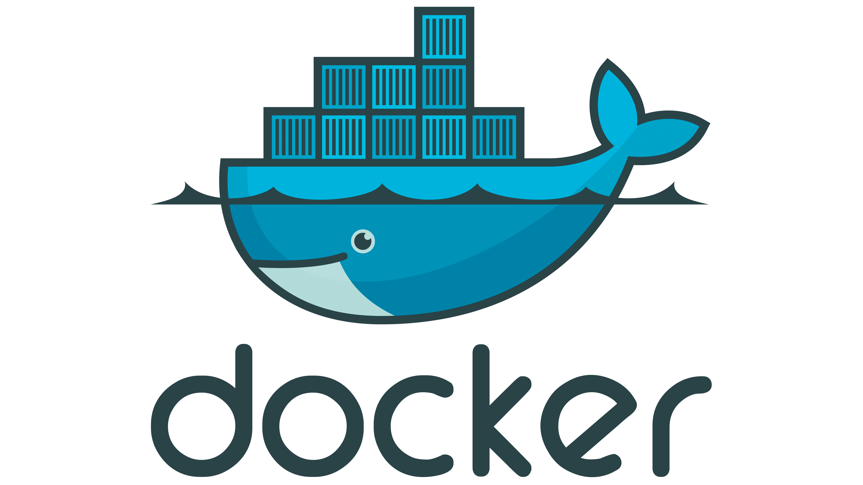

Singularity vs. docker
dominant container platform
most likely to encounter in tutorials, documentation, and online resources
images are stored in registries(Docker Hub and the Biocontainers)
HPC clusters: Docker requires root privileges.
No needing administrator access.
can also directly run Docker images

Slide 15
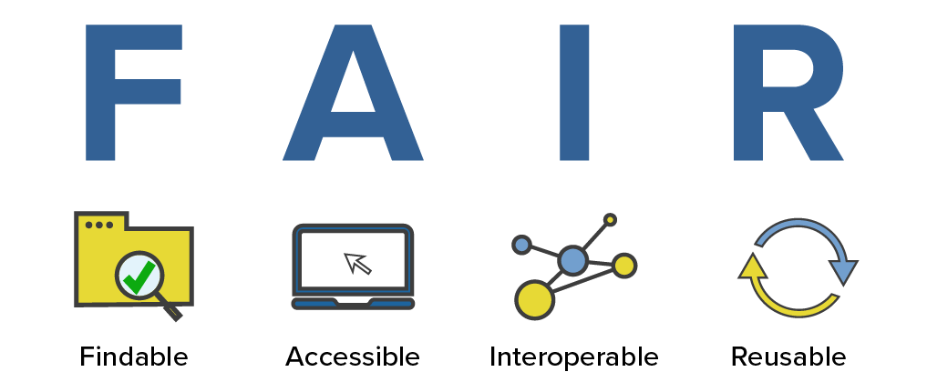
Reproducibility
and data

Slide 16
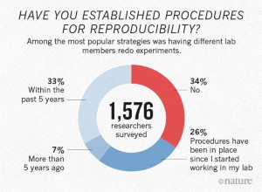
Reproducibility, Open Science, and FAIR Data
A substantial proportion of published computational analyses cannot be reproduced, even by the original authors, due to software version changes, undocumented preprocessing steps, unavailable data, or incomplete methods sections.
FAIR compliance
Required by funding agencies and journals
Depositing raw data in public repositories
Using community-standard metadata formats
Documenting analysis code in version-controlled repositories like GitHub or GitLab.
Electronic lab notebooks, tools like RMarkdown and Quarto for combining code and narrative
Platforms like Zenodo for archiving analysis code

Slide 17
GitHub
GitHub is a platform for version-controlling code and sharing workflows. In bioinformatics it serves three core purposes:
1. Tracking changes to analysis scripts
2. Collaborating with lab members and the broader community
3. Publishing reproducible pipelines alongside papers.
Repository
Commit
Branch
a project folder that tracks its full history of changes
a saved snapshot of your changes with a message describing what changed
a parallel copy of the repo where you can experiment without breaking the main version
Pull request (PR)
Fork
README.md
a request to merge your branch into another, reviewed by collaborators
your own copy of someone else's repo, used to propose changes or build on their work
the landing page of any repo; documents how to install dependencies, what data the tool expects, and how to run the analysis

Slide 18
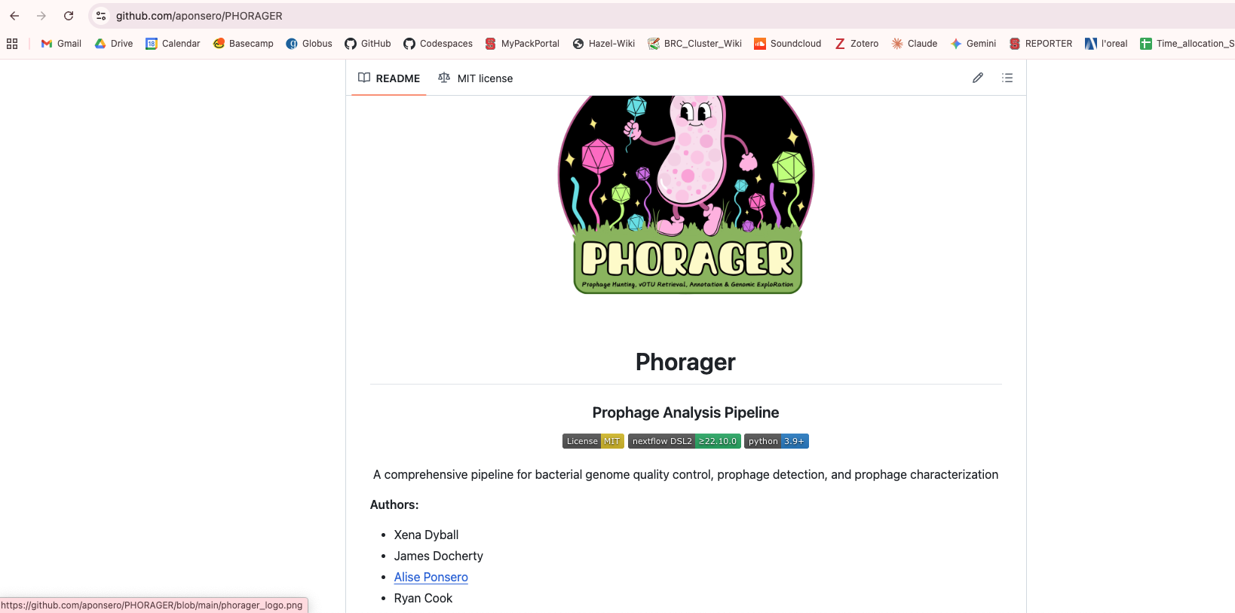
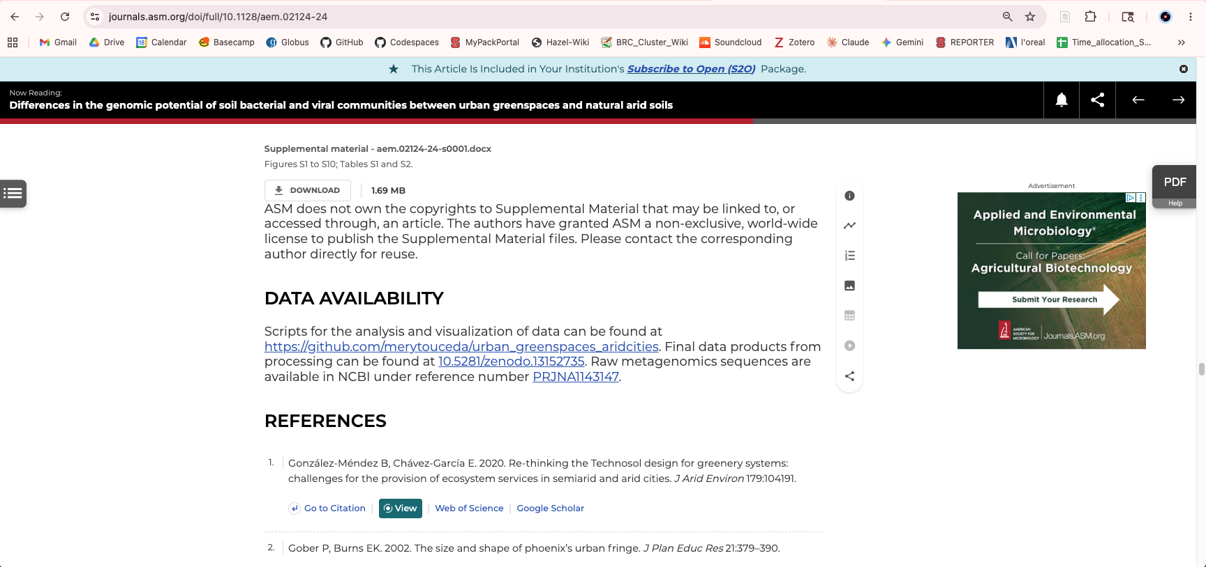
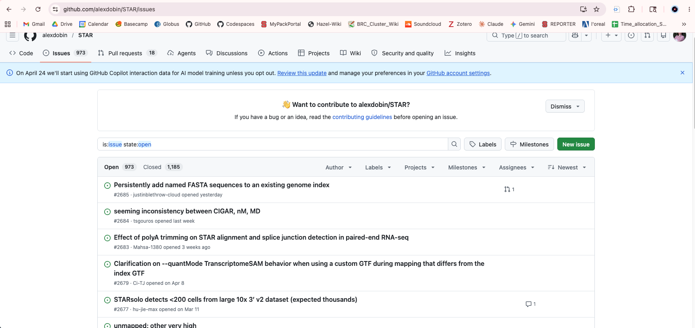
How we use GitHub
Basic usage:
Sharing tools and pipelines — tools like STAR, GATK, Seurat, and Scanpy all live on GitHub
Reproducibility — archiving the exact code used to generate figures in a paper
GitHub Releases + Zenodo — minting a DOI for a specific version of your software for citation
Issues tracker — filing bugs, requesting features, or asking the tool developer a question

Slide 19
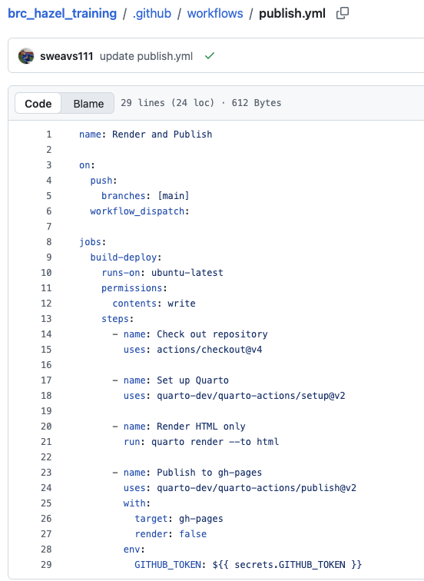
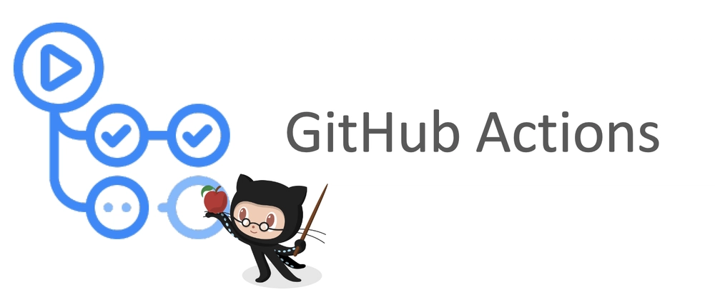
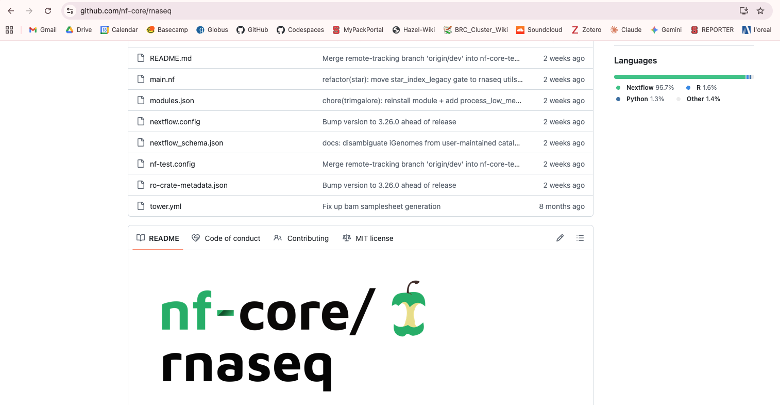
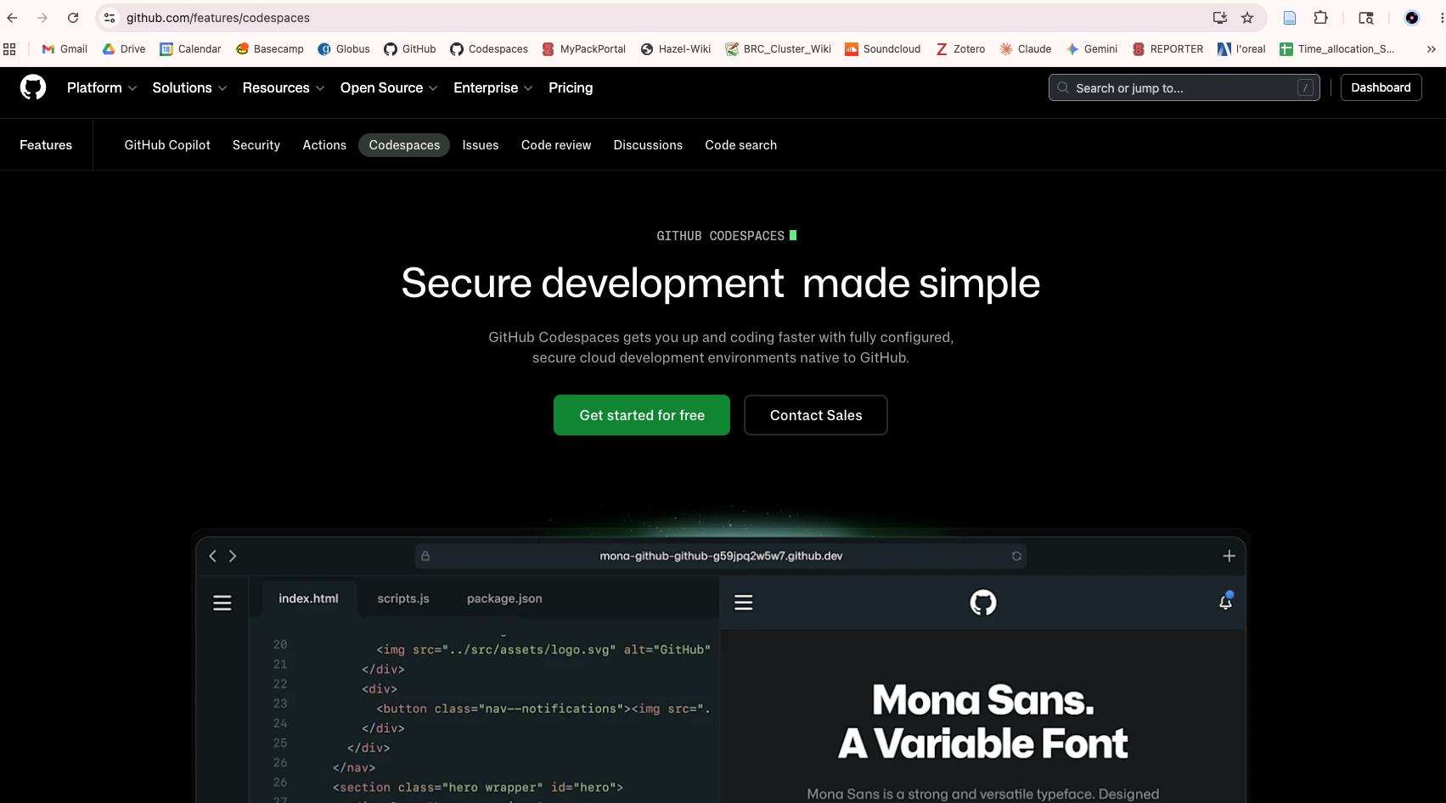

How we use GitHub
Newest things:
GitHub Actions — automated testing that runs every time code is pushed (continuous integration)
Workflow languages on GitHub Snakemake and Nextflow pipelines are now routinely hosted on GitHub.
GitHub Codespaces for reproducible environments Codespaces provides a cloud-based VS Code environment spun up from a repo.
Copilot in bioinformatics GitHub Copilot (AI code completion)
AI-generated notebooks and vignettes Researchers are using LLMs to generate tutorial notebooks directly from their GitHub repos.

Slide 20
AI in bioinformatics

Slide 21
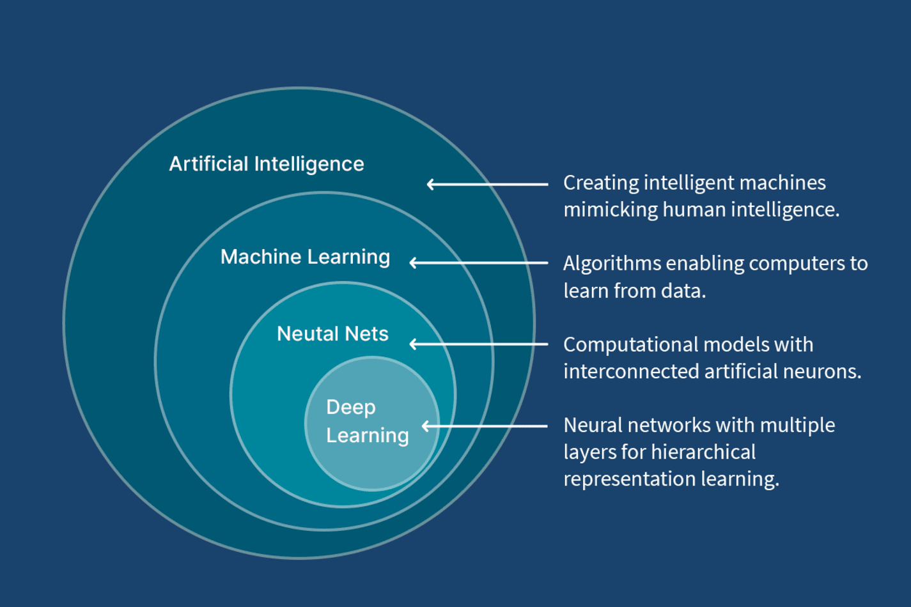
AI vs. ML
Notes:
Few areas of biology have been as dramatically affected by recent advances in machine learning as bioinformatics. It is worth being precise about what we mean, because the term artificial intelligence is used loosely to cover everything from classical statistical models to large language models. We will focus on the developments that are most immediately relevant and most likely to affect your work.

Slide 22

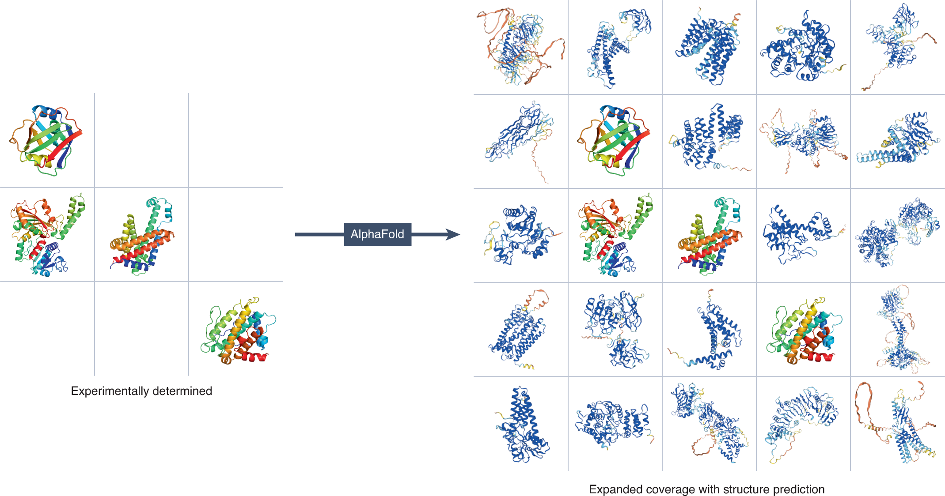

AlphaFold
We don’t give models rules but data to learn rules from
What it does
High-confidence, fast, free, protein structure prediction
What it uses
via X-ray crystallography or cryo-EM
Expensive and long
Protein Data Bank (for model training)
+
transformer-based neural network architecture
bacterial virulence factor
enzyme involved in antimicrobial resistance
zoonotic pathogen surface protein
host immune receptor
Notes:
AlphaFold is one of the most celebrated applications of AI in science. Here's how they're connected:
What AlphaFold is: A protein structure prediction system developed by Google DeepMind that solves a 50-year-old grand challenge in biology — predicting a protein's 3D shape from its amino acid sequence.
The AI behind it: AlphaFold uses deep learning, specifically a transformer-based neural network architecture (similar to what powers large language models). It was trained on the Protein Data Bank, a repository of experimentally determined protein structures, and learned to predict how proteins fold with remarkable accuracy.
Why it was a breakthrough: Before AlphaFold, determining protein structures experimentally (via X-ray crystallography or cryo-EM) took years and cost millions. AlphaFold 2 (released 2020–2021) achieved accuracy rivaling experimental methods, which stunned the scientific community. It won the CASP14 competition (a biennial protein-structure prediction contest) by a massive margin.
Impact: DeepMind made AlphaFold's predictions freely available, releasing structures for over 200 million proteins — essentially most known proteins across almost all organisms. This has accelerated research in drug discovery, understanding diseases, enzyme engineering, and vaccine development.
Recognition: The work earned Demis Hassabis (DeepMind's CEO) and John Jumper (lead researcher) a share of the 2024 Nobel Prize in Chemistry — a remarkable milestone for AI-driven science.
AlphaFold is widely regarded as a landmark moment showing that AI can make genuine scientific discoveries, not just assist with data analysis.

Slide 23
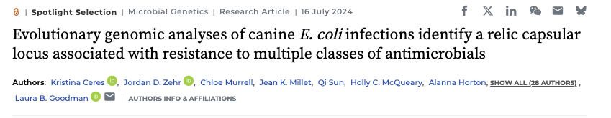
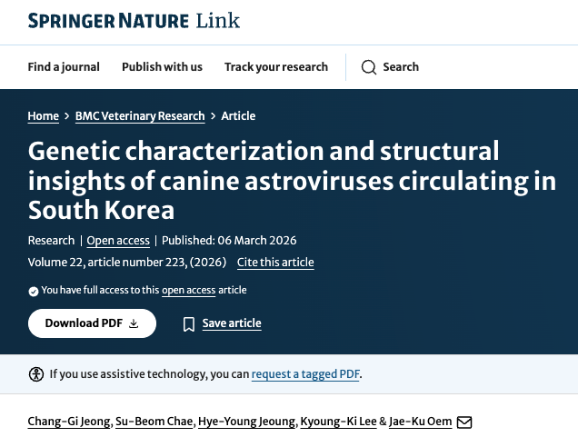
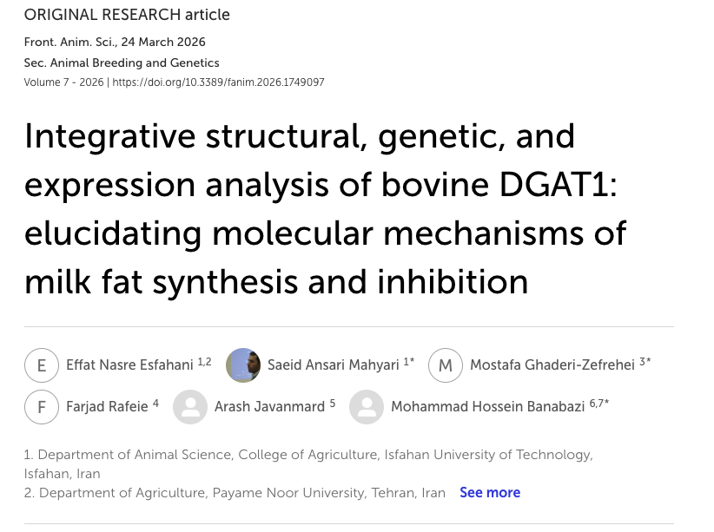

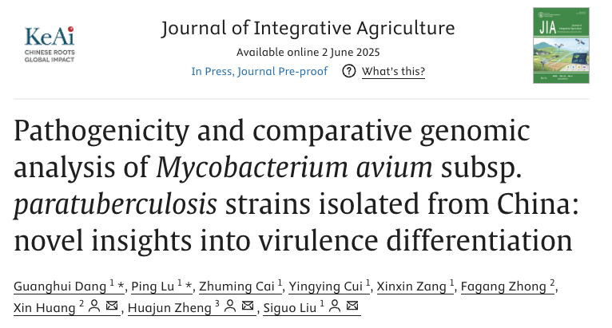
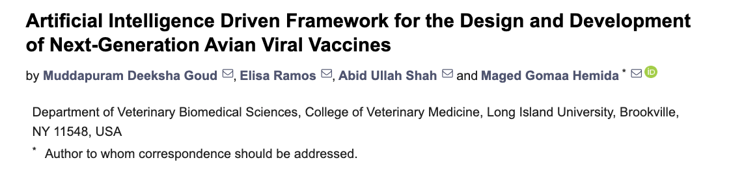
AlphaFold
Notes:
Top to bottom and Left to right:
https://journals.asm.org/doi/full/10.1128/aem.00354-24
https://www.sciencedirect.com/science/article/pii/S0304389425003061#fig0005
https://link.springer.com/article/10.1186/s12917-026-05370-6
https://www.frontiersin.org/journals/animal-science/articles/10.3389/fanim.2026.1749097/full
https://www.mdpi.com/2076-2607/13/10/2361

Slide 24
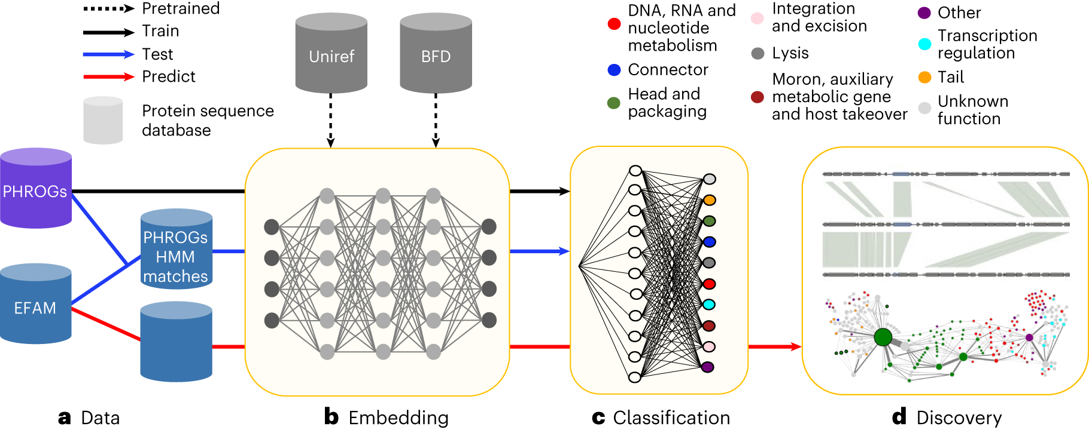
Large Language Models for Biology
Application of transformer architectures — the same underlying technology ChatGPT, claude, etc — to biological sequences.
Models treat genomic sequences as a language, enabling tasks like gene prediction, regulatory element identification, and even de novo sequence generationThese models are powerful but come with important caveats.
But!:
They require substantial computational resources to run,
They can produce confidently wrong outputs,
Their behaviour in understudied taxa is less well validated than in human-focused datasets.
Flamholz et al. (2024). Nature Microbiology. Large language models improve annotation of prokaryotic viral proteins

Slide 25


AI-Assisted Coding and Analysis
The most immediately practical aspect of AI in bioinformatics = large language models as coding assistants.
Learning to use these tools << learning to evaluate their outputs.
Issues:
- Generate plausible-looking code and explanations that are sometimes subtly wrong
- Important to know what you are trying to do and how to test it!
Manifest on rewriting code with AI responsibly: https://rewrites.bio/

Slide 26
The power combo:
AI Agents
Skills
GitHub Actions
+
+

Slide 27
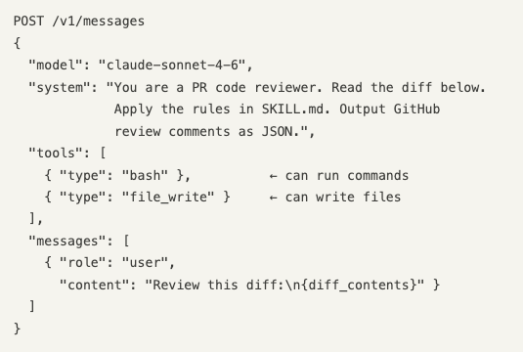
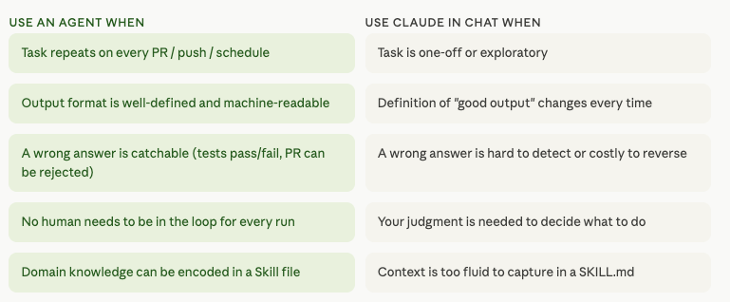
AI (claude) agents:
An agent is just Claude with a very focused system prompt. You call the API, you give Claude a system prompt that defines its role, the tools it can use, and the constraints it operates under, and that becomes your agent. Ex. A "PR review agent" is Claude + a system prompt that says "you are a code reviewer, here is the diff, here are the rules, output GitHub review comments." The specialization is entirely in how you configure the call.
An agent is just a Claude API call with three things configured: a system prompt (role + goal), optional tools (bash, file write, search), and a task as the user message.

Slide 28
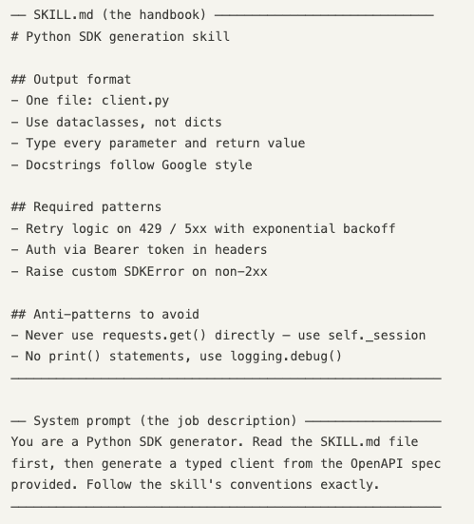
Claude skills
Reusable instruction sets that teach Claude how to produce high-quality, consistent output for specific tasks.
The system prompt alone is often not enough for complex, format-sensitive tasks. A Skill is a SKILL.md file that the agent reads before doing its work — think of it as the agent's reference manual. The system prompt gives the agent its identity and goal. The Skill gives it the detailed knowledge of how to do the task well: what libraries to use, what output format is expected, what mistakes to avoid, what conventions to follow. The agent reads the file at runtime (via a tool call or by having its contents injected into context), then applies that knowledge to the task.
What they contain
Step-by-step instructions, best practices, tool usage, and formatting standards for a given task type.
How Claude uses them
Claude reads the relevant SKILL.md file before starting a task to apply the right constraints and approach.
Why they exist
LLMs benefit from environment-specific constraints that aren't in training data — skills encode that hard-won knowledge.

Slide 29
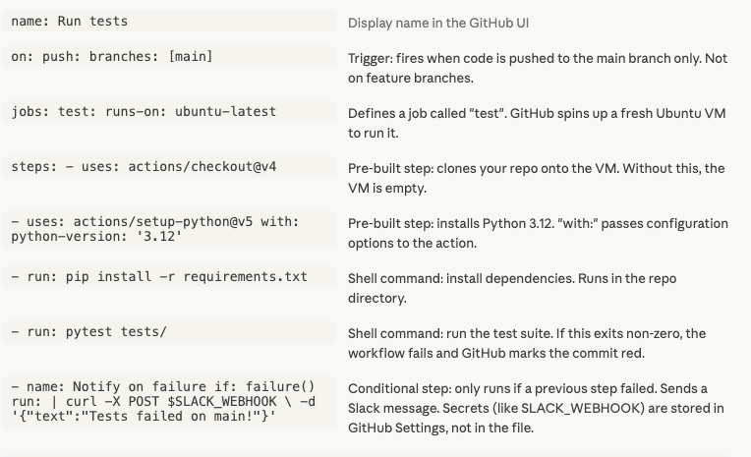
GitHub Actions
GitHub Actions is an automation platform built into GitHub. You describe what should happen and when it should happen in a YAML file, and GitHub runs it for you on its own servers — no infrastructure required.
It lives in your repo at .github/workflows/ as plain YAML files — versioned alongside your code, visible to the whole team, no external service to configure.
Without GitHub Actions
Developer pushes code → manually runs tests → manually builds the app → manually deploys it → manually notifies the team. All of this requires a human to remember and execute each step.
With GitHub Actions
Developer pushes code → GitHub automatically runs tests, builds the app, deploys it, and notifies the team. Every step happens in order, every time, with no human involvement.
Example: https://github.com/hurwitzlab/brc_hazel_training
Notes:
GitHub Actions is a robot that lives inside your repository and runs shell commands in response to events. Before it existed, all the work it does — running tests, deploying code, notifying people — either required a separate CI server (Jenkins, CircleCI, Travis) that you had to set up and maintain, or it just didn't happen and developers did it by hand.
What made it a big deal when it launched is that it's native to GitHub. The configuration file lives in the repo itself, it has direct access to all your repo's context (the diff, the PR number, the commit SHA, the secrets vault), and there's a huge marketplace of pre-built "actions" so you rarely have to write the plumbing from scratch — actions/checkout, actions/setup-python, actions/setup-node and so on are all one-liners.
https://github.com/hurwitzlab/brc_hazel_training

Slide 30
The power combo:
AI Agents
= Pattern
a focused Claude API call with a system prompt and a task
AI Agents
Skills
+
= Domain expert
it encodes all the knowledge that's too detailed and too specific to write into a system prompt every time
AI Agents
Skills
GitHub Actions
+
+
= Autonomous domain expert
fires on every event, injects its own context, routes its own output — no human in the loop

Slide 31
Resources
Long reads:
- PacBio intro: https://www.pacb.com/blog/long-read-sequencing/
Nextflow:
Trainings: https://training.nextflow.io/latest/
Containers:
Docker basics: https://www.docker.com/resources/what-container/
Singularity/Apptainer basics: https://docs.sylabs.io/guides/3.5/user-guide/introduction.html
Reproducibility and FAIR
The reproducibility crisis: https://www.nature.com/articles/533452a
Github:
Git Guides: https://github.com/git-guides
Desktop: https://docs.github.com/en/desktop
Codespaces: https://docs.github.com/en/codespaces/about-codespaces/what-are-codespaces
Copilot: https://github.com/features/copilot
AI in biology:
Alphafold paper: https://www.nature.com/articles/s41592-021-01362-6
Transformers: https://proceedings.neurips.cc/paper_files/paper/2017/file/3f5ee243547dee91fbd053c1c4a845aa-Paper.pdf
https://medium.com/@mayurchaudhari1675/transformers-in-ai-the-game-changer-powering-modern-artificial-intelligence-f85c93dd74e3
https://www.mygreatlearning.com/blog/understanding-transformer-architecture/
Rewrites manifest: https://rewrites.bio/
Claude code: https://code.claude.com/docs/en/overview

