Slide 1
Bonus: Bioinformatics tools (GitHub, HPC, Cloud)

Slide 2


local software tool used for version control
cloud-based platform that hosts Git projects and enables team collaboration

Slide 3
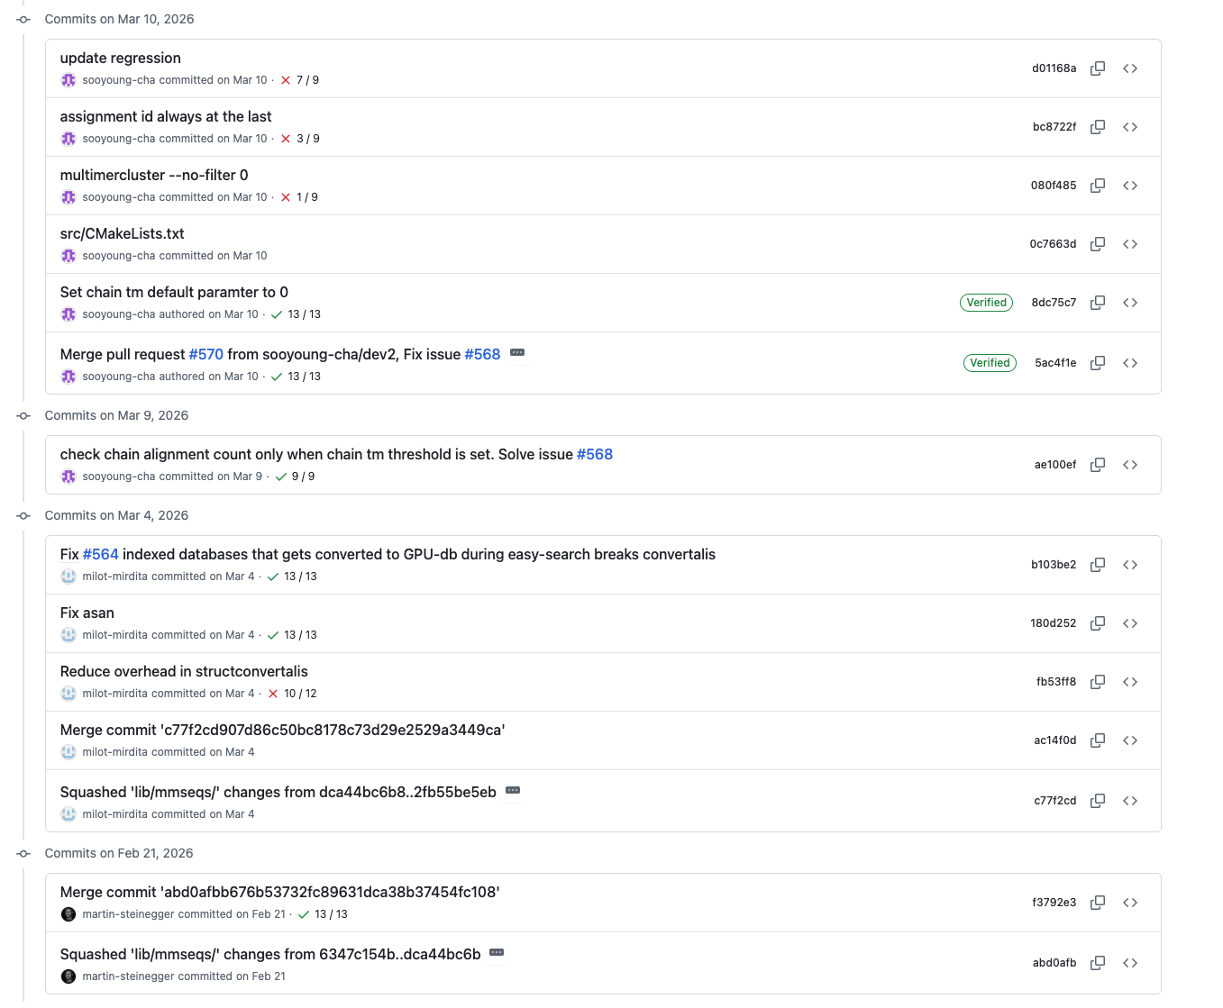
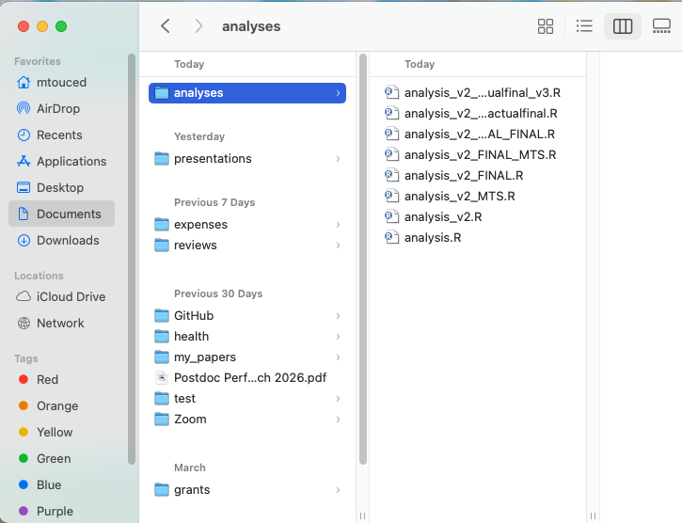
Why Git & GitHub
Commit history:
The problem
git solves: Track who changed what and when, revert mistakes, collaborate without overwriting
Bioinformatics angle: Reproducibility crisis, tracking pipeline versions, sharing analysis code with collaborators/reviewers

Slide 4
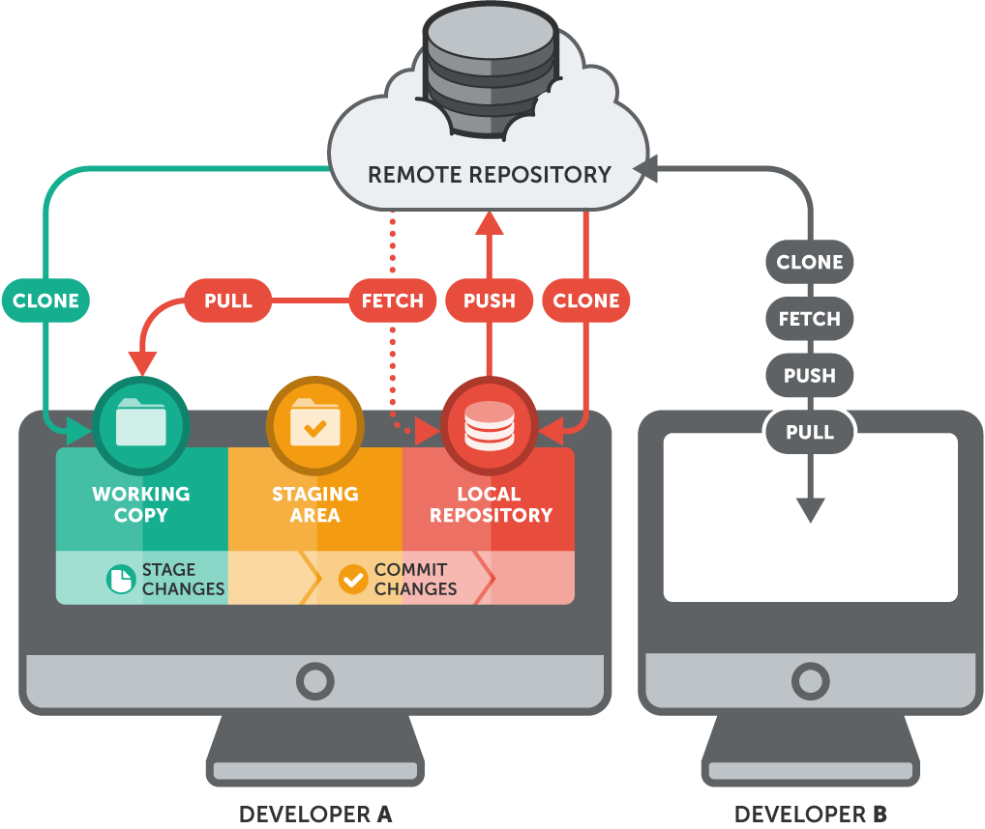
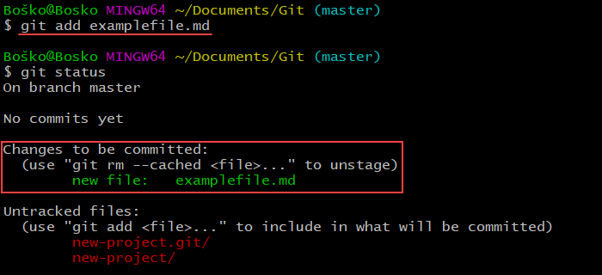
Basics of Git & GitHub
Key concepts:
Repository (a folder + history)
Commits (snapshots of work with messages)
Branches (parallel work streams)
Working directory → Staging area → Commit
Basic workflow:
git init (create a repo)
git add + git commit (save changes)
git log (see history)
git diff (see what changed)

Slide 5
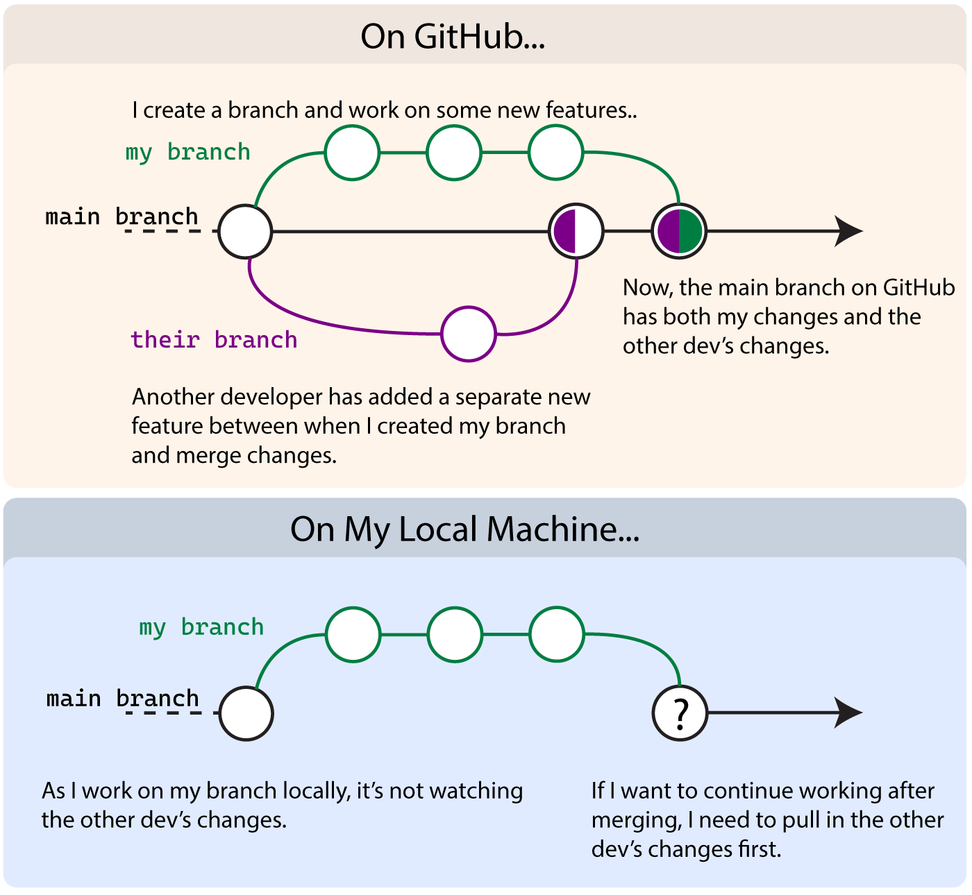
Branches
A pointer to a specific commit: a parallel timeline of your project
The default branch is main
Creating a branch doesn't copy files; it's just a lightweight reference
Scenario 1:
Main branch: your validated pipeline
New branch (try-deseq2-v2): experiment with a newer version of DESeq2
If it works → merge back to main
If it breaks downstream analysis → throw it away, main is untouched
Scenario 2: Multiple people working on the same project
Person A is working on quality control improvements (feature/qc-filters)
Person B is optimizing the alignment step (feature/faster-alignment)
Both work independently, merge when ready
No accidental overwrites

Slide 6
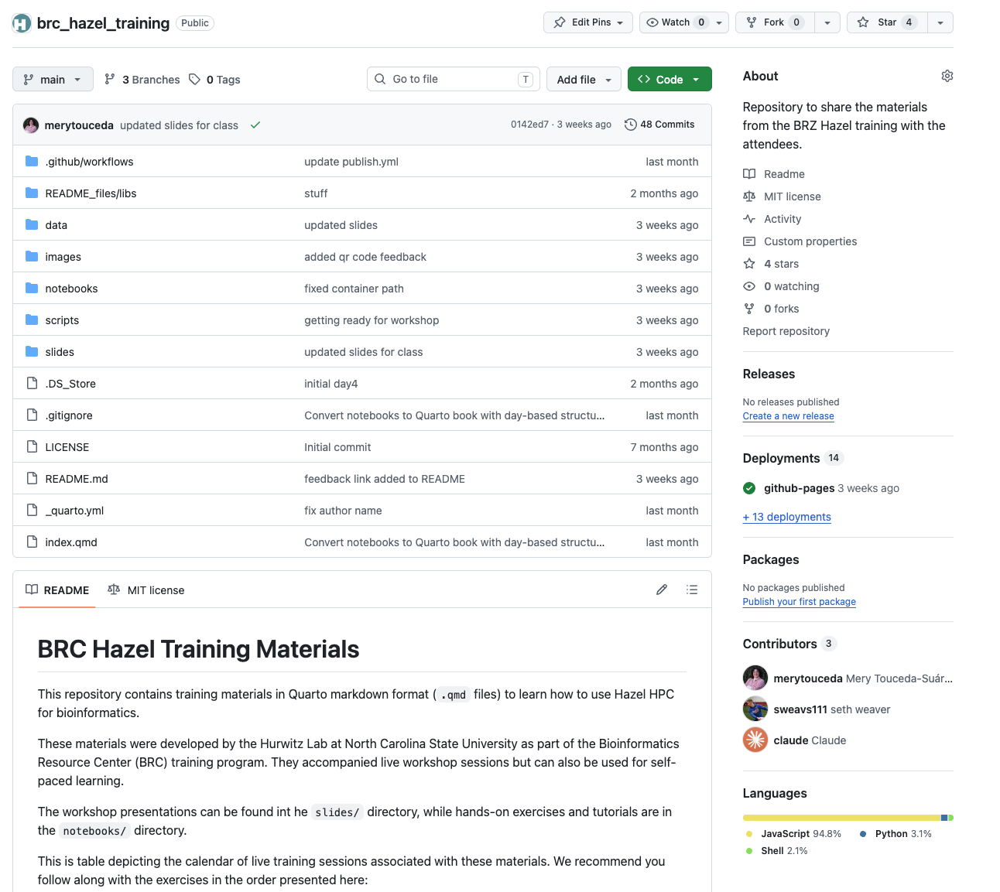
Collaborating with GitHub
What GitHub adds:
Cloud backup
Collaboration features
Visibility (sharing code)
Basic GitHub workflow:
git push (send to GitHub)
git pull (get others' changes)
Pull requests (propose, review, merge)
Simple merge conflicts & how to resolve them
GitHub as a portfolio:
Your repos as proof of work
README importance
Making repos public for sharing analyses

Slide 7
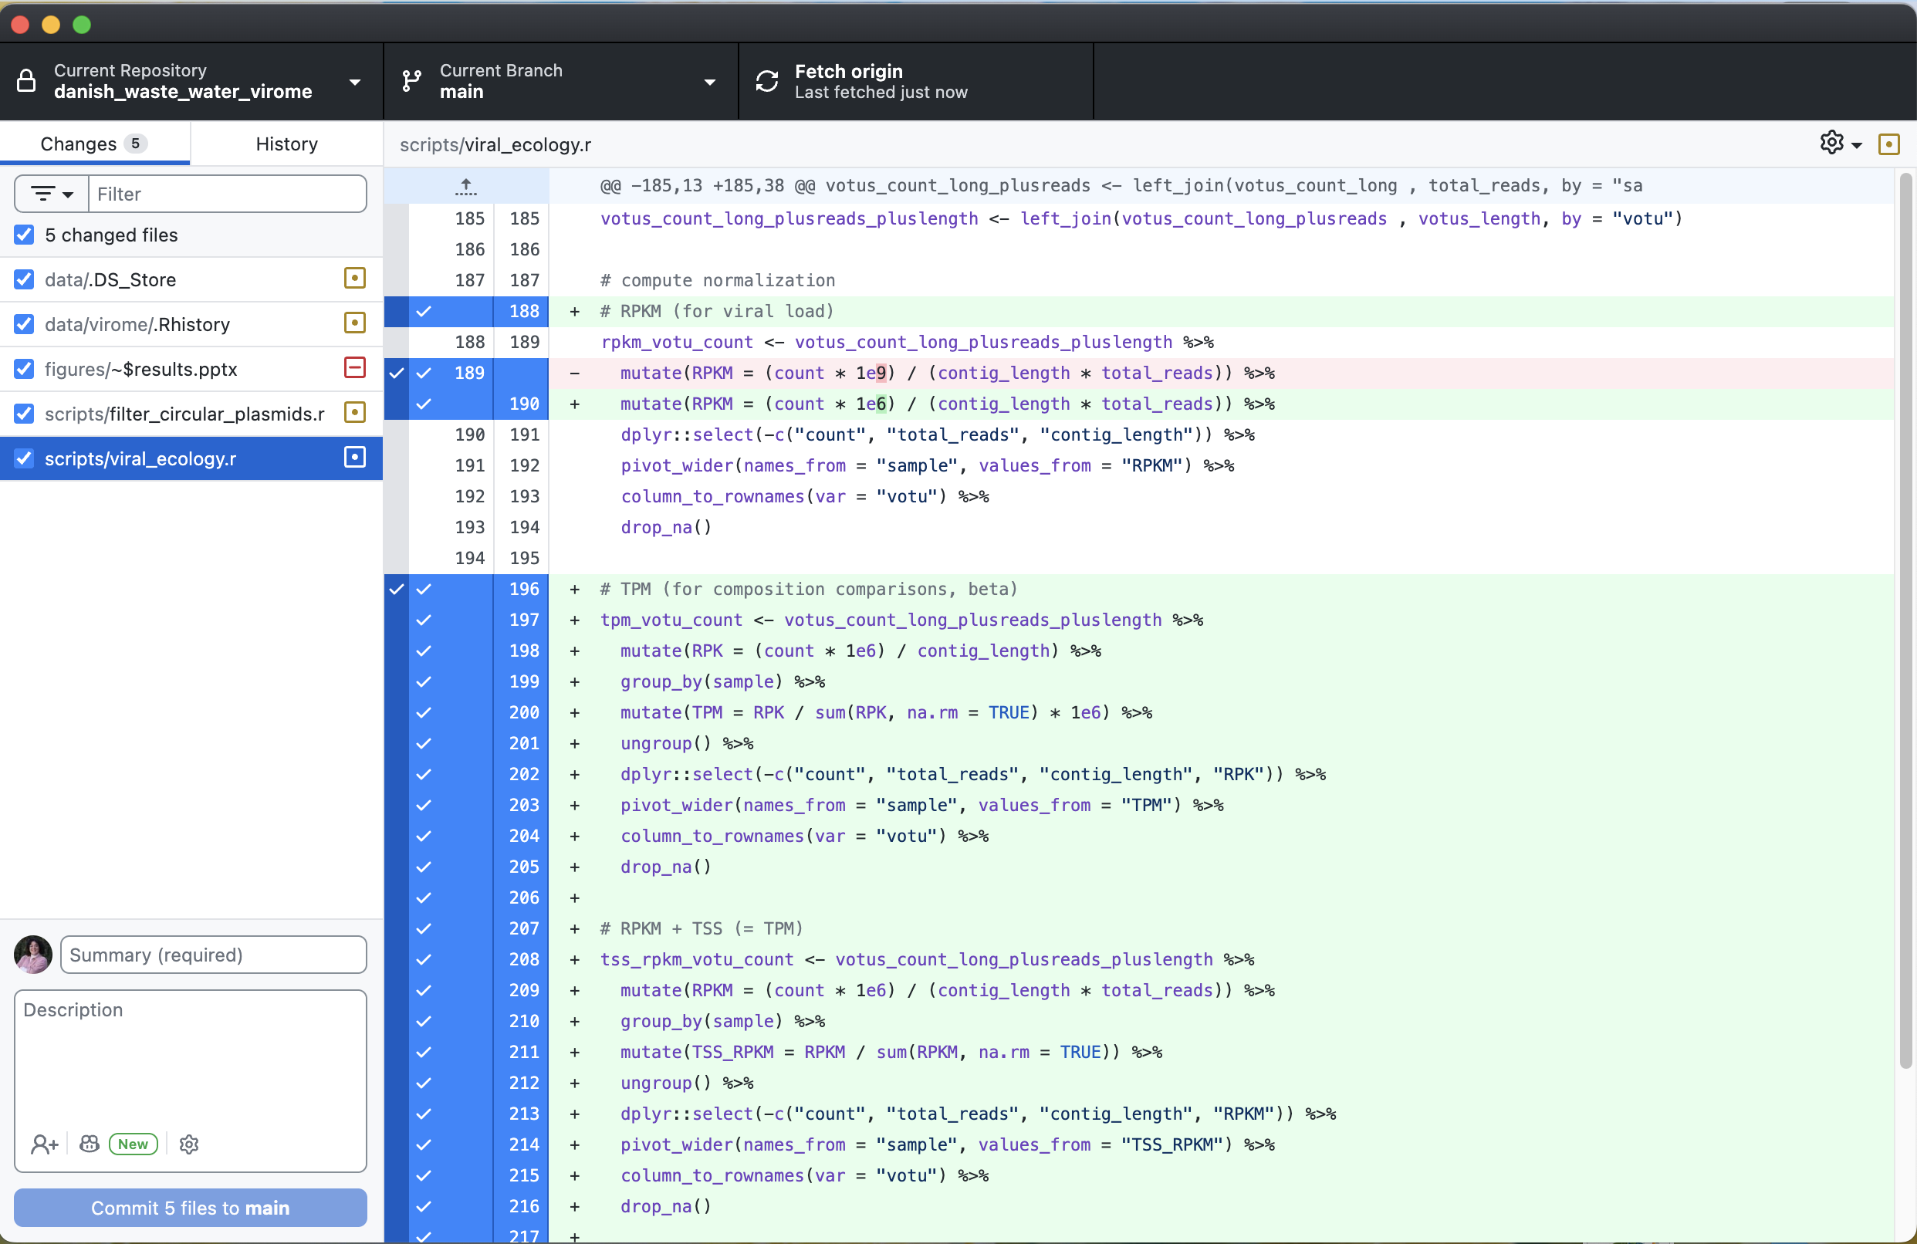
GitHub Desktop
Desktop application to manage git actions

Slide 8
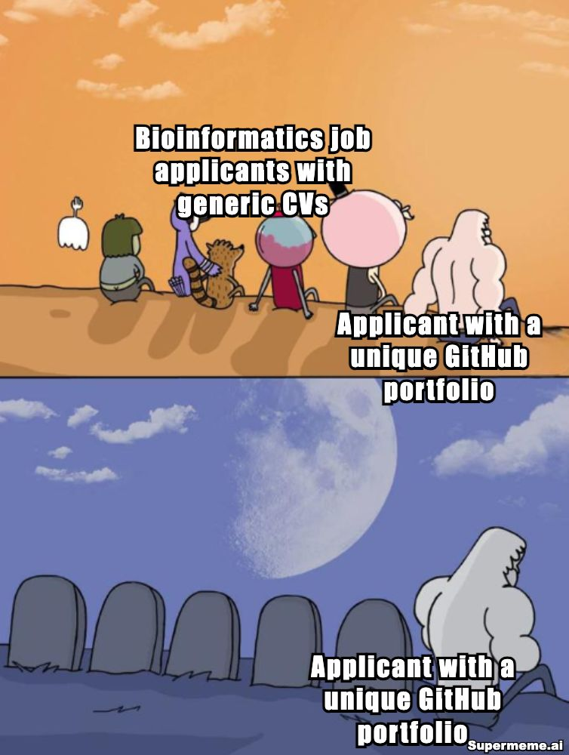
GitHub for Bioinformatics
Practical Bioinformatics Examples
Scenario 1: Tracking versions of a data analysis pipeline
Scenario 2: Two lab members working on the same pipeline avoiding overwriting
Scenario 3: Sharing your analysis code with a collaborator or for publication
Scenario 4: Finding when a bug was introduced in your preprocessing script
Best Practices for Bioinformaticians
What to version control: code, scripts, documentation, metadata
What NOT to version: raw/processed data (it's too large), large files → .gitignore
Commit message conventions (makes history readable)
When to branch: experimenting with new tools, trying new statistical methods

Slide 9


Slide 10

HPC fundamentals

Slide 11



The bioinformatics data challenge
Problem:
Computation takes too long
Modern datasets are too big
Too many calculations
Biological data
Personal computer
Solution:
Get a computer for exclusive use
Divide tasks between many computers
Use lots of computers simultaneously
Biological data
High performance cluster (HPC)

Slide 12
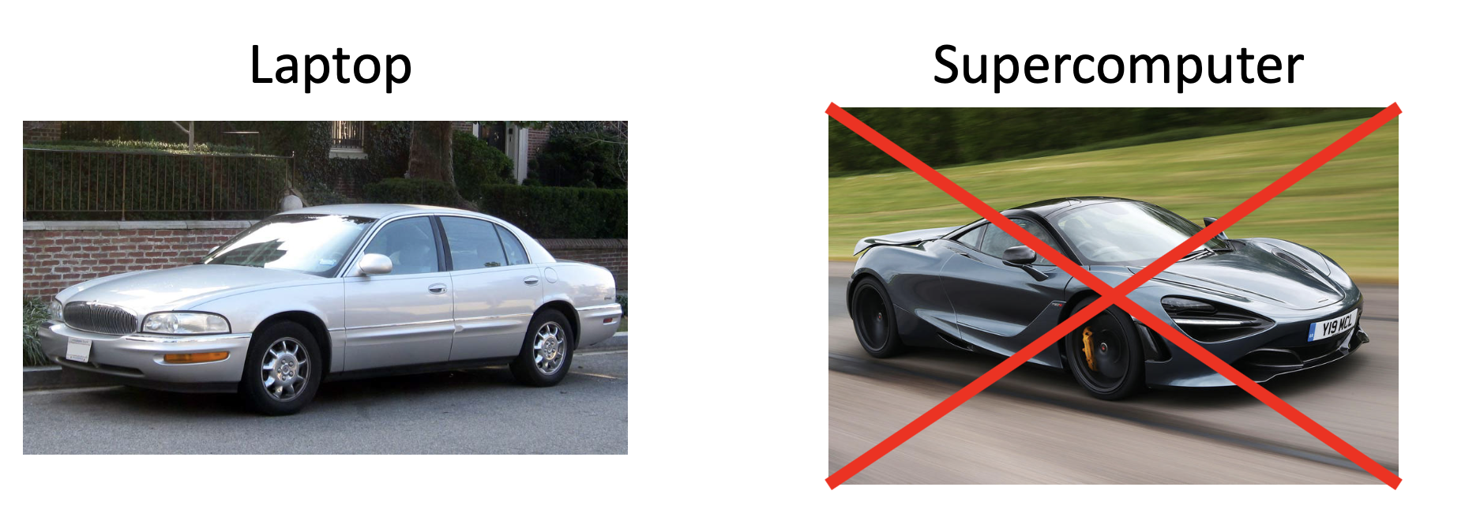
What is an HPC?
A shared collection, or cluster, of a large number of regular computers (compute nodes) connected over a network.

Slide 13
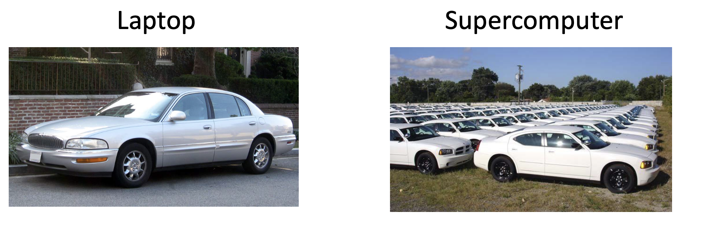
What is an HPC?
A shared collection, or cluster, of a large number of regular computers (compute nodes) connected over a network.

Slide 14
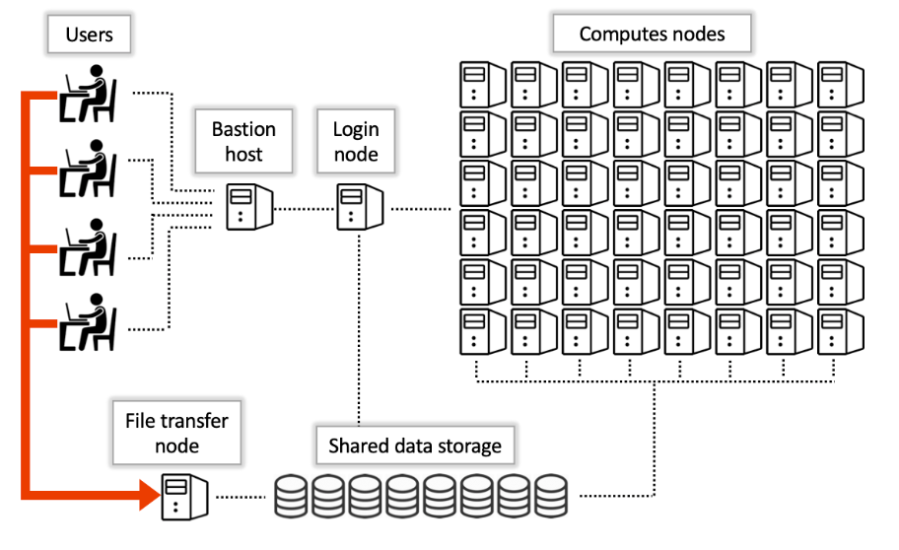
What is an HPC?
A shared collection, or cluster, of a large number of regular computers (compute nodes) connected over a network.

Slide 15
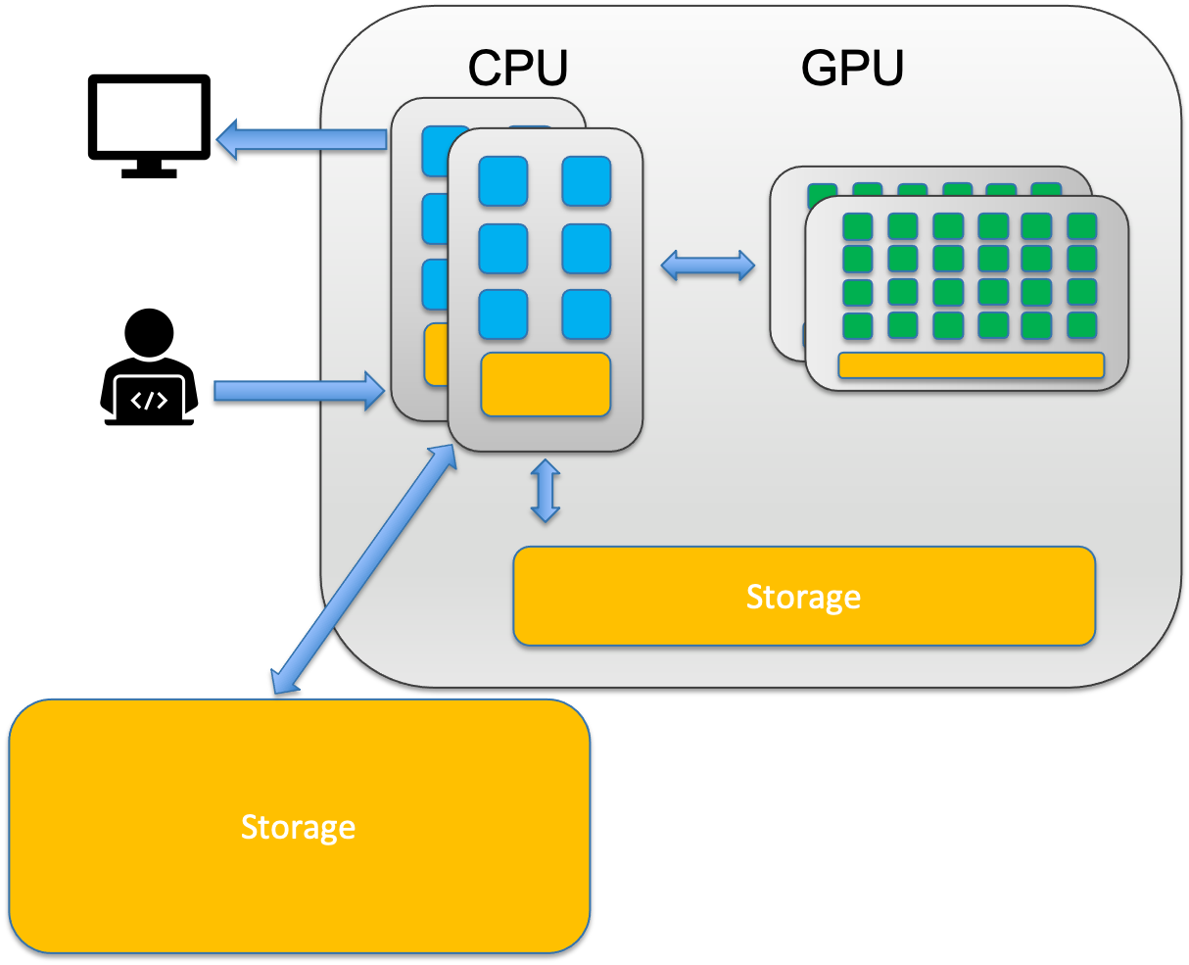
CPU vs. GPU
CPU (Central processing unit) = Taskmaster: General purpose, sequential work. 8-64 cores.
Think of a CPU as a small team of highly skilled experts. Each core can tackle complex, diverse tasks independently and make sophisticated decisions.
Sequence alignment (BWA, Bowtie)
Variant calling (GATK),
Gene expression analysis (DESeq2)

Slide 16
CPU vs. GPU
CPU (Central processing unit) = Taskmaster: General purpose, sequential work. 8-64 cores.
Think of a CPU as a small team of highly skilled experts. Each core can tackle complex, diverse tasks independently and make sophisticated decisions.
Sequence alignment (BWA, Bowtie)
Variant calling (GATK),
Gene expression analysis (DESeq2)
GPU (Graphic processing unit) = Turbo-Boost: Specialized, massive parallel work (Deep Learning, Protein Prediction). Thousands of cores.
A GPU is like having thousands of workers who can all do the same simple task simultaneously.
Deep learning (AlphaFold, protein structure prediction)
Molecular dynamics simulations
Some genome assembly algorithms

Slide 17
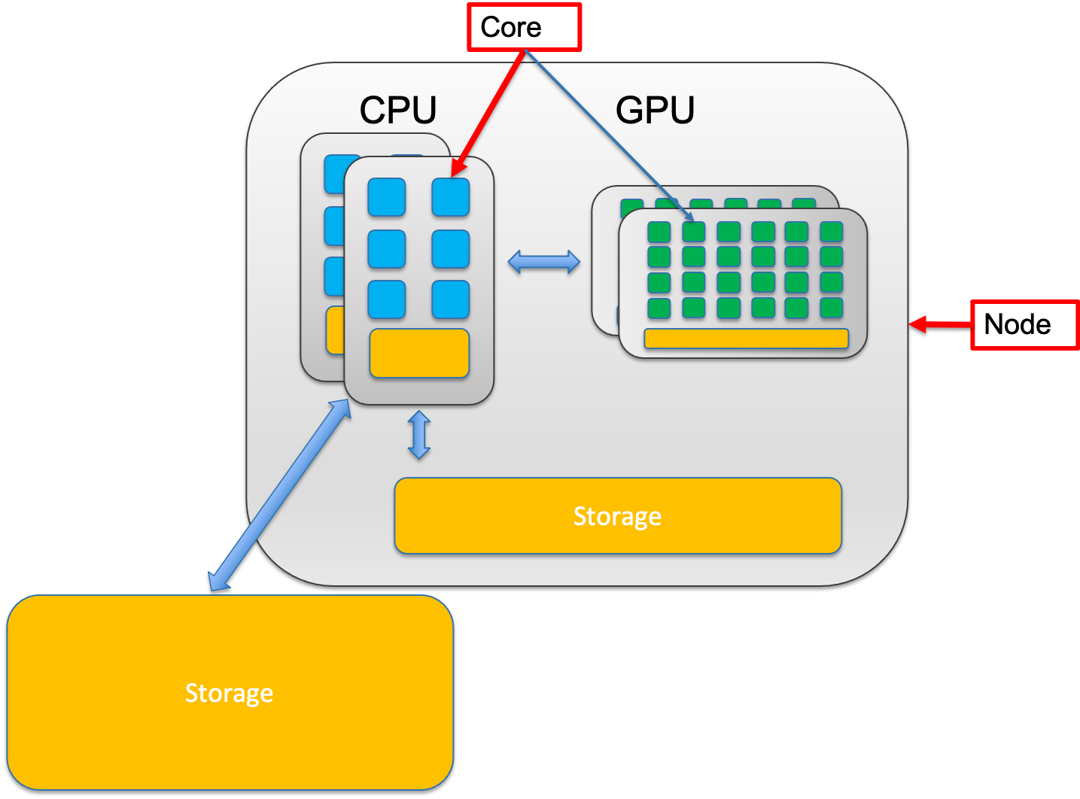
Node vs. core
A node is a single, self-contained computer in the cluster, connected to the others via a high-speed network. Each node has a number of computing units, cores.

Slide 18
Node vs. core
A node is a single, self-contained computer in the cluster, connected to the others via a high-speed network. Each node has a number of computing units, cores.
Node:
A node is an entire computer within the HPC cluster. Think of a node as a complete office workspace with everything needed to function independently. Each node contains:
One or more CPUs and/or GPUs (each with multiple cores)
Memory (RAM)
Storage connection
Network connection to other nodes
Note: in Hazel compute nodes do not have internet connection!

Slide 19
Node vs. core
A node is a single, self-contained computer in the cluster, connected to the others via a high-speed network. Each node has a number of computing units, cores.
Node:
A node is an entire computer within the HPC cluster. Think of a node as a complete office workspace with everything needed to function independently. Each node contains:
One or more CPUs and/or GPUs (each with multiple cores)
Memory (RAM)
Storage connection
Network connection to other nodes
Note: in Hazel compute nodes do not have internet connection!
Core:
A core is a single processing unit within a CPU. It's the fundamental unit that executes instructions. Think of a core as one individual worker who can complete tasks.
Modern CPUs contain multiple cores (typically 8-64 cores per CPU)
Each core can run its own thread of execution independently
More cores = more tasks can run simultaneously
Example: A 32-core CPU can theoretically run 32 different calculations at the same time

Slide 20
Node vs. core
Single-node jobs: Your program uses multiple cores on ONE node
Faster communication between cores (they share memory)
Limited by one node's resources (if a node has 32 cores and 128GB RAM, that's your max)
Example: Most alignment tools (BWA, STAR) run on a single node

Slide 21
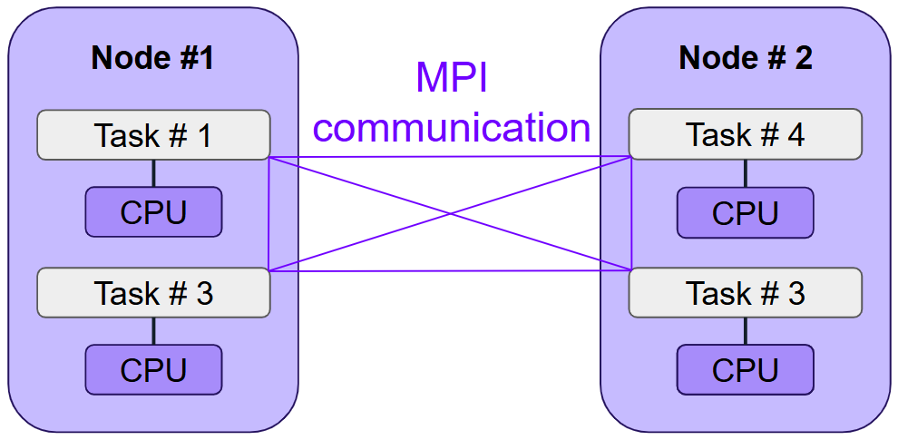
Node vs. core
Single-node jobs: Your program uses multiple cores on ONE node
Faster communication between cores (they share memory)
Limited by one node's resources (if a node has 32 cores and 128GB RAM, that's your max)
Example: Most alignment tools (BWA, STAR) run on a single node
Multi-node jobs: Your program uses cores across MULTIPLE nodes
Access to more total resources (hundreds of cores, terabytes of RAM)
Slower communication (data must travel over network between nodes)
Only works if your software supports it (needs MPI or similar)
Example: Large-scale genome assembly, distributed machine learning

Slide 22
Node vs. core
Single-node jobs: Your program uses multiple cores on ONE node
Faster communication between cores (they share memory)
Limited by one node's resources (if a node has 32 cores and 128GB RAM, that's your max)
Example: Most alignment tools (BWA, STAR) run on a single node
Multi-node jobs: Your program uses cores across MULTIPLE nodes
Access to more total resources (hundreds of cores, terabytes of RAM)
Slower communication (data must travel over network between nodes)
Only works if your software supports it (needs MPI or similar)
Example: Large-scale genome assembly, distributed machine learning
Not all bioinformatics software can use multiple nodes! Most tools are designed to use multiple cores on a single node. Always check your software's documentation before requesting multi-node resources.

Slide 23
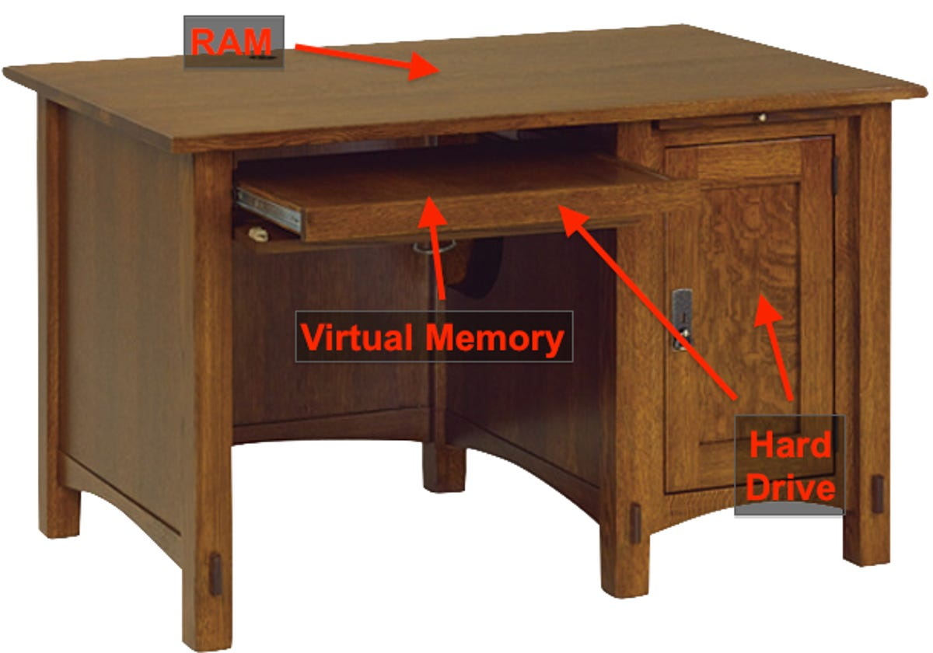
Memory vs. Storage
What lives in memory:
Currently running programs and their instructions
Data being actively processed (sequence reads being aligned RIGHT NOW)
Intermediate calculations
Variables and temporary results
Memory (RAM - Random Access Memory)
Small - Typically 16-512 GB per node on HPC systems
Fast - Nanosecond access times; data transfer at 100+ GB/second
Expensive - Costs significantly more per GB than storage
Volatile - All data is lost when the computer powers off or your job ends
Purpose: Memory is your active workspace. When your program runs, it loads data from storage into memory where the CPU can access it extremely quickly. Think of memory as your desk surface—limited space, but everything is immediately at hand.

Slide 24
Memory vs. Storage
What lives in memory:
Currently running programs and their instructions
Data being actively processed (sequence reads being aligned RIGHT NOW)
Intermediate calculations
Variables and temporary results
Memory (RAM - Random Access Memory)
Small - Typically 16-512 GB per node on HPC systems
Fast - Nanosecond access times; data transfer at 100+ GB/second
Expensive - Costs significantly more per GB than storage
Volatile - All data is lost when the computer powers off or your job ends
Purpose: Memory is your active workspace. When your program runs, it loads data from storage into memory where the CPU can access it extremely quickly. Think of memory as your desk surface—limited space, but everything is immediately at hand.
Storage (Disk - Hard Drives or SSDs)
Large - Terabytes to petabytes on HPC systems
Slower - Millisecond access times; data transfer at 1-10 GB/second
Cheaper - Costs much less per GB than memory
Non-volatile - Data persists even when powered off
Purpose: Storage is your filing cabinet. It holds all your data long-term: raw sequencing files, reference genomes, analysis results, scripts, and software. You can't work directly from storage—data must be copied into memory first.
What lives in storage:
Raw data files (FASTQ, FASTA)
Reference genomes and annotations
Final analysis results (BAM, VCF, counts tables)
Your scripts and programs
Everything you want to keep after the job finishes

Slide 25
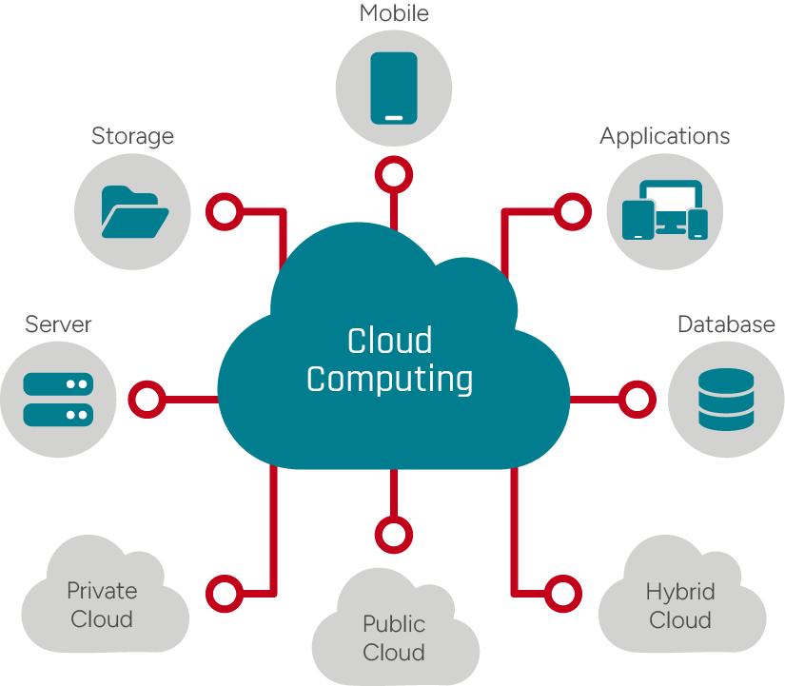

Slide 26
Cloud computing
Computing resources (CPU, storage, memory) rented on-demand instead of owning physical hardware
Pay for what you use, when you use it
Access from anywhere with internet
On-demand: spin up resources in minutes, tear down when done
Scalable: need 2 cores today, 100 cores tomorrow? Easy.
Flexible: different machine types for different jobs
Pay-as-you-go: no upfront hardware costs
HPC is like owning a car; cloud is like renting one when you need it.

Slide 27
Cloud computing
 | HPC Cluster | Cloud
Cost model | High upfront capital; fixed monthly | Pay per compute hour; variable
Setup time | Account access (hours); queue wait (mins-hours) | Account setup (mins); launch (mins)
Scalability | Fixed cluster size; job queue limits | Unlimited (pay for it)
Storage | Local, managed by your institution | Multiple options (object, block); pay per GB
Who maintains hardware | Your IT department | Cloud provider
Best for | Consistent, scheduled workloads | Bursty, variable workloads
Learning curve | Higher (job schedulers, modules) | Lower (GUI-based options)

Slide 28



Cloud computing
Dominant market share
Relevant services: EC2 (virtual machines), S3 (storage), Batch (job scheduler), SageMaker
Bioinformatics tools: Amazon Genomics CLI, pre-built AMIs (Amazon Machine Images)
Good for: large-scale analyses, startups, if you have AWS credits
Growing in bioinformatics
Relevant services: Compute Engine (VMs), Cloud Storage, Vertex AI, BigQuery
Bioinformatics tools: Terra (Google + Broad Institute partnership), Nextflow integration
Good for: academic labs (often cheaper for academia), integrates well with genomics databases
Enterprise-focused
Relevant services: Virtual Machines, Blob Storage, Batch
Bioinformatics tools: CyVerse, some institutional partnerships
Good for: if your institution uses Azure

Slide 29
