Slide 1

Day 4: Metagenomics 2 Viruses & Plasmids

Slide 2
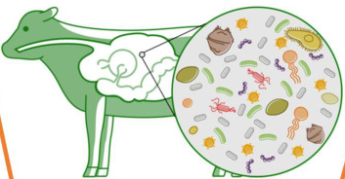
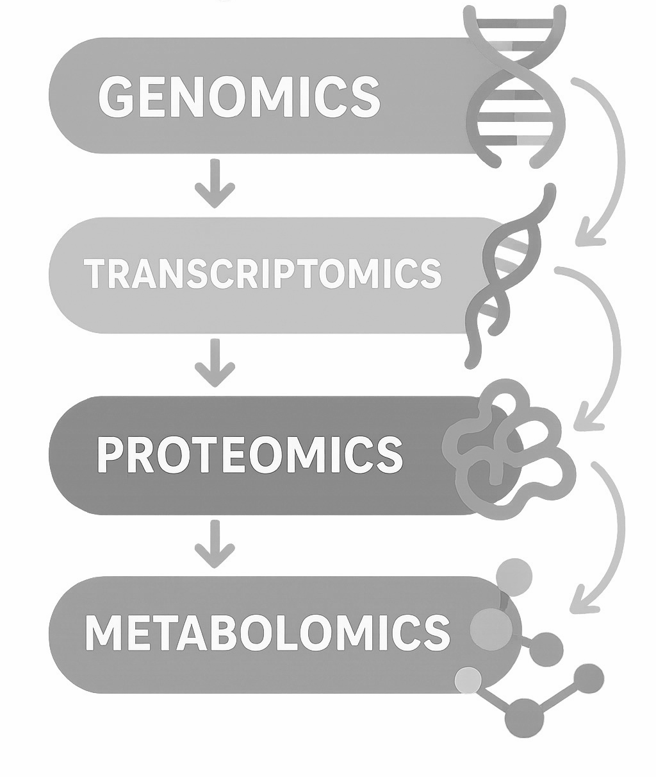
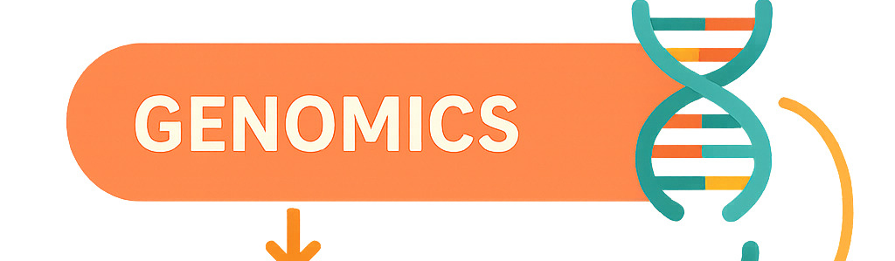
Metagenomics: the microbiome
Bacteria
Archaea
Fungi
Viruses
Mobile genetic elements
meta

Slide 3
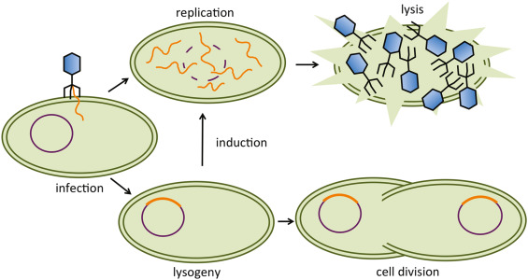
Viruses
Most abundant biological entities on earth — estimated 10³¹ virions in the biosphere
Bacteriophages dominate metagenomes but are massively understudied compared to bacteria
Drive bacterial evolution, regulate community dynamics, influence host immunity
Veterinary relevance: phage therapy interest, phage-bacteria dynamics in gut health, zoonotic viral discovery
Why they're hard to detect: no universal marker gene (unlike 16S for bacteria), enormous sequence diversity, large fraction are completely novel with no database hits
Insertion genes
Host gene

Slide 4
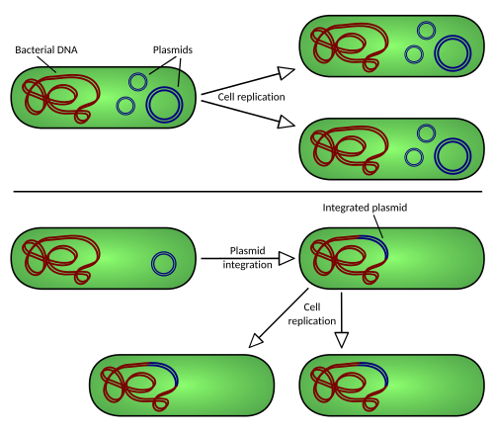
Plasmids
Extrachromosomal DNA elements, typically circular
Main vehicles for horizontal gene transfer — including AMR genes
Directly relevant for veterinary medicine: resistance plasmids in livestock pathogens, transmission between commensal and pathogenic bacteria
Also hard to detect: similar sequence composition to chromosomes, can integrate, variable copy number
Conjugation gene
Bacterial gene
Notes:
https://microbenotes.com/plasmids/

Slide 5
Metagenomics pipeline: functional annotation
Coding sequence inference
Assembly
Gene annotation
Contigs
Coding sequences
Functional annotations
Megahit
Prodigal
Hmmsearch
KEGG db
Gene
count table
Read mapping
BWA + CoverM
Taxonomic classification
Taxonomy
count table
Why does this not work for viruses/plasmids?
Reference databases miss most viruses/plasmids
Short reads don't contain enough signal to classify novel viruses/plasmids
Viruses/plasmids have shorter sequences → get “buried” under bacterial signal
Kraken2 + Bracken
Kraken db
Process
Tool

Slide 6
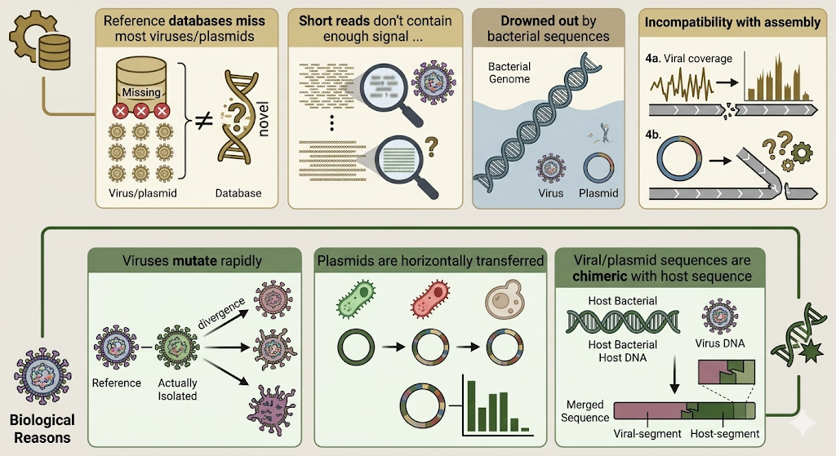
Why does this not work for viruses/plasmids?
Technical
Reasons
Notes:
Biological reasons:
Viruses mutate rapidly → diverge enough from the reference to go undetected
Plasmids are horizontally transferred between species, so their k-mer signal doesn't map cleanly to any one organism
Viral and plasmid sequences are chimeric with host sequence
Technical reasons:
Reference databases miss most viruses/plasmids
Short reads don't contain enough signal to classify novel viruses/plasmids
Viral and plasmid genomes = low abundance: they get drowned out by bacterial sequences
Incompatibility with assembly
Standard assembly tools are optimized for bacterial; viral sequences often assemble poorly because their coverage is spiky and uneven
Circular genomes confuse assemblers designed for linear chromosomes

Slide 7

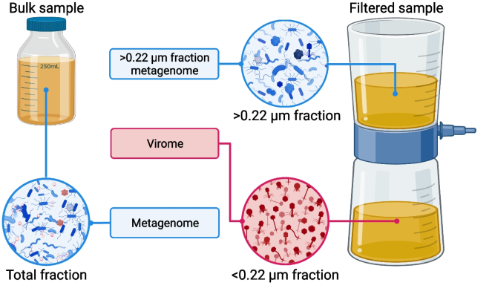
Two approaches for the study of viruses
 | Metagenomics | Viromes (virus-enriched)
Pros | Whole community No enrichment bias Host-virus context AMR and plasmid analysis possible Standardized protocols | High viral sensitivity Cost-effective for viral work Better novel virus discovery Lower sequencing depth needed Cleaner viral signal
Cons | Viral signal diluted by bacteria Poor sensitivity for rare viruses Requires very deep sequencing Poor viral genome assembly | Loses bacterial context entirely Enrichment introduces bias Protocol not standardized Some viruses lost in enrichment (prophages) Can't study AMR or plasmids
Kosmopoulos et al. 2024

Slide 8
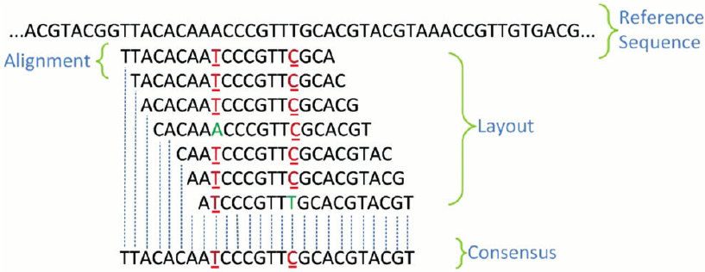
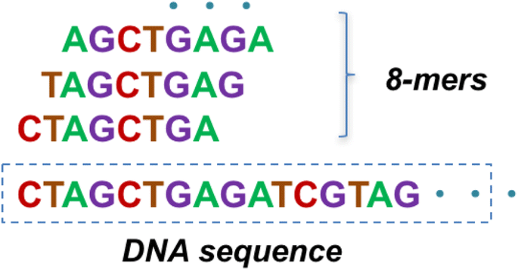
Viral and plasmid inference from metagenomes
Homology based:
“Does this look like a known virus?”
Looks for known viral signatures in reference databases
Enrichment of viral hallmark genes
Depletion of cellular genes
Limitation: blind to novel viruses with no known relatives
Sequence composition based:
“Does this feel like a virus based on its patterns?”
Learns the statistical "fingerprint" of viral sequences without needing a reference
Gene density and coding patterns
Protein family profiles → trained classifiers (random forest, naïve Bayes, neural networks)
Differential k-mer frequencies
k-mers
Homology-based methods find known viruses well. Composition-based methods find unknown ones — but with more uncertainty.

Slide 9
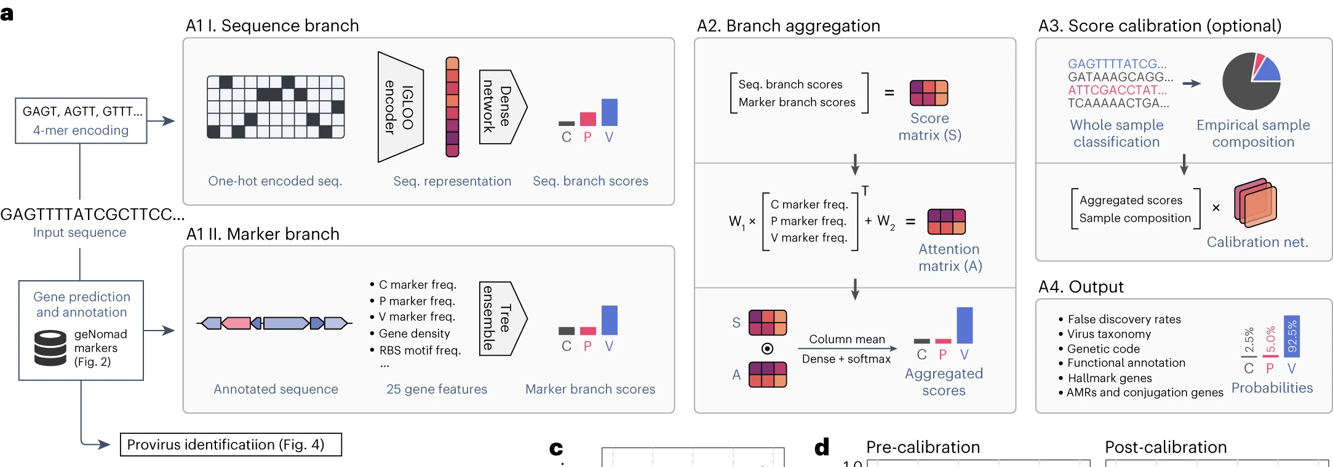
Viral and plasmid inference from metagenomes
Identification of mobile genetic elements with geNomad. Camargo et. al. (2024). Nature Biotechnology
= sequence composition
= homology

Slide 10


Slide 11
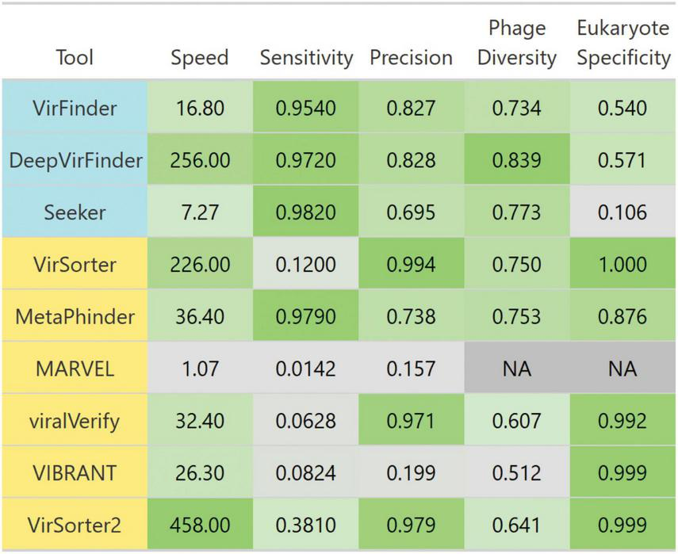
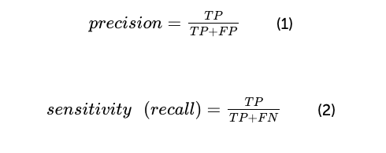
Limitations in viral inference
Homology-based methods find known viruses well. Composition-based methods find unknown ones — but with more uncertainty.
Homology-based
High precision
Low sensitivity
Composition-based
High sensitivity
Lower precision
Precision: the portion of all predicted phage sequences that are indeed phage
Sensitivity (recall): the proportion of all true phage sequences that were correctly identified

Slide 12
False positives in viral inference
Consequences of false positives:
Inflate viral diversity estimates — spurious contigs get annotated as novel viruses
Skew ecological conclusions — virus-to-host ratios, abundance profiles become unreliable
Propagate into databases — once deposited, false positives get picked up by future studies
A 3% false positive rate sounds small. Applied to 100,000 contigs, that's 3,000 spurious "viruses."
Evidence | Tool | What it tells you
Viral score | geNomad | How confidently the model calls it viral
Completeness | CheckV | How much of the viral genome is present
Contig length | geNomad | Short contigs = unreliable predictions
Hallmark genes | geNomad | Presence of capsid, terminase, etc.
No bacterial markers | CheckV contamination | Confirms it's not a misclassified bacterial contig
Solution = layers of information →
Bonus: do you see the problem here?
There is no perfect cutoff. You make a justified decision based on multiple lines of evidence and you report your filtering criteria explicitly so others can evaluate your choices.

Slide 13
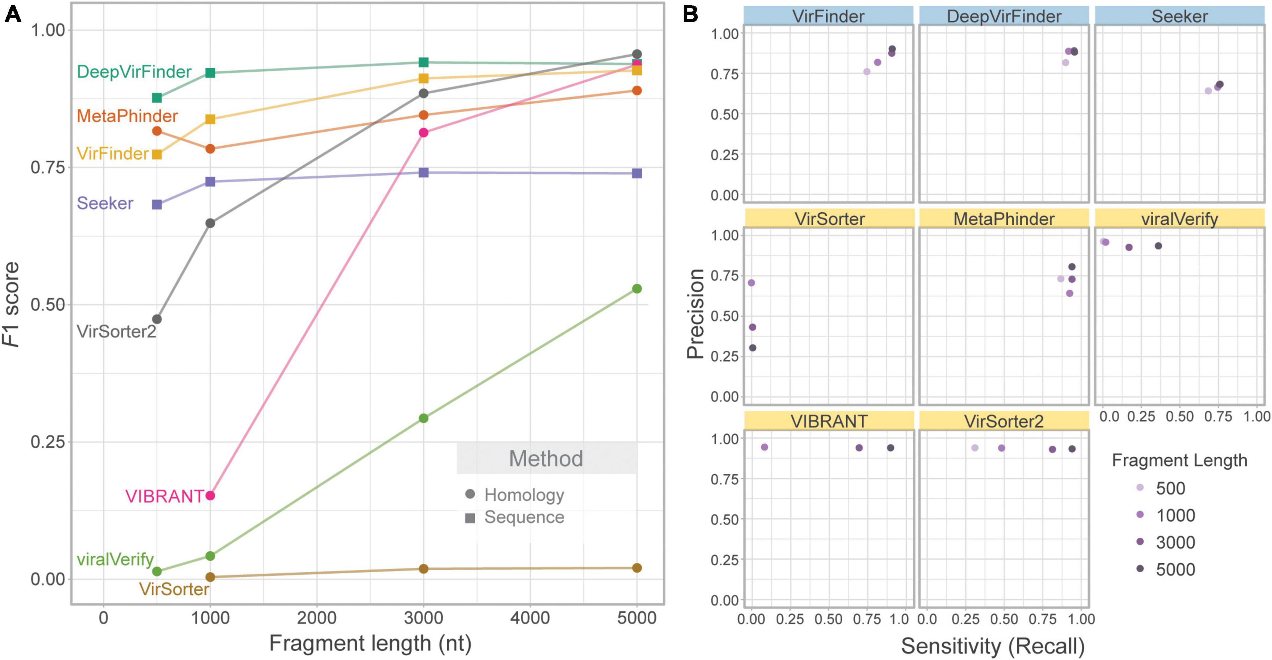
A note on benchmarking
What is benchmarking in bioinformatics?
Testing and comparing tools performances on datasets where you know the true answer (mock communities, simulated data)
Metrics: precision, recall, specificity, F1 score – compute time, installation complexity, etc
Why it matters for tool choice:
Tools don’t perform equally on all datasets
Performance varies by ecosystem (gut vs soil vs ocean), by virus type (phage vs eukaryotic virus), by contig length, by sequencing type and machine (illumina, pacbio, nanopore)
Tools have parameters that also determine their performance
Designing a pipeline
1. Look for a benchmark
Schackart III et. al. (2023) Fontiers in Microbiology
2. Read papers with similar system/questions
3. Do some testing and start conservative

Slide 14


Slide 15
Afternoon activity
geNomad output
R: merge and filter
checkV output
Fasta sequences of all viruses
Viral genome coverage
List of high-quality viral genomes
Python: extract sequences
Fasta sequences of high-quality viruses
Provided
You do
Result

Slide 16


Slide 17
Regroup: R filtering

Slide 19
Regroup: Python sequence extraction

Slide 20

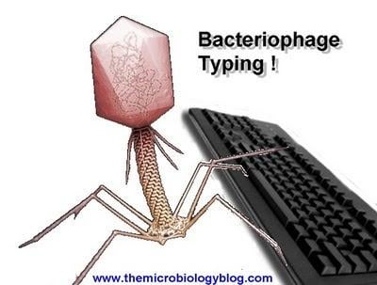
End of day 4

