Slide 1
Micro service Manager
Agenda
1 | Project scope
2 | Use cases
3 | User experience
4 | Reference
5 | Conclusion

Slide 2
Microservice manager - Project scope
Infrastructure for deploying and managing micro services as Docker Containers
Prepare DockerHost server for running containers
Manage life-cycle of containers using a web portal

Slide 3
Microservice manager - Use cases
Prepare infrastructure - Create a virtual machine having Ubuntu OS with docker engine installed
Create projects
Manager – Using DockerClient tool to communicate with docker engine
Common – Model and interface definition
Web – A portal to manage micro-services
Manage life cycle of a micro-service container
Add a new container
Remove a container
Stop a container
Start a container

Slide 4
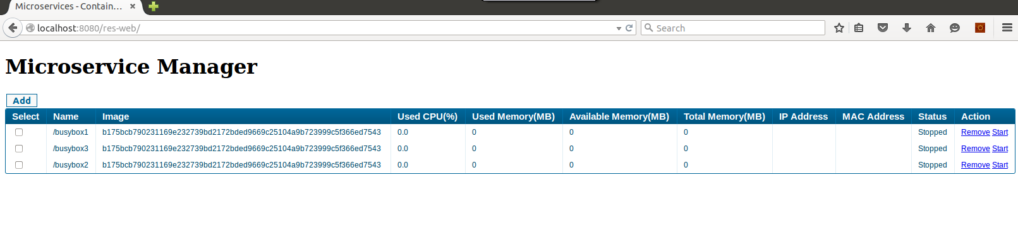
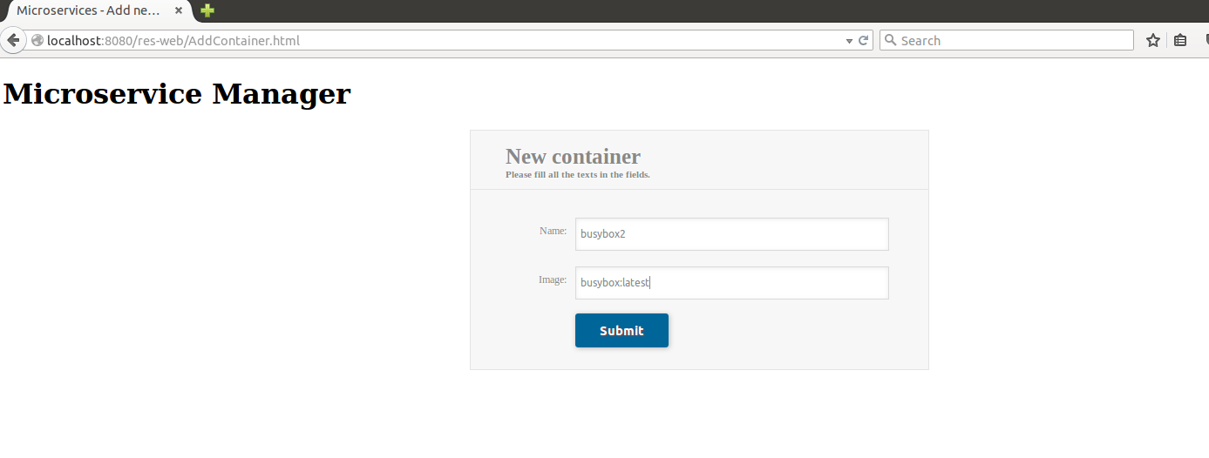
Microservice manager - User experience

Slide 5
Microservice manager - References
https://github.com/mes-pune/c3rm
User access already created
Project sample
https://github.com/mes-pune/c3rm/tree/master/rm
Documentation
https://github.com/mes-pune/c3rm/tree/master/docs
https://github.com/mes-pune/c3rm/README.md

Slide 6
Microservice manager - Conclusion
Using this portal we deployed containers remotely using docker web services
Demonstrated the life-cycle management of micro-services using the front-end web portal
Micro services is easily added, started, stopped and brought down

