Slide 1

Neuron Classification
Based on the types: Glutamatergic, GABAergic, Cholinergic
1 Introduction
2 Datasets
3 Algorithm
4 Result
2014150345 이강휘 2014150388 서석현 2016140083 류건희

Slide 2
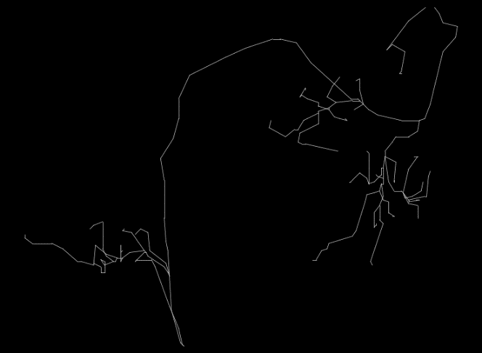
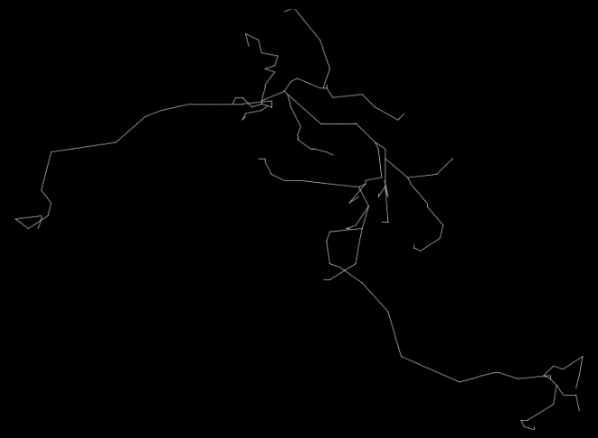
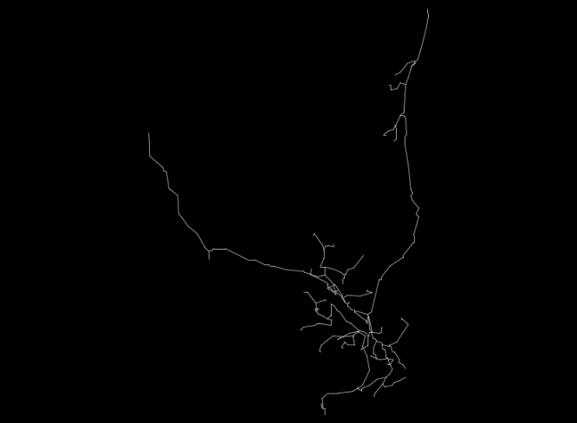
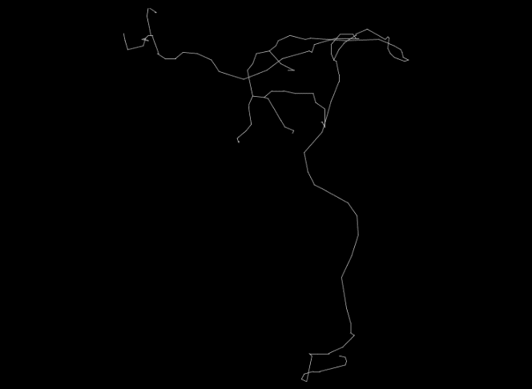
Introduction
01
Research Question
Glutamatergic
There are many cell types in neurons.
Some cell types are divided only by the type of neurotransmitter they release.
Is it possible to classify the cell types by analyzing the structural characteristics of each cell type?
GABAergic
Cholinergic
Serotonergic

Slide 3
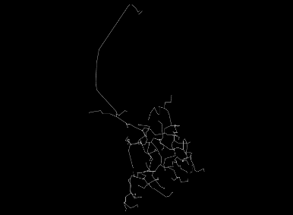
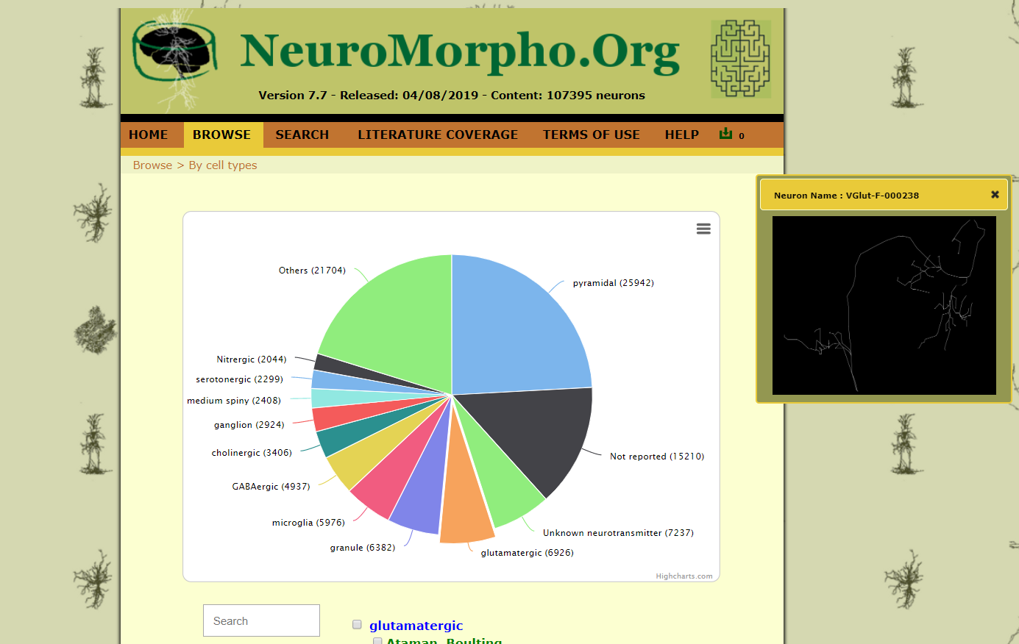
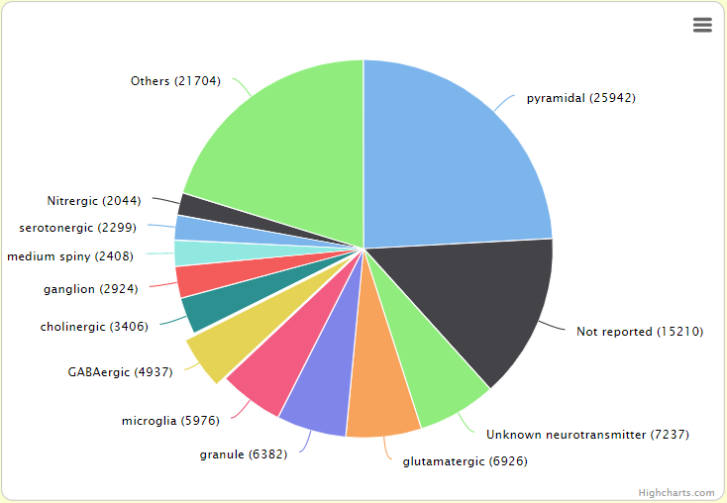
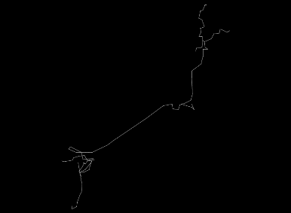
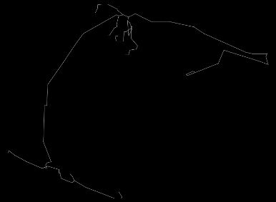
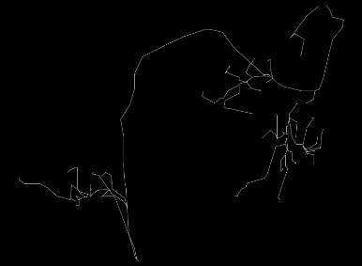
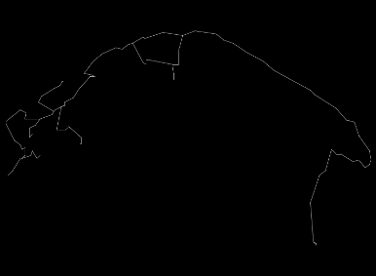
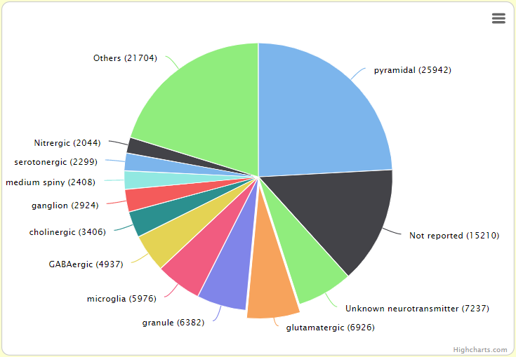
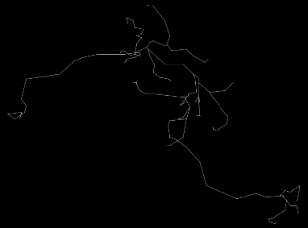

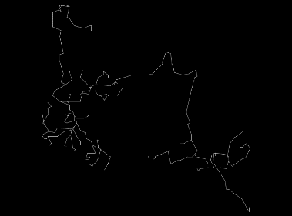
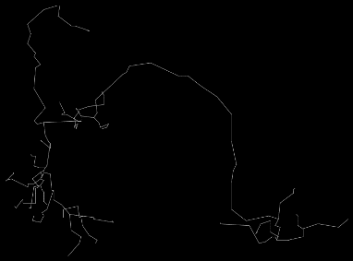
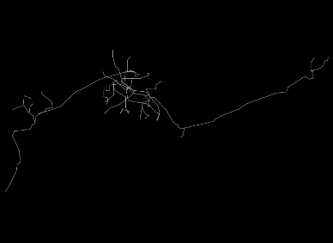
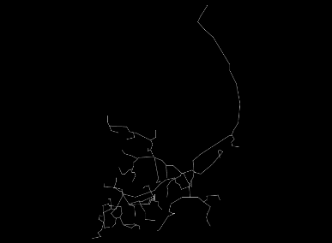
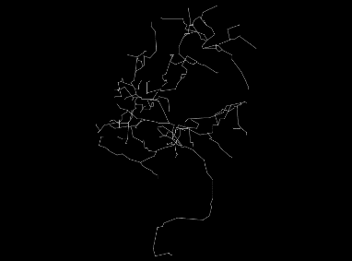
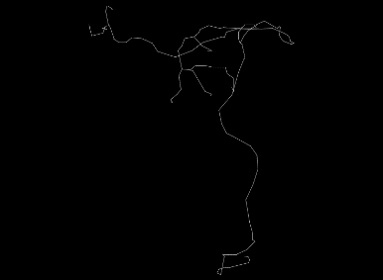
Abbreviation used in the datasets
Datasets
02
Different Cell Types of Neurons
Soma Surface : soma_Surface
Number of Stems : nstems
Number of Bifurcations : n_bifs
Number of Branches : n_branch
Overall Width : width
Overall Height : height
Overall Depth : depth
Average Diameter : diameter
Total Length : length
Total Surface : surface
Total Volume : volume
Max Euclidean Distance : eucDistanceMax
Path Distance : path
DistanceMax Branch Order : branch_Order
Average Contraction : contraction
Total Fragmentation : fragmentation
Partition Asymmetry : partition_asymmetry
Average Rall's Ratio : pk_classic
Average Bifurcation Angle Local : bif_ampl_local
Average Bifurcation Angle Remote : bif_ampl_remote
Fractal Dimension : fractal_Dim
Data was extracted from neuromorpho.org
URL to see data : http://neuromorpho.org/bycell.jsp
URL used for downloading data : http://neuromorpho.org/api/neuron
From the Chiang archive, neurons from drosophila melanogaster were chosen for analysis.
We randomly picked 3000 instances per type.
Out of the 3000, 2361 were chosen for training, and the rest(639) were put away for testing.
Here, we chose 3 types of neurons for our project :
glutamatergic, GABAergic, and cholinergic.

Slide 4
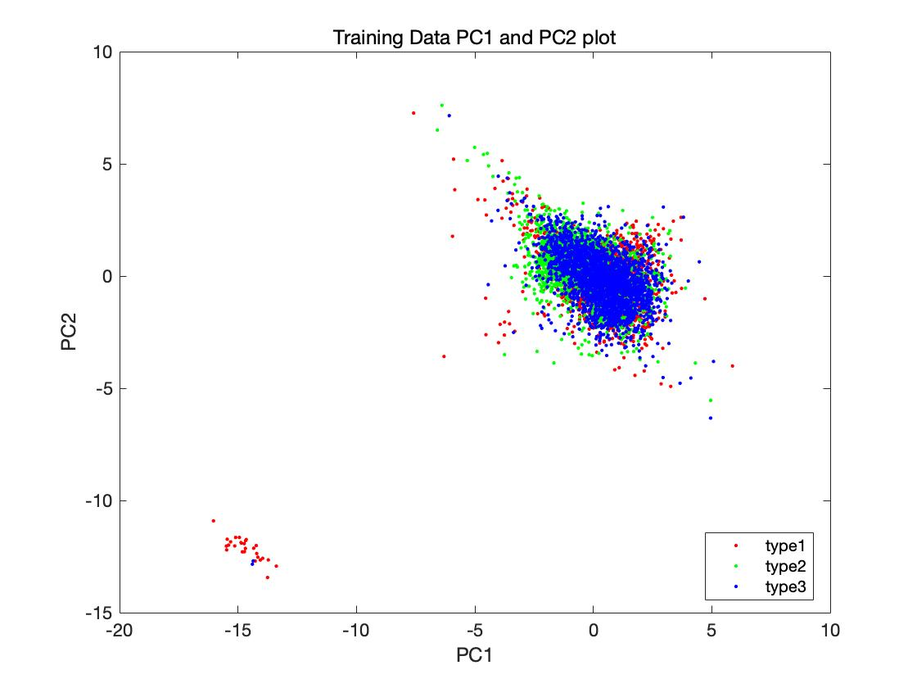
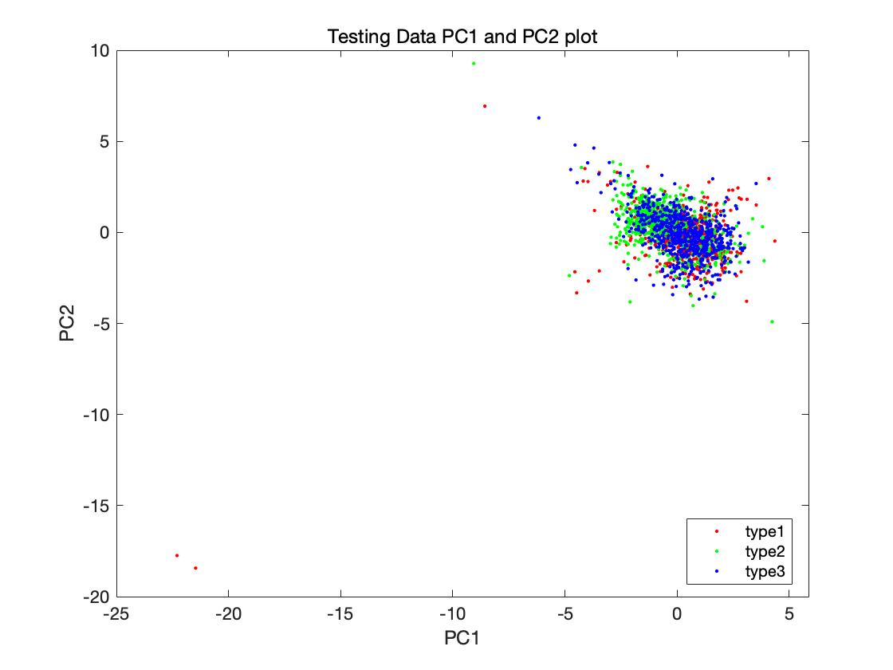
Algorithm
03
A. analyzed through numerical data of the neuron structures (Logistic Regression)
- Training step :
1. Preprocess (imputation, normalization, PCA, and visualization)
2. Train (using mnrfit())
3. Test performance with Training Data (using mnrval())
- Testing step :
1. Preprocess (imputation, normalization, PC scores, and visualization)
2. Test performance with Testing Data (using mnrval())
B. analyzed through 2D-image data of the neuron structures (CNN)
- To find the best model, we’ve tried some trials such as changing the architecture or making it less deeper. The models can be found in our matlab codes and We wrote some short reason why we failed in the script.
- We finally selected as best model 3 cnn blocks which consist of convolution layer(16 filters with filter size 3 by 3) , batchnorm, ReLU activation and maxpool.
- We’ve tried combinations for finding the best hyperparameters. Our fine tuning result was using ‘adam’ optimizer with L2 Regularization parameter 7 and learning rate 0.0001.

Slide 5
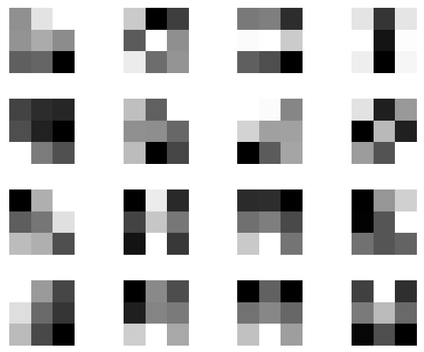
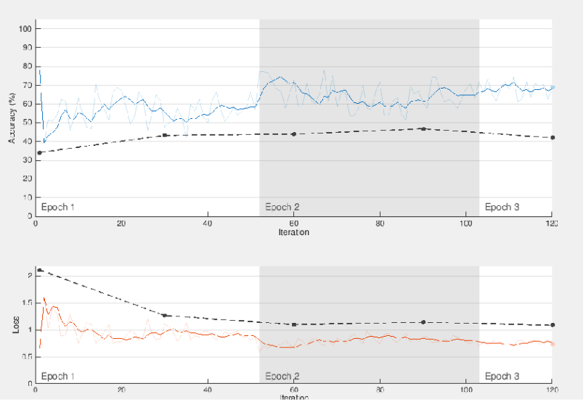
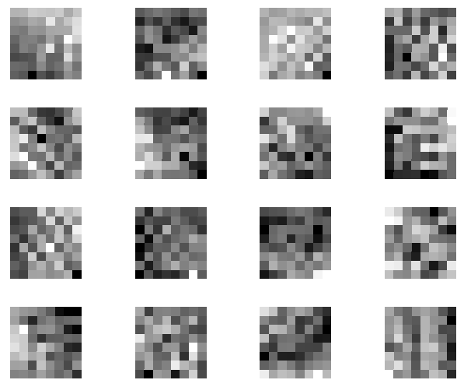
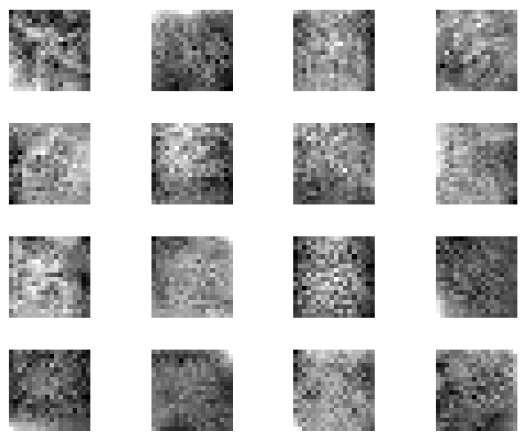
Result
04
A. analyzed through numerical data of the neuron structures (Logistic Regression)
Training accuracy: 0.5866
Test accuracy: 0.5816
Better than chance (0.3333%) and the test accuracy didn't drop drastically compared to the training.
B. analyzed through 2D-image data of the neuron structures (CNN)
Training accuracy: 0.80
Validation accuracy: 0.47
Test accuracy: 0.4637
Although it is still better than the chance, the performance is bit less than we expect.
(CNN)Each filter after ReLU activation
(CNN)Graphs in our best model

Slide 6
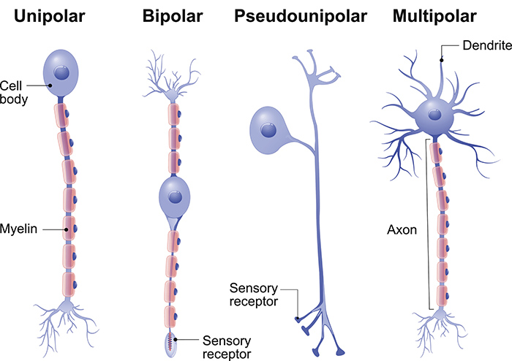
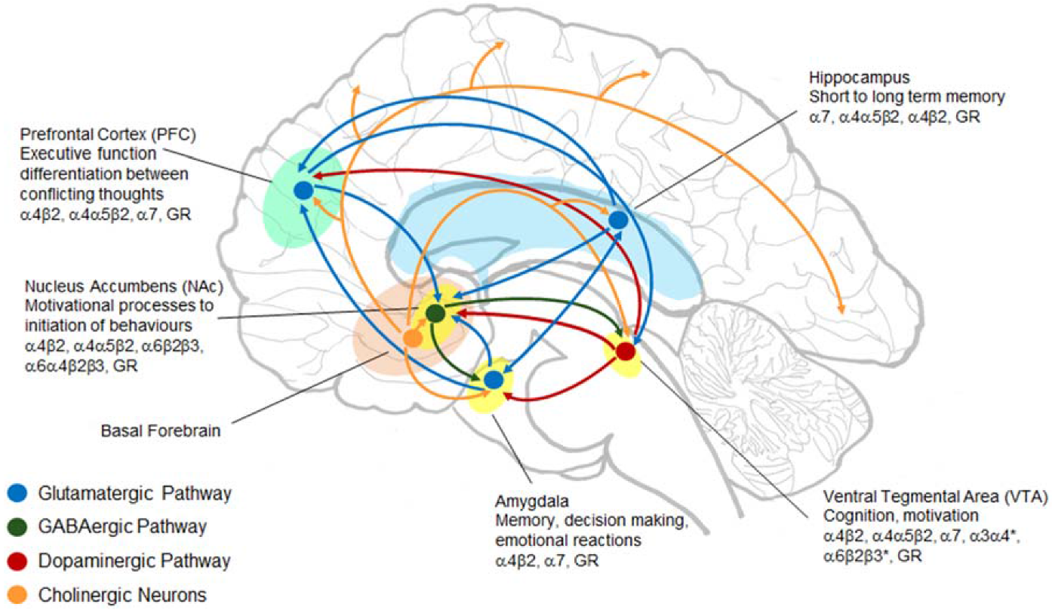
Result
04
Discussion
The most important role of neurotransmitters in neurons is to activate or inhibit the postsynaptic neurons. Since neuronal morphology is a determinant of the conduction velocity and projection of the neuron, it is not significantly affected by the neurotransmitter that the neuron has. In addition, glutamate, GABA, and acetylcholine are all too common neurotransmitters in the nervous system, and they are distributed in several places, so it is difficult to determine the neurotransmitter by observing only the structure.
Although it might have better performances if we analyze bipolar, unipolar, and multipolar neurons, which were separated by their structures, this project was a fresh attempt to predict the neurotransmitter that the neuron has through analyzing their morphology. And because the results were more than 10 percentage points above the chance, the project was worth it.

