Slide 1
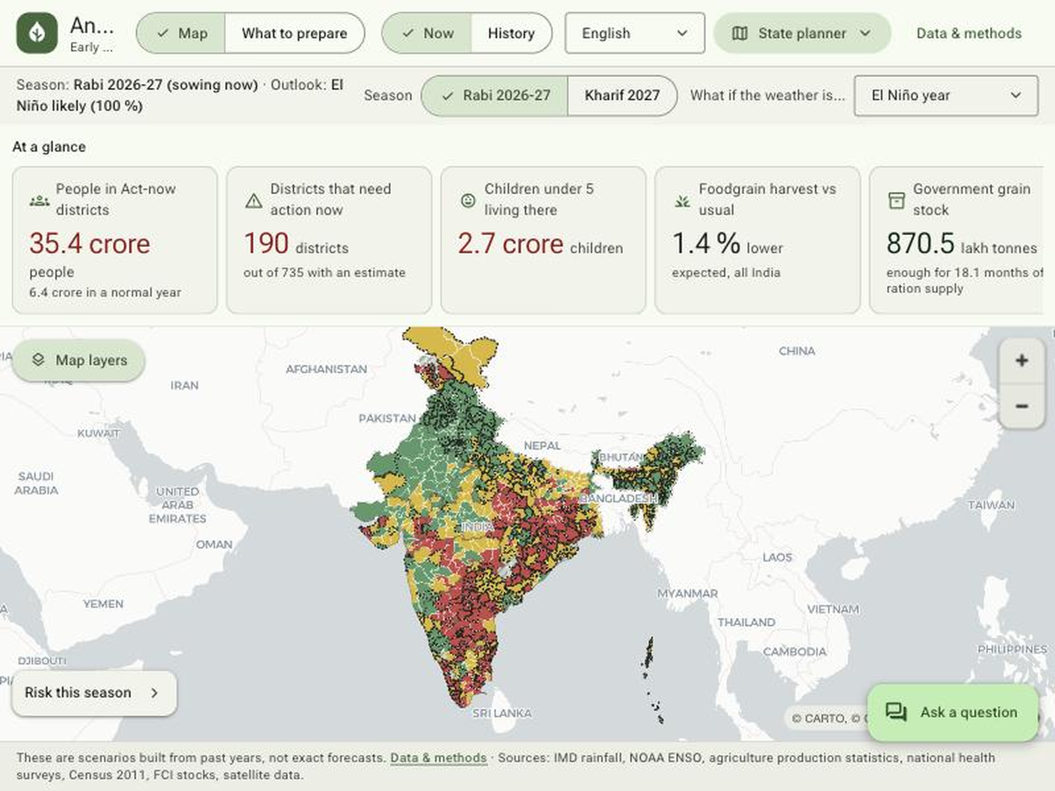
Google Cloud AI Builder Cup 2026 | Sustainability & Social Impact
AnnaDrishti
अन्नदृष्टि (grain + foresight)
Season-by-season food-security early warning for India's districts, run every year
This season: El Niño 2026-27
Where will food security break, why, how much buffer, and what should farmers plant, before each Rabi and Kharif season.
Live app (State planner): Rabi 2026-27, El Niño outlook
Team Sangam
190
35.4 cr
2.7 cr
Arulsrinivaasan · Nymisha Herrera Nimmagadda · Saket Kumar
Built on Google Cloud: Earth Engine · WeatherNext · Gemini · Cloud Run
districts need action
people in them
children <5
Live: https://annadrishti-801618653701.asia-south1.run.app
Notes:
Team Sangam (Arulsrinivaasan, Nymisha Herrera Nimmagadda, Saket Kumar). AnnaDrishti: a district-level early warning map that chains climate, crops, nutrition and buffer stock, with Gemini as the analyst. Built on Earth Engine, WeatherNext, Gemini and Cloud Run. Live app: https://annadrishti-801618653701.asia-south1.run.app

Slide 2
A record El Niño is forming now, and India has seen this before
+2.1 °C
Niño-3.4, NOAA CPC 8 Oct 2026. El Niño Advisory; still strengthening through end of 2026
All-India monsoon (JJAS) rainfall anomaly, past El Niño years
83%
CPC chance of a historic event by Oct-Dec 2026 (54% for SON)
~100%
IRI plume: El Niño probability through FMA 2027 (AMJ 90%), still 61% for MJJ 2027
The tool runs every Rabi and Kharif; ENSO outlook refreshes monthly.
India: rabi 2026-27 sows under a warm El Niño winter; kharif 2027 faces deficit risk if El Niño persists into MJJ.
2009 IMD reference: -22% (-16% on our grid). 2015: -14% (-11%).
Notes:
CPC 8 Oct 2026 diagnostic discussion and IRI plume of 21 Sep 2026 (artifacts/enso_status.json). Past anomalies from artifacts/reports/02_climate_report.md: our IMD-gridded district means vs 2000-24 mean, and IMD reference vs LPA.

Slide 3
Nothing links climate, crops, nutrition and stocks by district
Rain
12-18 mo
~4 yr
1 number
Climate forecasts stop at rainfall
Crop statistics arrive late
NFHS nutrition survey cadence
Buffer stock is national
No translation into yield, hunger or action
Yield data lags the season it describes
Vulnerability is measured long after the shock
Central pool 870 lmt (Sep 2026), no district view
AnnaDrishti joins all four, per district, ahead of sowing
Rainfall analogs → yield sensitivity → nutrition vulnerability → buffer and pre-positioning quantities, with a Gemini analyst on top. Rabi 2026-27 lead date: 15 Nov 2026.
Notes:
Four data streams exist, each on a different clock and geography. AnnaDrishti fuses them for 753 districts.

Slide 4
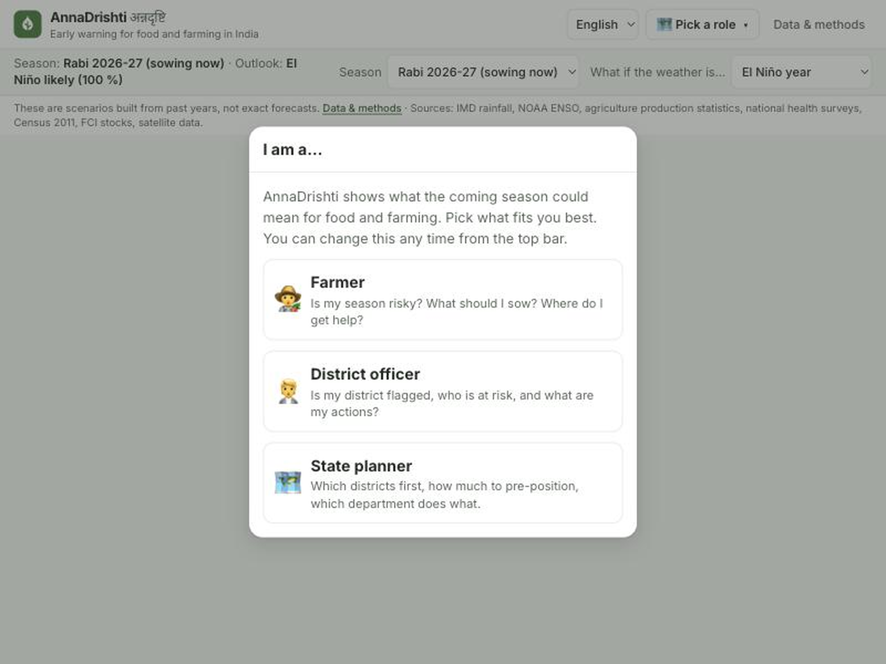
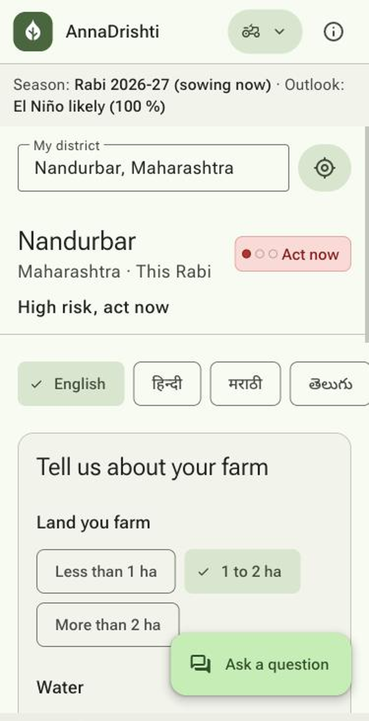
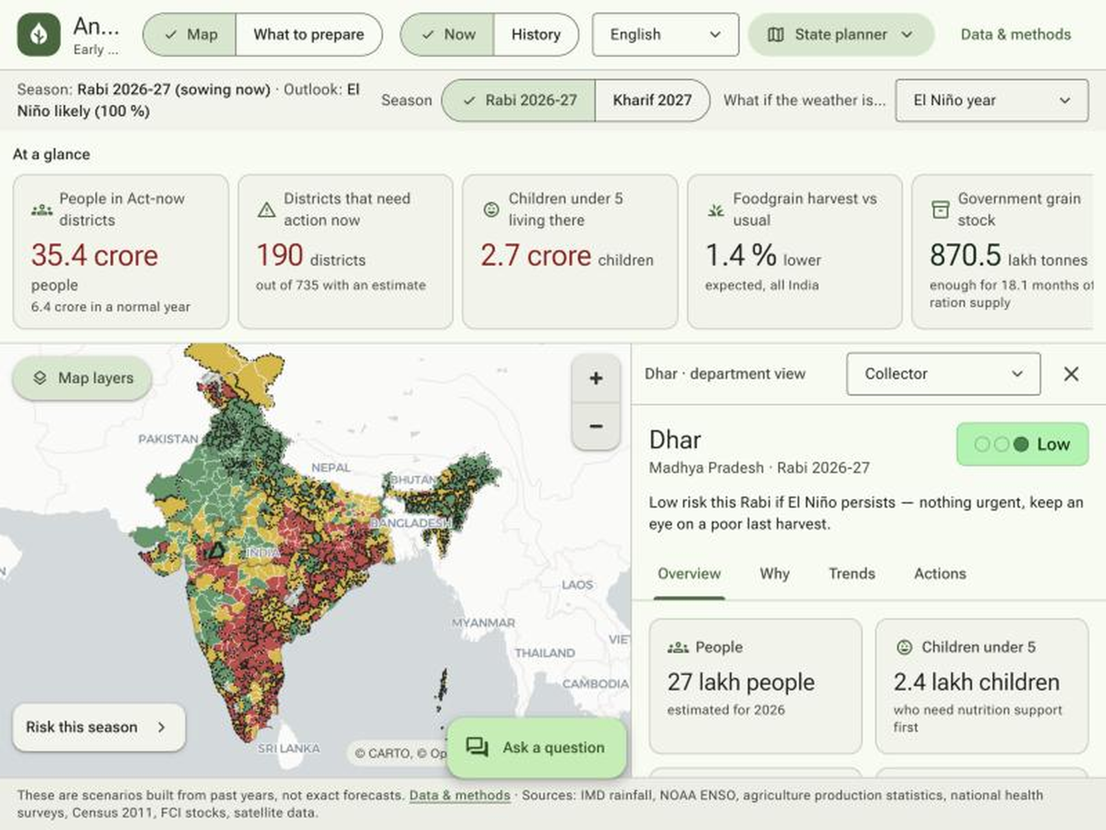
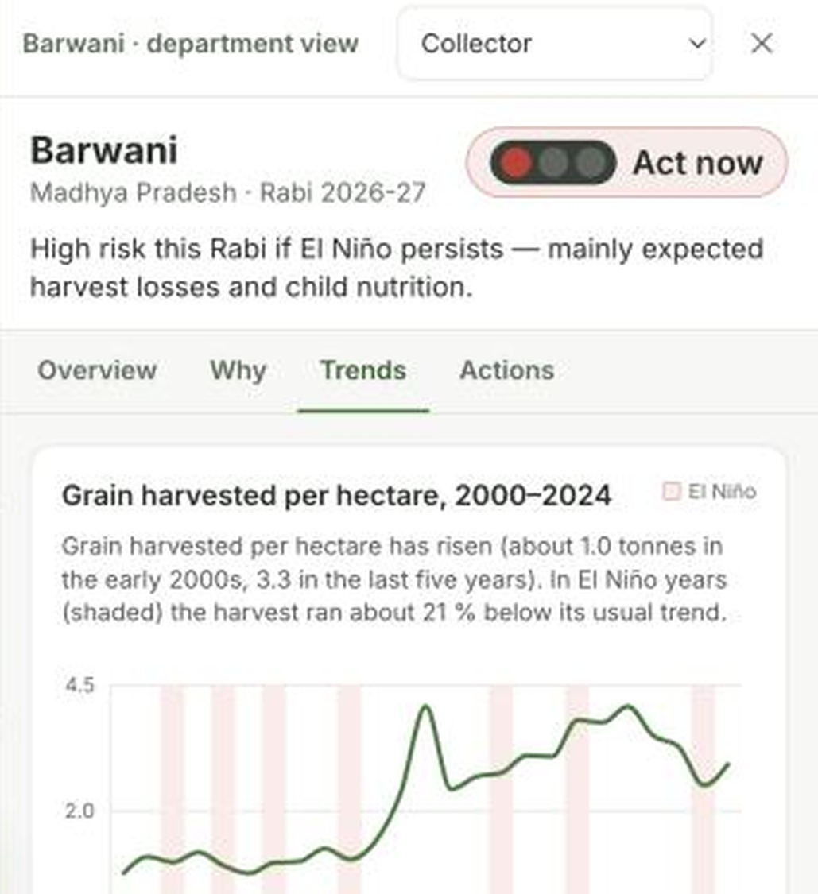
One app, three roles, five questions
Pick a role: Farmer, District officer, State planner
Farmer: phone-first, 9 languages, voice
Officer: plain-language Overview · Why · Trends · Actions
Trends: yield, monsoon, NFHS, prices
Where?
Why?
How much buffer?
What to plant?
For which season?
risk map of 753 districts, traffic light
top drivers in plain sentences
grain, pulses, stock vs norm
crop advice in 9 languages, spoken
Rabi 2026-27 now, Kharif 2027 next; 5 ENSO scenarios
Notes:
Material Design 3 web app with three role-based entry points: Farmer (phone-first, 9 languages, voice), District officer (department briefing, plain-language Overview / Why / Trends / Actions), State planner (map + pre-positioning). Five questions it answers: where, why, how much buffer, what to plant, for which season (Rabi 2026-27 sowing now, Kharif 2027 upcoming). Screenshots are the live light app (v2).

Slide 5
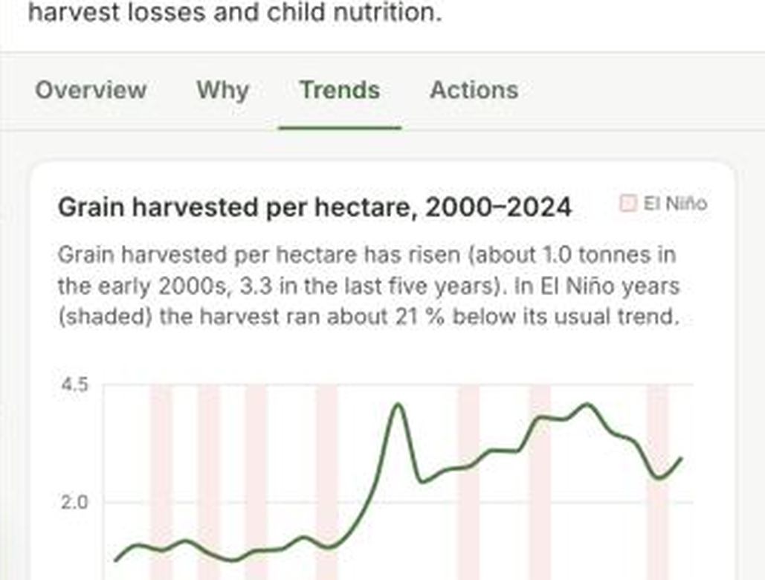
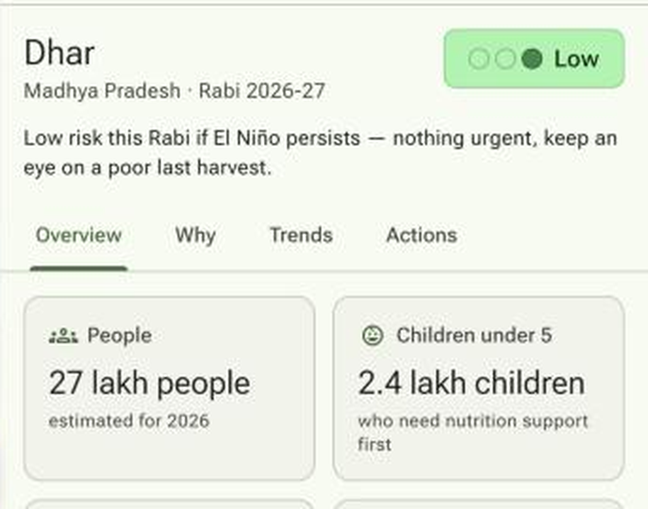
Data fusion: 14 public sources, from Earth Engine to Poshan
Source | Span | Granularity
IMD gridded rainfall | 2000-2025, daily | 0.25° grid → district
DES / UPAG crop statistics | 1997-2025 | district × ~60 crops
NFHS-4 / 5 / 6 | 3 survey rounds | district fact sheets
Census 2011 + NCP projections | projected to 2026 | district
PDS offtake | 2017+, monthly | district
FCI / DFPD central pool stocks | monthly, to Sep 2026 | national
ICRISAT districts + farm-harvest prices | 1966-2017; prices 1990-2020 | district
NOAA CPC ONI + IRI plume | ONI 2000-25; CPC 8 Oct 2026 | Niño-3.4, probabilities
DST climate-vulnerability index | static index | district
Poshan Tracker (live underweight) | Apr 2023 - Feb 2026, monthly | district
CGWB groundwater levels | pre-monsoon, 2019 mostly | district (505 of 753)
Cost of Cultivation | latest year, 2014+ | state × crop
Earth Engine: CHIRPS, NDVI, ERA5-Land | live to Sep 2026 | 250 m-11 km → district
WeatherNext 2 (Earth Engine asset) | init 2026-10-17; 6-240 h | 64 members → district
Per-district trends: yield, monsoon, NFHS, prices
Overview: people, children, harvest, stock; gaps flagged estimated
Notes:
All public. Earth Engine layers refresh live; WeatherNext 2 is the 64-member ensemble initialised 2026-10-17 with leads 6-240 h. New in v3: ICRISAT farm-harvest prices (1990-2020), Poshan Tracker (2023-26), CGWB groundwater (2019 pre-monsoon), Cost of Cultivation (state x crop, 2014+). Spans from README, CONCEPT, gee_live.json, 03b_extra_report.md.

Slide 6
Method: analog + LightGBM ensemble, season by season
ENSO phase
Analog β
LightGBM
Ensemble shock
E × S × C
Score + drivers
CPC + IRI; p(El Niño) 0.61 for kharif 2027
District rain departure × El Niño yield β (7 El Niño years)
18 features, ~13k district-years, leave-one-year-out
0.48 analog + 0.52 LightGBM; spread = confidence
Exposure, sensitivity, capacity deficit; rank-normalised
0-100, bands from El Niño tertiles
Out-of-sample skill (leave-one-year-out)
0.45
Exposure
0.30
Sensitivity
0.25
Capacity deficit
Model | ρ | MAE pp
LightGBM | 0.31 | 16.1
Analog β | 0.08 | 17.7
Predict 0 | - | 17.0
Ensemble yield loss, rain-deficit probability, dry antecedent, live NDVI
Rainfed share, crop concentration, yield CV, smallholders, self-sufficiency
NFHS stunting, wasting, anaemia, PDS dependency, climate vulnerability
+ price-spike risk
+ groundwater stress
+ Poshan live underweight
Season-specific drivers (same 0.45 / 0.30 / 0.25 score)
score = 100 × (0.45 E + 0.30 S + 0.25 C). Scenarios with uncertainty, not forecasts; skill is leave-one-year-out.
Kharif: JJAS rain, dry spells, onset, heat
Rabi: OND rain, Feb-Mar terminal heat, groundwater stress, previous-kharif carry-over
Phases: La Niña (flood rule), Neutral, El Niño, Strong; Current = probability-weighted
Notes:
Expected shock is a skill-weighted ensemble of the ENSO analog beta (weight 0.48) and LightGBM (0.52, huber, 18 features, 3 seeds), weights proportional to 1/pooled out-of-sample MAE. Validation: leave-one-year-out, 22 held-out monsoon years 2003-2024, 13,267 district-years. LightGBM rho 0.305, MAE 16.07; analog rho 0.077, MAE 17.71; predict-zero MAE 16.96. Not a forecasting backtest (training includes future years). New score terms: price-spike risk (E, 0.10 effective), groundwater stress (S, 0.10), Poshan live underweight (C, 0.10); component weights 0.45/0.30/0.25 unchanged. Price term covers 457/719 scored districts, groundwater 470, Poshan 716.

Slide 7
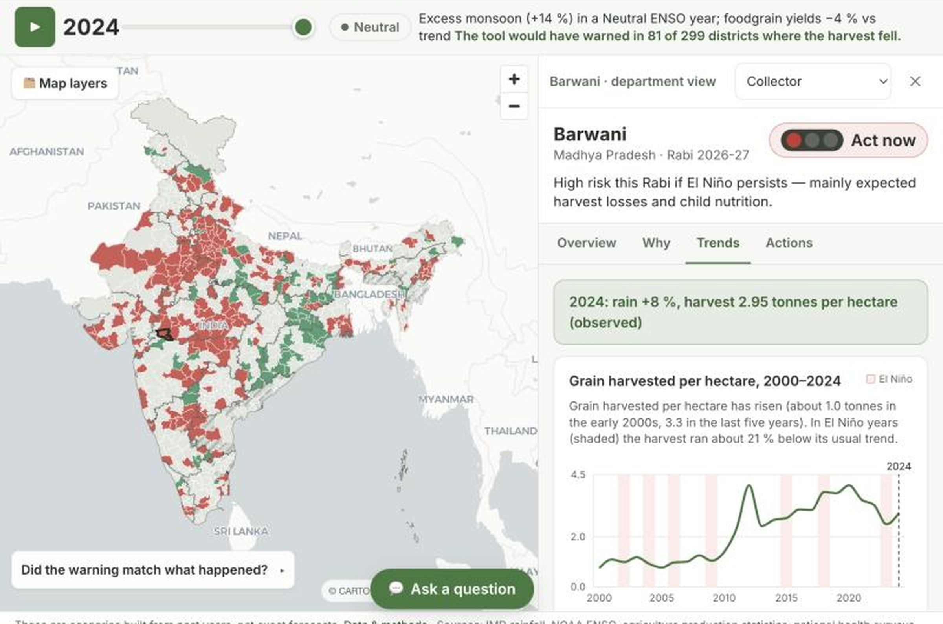
Would it have warned? Yes, in sample and out of sample
Year | Analog ρ in-sample (neg = good) | LightGBM ρ, out-of-sample (pos = good) | Analog gap pp | LightGBM gap pp
2009 El Niño | -0.30 | +0.28 | -16.1 | -16.3
2014 Neutral | -0.07 | +0.46 | -4.0 | -25.0
2015 El Niño | -0.53 | +0.33 | -27.3 | -12.1
2023 El Niño | -0.27 | +0.24 | -10.5 | -11.3
Rabi (4 winters) | -0.09 to -0.27 | +0.32 pooled | -3 to -13 | -5 to -19
Nandurbar, Maharashtra (2015 hindcast)
72.1
-26.6%
-11.9%
Kharif El Niño score, rank 2
actual yield 2015
LightGBM, out-of-sample
Yield gap, worst- vs best-predicted tercile (pp; negative = good)
History mode lets any user replay 2003-2024: in 2015 the tool would have warned in 71% of districts where the harvest fell
Notes:
Two different tests, opposite sign conventions. Analog: in-sample Spearman(risk score, actual yield deviation), negative = good, beta fitted on all years incl. the test year (optimistic). LightGBM: leave-one-year-out Spearman(predicted shock, actual deviation), positive = good; not a forecasting backtest because training includes future years. Gap = actual mean deviation of worst-predicted tercile minus best-predicted tercile (pp), negative = good. Analog gaps from kpis.json hindcast top_minus_bottom_pct; LightGBM gaps from gap_lgbm_oos (04b report). Nandurbar: Kharif 2027 El Niño score 72.1 (rank 2); 2015 actual -26.6%, LightGBM out-of-sample -11.9%, analog in-sample hindcast score 77.4. Rabi hindcast (04b_ml_report_rabi.md, kpis hindcast_rabi): winters 2009, 2015, 2021, 2022; analog in-sample rho -0.113, -0.267, -0.168, -0.090 (right sign in all four, weaker than kharif); LightGBM rabi leave-one-year-out pooled rho 0.317 (per-year 0.14-0.39); tercile gaps analog -3.2 to -13.0 pp, LightGBM -4.9 to -18.7 pp. Kharif values from kpis.json hindcast. History mode (artifacts/history/index.json pct_loss_warned): 2009 69%, 2014 45%, 2015 71%, 2023 65%; mean 43% over 2003-2024 (range 20-71%).

Slide 8
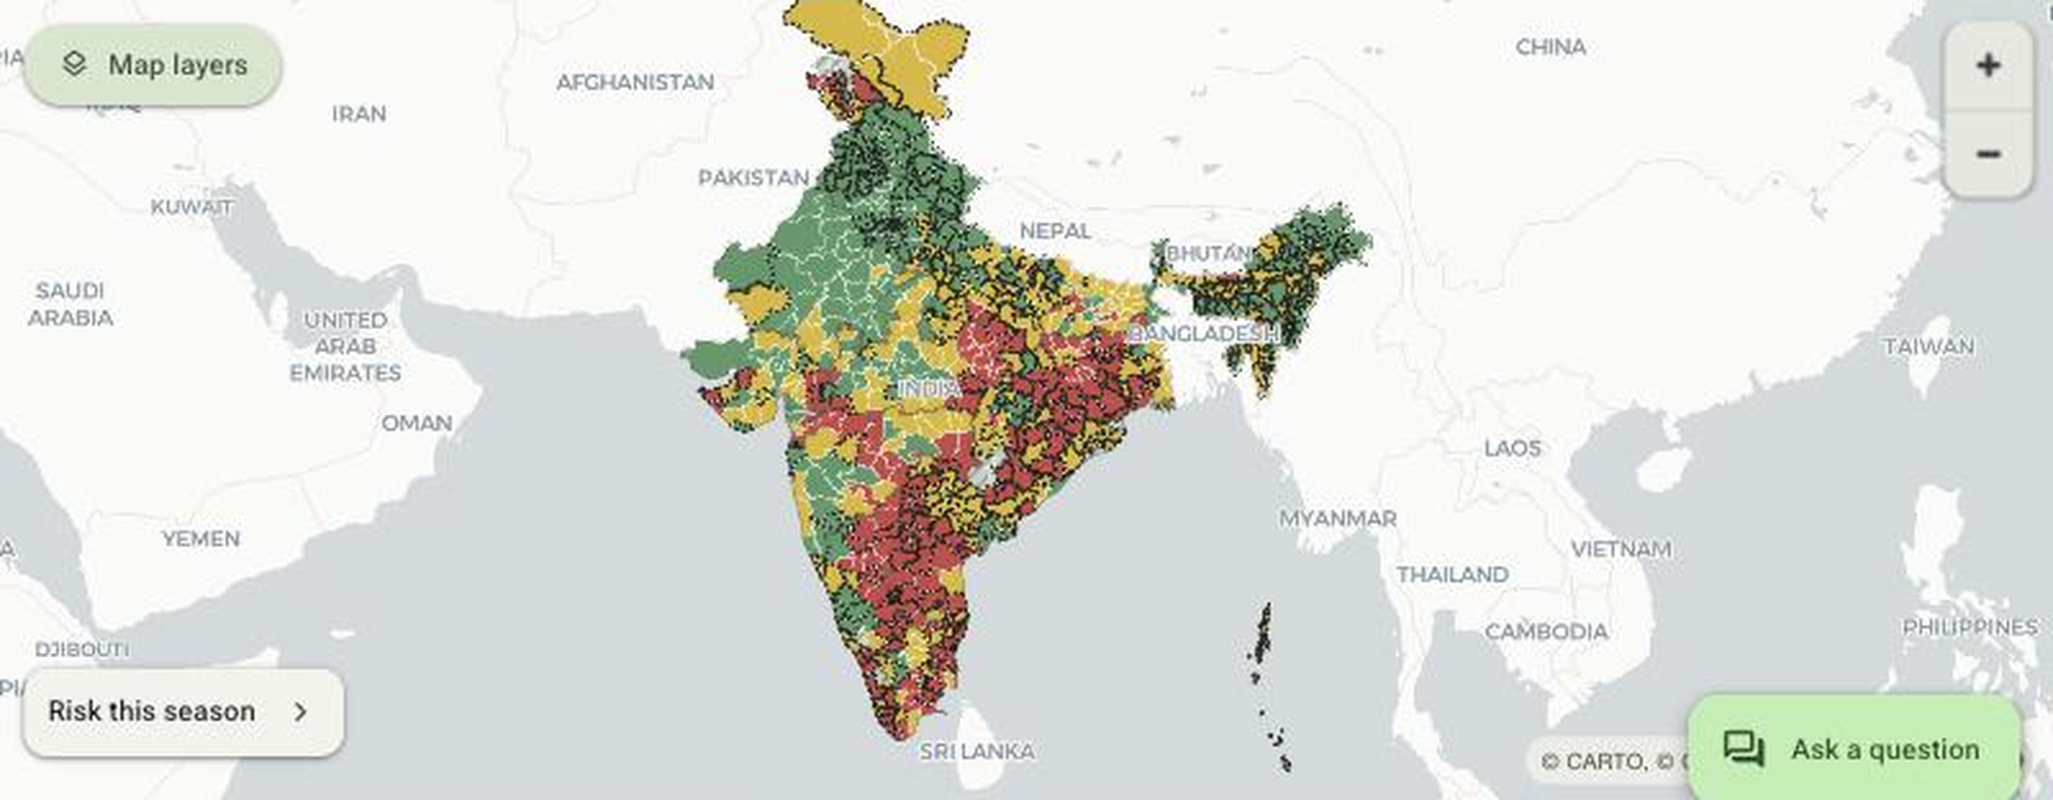
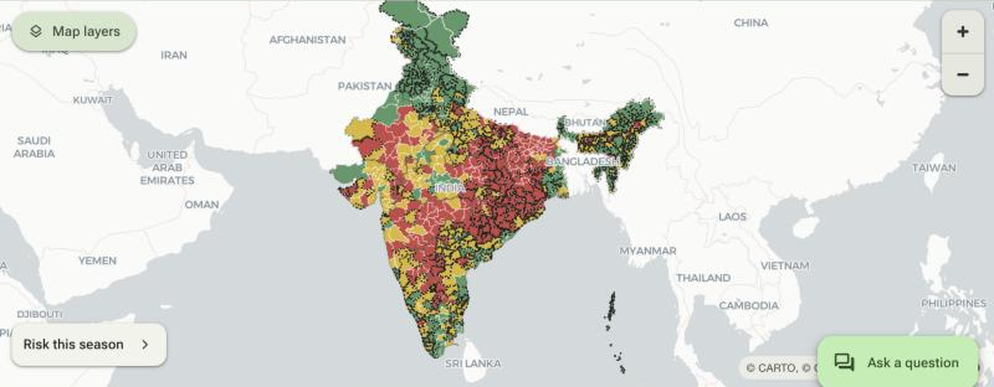
Under El Niño: 190 districts need action in Rabi, 242 in Kharif
Rabi 2026-27, El Niño
sowing now; act by 15 Nov 2026
Kharif 2027, El Niño
upcoming; act by 15 May 2027
190
35.4 cr
242
54.7 cr
districts need action
people
districts need action
people
2.7 cr
-1.4%
4.9 cr
-5.9%
children <5
national shock
children <5
national shock
# | Top districts | Score | Shock %
1 | Kalaburagi, KA | 76.2 | -16.1
2 | Giridih, JH | 76.0 | -8.9
3 | Gumla, JH | 74.1 | -7.8
4 | Purbi Singhbhum, JH | 73.8 | -5.0
5 | Simdega, JH | 72.5 | -8.8
# | Top districts | Score | Shock %
1 | Bilaspur, CG | 72.8 | -15.4
2 | Nandurbar, MH | 72.1 | -9.4
3 | Balangir, OD | 72.0 | -15.9
4 | Korba, CG | 71.1 | -19.1
5 | Kendujhar, OD | 71.0 | -18.1
Wheat belt (Punjab / Haryana) shows low rabi risk: the terminal-heat signal is flat there in our data. Flagged for review, not tuned.
Notes:
kpis.json by_season_scenario. Rabi 2026-27 El Niño: 190 districts need action (of 735 with an estimate), 35.36 cr people, 2.70 cr children under 5, national shock -1.36%. Kharif 2027 El Niño: 242 districts, 54.66 cr people, 4.91 cr children, production-weighted shock -5.88%. Bands: thresholds 45.0 / 55.0 (kharif El Niño tertiles). Top districts computed from districts.json risk scores. Wheat belt: Punjab and Haryana mean rabi El Niño score about 30 with 0 districts needing action; flagged for review, not tuned. Rabi LightGBM shocks are relative to each district's neutral-winter prediction. Screenshot is the live light app (Rabi view).

Slide 9
Gemini as analyst: grounded, personalised, tool-using
District evidence JSON
Official briefing
Farmer view: phone-first, 9 languages, voice, profile
drivers, analog + LightGBM shock, NFHS, prices, groundwater, live NDVI
Gemini 2.5 Flash
per department lens, 5 actions with unit + lead time
Farmer advisory
in 9 languages, spoken via Gemini TTS
Grounding rules
grounded, low temperature, 9 languages, TTS
cite ≤ 3 numbers; never invent; null → 'not available'; 'not a forecast'
State brief
pre-positioning plan, rabi / kharif timeline
Ask the map: function calling over the data
Personalised
Gemini
get_district
rank_districts
Farmer: holding, water, crop, livestock, tenant; 9 languages with voice; crop playbook
7 department lenses, each with named units and lead times
"Which Maharashtra districts should pre-position pulses?"
compare_scenarios
national_summary
Answers name districts, scores and scenario; the map highlights them. Up to 4 tool rounds; facts only from tools.
Notes:
Grounding: api/llm.py builds the prompt from the district evidence JSON plus rules (cite at most 2-3 numbers, never invent facts, null means information not available, early warning not certain forecast). Personalisation (api/personalize.py): farmer profile (holding, water, main crop, livestock, tenant), 9 languages (EN, Hindi, Marathi, Telugu, Bengali, Tamil, Kannada, Gujarati, Odia), crop playbook; 7 department lenses (collector, food and civil supplies, agriculture, WCD/ICDS, rural development, health, animal husbandry) each with named responsible units and lead times. Ask the map: function calling with get_district, rank_districts, compare_scenarios, national_summary; up to 4 tool rounds. Farmer-profile screenshot is from an intermediate model build (score values differ from v3).

Slide 10
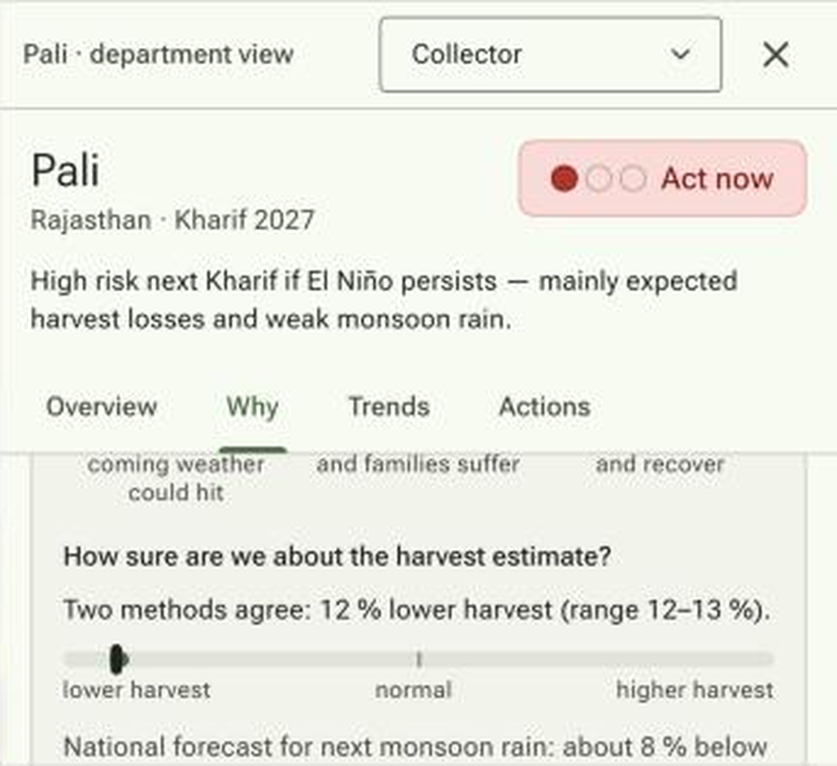
Google foundation models, used honestly
TimesFM 3.0 + ONI covariate, BigQuery AI.FORECAST
17-table BigQuery warehouse in asia-south1
749 district monthly rainfall series, 21-month horizon, ONI as future covariate
JJAS 2027 all-India: -8% (cropped-area-weighted -7.7%)
District-level hindcast ρ -0.06 to +0.26, RMSE no better than climatology: shown, not scored
Median forecast runs about 5-10 pp low; ONI after Jul 2026 is an assumption
TabFM: evaluated, not used
In-app card (Pali, Kharif 2027): two methods agree, 12% lower harvest (range 12-13%); national TimesFM line below
6.6 GB weights; CPU inference over 8 min per fold, 22 folds exceed a 24 h budget
Next: BigQuery AI.PREDICT once generally available
749
-8%
≈ 0
district rainfall series
JJAS 2027, all-India
district-level skill
Notes:
BigQuery warehouse: project dataset in asia-south1, 17 tables (07_bigquery_report.md). TimesFM 3.0 (Preview) with ONI covariate via AI.FORECAST on 749 district monthly rainfall series, 21-month horizon; ONI beyond JAS-2026 is an assumption. JJAS-2027 all-India anomaly -7.7% cropped-area-weighted (-9.1% mean; univariate TimesFM 2.5: -11.7% / -13.3%). Hindcast district-level correlation -0.06 to +0.26, RMSE no better than climatology, median forecasts biased about 5-10 pp low, so display-only. TabFM: 6.6 GB weights, CPU inference over 8 min per fold, 22 folds exceed the budget; slot left null in the ensemble. BigQuery AI.PREDICT path is a plan, not built. Model-agreement screenshot is the light app (Pali, Kharif 2027: two methods agree, 12% lower harvest, range 12-13%).

Slide 11
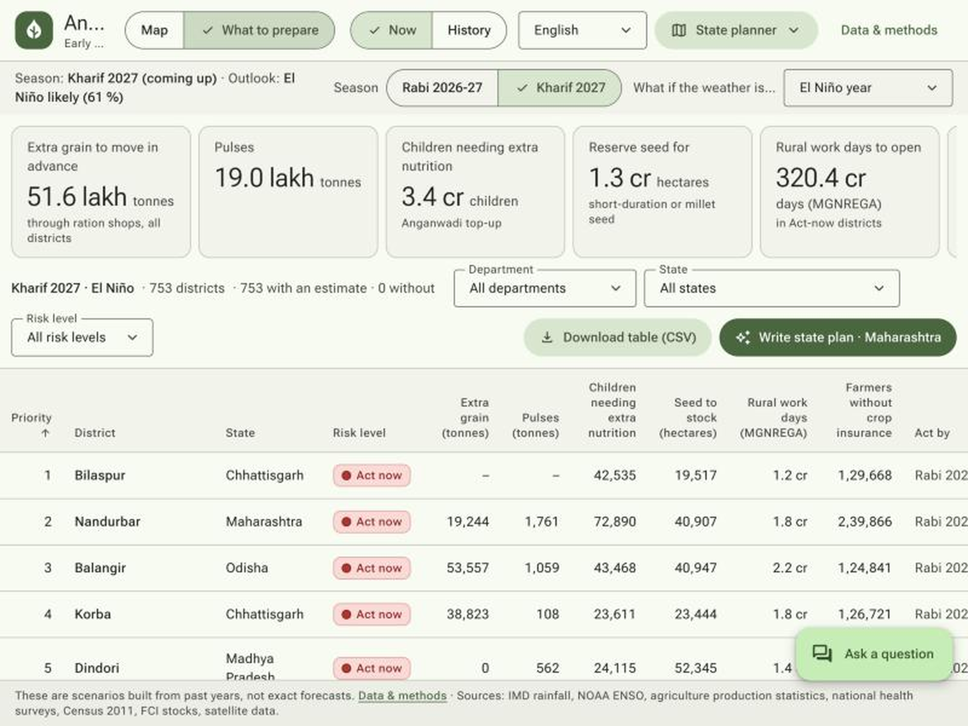
From score to action: quantities, dates and owners
Quantity (El Niño)
Rabi
Kharif
Owner
Grain to pre-position
7.3 lakh t
51.6 lakh t
Food & Civil Supplies
Pulses
5.6 lakh t
19.0 lakh t
Food & Civil Supplies
Anganwadi children
3.3 cr
3.4 cr
WCD / ICDS
Seed bank
0.6 cr ha
1.3 cr ha
Agriculture
MGNREGA person-days
218.5 cr
320.4 cr
Rural Development
PMFBY coverage gap
10.0 cr
10.1 cr
Agriculture
State planner, What to prepare (Kharif 2027, El Niño): totals, ranked table, CSV and Gemini state plan
Grain and pulses: extra stock vs a neutral year via PDS / OMSS. Anganwadi: children under 5 × stunting rate. Seed bank: short-duration / millet seed. MGNREGA: work demand. PMFBY: farmers not insured. Health owns the women's anaemia target (21.2 cr rabi).
Rabi: by 15 Nov 2026
Kharif: by 15 May 2027
Notes:
Totals from kpis.json by_season_scenario actions_total, El Niño. Rabi 2026-27: grain 7.3 lakh t, pulses 5.6 lakh t, anganwadi children 3.3 cr, seed bank 0.63 cr ha, MGNREGA 218.5 cr person-days, PMFBY gap 10.0 cr. Kharif 2027: grain 51.6 lakh t, pulses 19.0 lakh t, anganwadi 3.4 cr, seed bank 1.31 cr ha, MGNREGA 320.4 cr, PMFBY gap 10.1 cr. Lead dates: rabi by 15 Nov 2026, kharif by 15 May 2027. State planner view shows the map and pre-positioning table with CSV export and a Gemini state brief; the screenshot is the live light app (Rabi view). Screenshot shows the Kharif 2027 view.

Slide 12
Architecture: pipeline, BigQuery, Cloud Run, Gemini
Data + Earth Engine
Python pipeline
BigQuery
Cloud Storage
Cloud Run
Users
IMD, DES, NFHS, Census, FCI, Poshan, CGWB; Earth Engine; WeatherNext 2
00 boundaries … 03b extras → 04b LightGBM → 04 risk → 06 export
17-table warehouse; AI.FORECAST (TimesFM 3.0), asia-south1
artifact JSON, optional; else baked into image
annadrishti, asia-south1
FastAPI /api + Material 3 web app, role-based (farmer, officer, planner)
min-instances 0
State depts, collectors, FPOs, field teams
Cloud Scheduler
Secret Manager
Gemini API
daily refresh (planned)
GEMINI_API_KEY
2.5 Flash + TTS
Cloud Build
Artifact Registry
builds container
image repo
Deployed: Cloud Run asia-south1 · image in Artifact Registry · Gemini key in Secret Manager · artifacts synced from Cloud Storage
Notes:
Cloud Run service annadrishti in asia-south1 (min-instances 0). BigQuery dataset in asia-south1: 17 tables, AI.FORECAST with TimesFM. Artifacts can optionally be synced from Cloud Storage at startup (ARTIFACTS_GCS_URI), otherwise baked into the image; the GCS bucket was not created in the sandbox project (billing disabled). GEMINI_API_KEY in Secret Manager (or Vertex AI). Cloud Build builds the image into Artifact Registry. Daily refresh job (Cloud Scheduler) is planned, not yet in the repo.

Slide 13
Impact: a season of lead time for the people who act
State Food & Civil Supplies
where to pre-position grain and pulses (PDS / OMSS)
190
35.4 cr
districts need action (Rabi)
people in them
Agriculture departments
seed banks, short-duration / millet seed, PMFBY enrolment
2.7 cr
753
WCD / ICDS
anganwadi supplementary-nutrition top-ups
children under 5
districts scored
Lead time: from after-the-fact statistics to a season ahead
District collectors
one ranked list with drivers; MGNREGA planning
Go-to-market (proposed)
FPOs and farmers
crop-switch advisory in Hindi / Marathi / Telugu, spoken
Pilot with 1-2 state departments before the rabi window
District dashboards and field-team use before kharif 2027
Open code (MIT): any state can deploy on its own Cloud project
Khushi Baby field network
last-mile verification and delivery
Notes:
Metrics from kpis.json (Kharif 2027 El Niño). Go-to-market is proposed, not committed. Last-mile via Khushi Baby field network; Android field verification is a next step.

Slide 14
Honest limits, and what we build next
Limitations
Next steps
Consumption is normative (ICMR-NIN norm × projected population)
Buffer stock is national: 870 lmt central pool, no state-wise FCI stocks
NFHS about 4 years apart; NFHS-6 has no district anaemia
WeatherNext covers 10 days: in-season nowcast, not the annual outlook
Skill: analog hindcast is in-sample; LightGBM is leave-one-year-out, not a forecast backtest
LightGBM skill relies partly on previous-year deviation and state effects; TimesFM biased low; Poshan under-reports in some states (AP)
Gaps are imputed and flagged 'estimated' (417 districts have at least one); rabi is weak in label-gap states; La Niña flood rule flags few districts (3 high); rabi scored for 735 of 753
C3S seasonal ensembles for a true rainfall outlook
Spatial cross-validation and a true forecasting backtest for LightGBM
FCI state-wise stocks for the buffer view
ICAR contingency-plan RAG on Vertex AI Search
TabFM via BigQuery AI.PREDICT once available
WhatsApp farmer bot
Android field verification with Khushi Baby teams
Notes:
Limitations are also stated inside the app. Numbers: analog in-sample rho -0.09 to -0.53; LightGBM leave-one-year-out rho 0.24-0.46 on the four hindcast years; LightGBM top features: prev_year_ydev 28%, state 21%; 719 of 753 districts scored; central pool 870 lmt Sep 2026; Poshan median underweight about 10% vs NFHS-6 about 30%, Andhra Pradesh median 4%.

Slide 15
AnnaDrishti
A record El Niño is forming. Rabi sowing is weeks away. District decisions can start now.
Live app (Cloud Run)
GitHub
Demo video
https://annadrishti-801618653701.asia-south1.run.app
<GitHub URL>
<video URL>
Next season runs itself: monthly ENSO refresh, daily live layers, annual crop update.
The ask: back a rabi 2026-27 pilot with a state food and agriculture department; pre-position by 15 Nov 2026.
Team Sangam | Built on Google Cloud: Earth Engine · WeatherNext · Gemini · Cloud Run
Notes:
Live app: https://annadrishti-801618653701.asia-south1.run.app (Cloud Run, asia-south1). GitHub and video links to be filled before submission.

