Slide 1

Analysis and optimization of stock portfolios and their application in the Peruvian stock market using operations research and simulation tools.
June 2021

Slide 2

Content of the presentation
1
Study objectives
Motivation
The Peruvian Stock Market
Methodology
Results
Conclusions
Recommendations
2
3
4
5
6
7

Slide 3
Objectives
Motivation
Peruvian Stock Market
Methodology
Results
Conclusions
Recommendations
GENERAL OBJECTIVE
Applying mathematical tools, operations research, and simulation to determine efficient portfolios of stocks traded in the Lima Stock Exchange (BVL).
SPECIFIC OBJECTIVES
● Apply Markowitz's portfolio theory and propose a simulation tool based on copulas to determine the optimal investment weights for each selected stock, analyzing and comparing the results.
● Conduct a statistical analysis of the selected stocks, contrasting it with the assumptions of the Markowitz model and the stylized facts of financial asset returns.
● Analyze the effect of diversification as a tool for risk reduction in an investment portfolio.
1

Slide 4






Objectives
Motivation
Peruvian Stock Market
Methodology
Results
Conclusions
Recommendations
Tools for making intelligent decisions
Equity market
How to manage such risk?
What should be the investment strategy?
In which assets should I invest, and how much should I invest in each one?
Potential for high returns
Subject to higher risks
Stock Market
Uncertainty
Design efficient portfolios according to the level of risk aversion
Purchase and sale of securities
2

Slide 5



Objectives
Motivation
Peruvian Stock Market
Methodology
Results
Conclusions
Recommendations
Lima Stock Exchange (BVL)
Ensure a fair, transparent, and efficient market
Facilitator of transactions
Centralization of buying and selling of securities
Supervisory and regulatory body of the Peruvian stock market
Importance
Offers a variety of investment alternatives
The investor becomes a partial owner of large companies
Promotes the economic development of the country.
Legal entity intermediary of the stock market. Performs buying and selling operations
3

Slide 6
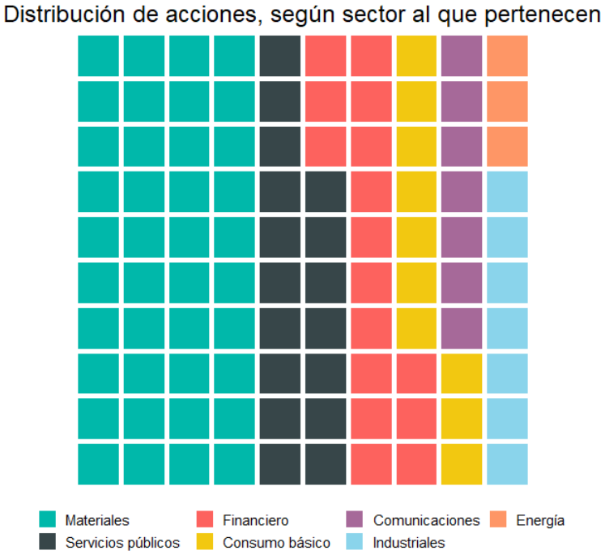
Objectives
Motivation
Peruvian Stock Market
Methodology
Results
Conclusions
Recommendations
Use of the R programming language.
A
B
Descriptive analysis
Stock selection
Data from 07/2007 to 06/2017 (10 years) were used.
30 stocks traded in the BVL
Price download from 06/2007 to 07/2020 (monthly data) - Bloomberg
1 Descriptive statistics and indicators
2 Analysis of the correlation matrix
3 Normality tests
4 Autocorrelation analysis
C
Modeling and optimization
1 Markowitz model
2 Simulation model based on copulas
D
Backtesting and results analysis
E
Conclusions and recommendations
4

Slide 7
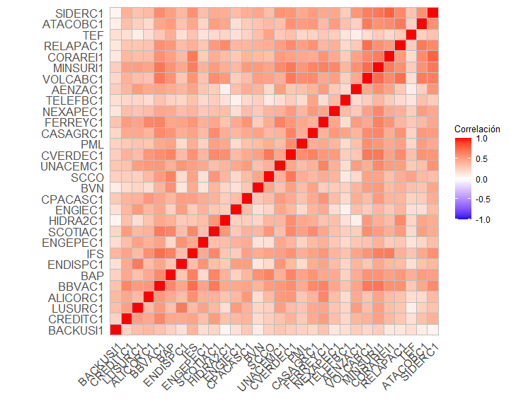
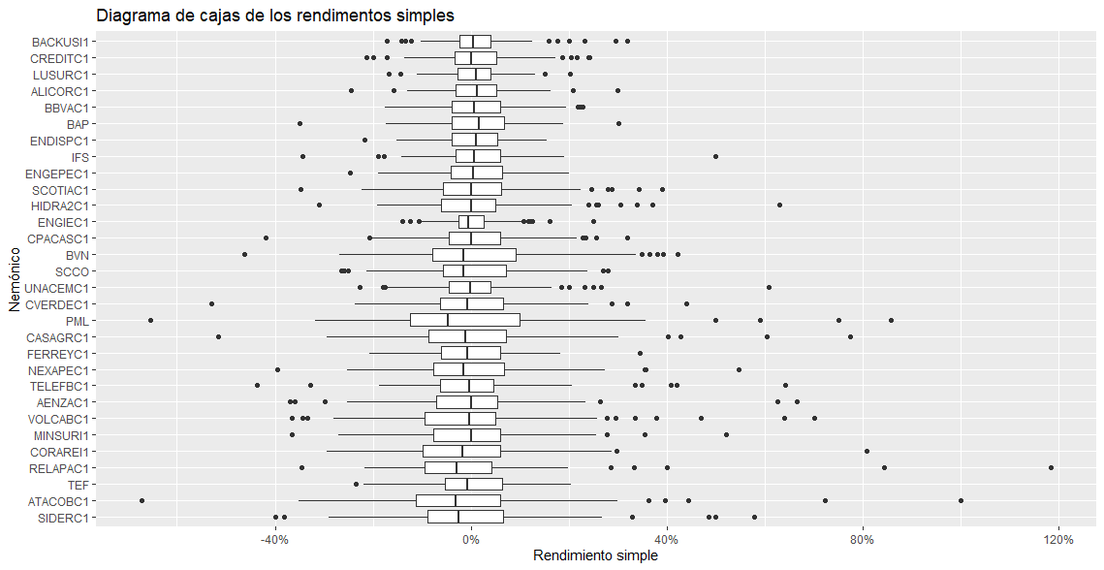
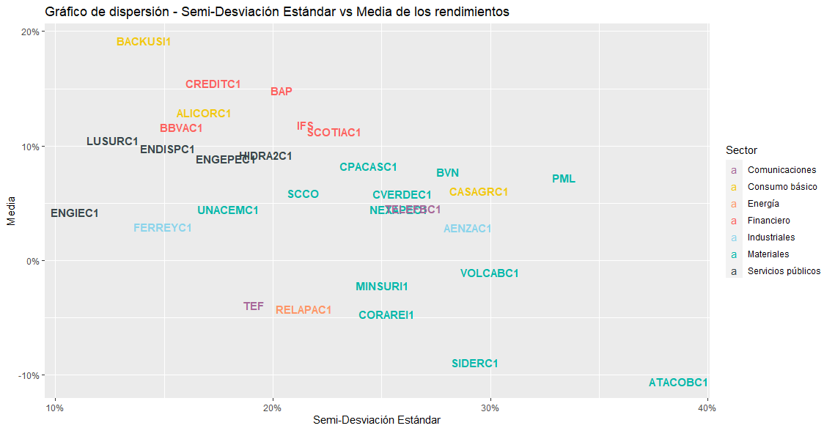

Objetivos
Motivación
Sistema Bursátil Peruano
Metodología
Resultados
Conclusiones
Recomendaciones
Descriptive statistics and indicators
Correlation matrix
Ranking using Sortino ratio
BACKUSI1: 1.36
CREDITC1: 0.90
LUSURC: 0.88
SIDERC1: -0.30
ATACOBC1: -0.27
TEF: -0.20
Symmetric matrix 30x30
No pair of stocks presents negative correlation
Higher correlation between assets of the same economic sector
Stocks with low correlation compared to the rest: TELEFBC1, TEF, BACKUSI1
Calculation of indicators (Mean, Standard Deviation, Semi-Standard Deviation, Sharpe Ratio, Sortino Ratio, Skewness, Kurtosis, Percentiles, etc.).
23 stocks with positive mean
7 stocks with negative mean
5

Slide 8
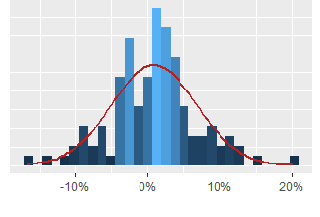
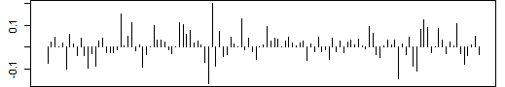
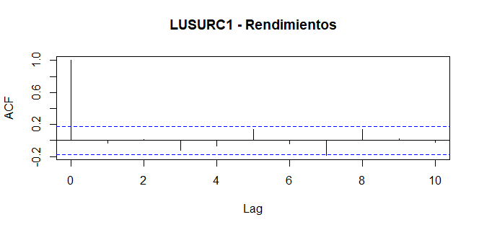
Objectives
Motivation
Peruvian Stock Market
Methodology
Results
Conclusions
Recommendations
Normality tests
Autocorrelation analysis
Evaluate if the returns and absolute returns exhibit an i.i.d. (independent and identically distributed) process.
Ljung-Box tests (α=5%)
Number of tests where H₀ is not rejected:
Returns (22)
Absolute returns (23)
Both criteria (18)
Considerable number of stocks pass the tests: monthly data periodicity.
100% of the stocks exhibit leptokurtosis
Goodness-of-fit tests(α=5%)
Number of tests where H₀ is not rejected:
Anderson-Darling (6)
Lilliefors (7)
Jarque-Bera (6)
In general, they do not meet normality
6

Slide 9
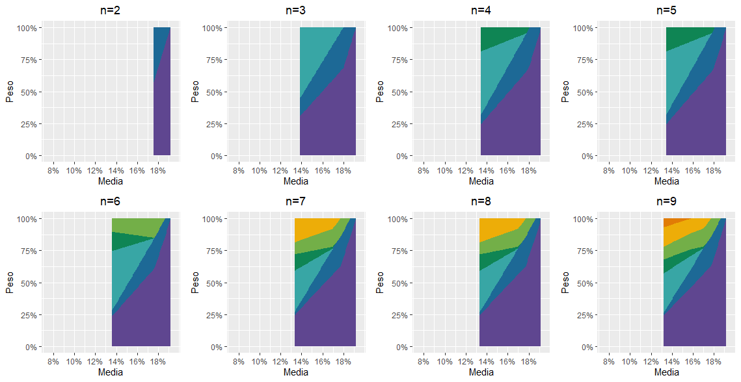
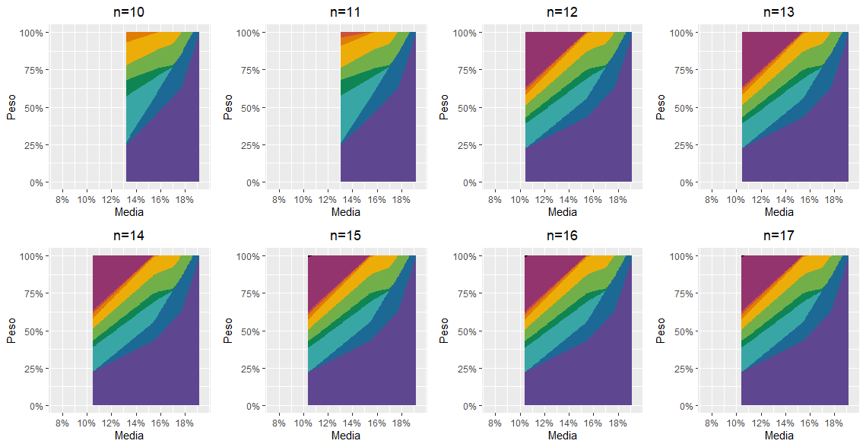
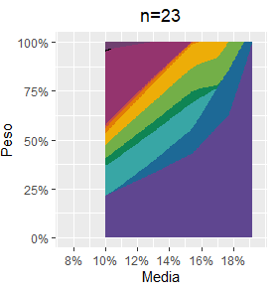
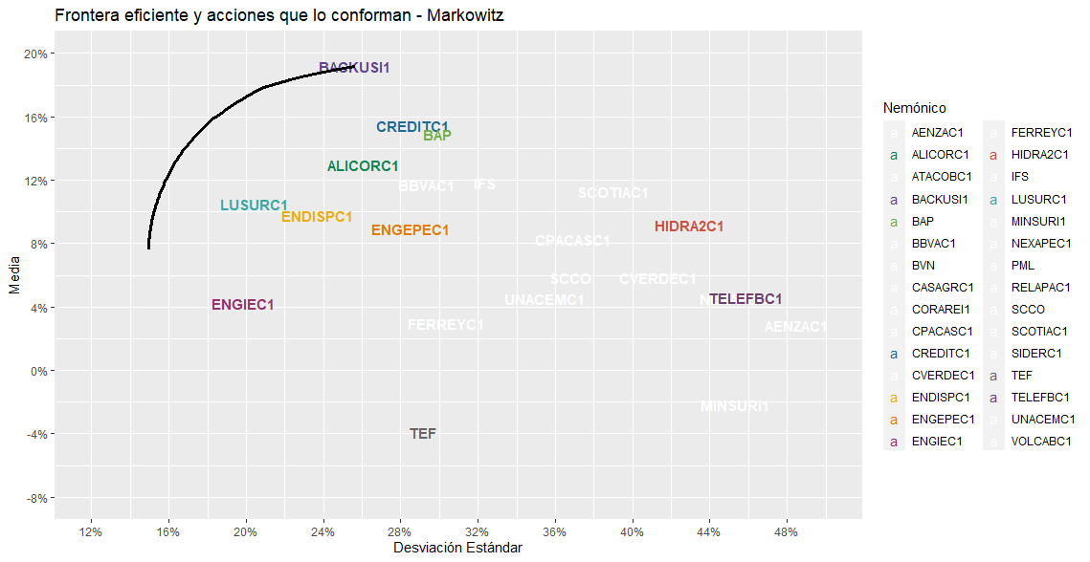
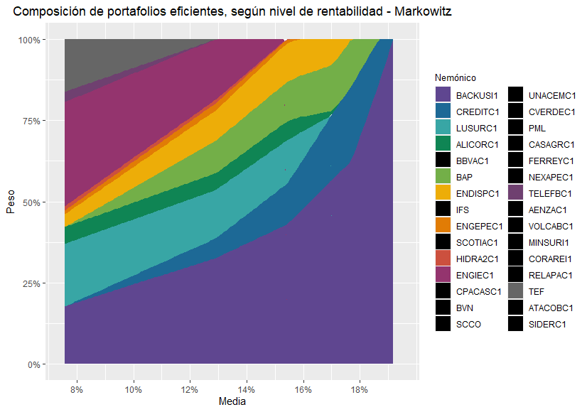
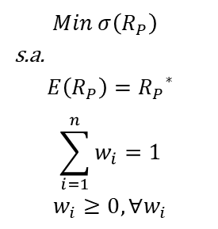
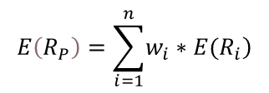
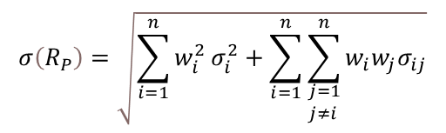
Objectives
Motivation
Peruvian Stock Market
Methodology
Results
Conclusions
Recommendations
Markowitz model
Analysis of the diversification effect:
$$Min σ\left(R_{P}\right)$$
s.a.
$$E\left(R_{P}\right)={R_{P}}^{∗}$$
$$\sum_{i=1}^{n}{w_{i}=1}$$
$$w_{i}≥0, ∀w_{i}$$
$$σ\left(R_{P}\right)=\sqrt{\sum_{i=1}^{n}{w_{i}^{2}}σ_{i}^{2}+\sum_{i=1}^{n}{\sum_{\begin{aligned}&j=1 \\ &j≠i\end{aligned}}^{n}{w_{i}w_{j}σ_{ij}}}}$$
$$E\left(R_{P}\right)=\sum_{i=1}^{n}{\left.w_{i}∗E(R_{i}\right)}$$
Optimization of 100 portfolios, with no short sales allowed. Portfolio returns ranging from the global minimum variance portfolio to the maximum return portfolio.
11 stocks comprise some efficient portfolio.
Helps determine investment strategy: portfolio composition in response to an increase in the level of return.
7

Slide 10
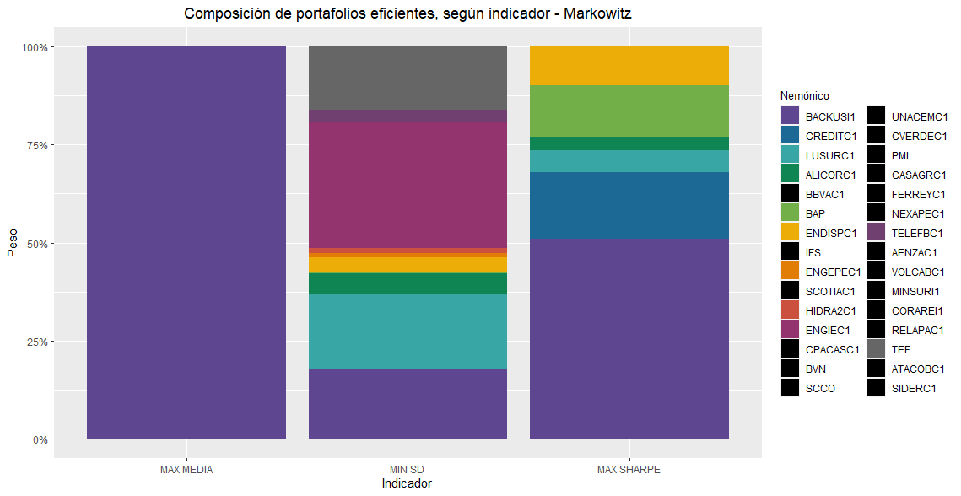
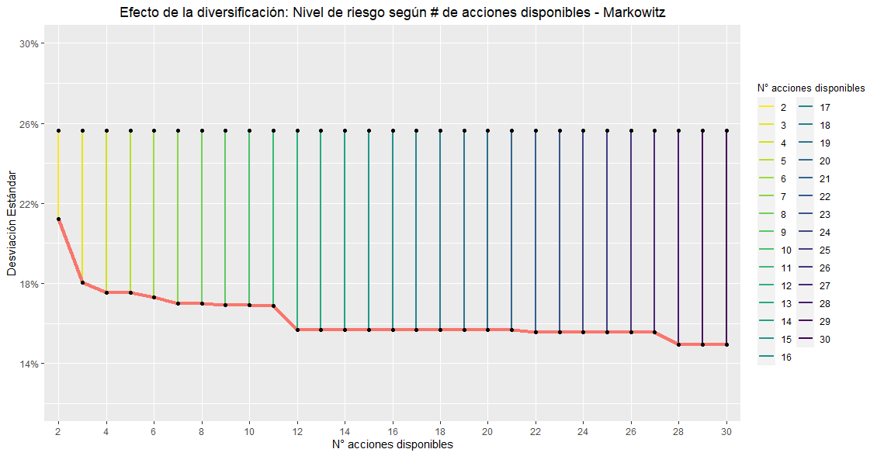
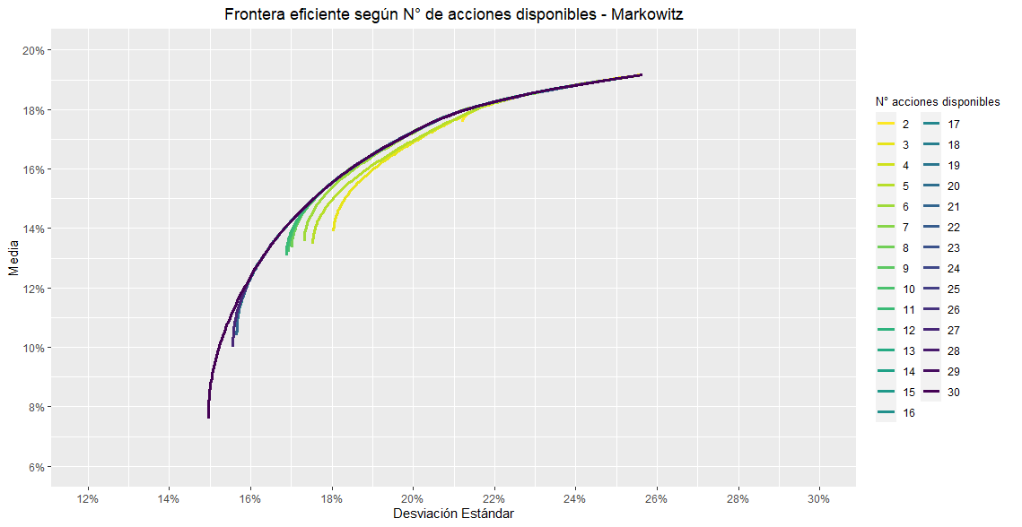
Objectives
Motivation
Peruvian Stock Market
Methodology
Results
Conclusions
Recommendations
Markowitz model
Markowitz – In Sample
 | MAX MEAN | MIN SD | MAX SHARPE
Annual. Geom. Mean | 19.2% | 7.6% | 16.4%
Annual. Std. Dev. | 25.6% | 15.0% | 18.8%
Annual. Sharpe (Rf=0%) | 0.75 | 0.51 | 0.87
The minimum-risk portfolio is composed of the largest number of stocks. The same model suggests diversification.
As the return increases (at the expense of bearing a higher level of risk), the number of stocks decreases until it becomes a concentrated portfolio.
8

Slide 11
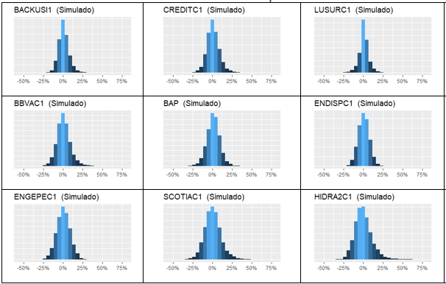
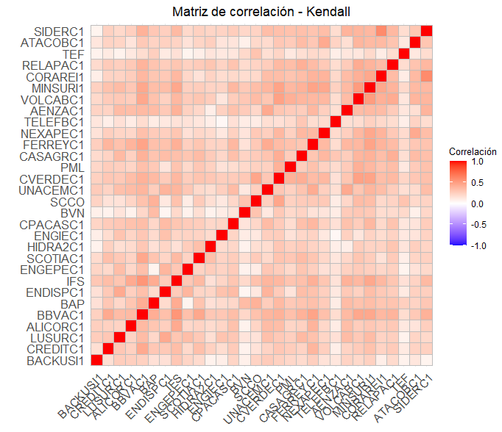


Objectives
Motivation
Peruvian Stock Market
Methodology
Results
Conclusions
Recommendations
Simulation model based on copulas
Data simulation
10,000 scenarios
Validation of simulated data and structure set by the copula.
Estimation of marginal probability distributions and their parameters
Anderson-Darling criterion
Copula estimation
(BIC, AIC, average log-likelihood, Goodness of Fit)
Distribution | Number of modeles stocks
Log-Logistic | 17
Laplace | 8
Normal | 3
Erlang | 1
Logistic | 1
Copula t ($v=9)$
Correlation matrix
Optimization
Methodology analogous to that developed in the Markowitz Model.
Max. Mean, Max. Geom. Mean,
Min. SD, Min Semi-SD
Min. VaR95, Min. VaR99
Min. CVaR95, Min. CVaR99
Max. Sharpe Ratio (Rf=0)
Max. Sortino Ratio (Rf=0)
9

Slide 12
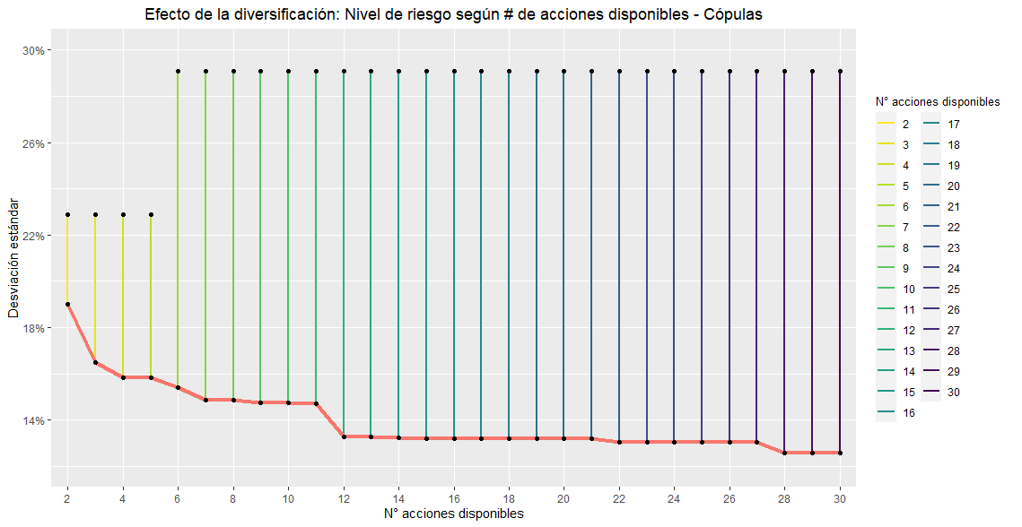
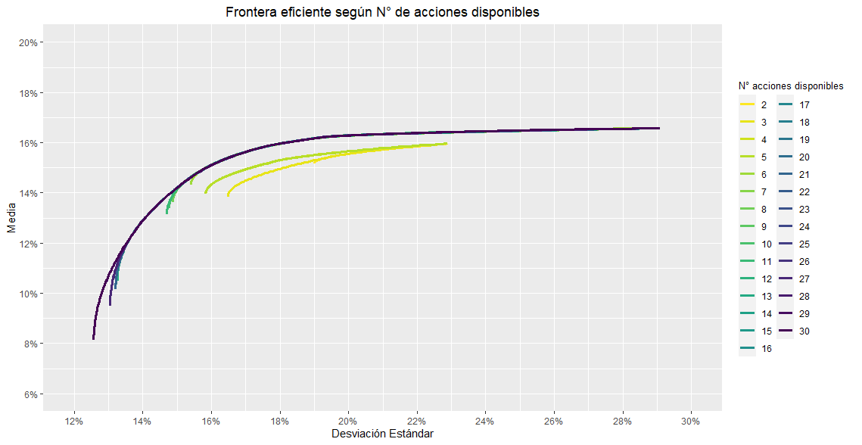
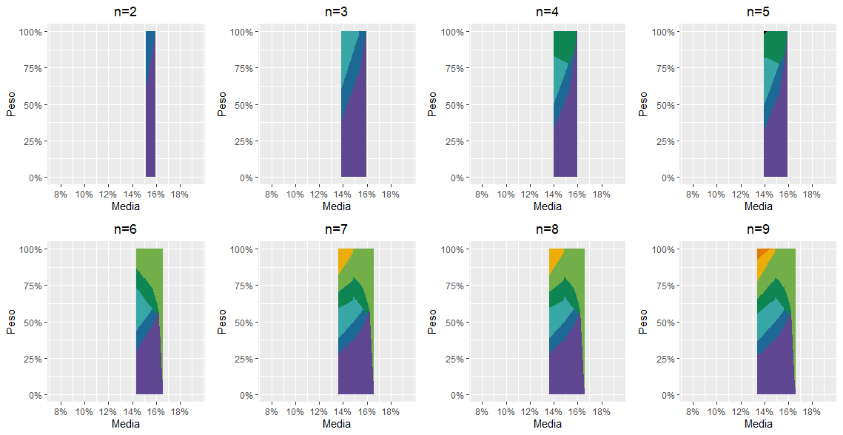
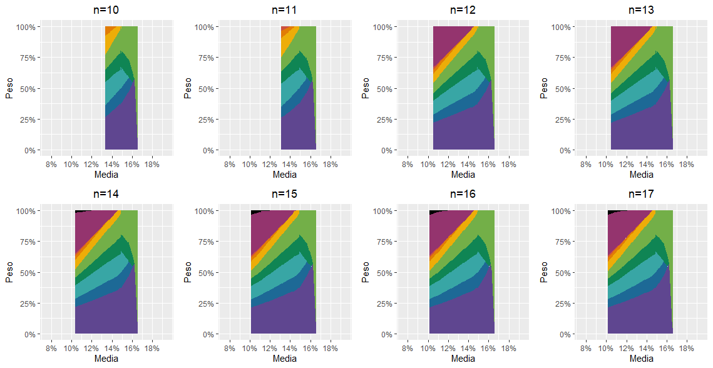
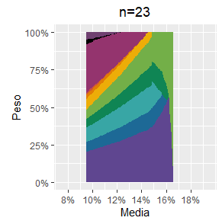
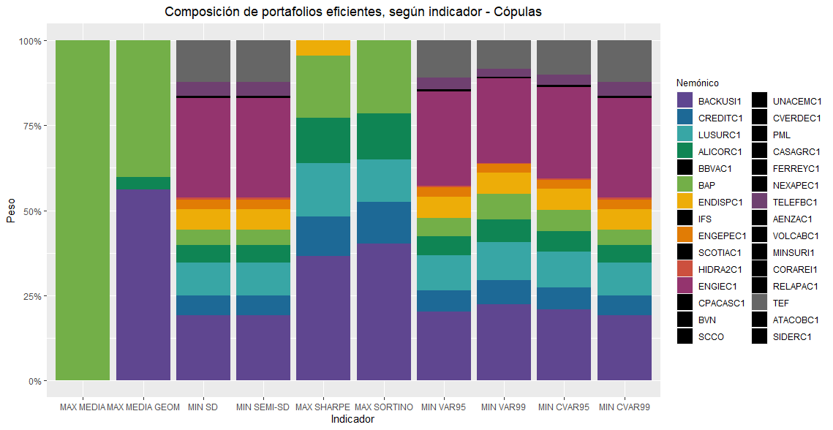
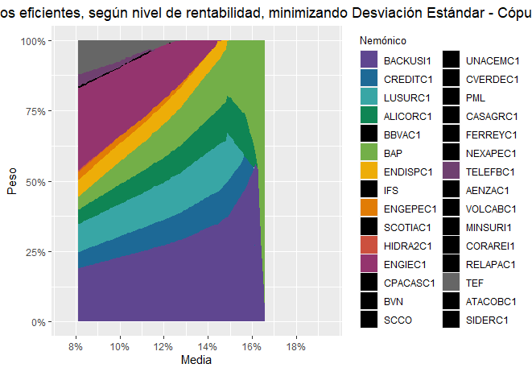
Objectives
Motivation
Peruvian Stock Market
Methodology
Results
Conclusions
Recommendations
Simulation model based on copulas
The portfolios had lower concentration in BACKUSI1 and were more diversified.
The method allowed modeling of the leptokurtosis of returns, according to the adjusted statistical distributions.
10

Slide 13
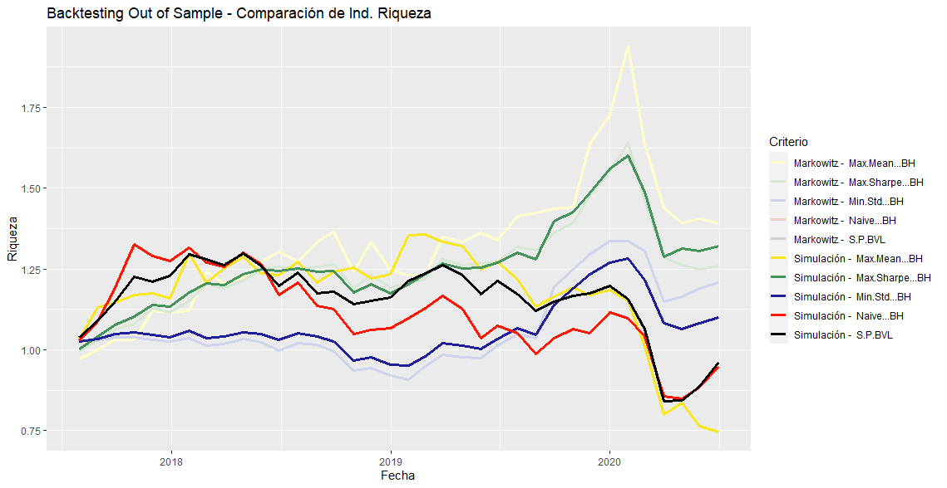
Objectives
Motivation
Peruvian Stock Market
Methodology
Results
Conclusions
Recommendations
Backtesting
Split-sample evaluation:
Estimation period: 07/2007 – 06/2017
Evaluation period: 07/2017 – 06/ 2020
Backtesting using the wealth index
Rebalancing strategies: Buy & Hold, monthly rebalacing, quarterly rebalancing.
Benchmarks: Naive diversified portfolio and S&P/BVL Peru General Index.
The optimized portfolios had significantly superior in-sample and out-of-sample performance compared to the benchmarks, which ended up with negative returns due to the impact of the pandemic.
 | Benchmarks |  | Markowitz |  |  | Simulation
 | NAIVE | S&P/BVL | MAX MEAN | MIN SD | MAX SHARPE | MAX MEAN | MIN SD | MAX SHARPE
Annual. Geom. Mean. | -1.8% | -1.3% | 11.6% | 6.5% | 8.0% | -9.3% | 3.2% | 9.7%
Annual. Std. Dev. | 19.5% | 18.2% | 21.2% | 14.1% | 13.8% | 21.0% | 11.7% | 13.0%
Annual. Sharpe (Rf=0%) | -0.09 | -0.07 | 0.55 | 0.46 | 0.58 | -0.44 | 0.28 | 0.74

Slide 14
Objectives
Motivation
Peruvian Stock Market
Methodology
Results
Conclusions
Recommendations
Conclusions
Non-normality in stock returns in the Peruvian stock market (leptokurtic distribution). Under monthly periodicity, most stock returns were independently distributed.
Lower-risk portfolios were composed of a greater number of assets, demonstrating the diversification effect. Results among the models were consistent and followed the same trend.
The Markowitz model was extremely efficient but less robust. The simulation method was computationally demanding but more flexible, resulting in less concentrated portfolios with similar performance.
Backtesting plays a fundamental role in portfolio optimization.
In-sample and out-of-sample results of optimized portfolios were significantly superior to the benchmarks.
The most plausible objective function was to maximize risk-adjusted returns. The importance of model development lies in making intelligent decisions in the allocation of financial resources
12

Slide 15


Objectives
Motivation
Peruvian Stock Market
Methodology
Results
Conclusions
Recommendations
Recommendations
Expand scope: include a larger number of stocks in the optimization process, explore other stock exchanges, include other financial instruments, etc.
Explore other models that allow for eliminating assumptions or modeling more accurately (robust parameter estimation).
Invest in a diversified portfolio, with risk-free or low-risk assets to mitigate the impact of a systemic crisis.
Conduct continuous backtesting and monitor results, analyzing the suitability of the strategy. Do not solely rely on the model as a blind tool. Supplement with fundamental analysis.
13

Slide 16
Thanks

