Slide 1
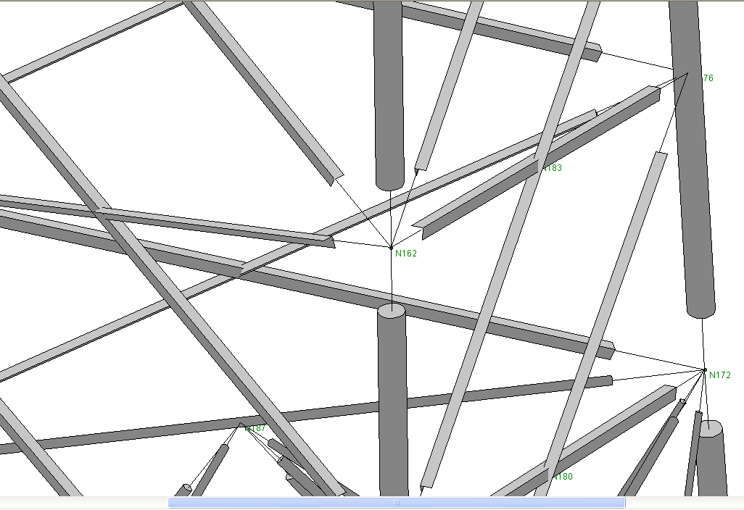
Slightly different color for two facets of the L shape cross section member
Slightly different color between end face and body face for Round Cross Section member

Slide 2
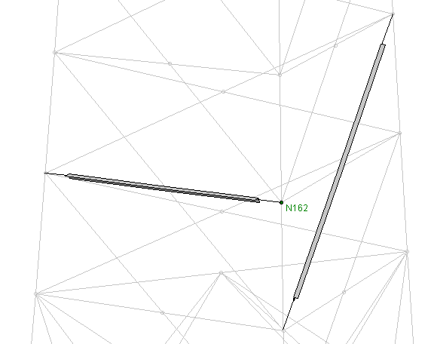
Fixed small size node and text to show for Mouse over action. The text to stay there with a click on the node til next click
Shortened from the ends
Tooltip for member:
Member Id (Node_I, Node_J)
Change the format of the node text to:
N162 (X, Y, Z)
Black connecting line. Choose a color good for the background you use

